Slide 1
Web Scraping
Nichita Trifan

Slide 2
WHY Web scraping?
Sell Collected Information.
Steal Information.
Machine Learning projects.

Slide 3
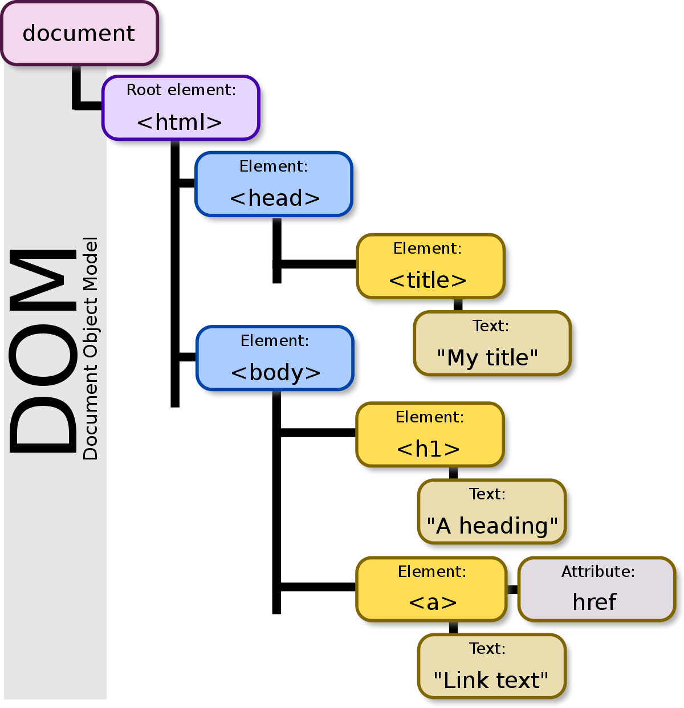
THE DOM (Document object model)

Slide 4

tools
Python 3
beautifulsoup4
requests

Slide 5
Main concepts
Find data on a webpage.
Find the way to get it:
Class name
Id
Other attributes
CSS selector
XPATH (the worst way!)
Organize and Store data.

Slide 6
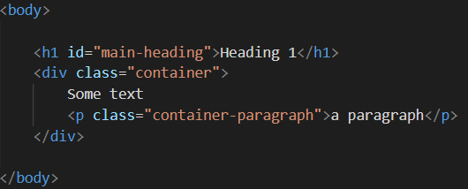
HTML Tags and attributes
HTML tags are the main part of the web-page.
HTML tags have different attributes.
We use HTML attributes as the main guide on the page to locate elements.

