Slide 1
The Use of Artificial Intelligence to Predict Fraud
Nicholai Shaw, Zachary Kroell, Timothy Coleman, Jessica Morris, Chris Moeglin

Slide 2
Background
Recent data from the Federal Trade Commission (FTC) show that consumers lost nearly $8.8 billion to fraud in 2022
According to the FTC, the 2.4 million consumers have been affected by scams
Most scams are imposters scams, followed by online shopping scams.
Due to significant financial burden of scams, we used a dataset from Kaggle to create a supervised machine learning model to predict future transactions as scams
("New FTC data," 2023)

Slide 3
The Dataset
Data of 111,144 transactions were collected
Data consisted of:
Transaction ID
Date and time
Credit Card Number and Transaction Number
Credit Card Owner’s First and Last Names
Merchant Name and Category
Geographic Information (lat, lon, street, zip, state, city)
City population
Date of Birth
Fraud status (If transaction was fraudulent or not)
Amount of Transactions

Slide 4
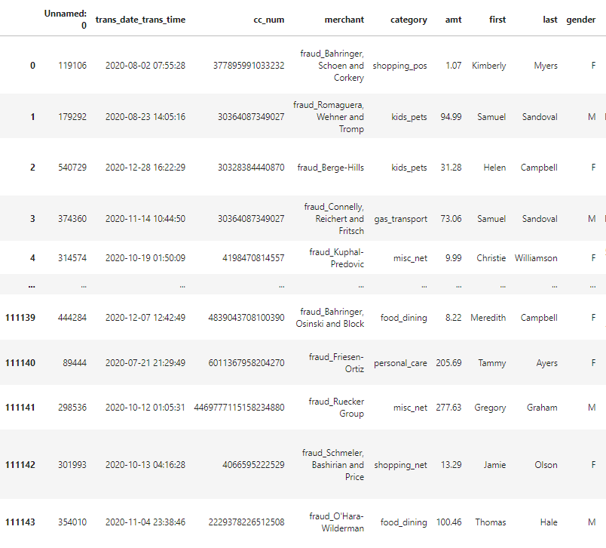
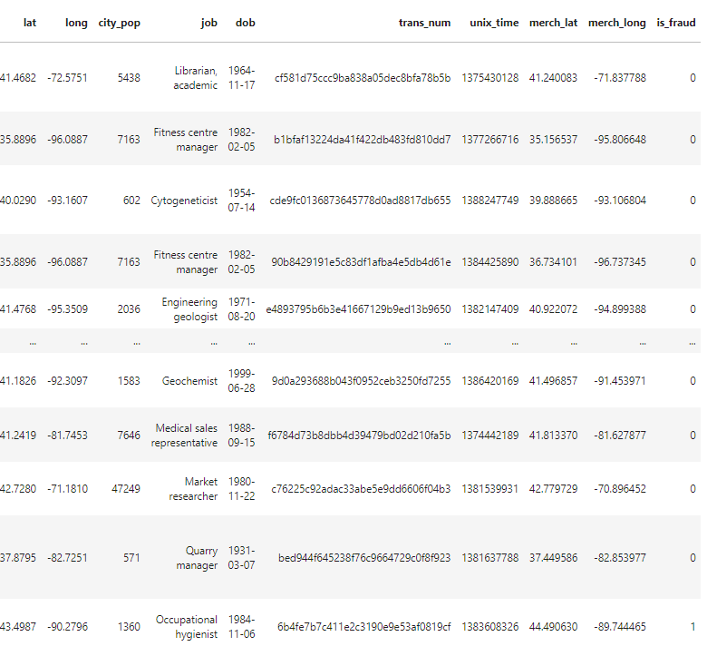
The Raw Dataset

Slide 5



Data Cleaning
Read csv files into pandas dataframe
Renamed two columns:
'Unnamed: 0' : 'transaction_id'
'amt' : 'amount'

Slide 6
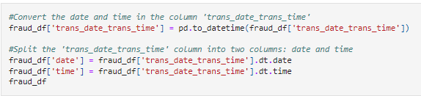
Data Cleaning
Separated the date and time into different columns

Slide 7
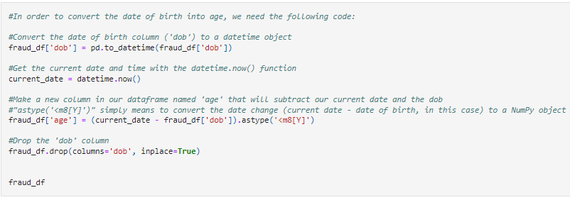
Data Cleaning
Converted the DOB into age

Slide 8
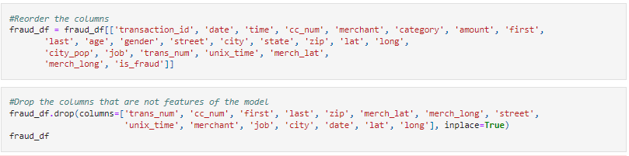
Data Cleaning
Dropped columns that were not features
Transaction id is not a feature, but it did not get dropped because SQLite needs a primary key to store the data
Re-ordered them for SQLite preparation

Slide 9
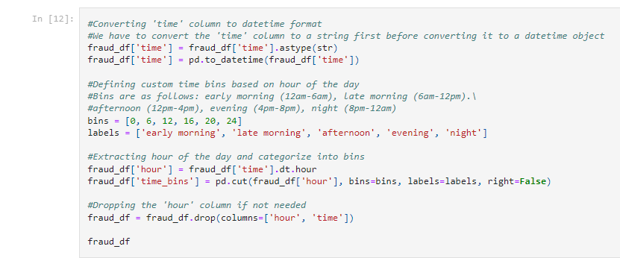
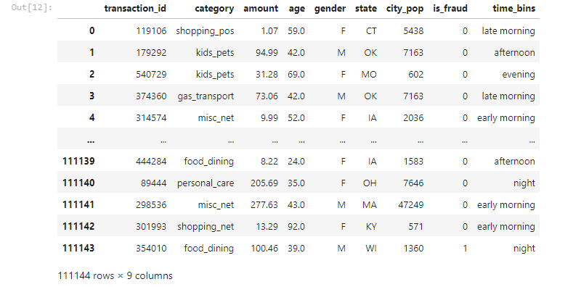
Data Cleaning
Transformed ‘time’ column
Converted the ‘time’ into date_time format
Binned the data into groups
12am-6am: early morning
6am-12pm: late morning
12pm-4pm: afternoon
4pm-8pm: evening
8pm-12am: night
This is necessary since the model cannot interpret time correctly since time of day is not a continuous variable
Time of day is a feature to predict fraud, but since it’s not coninuous, it needs to be categorical to be read by the model

Slide 10
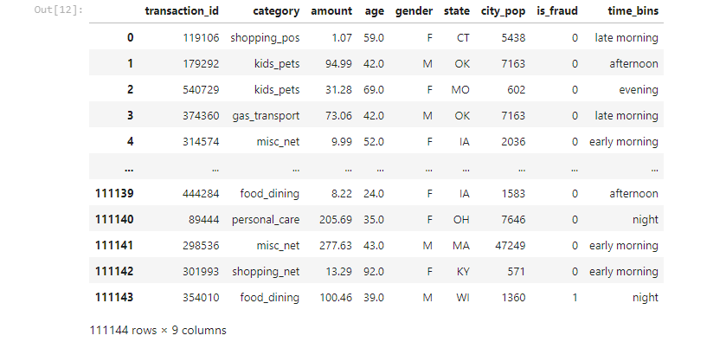
Cleaned Data

Slide 11
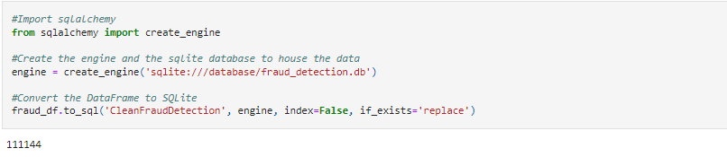
SQLite
SQLite was used to house the clean data
SQLalchemy was used to export the data into a SQLite database

Slide 12
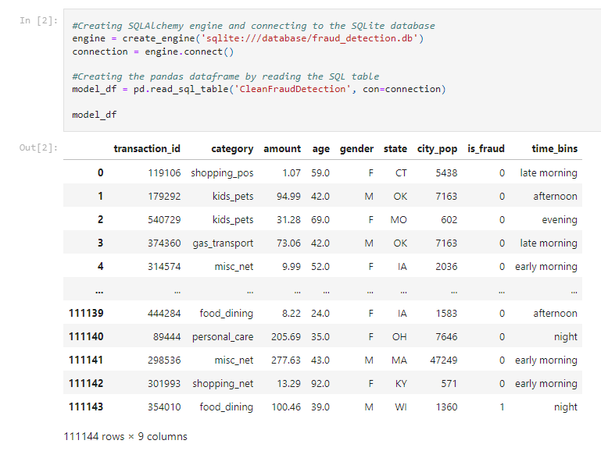
Logistic Regression - Model Creation
Used SQLAlchemy to import data from SQLite database into a Pandas dataframe

Slide 13
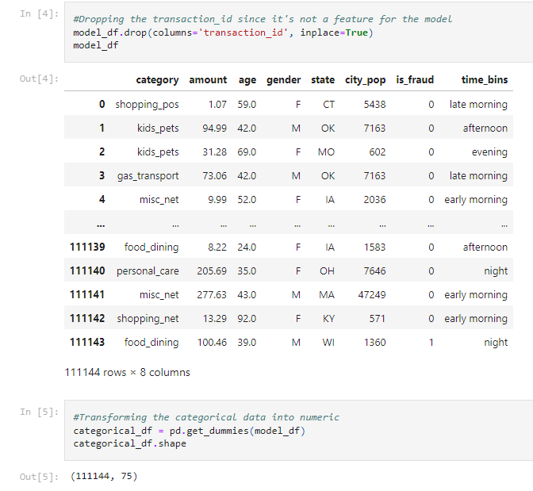
Logistic Regression - Model Creation
Dropped ‘transaction_id’ since it’s not a feature
Used ‘pd.get_dummies’ to transform the categorical data into numeric

Slide 14

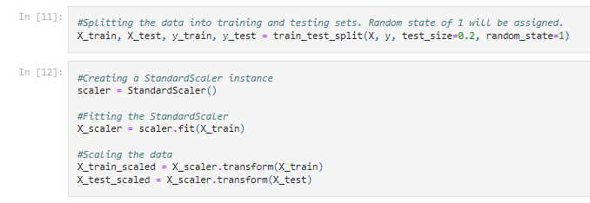
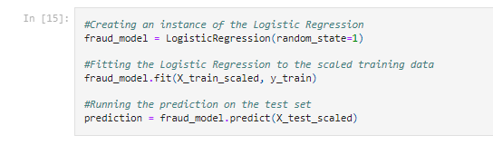
Logistic Regression - Model Compiling
Identified the Labels (fraud status column) and the features
Scaled the data
Split the data into training and testing sets
Fit and predicted the logistic regression to the dataset

Slide 15
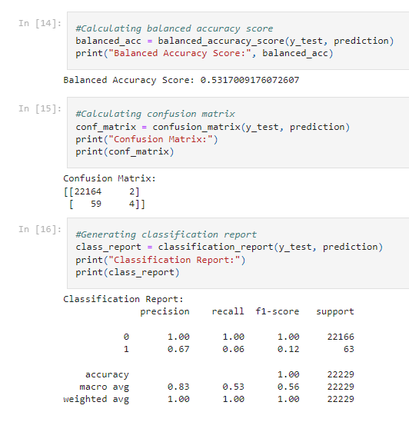
Logistic Regression - Model Performance
Balanced accuracy score of 53.1%
Very low accuracy
Confusion matrix showed very few true positives and a high amount of false negatives
Precision was high for both valid purchases and moderately low for fraudulent (100% vs. 67%)
Recall was high for valid purchases and very low for fraudulent (100% vs. 6%)

Slide 16
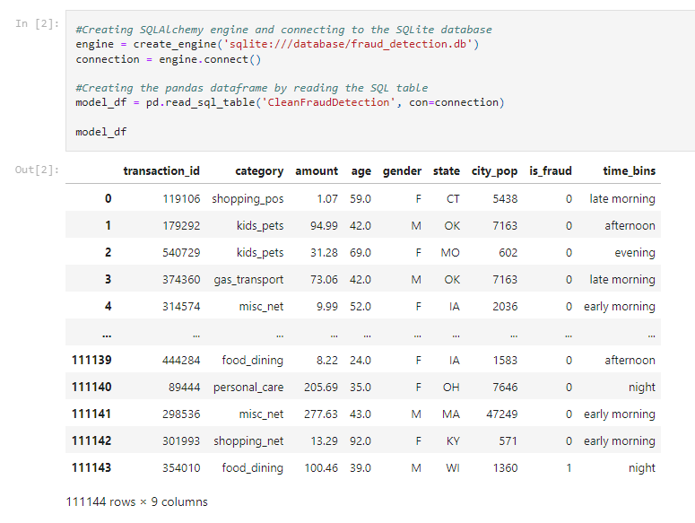
Random Forest- Model Creation
Used SQLAlchemy to import data from SQLite database into a Pandas dataframe

Slide 17
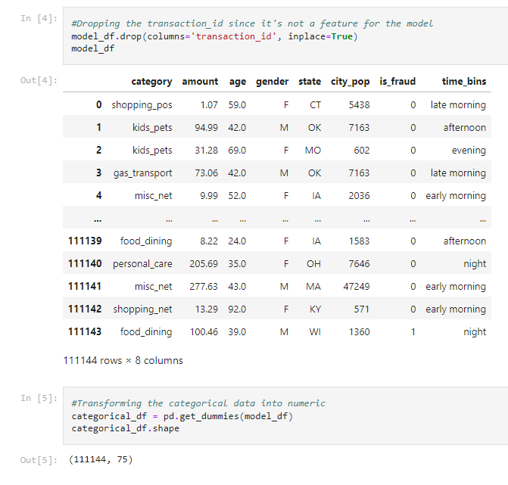
Random Forest- Model Creation
Dropped ‘transaction_id’ since it’s not a feature
Used ‘pd.get_dummies’ to transform the categorical data into numeric

Slide 18
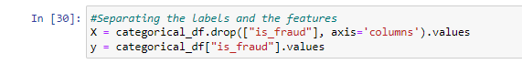
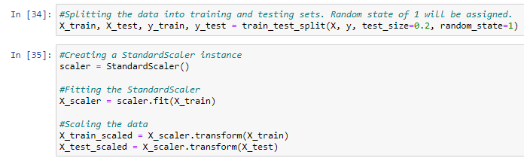
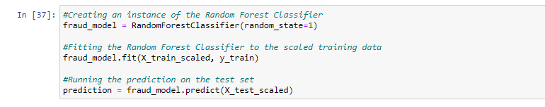
Random Forest- Model Compiling
Data splitting and scaling same as logistic regression
Identified the Labels (fraud status column) and the features
Scaled the data
Split the data into training and testing sets
Fit and predicted the random forest classifier to the dataset

Slide 19
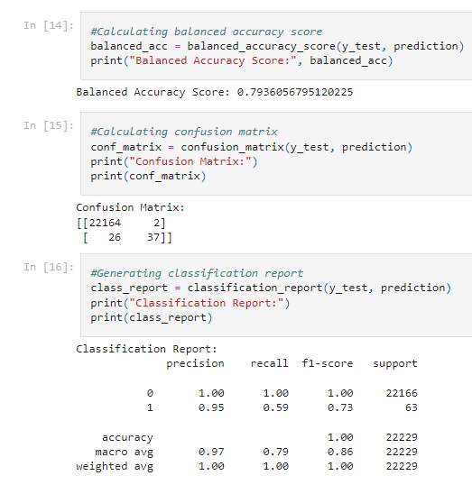
Random Forest- Model Performance
Balanced accuracy score was significantly higher than the logistic regression
Medium accuracy of 79.3%
Confusion matrix showed an imbalance in the groups
Precision was high for both classifications
100% for valid purchases
95% for fraudulent purchases
Recall was high for valid purchases and low for fraudulent (100% vs. 59%)

Slide 20
Next Steps
Balance the ‘not fraud’ and ‘fraud’ cases
Delete fewer features

Slide 21
References
New FTC data show consumers reported losing nearly $8.8 billion to scams in 2022. (2023, February 2023). Federal Trade Comission. Retrieved November 29, 2023, from https://www.ftc.gov/news-events/news/press-releases/2023/02/new-ftc-data-show-consumers-reported-losing-nearly-88-billion-scams-2022
Shenoy, Kartik. (2020). Credit Card Transactions Fraud Detection Dataset. Kaggle. https://www.kaggle.com/datasets/kartik2112/fraud-detection?select=fraudTrain

