Slide 1
WARNING
The contents of this presentation is based on mental health/illnesses. This includes depression, anxiety, panic attacks and dark thoughts that people face in the world.

Slide 2
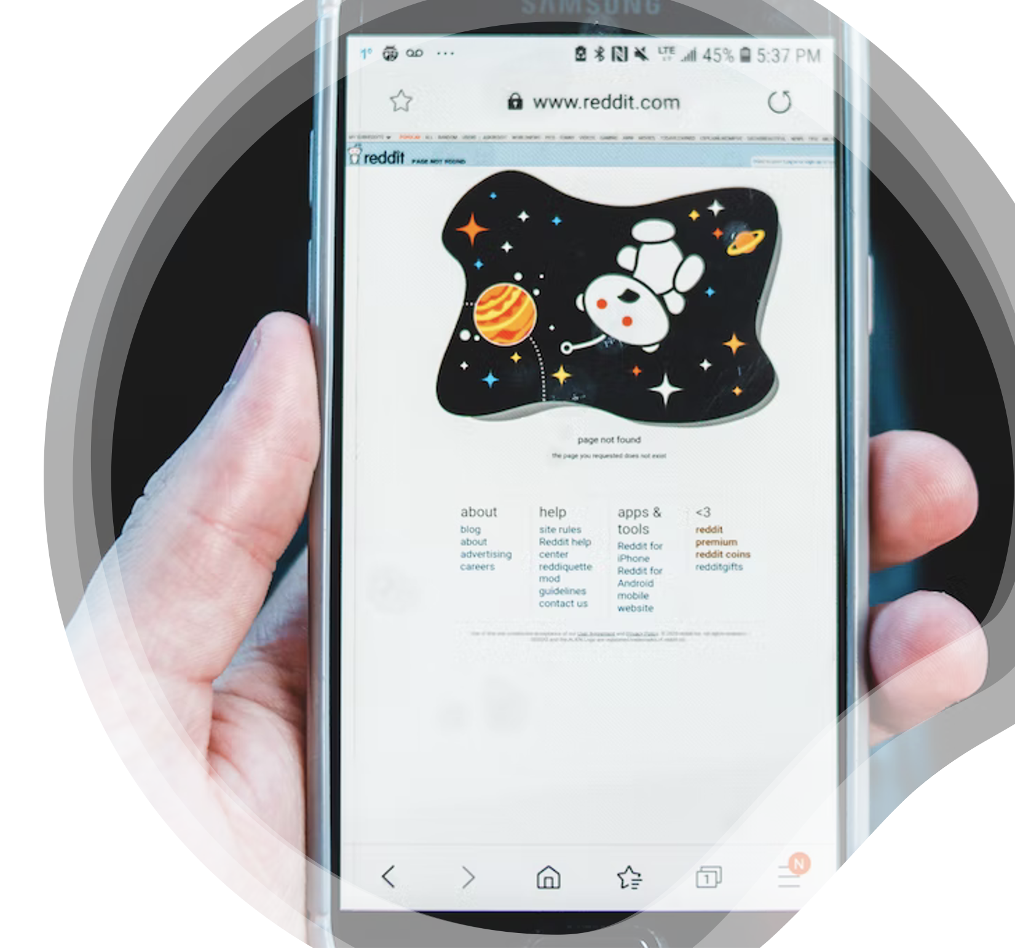
Natural Language Processing Binary Classification of Subreddits
(r/anxiety and r/depression)
Presented by:
Nicholas Khoo

Slide 3
Presentation Outline
Background
Data Science Approach
Natural Language Processing Binary Classification of Subreddits – r/depression and r/anxiety

Slide 4
Background
Reddit is a social networking site with subreddits, including r/depression and r/anxiety, focused on mental health support.
Proper subreddit categorization is crucial to ensure that users receive appropriate support and guidance.
Moderators play a crucial role in maintaining a safe and helpful community.
Natural Language Processing Binary Classification of Subreddits – r/depression and r/anxiety

Slide 5
Presentation Outline
Background
Data Science Approach
Natural Language Processing Binary Classification of Subreddits – r/depression and r/anxiety

Slide 6





Data Science Approach
Problem Statement
Data Cleaning & Exploratory Data Analysis
Pre-processing and Modelling
Conclusion & Recommendation
Data Collection
Natural Language Processing Binary Classification of Subreddits – r/depression and r/anxiety

Slide 7

Problem Statement
How can the moderators of r/depression and r/anxiety improve the classification of users’ posts to ensure their communities remain a safe and supportive space?
Natural Language Processing Binary Classification of Subreddits – r/depression and r/anxiety

Slide 8
Data Science Approach
Problem Statement
Data Cleaning & Exploratory Data Analysis
Pre-processing and Modelling
Conclusion & Recommendation
Data Collection
Natural Language Processing Binary Classification of Subreddits – r/depression and r/anxiety

Slide 9
Data Science Approach
Problem Statement
Data Cleaning & Exploratory Data Analysis
Pre-processing and Modelling
Conclusion & Recommendation
Data Collection
Natural Language Processing Binary Classification of Subreddits – r/depression and r/anxiety
Notes:
Lemmatization involves reducing words to their base or root form

Slide 10
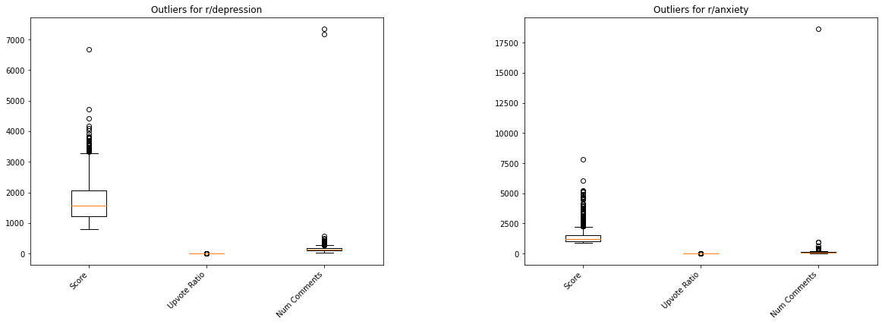
Outliers
Natural Language Processing Binary Classification of Subreddits – r/depression and r/anxiety

Slide 11
Outliers (Score)
r/depression
Title: Shout out to the particular hell that is functional depression.
Content: This is me. Don’t get me wrong, it’s better than don’t-leave-my-bed-for-a-week depression. I am grateful I can be an independent person. But there is something uniquely horrible about being able to go to work every day, occasionally clean up after yourself, pay your bills, generally put yourself together enough to look like a human being... but that’s it. Nothing else. No social life. No hobbies. Constantly battling your mind. And being absolutely fucking exhausted all the time.
r/anxiety
Title: Despite the anxiety, despite the depression, despite all my self criticism and imperfections - I was a beautiful bride this Saturday!
Natural Language Processing Binary Classification of Subreddits – r/depression and r/anxiety

Slide 12
Outliers (Num Comments)
r/depression
Title: Regular Check-In Post
Content: Welcome to /r/depression's check-in post - a place to take a moment and share what is going on and how you are doing. If you have an accomplishment you want to talk about (these shouldn't be standalone posts in the sub as they violate the "role model" rule, but are welcome here), or are having a tough time but prefer not to make your own post, this is a place you can share. We try our best to keep this space as safe and supportive as possible on reddit's wide-open anonymity-friendly platform …
r/anxiety
Title: Let's post good news on the coronavirus here.
Content: A place where only good news is posted, please keep this a positive thread. a place we can go for some reassurance that everything will be okay. We WILL get through this. edit: the link for this thread will be posted in the main thread, I will keep updating so save this thread to keep checking ♥️ …
Natural Language Processing Binary Classification of Subreddits – r/depression and r/anxiety

Slide 13


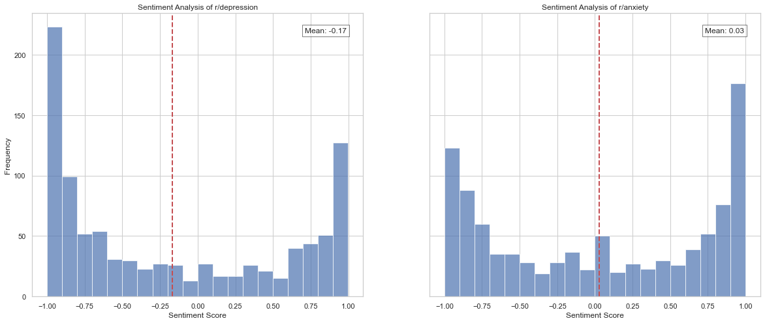
Sentiment Analysis
Natural Language Processing Binary Classification of Subreddits – r/depression and r/anxiety

Slide 14
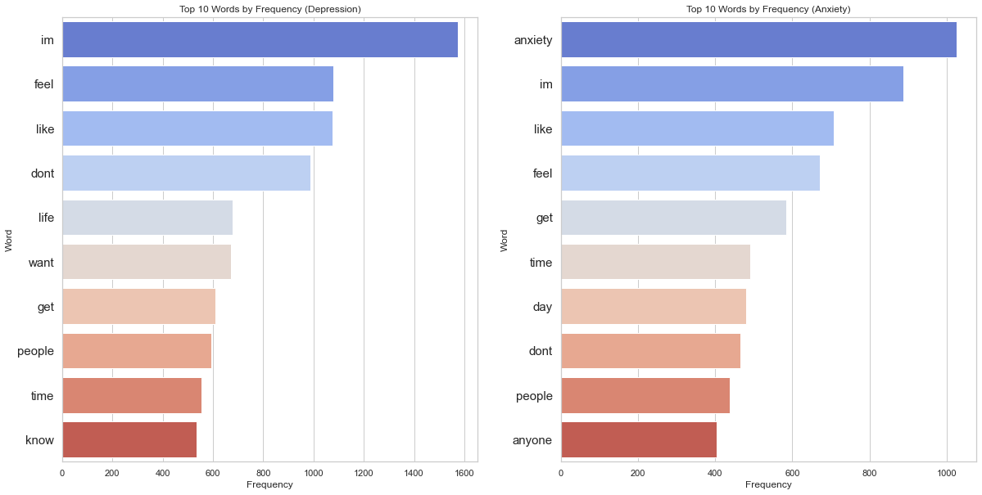
Frequency of Top Words
Natural Language Processing Binary Classification of Subreddits – r/depression and r/anxiety
Notes:
Both subreddits have some common themes, such as struggles with negative emotions, relationships and daily life challenges.
Differences are the specific concerns and experiences that the users are dealing with.
e.g. r/depression focuses on issues related to finding the meaning and purpose in life while r/anxiety focuses on the experience of anxiety and how to manage it on a daily basis.

Slide 15
Data Science Approach
Problem Statement
Data Cleaning & Exploratory Data Analysis
Pre-processing and Modelling
Conclusion & Recommendation
Data Collection
Natural Language Processing Binary Classification of Subreddits – r/depression and r/anxiety

Slide 16
Model Training and Comparison
Models Evaluated:
Naïve Bayes Model
Logistic Regression
Performance Benchmark
(Predicts majority class in dataset)
50.39%
Natural Language Processing Binary Classification of Subreddits – r/depression and r/anxiety
Notes:
Naively predicting the majority class – zero rate classifier
Based on the Bayes theorem and assumes that each feature is independent of the others.
Algorithm counts the frequency of words in each category, then uses these frequencies to predict which category a new text belongs to.
Statistical method that estimates the probability of a binary or categorical outcome based on one or more independent variables.
Generative vs Discriminative (how data is placed throughout the space vs. how boundaries are drawn)

Slide 17

Score Comparison – Which to prioritise?
Precision
Ratio of true positives to the total of the true positives and false positives.
Recall
Ratio of true positives to the total of the true positives and false negatives.
F1 Score
Balance of precision and recall.
TP/(TP + FP)
TP/(TP + FN)
Natural Language Processing Binary Classification of Subreddits – r/depression and r/anxiety
Notes:
building a tool to help users find support and resources related to mental health,

Slide 18
Score Comparison
Modelling Steps
In the context of mental health classification between r/depression and r/anxiety with the goal of helping individuals receive appropriate help and support from the community, both recall (sensitivity) and precision are equally important.
Metrics* | Naïve Bayes | Logistic Regression
Mean Cross-validation score | 0.8565560821484992 | 0.878041074249605
Accuracy | 0.8775252525252525 | 0.9090909090909091
Precision | 0.8416289592760181 | 0.9077306733167082
Recall | 0.9323308270676691 | 0.9122807017543859
F1 Score | 0.8846611177170036 | 0.9099999999999999
Natural Language Processing Binary Classification of Subreddits – r/depression and r/anxiety
Notes:
Mean cross validation score – estimate how well model is likely to perform on unseen data
Accuracy – proportion of correctly classified data points to total data points
Precision – TP to total predicted positives
Recall – TP to actual number of positives
Measures the proportion of true positives (correctly identified positives) to the total number of predicted positives.
Measures the proportion of true positives to the total number of actual positives
Harmonic mean of precision and recall, and it provides a single score that combines both metrics.

Slide 19
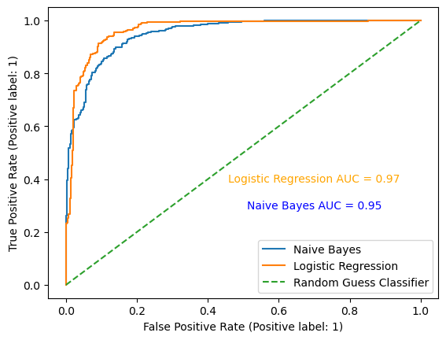

Receiving Operator Characteristic (ROC) Curve
Logistic Regression
90.9%
Natural Language Processing Binary Classification of Subreddits – r/depression and r/anxiety
Notes:
The ROC curve is a plot of the true positive rate (sensitivity) against the false positive rate (1-specificity) for different threshold values.
A good model should be closer towards the top left of the curve.

Slide 20
Data Science Approach
Problem Statement
Data Cleaning & Exploratory Data Analysis
Pre-processing and Modelling
Conclusion & Recommendation
Data Collection
Natural Language Processing Binary Classification of Subreddits – r/depression and r/anxiety

Slide 21
Conclusion and Recommendation
Moderators of both subreddits can utilise the trained model to have a preliminary classification of users' posts.
However, there is a need to scrutinise the content to have a second evaluation.
Natural Language Processing Binary Classification of Subreddits – r/depression and r/anxiety

Slide 22
Thank You

Slide 23
Annex
Natural Language Processing Binary Classification of Subreddits – r/depression and r/anxiety

Slide 24
Data Collection
Feature | Description
id | Unique identifier of a particular post or comment within a subreddit
created_utc | The time the post or comment was created
title | The title of the post.
is_self | Indicates whether the post is a self-post or not.
selftext | The actual text content of a self-post
score | The upvotes minus the downvotes of the post.
upvote_ratio | The ratio of upvotes to total votes.
num_comments | The total number of comments on the post.
permalink | The permanent link to the post.
author | The username of the person who submitted the post.
distinguished | Indicates whether the post or comment has been distinguished by a moderator or admin.
Natural Language Processing Binary Classification of Subreddits – r/depression and r/anxiety
Notes:
To answer this problem statement, two models were trained and evaluated – naïve bayes and logistic regression. With their respective accuracies evaluated to determine the best model.
Success is evaluated with its accuracy

Slide 25
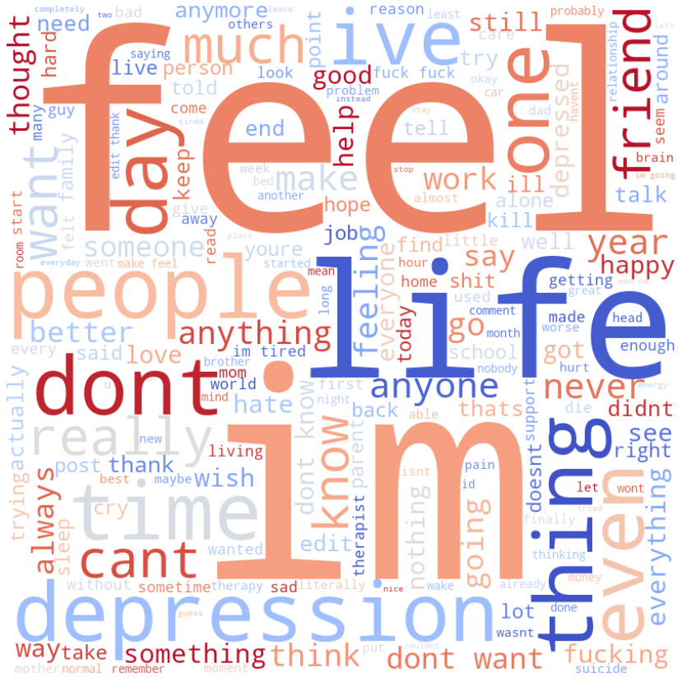
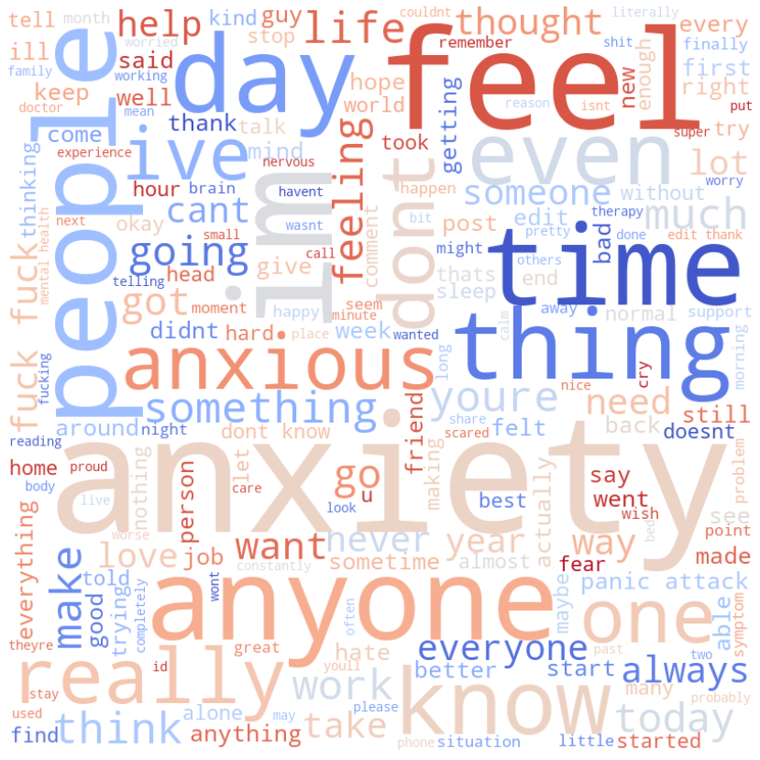
Word Cloud
r/depression
r/anxiety
Natural Language Processing Binary Classification of Subreddits – r/depression and r/anxiety
Notes:
To answer this problem statement, two models were trained and evaluated – naïve bayes and logistic regression. With their respective accuracies evaluated to determine the best model.
Success is evaluated with its accuracy

Slide 26
Misclassified Posts
Modelling Steps
Post 1:
Title: What do you do when you can’t focus on anything? Not even a shitty program or music. I don’t have adhd, just so you understand.
Post 2: Title: Sorry... I couldn't help myself. I haven't felt this happy since I was a kid.
Post 3:
Title: Feeling unattractive again.
Selftext: Being a bbw I constantly struggle to feel beautiful. I honestly hate my body…
Natural Language Processing Binary Classification of Subreddits – r/depression and r/anxiety

Slide 27
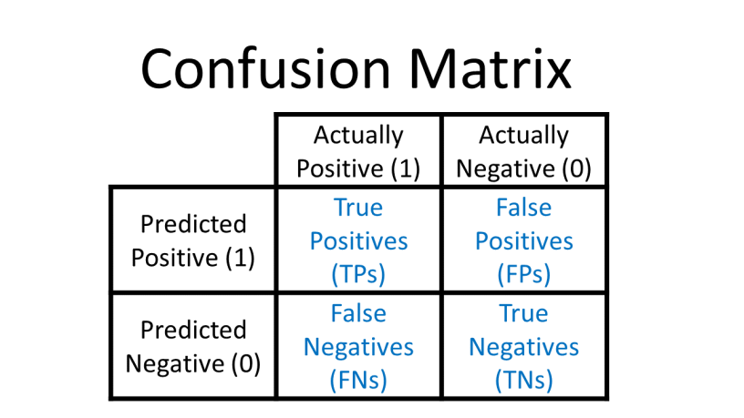
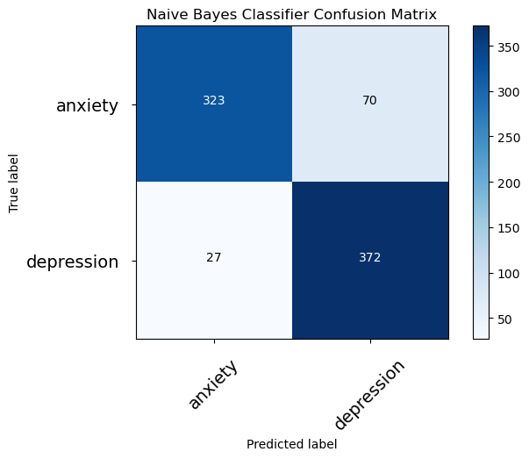
Naïve Bayes Model Confusion Matrix
Natural Language Processing Binary Classification of Subreddits – r/depression and r/anxiety

Slide 28
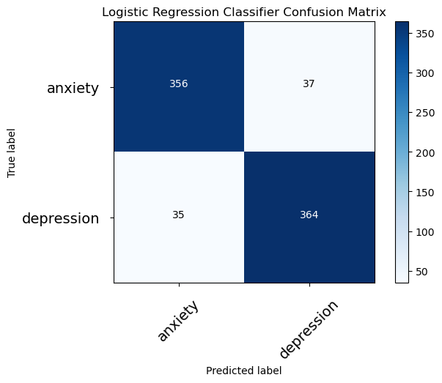
Logistic Regression Model Confusion Matrix
Natural Language Processing Binary Classification of Subreddits – r/depression and r/anxiety

Slide 29
Feature Importance
Top 10 Features | Importance
anxiety | -10.2146
depression | 6.3353
removed | 5.0625
anxious | -4.6802
depressed | 4.1259
life | 3.7131
panic | -2.7902
attack | -2.7340
kill | 2.4345
tired | 2.2143
Natural Language Processing Binary Classification of Subreddits – r/depression and r/anxiety

