Slide 1
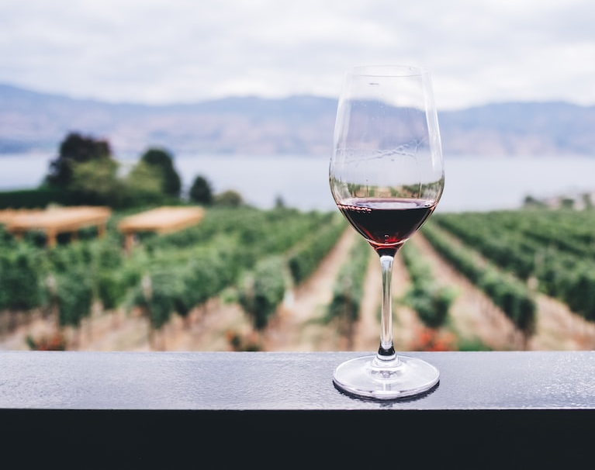
Vintage Intelligence: Using Machine Learning to Recommend Your Next Favorite Wine
Presented by:
Nicholas Khoo

Slide 2
Presentation Outline
Background
Data Science Approach
Vintage Intelligence: Using Machine Learning to Recommend Your Next Favorite Wine

Slide 3
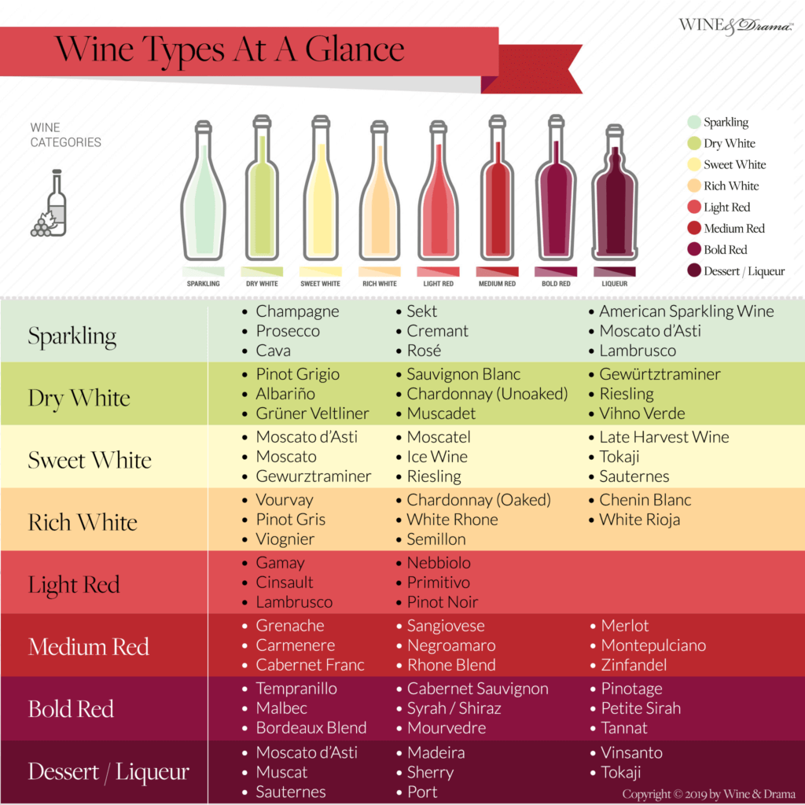
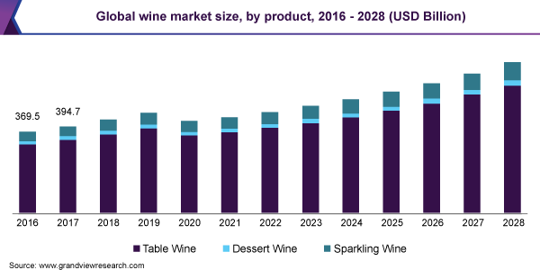
Background
The wine industry is a multi-billion dollar sector that is rapidly growing.
Choosing the right wine can be difficult for consumers due to the overwhelming selection and subjective nature of wine tasting.
Wine recommendation systems that use machine learning are effective in providing personalized recommendations based on various data points, increasing customer satisfaction and loyalty.
We are here
Source: Wine & Drama
Vintage Intelligence: Using Machine Learning to Recommend Your Next Favorite Wine
Notes:
https://www.straitstimes.com/singapore/health/more-than-30000-dengue-cases-reported-in-2022-6-times-that-of-2021-nea
https://www.straitstimes.com/opinion/singapore-s-dengue-numbers-may-swell-again-urgent-mitigation-efforts-are-needed-now
https://journals.plos.org/globalpublichealth/article?id=10.1371/journal.pgph.0000024
https://apps.who.int/iris/bitstream/handle/10665/75303/9789241504034_eng.pdf
According to recent reports, there were over 30,000 dengue cases reported in Singapore in 2022, which is six times more than in 2021.
This is a significant increase that should not be taken lightly.
To tackle this issue, more budget is being allocated to hospitals to help combat the spread of dengue fever.
This shows the government's commitment to addressing this problem and ensuring the health and safety of its citizens.
The World Health Organization has also implemented a strategic approach to address the issue. Their report provides useful guidelines for governments and healthcare professionals on how to prevent and control the spread of dengue fever.
However, urgent mitigation efforts are still needed to combat the spread of dengue fever in Singapore. We should all take personal responsibility and follow the recommended measures such as eliminating mosquito breeding sites and practicing good personal hygiene.

Slide 4
Presentation Outline
Background
Data Science Approach
Vintage Intelligence: Using Machine Learning to Recommend Your Next Favorite Wine

Slide 5



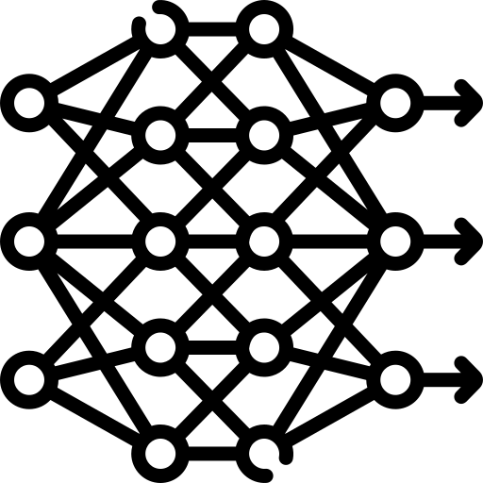

Data Science Approach
Problem Statement
Data Cleaning & Exploratory Data Analysis
Data Pre-processing and Machine Learning Modelling
Conclusion & Recommendation
Data Collection
Vintage Intelligence: Using Machine Learning to Recommend Your Next Favorite Wine

Slide 6
Problem Statement
Situation
Many consumers struggle to select the right wine due to the overwhelming selection and subjective nature of wine tasting.
Complication
This creates a challenge for wineries and wine sellers to provide personalized recommendations and can lead to decreased customer satisfaction and loyalty.
Resolution
Developing a wine recommendation system using machine learning algorithms that can provide accurate and personalized wine recommendations to customers, can ultimately increase customer satisfaction and loyalty for wineries and wine sellers.
Vintage Intelligence: Using Machine Learning to Recommend Your Next Favorite Wine

Slide 7
Data Science Approach
Problem Statement
Data Cleaning & Exploratory Data Analysis
Data Pre-processing and Machine Learning Modelling
Conclusion & Recommendation
Data Collection
Vintage Intelligence: Using Machine Learning to Recommend Your Next Favorite Wine

Slide 8
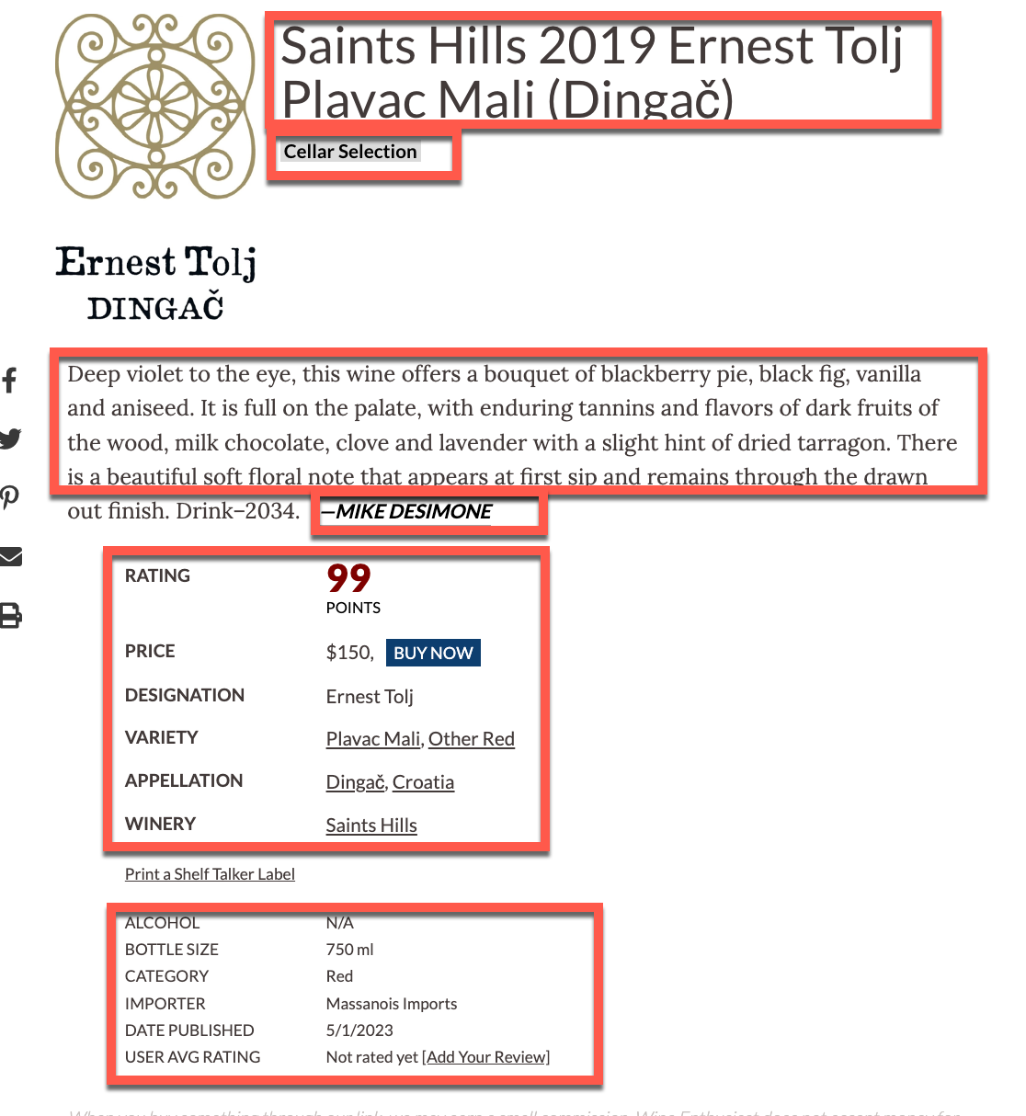

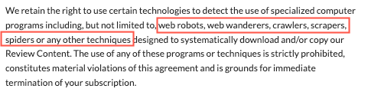
Data Collection
Initial Approach
Wine data was initially scrapped from Wine Enthusiast – a lifestyle magazine covering wine, food, travel, and entertaining topics.
Subsequent Approach
Wine dataset from Kaggle (https://www.kaggle.com/datasets/zynicide/wine-reviews)
Wine Descriptors from Ronald Shuring’s GitHub (https://github.com/RoaldSchuring/wine_recommender)
Vintage Intelligence: Using Machine Learning to Recommend Your Next Favorite Wine

Slide 9
Data Science Approach
Problem Statement
Data Cleaning & Exploratory Data Analysis
Data Pre-processing and Machine Learning Modelling
Conclusion & Recommendation
Data Collection
Vintage Intelligence: Using Machine Learning to Recommend Your Next Favorite Wine

Slide 10
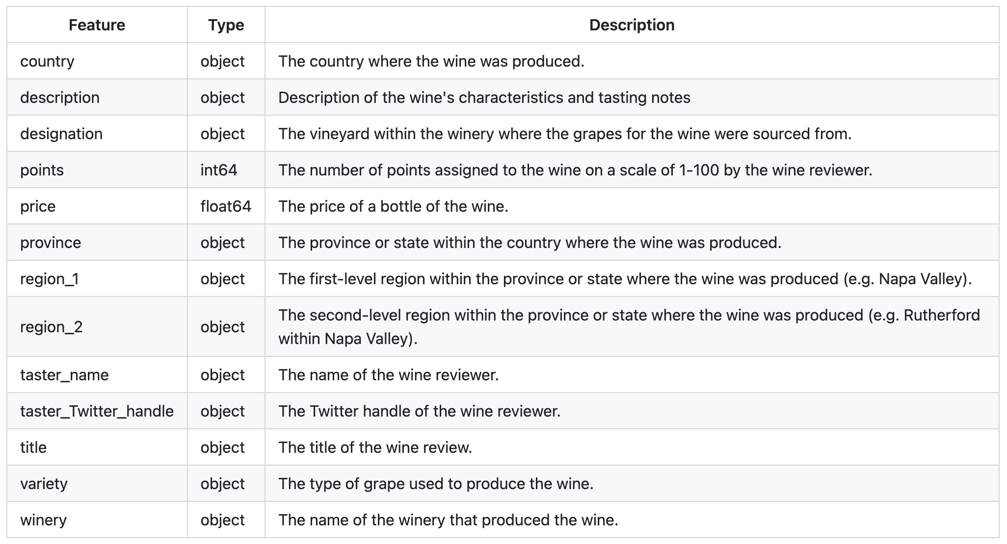
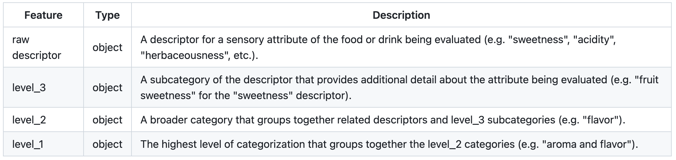
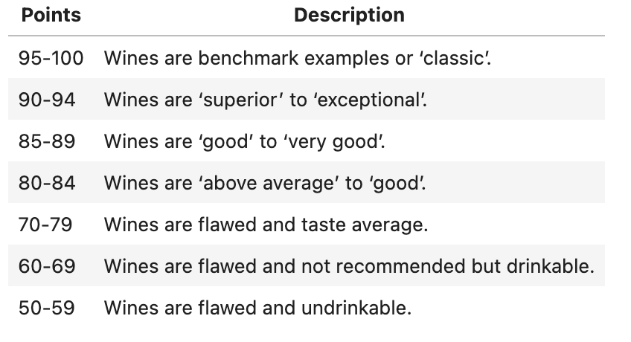
Data Cleaning
Irrelevant columns (e.g. taster_twitter_handle) were removed
Duplicate entries and null values were dropped
Scores were filtered > 88
Wine Reviews Dataset
Wine Descriptors Dataset
Source:
Wine Scores from Wine Searcher
Vintage Intelligence: Using Machine Learning to Recommend Your Next Favorite Wine

Slide 11
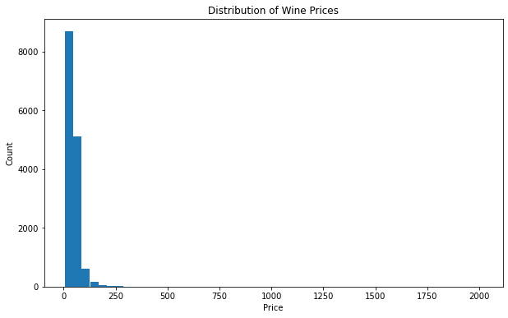
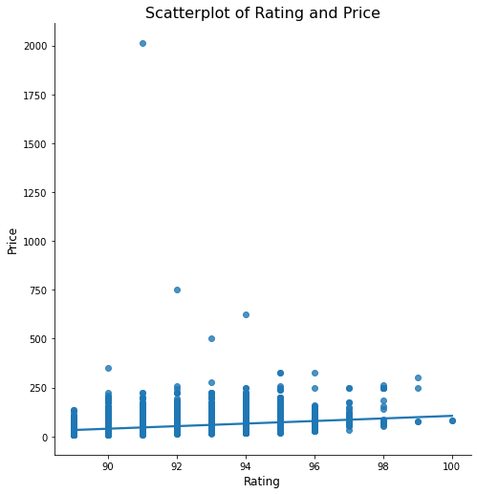
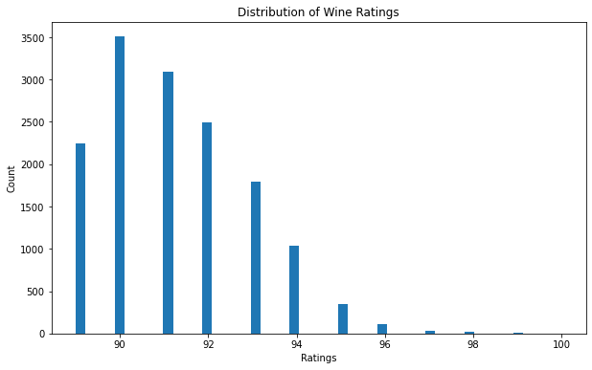
Wine Prices & Ratings
2
Key Findings
There is some relationship between "points" and "price", but it may not be a very strong one.
Distribution of wine prices is heavily right-skewed with majority of the wines being priced below approximately USD 100.
Wines with ratings of 90-92 are the most common in the dataset, while wines with ratings below 89 or above 95 are relatively rare, suggesting that wines with extreme ratings are less common and wines with ratings above 95 may be of particular interest to wine enthusiasts or collectors.
1
3
Vintage Intelligence: Using Machine Learning to Recommend Your Next Favorite Wine

Slide 12
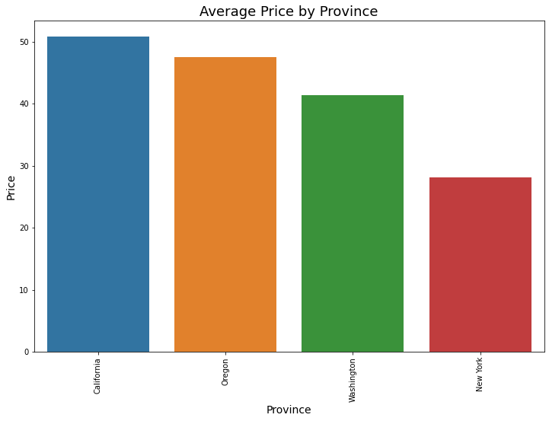
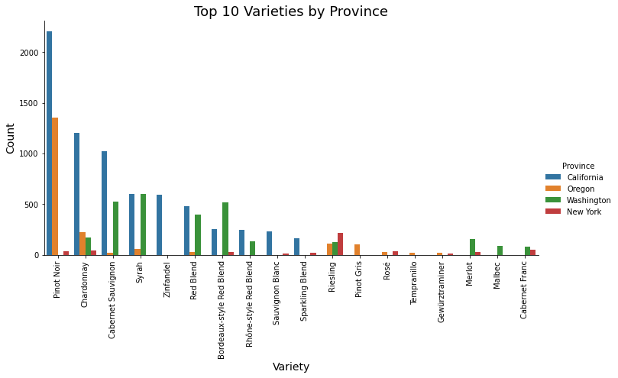
Exploration of Wine Variety and Provinces
Key Findings
Regions with higher average prices of wine may produce higher quality wines as consumers are often willing to pay a premium for them, and production costs may be higher as well, which consequently drives up the price of the wines.
Pinot Noir tends to be the most popular wine variety overall, but the popularity of varieties differs province to province, with no certain pattern.
1
2
Vintage Intelligence: Using Machine Learning to Recommend Your Next Favorite Wine

Slide 13
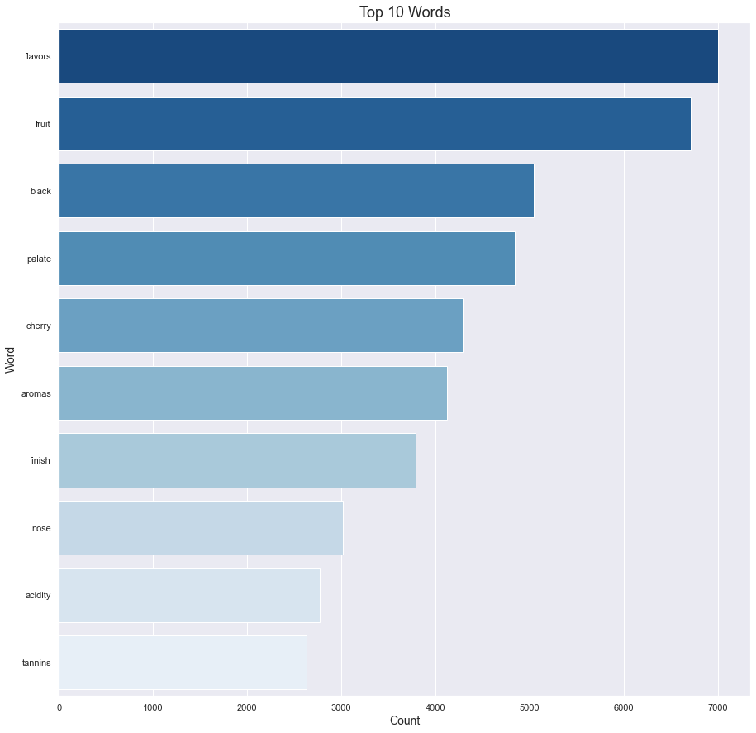
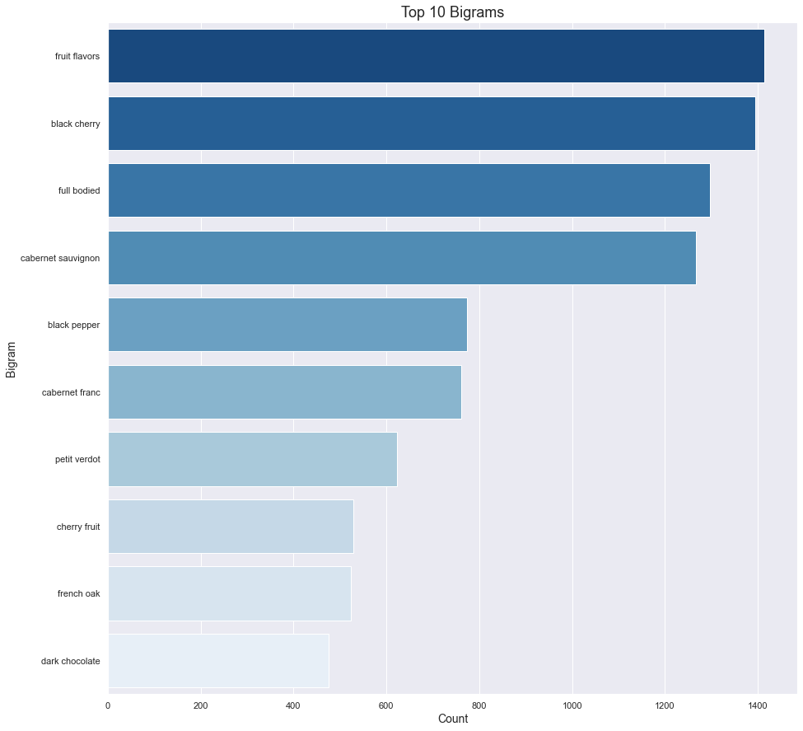
Top 10 Words & Bigrams
Vintage Intelligence: Using Machine Learning to Recommend Your Next Favorite Wine
Notes:
`flavors`, `fruit`, and `cherry`: These words suggest that wine drinkers pay close attention to the taste of the wine and the presence of fruit flavors, particularly cherry. This could be useful information for winemakers who are interested in creating wines with strong and enjoyable flavors.
`aromas` and `nose`: These words suggest that wine drinkers pay attention to the wine's aroma or scent. This could be useful information for winemakers who want to create wines with a pleasant and distinctive aroma.
`acidity` and `tannins`: These words suggest that wine drinkers pay attention to the structure and balance of the wine. Both acidity and tannins are important components of a wine's structure, and their presence and balance can have a significant impact on the wine's overall flavor and quality.
`palate` and `finish`: These words suggest that wine drinkers pay attention to the overall experience of drinking the wine, including the way it feels in the mouth and the aftertaste. This information could be useful for winemakers who are interested in creating wines that offer a satisfying and enjoyable drinking experience from start to finish.
Fruit flavors are highly emphasized in the descriptions, with `fruit flavors` and `cherry fruit` being two of the bigrams. Other common descriptors include `full-bodied`, `black cherry`, `black pepper`, and `dark chocolate`.
The mention of specific grape varieties such as `cabernet sauvignon`, `cabernet franc`, and `petit verdot` also indicates that these grapes are popular and commonly used in winemaking.
The use of terms like `french oak` suggests that the type of oak used for aging may also be an important factor in the flavor profile of the wines.

Slide 14
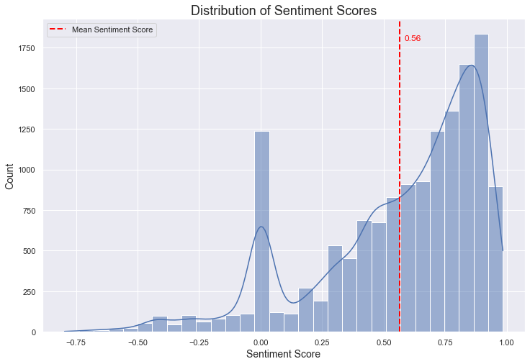
Sentiment Analysis of Wine Descriptions
Key Findings
Majority of the sentiments are positive.
Negative sentiment scores are more spread out and less frequent, which results in a left-skewed distribution.
The mean score being 0.56 indicates that the overall sentiment of the wine reviews is positive.
Vintage Intelligence: Using Machine Learning to Recommend Your Next Favorite Wine

Slide 15
Data Science Approach
Problem Statement
Data Cleaning & Exploratory Data Analysis
Data Pre-processing and Machine Learning Modelling
Conclusion & Recommendation
Data Collection
Vintage Intelligence: Using Machine Learning to Recommend Your Next Favorite Wine

Slide 16
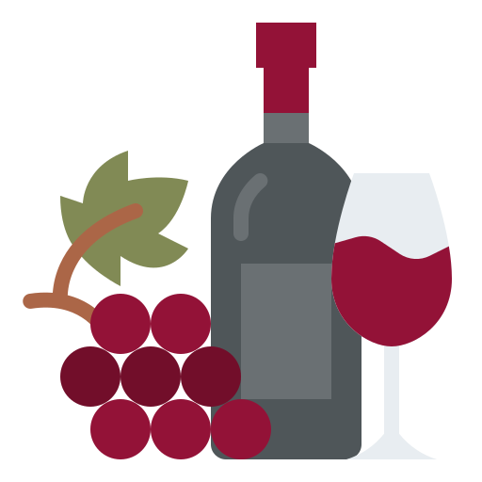


Content-based Filtering Wine Recommender
2. Finds other red wines that are “tangy”
Wine Recommendation System
1. Likes red wine that is “tangy”
3. Recommends other red wines that are tangy
Vintage Intelligence: Using Machine Learning to Recommend Your Next Favorite Wine
Notes:
For loop to normalize each sentence: The first for loop iterates over each sentence in the tokenized wine reviews and applies the normalize_text function to each sentence. The resulting normalized sentences are added to a list called normalized_sentences.
Map related phrases using Phrases_m: The normalized_sentences list is then used to create a Phrases_m model from Gensim, which is used to map related descriptors and combine them into a single string.
Create Phraser object: The Phrases_m model is then used to create a Phraser object called ngrams.
Set index for descriptor data: The 'raw descriptor' column of the descriptor data is set as the index for the DataFrame.
Normalize and extract descriptors from wine reviews: The wine reviews are normalized using the normalize_text function, and then the ngrams object is used to combine related descriptors in each review into a single string. The return_descriptor_from_mapping function is then used to extract the relevant descriptors from the string. Any None values are removed from the resulting list of descriptors, and the descriptors are joined into a single string called descriptorized_review. This process is repeated for each review in the wine_reviews list, and the resulting strings are added to the desc_reviews list.
Create wine traits dataframe: The desc_reviews list is used to create a new DataFrame called key_desc using the CountVectorizer from sklearn. This DataFrame contains the top 200 wine traits based on their frequency of occurrence in the wine reviews, encoded as boolean values.
Join wine_data with boolean descriptor data encoded: The key_desc DataFrame is joined with the original wine_data DataFrame to create a new DataFrame called model_df, which includes the boolean encoded descriptor data.
Create wine data final dataframe: The final step is to select only the relevant columns from the model_df DataFrame to create a new DataFrame called wine_data_final. This DataFrame includes the taster name, title, and points for each wine review, along with the top 200 wine traits based on their frequency of occurrence in the reviews.

Slide 17
Data Preprocessing Steps
Normalise each sentence in wine reviews
Map related phrases using Gensim Phrases_m
Normalise and extract descriptors from wine reviews
Descriptors stored in new dataframe
Join the dataframe with original dataframe with Boolean descriptor data encoded
Relevant columns – taster name, title and points for each wine review selected with top 200 wine traits
Vintage Intelligence: Using Machine Learning to Recommend Your Next Favorite Wine
Notes:
For loop to normalize each sentence: The first for loop iterates over each sentence in the tokenized wine reviews and applies the normalize_text function to each sentence. The resulting normalized sentences are added to a list called normalized_sentences.
Map related phrases using Phrases_m: The normalized_sentences list is then used to create a Phrases_m model from Gensim, which is used to map related descriptors and combine them into a single string.
Create Phraser object: The Phrases_m model is then used to create a Phraser object called ngrams.
Set index for descriptor data: The 'raw descriptor' column of the descriptor data is set as the index for the DataFrame.
Normalize and extract descriptors from wine reviews: The wine reviews are normalized using the normalize_text function, and then the ngrams object is used to combine related descriptors in each review into a single string. The return_descriptor_from_mapping function is then used to extract the relevant descriptors from the string. Any None values are removed from the resulting list of descriptors, and the descriptors are joined into a single string called descriptorized_review. This process is repeated for each review in the wine_reviews list, and the resulting strings are added to the desc_reviews list.
Create wine traits dataframe: The desc_reviews list is used to create a new DataFrame called key_desc using the CountVectorizer from sklearn. This DataFrame contains the top 200 wine traits based on their frequency of occurrence in the wine reviews, encoded as boolean values.
Join wine_data with boolean descriptor data encoded: The key_desc DataFrame is joined with the original wine_data DataFrame to create a new DataFrame called model_df, which includes the boolean encoded descriptor data.
Create wine data final dataframe: The final step is to select only the relevant columns from the model_df DataFrame to create a new DataFrame called wine_data_final. This DataFrame includes the taster name, title, and points for each wine review, along with the top 200 wine traits based on their frequency of occurrence in the reviews.

Slide 18
Baseline Model
A simple recommendation system for wines by selecting 10 wines at random for each user and evaluating how many of those wines are relevant to the user based on their previous wine ratings.
Two lists containing all the unique wine titles and taster names and set 10 wines to recommend to each user.
Loop through each taster, selects all the relevant wines based on their previous ratings, and randomly selects 10 wines to recommend to the taster.
Calculates the precision and recall values for these recommendations.
Calculate the average precision and recall values across all tasters, and prints these values as the output of the code.
0.53
0.000716
Average precision@k
Average recall@k
Vintage Intelligence: Using Machine Learning to Recommend Your Next Favorite Wine
Notes:
The precision value represents the fraction of recommended wines that were actually relevant to the taster, and the recall value represents the fraction of relevant wines that were recommended to the taster.

Slide 19
Models Evaluated and Results
algorithm_name | ave_precision@k_score | ave_recall@k_score
FunkSVD | 0.867917 | 0.257780
SVD | 0.865417 | 0.257334
Baseline Predictor | 0.822917 | 0.251537
KNN Baseline | 0.822917 | 0.251537
Slope One | 0.805417 | 0.250240
KNN Basic | 0.805417 | 0.250240
KNN Means | 0.805417 | 0.250240
KNN ZScore | 0.805417 | 0.250240
Co-clustering | 0.802917 | 0.249946
Normal Predictor | 0.719583 | 0.205594
NonNegative Matrix Factorization | 0.715417 | 0.246805
Vintage Intelligence: Using Machine Learning to Recommend Your Next Favorite Wine
Notes:
Normal Predictors and Baseline Predictor: These models were chosen as baseline models because they are simple and commonly used in recommender systems. They provide a basic level of performance against which more advanced models can be compared.
NonNegative Matrix Factorization: This matrix factorization-based model was chosen because it is a widely used and effective algorithm for recommendation tasks. It is particularly useful for datasets with non-negative values, which is common in recommendation systems.
Slope One: Slope One was chosen because it is a simple and effective collaborative filtering algorithm. It can be used to recommend items based on the preferences of similar users.
Singular Value Decomposition (SVD): SVD is a powerful matrix factorization-based model that is commonly used in recommender systems. It can be used to model complex user-item interactions and has been shown to be effective in a wide range of recommendation tasks.
Co-clustering: Co-clustering was chosen because it is a clustering-based algorithm that can be used to group users and items with similar preferences. It can be particularly useful for datasets with a large number of users or items.
K-Nearest Neighbors (KNN): KNN was chosen because it is a simple and effective algorithm for finding similarity between users or items in a dataset. It can be used to recommend items to users based on the preferences of similar users, or to recommend similar items to users based on the items they have liked or interacted with.
FunkSVD: FunkSVD was chosen because it is a matrix factorization-based model that is similar to SVD but uses a simpler update rule for the factorization process. It can be a good choice for larger datasets since it is computationally more efficient than SVD, while still providing a high level of accuracy.

Slide 20
Post Hyper-parameter Tuning
algorithm_name | ave_precision@k_score | ave_recall@k_score
Tuned FunkSVD | 0.952778 | 0.225906
FunkSVD | 0.867917 | 0.257780
SVD | 0.865417 | 0.257334
Baseline Predictor | 0.822917 | 0.251537
KNN Baseline | 0.822917 | 0.251537
Slope One | 0.805417 | 0.250240
KNN Basic | 0.805417 | 0.250240
KNN Means | 0.805417 | 0.250240
KNN ZScore | 0.805417 | 0.250240
Co-clustering | 0.802917 | 0.249946
Normal Predictor | 0.719583 | 0.205594
NonNegative Matrix Factorization | 0.715417 | 0.246805
Hyperparameters
'n_factors': 100
'n_epochs': 40
'lr_all': 0.01
'reg_all': 0.02}
Vintage Intelligence: Using Machine Learning to Recommend Your Next Favorite Wine
Notes:
Normal Predictors and Baseline Predictor: These models were chosen as baseline models because they are simple and commonly used in recommender systems. They provide a basic level of performance against which more advanced models can be compared.
NonNegative Matrix Factorization: This matrix factorization-based model was chosen because it is a widely used and effective algorithm for recommendation tasks. It is particularly useful for datasets with non-negative values, which is common in recommendation systems.
Slope One: Slope One was chosen because it is a simple and effective collaborative filtering algorithm. It can be used to recommend items based on the preferences of similar users.
Singular Value Decomposition (SVD): SVD is a powerful matrix factorization-based model that is commonly used in recommender systems. It can be used to model complex user-item interactions and has been shown to be effective in a wide range of recommendation tasks.
Co-clustering: Co-clustering was chosen because it is a clustering-based algorithm that can be used to group users and items with similar preferences. It can be particularly useful for datasets with a large number of users or items.
K-Nearest Neighbors (KNN): KNN was chosen because it is a simple and effective algorithm for finding similarity between users or items in a dataset. It can be used to recommend items to users based on the preferences of similar users, or to recommend similar items to users based on the items they have liked or interacted with.
FunkSVD: FunkSVD was chosen because it is a matrix factorization-based model that is similar to SVD but uses a simpler update rule for the factorization process. It can be a good choice for larger datasets since it is computationally more efficient than SVD, while still providing a high level of accuracy.

Slide 21
Model Performance Testing using Tuned FunkSVD
algorithm_name | ave_precision@k_score | ave_recall@k_score
Tuned FunkSVD | 0.952778 | 0.225906
FunkSVD | 0.867917 | 0.257780
SVD | 0.865417 | 0.257334
Baseline Predictor | 0.822917 | 0.251537
KNN Baseline | 0.822917 | 0.251537
Slope One | 0.805417 | 0.250240
KNN Basic | 0.805417 | 0.250240
KNN Means | 0.805417 | 0.250240
KNN ZScore | 0.805417 | 0.250240
Co-clustering | 0.802917 | 0.249946
Normal Predictor | 0.719583 | 0.205594
NonNegative Matrix Factorization | 0.715417 | 0.246805
title | matching points | points
Wayfarer 2014 Wayfarer Vineyard Chardonnay (Fort Ross-Seaview) | 91.689440 | 98
Quady 2006 Starboard Dessert Wine Port (Amador County) | 91.613462 | 95
Ryan Cochrane 2015 Solomon Hills Vineyard Chardonnay (Santa Maria Valley) | 91.592035 | 96
Williams Selyem 2014 Heintz Vineyard Chardonnay (Russian River Valley) | 91.562822 | 96
Gary Farrell 2014 Ritchie Vineyard Chardonnay (Russian River Valley) | 91.547778 | 96
Ryan Cochrane 2014 Solomon Hills Vineyard Chardonnay (Santa Maria Valley) | 91.536482 | 95
Schramsberg 2008 Extra Brut Sparkling (California) | 91.533279 | 94
Sandhi 2013 Sanford & Benedict Chardonnay (Sta. Rita Hills) | 91.524916 | 95
Dragonette 2013 MJM Syrah (Santa Ynez Valley) | 91.520572 | 95
Laetitia 2013 La Coupelle Single Vineyard Pinot Noir (Arroyo Grande Valley) | 91.517997 | 96
Wine Traits
“Warm”
“Tangy”
Vintage Intelligence: Using Machine Learning to Recommend Your Next Favorite Wine
Notes:
Based on the results, it appears that the recommender is performing well as the top 10 recommendations have high estimated match points (above 91) and high actual ratings (ranging from 94 to 100).

Slide 22
Data Science Approach
Problem Statement
Data Cleaning & Exploratory Data Analysis
Machine Learning Modelling
Conclusion & Recommendation
Data Collection
Vintage Intelligence: Using Machine Learning to Recommend Your Next Favorite Wine

Slide 23
Conclusion and Recommendation
The Tuned FunkSVD model performed well in a simple wine recommender system, allowing users to input several traits they look for in a wine to generate the top 10 recommendations.
Limitations of the project include the dataset not being representative of the entire wine industry and lacking some relevant features that could affect wine recommendations.
In the future, a larger datasets with more comprehensive wine features can be explored to improve the recommender system and deploy the model onto a Flask app.
Vintage Intelligence: Using Machine Learning to Recommend Your Next Favorite Wine
Notes:
Based on the results, it appears that the recommender is performing well as the top 10 recommendations have high estimated match points (above 91) and high actual ratings (ranging from 94 to 100).

Slide 24
Thank You

Slide 25
Annex
Average Points by Province
Vintage Intelligence: Using Machine Learning to Recommend Your Next Favorite Wine

Slide 26
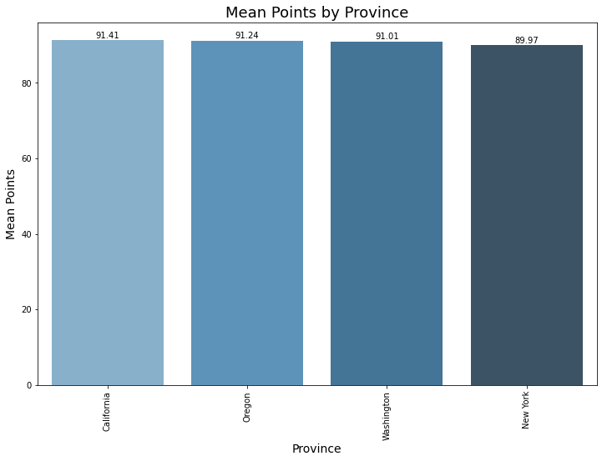
Average Points by Province
Vintage Intelligence: Using Machine Learning to Recommend Your Next Favorite Wine

