Slide 1
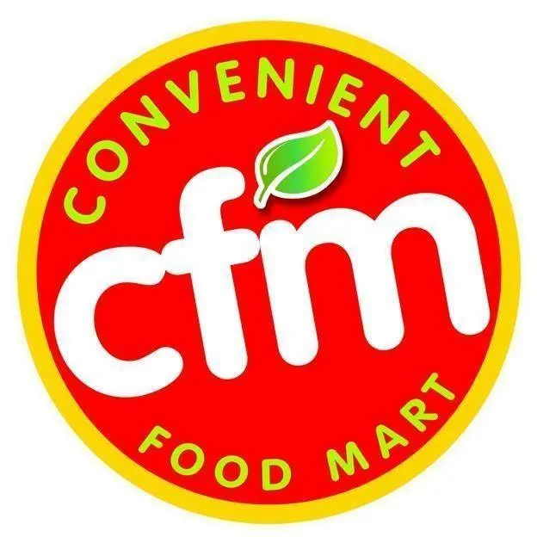
FOOD MART MEDIA TYPE COST PREDICTION
BY: Matthew Belizaire
Nicholas Nguyen
Tuyen Nguyen

Slide 2
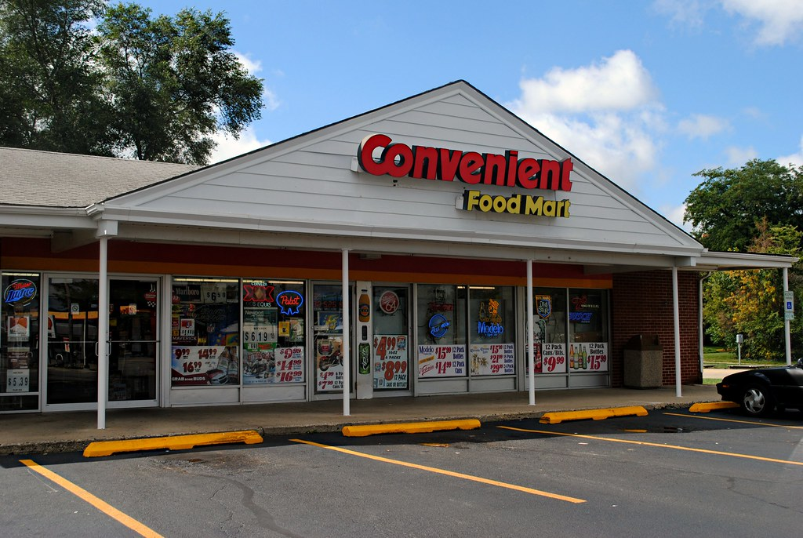
Introduction
Convenience store industry:
Revenue: $37.3 bil in 2022
Increase to 1.8% in market size
Grown 3.1% per year
27th ranked Retail Trade industry
Highly competitive
Purpose: understands about the predicted cost that Food Mart spends on their media types in order to get the right customer segmentation.

Slide 3
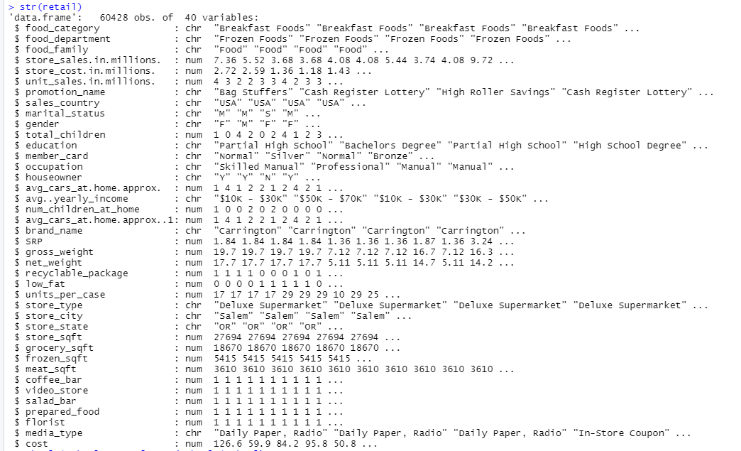
Dataset Information
Dataset:
60,428 observations of 40 variables
Comparison of media types gathered by costs, promotion names, stores, customers' information, etc.
Source: https://www.kaggle.com/code/firefoxmetzger/food-mart-campaign-cost

Slide 4
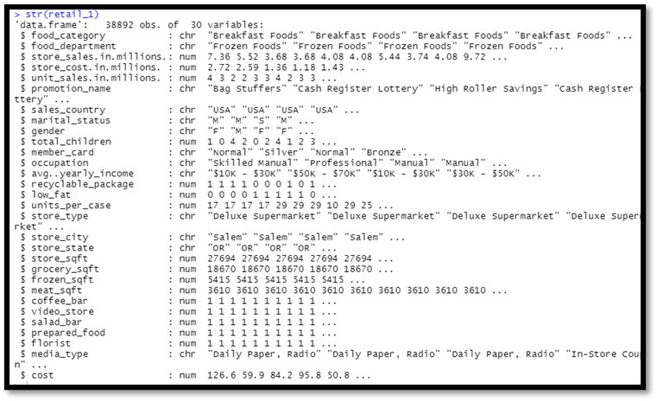
Analyzing Structure Data
Remove countries which are not the United States
Remove duplicate and unhelpful columns or information
No missing data
Depending on which analysis method --> Might need to remove more variables
Focus on the correlation between media_type and cost

Slide 5
Data Viz

Slide 6
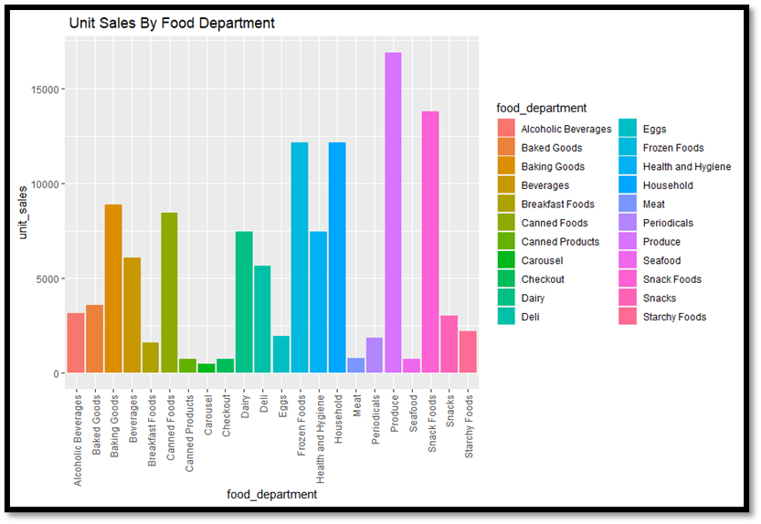
Unit Sales By Food Department
Meat, Seafood department -> lowest unit sales
Produce, Snack Foods department -> highest unit sales
=> Understandable for convenience store.

Slide 7
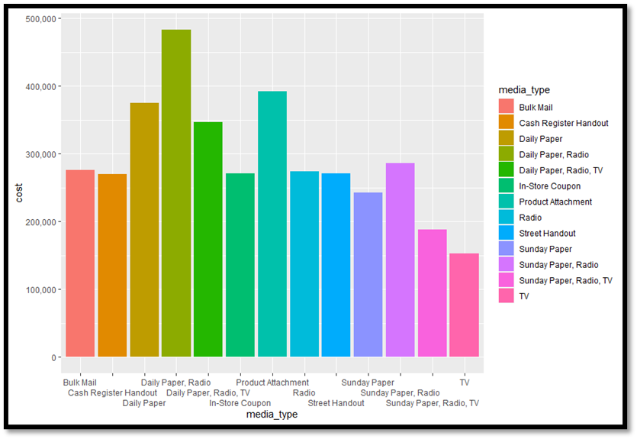
Cost By Media Type
Combined several media types or only used 1 method
Highest cost: Daily Paper, Radio
Lowest cost: TV
Target group: not spend time on TV
=> Spend less on TV marketing only

Slide 8
Analysis Method

Slide 9
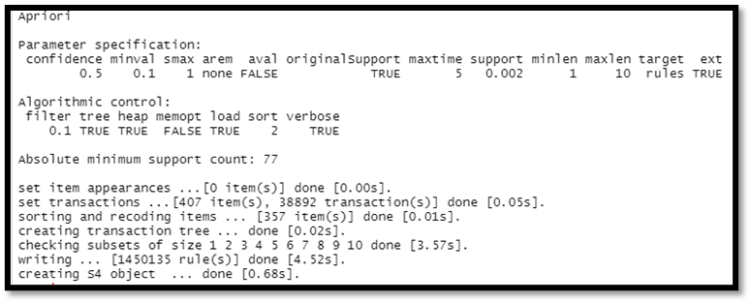
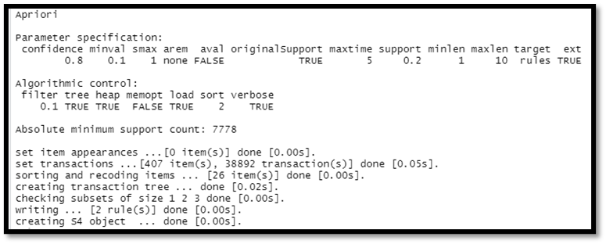
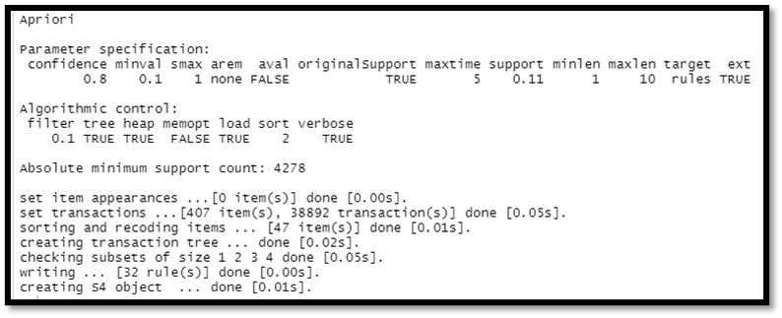
Association Rule Mining
Supp = 0.2 and conf = 0.8
Supp = 0.11 and conf = 0.8
Supp = 0.002 and conf = 0.5
Many Rules
Not Enough Rules
Enough Rules

Slide 10


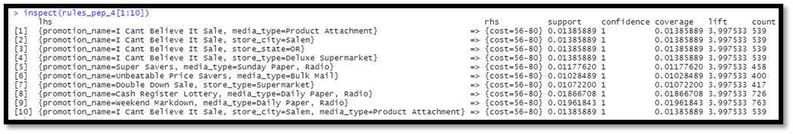
Association Rule Mining – RHS = Cost
Set up cost into 5 categories:
0-55
56-80
81-105
106-130
131+
When {cost = 56 –80}
Media_type = Product Attachement mostly
Promotion_name = I Can't Believe It Sale

Slide 11
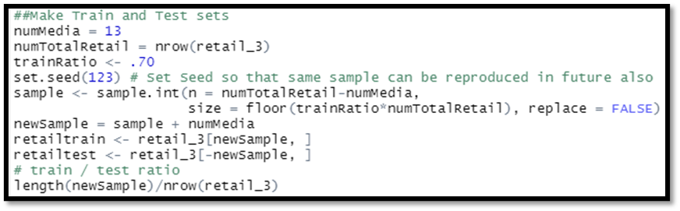
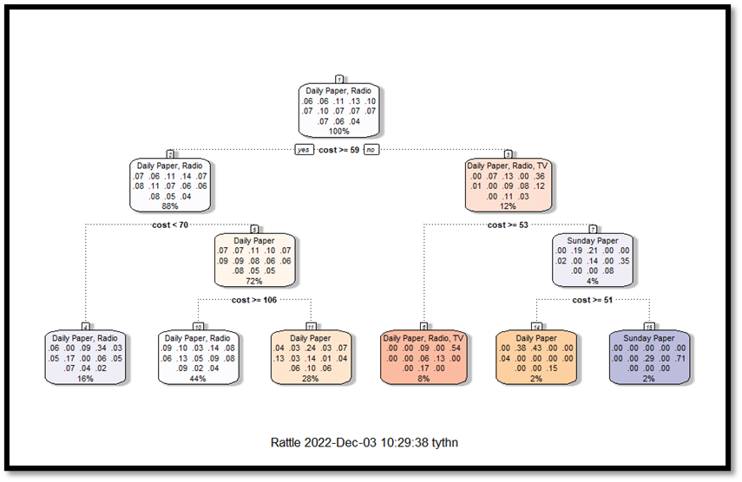

Decision Tree
Divided dataset into training/testing dataset
Predict the testing dataset
Plot the decision tree
Top notch: Daily Paper, Radio
Whether cost is >= 59
88%: Daily Paper, Radio
12%: Daily Paper, Radio, TV

Slide 12
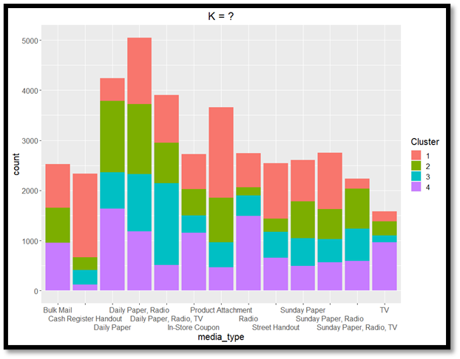
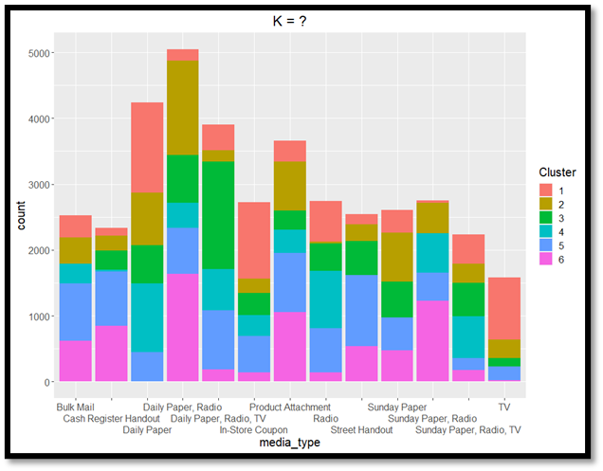

K-Means
Remove media_type for cluster purposes
Run with different k values
K= 4
No cluster 3 for Bulk Mail
K = 6
No cluster 3 for Bulk Mail
No cluster 6 for Daily Paper

Slide 13
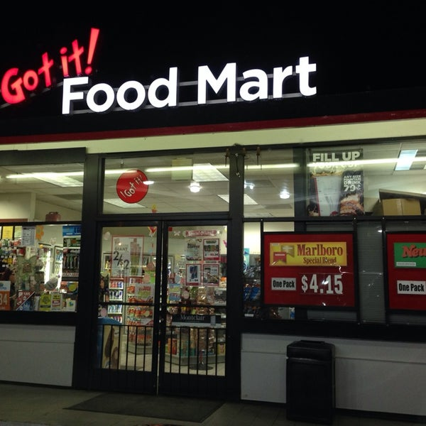
Conclusion
With analysis methods, Food Mart:
Realize how effective each media type is
Direct to which media type is suitable for group of customers
Ex: Association Rule Mining
Cost: 56 – 80
Media_type: Product Attachment
Ex: Decision Tree
Based on range of cost,
Focus on which media type

Slide 14
Thank you
Any questions?

