Slide 1

Java Spring Boot Tugas Individu Nicholas Phandinata | 39385

Slide 2
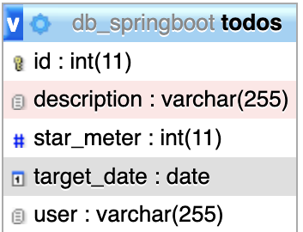
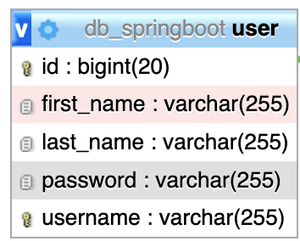
Database
MySQL (XAMPP)
db_springboot
2 Tables: Todos (CRUD Operation) & User (Login/logout)

Slide 3
Depedencies
Spring Boot Starter Security
Thymeleaf Spring Security
Spring Boot Starter Web
Spring Boot Starter Data JPA
Spring Boot Starter Thymeleaf
MySQL Connector
Project Lombok
Spring Boot Devtools
Openpdf

Slide 4
Features
Login/logout with register
Active search
Modal detail
Export to PDF
Sorting
Auto pagination
Card view (Prototype)

Slide 5
References
https://www.color-hex.com/
https://freefrontend.com/
https://getbootstrap.com/
https://www.flaticon.com/
https://www.codejava.net/

Slide 6
Live Demo

Slide 7
Thank You

