Slide 1
Language Semantics by Example
A Practical Approach to Language Design Using the K Framework

Slide 2
Language Primitives
In order to design a programming language, you need to know what a programming language is.
In terms of language design, a programming language is the abstraction from hardware level commands executed in binary on a CPU to something human readable.
At its fundamental level a programming language is broken into two parts, syntax and semantics.

Slide 3
Language Syntax
The syntax of a language is what you read and write. It's all the text that sits inside of a source code file.
In regards to just the language, you can think of it as the language keywords, logic operators, control structure, arithmetic operators, etc.
Syntax is usually what a programmer gets most confused about when using different programming languages.
  In Java there's a for-each statement, how the heck do you write a for-each in Haskell!?

Slide 4
Language Semantics
If syntax is the words of a language them semantics is the meaning.
All programmers know what an 'if' statement is, but a computer doesn't know. When you define that symbol in a programming language you need a meaning.
Upon running a programming, the source needs to parsed. If it successfully parses, it will then be executed. The semantics of the language will dictate how parsed coded will operate.
  1 + 1 is addition in a language only because you said it is, “Hello “ + “, world!” adds two strings only because you said that's what it should do.

Slide 5
Language Semantics Example
The table below shows the syntax of addition for various languages. The semantics is the same for every one of them, increment x by y.
x += y | C, C++, Java, etc.
x := x + y | ALGOL, Simla, Smalltalk
ADD x, y | Assembly (Intel 8086)
LET x = x + y | Basic
(incf x y) | Common Lisp

Slide 6
Popular Tools
Yacc/Bison are two popular tools used to write BNF (Backus–Naur Form) for the syntax and implementation of the language semantics. This is used when C is the compilation target.
ANTLR is a popular choice for the JVM. BNF is also used for the context free grammar (BNF) and Java is used to implement the semantics of the grammar.
  Groovy and Jython are at least partly written with ANTLR.
K is a newer framework that abstracts away the common patterns of language design and focuses on the symbolic representations of syntax and semantics. Allowing the user to write in more of an abstract manner.

Slide 7
The K Framework
Using K (http://www.kframework.org/index.php/Main_Page), we will develop our own programming language.
Installation steps can be found on their website.
All source code and a formal language specification is provided with this presentation.

Slide 8
K Syntax for the Quirky Language
The code below shows how to write the syntax of a language in BNF. In this toy language, arithmetic operators are the last argument: (1 1 +) => 2
An AExp is just a symbol for an arithmetic expression. Anything on the RHS is an AExp. This means an AExp has a recursive definition, (1 1 +) (1 1 +) +. This is evaluated recursively 5 times, can you see why 5 and not 3?
syntax AExp ::= Int | Id
| AExp AExp "/"
| AExp AExp "+"
| AExp AExp "-"
| AExp AExp "*"
| AExp AExp "%"
| "(" AExp ")"

Slide 9
K Semantics for the Quirky Language
The LHS is the syntax we specified, and the RHS is semantics of the language. We can also put a constraint on division when the denominator is zero.
rule I1:Int I2:Int / => I1 /Int I2 when I2 =/=Int 0
rule I1:Int I2:Int + => I1 +Int I2
rule I1:Int I2:Int - => I1 -Int I2
rule I1:Int I2:Int * => I1 *Int I2
rule I1:Int I2:Int % => I1 %Int I2

Slide 10
That Was Kind of Boring! How About This?
Here is the syntax for statements, my if-statement is a 'does (B) { S } if_not { S }' statement. My while-statement is a 'dont_stop_if (B) { S }
syntax Stmt ::= Block
| Id "=" AExp ";"
| "does" BExp
Block "if_not" Block
| "int" Ids ";"
| "dont_stop_if" "(" BExp ")" Block
| "function" "(" ")" Block
| "function" Id "(" ")" Block
> Stmt Stmt

Slide 11
If-Statement Defined
The rule below shows how to define the semantics of an if-statement. If the 'does' has a true value, then the statement S in its block statement is executed. If the 'does' has a false value, then the 'if_not' statement S is executed. Underscores are used when a statement shouldn't be evaluated.
rule does true S if_not _ => S
rule does false _ if_not S => S

Slide 12
While-Statement Defined
With the help of our if-statement 'does', we also define a while-statement 'dont_stop_if'. Our while-statement is a recursive if!
If our statement is true, we execute our block and call 'dont_stop_if' again, which at its top level is our if-statement.
rule dont_stop_if (B) S =>
does (B) {
S
dont_stop_if (B) S
} if_not {} [structural]

Slide 13
That Was Easy
With arithmetic operators and a while construct, we can find the nth value in a Fibonacci sequence.
View quirky.k see see the full language implementation (check out how boolean operations are defined).

Slide 14
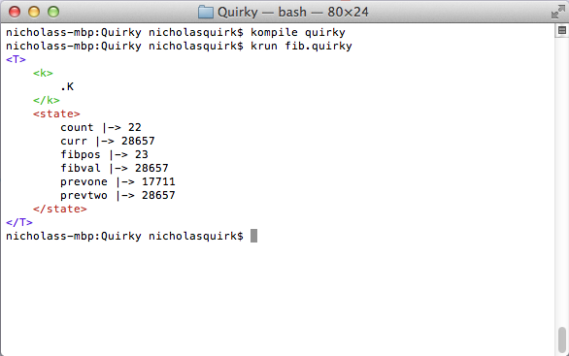
The Test
Given the language implementation quirky.k and the source file fib.quirky, we can find the nth value in a Fibonacci sequence. The list of variable names are displayed with their state when the program ends, we wanted the 23rd Fibonacci sequence position (fibpos), which is 28,657 (fibval).

Slide 15
The Source
// Here is a crude example of how to find the nth number in a Fibonacci sequence.
// Fibpos is the position within the sequence to find and fibval is the value at
// that position.
int curr, prevone, prevtwo, fibpos, count;
curr = 0;
prevone = 0;
prevtwo = 1;
fibpos = 23;
count = 0;
dont_stop_if(count < (fibpos -1 +)) {
curr = prevone prevtwo +;
prevone = prevtwo;
prevtwo = curr;
count = count 1 +;
}
int fibval;
fibval = prevtwo;

Slide 16
Wrap Up
This has been a high level overview on how to design a language and provide semantics with the K framework.
The framework allows designers to specify the language in a more mathematical style, abstracting away many common language features.
  We got the int data type for free here. Most tool like Yacc/Bison and ANTLR require int be be defined by the designer.
View the included files to better understand how to implement language semantics (because syntax is usually the easy part).

Slide 17
Included Files
quirky.k → Language implementation
fib.quirky → Find the nth Fibonacci number using Quirky
fun_times.quirky → An example of some of the things you can do with the language.
quirky.pdf → A prettier way to read the source code.

