Slide 1
The different kinds of files
Compiling C programs requires you to work with four kinds of files:
Regular source code files. These files contain function definitions, and have names which end in ".c" by convention.

Slide 2
The different kinds of files
Header files. These files contain function declarations (also known as function prototypes) and various preprocessor statements. They are used to allow source code files to access externally-defined functions. Header files end in ".h" by convention.

Slide 3
The different kinds of files
Object files. These files are produced as the output of the compiler. They consist of function definitions in binary form, but they are not executable by themselves. Object files end in ".o" by convention, although on some operating systems (e.g. Windows, MS-DOS), they often end in ".obj".

Slide 4
The different kinds of files
Binary executables. These are produced as the output of a program called a "linker". The linker links together a number of object files to produce a binary file which can be directly executed. Binary executables have no special suffix on Unix operating systems, although they generally end in ".exe" on Windows.

Slide 5
Modular compilation
Using separate files to organize code can also help to make the compilation process more efficient.
So far, we used a single-step compilation approach in which all source files are compiled at the same time to create the executable, e.g.
gcc main.c threenumsfcts.c.

Slide 6
Modular compilation
This approach has a significant drawback. Anytime one of the source files is modified, all files must be recompiled. Even a small change, such as modifying a printf statement to fix a spelling error, would require all files be recompiled.

Slide 7
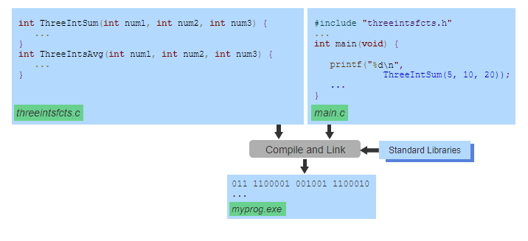
Single-step compilation compiles and links all source files and libraries.

Slide 8
As programs become larger and the number of source files increases, the time required to recompile and link all source files can become very long - often requiring minutes to hours.
Instead of compiling an executable using a single step, a modular compilation approach can be used that separates the compiling and linking steps within the compilation process.

Slide 9
In this approach, each source file is independently compiled into an object file. An object file contains machine instructions for the compiled code along with placeholders, often referred to as references, for calls to functions or accesses to variables or classes defined in other source files or libraries.
gcc –c main.c
gcc –c threenumsfcts.c
files can be compiled separately into two object files named main.o and threenumsfcts.o

Slide 10
The resulting object files will include several placeholders for functions that are defined in other files. For example, the main.o object file may contain placeholders for calls to any functions in threenumsfcts.o.

Slide 11
Linker
After each source file has been compiled, the linker will create the final executable by linking together the object files and libraries.
gcc main.o threenumsfcts.o –o myprog
This line tells the compiler to link together two object files into a binary executable file named myprog.

Slide 12
Linker
For each placeholder found within an object file, the linker searches the other object files and libraries to find the referenced function or variable.
When linking the main.o and threenumsfcts.o files, the placeholder for a call to a function in main.o will be replaced with a jump to the first instruction of that function within the threenumsfcts.o object file.
This creates a link between the code within the main.o and threenumsfcts.o object files. Once all placeholders have been linked together, the final executable can be created.

Slide 13
The math function implementations are in a separate libm file that is not linked to by default so you have to specify it -lm.
There is no relation between those header files and library files.

Slide 14
Makefiles
While modular compilation offers many advantages, manually compiling and linking a program with numerous source and header files can be challenging.
For example, a change within a single header file will require recompiling all source files that include that header file. Keeping track of these dependencies to determine which files need to be recompiled is not trivial and can require considerable effort, if done manually.

Slide 15
For large programs, programmers often utilize project management tools to automate the compilation and linking process. make is one project management tool that is commonly used on Unix and Linux computer systems.

Slide 16
The make utility uses a makefile to recompile and link a program whenever changes are made to the source or header files.
The makefile consists of a set of rules and commands. Make rules are used to specify dependencies between a target file (e.g., object files and executable) and a set of prerequisite files that are needed to generate the target file (e.g., source and header files).

Slide 17
A make rule can include one or more commands -- referred to as make recipe -- that will be executed in order to generate the target file.
The make rule's target and prerequisites are defined on a single line. The commands for the make rule should be specified one per line starting with a single tab character.

Slide 18
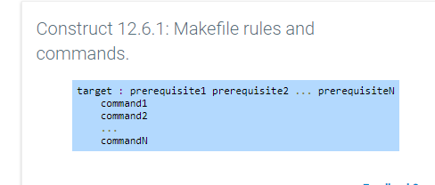

Slide 19
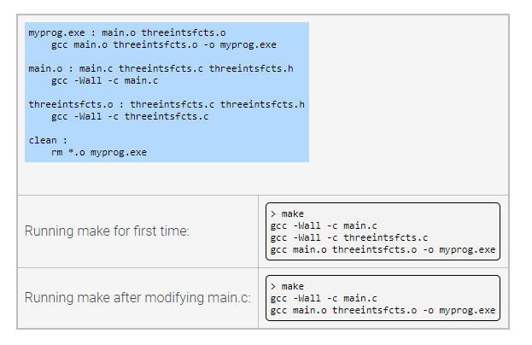

Slide 20
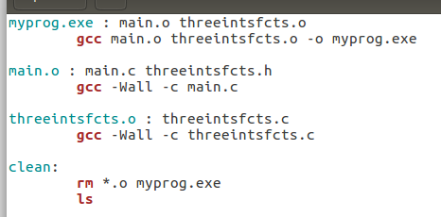
zyBooks example had a few errors

Slide 21
Make rules can also be used to define common operations used when managing larger programs. One common make rule is the clean : rule that is used to execute a command for deleting all generated files such as object files and the program executable. In the above example, this is accomplished by running the command rm *.o myprog.exe.

Slide 22
By default make assumes the makefile is named makefile or Makefile. The -f flag can be used to run make using a different filename. For example, make -f MyMakefile will run make using the file named MyMakefile.

