Slide 1


Nicholas Yap
12 October 2026
https://github.com/nicholas-yap/spacex-data-science-capstone
Notes:
IBM Applied Data Science Capstone. Nicholas Yap. Analysis of historical Falcon 9 launches.
Sources: https://github.com/nicholas-yap/spacex-data-science-capstone/blob/main/data/dataset_part_2.csv
Course datasets are historical snapshots, not current SpaceX operational data.

Slide 2
Rubric Evidence Index
Criterion | Evidence in this report
Q1 Repository and completed files | Public repository URL: pages 1, 40.
Q2 Final presentation in PDF format | Complete PDF: 40 pages.
Q3 Executive summary | Page 3: methods, results and limitations.
Q4 Introduction | Page 9: business question and scope.
Q5 Collection and wrangling | Pages 10-12: collection and wrangling.
Q6 EDA methodology | Pages 13-14: charts and SQL methods.
Q7 Classification methodology | Page 17: split, scaling and tuning.
Q8 EDA visualizations | Pages 18-23: six charts with analysis.
Q9 SQL results and queries | Pages 14, 24-33: ten SQL results.
Q10 Folium maps | Pages 15, 34-36: three map views.
Q11 Plotly Dash | Pages 16, 37-39: dashboard interactions.
Q12 Predictive results | Pages 4-6: accuracy, matrix and selection.
Q13 Conclusion | Page 7: findings, limits and next steps.
Q14 Creativity | Custom flows/charts: 10-12, 18-23. Maps: 34-39.
Q15 Additional insights | Page 8: three insights with numerical evidence.
2
Notes:
Evidence map for the fifteen criteria supplied by the learner. Expanded subcriteria for questions 12-15 were not supplied. Page numbers identify substantive evidence, not divider slides.
Sources: https://github.com/nicholas-yap/spacex-data-science-capstone/blob/main/README.md
Course datasets are historical snapshots, not current SpaceX operational data.

Slide 3
Executive Summary
Methods: archived API data and web scraping, data cleaning, SQL and visual EDA, Folium maps, a Dash dashboard and four tuned classifiers.
Results: 60 of 90 launches have Class 1 outcomes (66.7%). KSC LC 39A has the highest observed site rate at 17/22 (77.3%).
Prediction: all four classifiers score 83.33% on 18 test launches. Decision tree leads cross-validation at 87.68%.
Interpretation: outcome definition, mission mix, small samples and preprocessing leakage limit business use of these predictions.
3
Notes:
Executive summary includes both methodology and results. n=90, Class 1=60, KSC=17/22. All four test scores 15/18; tree CV=0.8767857143.
Sources: https://github.com/nicholas-yap/spacex-data-science-capstone/blob/main/data/dataset_part_2.csv
Course datasets are historical snapshots, not current SpaceX operational data.

Slide 4

Classification Accuracy
All models tie at 83.33% on the test set. The decision tree leads CV at 87.68%. The always-Class-1 test baseline is 66.67%.
Notes:
Saved notebook results. 72 training rows; 18 test rows; 12 test positives. Tree params: gini, max_depth=8, max_features=sqrt, min_samples_leaf=2, min_samples_split=10, splitter=best.
Sources: https://github.com/nicholas-yap/spacex-data-science-capstone/blob/main/notebooks/SpaceX-Machine-Learning-Prediction-Part-5-v1.ipynb
Course datasets are historical snapshots, not current SpaceX operational data.

Slide 5
Decision Tree Confusion Matrix
Actual / Predicted | Class 0 | Class 1
Class 0 | 3 | 3
Class 1 | 0 | 12
15/18 correct (83.33%)
Class 1 precision: 12/15 = 80%
Class 1 recall: 12/12 = 100%
3 of 6 actual Class 0 outcomes are false positives
Notes:
Matrix transcribed from saved decision-tree output: [[3,3],[0,12]]. Actual rows, predicted columns. Half of six actual Class 0 outcomes become false positives. The tree is selected by highest CV, with tied test accuracy.
Sources: https://github.com/nicholas-yap/spacex-data-science-capstone/blob/main/notebooks/SpaceX-Machine-Learning-Prediction-Part-5-v1.ipynb
Course datasets are historical snapshots, not current SpaceX operational data.

Slide 6
Model Evaluation and Selection
Classifier | 10-fold CV accuracy | Test accuracy
Logistic regression | 84.64% | 83.33%
Support vector machine | 84.82% | 83.33%
Decision tree | 87.68% | 83.33%
K-nearest neighbors | 84.82% | 83.33%
Decision tree is selected for its highest cross-validation accuracy: 87.68%. All four models tie at 83.33% on 18 test launches.
Split: 72 train, 18 test. Small samples and preprocessing leakage limit confidence.
https://github.com/nicholas-yap/spacex-data-science-capstone/blob/main/
notebooks/SpaceX-Machine-Learning-Prediction-Part-5-v1.ipynb
6
Notes:
Selected by highest 10-fold CV, with tied test accuracy. CV values: LR 0.8464285714285713, SVM 0.8482142857142856, tree 0.8767857142857143, KNN 0.8482142857142858. All test scores 15/18.
Sources: https://github.com/nicholas-yap/spacex-data-science-capstone/blob/main/notebooks/SpaceX-Machine-Learning-Prediction-Part-5-v1.ipynb
Course datasets are historical snapshots, not current SpaceX operational data.

Slide 7
Conclusions
Historical results: 60/90 Class 1 outcomes (66.7%), rising to 16/19 (84.2%) in 2020.
KSC leads observed site rate at 17/22 (77.3%). CCAFS contributes the most successes, 33. Mission mix limits comparisons between sites.
All four classifiers achieve 83.33% test accuracy. Decision tree leads CV at 87.68%, but predicts success for 3 of 6 actual Class 0 outcomes.
Next steps: fit preprocessing inside cross-validation, check which features are available before launch, and test on later launches before using predictions in business decisions.
7
Notes:
Conclusions connect exploratory results, model evaluation, error costs and methodological improvements.
Sources: https://github.com/nicholas-yap/spacex-data-science-capstone/blob/main/data/dataset_part_2.csv
Course datasets are historical snapshots, not current SpaceX operational data.

Slide 8
Additional Insights
Finding | Numerical evidence | Interpretation
Count differs from rate | CCAFS: 33/55 (60.0%) KSC: 17/22 (77.3%) | Most successes and highest success rate occur at different sites.
Outcome label differs from pad landing | Class 1: 60/90 (66.7%) ASDS or RTLS: 55/90 (61.1%) | Five controlled ocean outcomes add 5.6 percentage points to Class 1 rate.
Booster era matters | Block 5: 33/39 (84.6%) Block 1: 4/19 (21.1%) | Technology and date overlap. This comparison does not isolate a causal effect.
Block 2 has 6/6 successes, but its small sample prevents a strong reliability claim. These are historical associations, not estimates of launch price or savings.
8
Notes:
Calculated from dataset_part_2.csv. CCAFS n55,33 successes; KSC n22,17 successes. Class 1 n60 including five True Ocean outcomes. True ASDS n41 plus True RTLS n14 =55. Block5 n39,33 successes; Block1 n19,4 successes; Block2 n6,6 successes. Differences are descriptive, not causal.
Sources: https://github.com/nicholas-yap/spacex-data-science-capstone/blob/main/notebooks/04-additional-insights.ipynb
Course datasets are historical snapshots, not current SpaceX operational data.

Slide 9
Introduction
Business question: how can historical launch characteristics help estimate the chance of a successful first-stage outcome?
Reusable boosters create a reason to study landing outcomes. This project predicts the course outcome label, not launch price or cost savings.
Compare launch sites, payload, orbit and experience, then evaluate four classification models.
Scope: historical course snapshots. A successful mission and a successful first-stage outcome measure different events.
Notes:
Business question: how can historical launch characteristics help estimate the chance of a successful first-stage outcome?
Reusable boosters create a reason to study landing outcomes. This project predicts the course outcome label, not launch price or cost savings.
Compare launch sites, payload, orbit and experience, then evaluate four classification models.
Scope: historical course snapshots. A successful mission and a successful first-stage outcome measure different events.
Sources: https://github.com/nicholas-yap/spacex-data-science-capstone/blob/main/data/dataset_part_2.csv
Course datasets are historical snapshots, not current SpaceX operational data.

Slide 10
Data Collection – SpaceX API
GET launches/past
Archived JSON
Filter single core
and single payload
Resolve IDs
Rocket, pad, payload
Falcon 9 features
90 saved records
The archived launch response supports reproducible inspection. The supplied course CSV contains the enriched rocket, launchpad, payload and core fields.
The companion notebook validates the snapshot and the 90-row feature table without claiming a fresh API extraction.
https://github.com/nicholas-yap/spacex-data-science-capstone/blob/main/
notebooks/01-data-collection.ipynb
Notes:
API provenance: https://api.spacexdata.com/v4/launches/past . Archived response supplied by IBM in API_call_spacex_api.json. Enriched feature data comes from the supplied dataset_part_1.csv, not a newly executed online enrichment.
Sources: https://github.com/nicholas-yap/spacex-data-science-capstone/blob/main/notebooks/01-data-collection.ipynb
Course datasets are historical snapshots, not current SpaceX operational data.

Slide 11
Data Collection – Web Scraping
Wikipedia snapshot
Revision 1027686922
BeautifulSoup
Launch tables
Parse cells
Dates, payload, orbit
Validate and export
121 rows, 11 columns
The completed notebook extracts numbered launch rows and checks flight IDs, dates and times.
The June 2021 page snapshot extends beyond the 90-row modeling sample. The scraped table remains a separate source.
https://github.com/nicholas-yap/spacex-data-science-capstone/blob/main/
notebooks/jupyter-labs-webscraping.ipynb
Notes:
Saved notebook outputs report 121 rows and 11 columns. Wikipedia archived revision: https://en.wikipedia.org/w/index.php?title=List_of_Falcon_9_and_Falcon_Heavy_launches&oldid=1027686922
Sources: https://github.com/nicholas-yap/spacex-data-science-capstone/blob/main/notebooks/jupyter-labs-webscraping.ipynb
Course datasets are historical snapshots, not current SpaceX operational data.

Slide 12
Data Wrangling
Validate schema
Dates and flight IDs
Payload mass
Mean-imputed input
Outcome label
60 class 1, 30 class 0
One-hot encoding
83 model features
Class 1 includes True ASDS, True RTLS and True Ocean. Class 0 includes failed, missing and no-attempt outcomes.
Controlled ocean outcomes do not establish booster recovery. Keep this distinction when interpreting “success.”
https://github.com/nicholas-yap/spacex-data-science-capstone/blob/main/
notebooks/02-wrangling-eda.ipynb
Notes:
Outcome mapping verified against dataset_part_2.csv. The five True Ocean rows count as Class 1. Payload mean imputation is already present in supplied data.
Sources: https://github.com/nicholas-yap/spacex-data-science-capstone/blob/main/notebooks/02-wrangling-eda.ipynb
Course datasets are historical snapshots, not current SpaceX operational data.

Slide 13
EDA with Data Visualization
Scatter plots compare flight number and payload with launch site and orbit. Color separates the two outcome classes.
Orbit success bars show rates with launch counts so small groups remain visible.
The yearly line chart shows changes in outcome rate, with year-specific denominators.
Charts describe associations. Site, orbit, payload and technology changed together over time.
https://github.com/nicholas-yap/spacex-data-science-capstone/blob/main/
notebooks/02-wrangling-eda.ipynb
Notes:
Scatter plots compare flight number and payload with launch site and orbit. Color separates the two outcome classes.
Orbit success bars show rates with launch counts so small groups remain visible.
The yearly line chart shows changes in outcome rate, with year-specific denominators.
Charts describe associations. Site, orbit, payload and technology changed together over time.
Sources: https://github.com/nicholas-yap/spacex-data-science-capstone/blob/main/notebooks/02-wrangling-eda.ipynb
Course datasets are historical snapshots, not current SpaceX operational data.

Slide 14
EDA with SQL
DISTINCT and LIKE identify launch-site labels and the first five CCA records.
SUM, AVG and MAX summarize payload mass and the boosters carrying the maximum.
Date and outcome filters identify the first ground landing, drone ship landings and failures in 2015.
GROUP BY and COUNT summarize mission results and rank landing outcomes for the specified period.
https://github.com/nicholas-yap/spacex-data-science-capstone/blob/main/
notebooks/jupyter-labs-eda-sql-coursera_sqllite.ipynb
Notes:
DISTINCT and LIKE identify launch-site labels and the first five CCA records.
SUM, AVG and MAX summarize payload mass and the boosters carrying the maximum.
Date and outcome filters identify the first ground landing, drone ship landings and failures in 2015.
GROUP BY and COUNT summarize mission results and rank landing outcomes for the specified period.
Sources: https://github.com/nicholas-yap/spacex-data-science-capstone/blob/main/notebooks/jupyter-labs-eda-sql-coursera_sqllite.ipynb
Course datasets are historical snapshots, not current SpaceX operational data.

Slide 15
Interactive Map with Folium
Site circles and labels locate the three modeled launch facilities on a continental map.
A MarkerCluster groups overlapping launches. Green marks Class 1 and red marks Class 0.
Popup details show flight, date, payload and outcome. Expanding a cluster separates markers for inspection.
Lines connect CCAFS SLC 40 to selected road, rail and coastline points. Haversine distance gives approximate straight-line separation.
https://github.com/nicholas-yap/spacex-data-science-capstone/blob/main/
notebooks/03-interactive-maps.ipynb
Notes:
Site circles and labels locate the three modeled launch facilities on a continental map.
A MarkerCluster groups overlapping launches. Green marks Class 1 and red marks Class 0.
Popup details show flight, date, payload and outcome. Expanding a cluster separates markers for inspection.
Lines connect CCAFS SLC 40 to selected road, rail and coastline points. Haversine distance gives approximate straight-line separation.
Sources: https://github.com/nicholas-yap/spacex-data-science-capstone/blob/main/notebooks/03-interactive-maps.ipynb
Course datasets are historical snapshots, not current SpaceX operational data.

Slide 16
Dashboard with Plotly Dash
The site dropdown switches between all launches and a selected facility.
The all-sites pie chart shows each site’s contribution to successful outcomes. A selected-site pie shows its success ratio.
The payload range slider filters the outcome scatter plot. Color identifies booster block.
Hover details reveal launch date, flight number and outcome. The dashboard uses the same 90-row sample as the EDA.
https://github.com/nicholas-yap/spacex-data-science-capstone/blob/main/
spacex_dashboard.py
Notes:
The site dropdown switches between all launches and a selected facility.
The all-sites pie chart shows each site’s contribution to successful outcomes. A selected-site pie shows its success ratio.
The payload range slider filters the outcome scatter plot. Color identifies booster block.
Hover details reveal launch date, flight number and outcome. The dashboard uses the same 90-row sample as the EDA.
Sources: https://github.com/nicholas-yap/spacex-data-science-capstone/blob/main/spacex_dashboard.py
Course datasets are historical snapshots, not current SpaceX operational data.

Slide 17
Predictive Analysis
83 input features
StandardScaler
80/20 split
72 train, 18 test
GridSearchCV
10 folds, accuracy
Four classifiers
Score and compare
Logistic regression, SVM, decision tree and KNN use the saved lab configuration. random_state=2 fixes the train/test split.
The lab scales all 90 rows before splitting. Future evaluation should fit preprocessing inside each training fold and use a chronological holdout.
https://github.com/nicholas-yap/spacex-data-science-capstone/blob/main/
notebooks/SpaceX-Machine-Learning-Prediction-Part-5-v1.ipynb
Notes:
Results reproduced from saved notebook outputs. Pre-split scaling exposes test distribution to preprocessing. GridSearchCV has 10 folds; no claim of a leakage-free evaluation.
Sources: https://github.com/nicholas-yap/spacex-data-science-capstone/blob/main/notebooks/SpaceX-Machine-Learning-Prediction-Part-5-v1.ipynb
Course datasets are historical snapshots, not current SpaceX operational data.

Slide 18
Flight Number vs. Launch Site
1: CCAFS SLC 40 2: KSC LC 39A 3: VAFB SLC 4E
Later launches show more Class 1 outcomes. Site and flight sequence overlap, so the plot cannot isolate a site effect.
Notes:
Later launches show more Class 1 outcomes. Site and flight sequence overlap, so the plot cannot isolate a site effect. Category codes: CCAFS SLC 40, KSC LC 39A, VAFB SLC 4E
Sources: https://github.com/nicholas-yap/spacex-data-science-capstone/blob/main/data/dataset_part_2.csv
Course datasets are historical snapshots, not current SpaceX operational data.

Slide 19
Payload vs. Launch Site
1: CCAFS SLC 40 2: KSC LC 39A 3: VAFB SLC 4E
CCAFS SLC 40 covers the broadest history. Both outcome classes occur across payload ranges, and some payload values are mean-imputed.
Notes:
CCAFS SLC 40 covers the broadest history. Both outcome classes occur across payload ranges, and some payload values are mean-imputed. Category codes: CCAFS SLC 40, KSC LC 39A, VAFB SLC 4E
Sources: https://github.com/nicholas-yap/spacex-data-science-capstone/blob/main/data/dataset_part_2.csv
Course datasets are historical snapshots, not current SpaceX operational data.

Slide 20
Success Rate vs. Orbit Type
SSO records 5/5 successes. GEO, HEO and ES-L1 each have only one launch, so their 100% rates provide little evidence.
Notes:
Orbit rates use Class means. Count labels show sample sizes.
Sources: https://github.com/nicholas-yap/spacex-data-science-capstone/blob/main/data/dataset_part_2.csv
Course datasets are historical snapshots, not current SpaceX operational data.

Slide 21
Flight Number vs. Orbit Type
1: ES-L1 2: GEO 3: GTO 4: HEO 5: ISS 6: LEO 7: MEO 8: PO 9: SO 10: SSO 11: VLEO
VLEO launches cluster late in the sample. Differences by orbit may partly reflect changes in booster technology and experience.
Notes:
VLEO launches cluster late in the sample. Differences by orbit may partly reflect changes in booster technology and experience. Category codes: ES-L1, GEO, GTO, HEO, ISS, LEO, MEO, PO, SO, SSO, VLEO
Sources: https://github.com/nicholas-yap/spacex-data-science-capstone/blob/main/data/dataset_part_2.csv
Course datasets are historical snapshots, not current SpaceX operational data.

Slide 22
Payload vs. Orbit Type
1: ES-L1 2: GEO 3: GTO 4: HEO 5: ISS 6: LEO 7: MEO 8: PO 9: SO 10: SSO 11: VLEO
GTO has 14/27 Class 1 outcomes (51.9%). VLEO has 12/14 (85.7%). Payload alone does not explain the difference.
Notes:
GTO has 14/27 Class 1 outcomes (51.9%). VLEO has 12/14 (85.7%). Payload alone does not explain the difference. Category codes: ES-L1, GEO, GTO, HEO, ISS, LEO, MEO, PO, SO, SSO, VLEO
Sources: https://github.com/nicholas-yap/spacex-data-science-capstone/blob/main/data/dataset_part_2.csv
Course datasets are historical snapshots, not current SpaceX operational data.

Slide 23
Yearly Outcome Trend
The rate rises from 0% in early years to 84.2% in 2020, with a dip in 2018. The sample contains no 2011 launch.
Notes:
Yearly means of the course Class label; this is not mission success rate. Years with no observations are omitted.
Sources: https://github.com/nicholas-yap/spacex-data-science-capstone/blob/main/data/dataset_part_2.csv
Course datasets are historical snapshots, not current SpaceX operational data.

Slide 24
All Launch Site Names
Launch site
CCAFS LC-40
CCAFS SLC-40
KSC LC-39A
VAFB SLC-4E
The SQL source contains four labels. CCAFS LC-40 and CCAFS SLC-40 appear separately in this snapshot.
Notes:
SELECT DISTINCT Launch_Site
FROM SPACEXTABLE
ORDER BY Launch_Site;
Result: [["CCAFS LC-40"],["CCAFS SLC-40"],["KSC LC-39A"],["VAFB SLC-4E"]]
Sources: https://github.com/nicholas-yap/spacex-data-science-capstone/blob/main/notebooks/jupyter-labs-eda-sql-coursera_sqllite.ipynb
Course datasets are historical snapshots, not current SpaceX operational data.

Slide 25
Launch Sites Beginning with ‘CCA’
Date | Booster version | Payload (kg) | Site
2010-06-04 | F9 v1.0 B0003 | 0 | CCAFS LC-40
2010-12-08 | F9 v1.0 B0004 | 0 | CCAFS LC-40
2012-05-22 | F9 v1.0 B0005 | 525 | CCAFS LC-40
2012-10-08 | F9 v1.0 B0006 | 500 | CCAFS LC-40
2013-03-01 | F9 v1.0 B0007 | 677 | CCAFS LC-40
The earliest five CCA records span June 2010 to March 2013. The query orders by date and UTC time before LIMIT 5.
Notes:
SELECT *
FROM SPACEXTABLE
WHERE Launch_Site LIKE 'CCA%'
ORDER BY Date, "Time (UTC)"
LIMIT 5;
Result: [["2010-06-04","18:45:00","F9 v1.0 B0003","CCAFS LC-40","Dragon Spacecraft Qualification Unit",0,"LEO","SpaceX","Success","Failure (parachute)"],["2010-12-08","15:43:00","F9 v1.0 B0004","CCAFS LC-40","Dragon demo flight C1, two CubeSats, barrel of Brouere cheese",0,"LEO (ISS)","NASA (COTS) NRO","Success","Failure (parachute)"],["2012-05-22","7:44:00","F9 v1.0 B0005","CCAFS LC-40","Dragon demo flight C2",525,"LEO (ISS)","NASA (COTS)","Success","No attempt"],["2012-10-08","0:35:00","F9 v1.0 B0006","CCAFS LC-40","SpaceX CRS-1",500,"LEO (ISS)","NASA (CRS)","Success","No attempt"],["2013-03-01","15:10:00","F9 v1.0 B0007","CCAFS LC-40","SpaceX CRS-2",677,"LEO (ISS)","NASA (CRS)","Success","No attempt"]]
Sources: https://github.com/nicholas-yap/spacex-data-science-capstone/blob/main/notebooks/jupyter-labs-eda-sql-coursera_sqllite.ipynb
Course datasets are historical snapshots, not current SpaceX operational data.

Slide 26
Total NASA (CRS) Payload Mass
45,596 kg
SUM(PAYLOAD_MASS__KG_)
WHERE Customer = 'NASA (CRS)'
This is the NASA Commercial Resupply Services subset. It does not include every customer label containing NASA.
Notes:
SELECT SUM(PAYLOAD_MASS__KG_) AS Total_Payload_Mass_KG
FROM SPACEXTABLE
WHERE Customer = 'NASA (CRS)';
Result: [[45596]]
Sources: https://github.com/nicholas-yap/spacex-data-science-capstone/blob/main/notebooks/jupyter-labs-eda-sql-coursera_sqllite.ipynb
Course datasets are historical snapshots, not current SpaceX operational data.

Slide 27
Average Payload Mass for F9 v1.1
2,928.4 kg
AVG(PAYLOAD_MASS__KG_)
WHERE Booster_Version = 'F9 v1.1'
The exact version label matches five rows. Including every label beginning with F9 v1.1 would answer a different query.
Notes:
-- Match the exact booster-version label specified in the assignment.
SELECT AVG(PAYLOAD_MASS__KG_) AS Average_Payload_Mass_KG
FROM SPACEXTABLE
WHERE Booster_Version = 'F9 v1.1';
Result: [[2928.4]]
Sources: https://github.com/nicholas-yap/spacex-data-science-capstone/blob/main/notebooks/jupyter-labs-eda-sql-coursera_sqllite.ipynb
Course datasets are historical snapshots, not current SpaceX operational data.

Slide 28
First Successful Ground Landing
22 December 2015
MIN(Date)
WHERE TRIM(Landing_Outcome) = 'Success (ground pad)'
This is the earliest successful ground-pad landing recorded in the SQL snapshot.
Notes:
SELECT MIN(Date) AS First_Successful_Ground_Pad_Landing
FROM SPACEXTABLE
WHERE TRIM(Landing_Outcome) = 'Success (ground pad)';
Result: [["2015-12-22"]]
Sources: https://github.com/nicholas-yap/spacex-data-science-capstone/blob/main/notebooks/jupyter-labs-eda-sql-coursera_sqllite.ipynb
Course datasets are historical snapshots, not current SpaceX operational data.

Slide 29
Drone Ship Landings at 4,000–6,000 kg
Booster version
F9 FT B1021.2
F9 FT B1031.2
F9 FT B1022
F9 FT B1026
Four boosters meet both conditions: successful drone ship landing and payload strictly above 4,000 kg and below 6,000 kg.
Notes:
SELECT DISTINCT TRIM(Booster_Version) AS Booster_Version
FROM SPACEXTABLE
WHERE TRIM(Landing_Outcome) = 'Success (drone ship)'
AND PAYLOAD_MASS__KG_ > 4000
AND PAYLOAD_MASS__KG_ < 6000
ORDER BY Booster_Version;
Result: [["F9 FT B1021.2"],["F9 FT B1031.2"],["F9 FT B1022"],["F9 FT B1026"]]
Sources: https://github.com/nicholas-yap/spacex-data-science-capstone/blob/main/notebooks/jupyter-labs-eda-sql-coursera_sqllite.ipynb
Course datasets are historical snapshots, not current SpaceX operational data.

Slide 30
Mission Outcomes
Mission result | Missions
Success | 100
Failure | 1
100/101 missions count as successful. “Success (payload status unclear)” is included. Mission results differ from landing outcomes.
Notes:
-- Count mission outcomes, which are distinct from booster landing outcomes.
-- Include "Success (payload status unclear)" in the success category.
SELECT CASE
WHEN TRIM(Mission_Outcome) LIKE 'Success%' THEN 'Success'
WHEN TRIM(Mission_Outcome) LIKE 'Failure%' THEN 'Failure'
ELSE 'Other'
END AS Mission_Result,
COUNT(*) AS Total_Missions
FROM SPACEXTABLE
GROUP BY Mission_Result
ORDER BY Total_Missions DESC;
Result: [["Success",100],["Failure",1]]
Sources: https://github.com/nicholas-yap/spacex-data-science-capstone/blob/main/notebooks/jupyter-labs-eda-sql-coursera_sqllite.ipynb
Course datasets are historical snapshots, not current SpaceX operational data.

Slide 31
Boosters Carrying the Maximum Payload
Booster | Payload (kg) | Booster | Payload (kg)
F9 B5 B1048.4 | 15600 | F9 B5 B1051.4 | 15600
F9 B5 B1048.5 | 15600 | F9 B5 B1051.6 | 15600
F9 B5 B1049.4 | 15600 | F9 B5 B1056.4 | 15600
F9 B5 B1049.5 | 15600 | F9 B5 B1058.3 | 15600
F9 B5 B1049.7 | 15600 | F9 B5 B1060.2 | 15600
F9 B5 B1051.3 | 15600 | F9 B5 B1060.3 | 15600
Twelve booster-flight labels share the maximum payload of 15,600 kg in this snapshot.
Notes:
SELECT DISTINCT TRIM(Booster_Version) AS Booster_Version,
PAYLOAD_MASS__KG_
FROM SPACEXTABLE
WHERE PAYLOAD_MASS__KG_ = (
SELECT MAX(PAYLOAD_MASS__KG_)
FROM SPACEXTABLE
)
ORDER BY Booster_Version;
Result: [["F9 B5 B1048.4",15600],["F9 B5 B1048.5",15600],["F9 B5 B1049.4",15600],["F9 B5 B1049.5",15600],["F9 B5 B1049.7",15600],["F9 B5 B1051.3",15600],["F9 B5 B1051.4",15600],["F9 B5 B1051.6",15600],["F9 B5 B1056.4",15600],["F9 B5 B1058.3",15600],["F9 B5 B1060.2",15600],["F9 B5 B1060.3",15600]]
Sources: https://github.com/nicholas-yap/spacex-data-science-capstone/blob/main/notebooks/jupyter-labs-eda-sql-coursera_sqllite.ipynb
Course datasets are historical snapshots, not current SpaceX operational data.

Slide 32
Drone Ship Landing Failures in 2015
Month | Landing outcome | Booster | Site
January | Failure (drone ship) | F9 v1.1 B1012 | CCAFS LC-40
April | Failure (drone ship) | F9 v1.1 B1015 | CCAFS LC-40
Two 2015 records show failed drone ship landings: January (B1012) and April (B1015), both at CCAFS LC-40.
Notes:
SELECT CASE SUBSTR(Date, 6, 2)
WHEN '01' THEN 'January'
WHEN '02' THEN 'February'
WHEN '03' THEN 'March'
WHEN '04' THEN 'April'
WHEN '05' THEN 'May'
WHEN '06' THEN 'June'
WHEN '07' THEN 'July'
WHEN '08' THEN 'August'
WHEN '09' THEN 'September'
WHEN '10' THEN 'October'
WHEN '11' THEN 'November'
WHEN '12' THEN 'December'
END AS Month,
Landing_Outcome,
TRIM(Booster_Version) AS Booster_Version,
Launch_Site
FROM SPACEXTABLE
WHERE SUBSTR(Date, 1, 4) = '2015'
AND TRIM(Landing_Outcome) = 'Failure (drone ship)'
ORDER BY Date;
Result: [["January","Failure (drone ship)","F9 v1.1 B1012","CCAFS LC-40"],["April","Failure (drone ship)","F9 v1.1 B1015","CCAFS LC-40"]]
Sources: https://github.com/nicholas-yap/spacex-data-science-capstone/blob/main/notebooks/jupyter-labs-eda-sql-coursera_sqllite.ipynb
Course datasets are historical snapshots, not current SpaceX operational data.

Slide 33
Landing Outcome Ranking, 2010–2017
Landing outcome | Count
No attempt | 10
Failure (drone ship) | 5
Success (drone ship) | 5
Controlled (ocean) | 3
Success (ground pad) | 3
Failure (parachute) | 2
Uncontrolled (ocean) | 2
Precluded (drone ship) | 1
Inclusive period: 4 June 2010 to 20 March 2017. No attempt is most frequent (10). Drone ship successes and failures tie at five.
Notes:
SELECT TRIM(Landing_Outcome) AS Landing_Outcome,
COUNT(*) AS Outcome_Count
FROM SPACEXTABLE
WHERE Date BETWEEN '2010-06-04' AND '2017-03-20'
GROUP BY TRIM(Landing_Outcome)
ORDER BY Outcome_Count DESC, Landing_Outcome;
Result: [["No attempt",10],["Failure (drone ship)",5],["Success (drone ship)",5],["Controlled (ocean)",3],["Success (ground pad)",3],["Failure (parachute)",2],["Uncontrolled (ocean)",2],["Precluded (drone ship)",1]]
Sources: https://github.com/nicholas-yap/spacex-data-science-capstone/blob/main/notebooks/jupyter-labs-eda-sql-coursera_sqllite.ipynb
Course datasets are historical snapshots, not current SpaceX operational data.

Slide 34
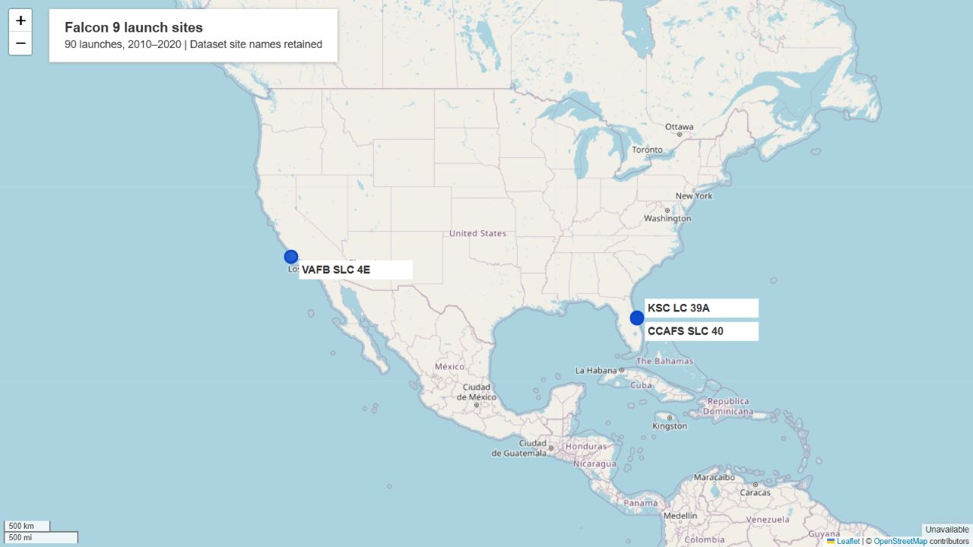
Launch Sites on the US Coasts
Florida
CCAFS SLC 40
KSC LC 39A
California
VAFB SLC 4E
All three facilities are coastal. The two Florida pads lie close together. Location alone does not explain landing performance.
Notes:
Actual Folium screenshot. Basemap © OpenStreetMap contributors, https://www.openstreetmap.org/copyright . Dataset coordinates.
Sources: https://github.com/nicholas-yap/spacex-data-science-capstone/blob/main/maps/launch_sites.html
Course datasets are historical snapshots, not current SpaceX operational data.

Slide 35
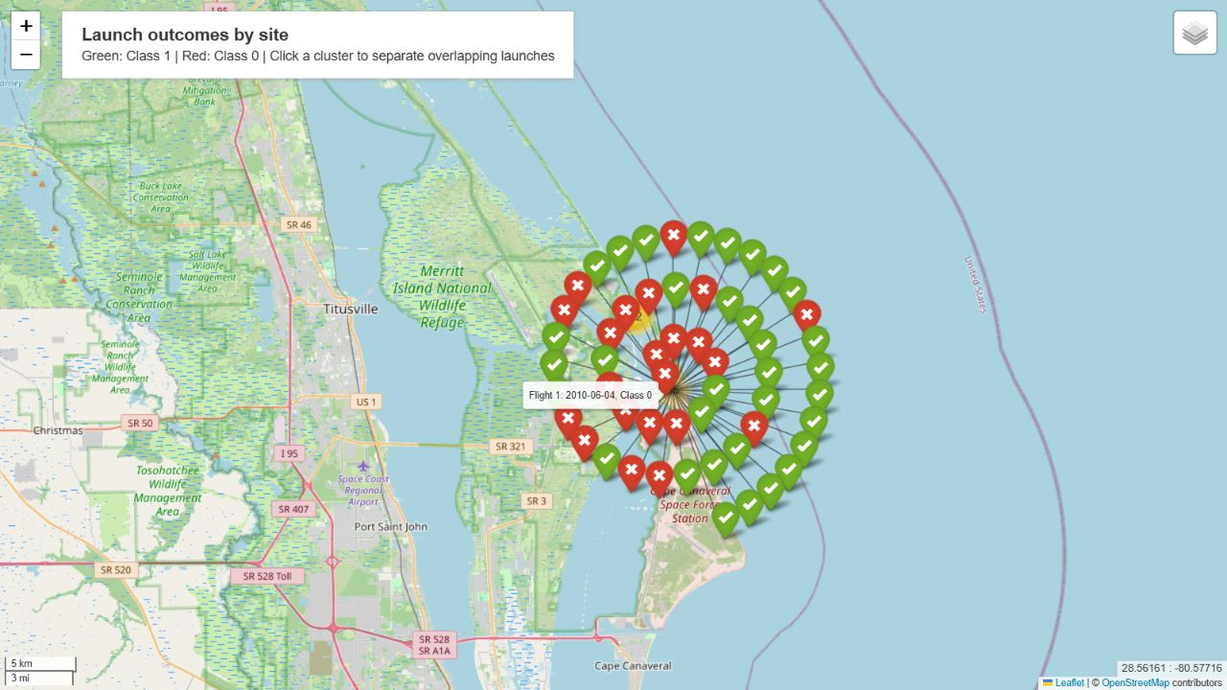
Launch Outcomes at CCAFS SLC 40
55 launches
33 Class 1
22 Class 0
60.0% success
Expanded markers separate overlapping records around the same launch site. Their displayed offsets are not actual launch locations.
Notes:
Actual Folium MarkerCluster spiderfy screenshot. Green Class 1, red Class 0. OSM basemap attribution.
Sources: https://github.com/nicholas-yap/spacex-data-science-capstone/blob/main/maps/launch_outcomes.html
Course datasets are historical snapshots, not current SpaceX operational data.

Slide 36
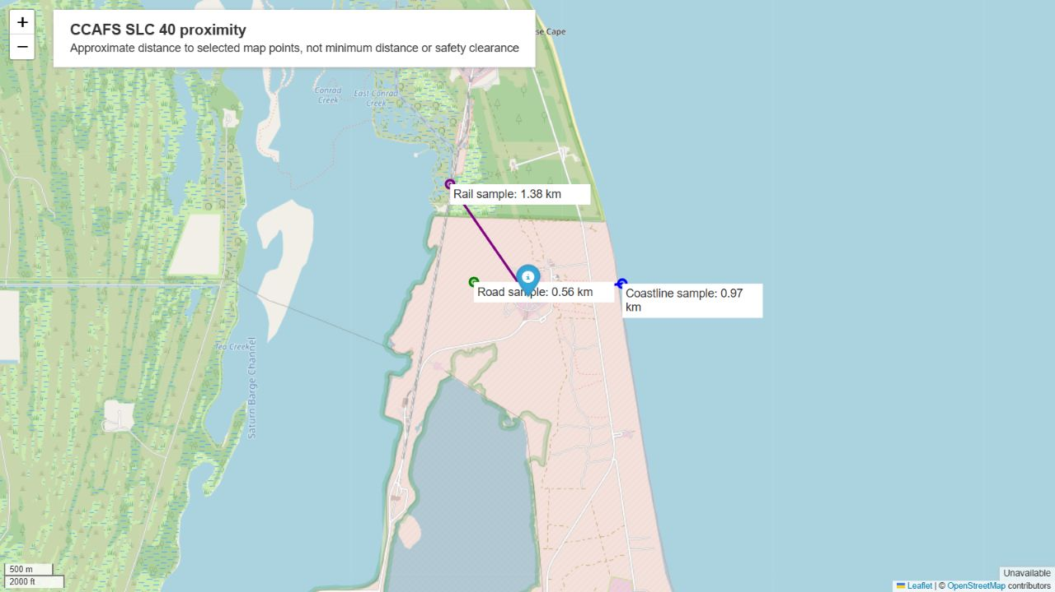
CCAFS SLC 40 and Nearby Features
Selected points
Coast: 0.97 km
Road: 0.56 km
Rail: 1.38 km
Approximate straight-line distances to selected map points. These are not surveyed minimum distances or safety clearances.
Notes:
Haversine distances with Earth radius 6371 km. Selected points: [{"name":"Coastline sample","latitude":28.563,"longitude":-80.5675,"km":0.9718793646856646},{"name":"Road sample","latitude":28.5631,"longitude":-80.5829,"km":0.557852641160271},{"name":"Rail sample","latitude":28.5721,"longitude":-80.5854,"km":1.383039420705225}]. OSM basemap.
Sources: https://github.com/nicholas-yap/spacex-data-science-capstone/blob/main/maps/proximity.html
Course datasets are historical snapshots, not current SpaceX operational data.

Slide 37
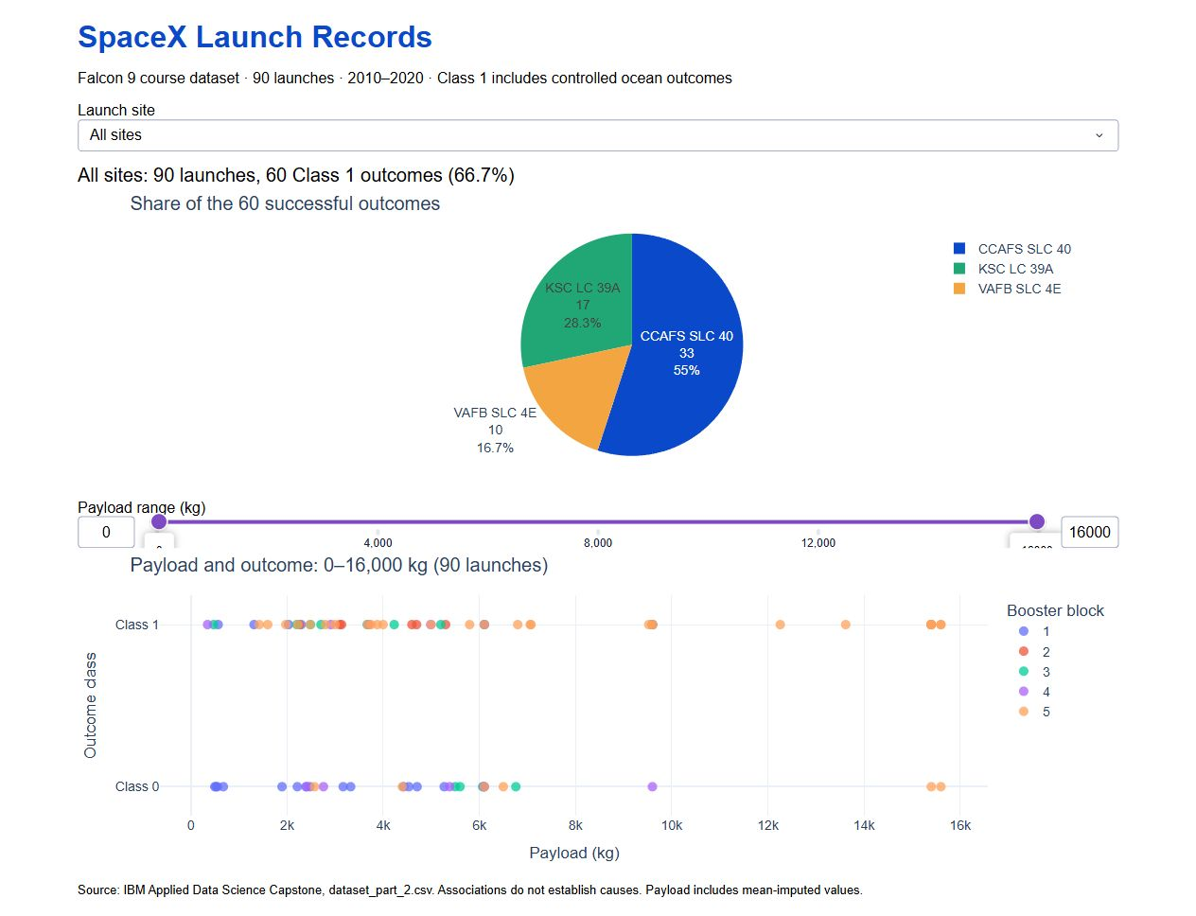
Dashboard: Successful Outcomes by Site
60 successes
CCAFS: 33
KSC: 17
VAFB: 10
CCAFS contributes 55% of successes.
The pie compares successful-outcome counts. A larger slice does not imply a higher success rate.
Notes:
Actual running Dash dashboard screenshot. Same 90-launch course dataset.
Sources: https://github.com/nicholas-yap/spacex-data-science-capstone/blob/main/spacex_dashboard.py
Course datasets are historical snapshots, not current SpaceX operational data.

Slide 38
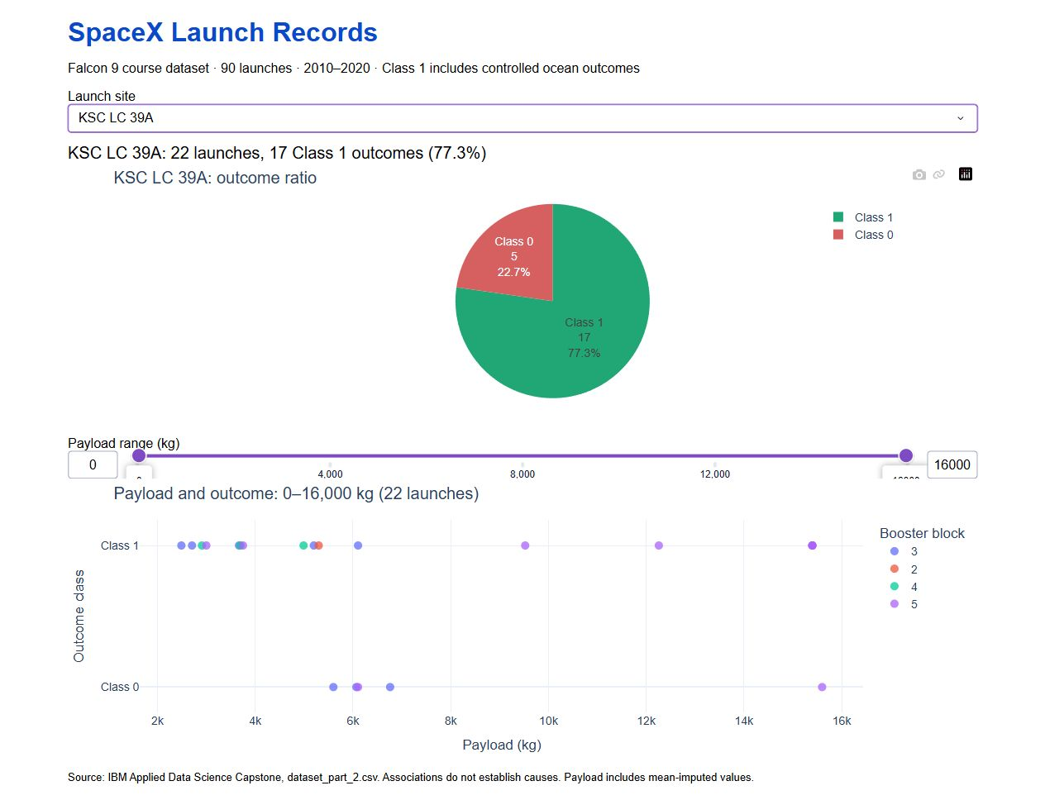
Dashboard: Highest Observed Site Rate
KSC LC 39A
17 successes
5 class 0
77.3% success
22 launches
KSC narrowly exceeds VAFB’s 76.9% (10/13). These small samples do not establish a reliable ranking of site quality.
Notes:
Actual selected-site Dash screenshot. KSC 17/22, VAFB 10/13, CCAFS 33/55.
Sources: https://github.com/nicholas-yap/spacex-data-science-capstone/blob/main/spacex_dashboard.py
Course datasets are historical snapshots, not current SpaceX operational data.

Slide 39
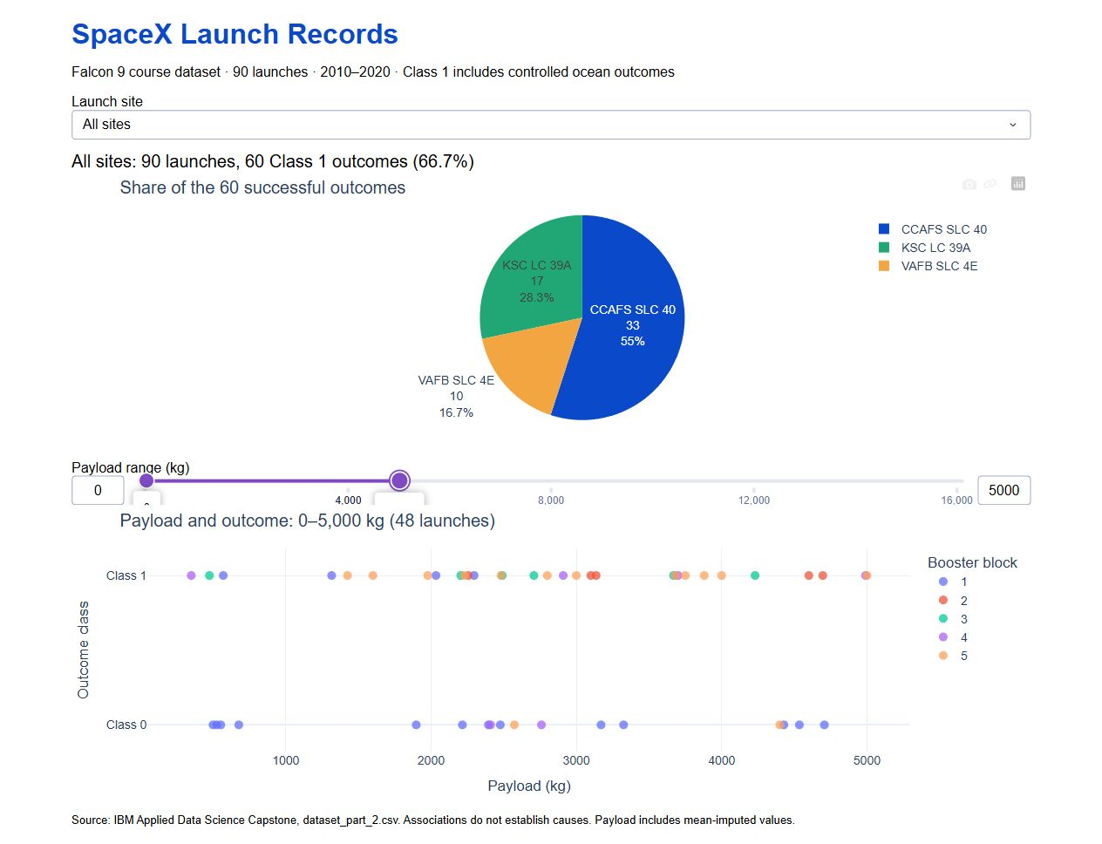

Dashboard: Payload Range Filters
Two slider selections isolate different payload bands. Booster block and flight date also vary, so a payload association is not a causal effect.
Notes:
Actual Dash screenshots for all sites with 0–5000 kg and 5000–16000 kg payload ranges.
Sources: https://github.com/nicholas-yap/spacex-data-science-capstone/blob/main/spacex_dashboard.py
Course datasets are historical snapshots, not current SpaceX operational data.

Slide 40
Appendix and Reproducible Sources
Public repository
https://github.com/nicholas-yap/spacex-data-science-capstone
notebooks/ Collection, scraping, wrangling, EDA, SQL, maps and classification
data/ Historical course snapshots and scraped records
maps/ Interactive HTML maps
spacex_dashboard.py Runnable dashboard on port 8051
Notes:
Repository contains the completed deck and supporting files. Dataset scope and methodological limitations are described in README.md.
Sources: https://github.com/nicholas-yap/spacex-data-science-capstone/blob/main/README.md
Course datasets are historical snapshots, not current SpaceX operational data.

