Slide 1
04
Data Design
Issue
Our Solution
Lesson Learned

Slide 2
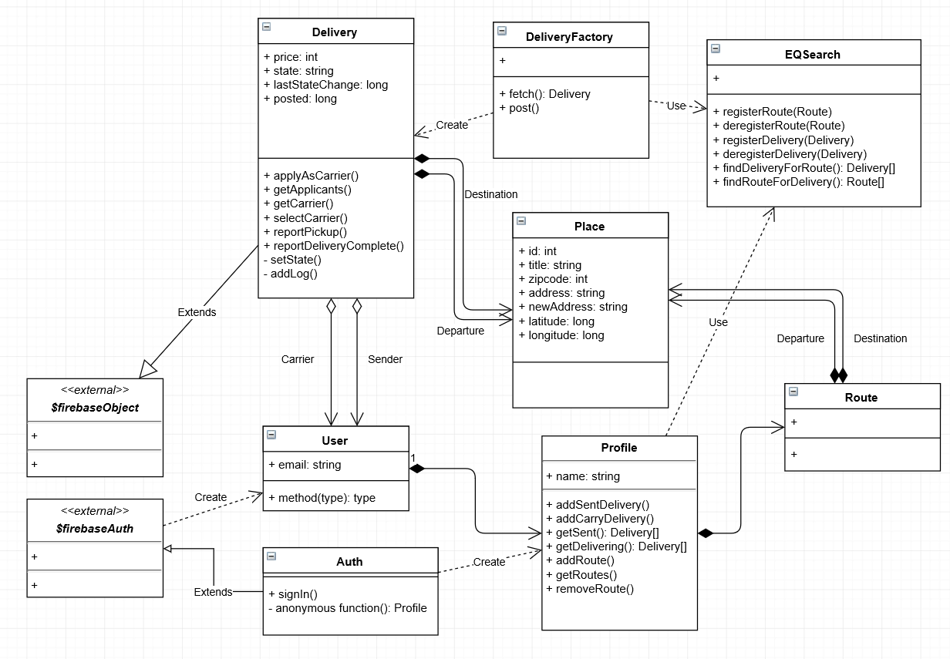
Data Design - Class Diagram

