Slide 1
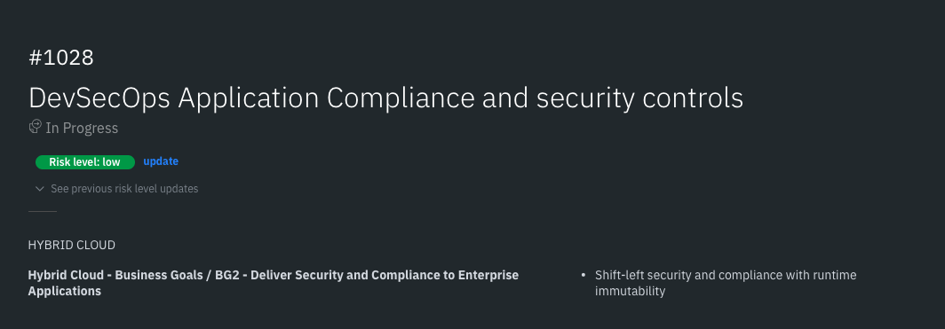

Slide 2

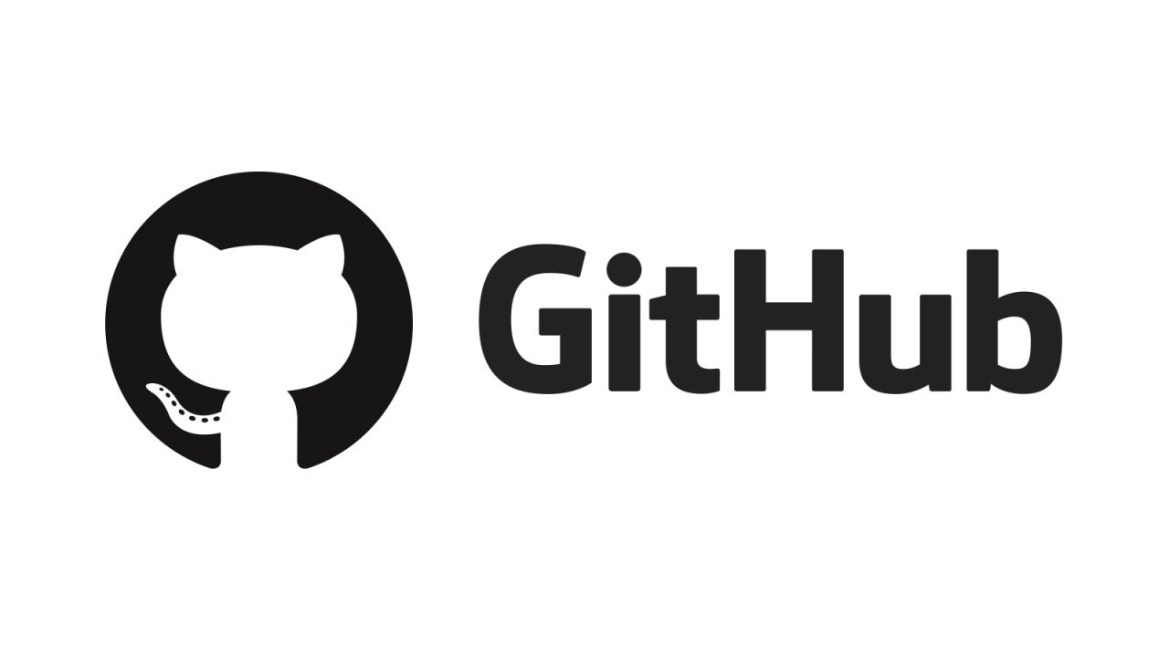

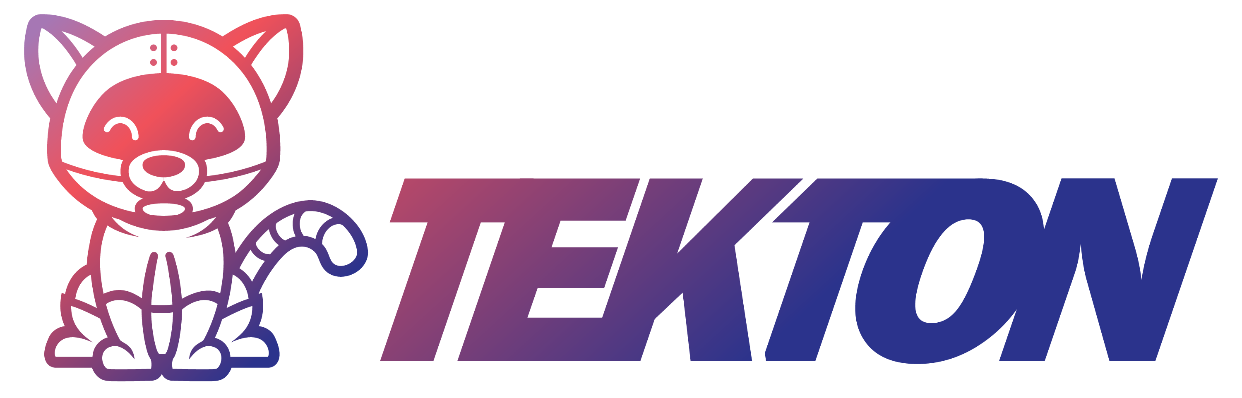
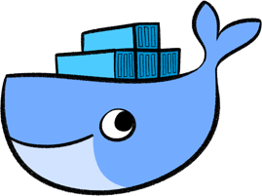
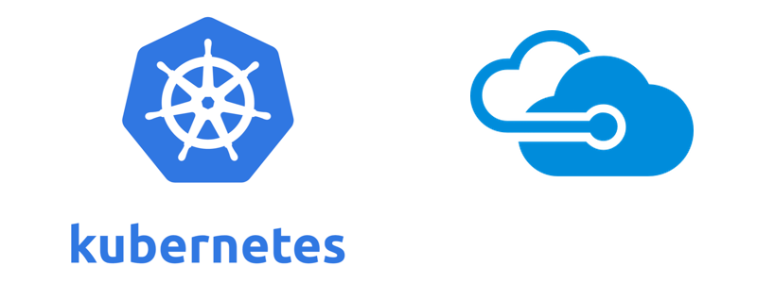
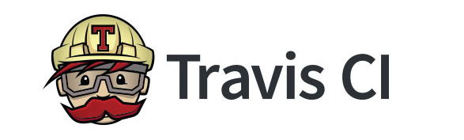
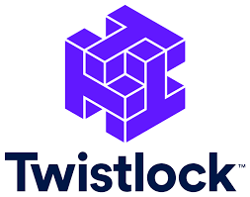


GitSecure Overview
Image Registry
GitSecure
IBM VA
Terraform
Ansible
Operators
Dockerfile
requirements.txt
package-lock.json
Vulnerability Scan
Deployment Configuration Scan
Infrastructure
Build
Bill Of Material
Micro-service App
Network Policy Scan
Configs
Deployment
Dockerfile Lint
Deployment Image Scan
*.conf
configmaps
secrets
Deploy.yaml
Service.yaml
Configuration Compliance Scan

Slide 3
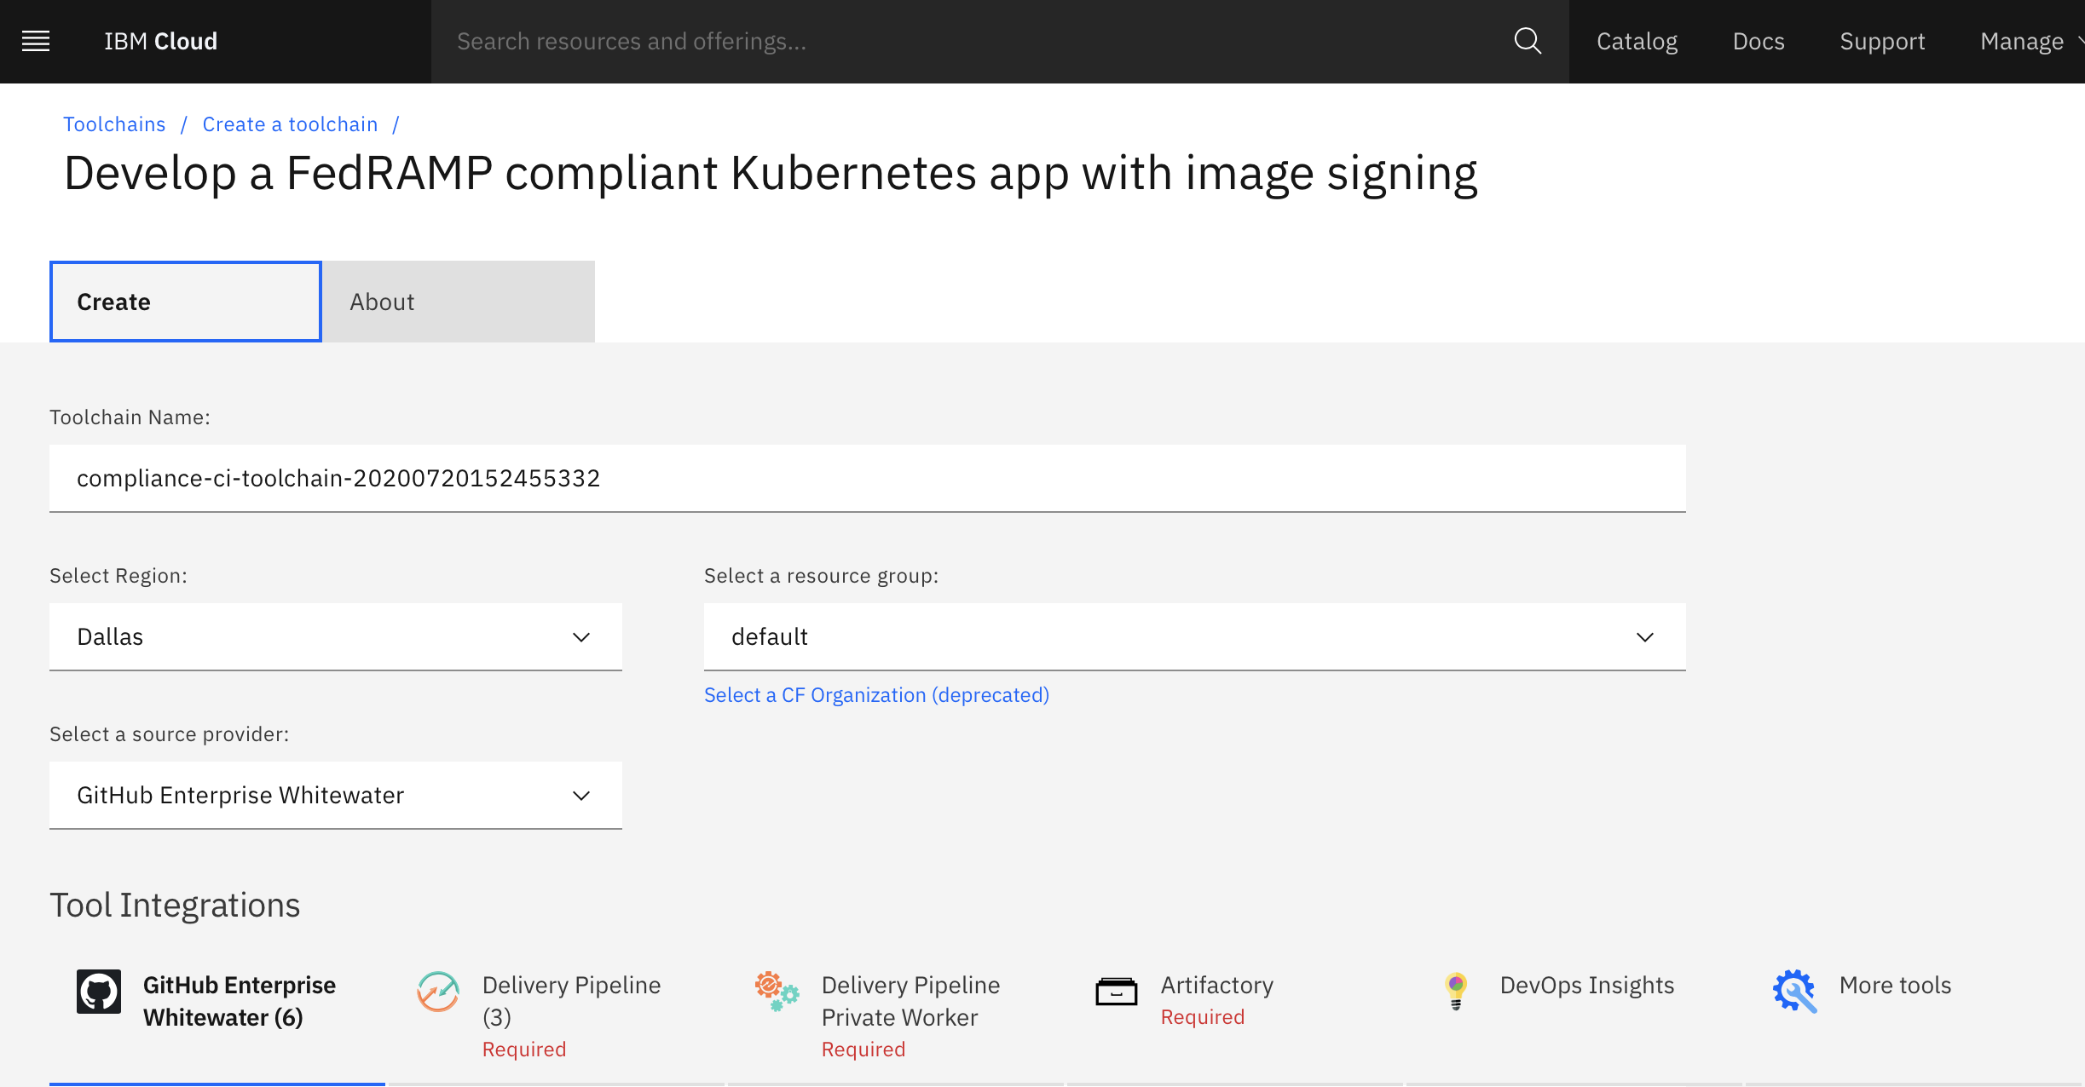
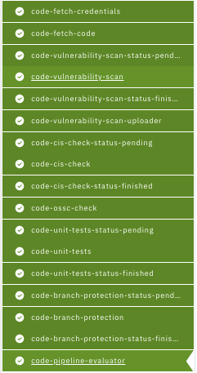
GitSecure Partnerships: Compliance Template Philippe Mulet
Initialization
Static Code Scan
Open Source Scan
Production Readiness Activities
Proposed agreement in place between IBM/Snyk for OEM threat intelligence
Partnership and technology ensure consistency with RH CRDA
OM team working on closing biz case
Objective for next week closure with Snyk and IBM
Unit Tests
Code Review
Completion

Slide 4
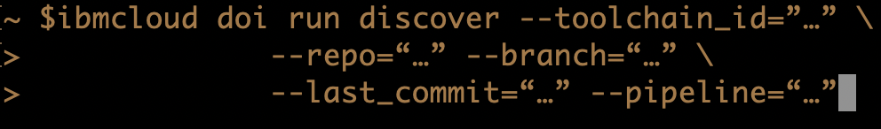
GitSecure Partnerships: CD/Insights Integration Philippe Mulet, Peter Klenk, Vijay Aggarwal
DOI CLI extension to invoke/manage GitSecure Analytic Pipeline
Capturing/Presenting dependency provenance into DOI
Policy Control Gates integration

Slide 5

GitSecure Partnerships: Schematic CD Integration Albee Jhoney
Policy-as-code
Policy can be architecture in layers
Policy can be encapsulated in packages
Use Schematics OPA library
Reuse of policy across all partnerships
Allow / Denny
CD integration
Import current state of an IBM Cloud account
Translate into code format
Assess compliance if a config is updated
Policies

Slide 6
GitSecure Partnerships: Juno Security Integration John Ponzo, Jim Mulvey
On-boarding GitSecure Analytic Tasks for Juno Security
The Security Engineer and Application Developer can see the impact of vulnerability from various security tools* and be notified of any security problems with recommendations to close security holes and fix it from one place
OPA-based Policy control
The Solution Architect is aware, early in the development cycle, of the CISO required group security policies and manages the application's adherence to group policies to minimize the risk exposure to the company.
Integration with Operational Data Layer eventing framework
Emitting gitsecure pipeline operational as events
Emitting gitsecure analytic task finings as events

Slide 7
GitSecure Next
Network Policy Analyzer
Built-in checks to identify vacuity or redundancy in your policy
Semantic diff to allow developers verify their intensions
Enforcement of organizational policies for compliance and governance
Smart Rx (Recommendation)
Side-Channels exists for changes to leak into application image through dependency updates
Smart Rx in the pipeline to ensure temper-proof build by pinning all dependencies
Regulated and Audited change protocol for dependency updates
Code2Container Security Federation
Establishing complete provenance of code transformation (Code-> Image -> Container)
Determine impact of security violations in the Dev-pipeline on running workload (Code 2 Container)
Bringing existing runtime analytics (MA, SysDig,..) visibility to developers (Container 2 Code)
Infrastructure-as-code auto remediation and multi-cloud support
Automatically remediate infrastructure config to comply with regulations and best practices
Support terraform for multi cloud: AWS, Azure, …
Support hybrid cloud config compliance: OpenShit
Support application configuration compliance (example, Kafka)

Slide 8
Backups

Slide 9
GitSecure Next: Network Analyzer
Use case 1: built-in checks
Automatically find network config files and check them
Vacuity, redundancy
Use case 2: change impact analysis
compute semantic diff between base and updated branches
Use case 3: organizational policies
Future research
PR in repo with k8s nw config files
namespace and pod definitions
(from live cluster)
NW Analyzer
Comment on PR

Slide 10
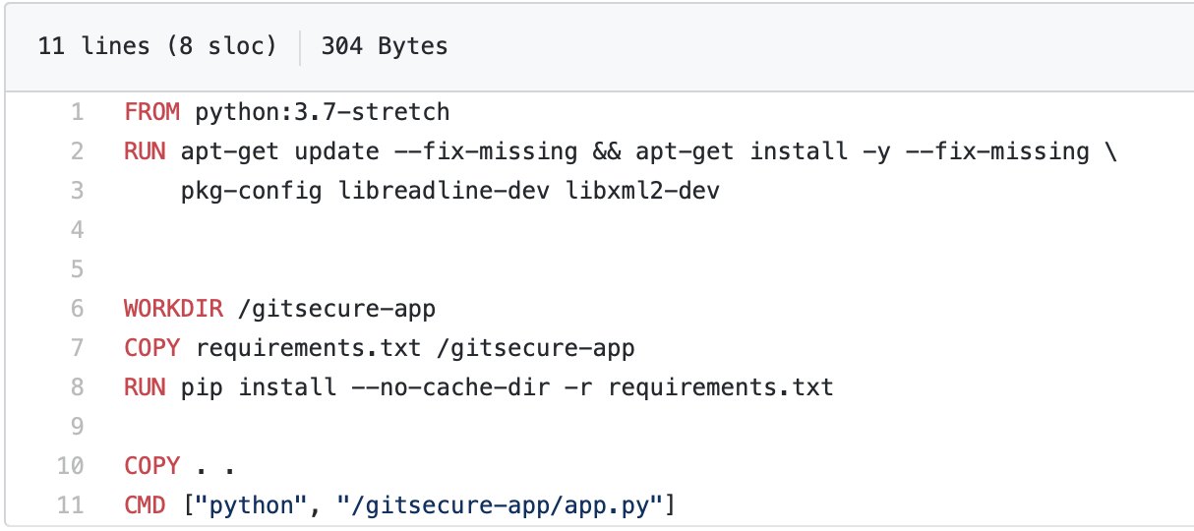
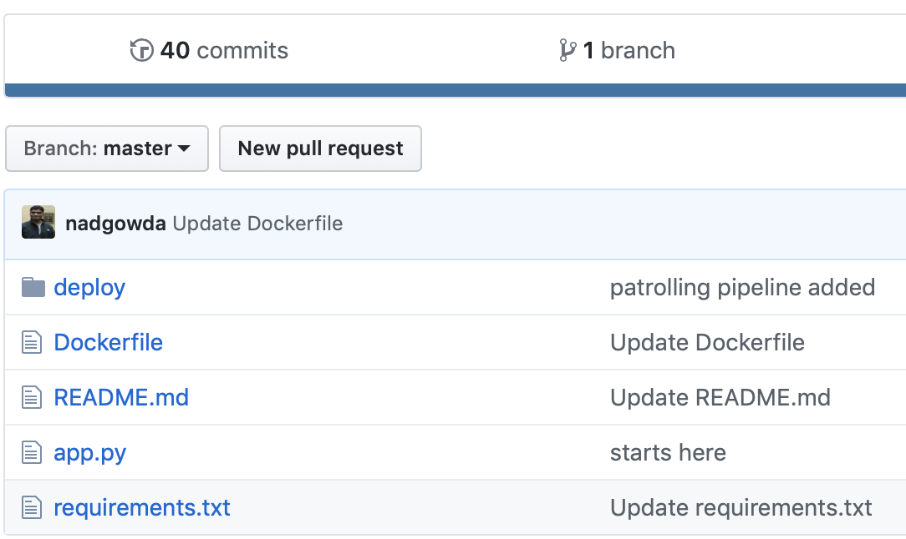
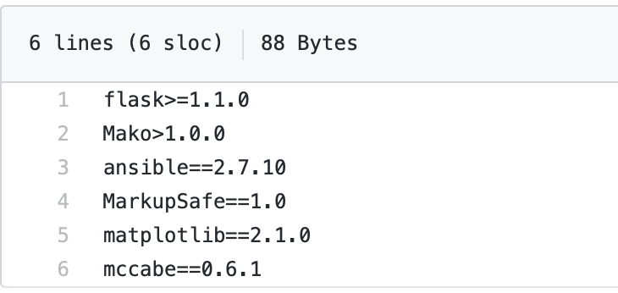
GitSecure Next: Smart Recommendation
Base Image is not tagged with SHA256
OS Packages not bound to version, defaults to `latest version` at the time of build
App packages with unbounded upper version constraint
Side-Channels for change leaks into application image
Sources of dependencies for an application gets updated out-of-bound at different frequencies
If not pinned, these dependencies gets resolved at build time
No audit record for dependency version changed

Slide 11
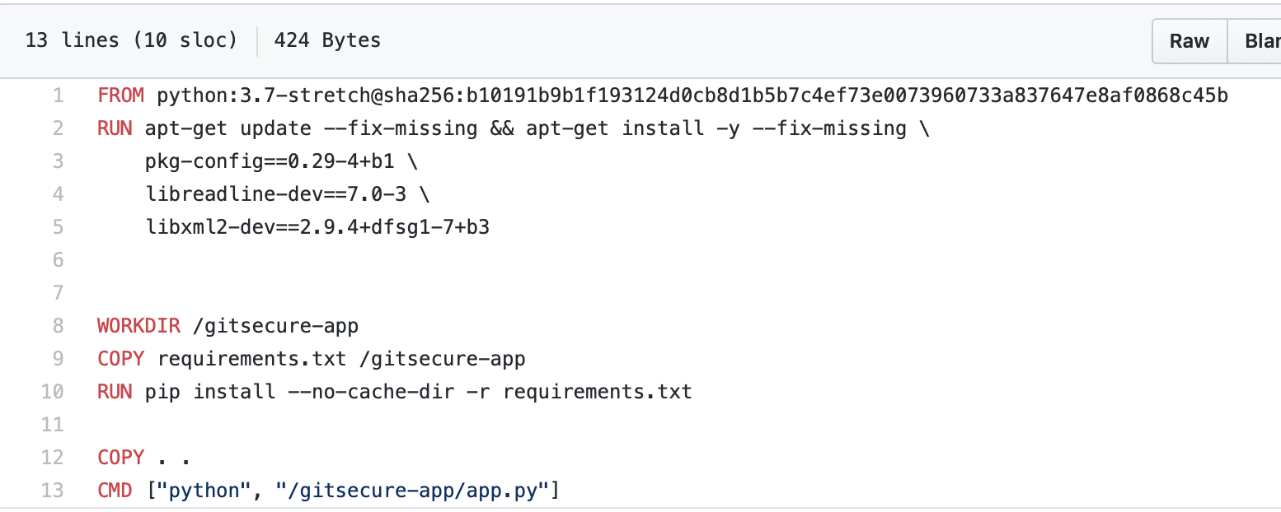

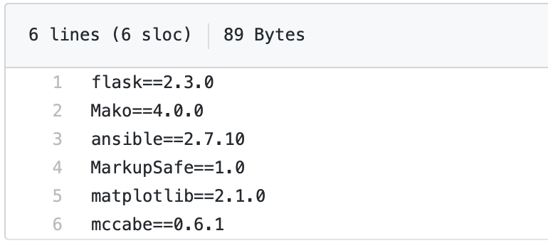
GitSecure Next: Smart Recommendation
GitSecure Smart Rx
Smart Rx
Takes into account constraints specified by Developer
Freezes source of dependency changes
Dependency changes can be audited and incorporated through controlled build pipeline

Slide 12


GitSecure Next: Code2Container Security Federation
Code 2 Container
Continuous monitoring of vulnerabilities at the source with runtime impact analysis (e.g. discovering new vulnerability at the source and their impact on running containers)
Network Policy Analytic and Change Impact Analysis to regulate change management
GitSecure Compliance Pipeline
Cluster
Op State
read cluster ops state
Image Registry
GS
Controller
Pkg
repo
Image
container
Container 2 Code
Bringing existing runtime analytics (MA, SysDig,..) visibility to developers (e.g. allowing developer see which files are mutating, so they can change file permissions)

