Slide 1



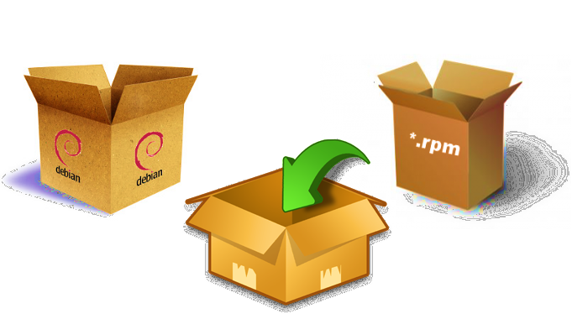
GitSecure Analytic
Base Image (new)
Image
Repo
Repo
Repo
CVE
Pkg
Image
Base Image
Pkg
Base Image
Repo
Pkg
Base Image
Base Image (old)
sha256
version
Smart Remediation
Smart Recommendation
Smart Build
Smart Updates
Discover dependencies across multiple repos
Outlier detection: discover in-consistency in bill-of-material across multiple repos to drive smart recommendations
Freezing the bill-of-material for application to avoid any un-managed changes in the build
Monitoring source for all application dependencies
Deep provenance of vulnerability and non-compliance across repo
Categorize the change (performance, bug fix, new feature..) based on change logs, release notes
Auto-Generating Dockerfile.freeze
Smart remediation strategy for effective remediation across repos
Provide Update notifications with insights/ impact evaluation

