Slide 1

SARCASTIC COMMENT DETECTION
- NICHOLAS AROCKIARAJ
185214141
Under the guidance of Dr. K. RAJKUMAR, M.Sc., M.Phil., Ph.D.

Slide 2
Problem Description
Humans have a social nature. Social nature means that we interact with each other in positive, friendly ways, and it also means that we know how to manipulate others in a very negative way.
Sarcasm, which is both positively funny and negatively nasty, plays an important part in human social interaction..
But sometimes it is difficult to detect whether someone is making fun of us with some irony.
Our goal is to train a model by using machine learning algorithm which can predict if a statement is sarcastic or not.

Slide 3
Proposed Methodology
1
2
Data Collection
Data Preprocessing
3
Feature Engineering
4
5
Model Building
Prediction

Slide 4
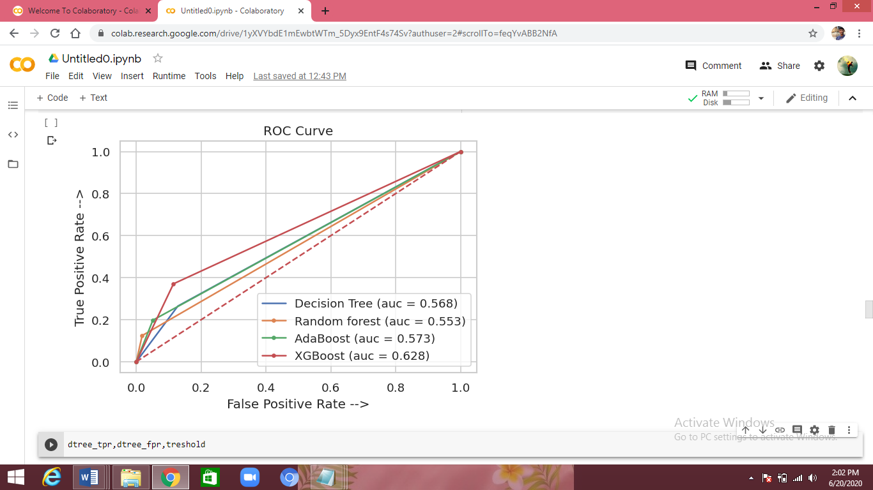
Experimental Results
Algorithms | Training accuracy | Test accuracy | Precision | Recall | F1
Decision tree | 62 | 62 | 61 | 62 | 58
Random forest | 64 | 63 | 70 | 63 | 54
Adaboost | 64 | 64 | 67 | 64 | 57
XGBoost | 71 | 68 | 68 | 67 | 65

Slide 5

THANKYOU
THANKYOU
Thank You

