Slide 1
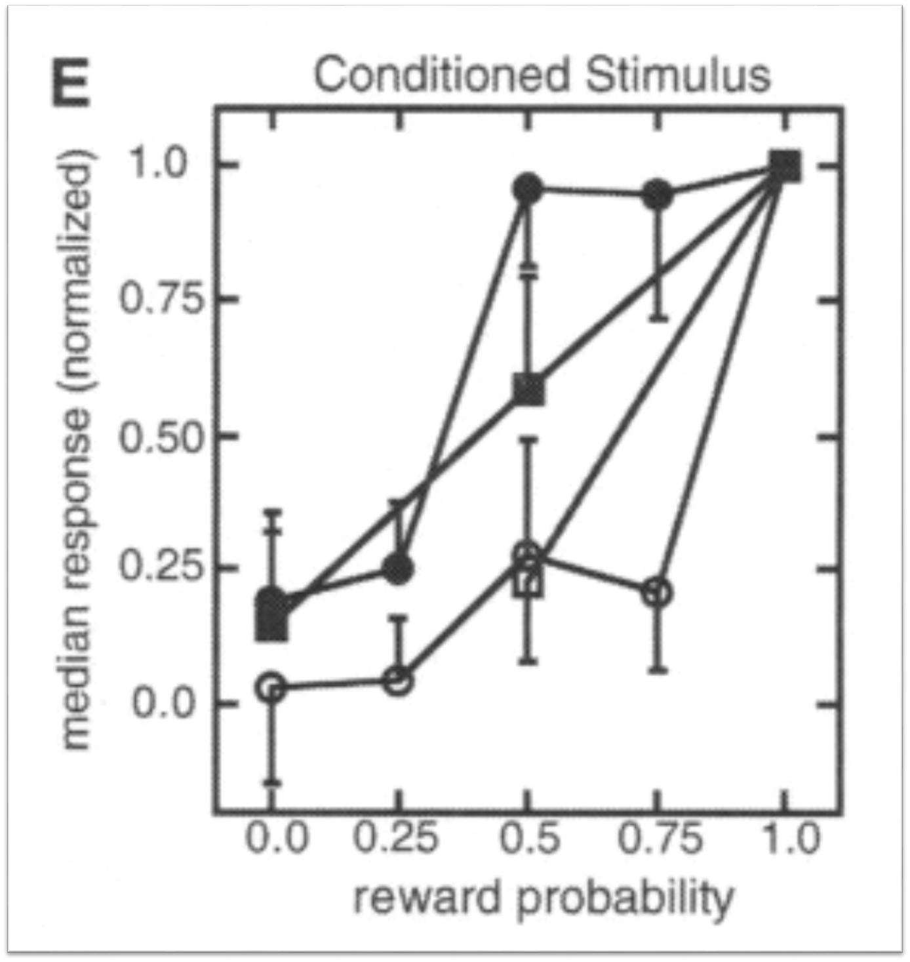
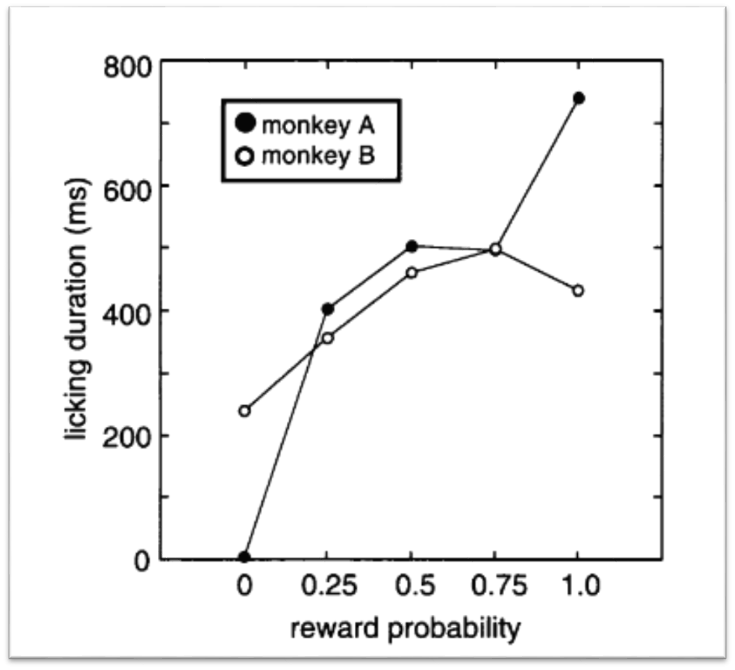
MODELS OF DOPAMINE REWARD-RESPONSE MODULATION AND POSSIBLE IMPLICATIONS FOR NETWORK ARCHITECTURE
Nicholas Burka and Prof. Josh de Leeuw; COGS282
PSYCHOLOGICAL DEFINITIONS OF DOPAMINE
In 1998, K.C. Berridge suggested that dopamine’s role in reward mechanisms must be along one of three distinct axes: regulating ‘liking’, ‘learning’, or ‘wanting’. 9 years later Berridge put forth “the case for incentive salience”, in favor of the ‘wanting’ hypothesis.
In this now prevalent view of dopamine function, it is hypothesized that dopamine is a necessary component of wanting – dopamine makes rewards for a given response desirable, rather than more likeable or predictable (Berridge, 2007).
DOPAMINE NEURONS ENCODE PROBABILITY OF REWARD FROM STIMULUS
From Fiorillo, Tobler, and Schultz (2003). Two monkeys show an increased activation of dopamine neurons proportional to the probability of a reward to a conditioned stimulus. Dopamine neurons were located in the ventral midbrain and were determined based on electrophysiological impulse properties.
NEURAL NETWORK ARCHITECTURES
Stimulus Reward Action
The basic three-layer perceptron architecture. A middle layer mediates activation from a perceived stimulus and transforms that activation into a signal to the motor layer; with activation calculated as a function of the weighted sum of the previous layer’s activation and the weights between layers. This kind of a model suggests that some “reward module” assesses and causally determines whether an action takes place.
Is there a recurrent relationship from the reward layer to perceptive neurons? A study by Jacob, Ott, and Nieder (2013) found that dopamine regulated sensory signals in the prefrontal cortex, suggesting that the chemical expectation of a reward may enhance – through excitatory and inhibitory connections – the perception of the corresponding stimulus. Similar findings have been noted in research on addiction to dopamine-system affective drugs. These in sum accord with the idea of “incentive salience”.
Does the stimulus layer immediately provoke or influence the response? This type of connection might be considered a rough approximation of an embodied response, encoding the associations between the perception of a stimulus and the motor actions an organism has taken.
How might this type of connectivity interact with (or subvert) reward mechanisms?
NEURAL NETWORK PARAMETER FITTING
Each weight is a parameter to be optimized. Optimality can be defined in terms of best fit of experimental data. Optimality can also be said to be when the response exactly equals the reward given.
EVOLUTIONARY SIMULATION
Would the model that best fits with experimental results “win” in an evolutionary simulation?
SAVING YOUR FILE (SECTION 4)
Go to FILE > Print. Choose Adobe PDF as the printer. Click Printer Properties. For Default Settings, choose High Quality Print. Click OK. Click Add. Type "poster" for Paper Names. Type 36.0 for Width and 35.0 for Height. Click Add/Modify. Choose "poster" for Adobe PDF Page Size. Click Print to save the file.

