Slide 1

Movie Recommender
By: Nicholas Candra
Purwadhika Data Science Job Connector JKT 07

Slide 2
IMDb Dataset
https://www.kaggle.com/stefanoleone992/IMDb-extensive-dataset

Slide 3


IMDb
Internet Movie Database or IMDb is an online database of information related to films, television programs, home videos, video games, and streaming content online.
An Amazon subdisiary
Has approximately 6.5 million titles in the database as of January 2020

Slide 4

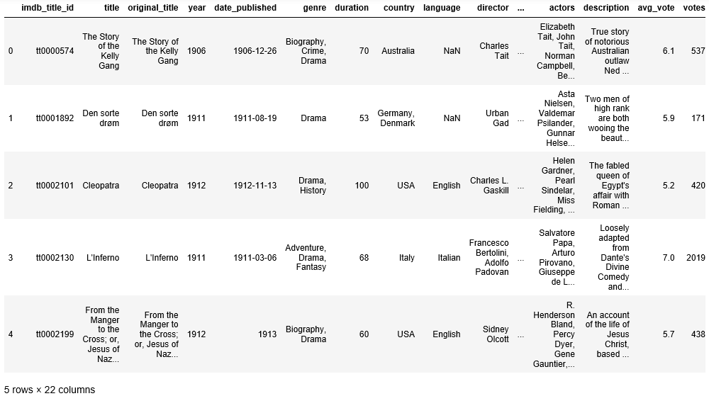
From the Data

Slide 5
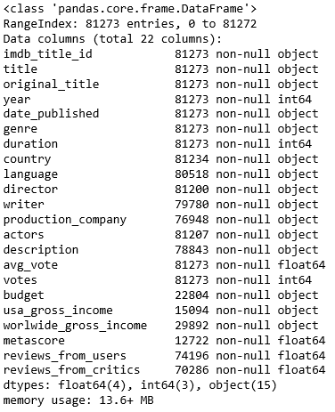
From the Data

Slide 6
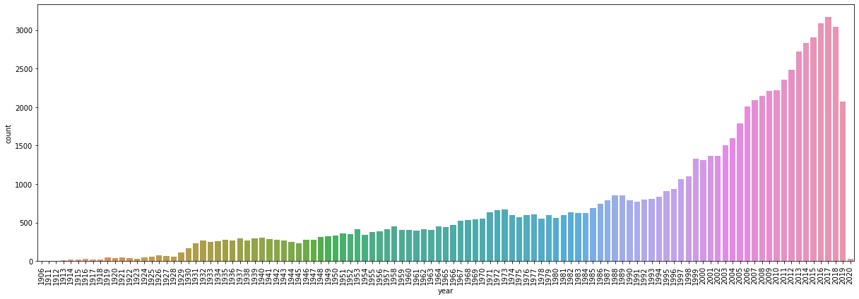
Movies by Year

Slide 7

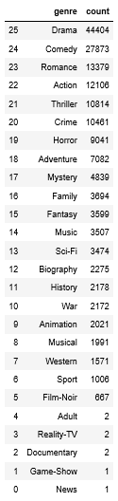
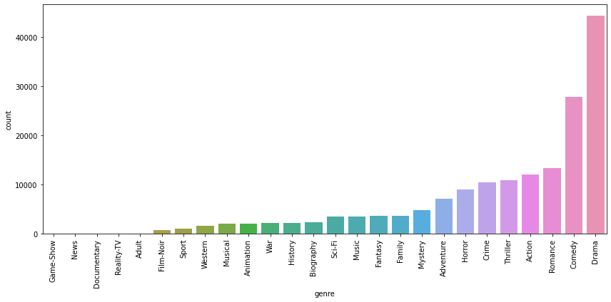
Movies by Genre

Slide 8
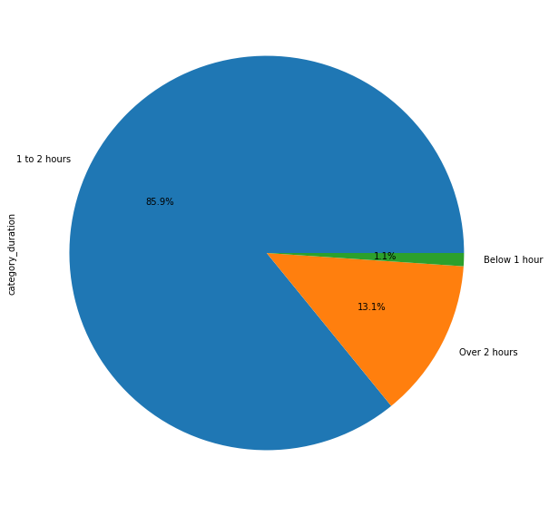
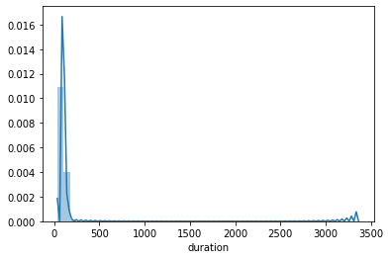
Duration

Slide 9

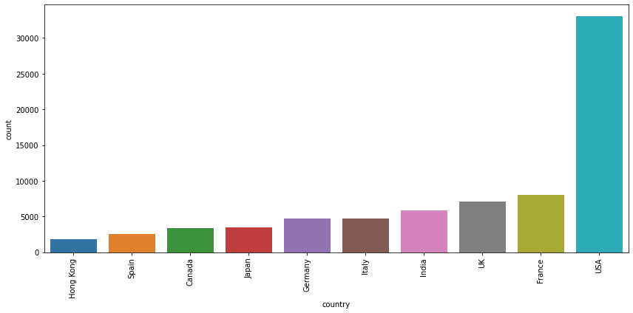
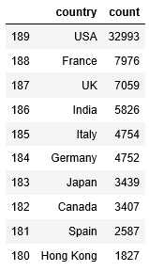
Movies by Country Origin

Slide 10
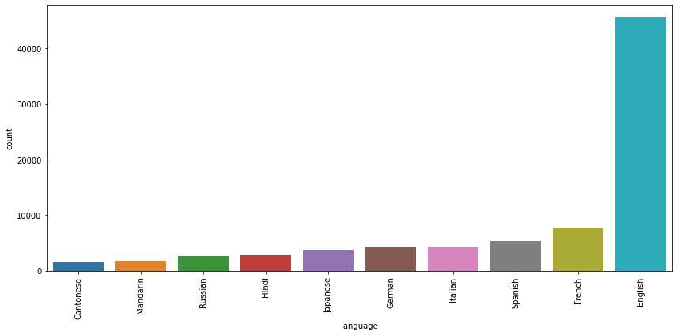
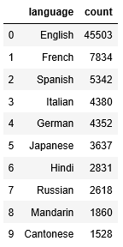
Movies by Language

Slide 11


Top 10 Director
Francis Ford Coppola (The Godfather) with IMDb average rating of 8.87
Christopher Nolan (The Dark Knight) with IMDb average rating of 8.56
Peter Jackson (The Lord of the Rings: The Fellowship of the Ring) with IMDb average rating of 8.4
Martin Scorsese (The Departed) with IMDb average rating of 8.36
Quentin Tarantino (Pulp Fiction) with IMDb average rating of 8.33
Steven Spielberg (Saving Private Ryan) with IMDb average rating of 8.33
Stanley Kubrick (The Shining) with IMDb average rating of 8.32
David Fincher (Fight Club) with IMDb average rating of 8.2
Pete Docter (Up) with IMDb average rating of 8.13
Anthony Russo (Avengers: Infinity War) with IMDb average rating of 8.12
*with minimum of 3 Movies above 500.000 votes on IMDb.

Slide 12

Top 10 Actor / Actress
Tom Hanks with IMDb average rating of 8.45
Cate Blanchett with IMDb average rating of 8.42
Morgan Freeman with IMDb average rating of 8.41
Gary Oldman with IMDb average rating of 8.4
Harrison Ford with IMDb average rating of 8.33
Michael Caine with IMDb average rating of 8.31
Matt Damon with IMDb average rating of 8.28
Leonardo DiCaprio with IMDb average rating of 8.24
Mark Hamill with IMDb average rating of 8.24
Robert De Niro with IMDb average rating of 8.22
*with minimum of at least 5 starring on 500,000 votes or more Movies on IMDb.

Slide 13
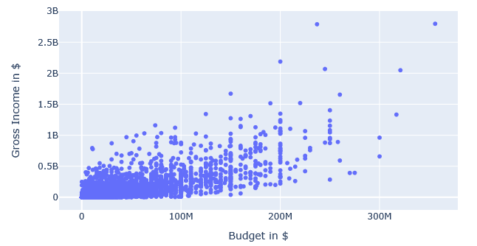
Movies Budget vs Movies Income

Slide 14
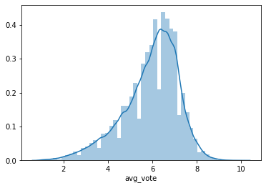
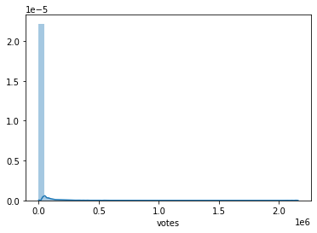
Votes
Average Votes
Votes

Slide 15
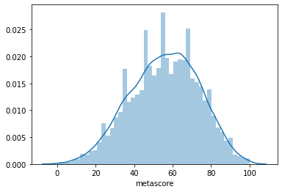
Metascore

Slide 16
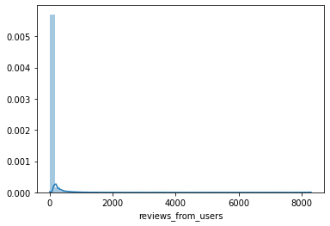
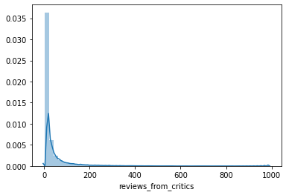
Reviews
Users
Critics

Slide 17
Reviews

Slide 18
Movie Recommender
Data Processing
Dropping Unnecessary Columns
Filling NaN value
Bagging of Words
Count Vectorizer of Words
Cosine Similarity
Recommender
Movies with Similar Top Actor
Similar Movies
Top 10 Recommended Movies

Slide 19
Cosine Similarity
Definition
Cosine similarity is a measure of similarity between two non-zero vectors of an inner product space that measures the cosine of the angle between them. The cosine of 0° is 1, and it is less than 1 for any angle in the interval 0, π] radians.
A metric used to measure how similar the documents are irrespective of their size.
If the two similar documents are far apart by the Euclidean distance (due to the size of the document), chances are they may still be oriented closer together. The smaller the angle, higher the cosine similarity.

