Slide 1
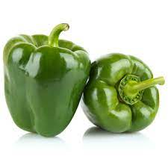
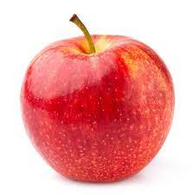
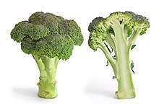
Vegetable Image Classifier
By Nick Carlin and Nick Bohm

Slide 2
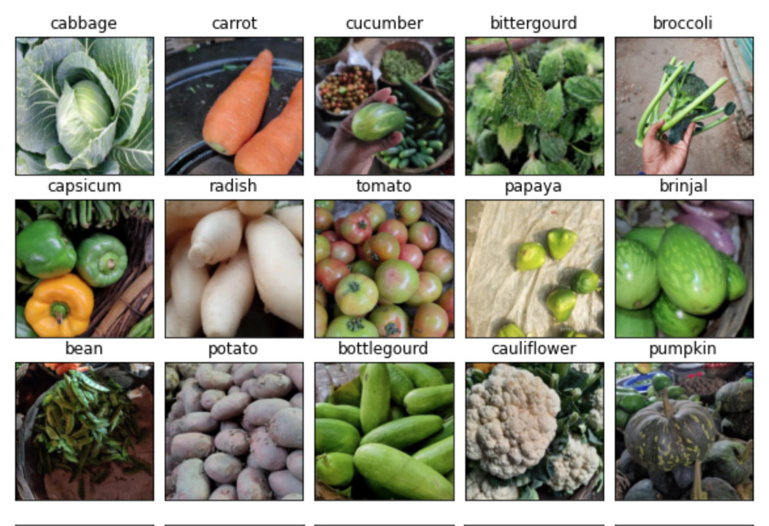
Data Setup
First imported two datasets for this project
Combine these to get a new dataset stored as ‘final_data’
Generate datasets using Image Generators
Filepath -> Datatframes -> Image Generators to get ‘test/train/validate’ data to input into our model.

Slide 3
Model Setup 2
One we have 9 total image inputs: a train/test/validate image set for dataset one, two, and three, we 6 different trained models.
Our model on data 1
Our model on data 2
Our model on combined
Pre-trained model on data 1
Pre-trained model on data 2
Pre-trained model on combined

Slide 4
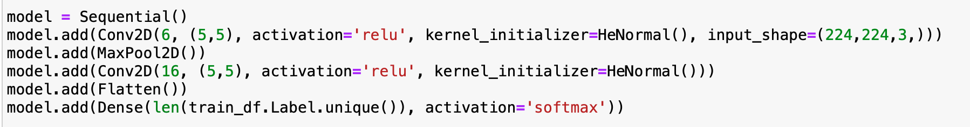
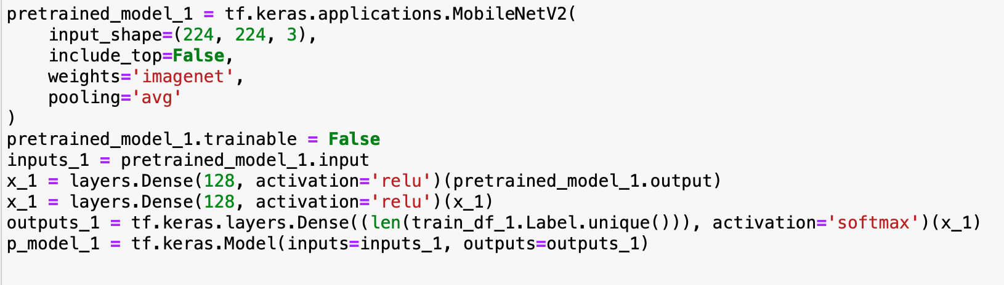
Pre-Trained Model vs Our Model
Our Model
Pre-trained Model

Slide 5
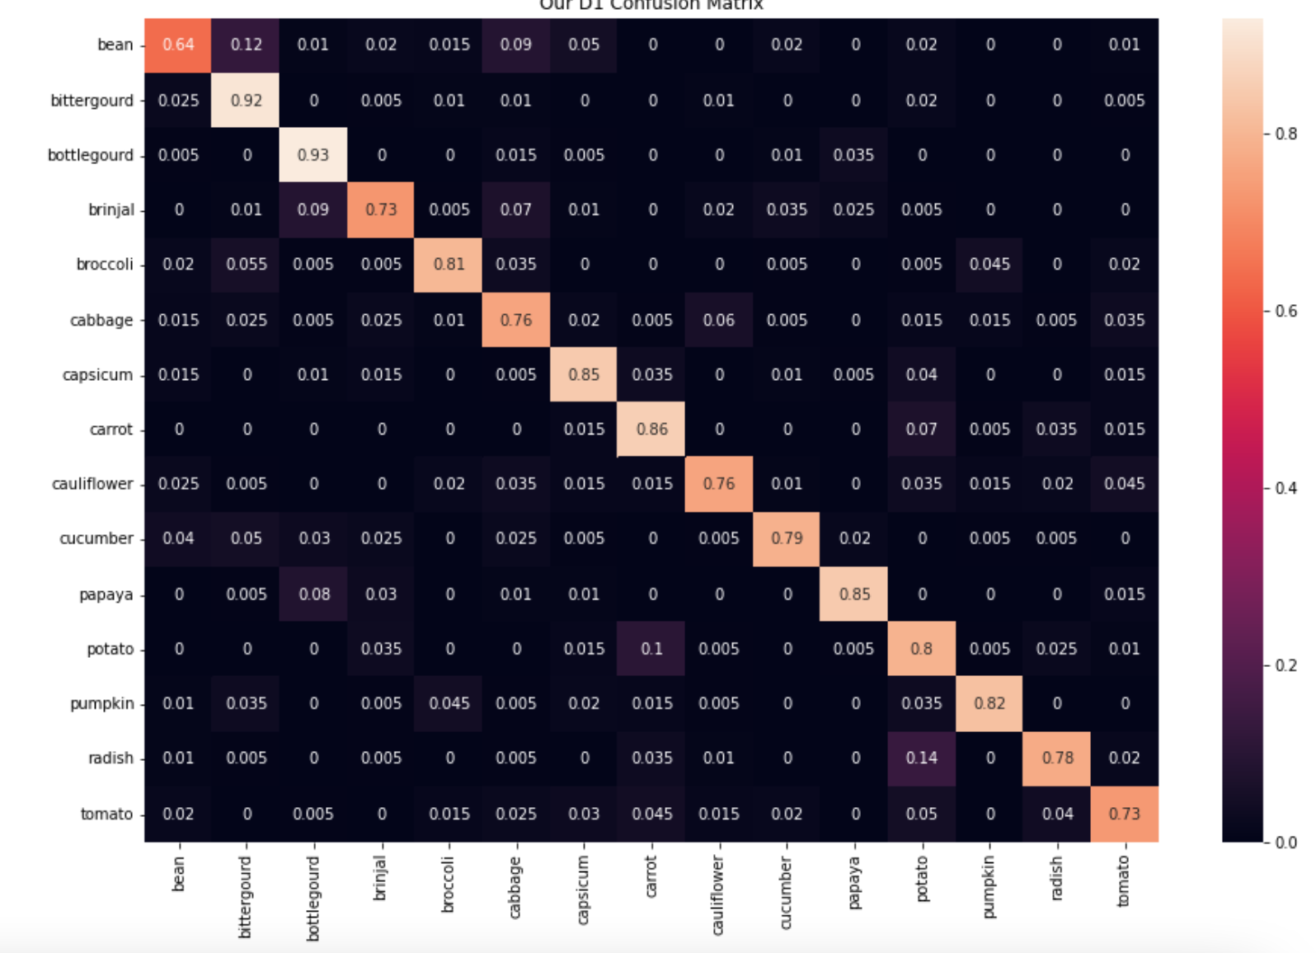
Our Results
First tested accuracy of our model vs pre-trained
Our model had an 82%, 81%, and 82% accuracy for dataset 1,2 and 3.
Pretrained model had a 99% accuracy for all datasets.
Generated a confusion matrix for each predicion

Slide 6
Main Challenges
Generating a dataset that can be using in our model (train_generator.flow_from_dataframe vs BatchDataset)
Having a model which only predicted pumpkins (softmax activation)
Finding a way to get our X_test and Y_test variables from our test_images

Slide 7
Thanks for Listening

