Slide 1
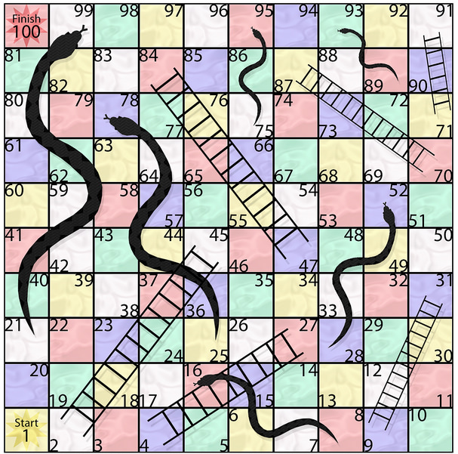
Board
has
Square
100
number
SnakeHeadSquare
SnakeTailSquare
1
1
1
Snake
has
1
6
Image credit: https://www.flickr.com/photos/7819129@N07/4366373472

