Slide 1
Assignment 2 Writeup
Name: Nicholas Changwoo Park
GT Email: npark62@gatech.edu

Slide 2
Part-1 ConvNet

Slide 3
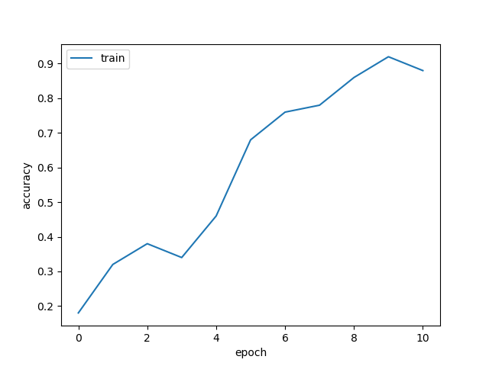
ConvNet Learning Curve
Put your learning curve here:
Output >
Finished epoch 0 / 10: cost 2.306153, train: 0.180000, lr 1.000000e-04
Finished epoch 1 / 10: cost 2.251948, train: 0.320000, lr 9.500000e-05
Finished epoch 2 / 10: cost 2.159310, train: 0.380000, lr 9.025000e-05
Finished epoch 3 / 10: cost 1.805048, train: 0.340000, lr 8.573750e-05
Finished epoch 4 / 10: cost 1.545141, train: 0.460000, lr 8.145062e-05
Finished epoch 5 / 10: cost 1.097030, train: 0.680000, lr 7.737809e-05
Finished epoch 6 / 10: cost 0.666996, train: 0.760000, lr 7.350919e-05
Finished epoch 7 / 10: cost 1.318808, train: 0.780000, lr 6.983373e-05
Finished epoch 8 / 10: cost 0.306557, train: 0.860000, lr 6.634204e-05
Finished epoch 9 / 10: cost 0.097204, train: 0.920000, lr 6.302494e-05
Finished epoch 10 / 10: cost 0.614703, train: 0.880000, lr 5.987369e-05

Slide 4
My CNN Model

Slide 5
Describe your model design in plain text here:
The design of the “my_model” is inspired from the VGG net described in the lecture but curtailed in the number of parameters to use per convolution layer to accommodate the smaller pixel sizes of the CIFAR-10 images compared to those of the ImageNet images.
Convolution Layers (Feature learner):
As the first feature extracting layers to the input, there are two sets of the following blocks: two 2D Convolution layers followed by a ReLU, Batch Normalization then max pooling.
As for the rest of the feature extracting layers, there are four sets of the following blocks: three 2D Convolution layers followed by a ReLU, Batch Normalization then max pooling.
Fully Connected Layers (Classifier):
There are two fully connected layers to the flattened output of the last convolution layer which has the size of 3x3 with 128 out channels → two linear layers for 1152 x 1152
Then the output is fed to the final linear layer for classification → 1152 x 10
Dropout Layers
Right before each of the 3 fully connected linear layers, there is a dropout layer with a particular retention probability for the input nodes from the previous layer.

Slide 6
Describe your choice of hyper-parameters:
<Model Architecture>
The convolution layers inspired from VGG also had a 3x3 kernel with a stride and padding of 1 to ensure that similar feature extraction occurs while matching the output channel size to the input.
The number of out-channels (filters) is doubled per block of convolution layer series before the pooling to have enough parameters for feature learning for the model’s sufficient representational power before classification.
The max pooling layers did not always follow the stride of 2 as in the case of ImageNet to ensure that the dimensions are not over-reduced during the convolution layers before the fully-connected linear layers. The stride value is alternated between 1 and 2 upon experimentation to have enough parameters for flexibility in the fully connected layers.
Each of the dropout layers before a linear layer are given a retention rate of 0.75 upon experimentation with the model that was otherwise tuned, whose value is motivated from a paper (https://jmlr.org/papers/v15/srivastava14a.html) and appeared to perform the best upon trials varying their combinations.
The batch normalization layer was chosen without any parameters for stability without any further complexity.

Slide 7
Describe your choice of hyper-parameters (2):
<Model Config>
A grid search of the hyper-parameter space (learning rate, regularization coefficient and momentum) was done using geometric intervals assuming their potential interdependence.
batch_size: {16, 32, 64, 128, 256}
learning_rate: {0.00001, 0.0001, 0.001, 0.01, 0.1}
reg: {0.0001, 0.001, 0.01, 0.0005, 0.005, 0.05}
momentum: {0.9, 0.99, 0.999, 0.95}
The batch size is of 64 with learning rate 0.001 performed the best using otherwise tuned model, confirming the grid search results. No significant variation in runtime was observed. The weight decay parameter “reg” does not seem to affect the performance a lot among the following values: {0.0005, 0.001, 0.005}. Momentum value higher than 0.9 exhibited a reproducible worsening performance when all other hyperparameters remain the same. Typically, the final validation accuracy plateaued after “epoch” = 15. The comparison was done under epoch = 10.
The config_mymodel.yaml and main.py are made available to run the my_model using focal loss instead of CE loss with or without reweighting the losses. Without any reweighting, the CE loss typically outperformed the focal loss in final validation accuracy by roughly 0.01.

Slide 8
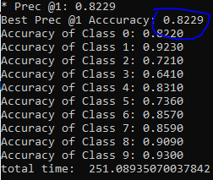
What’s your final accuracy on validation set?
Using the architecture and hyperparameters specified:
The final validation accuracy is 0.8229.
Per-class accuracy →

Slide 9
Data Wrangling

Slide 10
What’s your result of training with regular CE loss on imbalanced CIFAR-10?
→ The final best Prec @1 Accuracy is 0.2607
Fill in your per-class accuracy in the table
 | Class 0 | Class 1 | Class 2 | Class 3 | Class 4 | Class 5 | Class 6 | Class 7 | Class 8 | Class 9 | Final Valid. Acc.
CE Loss | 0.9200 | 0.7740 | 0.4050 | 0.3480 | 0.1480 | 0.0110 | 0.0010 | 0.0000 | 0.0000 | 0.0000 | 0.2607

Slide 11
What’s your result of training with CB-Focal loss on imbalanced CIFAR-10?
The final best Prec @1 Accuracy with beta tuning is 0.4492
Tune the hyper-parameter beta and fill in your per-class accuracy in the table
 | Class 0 | Class 1 | Class 2 | Class 3 | Class 4 | Class 5 | Class 6 | Class 7 | Class 8 | Class 9 | Final Valid. Acc.
beta=0.99 | 0.9300 | 0.9090 | 0.4490 | 0.4540 | 0.2540 | 0.0620 | 0.1440 | 0.0960 | 0.0180 | 0.0000 | 0.3316
beta=0.999 | 0.8370 | 0.7750 | 0.3820 | 0.3540 | 0.2250 | 0.0980 | 0.4490 | 0.4200 | 0.2740 | 0.2020 | 0.4016
beta=0.9999 (best) | 0.6220 | 0.7000 | 0.3110 | 0.3580 | 0.2860 | 0.3040 | 0.5000 | 0.4560 | 0.6060 | 0.3490 | 0.4492
beta=0.99999 | 0.5290 | 0.5090 | 0.3100 | 0.3100 | 0.2580 | 0.3340 | 0.5110 | 0.4660 | 0.5350 | 0.5240 | 0.4286

Slide 12
Put your results of CE loss and CB-Focal Loss(best) together:
 | Class 0 | Class 1 | Class 2 | Class 3 | Class 4 | Class 5 | Class 6 | Class 7 | Class 8 | Class 9
CE Loss | 0.9200 | 0.7740 | 0.4050 | 0.3480 | 0.1480 | 0.0110 | 0.0010 | 0.0000 | 0.0000 | 0.0000
CB-Focal (best) | 0.6220 | 0.7000 | 0.3110 | 0.3580 | 0.2860 | 0.3040 | 0.5000 | 0.4560 | 0.6060 | 0.3490
The final best Prec @1 Accuracy of the CE Loss is 0.2607
The final best Prec @1 Accuracy of the CB-Focal Loss is 0.4492

Slide 13
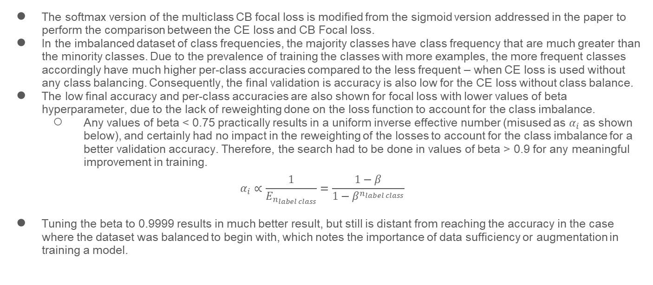
Describe and explain your observation on the result:
The softmax version of the multiclass CB focal loss is modified from the sigmoid version addressed in the paper to perform the comparison between the CE loss and CB Focal loss.
In the imbalanced dataset of class frequencies, the majority classes have class frequency that are much greater than the minority classes. Due to the prevalence of training the classes with more examples, the more frequent classes accordingly have much higher per-class accuracies compared to the less frequent – when CE loss is used without any class balancing. Consequently, the final validation is accuracy is also low for the CE loss without class balance.
The low final accuracy and per-class accuracies are also shown for focal loss with lower values of beta hyperparameter, due to the lack of reweighting done on the loss function to account for the class imbalance.
Any values of beta < 0.75 practically results in a uniform inverse effective number (misused as $α_{i}$ as shown below), and certainly had no impact in the reweighting of the losses to account for the class imbalance for a better validation accuracy. Therefore, the search had to be done in values of beta > 0.9 for any meaningful improvement in training.
$$α_{i}∝\frac{1}{E_{n_{label class}}}=\frac{1−β}{1−β^{n_{label class}}}$$
Tuning the beta to 0.9999 results in much better result, but still is distant from reaching the accuracy in the case where the dataset was balanced to begin with, which notes the importance of data sufficiency or augmentation in training a model.

Slide 14
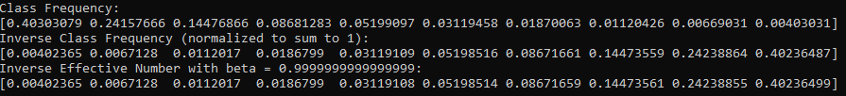
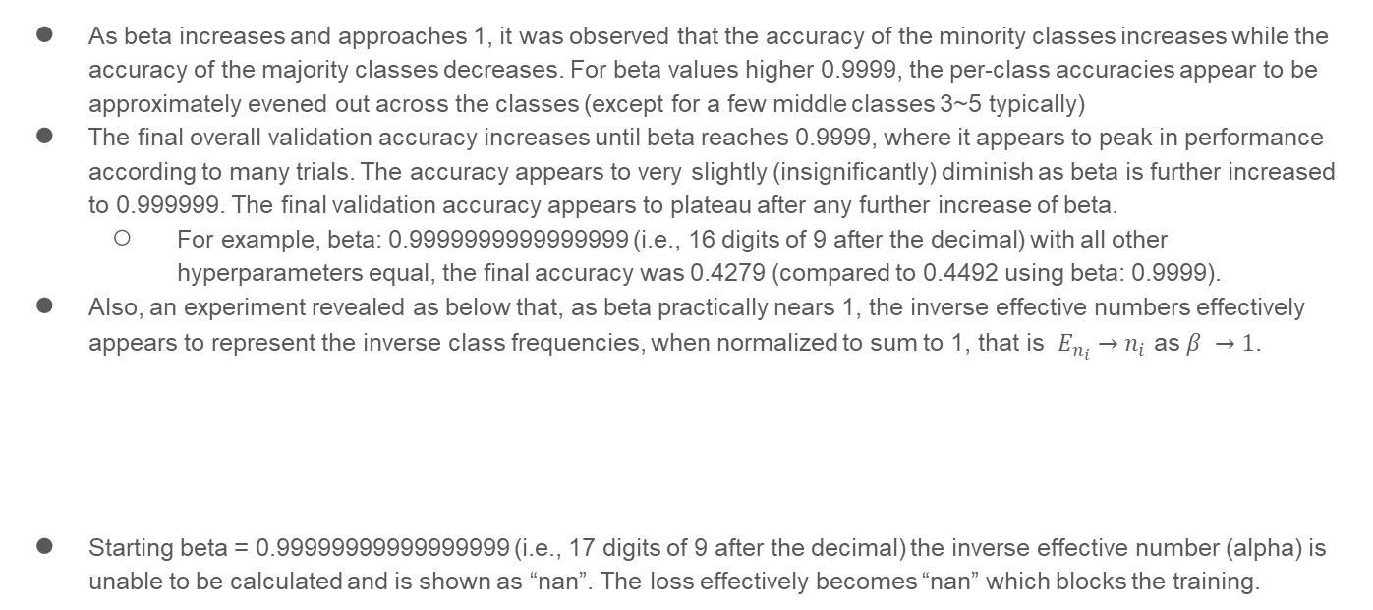
Describe and explain your observation on the result (2):
As beta increases and approaches 1, it was observed that the accuracy of the minority classes increases while the accuracy of the majority classes decreases. For beta values higher 0.9999, the per-class accuracies appear to be approximately evened out across the classes (except for a few middle classes 3~5 typically)
The final overall validation accuracy increases until beta reaches 0.9999, where it appears to peak in performance according to many trials. The accuracy appears to very slightly (insignificantly) diminish as beta is further increased to 0.999999. The final validation accuracy appears to plateau after any further increase of beta.
For example, beta: 0.9999999999999999 (i.e., 16 digits of 9 after the decimal) with all other hyperparameters equal, the final accuracy was 0.4279 (compared to 0.4492 using beta: 0.9999).
Also, an experiment revealed as below that, as beta practically nears 1, the inverse effective numbers effectively appears to represent the inverse class frequencies, when normalized to sum to 1, that is $E_{n_{i}}→n_{i}$ as $β →1$.
Starting beta = 0.99999999999999999 (i.e., 17 digits of 9 after the decimal) the inverse effective number (alpha) is unable to be calculated and is shown as “nan”. The loss effectively becomes “nan” which blocks the training.

