Slide 1
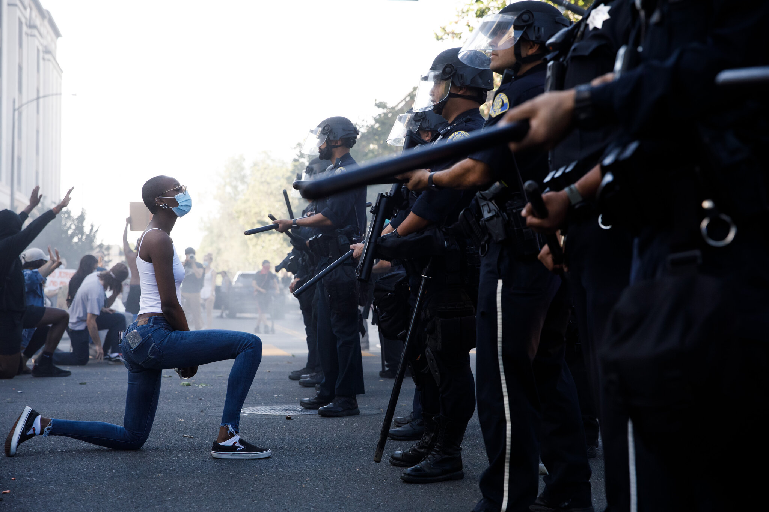
U.S. Officer Involved Shooting Deaths
Nicholas Cuneo
Capstone 1

Slide 2
Since the 2014 killing of Michael Brown in Ferguson, Missouri, there has been a growing focus on police accountability nationwide. The killing of George Floyd by a Minneapolis police officer in May 2020 ignited the issue in front of a worldwide audience and influenced protests and calls for reform across the globe. Since the start of 2015, over 6,000 people have been shot and killed by law enforcement officers.
Is there a systemic issue within our law enforcement agencies that disproportionally targets specific demographical groups?
In what states should we implement the creation of Crisis Intervention Teams within police departments specialized in de-escalation of mentally unstable situations , as well as overhaul racial sensitivity training to reduce the frequency of these occurrences?
Insights:
Police violence disproportionately affects minorities and people of color, and the minorities affected are disproportionately younger. Black people are killed at a rate of 36 deaths per million, over 2.5x the rate of white people.
West Virginia and Southwestern states have among the highest rates of minorities killed at the hands of law enforcement. These states would benefit most from reallocating funding to racial sensitivity training to reverse the rate of these incidences.
Some form of mental illness is present in 23% of all shootings, higher than the prevalence of mental illness in the general population. The Northeast part of the U.S. have the highest rates of theses occurrences, and thus is where the test of Crisis Intervention Teams should first be implemented.
Data Source:
Washington Post police shootings data -> https://github.com/washingtonpost/data-police-shootings/releases/download/v0.1/fatal-police-shootings-data.csv
2019 National Survey on Drug Use and Health → https://www.samhsa.gov/data/data-we-collect/nsduh-national-survey-drug-use-and-health

Slide 3
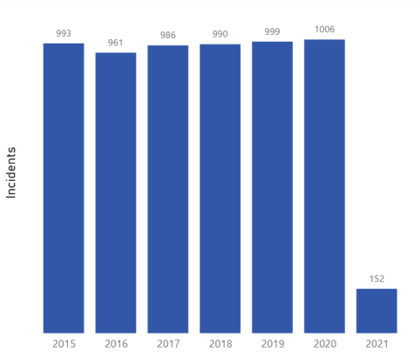
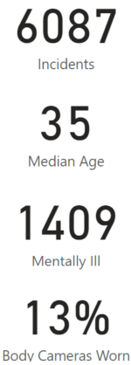
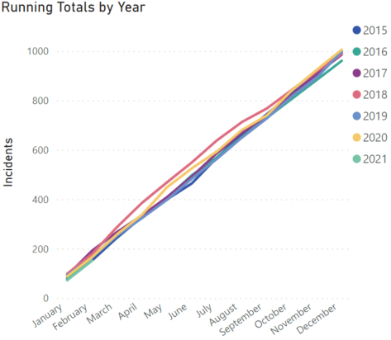
Nearly 1/4 of shootings involve some form of mental illness. We see that yearly officer involved shooting deaths have been consistent since 2015, with an average 989 deaths per year at the hands of the police. We also see that the rate of shootings YOY also remains consistent.
Data Source:
Washington Post police shootings data -> https://github.com/washingtonpost/data-police-shootings/releases/download/v0.1/fatal-police-shootings-data.csv
2019 National Survey on Drug Use and Health → https://www.samhsa.gov/data/data-we-collect/nsduh-national-survey-drug-use-and-health

Slide 4
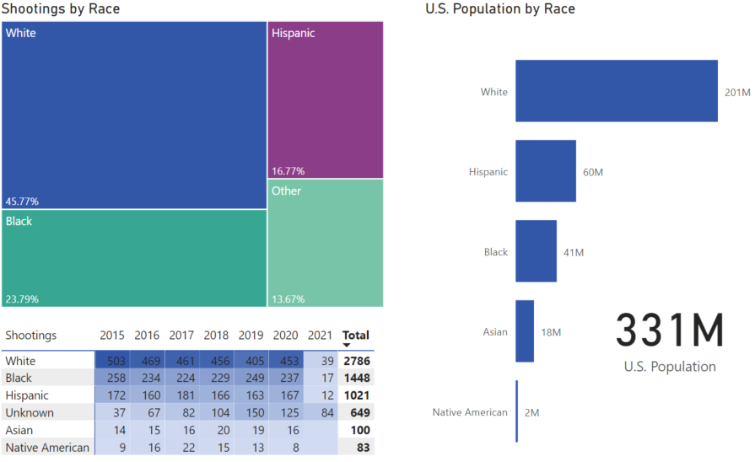
White people are killed much more frequently than minorities. In fact, the number of white people killed at the hands of the police is more than double the victims of Black and Hispanic descent combined. This is most likely due to the fact that White people make up the majority of the American population. In fact, 60% of the U.S. population (201M out of 331M) is White. As white people make up 60% of the population, but only 45% of the shootings, this is worth looking into further.

Slide 5
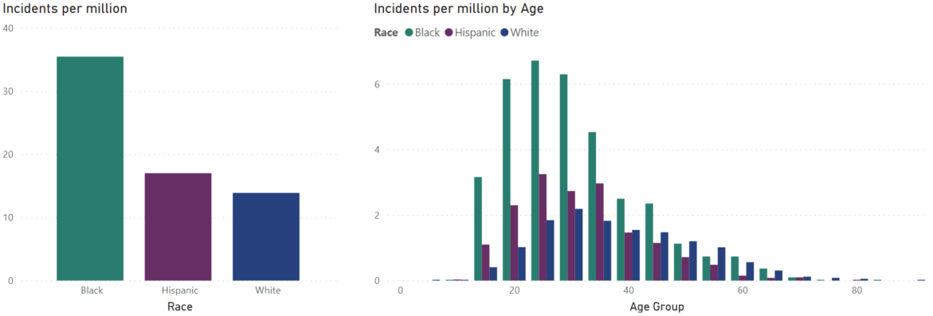
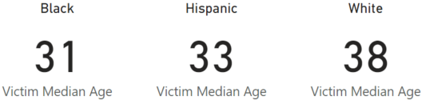
On a per million basis, minorities are killed at significantly higher rates that white people. Countrywide, black people are killed at a rate that is more than double that of white people. Black people are killed at a rate of 35 per million, followed by Hispanics at 17 per million, and White people at 14 per million. Minorities are also killed at a much younger age when compared to white people.

Slide 6
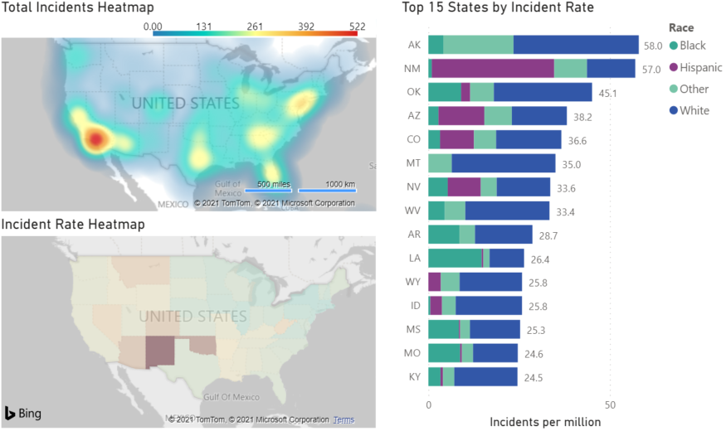
The majority of the shootings occur within the southern California and the Northeastern United States, which makes sense since these are two of the largest metropolitan areas in the country. However, when looking at the incident rate, Alaska has the highest rate with 58 per million, followed by the Southwestern states of New Mexico and Arizona, and Oklahoma.

Slide 7
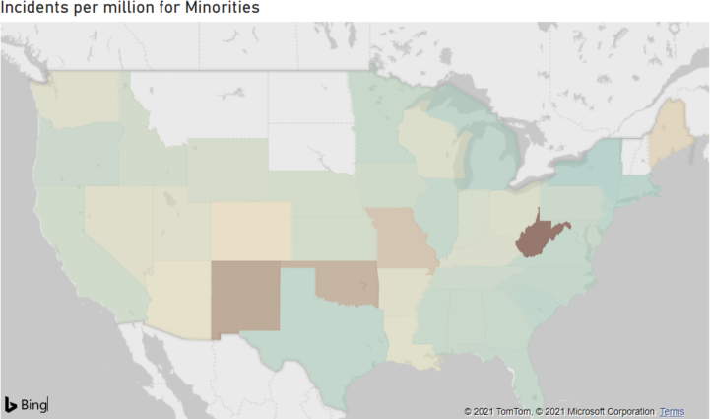
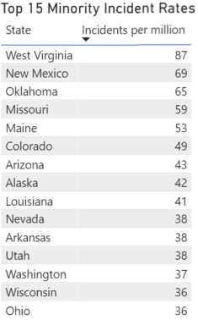
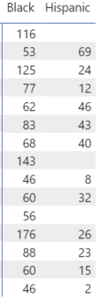
When looking at strictly Minority shooting rates, West Virginia appears to be the state of most concern with regards to shootings involving minorities. The incident rate for minorities is 87 per million compared to a rate of 33 per million overall. Other states of substantial concern include New Mexico, Oklahoma, and Missouri. It was surprising to see Maine in the Top 5 for Minority incident rates. West Virginia, Oklahoma, and Alaska are the worst states for black victims, while New Mexico has the highest rate for Hispanic victims.

Slide 8
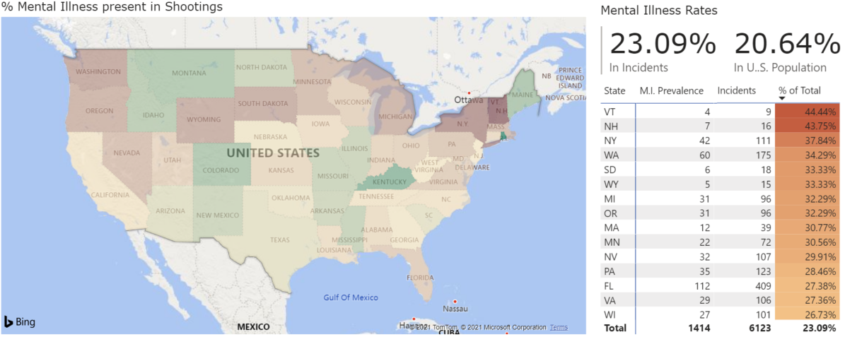
Victims with signs of mental distress make up almost 1/4 of all shootings while the overall all rate of mental illness in the population is 1 in 5. This is particularly troubling because if law enforcement is able to accurately identify signs of mental distress, a lot of these escalations can be avoided. The Northeast region in particular has an issue in being able to identify cases of mental illness that lead to shootings. The top 3 States with the worst record are Vermont, New Hampshire and New York. These states would benefit most from de-escalation training and training to identify cases of mental illness before resorting to use of deadly force.

Slide 9
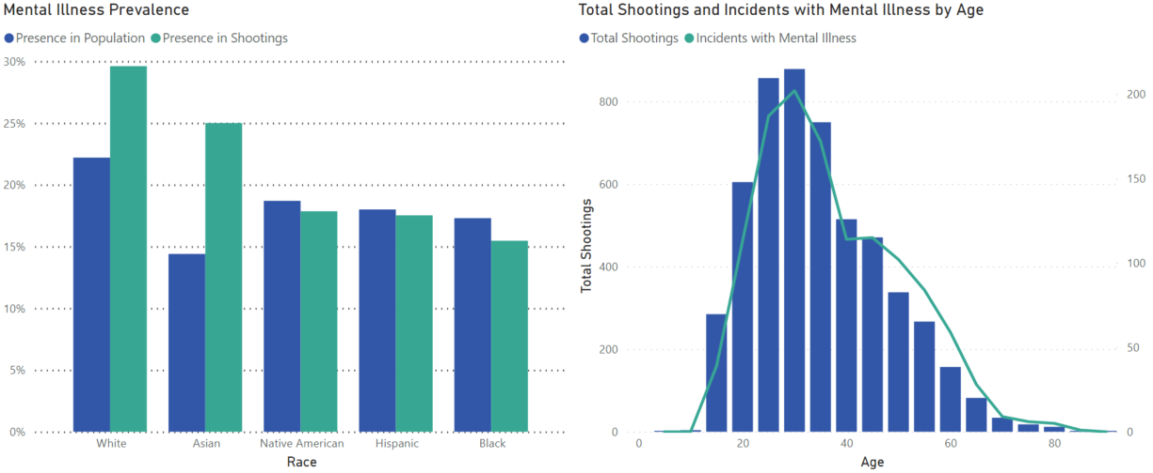
When broken down by age group, we see the rate of incidents involving mental illness follows the rate of total shootings. Therefore, it does not appear that any one age group is disproportionally affected by the presence of mental illness. In terms of race, the rate of mental illness prevalence in White and Asian people is much higher than the rates for their overall population. Black people have the lowest rate of incidents involving mental illness with 15.5% of shootings compared to 17.3% in the total population, possibly meaning as a race, they are being unfairly targeted.
Data Source:
2019 National Survey on Drug Use and Health → https://www.samhsa.gov/data/data-we-collect/nsduh-national-survey-drug-use-and-health

