Slide 1


A Declarative Domain-Free Approach for Querying and Generating Visualizations
Nicholas Del Rio¹
Committee Chair: | Dr. Paulo Pinheiro¹
 | Dr. Vladik Kreinovich¹
 | Dr. Rodrigo Romero¹
 | Dr. Aaron Velasco²
¹Dept. of Computer Science and ²Dept. of Geological Science

Slide 2
Outline
The Visualization Toolkit Deluge
Visualization Queries
A Toolkit-Centric Model Supporting Queries
Answering Visualization Queries
Applications
User Study
Conclusion

Slide 3
At AGU 2012…
1000’s of scientists generating visualizations using a variety of toolkits:

Slide 4
Multiple Toolkits
Some scientists are proficient with > 1 toolkit:
Percentage of Users
Number of toolkits

Slide 5
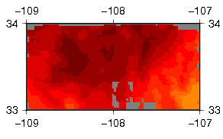
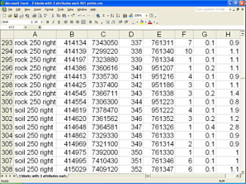

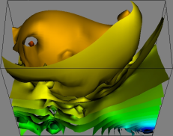
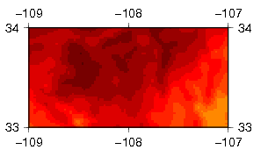
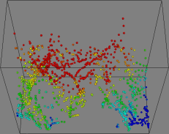

The Benefit of Multiple Toolkits
There are many ways to visualize a single dataset
Near neighbor vs. surface gridding techniques
3D views: isosurfaces vs. point plot
Multiple visualizations provide different perspectives of data and thus different insights

Slide 6
Challenges of using Multiple Toolkits
Disparities:
Supported Operators
Supported parameters
Data models (2D vs. 3D)
Languages
portability
awk 'BEGIN {FS=" "} {if (NR > 1) print $1,$2,$3}' $infile > $tmpfile
if [ $calc_region -eq 0 ] ; then
region=$5
else
minmaxvals=`minmax -C $tmpfile`
set -- $minmaxvals
region="${1}/${2}/${3}/${4}"
Fi
nearneighbor -R$region -I$gridspacing -S$searchradius -G$gridfile $tmpfile
colorsFile=$workspace/colors.cpt
makecpt -C$colorPallet -T$colorrange > $colorsFile
grdimage $infile -J$projection -P -B$boundaryAnnotationInterval -C$colorsFile > $outfile
dos.DebugOn();
dos.SetExecuteMethod(this, "loadFieldData");
dos.Update();
vtkShepardMethod sm = new vtkShepardMethod();
sm.DebugOn();
sm.SetInputConnection(aa.GetOutputPort());
sm.SetSampleDimensions(40,42,1);
sm.SetMaximumDistance(0.2);
sm.SetModelBounds(-109,-107,33,34,0,1);
sm.Update();
vtkExtractVOI ev = new vtkExtractVOI();
ev.SetInputConnection(sm.GetOutputPort());
ev.SetVOI(0,40,0,42,0,0);
ev.Update();
vtkContourFilter contours = new vtkContourFilter();
contours.SetInputConnection(ev.GetOutputPort());
contours.DebugOn();
contours.GenerateValues(10, ev.GetOutput().GetScalarRange());
contours.Update();
Similarities:
Modular (pipeline based)
Pipelines serve as the visualization specification

Slide 7

Goal
Provide an abstraction from which scientists can use to specify visualizations declaratively
Declarative Specification
Proposed Layer
Abstraction Layer (interpret, assemble, execute)
Toolkit layer
Conversion Operators
Transformation Operators
Mapping Operators
Viewing Operators
Graphics and Data layer
Graphics Libraries (e.g., OpenGL)
Data Streaming Libraries
Performance Layer
Parallel Libraries (MPI, OpenMP)

Slide 8
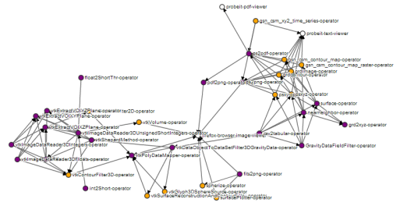
Approach
Apply the query-answering paradigm supported by DBMS to visualization
VISUALIZE http://cs.utep.edu/dataX.xyz
AS isosurfaces IN firefox
WHERE FORMAT = csv
AND TYPE = gravity
AND interval = 5
AND xRotation = 10
1
Abstract visualization pipelines in the form of declarative requests (visualization queries)
2
Construct knowledge bases of visualization operators
3
Develop methods for translating the abstractions into pipelines (query answering)

Slide 9



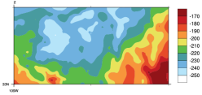
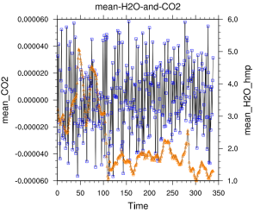
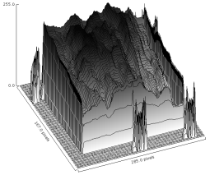

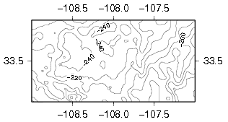
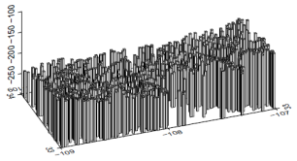
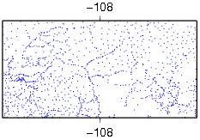

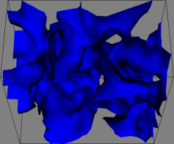
Proposed Usage Pattern
Visualize http://utep.edu/gravity.txt
AS * IN web-browser
WERE FORMAT = csv AND
TYPE = gravity
System may generate other visualizations of the same dataset from a variety toolkits

Slide 10
Visualization Query Language
A visualization query specifies a visualization in a machine readable and declarative form
Source Data
VISUALIZE http://trust.utep.edu/HolesCode/time.3d
AS isosurfaces IN web-browser
WHERE FORMAT = binaryFloatArray AND
TYPE = griddedTime AND
zRot = 45 AND
numConts = 35
Visualization Abstraction and ViewerSet
Data Characterization
Parameter Bindings
Can also use wildcard (VISUALIZE *) for explorative scenarios

Slide 11
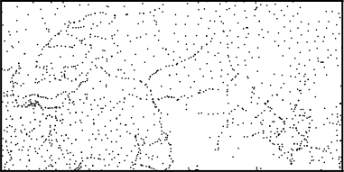
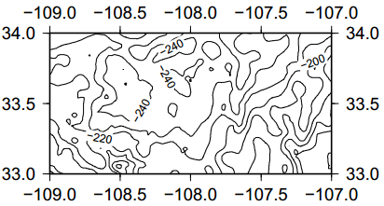
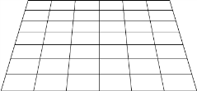
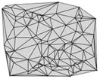
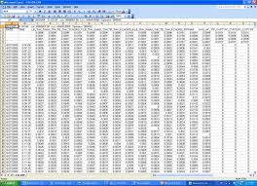

Queries versus Pipelines
VISUALIZE
http://iw.cs.utep.edu/visko-web/test-data/gravity/gravityDataset.txt
AS views:2D_ContourMap IN viewersets:PDFViewer
Visualization Abstraction
1
2
3
4
5
Query Answering

Slide 12

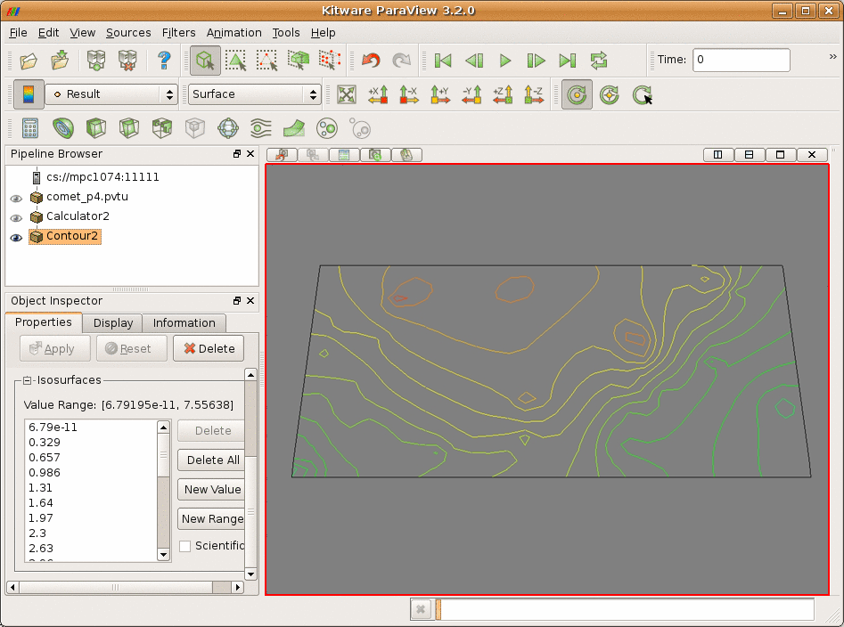
Using MVE-based Toolkits
Modular Visualization Environment (MVE) based toolkits provide building blocks from which to compose visualizations
Sequence of visualization operators known as a pipeline

Slide 13

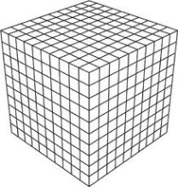
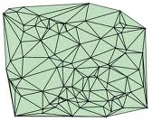
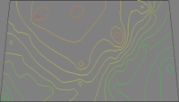
Data Flow/State Pipeline Structure
Value
1
Op1: vtkDataObjectToDataSetFilter
Op 1
Data Gathering
2
Op2: vtkShepardMethod
Op 2
Mapping
3
Op 3: vtkExtractVOI
Op 3
Visualization Abstraction
4
specified in the query
Op 4: vtkContourFilter
Op 4
Op 5
Rendering
5
Op 5: vtkPolyDataMapper
View
6
Data Flow Model – Haber and McNabb 90
2
3
4
5
Data State Model – Chi 98
1
4
6

Slide 14
Other Toolkit Models
Class | Model | Ops. | Params. | Data | Tasks | Vis.
Transform-Centric | Data State¹ | 1 | 0 | 1 | 0 | 0
 | Data Flow⁴ | 2 | 0 | 1 | 0 | 0
 | Lattice⁵ | 0 | 0 | 2 | 0 | 2
Data-Centric | Mackinlay⁶ | 0 | 2 | 2 | 0 | 2
 | Zhou⁸ | 0 | 2 | 2 | 0 | 1
User-Centric | Task-by-Data⁷ | 0 | 0 | 1 | 2 | 1
 | Domino² | 0 | 0 | 1 | 0 | 1
Hybrid | Duke Ontology³ | 1 | 0 | 1 | 1 | 1
0 = no modeling
1 = coarse level modeling
2 = find level modeling
We extend Data Flow and borrow from Data State, Zhou, and Duke

Slide 15
Our Model
Web Service
Visualization
Abstraction
isosurfaces
implBy
treemap
mapsTo
Data Enricher/Gatherer
Format[Type]
Format[Type]
Format
Converter
Format[Type]
Mapper
Viewer
Format Converter
Type Transformer
Data Filterer
Operator based perspective (Data State)
Data Enricher/Gatherer specialties
Input/output in terms of format[type] (Mackinlay and MIME)
Mapper (Data Flow)
Operators as web services
Injects an optional Format Converter after Mappers
Fuses Renderer with Viewer, inspired by Data State

Slide 16
Model Limitations
Interactive viewers
Composite operators (i.e., operators that perform both gridding and filtering)
Need to model these from a singular perspective
Multi-faceted operators (i.e., operators that serve different functions based on input data or parameter settings)
Need to model these from multiple perspectives (multiple desciptions)
Might employ rules in future versions (i.e., if 2D input, then 2D output)

Slide 17
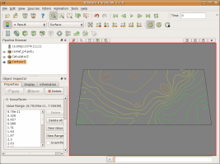
A VTK Pipeline in terms of our Model
SSV [gravity-data]
OBSERVATION 1
Op1
Format converters are type agnostic; Ingest/output owl:Thing and propagate type.
Converter
CSV [owl:Thing
gravity-data]
Transformer
Op1
OBSERVATION 2
XML [vtkPolyData]
Type polymorphism; scalable MIME
Transformer
Op 2
XML [vtkImageData3D]
OBSERVATION 3
Transformer
Op 3
Dimension reduction not explicitly specified; inferred through type requirements
XML [vtkImageData2D]
Mapper
Op 4
XML [vtkPolyData]
OBSERVATION 4
Formats and types defined in ontologies, fostering interoperability
Viewer

Slide 18
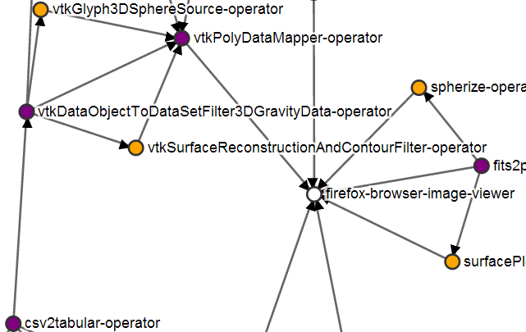
Populating the Knowledge Base
Users register operators by describing their functions in terms of our model:
Classify: converter, transformer, filter, mapper, and viewer
Specify: visualization abstraction if mapper
Specify: input/output format[type]
The resulting operator descriptions form a search graph
Nodes are operators
Arcs are data (i.e, format[type])
Transformer
Mapper
Viewer

Slide 19
Answering Visualization Queries
VISUALIZE http://somedata.csv
AS 3d-point-plot IN firefox
WHERE FORMAT = csv AND
TYPE = gravity-data
Visualization Queries Specify:
Source format[type]
Target Visualization Abstraction
Target Viewer
Search algorithm:
Specialized depth-first-traversal
Tailored for ensuring pipeline model structure
Transformer
Mapper
Viewer

Slide 20
Multiple Pipeline Results
gravity-data[CSV]
Kick off DFS
Pipeline Results
Kick off DFS
1
2
1
1
2
2
3
4
4
5
3
4
5
6
Forest
7
8
7
7
9
8
9
10
9
9
PDF Viewer
JPEG
Viewer
FITS
Viewer
Web Browser Viewers
Query requested that gravity-data[CSV] be viewed in Web Browser

Slide 21
Pipeline Structure (Automata)
A pipeline can be considered a sentence in a pipeline language that describes a visualization.
It has an alphabet (i.e., operators types) and a grammar (i.e., structure)
V
T
FT
V
F
V
M
MC
V
V
C
FC
T: Transformer
C: Converter
F: Filter
FT: Post Filtering Transformer
FC: Post Filtering Converter
M: Mapper
MC: Post Mapping Converter

Slide 22



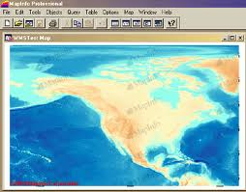

Sharing Visualizations
Recipient may be unable to adjust any properties such as contour interval, color tables, projection and labels
1. Send image (contents or by URL)
Recipient may not have tools, capabilities, and expertise to regenerate visualization from data
2. Send data
These solutions have been implemented only for specific domains , for example OGC
3. Send URL of visualization embedded in viewer
Visualize http://utep.edu/gravity.txt
AS contour-map IN web-browser
WERE FORMAT = csv AND
TYPE = gravity
VisKo queries address the limitations above
4. Send a VisKo Query specifying the visualization

Slide 23
Evaluation
There are many facets associated with our approach:
Facet | Evaluation | Metric
Model | Validity | Toolkit Coverage
 | Intuition of Visualization Abstractions | Survey
Performance | Search Algorithm | Complexity
 | Pipeline Execution | Execution/Data Transfer Time
Query | Effectiveness | Readability and Writability

Slide 24
User Study
Compare our query language to pipeline languages:
(Use 1) Is our query language more readable than pipeline code
(Use 2) Is our query language more writeable than pipeline code
Control: pipeline specifications
Independent Variable: Pipeline/Query Language
Dependent Variable: Correctness
Given | Task | Required
Pipeline/Query | Identify | A visualization selection
Visualization Options
Readability Trails
Given | Task | Required
Operators/Resources | Compose | Pipeline/Query
Visualization
Writability Trails

Slide 25
Independent Variable Isolation
Pre-existing toolkit knowledge:
Target demographic had experience using MVE-based toolkit
The Language Factor:
Pipelines specified in an abstract form
Visualization misinterpretation:
All visualizations were labeled
The parameter factor:
No parameters
Operator 1
Operator 2
Operator 3
…

Slide 26
Results: Tasks
Failed Readability
Passed Writability
 | Pipeline | Query
Mean | 0.8 | 0.733333
Variance | 0.171428571 | 0.209524
Observations | 15 | 15
Pearson Correlation | -0.301511345
Hypothesized Mean Difference | 0
df | 14
t Stat | 0.366899693
P(T<=t) one-tail | 0.359590005
t Critical one-tail | 1.761310136
P(T<=t) two-tail | 0.719180011
t Critical two-tail | 2.144786688
 | Pipeline | Query
Mean | 0.133333333 | 0.545455
Variance | 0.123809524 | 0.272727
Observations | 15 | 11
Pooled Variance | 0.185858586
Hypothesized Mean Difference | 0
df | 24
t Stat | -2.40818004
P(T<=t) one-tail | 0.012037278
t Critical one-tail | 1.71088208
P(T<=t) two-tail | 0.024074556
t Critical two-tail | 2.063898562

Slide 27
Results: Questionnaire
Passed Readability
Passed Writability
 | Pipeline | Query
Mean | 3.133333 | 4.066667
Variance | 1.552381 | 1.066667
Observations | 15 | 15
Pearson Correlation | -0.0074
Hypothesized Mean Difference | 0
df | 14
t Stat | -2.22555
P(T<=t) one-tail | 0.021494
t Critical one-tail | 1.76131
P(T<=t) two-tail | 0.042988
t Critical two-tail | 2.144787
 | Pipeline | Query
Mean | 2.733333 | 4.066667
Variance | 1.780952 | 1.638095
Observations | 15 | 15
Pearson Correlation | 0.303887
Hypothesized Mean Difference | 0
df | 14
t Stat | -3.34664
P(T<=t) one-tail | 0.002398
t Critical one-tail | 1.76131
P(T<=t) two-tail | 0.004796
t Critical two-tail | 2.144787

Slide 28
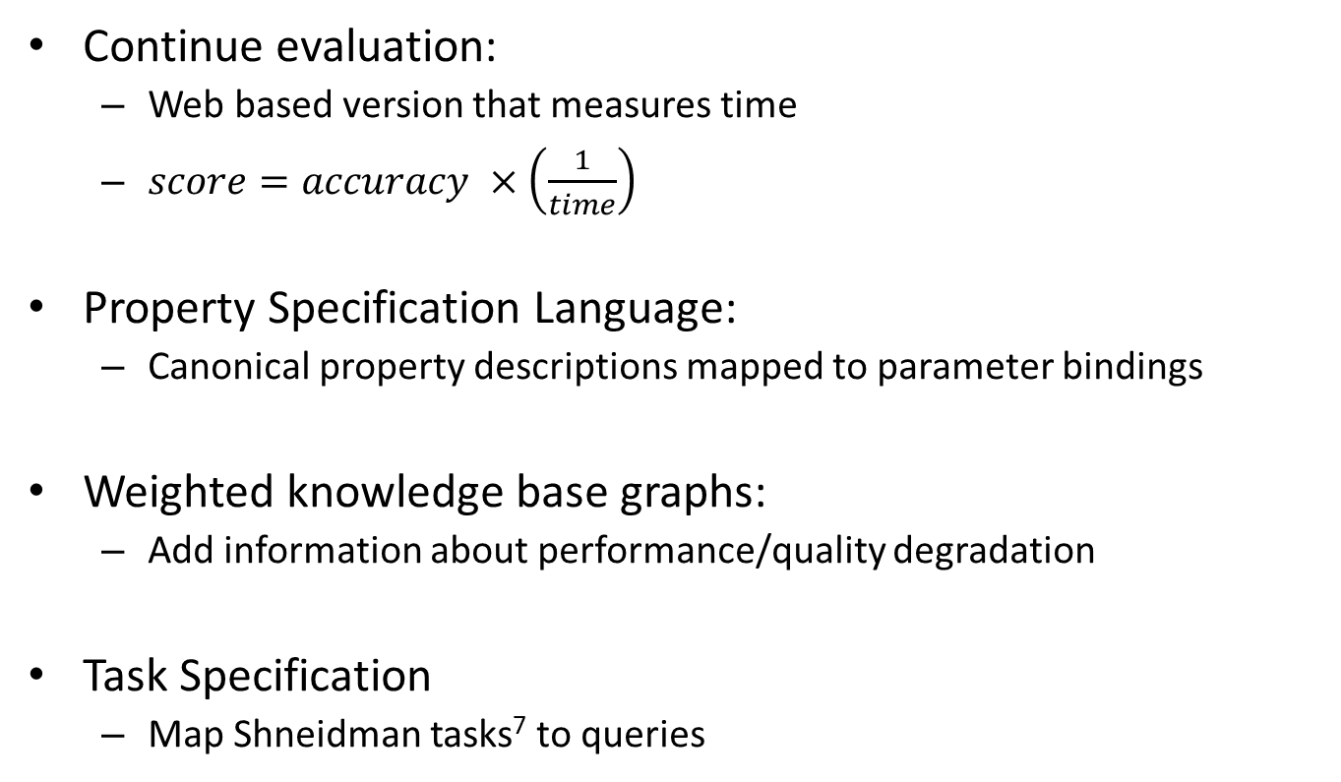
Future Work
Continue evaluation:
Web based version that measures time
$score=accuracy ×\left(\frac{1}{time}\right)$
Property Specification Language:
Canonical property descriptions mapped to parameter bindings
Weighted knowledge base graphs:
Add information about performance/quality degradation
Task Specification
Map Shneidman tasks⁷ to queries

Slide 29
References
E.H. Chi and J. Riedl. An operator interaction framework for visualization systems.
K. Brodlie and N.M. Noor. Visualization notations, models and taxonomies.
D. J. Duke, K. W. Brodlie, and D. A. Duce. Building an ontology of visualization.
B. Haber and D. A. McNabb. Visualization Idioms: A Conceptual Model for Scientific Visualization Systems.
W. L. Hibbard, C. R. Dyer, and B. E. Paul. A lattice model for data display.
J. Mackinlay, P. Hanrahan, and C. Stolte. Show me: Automatic presentation for visual analysis.
B. Shneiderman. The eyes have it: A task by data type taxonomy for information visualizations.
M.X. Zhou and S.K. Feiner. Data characterization for automatically visualizing heterogeneous information.

Slide 30
Backup Slides

Slide 31
Resources Snippet
Formats:
Types:
http://rio.cs.utep.edu/formats.owl#GIF
http://rio.cs.utep.edu/formats.owl#JPEG
http://rio.cs.utep.edu/formats.owl#PNG
http://rio.cs.utep.edu/formats.owl#VTKPOLYDATA
http://rio.cs.utep.edu/formats.owl#PDF
http://rio.cs.utep.edu/formats.owl#NETCDF
http://rio.cs.utep.edu/formats.owl#SPACEDELIMITEDTABULARASCII
http://rio.cs.utep.edu/formats.owl#ESRIGRID
http://rio.cs.utep.edu/formats.owl#BINARYINTARRAY
http://rio.cs.utep.edu/formats.owl#BINARYSHORTINTARRAY
http://rio.cs.utep.edu/types.owl#UNSTRUCTURED-POINTS-2D
http://rio.cs.utep.edu/types.owl#UNSTRUCTURED-POINTS-3D
http://rio.cs.utep.edu/types.owl#STRUCTURED-POINTS-2D
http://rio.cs.utep.edu/types.owl#STRUCTURED-POINTS-3D
http://rio.cs.utep.edu/types.owl#GRIDDED-SCALARS-2D
http://rio.cs.utep.edu/types.owl#GRIDDED-SCALARS-3D
http://rio.cs.utep.edu/types.owl#GRIDDED-VECTORS-2D
http://rio.cs.utep.edu/types.owl#GRIDDED-VECTORS-3D
http://rio.cs.utep.edu/types.owl#TIME-SERIES

Slide 32
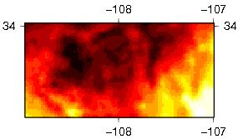


Pipeline Readability
Trial Type 1 (GMT-based)
Instructions: Using the input data and pipeline described below, choose the visualization that would most likely be generated by circling it.
NOTE: Please refrain from leveraging any source outside of the evaluation material presented to you. This includes toolkit manuals of any kind (e.g., versions published on the Web).
Input Data Description:
Data Format: XYZ List (longitude, latitude, scalar-of-interest) in tabular ASCII
Data Type: Unstructured Points
Data Dimensionality: 2
Pipeline:
Possible Visualization Outputs (circle the most likely output):
surface.exe grdImage.exe ps2pdf.exe
Visualization A: Raster Map | Visualization B: Contour Map | Visualization C: other

Slide 33
Pipeline Writability
Trial Type 2 (GMT-based)
Instructions: Using the input data, list of pipeline operators, and visualization shown below, write the visualization pipeline that would most likely generate the visualization.
NOTE: Please refrain from leveraging any source outside of the evaluation material presented to you. This includes toolkit manuals of any kind (e.g., versions published on the Web).
Input Data Description:
Data Format: XYZE (longitude, latitude, scalar-of-interest, elevation) in tabular ASCII
Data Type: Unstructured Points
Data Dimensionality: 3
Visualization: XY Plot to be viewed in a web browser
Visualization Pipeline (please write down the pipeline that could generate the visualization):

Slide 34
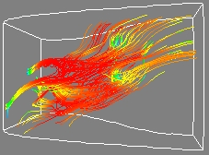
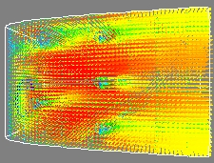
Query Readability
Example: Trial Type 3 (VTK-based)
Instructions: Using the input data and query described below, choose the visualization that would most likely be generated by circling it.
NOTE: Please refrain from leveraging any source outside of the evaluation material presented to you. This includes toolkit manuals of any kind (e.g., versions published on the Web).
Input Data Description:
Data Format: Binary Float Array
Data Type: Gridded Vectors
Data Dimensionality: 3
Query:
Possible Visualization Outputs (circle the most likely output and justify your selection on the back):
VISUALIZE http://density-data.bin AS http://rio.cs.utep.edu/views.owl#STREAM-LINES IN http://rio.cs.utep.edu/viewer-sets.owl#WebBrowser WHERE TYPE = http://rio.cs.utep.edu/types.owl#GRIDDED-VECTORS-3D AND FORMAT = http://rio.cs.utep.edu/formats.owl#BINARYFLOATARRAY
Visualization A: Hedge-Hog | Visualization B: Stream-lines | Visualization C: null

Slide 35
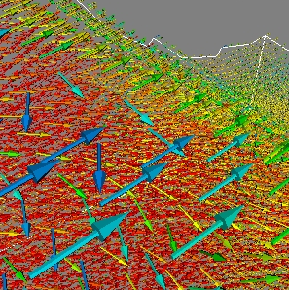
Query Writability
Example: Trial Type 4 (VTK-based)
Instructions: Using the input data, list of visualization resources, and visualization shown below, write the visualization query that would most likely generate the visualization.
NOTE: Please refrain from leveraging any source outside of the evaluation material presented to you. This includes toolkit manuals of any kind (e.g., versions published on the Web).
Input Data Description:
Data Format: Binary Float Array
Data Type: Gridded Vectors
Data Dimensionality: 2
Data Location: http://trust.utep.edu/data.bin
Visualization: Glyphs to be viewed in a web browser
Visualization Query (please write down the query that could generate the visualization):

Slide 36
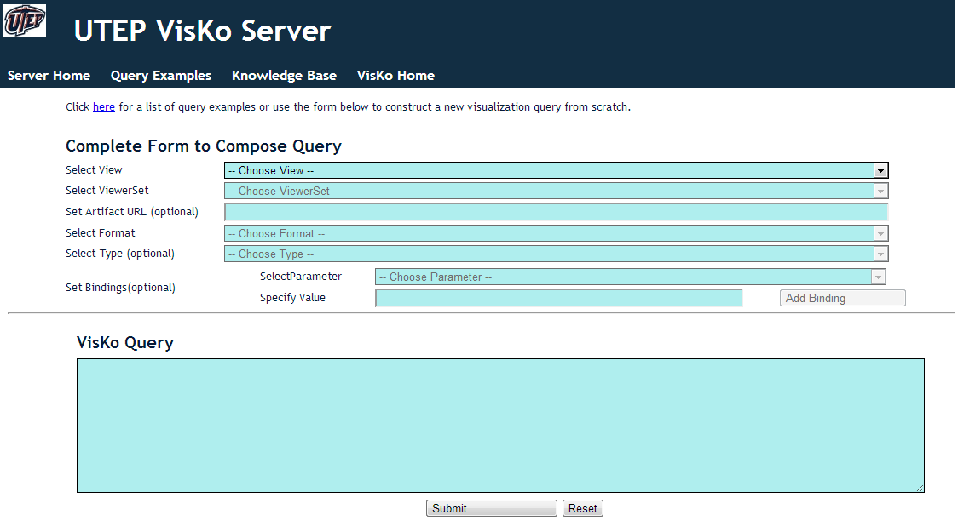
VisKo Query Submission

Slide 37
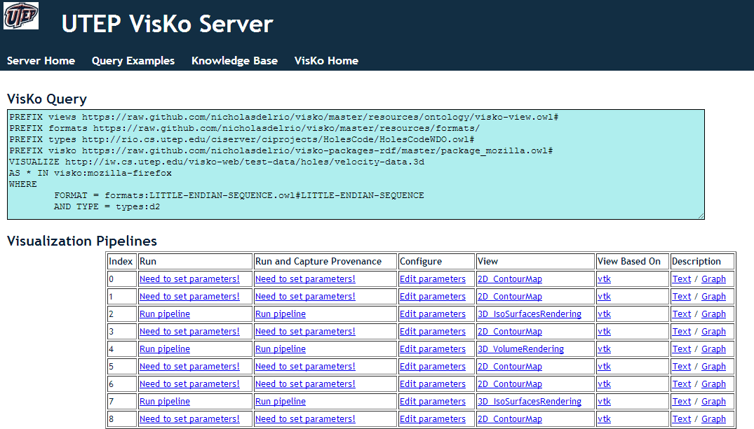
VisKo Pipeline Results

Slide 38
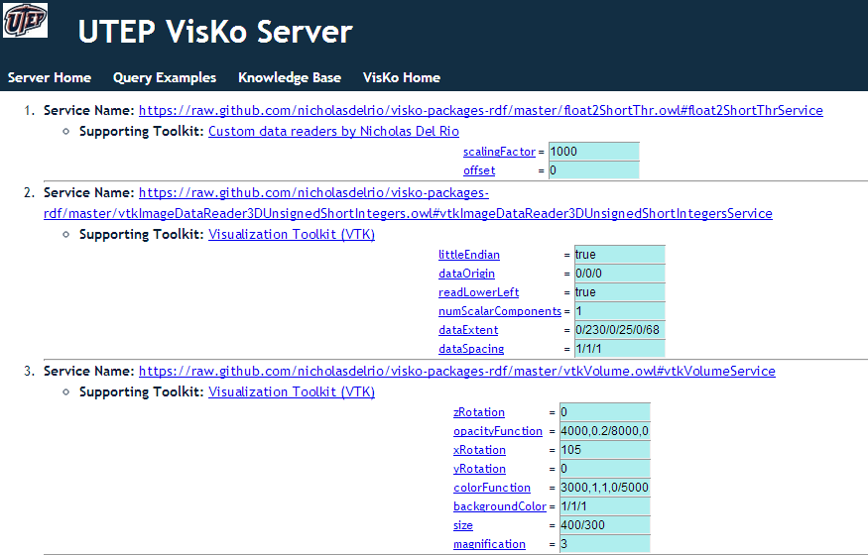
Parameter Editing

Slide 39
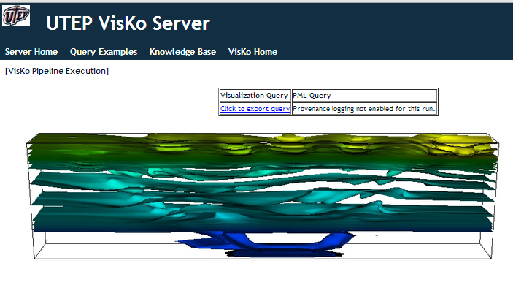
Visualization Result

Slide 40
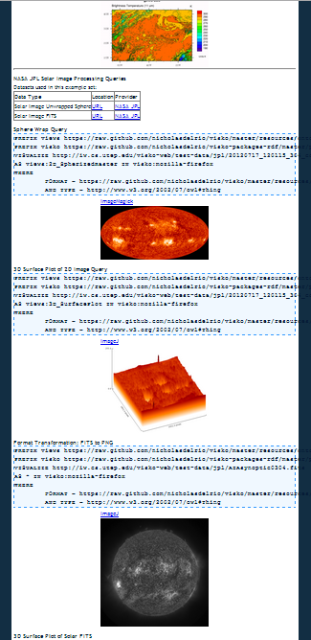
Query Examples

Slide 41
Contributing Knowledge through Modules
Module
Resources: types, formats, and vis abstractions
Service source
reads
Service Meta-data generation source
refs
execs
Server
installs
Services
Visko-app
ModuleSDK
Service Libs
Meta-data gen libs
Service Meta Data
searches
publishes
Client Side
Server Side

