Slide 1
Model Results

Slide 2
Simple Linear Regression Model
Build using only distance as the model parameters
General form:-
Kilowatts Used = Distance_coefficient*journey distance + y-axis intercept
In mathematical notation:-
Y = m*x + c (where m = 0.000119578, & c = 0.403334)
Can be used to predict vehicle end charge (most useful end-product for model user)

Slide 3
Why Only Distance as the Model Parameter?
Only independent variable found to have:-
Significant p-value (<0.05)
High R-square value (~0.868)
Have residuals that are roughly randomly distributed
Other independent variables that were looked at include:-
Absolute Elevation
Up Elevation
Down Elevation
Duration
However they were ultimately rejected due to not meeting one of the 3 reason stated above (usually point 3)

Slide 4
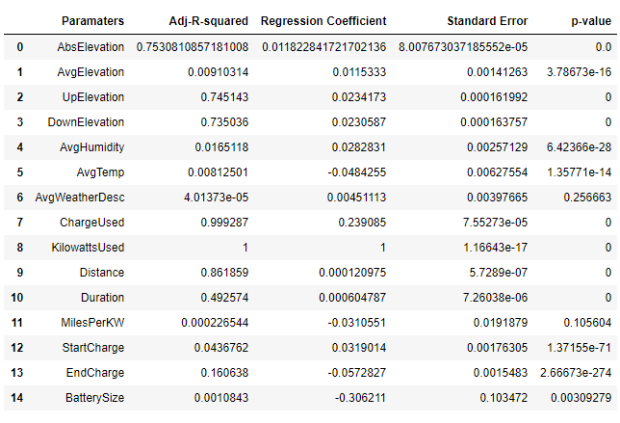

Slide 5
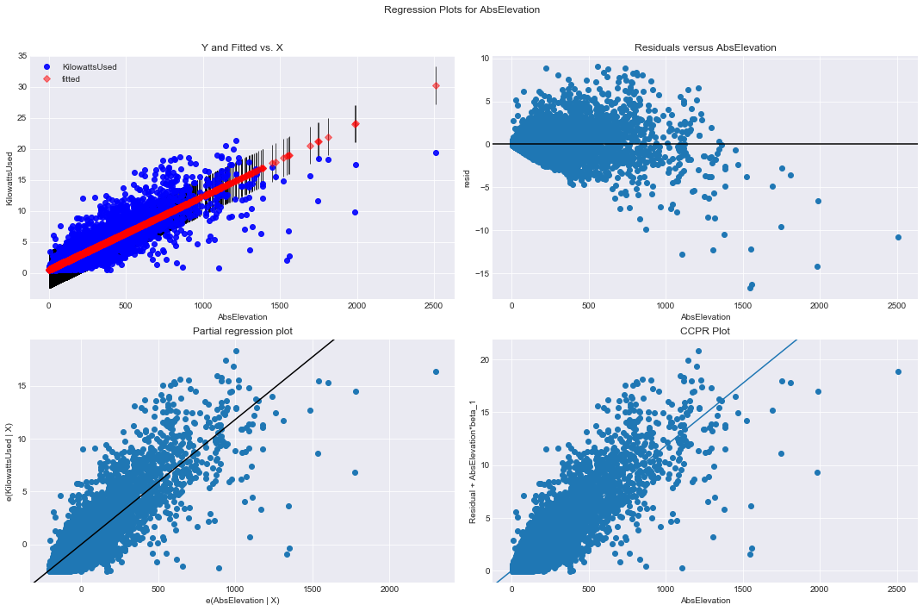
Figure1: Regression plot for Absolute Elevation Against Kilowatts Used

Slide 6

Figure2: Regression plot for Up Elevation Against Kilowatts Used

Slide 7
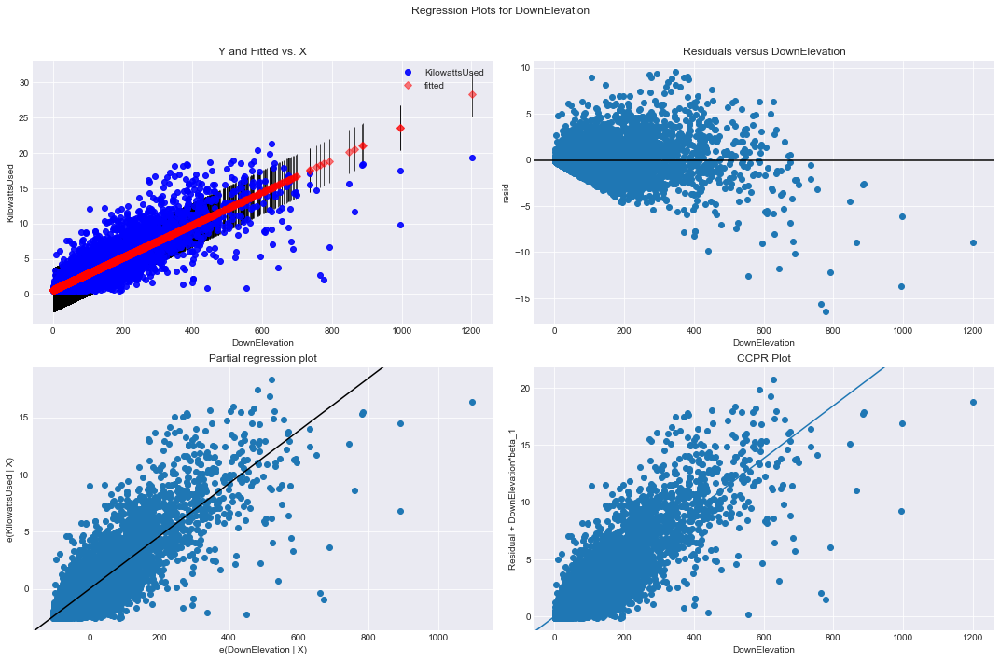
Figure3: Regression plot for Down Elevation Against Kilowatts Used

Slide 8
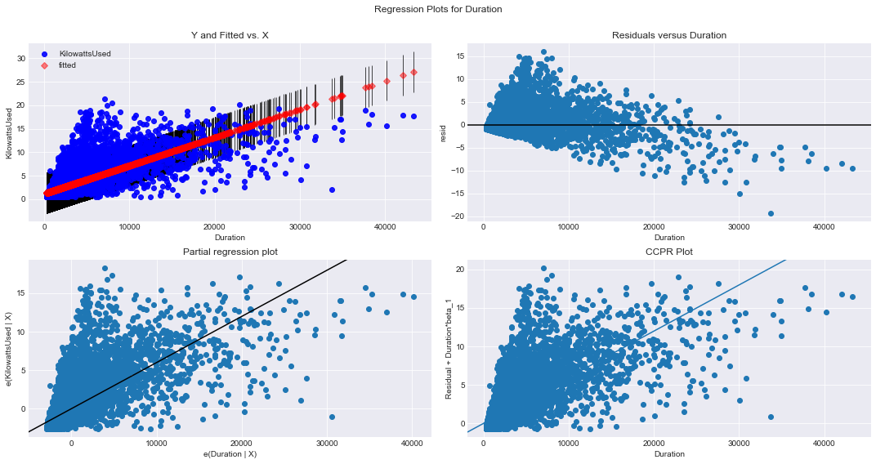
Figure4: Regression plot for Duration Against Kilowatts Used

Slide 9
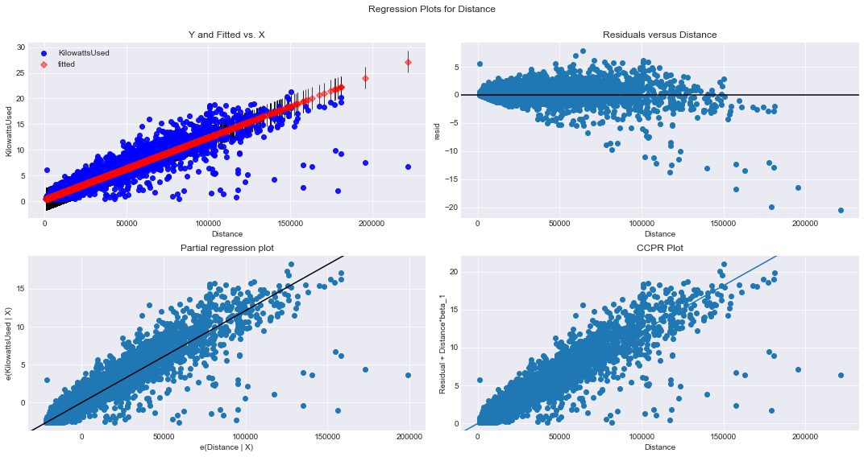
Figure5: Regression plot for Distance Against Kilowatts Used

Slide 10
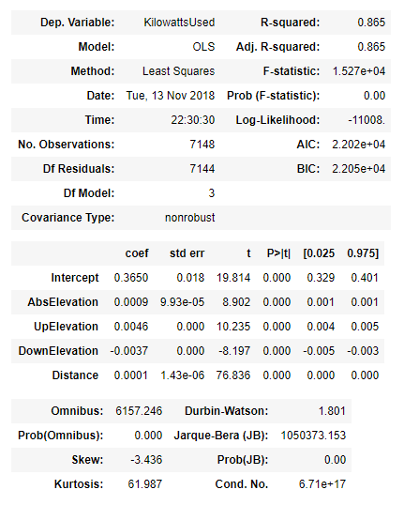
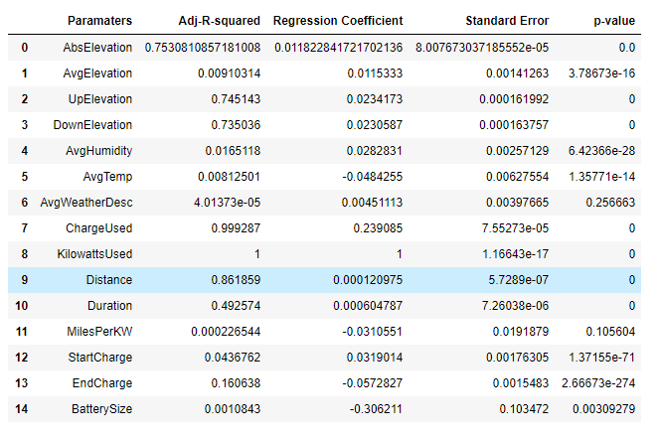
Why not build a Mixed Regression Model?
Not much improvement in R-square value (measure of correlation)

Slide 11
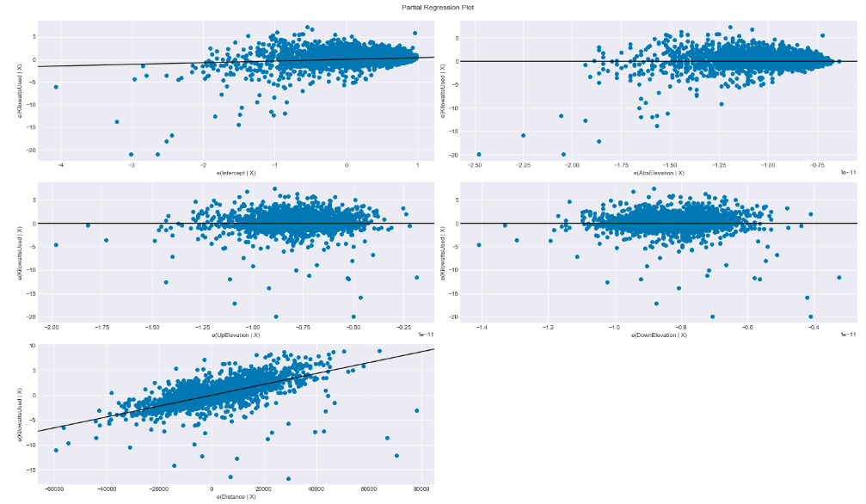
Note that only distance (the bottom right image)
has a `steep’ gradient (want we want to see).
Figure6: Partial Regression Plot of Different Model Parameters

Slide 12
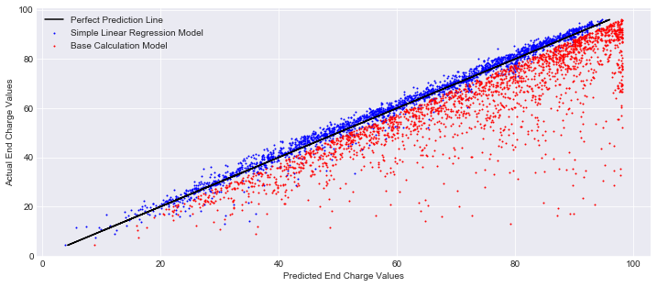
Simple Linear Regression Model vs Base_Calculation Model
Figure7:Plot of Simple Linear Regression Model vs Base Calculation Model

Slide 13
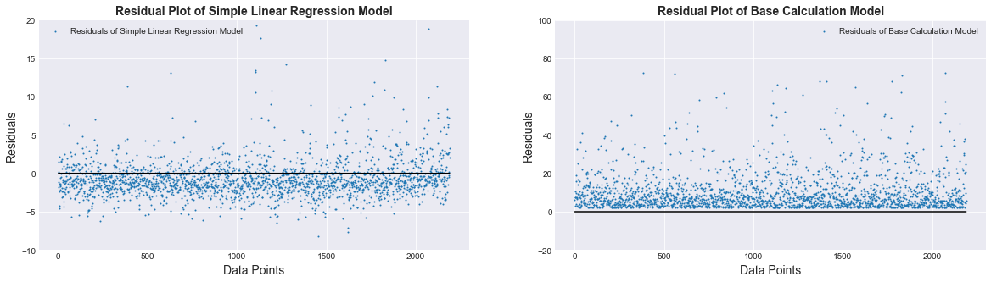
Figure8:Plot of Residuals for Simple Linear Regression Model & Base Calculation Model
How to know which is better? => Use sum of Residual Square = lower number indicated better model
Sum of residual square for Simple Linear Regression Model : 14496.72
Sum of residual square for Base_Calculation Model: 454880.51
Simple Linear Regression Model is the better model & can serve as the baseline model moving forward to Phase 2

