Slide 1
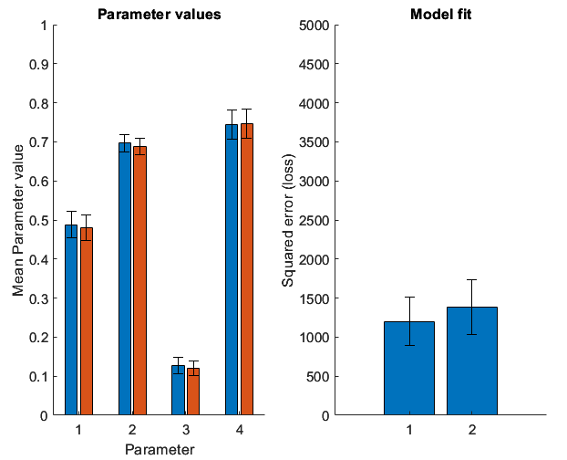
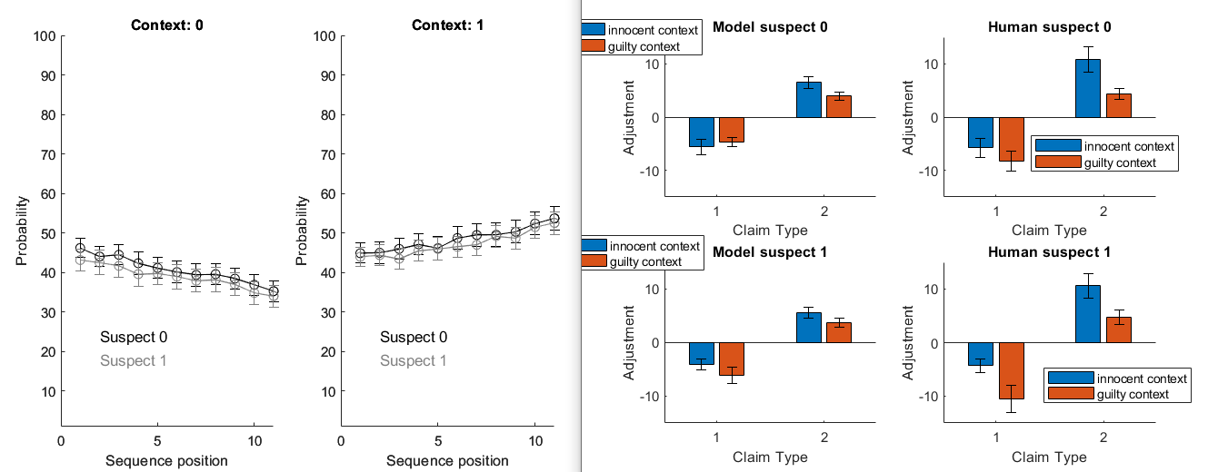
Study 1 model fits, prior, split, bias and slope
This one looks ok. Split is overestimated a little (~.7 instead of .6) and there’s some oddball effect, though it’s not as large as in human. Probably split should be even higher?

Slide 2
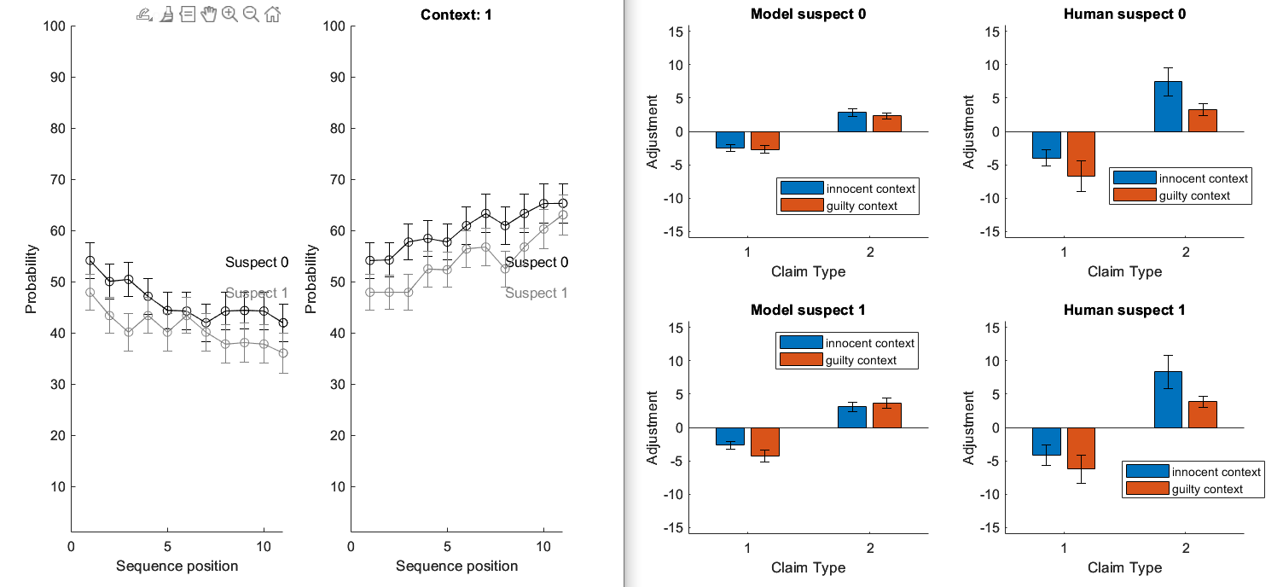
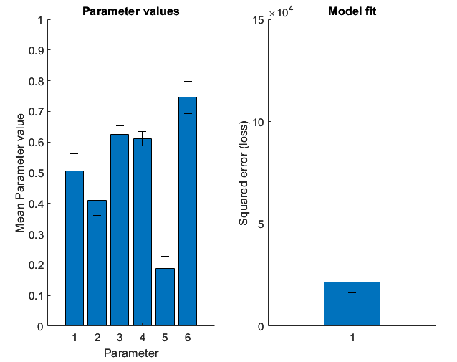
Study 2
Two priors and two splits but one bias and one slope fitted per participant (due to within [participants design)
forensic_beads_simplify_study2.m
Model of prior is ok. Parameter difference is enough to be significant? Yes! Quite so P value and BF10 good. Oddball effect not so much. Kind of works for claim type = 1 (innocent?). Split is underestimated, not overestimated.

Slide 3
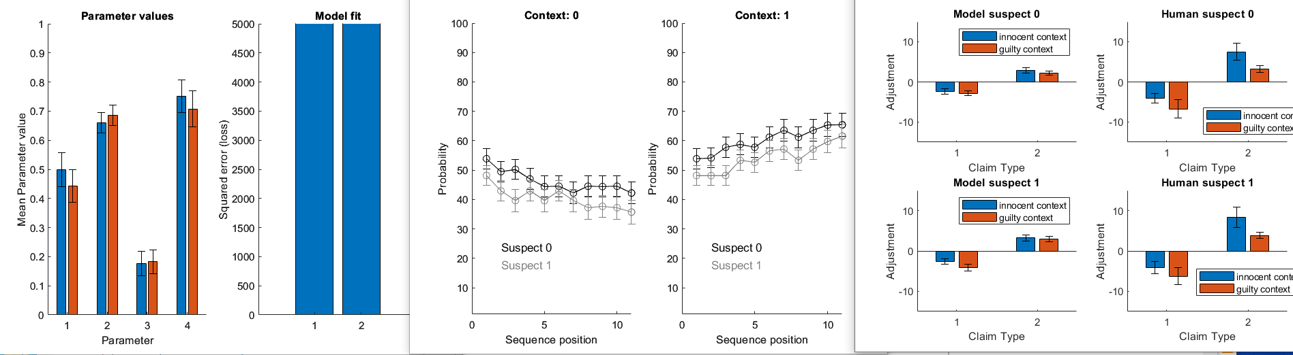
Study 2 model fits, prior, split, bias and slope
forensic_beads_splitTerm_study2_2Suspects_simplify.m
Prior effect on parameters smaller than for the analysis where each P shares three parameters. P=.09 BF10 = 0. Probabilities / behaviour look just as good though. Splits roughly correctly estimated or slightly under. Oddball effect still only slight for innocent claims and absent for guilty claims.
What to do?
Talk to Matteo
Try cbm fitting
Accept these results, delete io from paper and report this instead. Conclude it can model prior but external processes needed to model oddball and speculate about that.

Slide 4
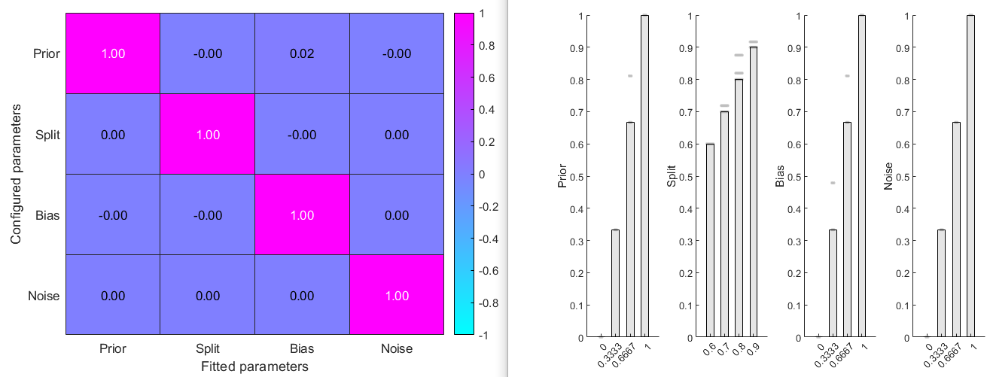
Study 1 parameter recovery

Slide 5
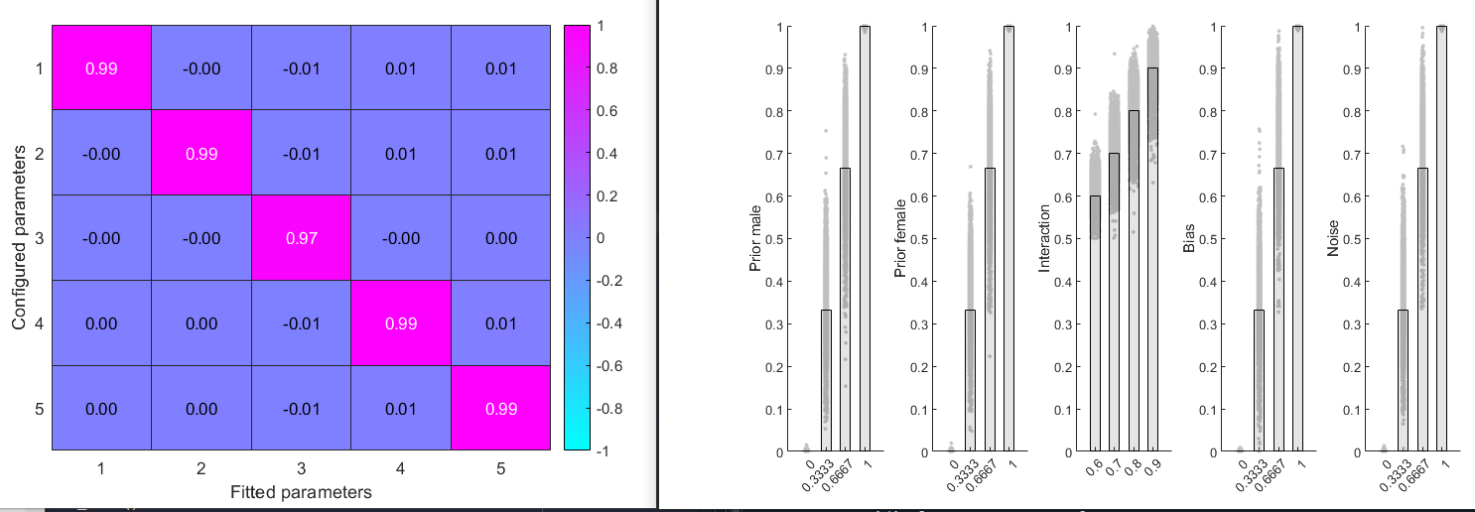
Study 1 parameter recovery
forensic_beads_parameter_recovery_study2_simple.m
This ran for most of a week.
Graph says interaction but I checked and code is actually computing split and plot is mislabelled
fitting different priors to male and female sequences
%within-participant but one split, bias and noise parameter per participant.

Slide 6
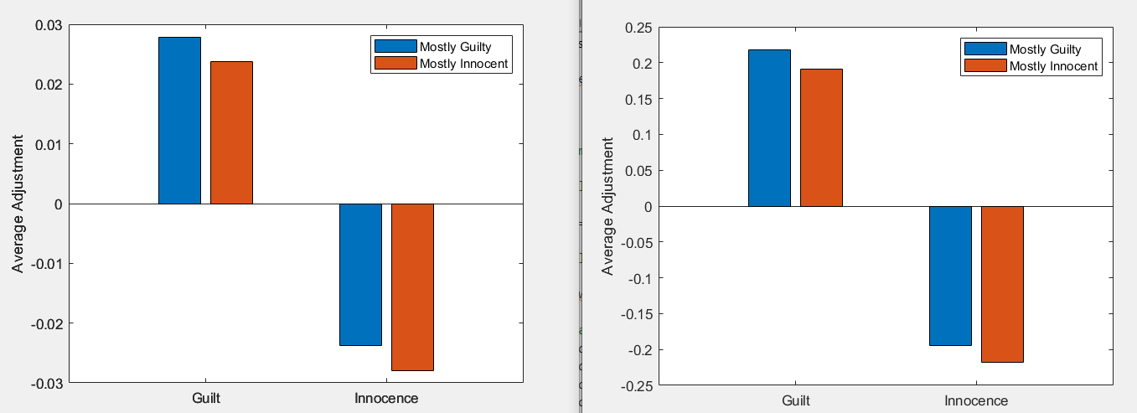
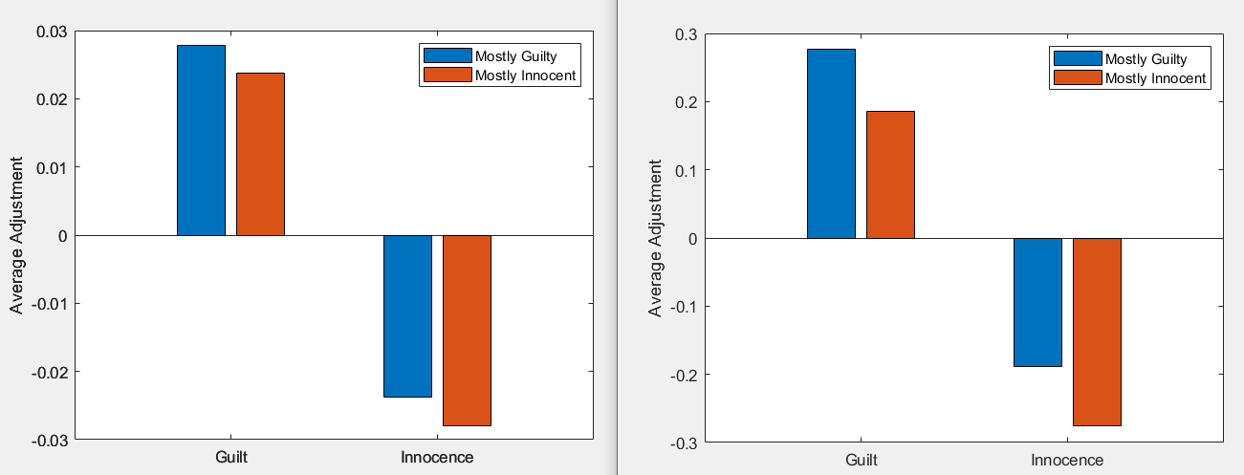
Delta model, prior = 0.5, split = 0.6, average adjustments over 600 sequences
Beta = 1, alpha = 0.1
Beta = 13, alpha = 0.1
Beta = 1, alpha = 0.1
Beta = 1, alpha = 0.9
Note y axis scale, beta shrinks adjustment size (as shown in Matteo’s PDF) but leaves pattern of responses to confirmatory versus disconfirmatory claims intact
Increasing alpha appears to create opposite pattern: adjustments are (somewhat) increased to confirmatory, rather than disconfirmatory samples

Slide 7
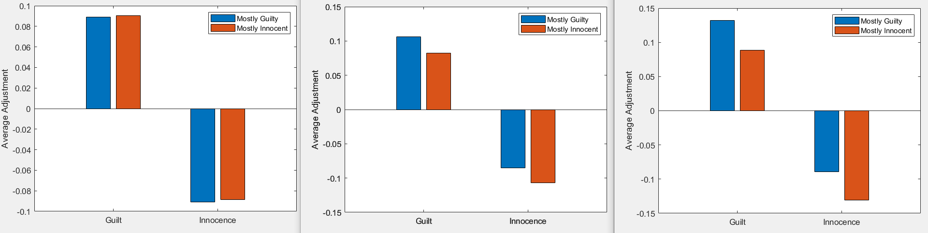
Time window model, prior = 0.5, split = 0.6, average adjustments over 600 sequences
Window = last Inf samples
Window = last 3 samples
Window = last 1 sample

