Slide 1
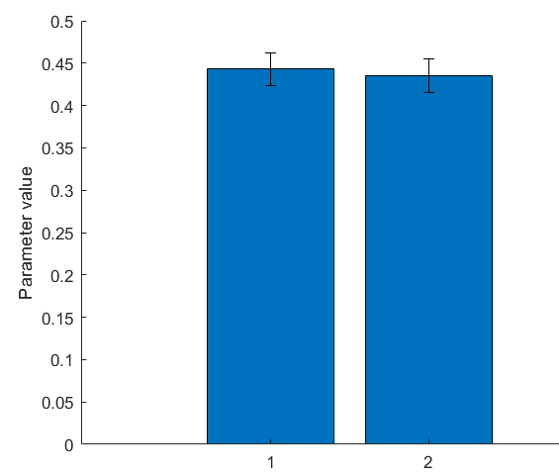
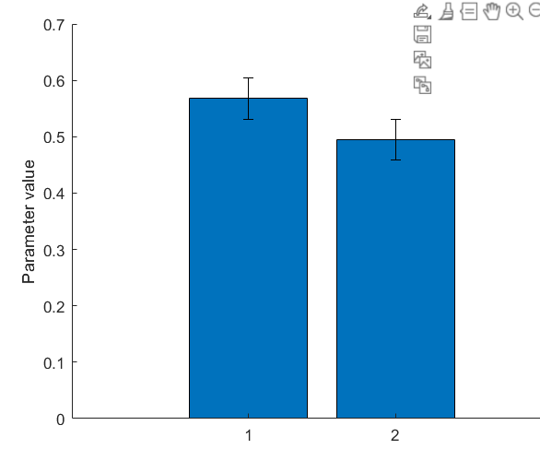
Study 1 (Atheist suspect = 1)
Study 1 (Male suspect = 1)

Slide 2
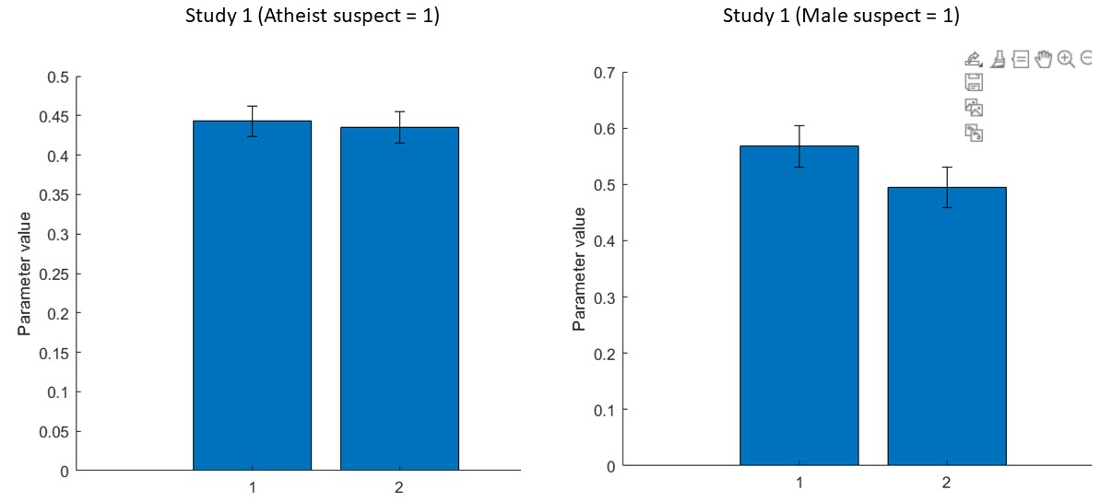

Slide 3
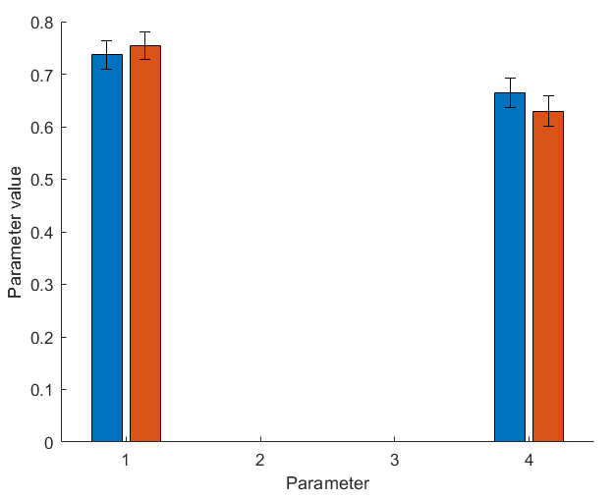
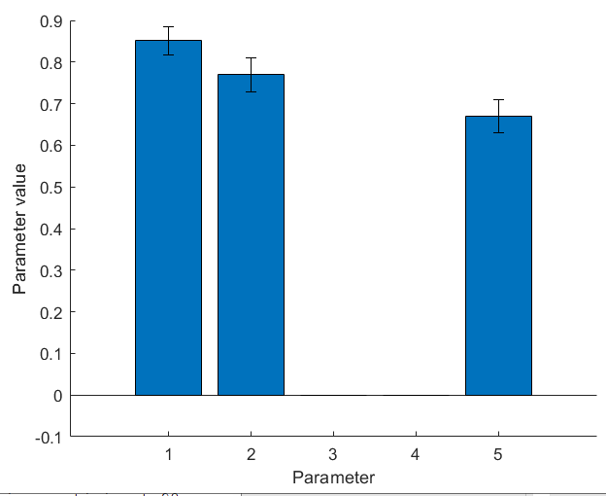
Study 1
Blue and orange bars are Suspect conditions)
Study 2
First two parameters are suspect conditions

Slide 4
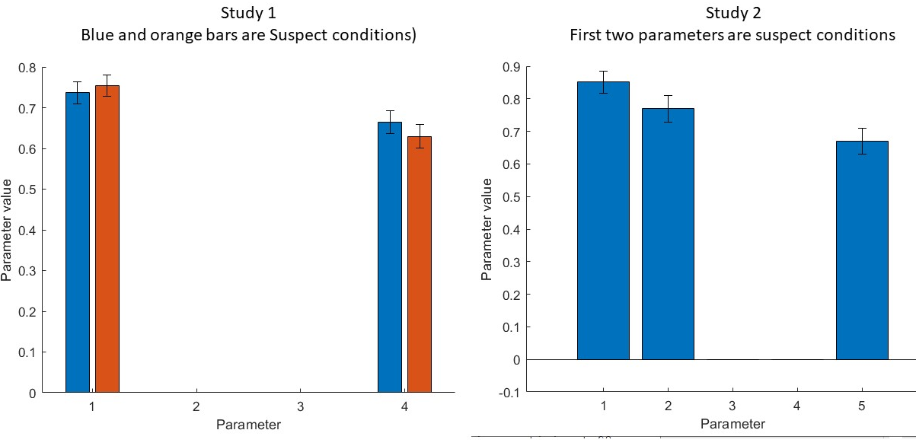

Slide 5
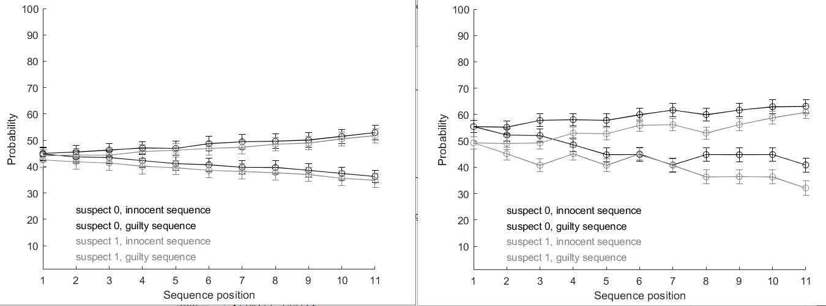
Study 1
Study 2

Slide 6
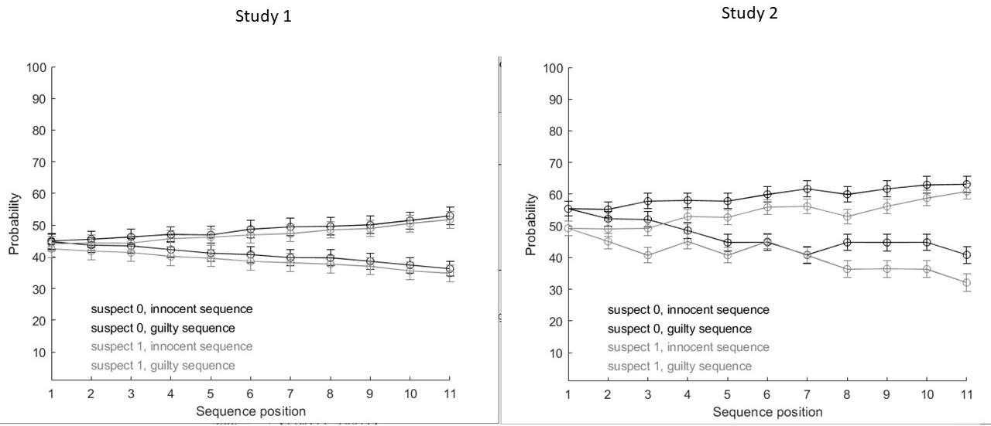

Slide 7
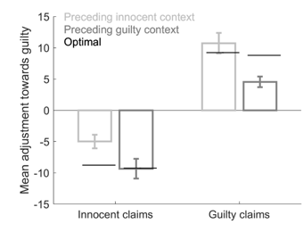

Study 1
Study 2

Slide 8
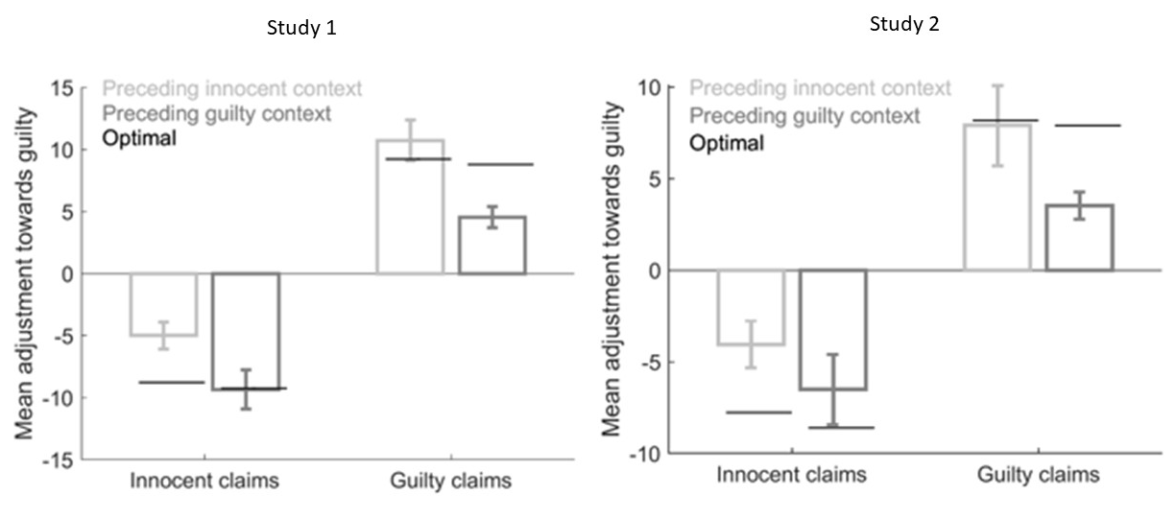

Slide 9
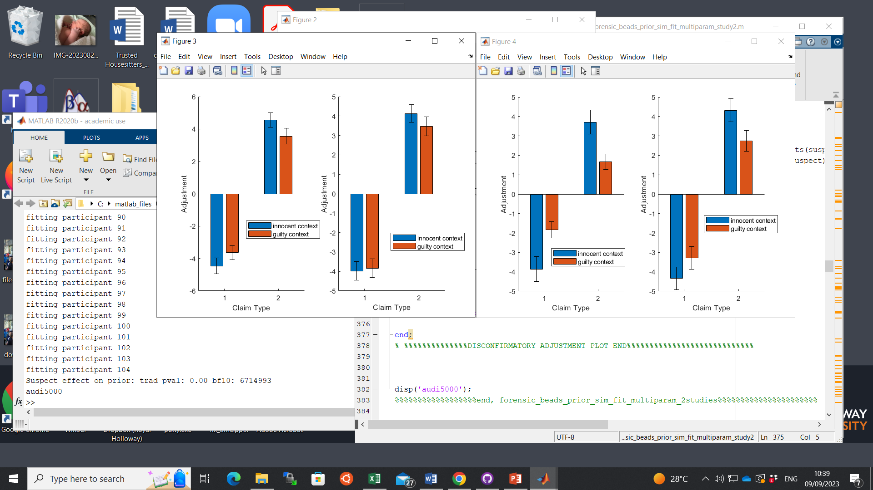
Study 1
Study 2
Atheist Suspect
Christian Suspect
Male Suspect
Female Suspect

Slide 10
