Slide 1
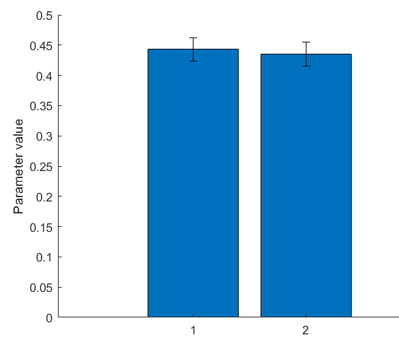
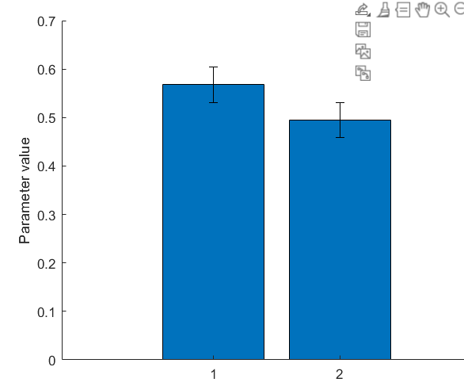
Study 1 (Atheist suspect = 1)
Study 1 (Male suspect = 1)

Slide 2
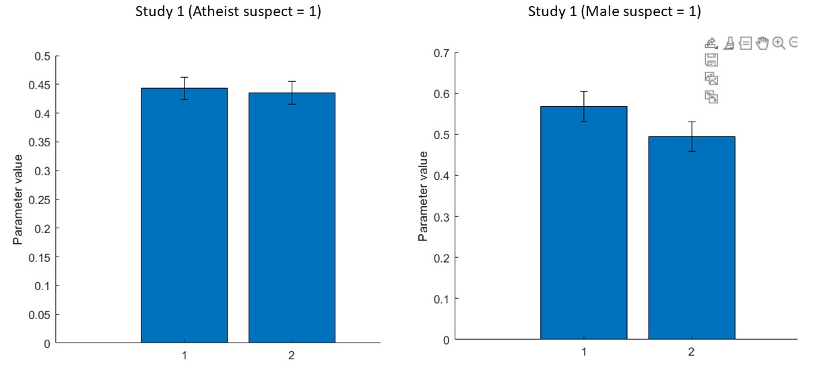

Slide 3
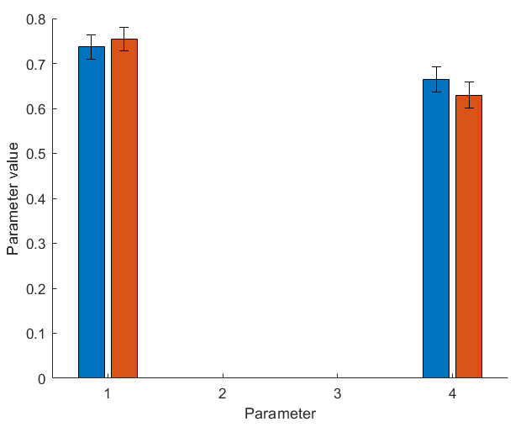
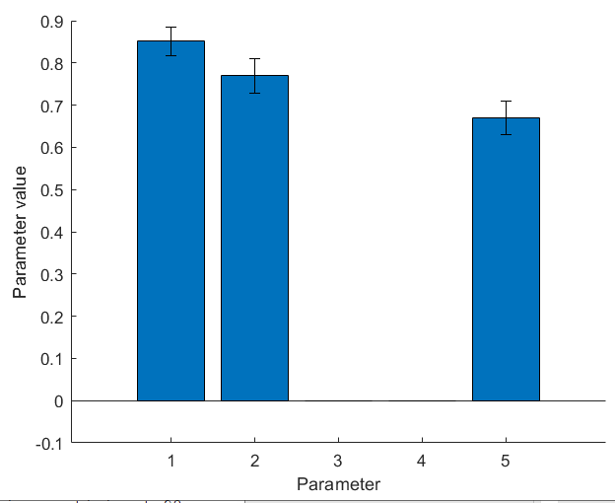
Study 1
Blue and orange bars are Suspect conditions)
Study 2
First two parameters are suspect conditions

Slide 4
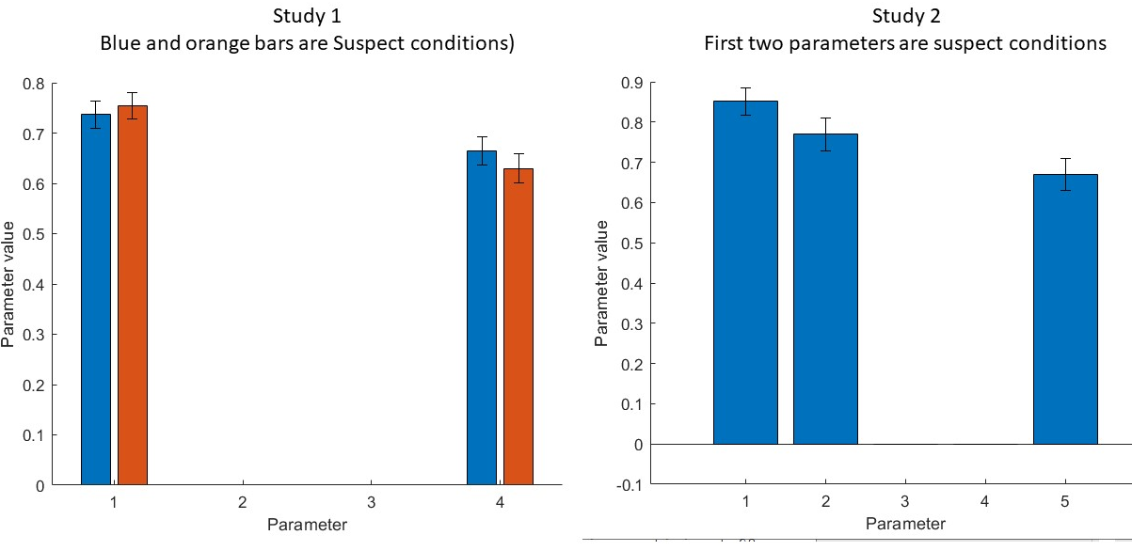

Slide 5
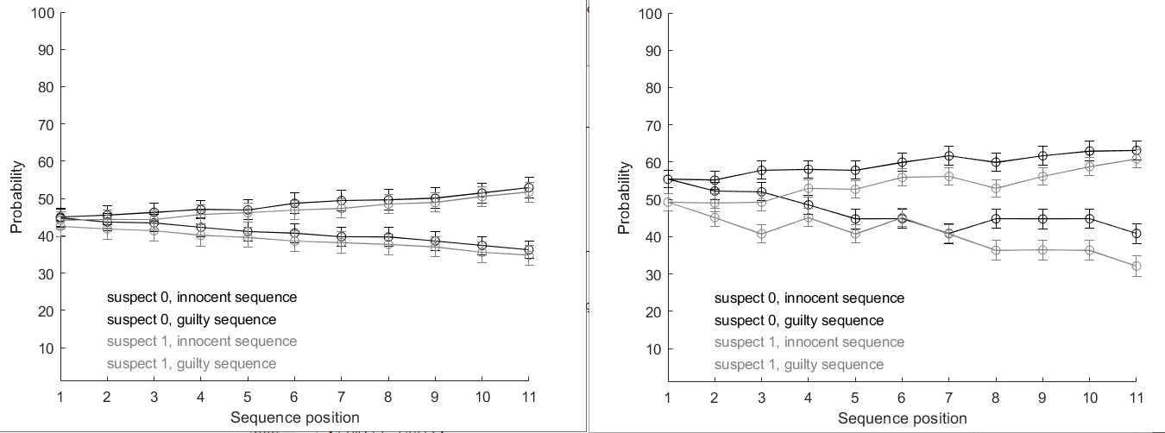
Study 1
Study 2

Slide 6
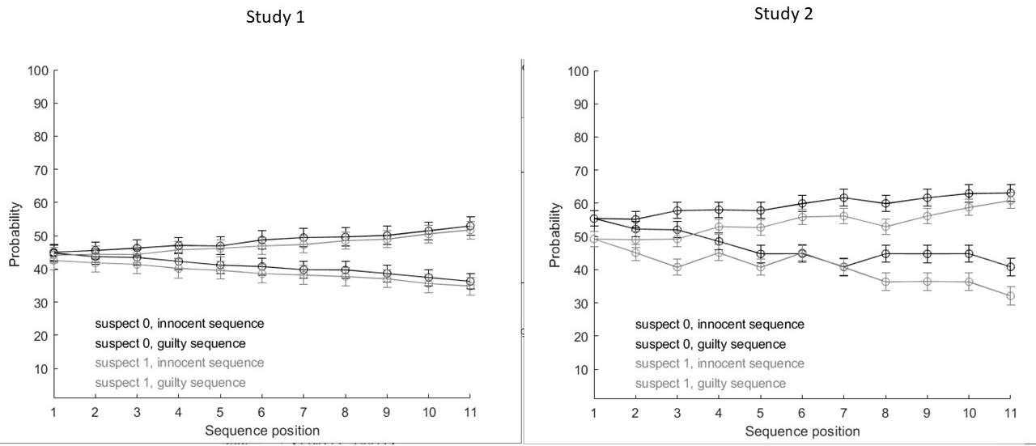

Slide 7
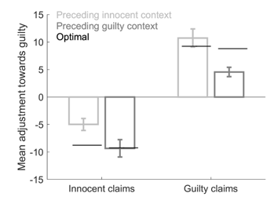

Study 1
Study 2

Slide 8
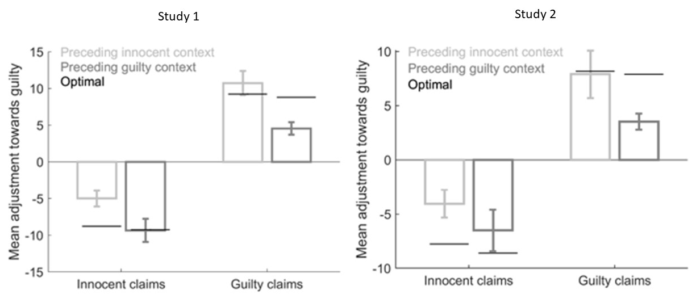

Slide 9
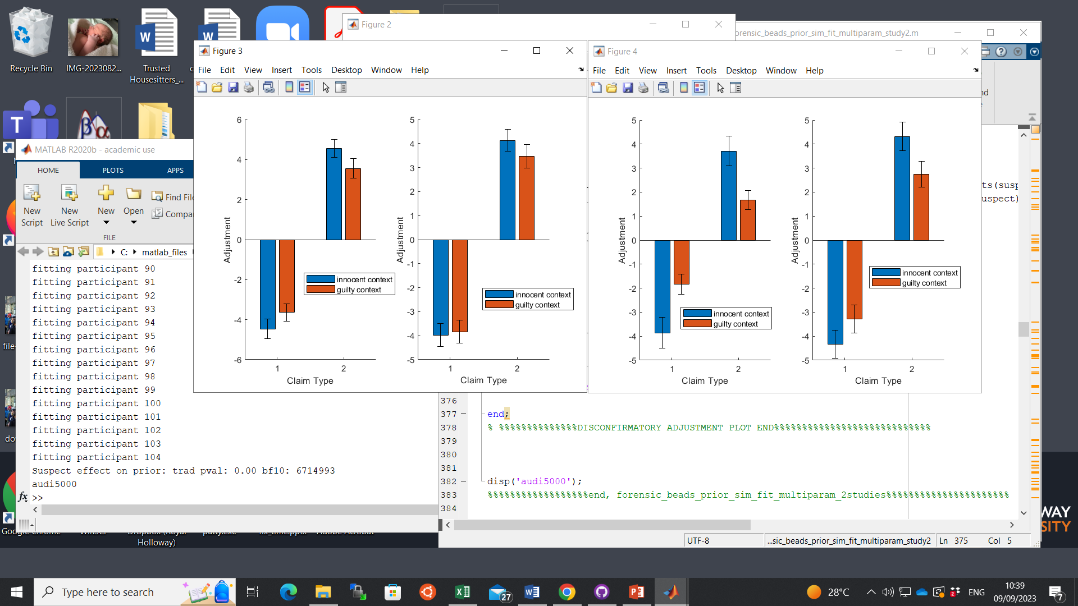
Study 1
Study 2
Atheist Suspect
Christian Suspect
Male Suspect
Female Suspect

Slide 10
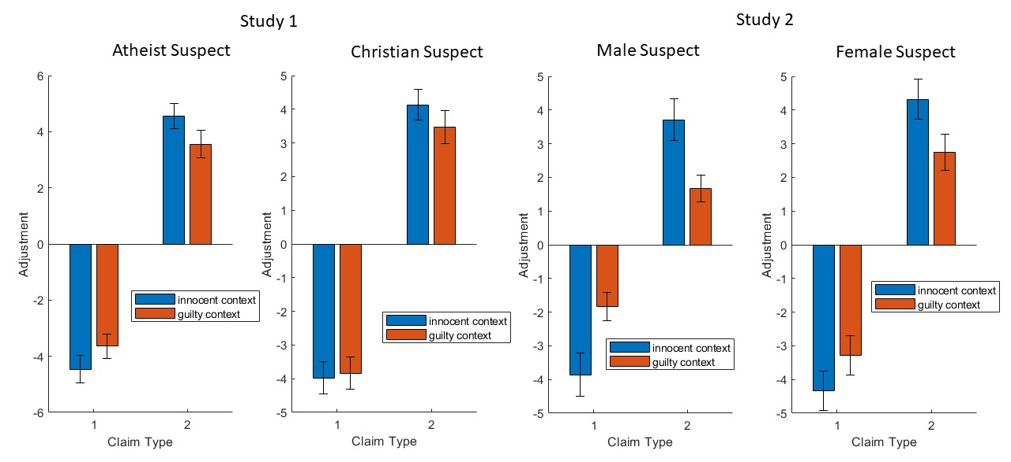

Slide 11
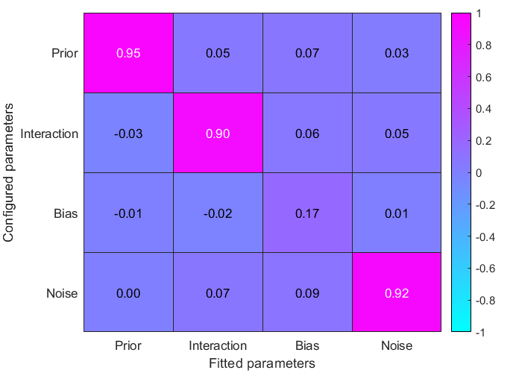
Study 1
config_prior = linspace(0,1,4);
config_interaction = linspace(0,50,4);
config_response_bias = linspace(0,1,4);
config_response_noise = linspace(0,1,4);

Slide 12
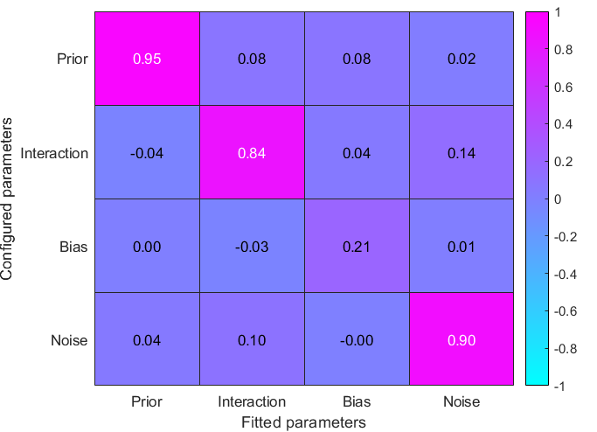
Study 2, but fitting one prior to all data (both suspects) using study 1 code
config_prior = linspace(0,1,4);
config_interaction = linspace(0,50,4);
config_response_bias = linspace(0,1,4);
config_response_noise = linspace(0,1,4);

Slide 13
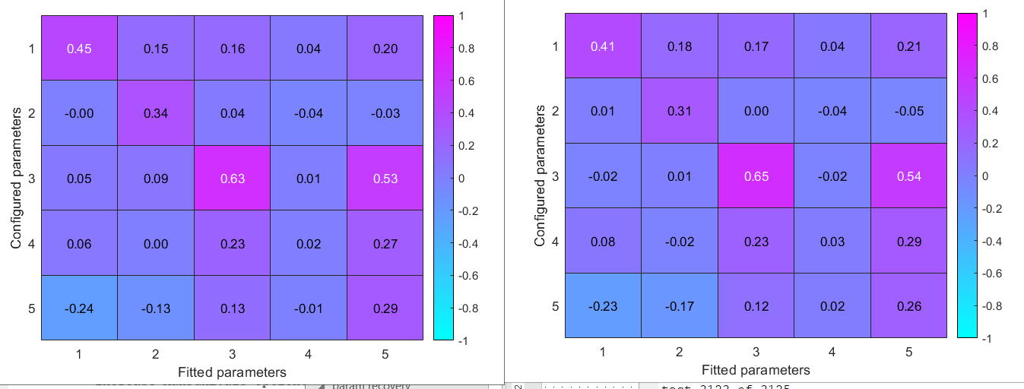
Correlation between fitted and configured probability ratings: r = 0.0272 p = 0.0000

