Slide 1
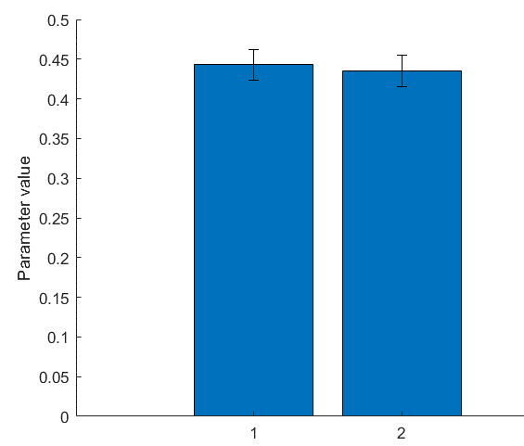
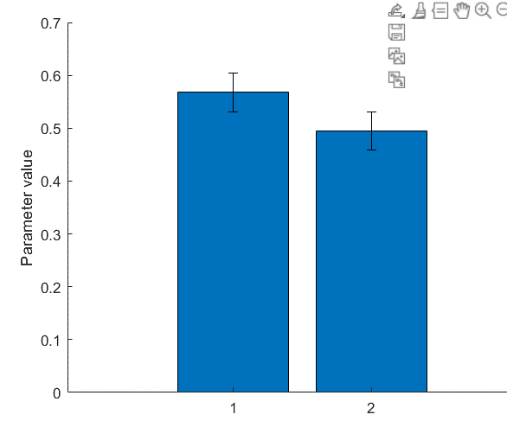
Study 1 (Atheist suspect = 1)
Study 1 (Male suspect = 1)

Slide 2
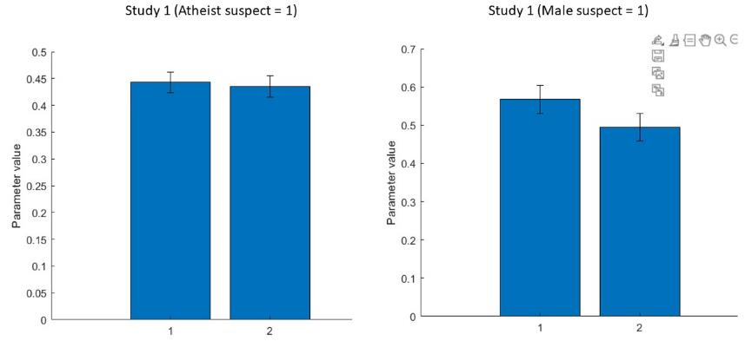

Slide 3
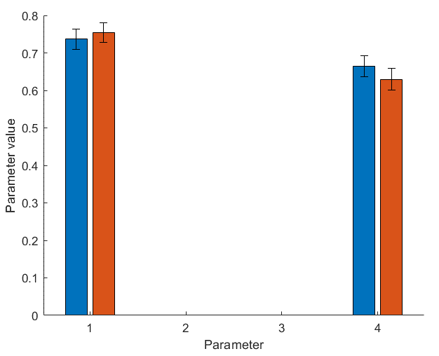
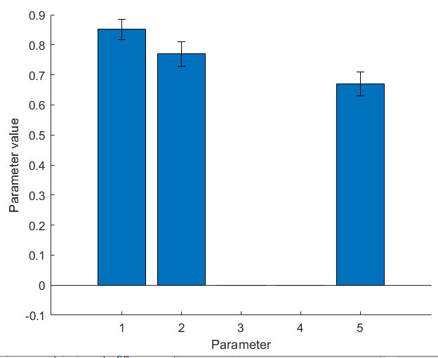
Study 1
Blue and orange bars are Suspect conditions)
Study 2
First two parameters are suspect conditions

Slide 4
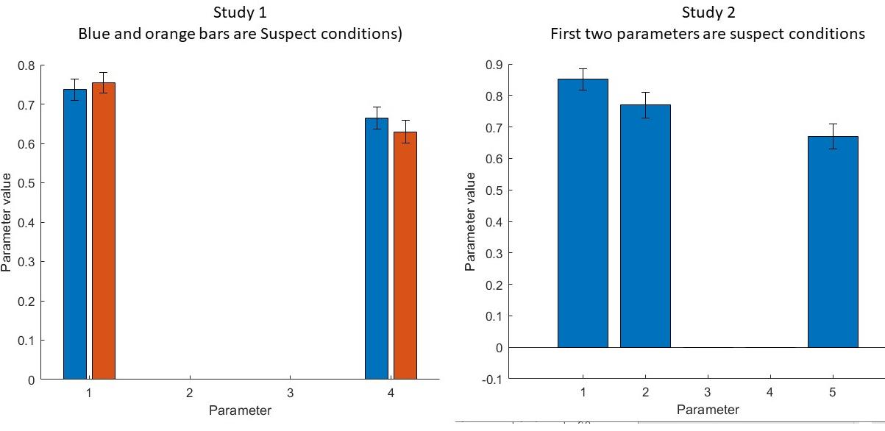

Slide 5
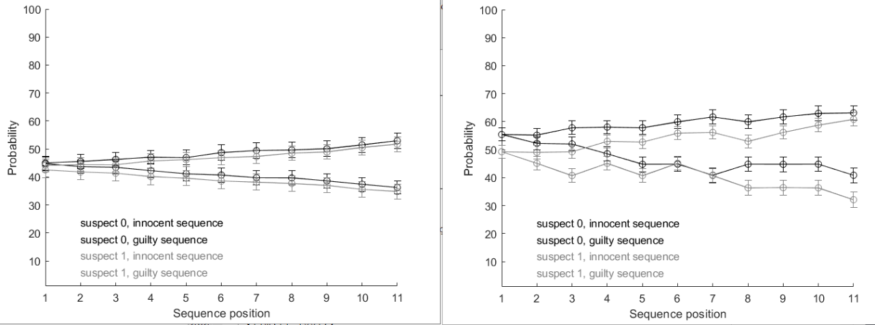
Study 1
Study 2

Slide 6
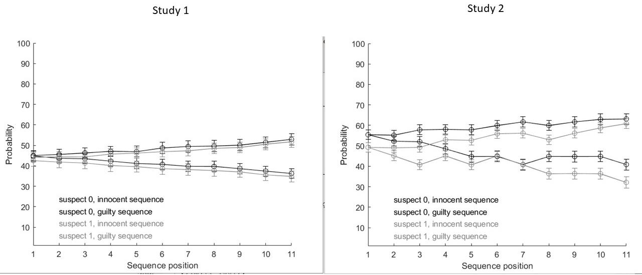

Slide 7
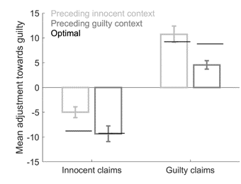
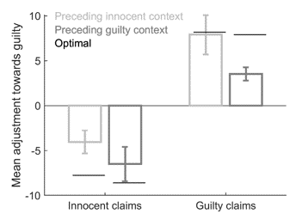
Study 1
Study 2

Slide 8
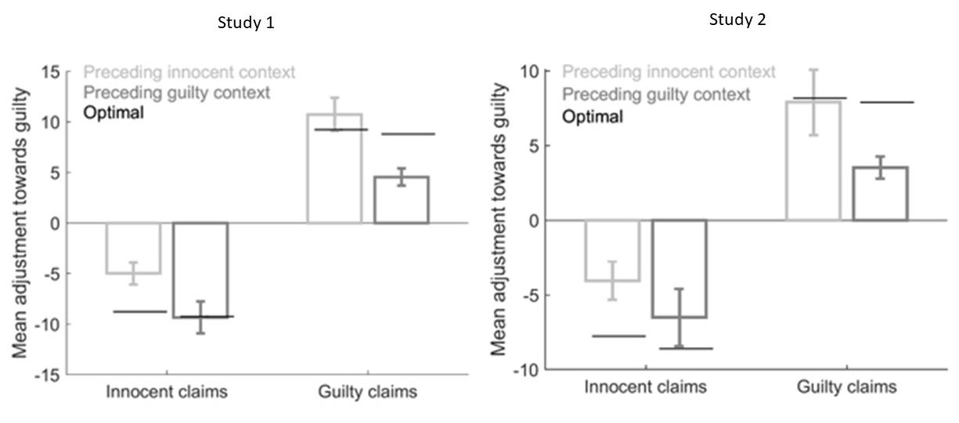

Slide 9
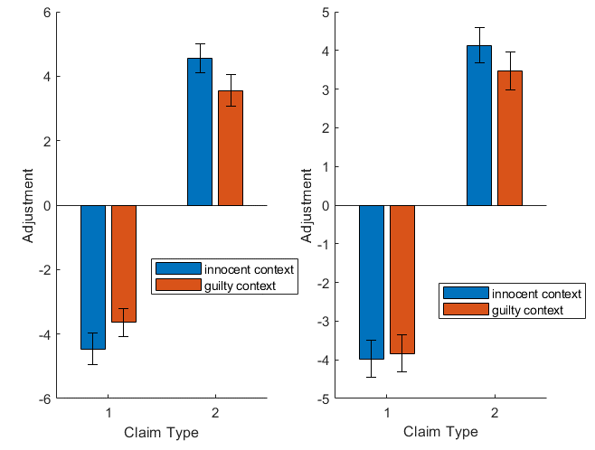
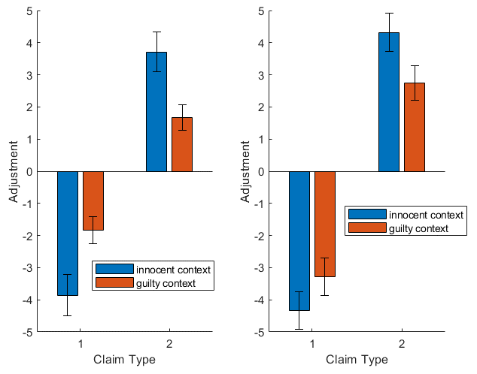
Study 1
Study 2
Atheist Suspect
Christian Suspect
Male Suspect
Female Suspect

Slide 10
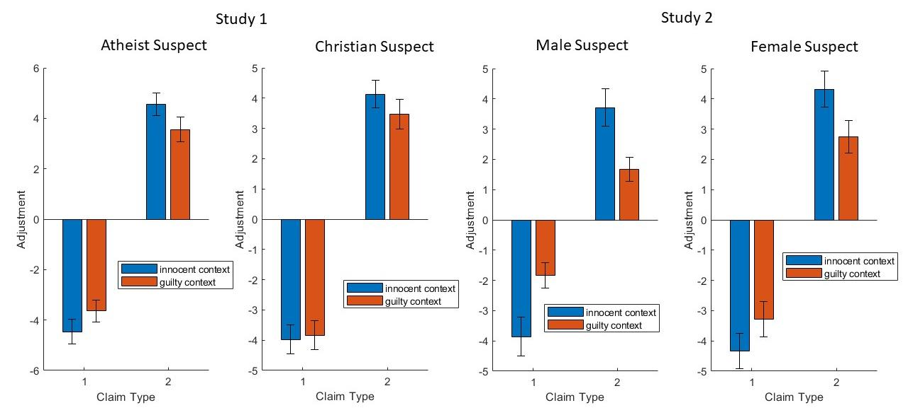

Slide 11
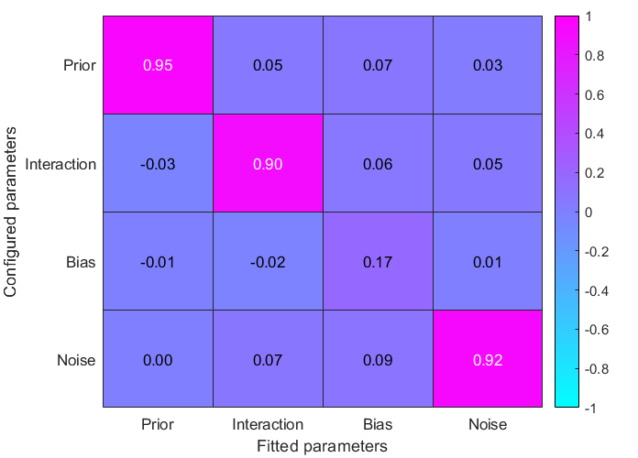
Study 1
config_prior = linspace(0,1,4);
config_interaction = linspace(0,50,4);
config_response_bias = linspace(0,1,4);
config_response_noise = linspace(0,1,4);

Slide 12
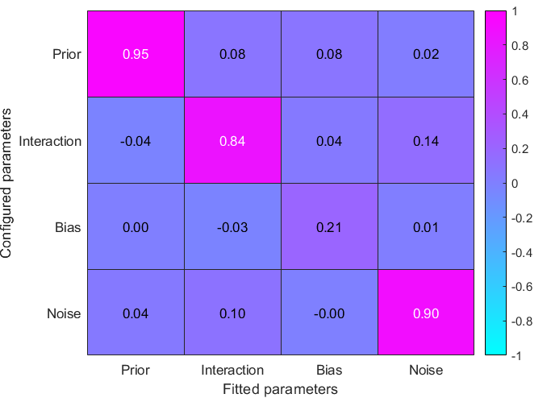
Study 2, but fitting one prior to all data (both suspects) using study 1 code
config_prior = linspace(0,1,4);
config_interaction = linspace(0,50,4);
config_response_bias = linspace(0,1,4);
config_response_noise = linspace(0,1,4);

Slide 13
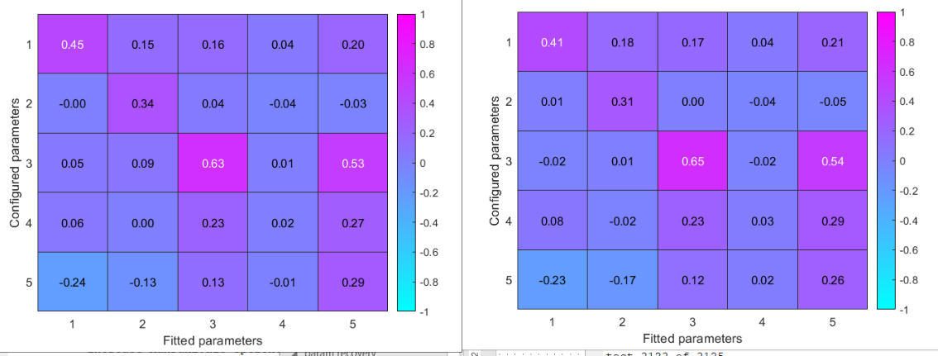
Correlation between fitted and configured probability ratings: r = 0.0272 p = 0.0000

Slide 14
Matteo meeting

Slide 15
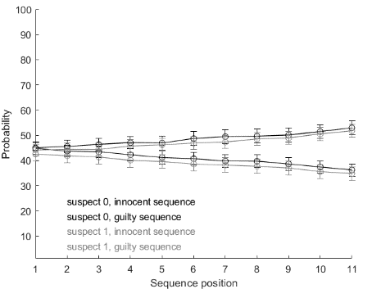
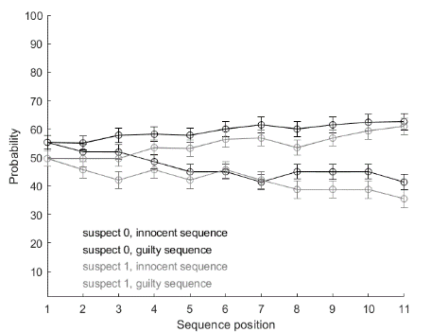
Study 1
Study 2

Slide 16
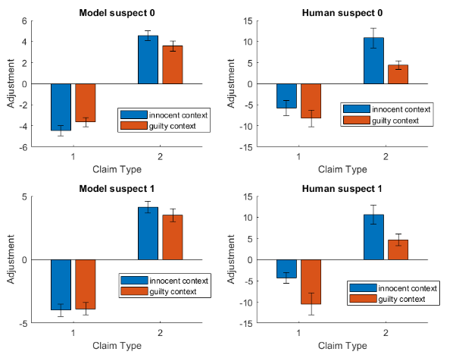
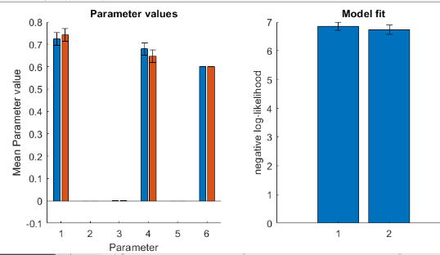
Study 1, prior (1), bias (3), noise (4), split (6) fixed

Slide 17
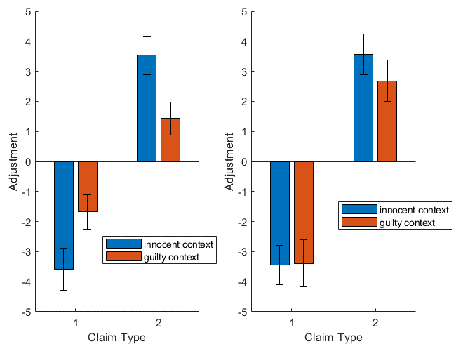
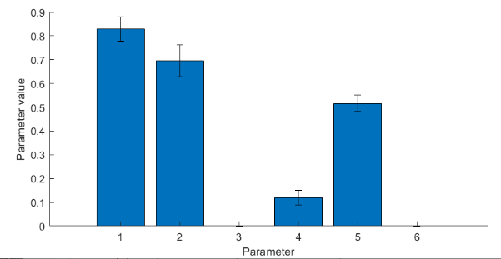
Study 1, priors for different suspects (1 and 2), bias (4), noise (5)
Suspect 0 (males)
Suspect 1 (females)

Slide 18
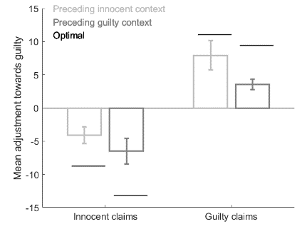

Slide 19
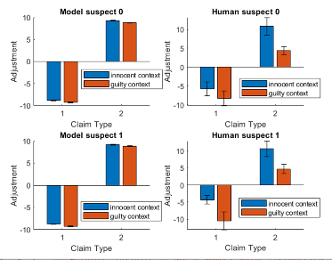
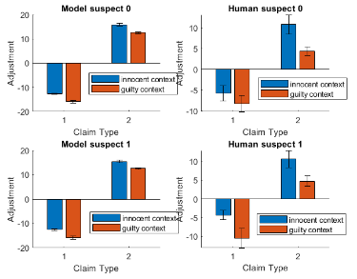
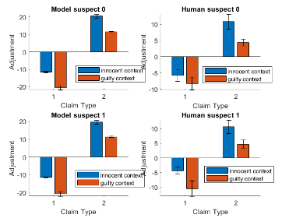
60/40 split
70/30 split
80/20 split

Slide 20
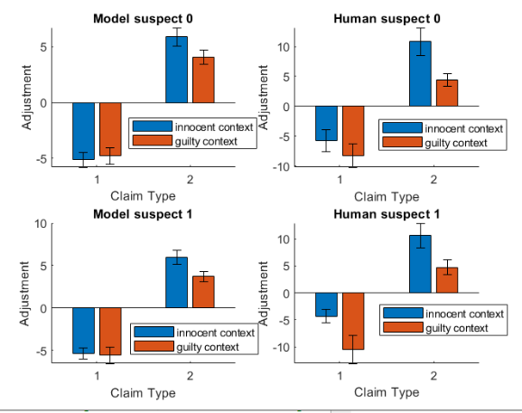
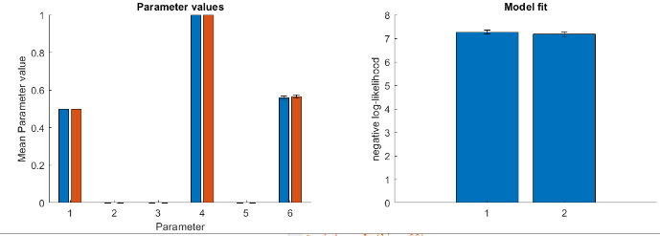
Study 1, prior (1), bias (3), noise (4) all fixed but split (6) free parameter
Blue atheist suspect
Red Christian suspect

Slide 21
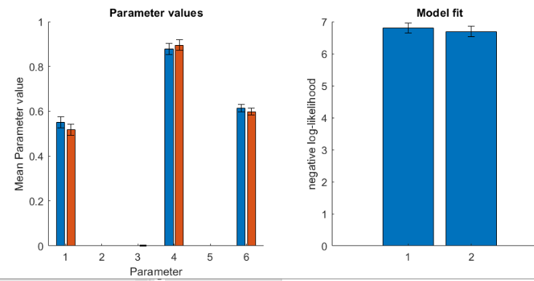
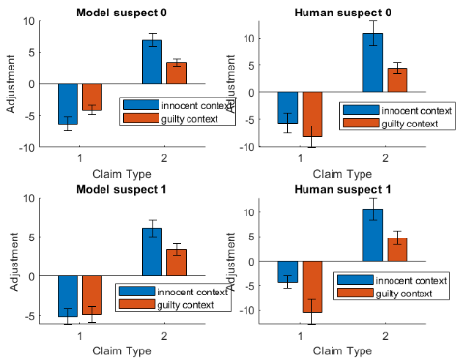
Study 1, prior (1), bias (3), noise (4), split (6) all free parameters

Slide 22
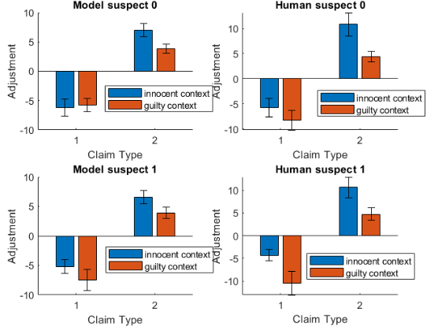
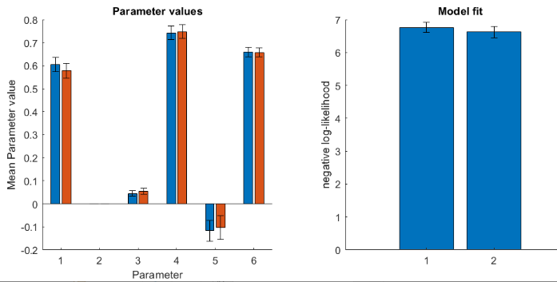
Study 1, prior (1), bias (3), noise (4), interaction (5), split (6) all free parameters

Slide 24
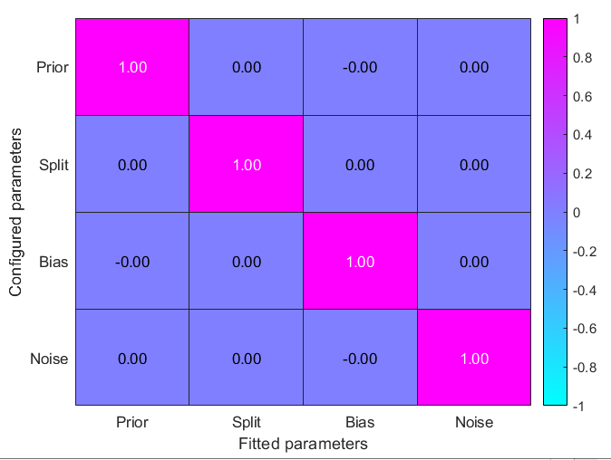
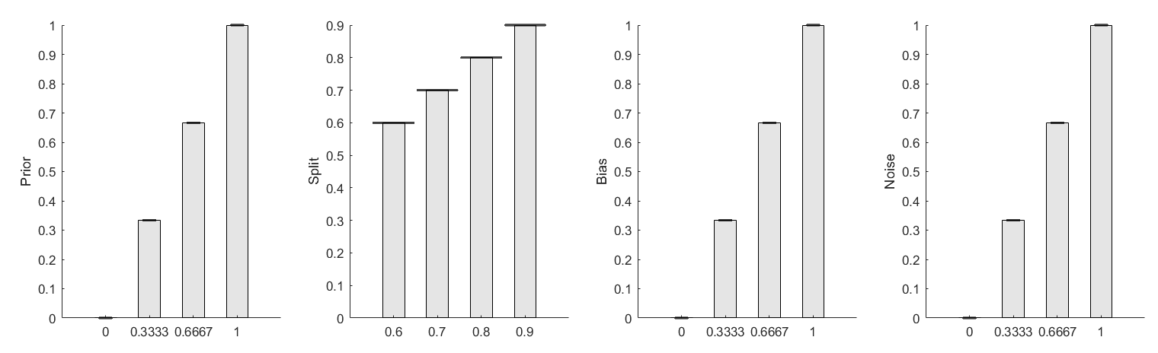
Study 2
(Study 1 takes a long time to run and get a new figure, but it looks exactly the same. Near-perfect recovery)

Slide 25
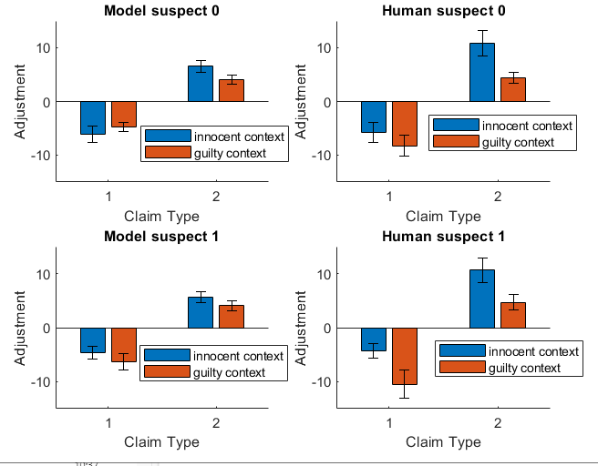

Slide 26
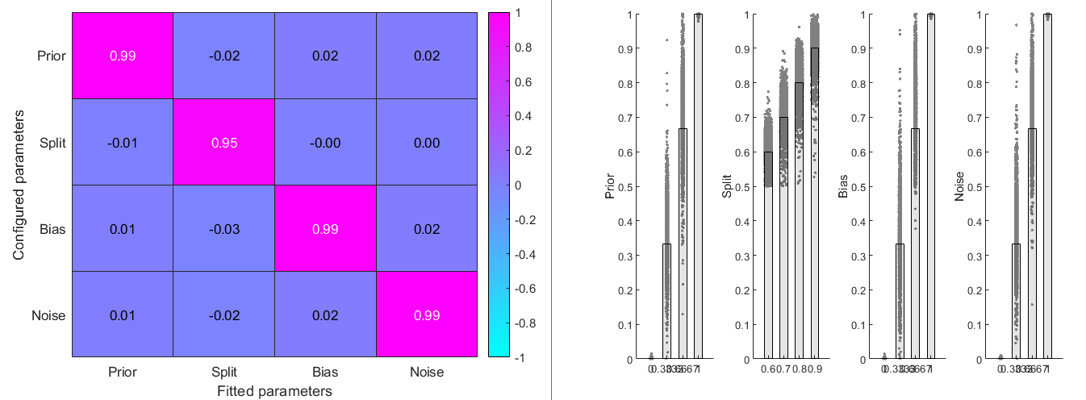
Study 1

Slide 27
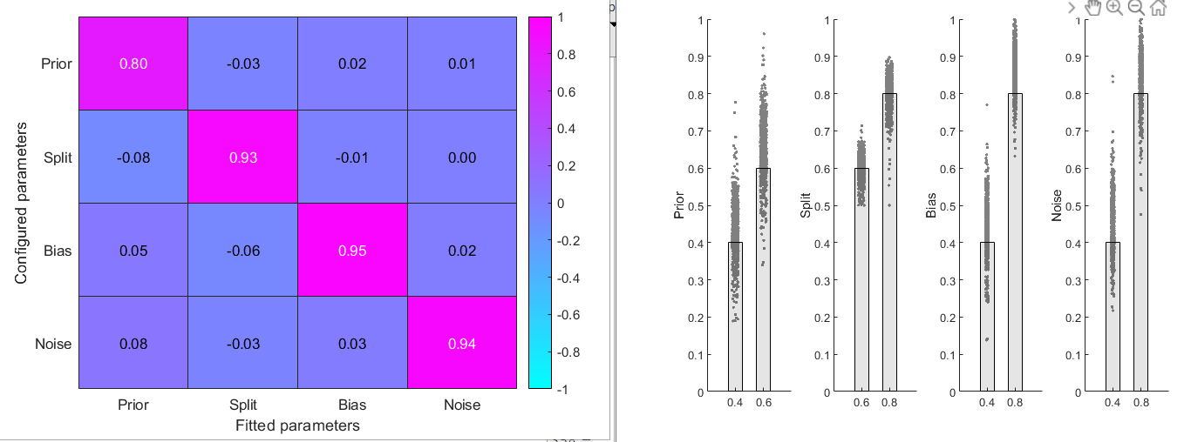
Study 2, four parameter (i.e., one suspect) model, small sim

Slide 28
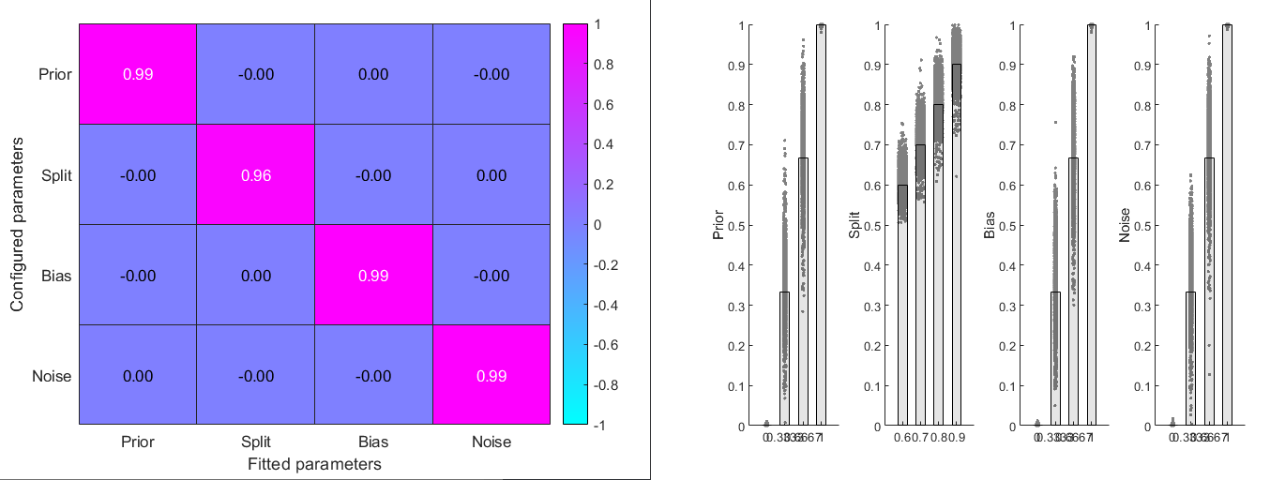
Study 2, four parameter (i.e., one suspect) model, bigger sim

Slide 29
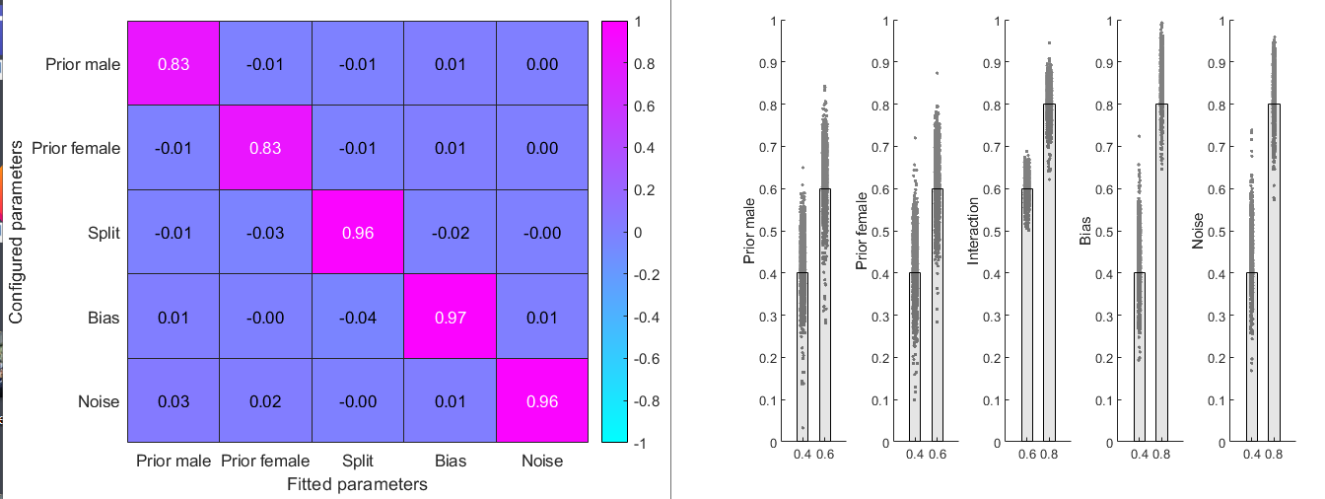
Study 2 two prior, within/subjects model, small sim

