Slide 1
Does the Land Bank Affect School Results?
Originally we were trying to use Ohio Government Data
There is no API, and the website is not great
Fortunately NEOCANDO has test scores by neighborhood
There are multiple tests for 3rd, 4th, 5th, 6th, 7th, 8th, 10th, and 11th grades for years 2010-2016
For all neighborhoods we’re testing, I averaged the scores This allows us to compare them
The graph is on the next page
Note the precipitous drop in 2016 was state-wide, they had to change graduation requirements

Slide 2
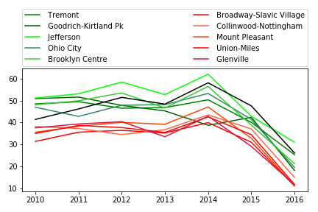

Slide 3
It does not look like the Land Bank Affects Test Scores
But does the math back that up?
To do that I copied the relevant neighborhood scores into a file, got rid of the noise by subtracting the mean suburban score from that year, and did a t test.
Ttest_indResult(statistic=array([9.35983265, 6.11359353, 5.17652858, 7.45770055, 2.21798661, 5.26095049, 4.46843839]), pvalue=array([1.38787037e-05, 2.85170586e-04, 8.46342784e-04, 7.21148008e-05, 5.73619772e-02, 7.63622391e-04, 2.08755103e-03]))
In English: There is a .0000138 chance the land bank affected 2010 test scores, .000285 for 2011, .000846 for 2012, .0000721 for 2013, .0573 for 2014, .000763 for 2015, and .00208 for 2016
If we use 5% as our level of statistical significance, our result of no-result is statistically for every year except 2014

