Slide 1
Saccheri
The proof of Euclid V

Slide 2
Birth and Life
Born in Sanremo, Genoa (1667)
Entered Jesuit novitiate at 18
Acquired a Doctorate in Theology
Became an ordained priest at 27

Slide 3
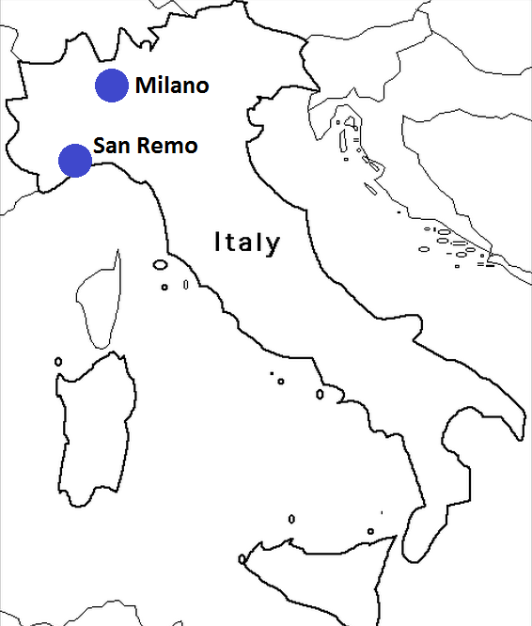

Slide 4
Life
He grew interested in Mathematics
Influence from a teacher
Eventually became the chair of Mathematics in the University of Pavia

Slide 5
Books
Logica demonstrativa
Neo-statica
Euclides ab omni naevo vindicatus (Euclid cleared of every defect)

Slide 6
Proof
He created a Saccheri quadrilateral and showed that the summit angles were congruent
He reasoned that they must either be obtuse, right, or acute.

Slide 7
His mistake
“The hypothesis of the acute angle is absolutely false; because it is repugnant to the nature of straight lines.”

Slide 8
References
http://galileo.rice.edu/Catalog/NewFiles/saccheri.html
http://www-history.mcs.st-and.ac.uk/Biographies/Saccheri.html
http://math.ups.edu/~bryans/Current/Journal_Spring_2002/300_EBarrat_2002.pdf
http://www.faculty.fairfield.edu/jmac/sj/sacflaw/sacther.htm

