Slide 1
Applications of Machine Learning to Pairs Trading
Nicholas Kim

Slide 2
ABSTRACT
Trading in financial markets is an ever-present part of modern society, driving the fundamental aspects of price discovery and liquidity. Countless strategies for efficient trades exist today, with one of the most popular being a form of statistical arbitrage known as "pairs trading".
A pairs trading strategy aims to find stocks that are highly cointegrated, and uses the mean reverting nature of such pairs to predict price movements
While deceptively simple, pairs trading in practice is quite difficult to profitably implement.
Many approaches rely simply on observing the difference between the pair’s price on a given day, the historical difference, and an implementation of a manual threshold
Such approaches have high propensity for false trading signals, and fail to make use of a plethora of other highly rich data sources
We seek to explore applications of machine learning to generate more reliable trading signals. We present an analysis of two strategy approaches - one based on difference halving, the other on velocity reversals

Slide 3
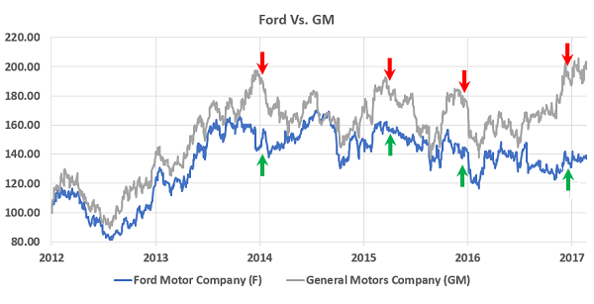
BACKGROUND AND APPROACH
A Simple Example of an Optimal Pairs Trading Strategy for Ford and GM
Optimal trades occur at the “maximum split” points, right before the prices begin to correct. The question becomes how to best predict the start of a reversal.

Slide 4
How to predict profitable trading times with ML technques?
Dataset: Quantopian Morningstar Pipeline – Includes thousands of highly traded US equities
First Task – Deriving a dataset of highly cointegrated stocks
Many potential ways to go about. For instance, raw cointegration tests could be computed between the equities in the dataset, and some percentage threshold of cointegration could be used
However, approach runs into many issues. 1) Computationally expensive 2) Arbitrary Separations 3) Lack of global consistency. Too many idiosyncrasies in comparing only specific pairs one at a time
Solution – DBScan Clustering (from open source Quantopian code)

Slide 5
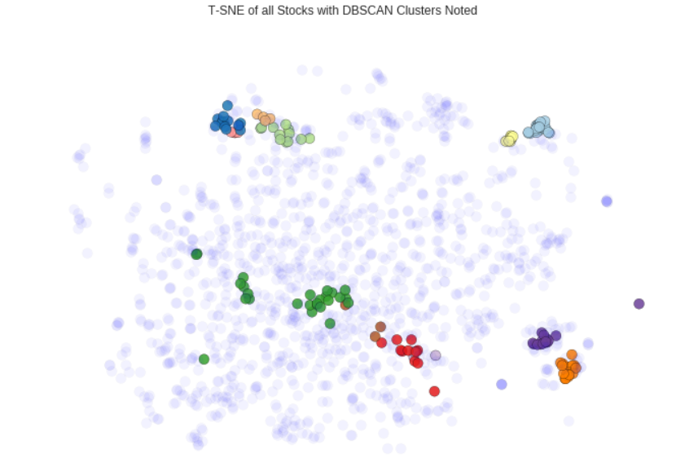
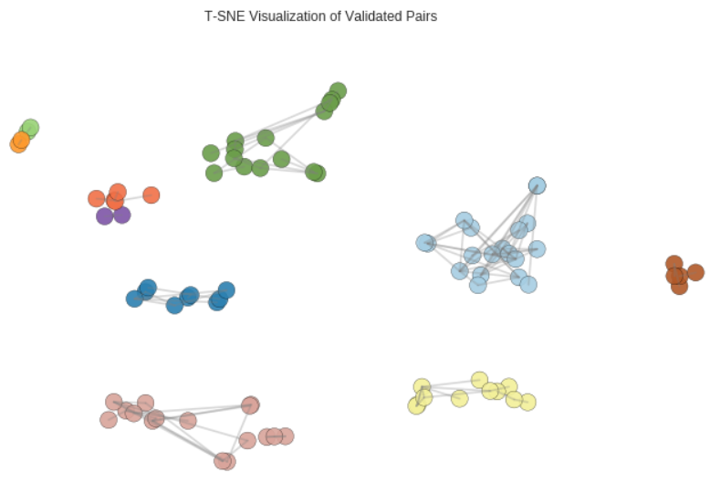
Convert prices into returns to capture percentage changes
Apply principal component analysis to reduce dimensionality of data (since there are prices for hundreds of days, this creates extremely high dimensional data)
Apply DBSCAN algorithm, which automatically finds an optimal number of clusters and does not include data points that do not fit well into any cluster.

Slide 6
COMPARING AND EVALUATING
Sample Strategies for Comparison
1) Buy and Hold – How does a given strategy compare to a simple hold of the two equities in a pair?
2) Rudimentary Algorithmic Pairs Trading – Find a historical mean difference, and then establish a valid trading signal whenever the mean difference is more than a certain % (in this case 30) away from the historical
METRICS
Returns – The percentage change in value of one’s portfolio
Profitability – Percentage of trades that were profitable
Volatility – Standard deviation of returns
Sharpe Ratio – Risk adjusted returns, defined as (returns – risk-free returns)/Volatility
Maximum Drawdown – The worst trade executed by a given strategy

Slide 7
STRATEGY 1) – SVM Applied to Return Difference Velocity
A Classification Problem Approach - Determining whether or not it would be profitable to enter a trade at a given time
Issues – 1) Target Labels 2) Features
Target Label – Return difference halves in the next 80 trading days.
Observe the difference between the log returns of the two equities in the pair
If this difference halves in the next 100 trading days, then we consider it safe to enter into a trading position
Main Feature – 20-day Trailing Velocity of Return Difference
First, the difference in log returns is derived between the two pairs
Then, the percentage change in this difference is calculated for each day
Then, for any given day where we are trying to predict the trading signal, we use the past 20 days of trailing returns

Slide 8
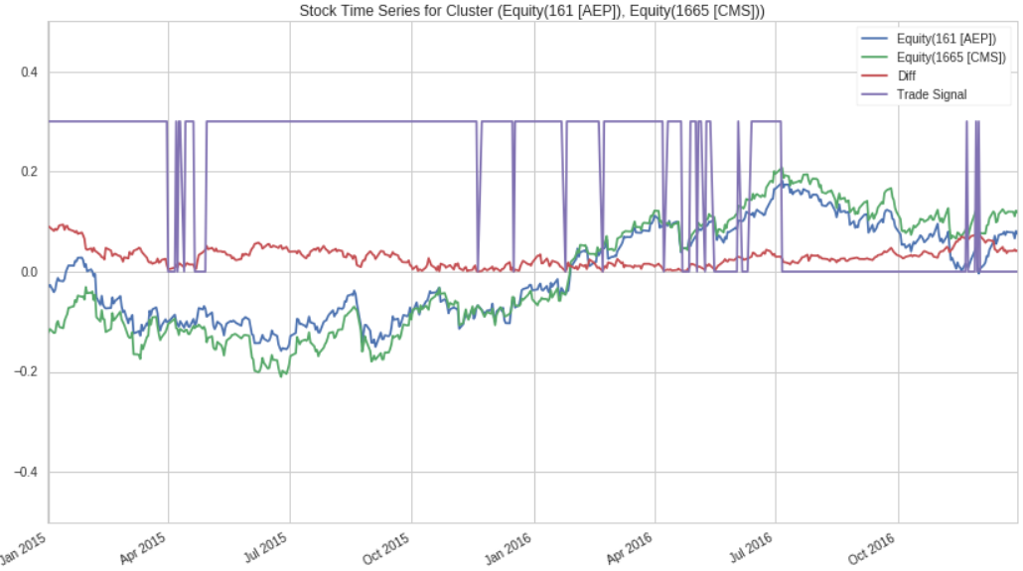
Illustration of Derived Features for Pair AEP, CMS
SVM was applied to the classification problem with an 80:20 train:test split applied to the valid pairs
In the test set, SVM managed to achieve 77.67% Accuracy in determining “difference halving” scenarios

Slide 9
Converting Signals Into A Testable Trading Strategy
Now for a given time series, we are able to sequentially predict whether or not it is safe to open a trade. However, this is far from a testable strategy, since one does not have infinite money to trade
An algorithm to test was decided with a minimalistic framework. This was applied and averaged over all equity pairs in the test set to obtain evaluation metrics.
1) Check to see if it is valid to open a trade
2) If it is valid, then the strategy assumes that all of one’s initial capital is dumped into the trade
3) If the return difference halves within the next 100 days, close the trade and collect the returns
4) If the return difference fails to half, then the trade is automatically closed after 100 days to cut potential losses

Slide 10
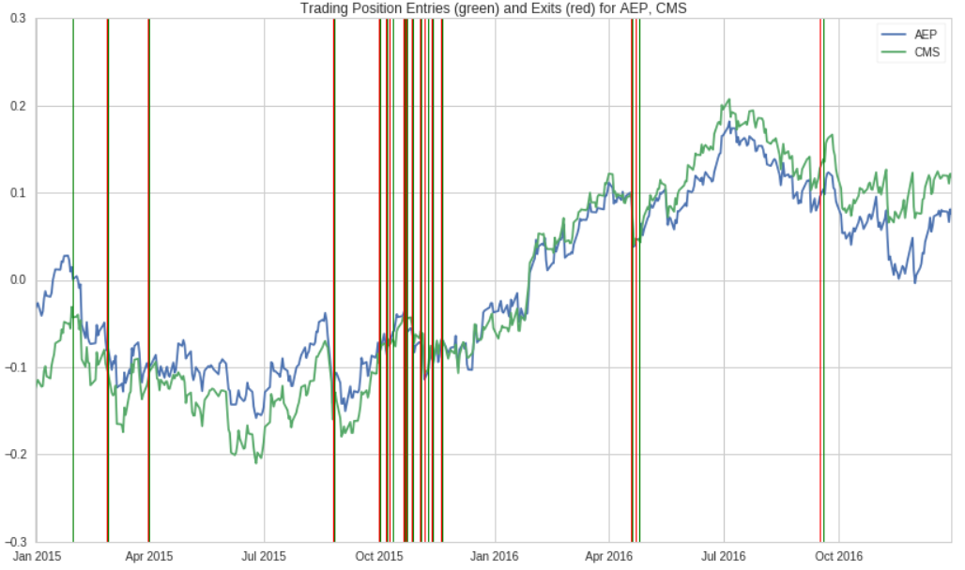
Trading Strategy Avg Returns 1.0671
Buy and Hold Avg Returns 1.2196
Risk-Free Returns 1.0066
Percentage of Profitable Trades 0.9071
Volatility of Returns 0.04733
Worst 10 Trades Avg -0.05806
Single Worst Trade -0.1067
Sharpe Ratio 1.4149
Simple Algorithmic Pairs Returns – 1.0821

Slide 11
STRATEGY 2) – Decision Tree Classifier Applied to Difference Moving Average Reversal
Modified Problem Approach - Determining whether or not it would be profitable to enter a trade at a given time, purely based on velocity factor
Issues – 1) Target Labels 2) Features
Target Label – The average 20-day trailing difference velocity is positive, and the future 20-day velocity is negative.
Observe the difference between the past 20 days of “difference returns”, or percentage changes in differences
If at any point there is a positive past and negative future, then we consider it safe to enter into a trading position
Main Features – Historic Mean Diff, Difference, 20-day trailing velocity, Difference Acceleration
Calculate mean of all past instances of return differences
Acceleration comes from taking the second derivative of difference movements

Slide 12
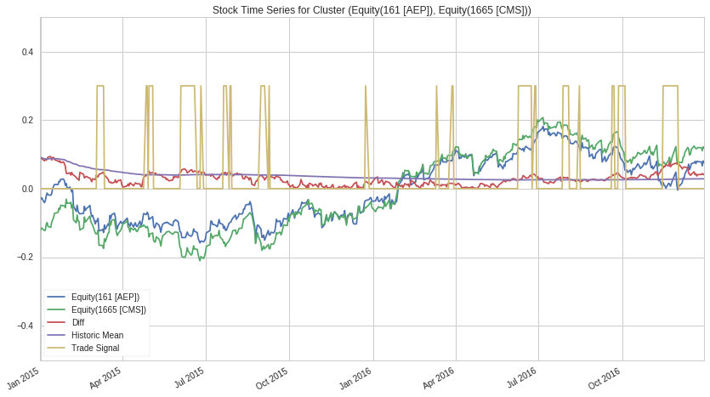
Illustration of Derived Features for Pair AEP, CMS
DT was applied to the classification problem with an 80:20 train:test split applied to the valid pairs
In the test set, DT managed to achieve 91.90% Accuracy in determining “Velocity Reversing” scenarios

Slide 13
Converting Signals Into A Testable Trading Strategy
Now for a given time series, we are able to sequentially predict whether or not it is safe to open a trade. However, this is far from a testable strategy, since one does not have infinite money to trade
An algorithm to test was decided with a minimalistic framework. This was applied and averaged over all equity pairs in the test set to obtain evaluation metrics.
1) Check to see if it is valid to open a trade
2) If it is valid, then the strategy assumes that all of one’s initial capital is dumped into the trade
3) If the past 20 days have a negative rate of movement, then it is safe to trade.
4) If the return difference fails to half, then the trade is automatically closed after 100 days to cut potential losses

Slide 14
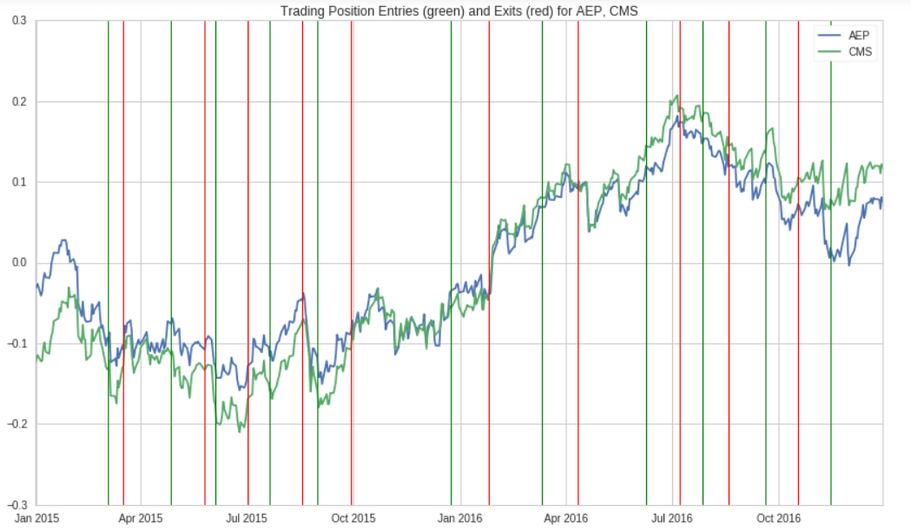
Trading Strategy Avg Returns 1.114
Buy and Hold Avg Returns 1.2196
Risk-Free Returns 1.0066
Percentage of Profitable Trades 0.915
Volatility of Returns 0.04023
Worst 10 Trades Avg -0.00515
Single Worst Trade -0.00882
Sharpe Ratio 2.54
Simple Algorithmic Pairs Returns – 1.0821

Slide 15
CONCLUSIONS
Machine Learning shows some promise in being able to derive profitable trading strategies, even with relatively simple indicators
The results, while safe, seem to not generate high amounts of excess returns, and often seem to fall short of buy-and-hold strategies
Trading based off of a velocity reversal indicator seems superior to pair halving, with higher returns, safer maximum drawdowns, better risk-adjusted returns, and a higher percentage profitability. We note the incredibly low levels for maximum drawdown as well.
Work remains to be done in automating more of the feature and label engineering process. Numerous other trading strategies also ought to be explored.
Additional studies could include modifications for the assumptions made. Key flawed assumptions to explore include – full entry into each trade, lack of transaction costs, dividend payments.

