Slide 1
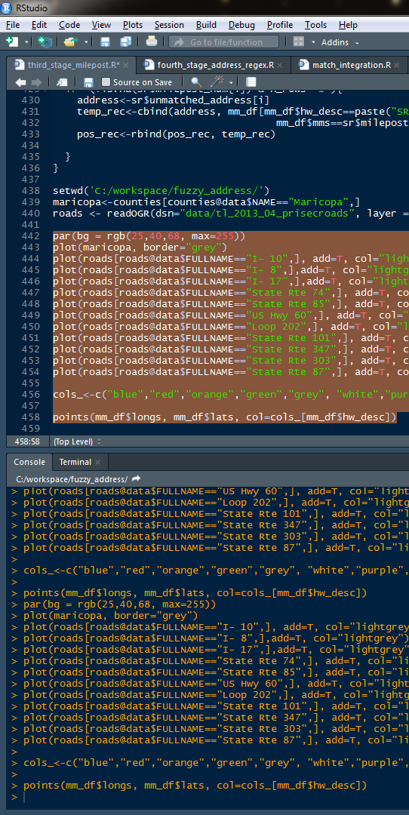
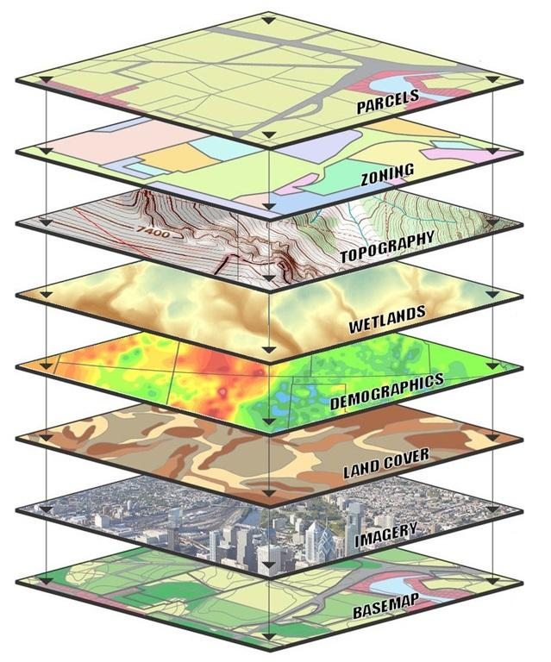
MVZ GIS in R Workshop
15 April 2019
Nick Mason
Ammon Corl
Phred Benham
Libby Beckman

Slide 2
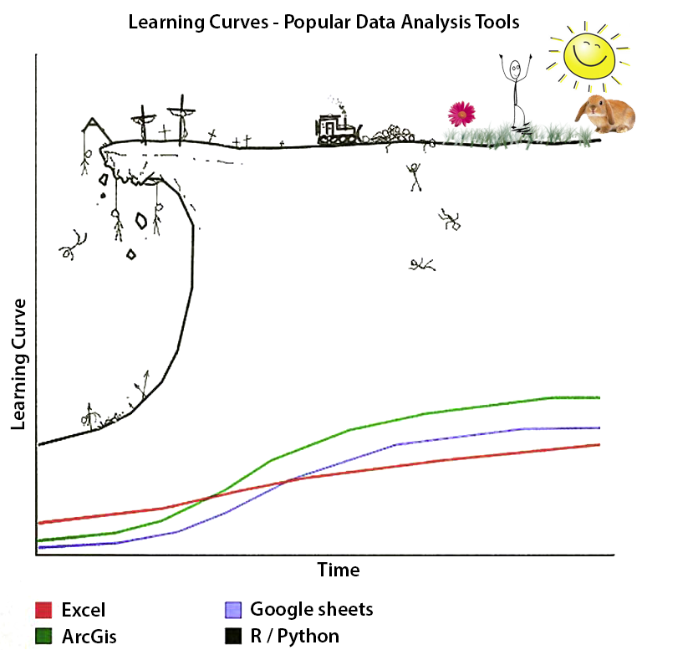

Slide 3
Why Learn GIS in R?
Specific to spatial data, R allows you to:
Create automated data cleaning workflows that crop, reproject, convert data formats across many, large datasets
Repeat workflows over and over without having to step through tasks
Repeat select portions of a workflow over and over if need be
Add new / updated data to your workflow easily if the processing workflow is robust (e.g. data sets that grow / mature over course of PhD)
Create figures that can be updated easily
Document your workflow to remind your future self about the steps that you took to implement your workflow

Slide 4
Outline
Basics of GIS
Data types: vector, raster, points
Projections and other attributes
GIS data in R
Available data: GADM, R Packages, other online sources
Reading in vectors, rasters
Plotting vectors, rasters
Figure generation
Tutorial of figure from Mason et al. (2017), Ecol Evol

Slide 5
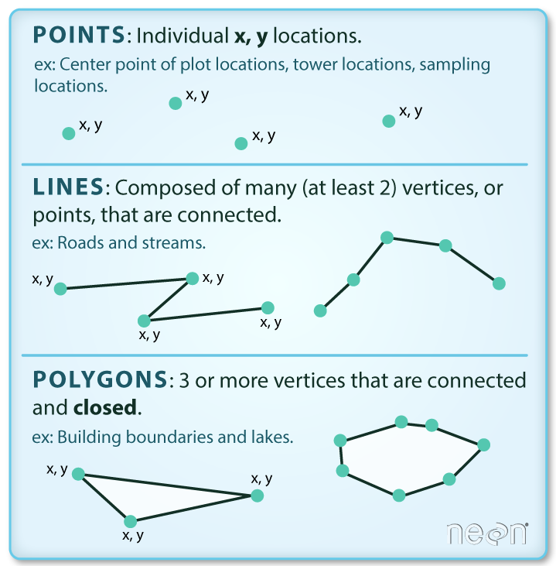

Slide 6
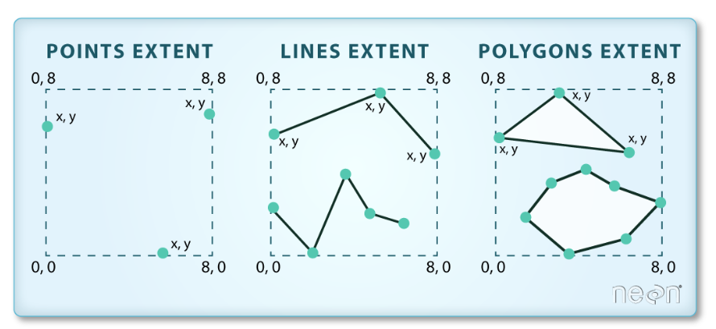
Vector Data Attributes
Extent
Associated data
Sex
Age
Taxonomy

Slide 7
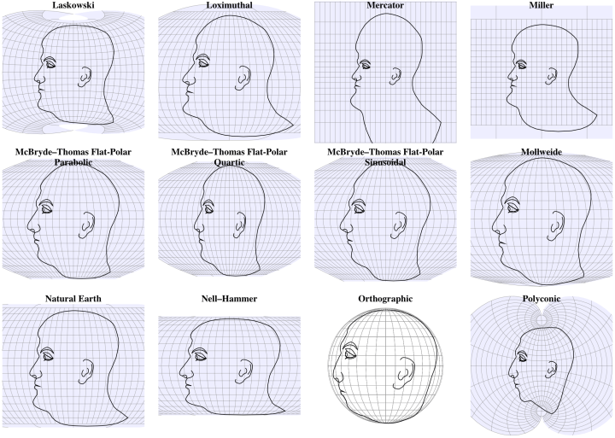
Projections

Slide 8
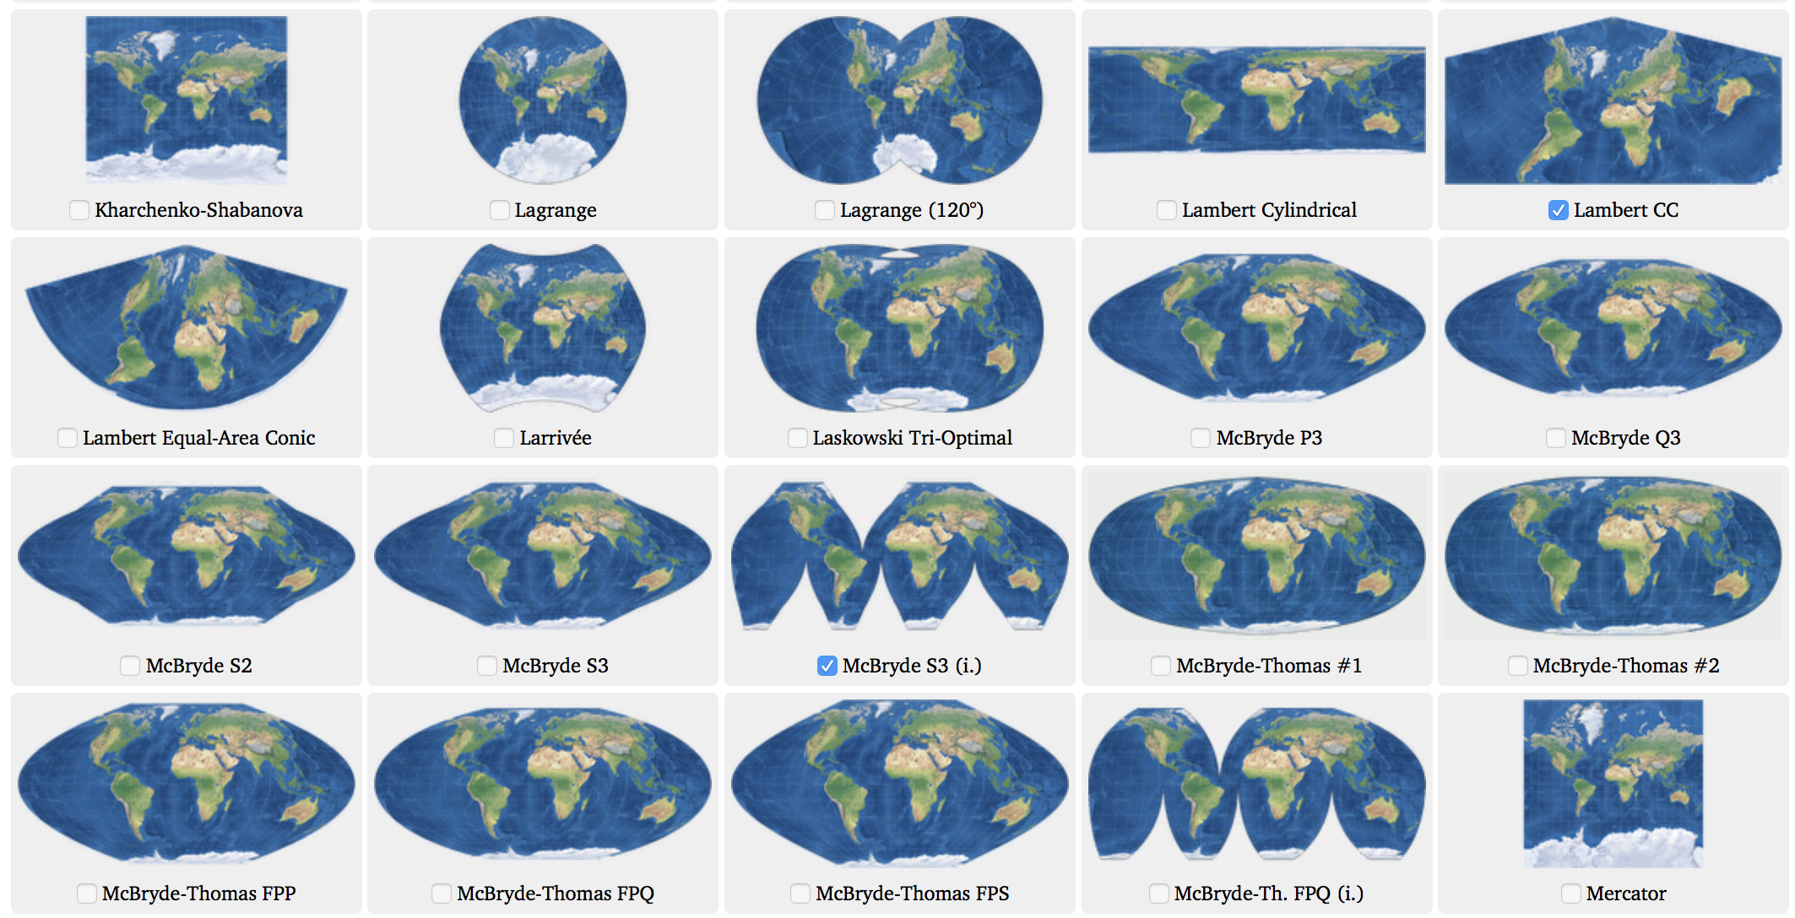

Slide 9

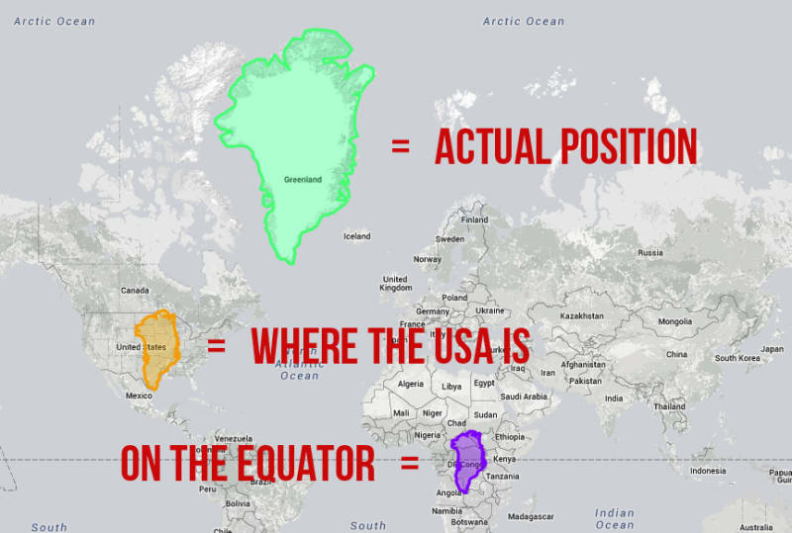

Slide 10
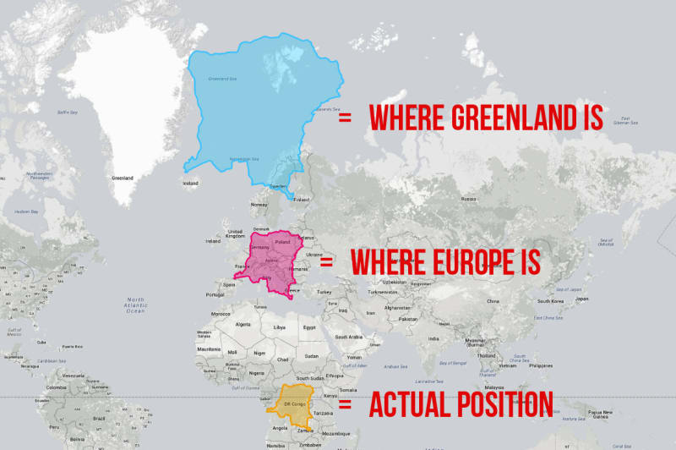

Slide 11
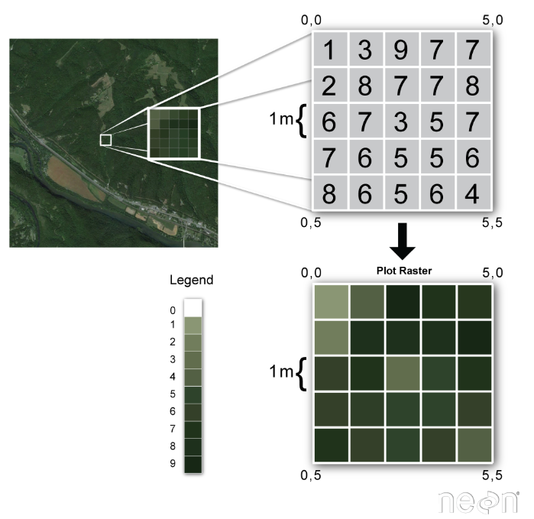
Rasters

Slide 12
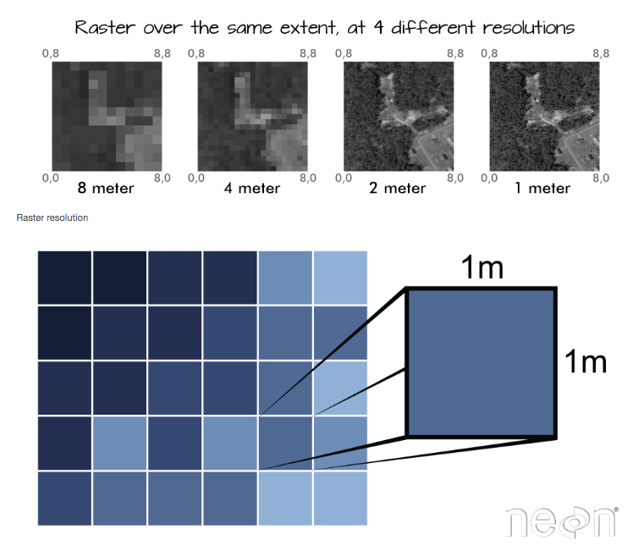
Rasters

