Slide 1
Kestrel Preliminary Design Review (PDR)
Northwind Orbital | Fictional test briefing

Slide 2
Agenda
SOW compliance status
LEO mission design
EPS and ADCS trades
CDR readiness and open RFAs

Slide 3
Subsystem Status
Subsystem | Status | Notes
C&DH | Green | Flight board at TRL 6
EPS | Yellow | 1.8 kWh battery, cell lot TBD
Propulsion | Green | COPV proof at 3,600 psi
GNC | Green | ICD signed

Slide 4
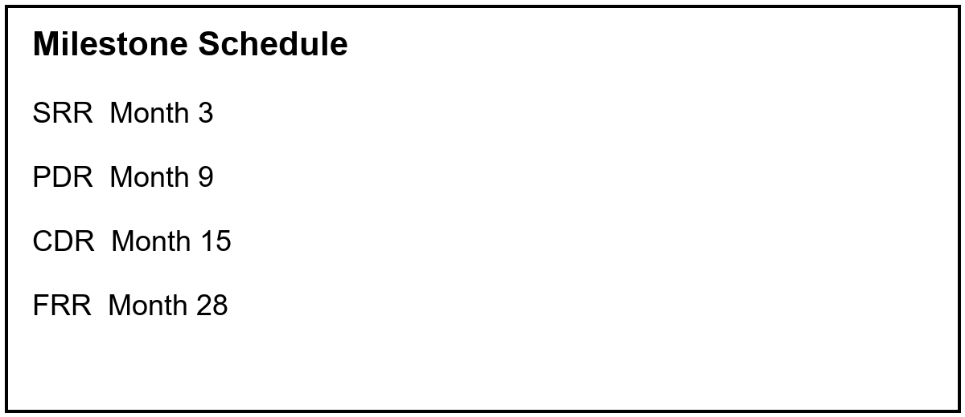
Milestones

Slide 5
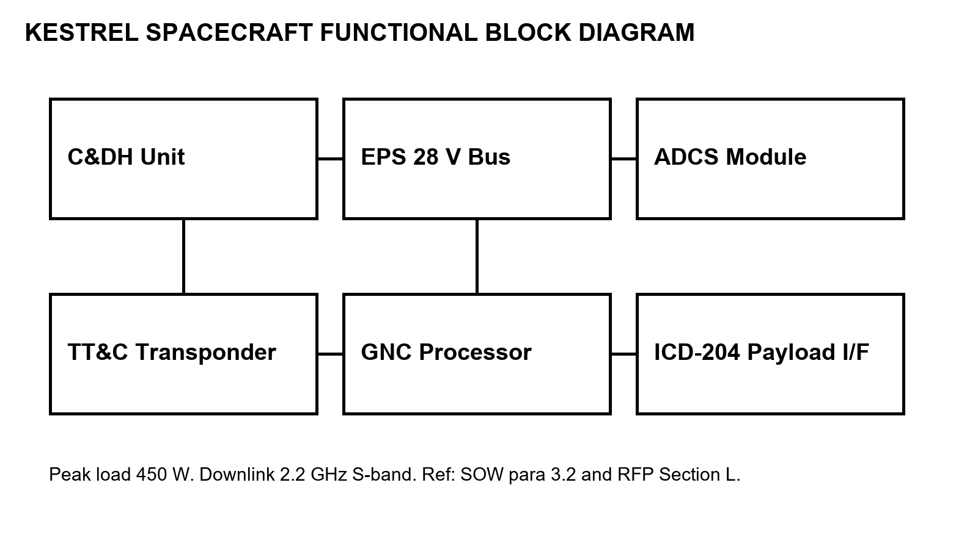
Architecture
Grouped callout: MOC handover after LEOP
Notes:
Speaker notes: mention the QA audit and the FRR date.

