Slide 1
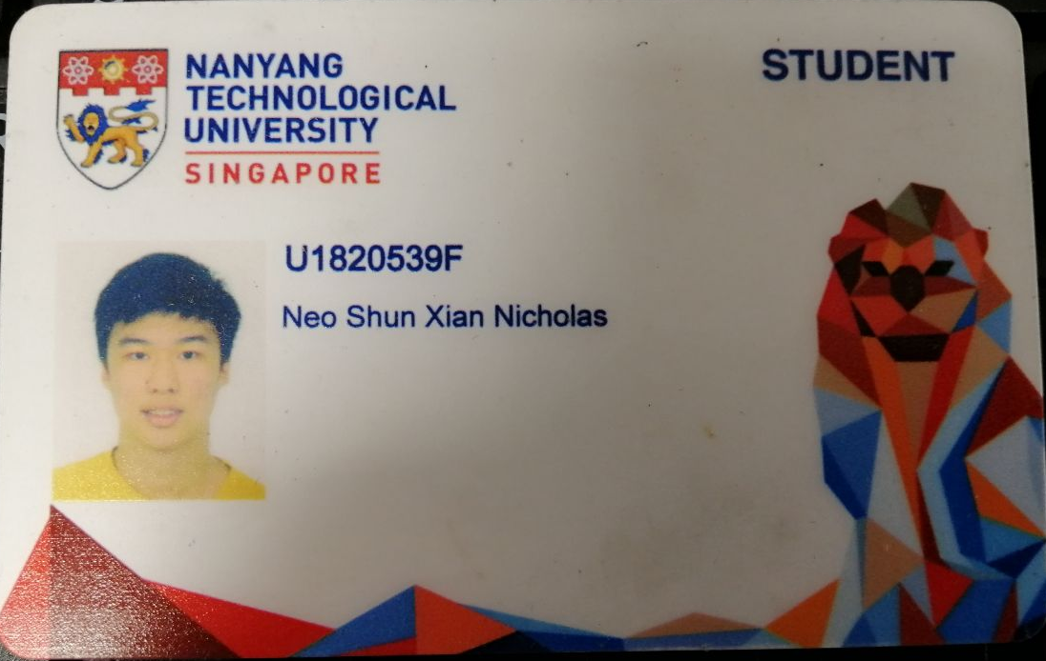

Slide 2
CE4062 Project Case Studies
Neo Shun Xian Nicholas
U1820539F

Slide 3

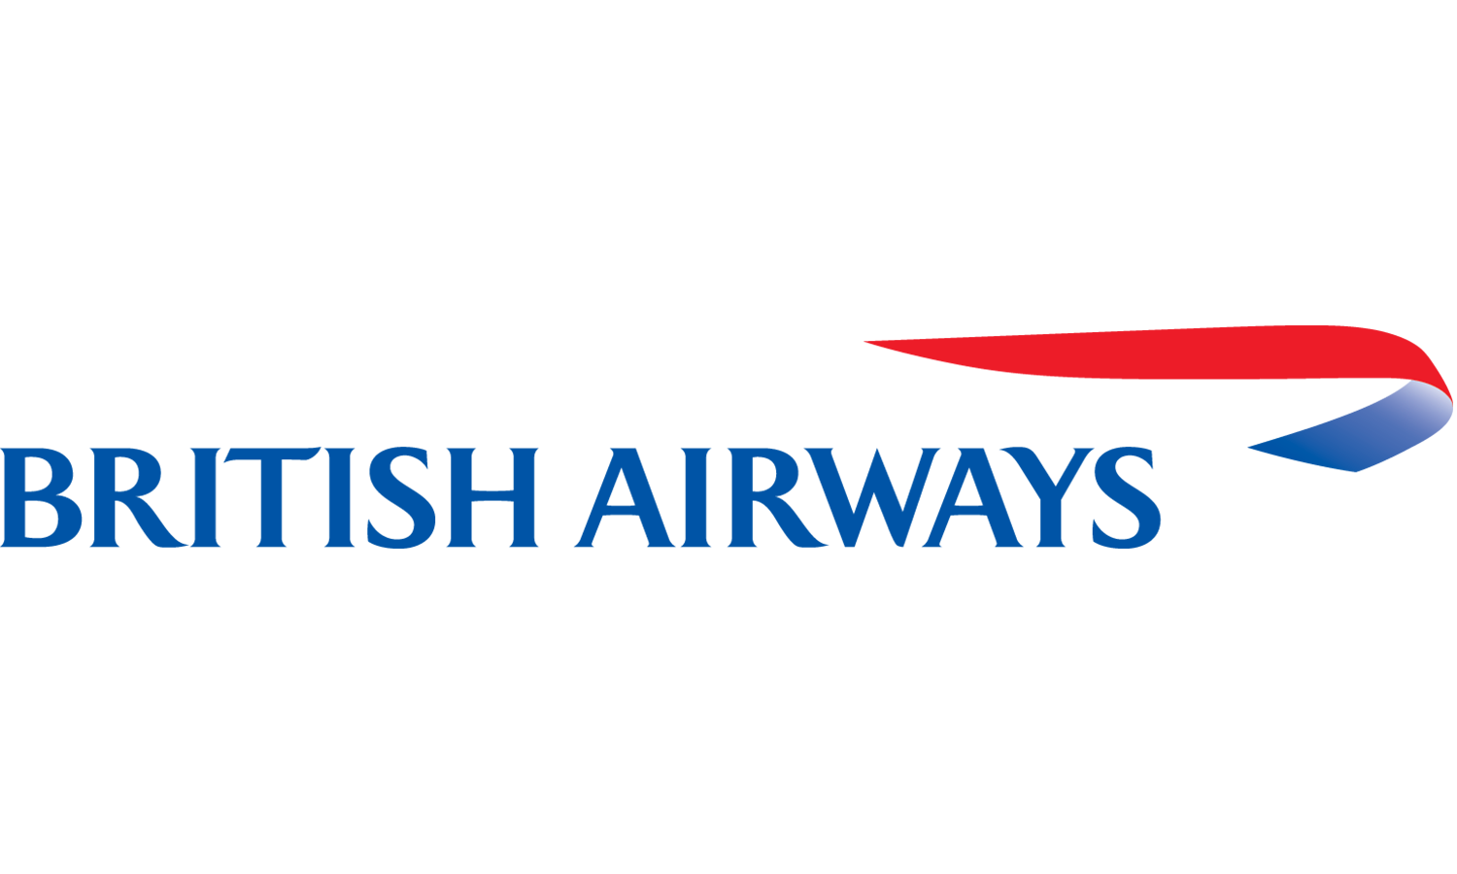
Case Studies Presented
Atrium Health Data Breach (2018)
British Airways Data Breach (2018)

Slide 4

Atrium Health Data Breach

Slide 5
Atrium Health Data Breach
General Information
Where: Happens in Charlotte, North Carolina, United States
When: 22-29 September 2018
What: About 2.65 million patients’ data were accessed unauthorizedly by the cyber-attackers
Type of information accessed: personal, financial and medical
Type of Attack: Unauthorized access through third-party supplier (An attack on external billing vendor)
AccuDoc Solution Inc: provides IT and payment services for Atrium Health

Slide 6
Atrium Health Data Breach
How it was being found out?
On 1 October 2018, AccuDoc Solutions notified Atrium Health that an unauthorized third party has gained access to its databases between 22-29 September 2018.
According to the forensics investigations, the information of the patients had been compromised, though the information stored in the databases could only be viewed.
No signs of download and the information being distributed to other platforms.

Slide 7
Atrium Health Data Breach
Summary of Key Events
AccuDoc Solutions reported that the breach was due to a security vulnerability at a third-party vendor.
Business relationship with that vendor has now been terminated.
Information compromised in the attack were the name, addresses, invoice numbers, account balances, service dates and health insurance information of the patients.
About 700,000 Social Security numbers were also compromised.
No sensitive financial information or medical records were affected.

Slide 8
Atrium Health Data Breach
Steps adopted after the breach
After the incident was discovered, AccuDoc brought on a forensic firm and has worked to ensure its database are secure.
Atrium to relook at its security measures taken and to work with a forensic investigative firm to conduct an independent review of the incident.
The Federal Bureau of Investigation (FBI) were also activated to investigate this breach.

Slide 9
Atrium Health Data Breach
Key Findings – Impacted Data
Fortunately, the information from the database were not removed/tampered from the AccuDoc’s systems.
Also, Atrium Health’s core systems information were unaffected and separated from AccuDoc’s systems.

Slide 10
Atrium Health Data Breach
Key Findings – Vendor’s Risk Management
Atrium Health and AccuDoc did not perform risk assessment on their third-party vendors, which may be detrimental if the compromised data were actually being used, copied or sold.
Due diligence should be heightened for those vendors with respect to the active protections they employ around Atrium’s computing environments or applications.

Slide 11
Atrium Health Data Breach
Key Findings – Vendor’s Risk Management (cont’d)
No other forms of evaluation was done on the services provided by the third party.
Only business associate agreement was signed, which was inadequate to deter potential cyber threats from the third party’s services.
Atrium & AccuDoc should do regular security checks on the services provided by the third-party so as to mitigate the risks of getting its data breached again

Slide 12
Atrium Health Data Breach
Contributing factors leading to the cyber attack
Security vulnerability of third party supplier
Failure of Atrium Health and AccuDoc Solutions to do regular safety check with their third party supplier

Slide 13
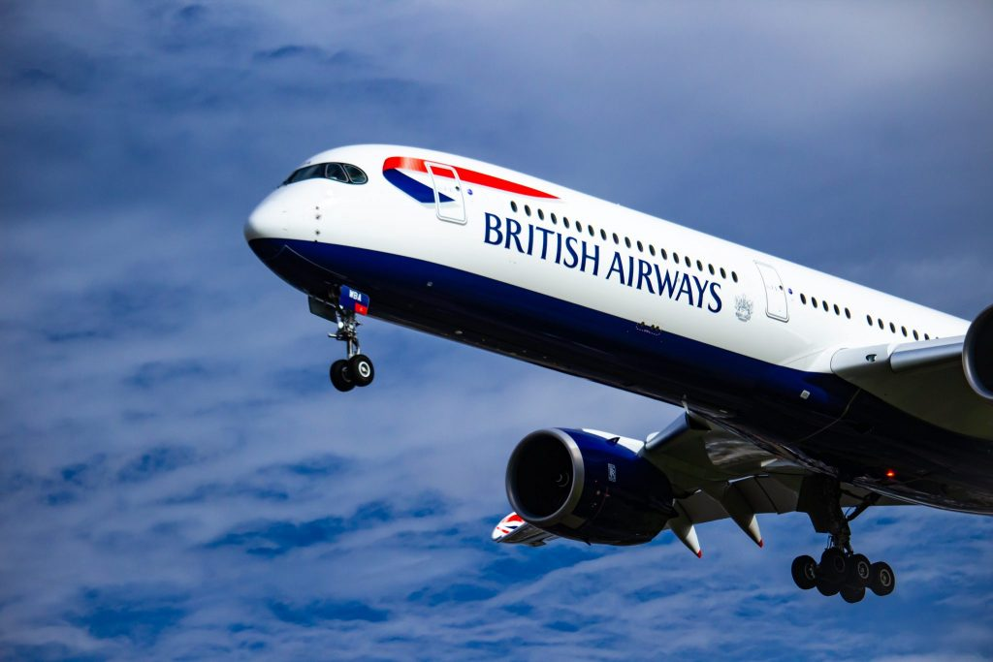
British Airways Data Breach

Slide 14
British Airways Data Breach
General Information
Where: Headquarters at Harmondsworth, United Kingdom
When: 21 August to 5 September 2018
What: About 429,000 customers’ data were hacked by the cyber-attackers
Type of information accessed: Personal and financial information
Type of Attack: Vulnerability in security, presence of malware and cross-site scripting, data exfiltration

Slide 15
British Airways Data Breach
Introduction
On 7 September 2018, British Airways revealed a data breach impacting customer information from roughly 380,000 booking transactions made between 21 August and 5 September 2018.
Names, addresses, email addresses and sensitive payment card details were all compromised.

Slide 16
British Airways Data Breach
How it was being found out?
British Airways did not detect the data exfiltration from its website for more than two months after the attack began on 22nd June 2018.
It was only after a third party alerted the airline about the cyber attack that it acted promptly and notified the Information Commissioner’s Office (ICO).

Slide 17
British Airways Data Breach
How the attackers managed to pull the data
Researchers from RiskIQ , a firm that does threat detection, share some insights on the strategy the attackers took to cause this data breach.
Draw similarity and link to a criminal hacking gang that has been active since 2015, named Magecart.

Slide 18
British Airways Data Breach
About Magecart
Magecart is known for web-based credit card skimming
Finding websites that don’t secure payment data entry form and deleting everything after the form has been submitted.
Before this attack, Magecart previously used their master code to sift data from various third-party websites that were security vulnerable.
But for this British Airways data breach, RiskIQ found that the attack was more sophisticated and tailored to the company’s specific infrastructure.

Slide 19
British Airways Data Breach
Summary of key events - Inaccurate initial disclosure from British Airways
British Airways claimed that the breach did not impact passport numbers or other travel data.
But RiskIQ later clarified that the compromised data included payment care expiration dates and Card Verification Value codes (CVV) – A verification code to authenticate a card.
The breach affects customers who made transactions during a specific timeframe of 22:58 BST on 21 August to 21:45 BST on 5 September.

Slide 20
British Airways Data Breach
Summary of key events – Cross-site scripting attack
The details from the previous slide serves as a clue to suspect that attackers are using a “cross-site scripting” attack.
Cross-site scripting is one in which bad actors identify a poorly secured webpage component and inject their own code into the webpage to alter the webpage’s behaviour.
The attack need not involve in penetrating an organisation’s network or servers.
This explains how attackers only accessed information submitted during a very specific timeframe and compromise data that British Airways itself doesn’t store.

Slide 21
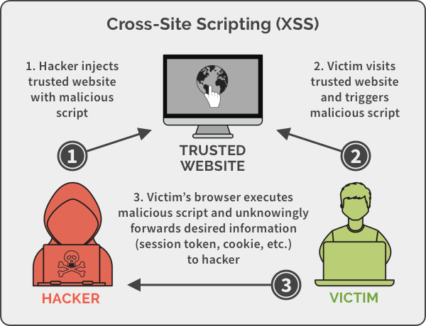
British Airways Data Breach
Cross-Site Scripting

Slide 22
British Airways Data Breach
Summary of key events – Cross-site scripting attack (cont’d)
The script is connected to the British Airways baggage claim information page.
The last time the webpage had been modified prior to the breach is 2012.
The attacker only included 22 more lines of code.
The malicious code grabbed data that customers entered into the payment form and sent it to an attacker-controlled server when a user clicked or tapped the submission button.

Slide 23
British Airways Data Breach
Summary of key events – Cross-site scripting attack (cont’d)
The attackers were so sophisticated that they even paid to set up a Secure Sockets Layer (SSL) certificate for their server, a credential that confirms a server has web encryption enabled to protect data in transit.
Attackers of all sorts have increasingly used these certificates to help create a sense of legitimacy, even though an encrypted site might not be necessarily safe.

Slide 24
British Airways Data Breach
Summary of key events – Cross-site scripting attack (cont’d)
Part of the British Airways Android app was built off from the same code as compromised portion of the airline’s website.
Hence, the malicious JavaScript component the attackers injected have also affected its mobile users.
The attackers seemed to have designed the script with the mind of including touchscreen input components as well.
The attack was effective as it was tailored to the specific scripting and data flow weaknesses of the British Airways site.

Slide 25
British Airways Data Breach
Key Findings – Breach due to failing to implement access limitation
Information Commissioner’s Office (ICO) stated that the attack on the breach of data belonging to customers and staff could have been prevented.
It can be prevented by limiting access to applications, data, and tools, undertaking rigorous testing, in the form of simulating a cyber-attack, on the business’ systems, and protecting employee and third party accounts with multi-factor authentication

Slide 26
British Airways Data Breach
Key Findings – No early detection from British Airways
As the attack was realised by third party after two month, this was considered to be a severe failing from the British Airways because the number of people affected and the potential financial harm could have been more significant.
The failure to detect and mitigate have affected all the victims, causing some anxiety and distress as a result, hence the ICO issued £183.39 million fine to British Airways.

Slide 27
British Airways Data Breach
Key Findings – Poor security arrangements
British Airways was not taking proper precautions when rolling out new websites and applications.
They should adopt the correct security management infrastructure, knowing at all times what the risks are and being able to find the solutions before the systems are rolled out to the users.

Slide 28
British Airways Data Breach
Key Findings – Breach due to British Airways negligence according to ICO
Personal data of approximately 429,612 customers and staff, including names, addresses, payment card numbers, and CVV numbers of 244,000 customers.
Combined card and CVV numbers of 77,000 customers and card numbers only for 108,000 customers.
Usernames and passwords of employee and administrator accounts as well as usernames and PINs of up to 612 Executive Club accounts.

Slide 29
British Airways Data Breach
Summary - Timeline
15 Aug 2018: Hackers issued with SSL certificate
5 September 2018: Breach discovered by BA monitoring partner
6 September 2018: British Airways first reports data breach affecting 380,000 customers
7 September 2018: Reports of fraudulent activity on affected cards.
25 October 2018: British Airways parent International Airlines Group announces that a further 185,000 customers affected, of which 77,000 had had CVV number taken

Slide 30
British Airways Data Breach
Contributing factors leading to the cyber attack
No access limitation to the applications, data and tools
No early detection of the sites in the event of an attack
Poor security arrangements

Slide 31
References
https://www.prnewswire.com/news-releases/to-improve-health-outside-of-hospital-walls-atrium-health-commits-10-million-to-affordable-housing-300861721.html
https://www.asiamiles.com/en/earn-miles/airlines/detail.html/british-airways
https://skift.com/2020/06/29/british-airways-reportedly-lays-off-350-pilots-and-puts-300-in-pool-for-rehire/
https://managingrisktogether.orx.org/sites/default/files/public/downloads/2019/01/british-airways-suffers-data-breach-compromising-information-over-429-000-customer-cards.pdf
https://www.globalsign.com/en/blog/how-well-did-british-airways-handle-their-data-breach
https://www.wired.co.uk/article/british-airways-data-breach-gdpr-fine
https://www.wired.com/story/british-airways-hack-details/
https://www.bbc.com/news/technology-45446529
https://www.wired.com/story/british-airways-hack-details/
https://www.bbc.com/news/business-48905907
https://www.teiss.co.uk/ico-fines-british-airways/
https://www.securityinfowatch.com/healthcare/news/12438109/personal-data-of-more-than-2m-patients-compromised-in-atrium-health-data-breach
https://www.modernhealthcare.com/article/20181128/NEWS/181129940/2-65-million-atrium-health-patients-data-potentially-exposed
https://medcitynews.com/2018/11/atrium-health-billing-vendor-patients/?rf=1
https://www.hipaajournal.com/2-65-million-atrium-health-patients-impacted-by-business-associate-data-breach/
https://www.bankinfosecurity.com/attack-on-billing-vendor-results-in-massive-breach-a-11740
https://spanning.com/blog/cross-site-scripting-web-based-application-security-part-3/

