Slide 1
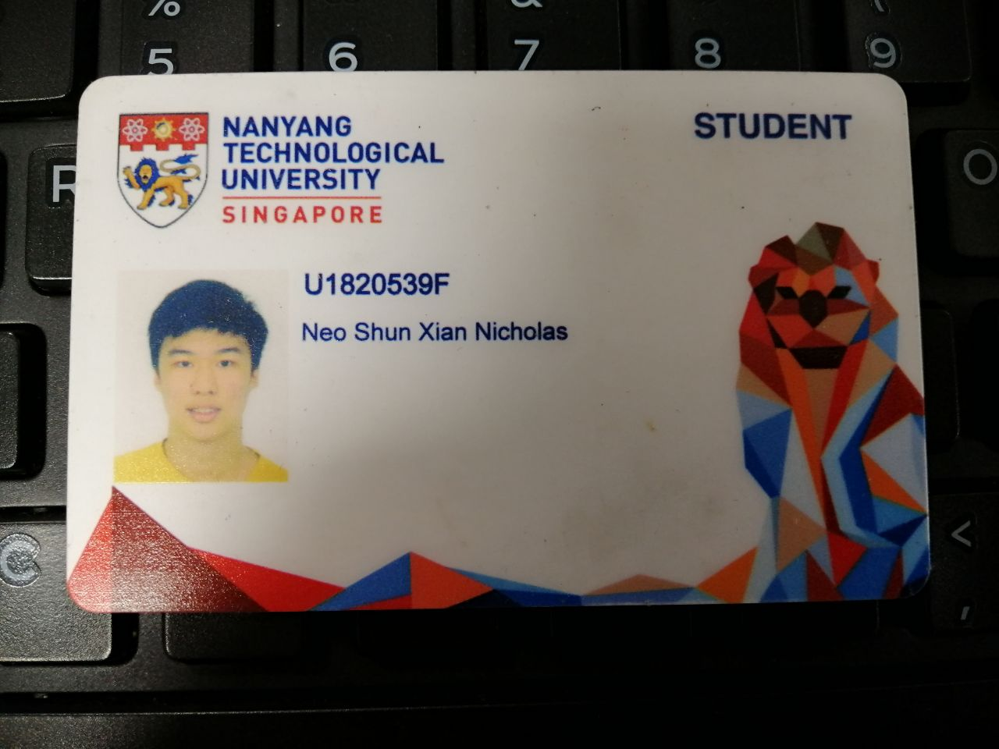

Slide 2
CE4062 Project Case Studies
Neo Shun Xian Nicholas
U1820539F

Slide 3
Case Studies Presented
Atrium Health Data Breach
British Airways

Slide 4
Atrium Health Data Breach
Happens in

