Slide 1
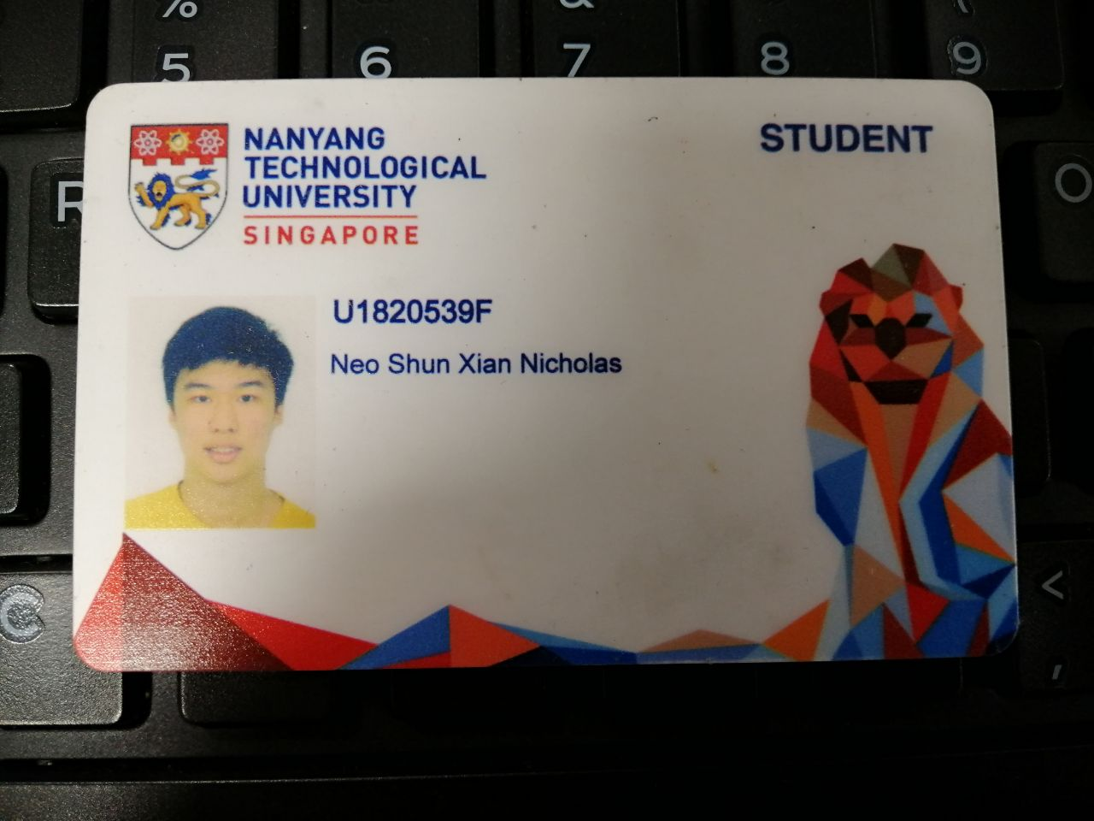

Slide 2
CE4062 Project Case Studies INSERT SOME CHARTS DIAGRAM FOR ANALYSIS AND EXPLAIN IT
Neo Shun Xian Nicholas
U1820539F

Slide 3


Case Studies Presented
Atrium Health Data Breach (2018)
British Airways Data Breach (2018)

Slide 4
Atrium Health Data Breach
General Information
Where: Happens in Charlotte, North Carolina, United States
When: 22-29 September 2018
What: About 2.65 million patients’ data were accessed unauthorizedly by the cyber-attackers
Type of information accessed: personal, financial and medical
Type of Attack: Unauthorized access through third-party supplier (An attack on external billing vendor)
AccuDoc Solution Inc: provides IT and payment services for Atrium Health

Slide 5
Atrium Health Data Breach
How it was being found out?
On 1 October 2018, AccuDoc Solutions notified Atrium Health that an unauthorized third party has gained access to its databases between 22-29 September 2018.
According to the forensics investigations, the information of the patients had been compromised, though the information stored in the databases could only be viewed.
No signs of download and the information being distributed to other platforms.

Slide 6
Atrium Health Data Breach
Summary of Key Events
AccuDoc Solutions reported that the breach was due to a security vulnerability at a third-party vendor.
Business relationship with that vendor has now been terminated.
Information compromised in the attack were the name, addresses, invoice numbers, account balances, service dates and health insurance information of the patients.
About 700,000 Social Security numbers were also compromised.
No sensitive financial information or medical records were affected.

Slide 7
Atrium Health Data Breach
Steps adopted after the breach
After the incident was discovered, AccuDoc brought on a forensic firm and has worked to ensure its database are secure.
Atrium to relook at its security measures taken and to work with a forensic investigative firm to conduct an independent review of the incident.
The Federal Bureau of Investigation (FBI) were also activated to investigate this breach.

Slide 8
Atrium Health Data Breach
Key Findings – Impacted Data
Fortunately, the information from the database were not removed/tampered from the AccuDoc’s systems.
Also, Atrium Health’s core systems information were unaffected and separated from AccuDoc’s systems.

Slide 9
Atrium Health Data Breach
Key Findings – Vendor’s Risk Management
Atrium Health and AccuDoc did not perform risk assessment on their third-party vendors, which may be detrimental if the compromised data were actually being used, copied or sold.
Due diligence should be heightened for those vendors with respect to the active protections they employ around Atrium’s computing environments or applications.

Slide 10
Atrium Health Data Breach
Key Findings – Vendor’s Risk Management (cont’d)
No other forms of evaluation was done on the services provided by the third party.
Only business associate agreement was signed, which was inadequate to deter potential cyber threats from the third party’s services.
Atrium & AccuDoc should do regular security checks on the services provided by the third-party so as to mitigate the risks of getting its data breached again

Slide 12
British Airways Data Breach
General Information
Where: Headquarters at Harmondsworth, United Kingdom
When: 21 August to 5 September 2018
What: About 429,000 patients’ data were accessed unauthorizedly by the cyber-attackers
Type of information accessed: Personal and financial information
Type of Attack: Vulnerability in security and presence of Malware

Slide 13
British Airways Data Breach
How it was being found out?
On 1 October 2018, AccuDoc Solutions notified Atrium Health that an unauthorized third party has gained access to its databases between 22-29 September 2018.
According to the forensics investigations, the information of the patients had been compromised, though the information stored in the databases could only be viewed.
No signs of download and the information being distributed to other platforms.

Slide 14
References
https://www.prnewswire.com/news-releases/to-improve-health-outside-of-hospital-walls-atrium-health-commits-10-million-to-affordable-housing-300861721.html
https://www.asiamiles.com/en/earn-miles/airlines/detail.html/british-airways

