Slide 1


Don’t Leave Laundry Messy
Team 17

Slide 2
Problem & Motivation
Problem
Residents face frustration and inconvenience with limited laundry facilities, as they have to check machine availability in-person.
Motivation
To make our lives easier (lazier) and reduce the need to check the laundry machines in person :))

Slide 3
What is DLLM?
A smart, integrated system that uses IoT sensors, machine learning, and a mobile web app to notify users of machine availability and cycle completion.
Overview
Key Benefits
  Real-time monitoring!
  Notifications to remind people to collect their laundry and prevent congestion!
  Enhanced convenience for residents!

Slide 4

Sensors/ Cameras
How does it work?
Laundry Machines
Application
User

Slide 5
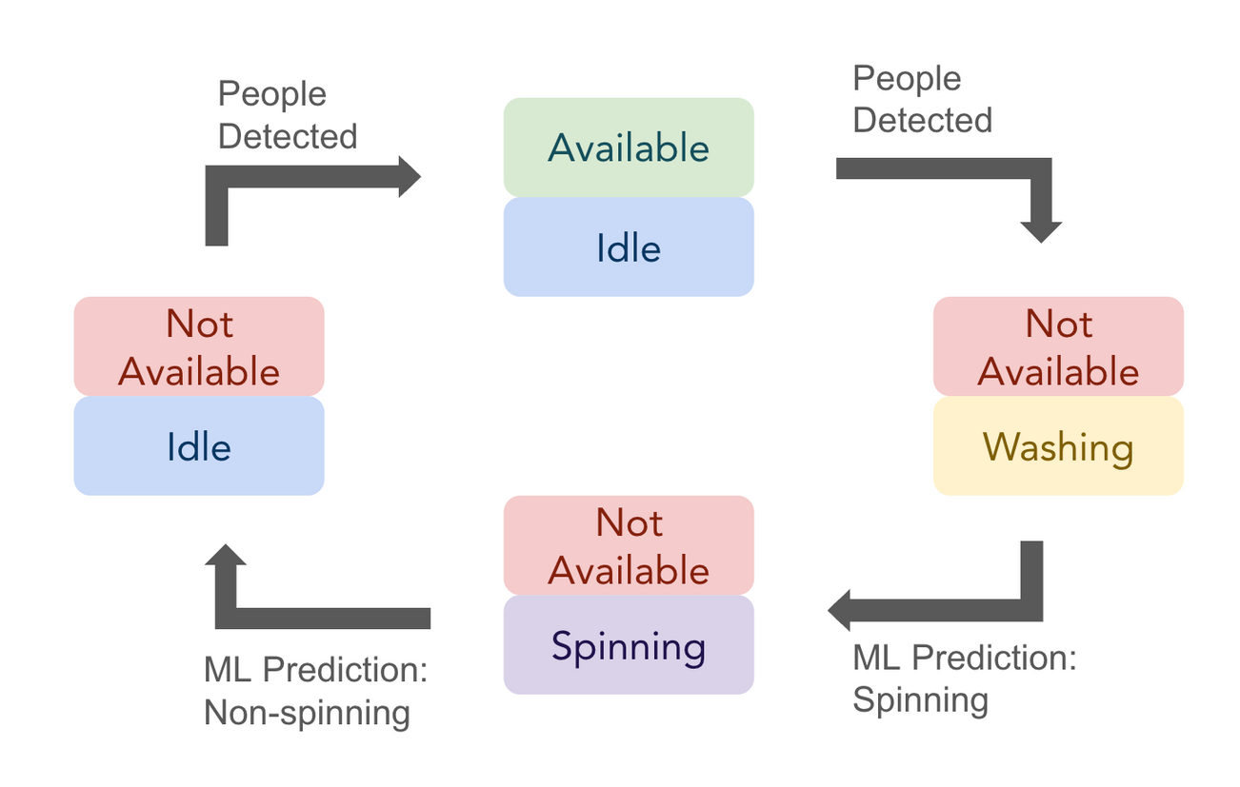
Washer

Slide 6
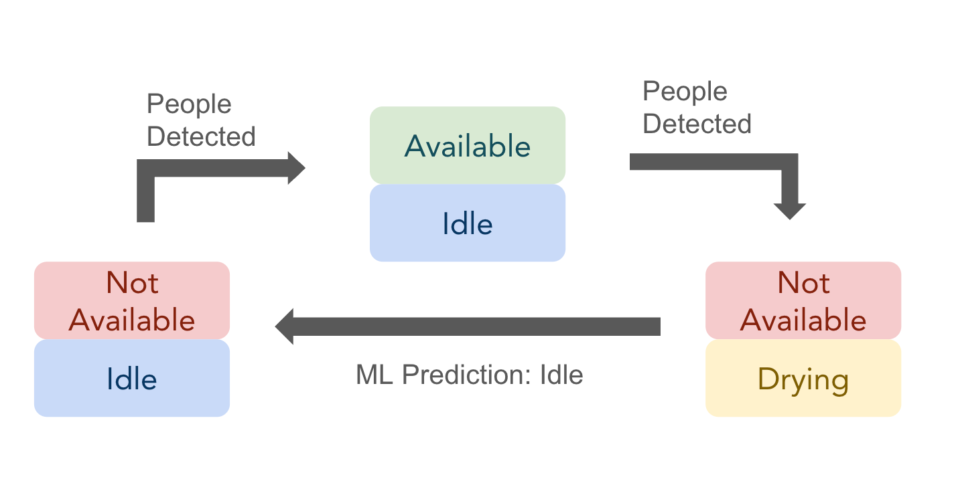
Dryer

Slide 7
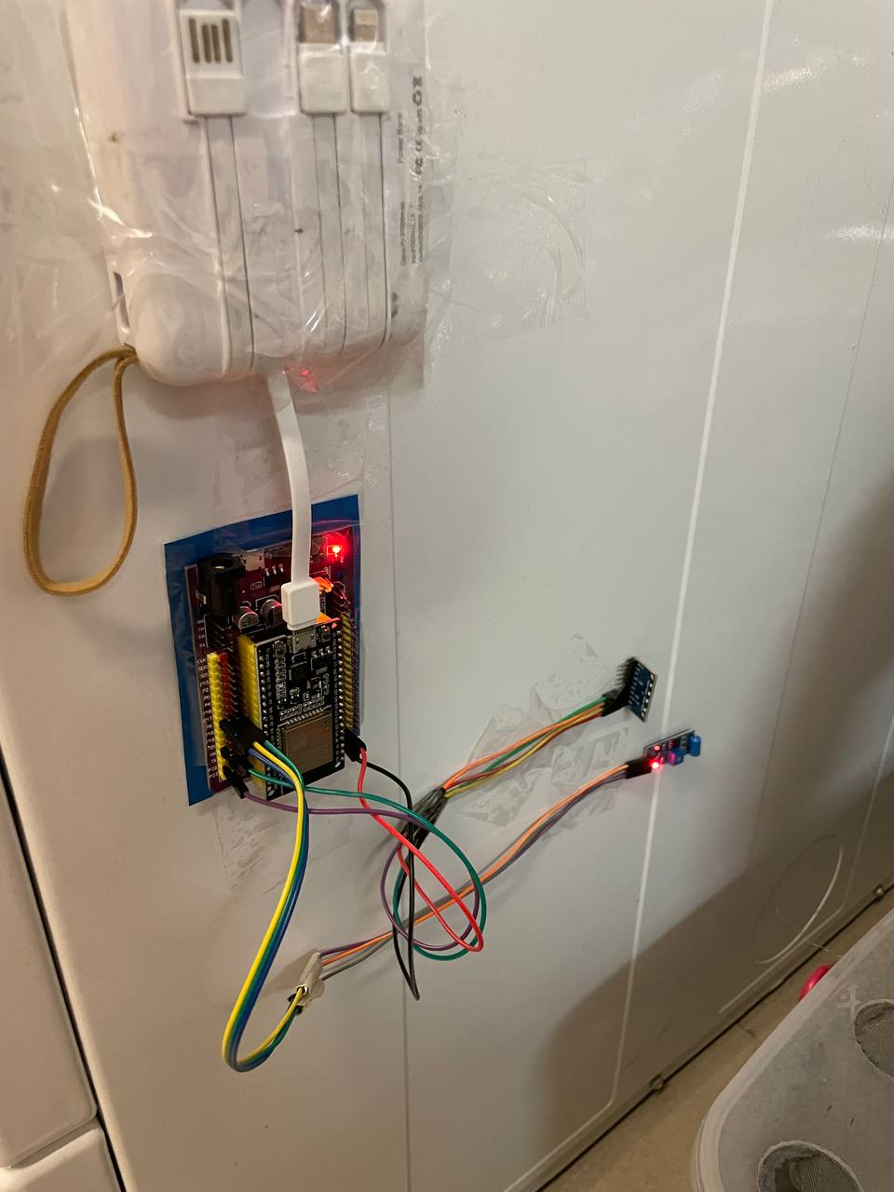
Sensors
IMU Sensors
Capture acceleration and angular velocity of the machine!
Provides analog reading for machine learning model :)
Vibration Sensor
Capture vibration and provide digital readings.

Slide 8
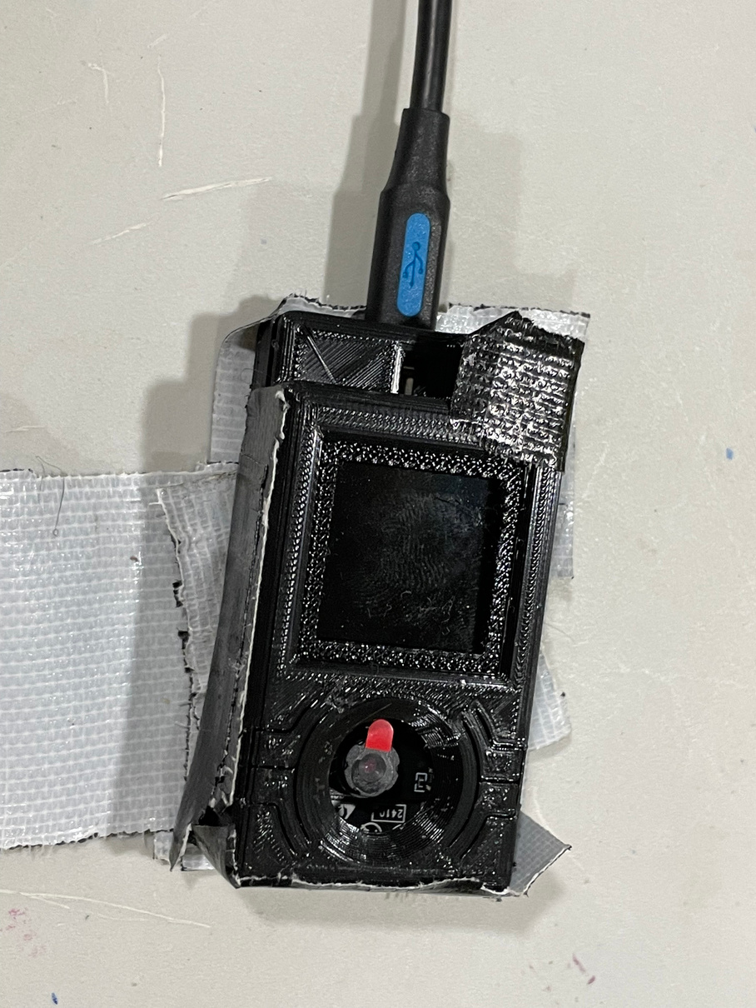
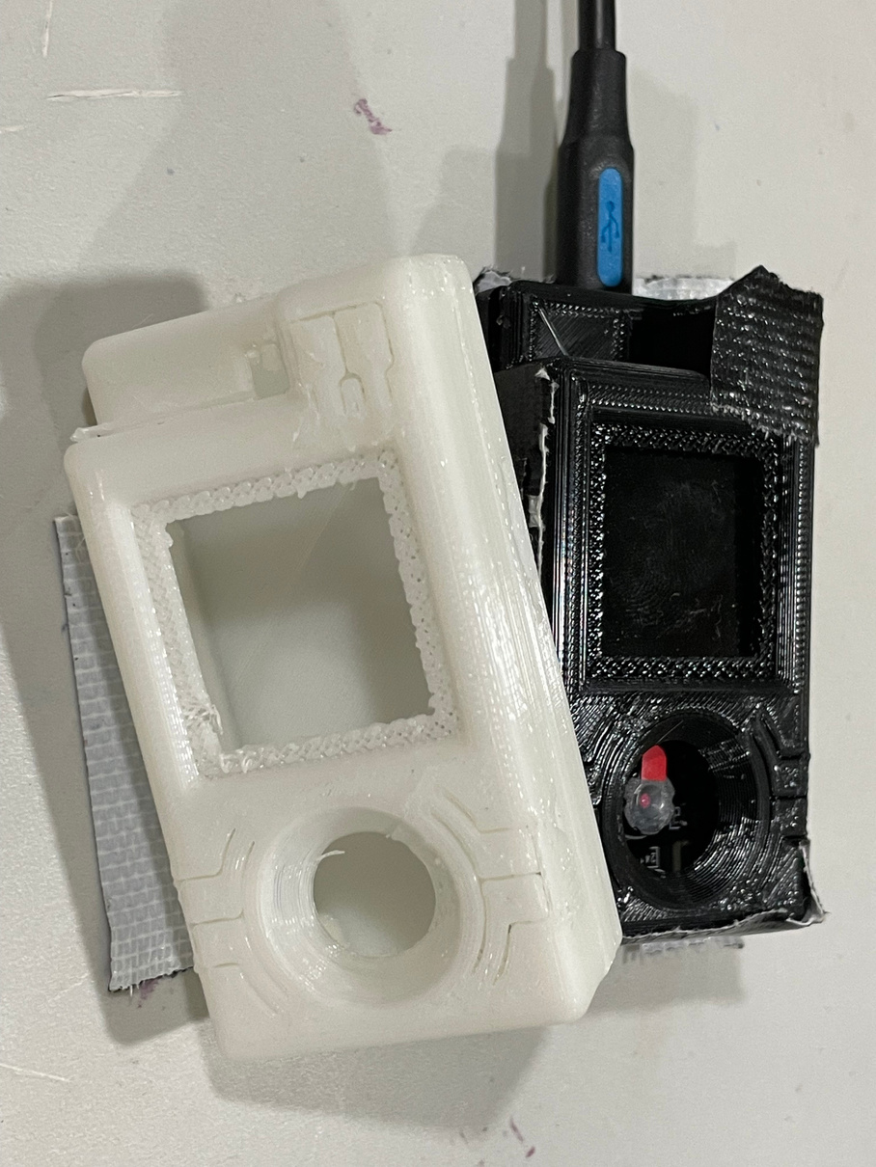
ESP32 Eye
ESP32 Eye
Camera
Capture people in front of the laundry machine!
3D printed case
Protective case to hold the camer :)

Slide 9

ESP32 Microcontrollers
connect to the sensors/ camera and send data to the cloud!

Slide 10
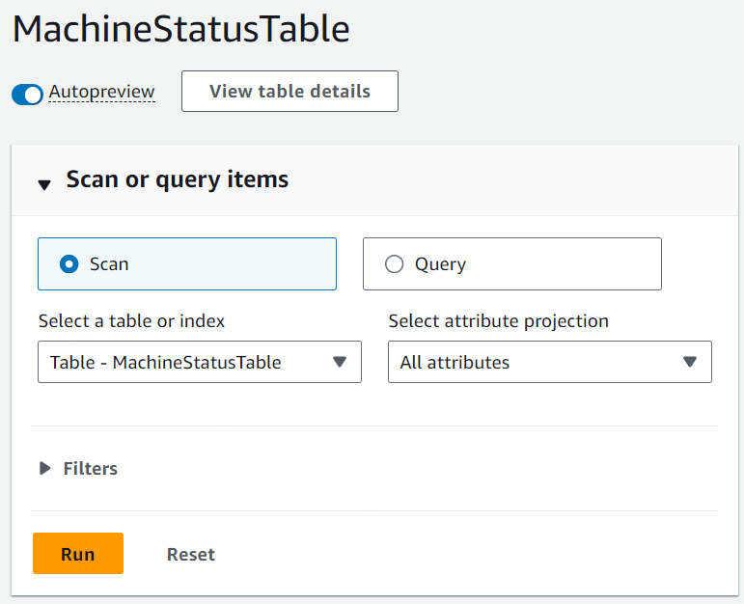


AWS Cloud Services
for data processing and updates

Slide 11
Machine Learning -
Sensors
Washer Status
Determine if the washer is spinning!
Dryer Status
Determine if the dryer is drying clothes.

Slide 12

Machine Learning -
Camera
Washer Status
Determine if someone put/ take out clothes from the washer.
Dryer Status
Determine if someone put/ take out clothes from the dryer.

Slide 13
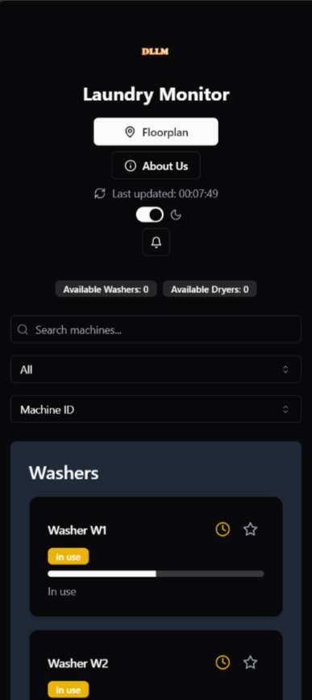
Vercel Web App (Gateway)
Make our lives easier

Slide 14
Power Usage
Power Management
Deep Sleep
How long can the system support itself?
Interval
Duty Cycle
Notes:
Power Usage in Different Modes: In boot or WiFi operation, the ESP32 draws around 250 mA of current; in deep sleep mode, the power consumption is around 100 μA. Assuming the power bank has a capacity of 5,000mAh and the ESP32 is always active, the ESP32 can only last for 40 hours. This is consuming too much power and can be improved.
Determine the Interval: Knowing that each washing or drying cycle is around 30 minutes, and the system does not require data being specific to seconds to send out push notifications to the users, the ESP32 does not have to be active all the time. Furthermore, in order to capture the spin stage of the washer, which occurs in the last ten minutes of a washing cycle. We decided with a sampling interval of 1 minute. To ensure both sufficient sensor readings and maximise power usage, we set a 20% duty cycle sensing for the ESP32. It will read in sensor data and perform data transmission to the cloud for 12 seconds, then go into sleep mode for 48 seconds to save power.
Duty Cycle Sensing: Having the 20% duty cycle sensing, the average power consumption will reduce around 80% as deep sleep mode barely consumes power. Therefore, a single power bank will be able to support the ESP32 for 100 hours, which significantly improves the power usage condition.

Slide 15
ESP32
Data Transmission
AWS
How does the data transmit between different devices?
MQTT Broker
App
Notes:
Power Usage in Different Modes: In boot or WiFi operation, the ESP32 draws around 250 mA of current; in deep sleep mode, the power consumption is around 100 μA. Assuming the power bank has a capacity of 5,000mAh and the ESP32 is always active, the ESP32 can only last for 40 hours. This is consuming too much power and can be improved.
Determine the Interval: Knowing that each washing or drying cycle is around 30 minutes, and the system does not require data being specific to seconds to send out push notifications to the users, the ESP32 does not have to be active all the time. Furthermore, in order to capture the spin stage of the washer, which occurs in the last ten minutes of a washing cycle. We decided with a sampling interval of 1 minute. To ensure both sufficient sensor readings and maximise power usage, we set a 20% duty cycle sensing for the ESP32. It will read in sensor data and perform data transmission to the cloud for 12 seconds, then go into sleep mode for 48 seconds to save power.
Duty Cycle Sensing: Having the 20% duty cycle sensing, the average power consumption will reduce around 80% as deep sleep mode barely consumes power. Therefore, a single power bank will be able to support the ESP32 for 100 hours, which significantly improves the power usage condition.

Slide 16
Any Questions

