Slide 1


XHAW5112 · TASK 3 GROUP PRESENTATION
Pawsitive Pet Academy
Designing and developing our website and mobile application
Dogs, cats & companions
Education for happier lives together
Hlumelo · Ntsako · Nicholas · Musawenkosi · Ruthwane
Notes:
SPEAKER: Hlumelo
Hello everyone, and welcome. We're the Pawsitive Pet Academy group, and this is our Task 3 presentation for XHAW5112.
Today we'll show you how we designed and built a website and a mobile app for Pawsitive Pet Academy. Each of us will present a different part of the project.
Let's start with a quick introduction.

Slide 2
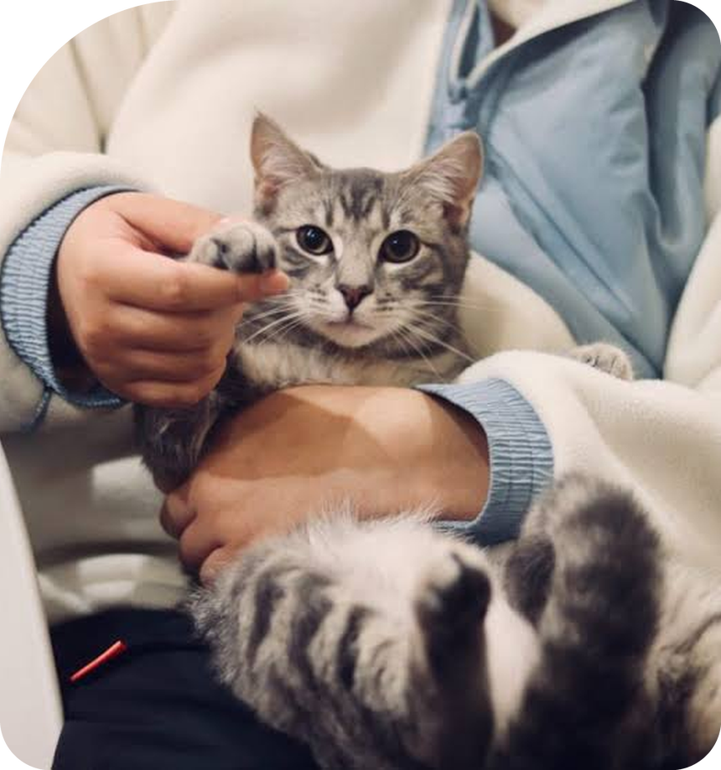
Pet care education for Durban
01 · PROJECT INTRODUCTION
01
What it is
A Durban-based academy offering seven practical pet care and animal training courses.
02
The need
Pet owners and aspiring pet professionals need one clear place to compare courses, see fees and ask questions.
03
Our solution
A website and an Android app where people can browse courses, calculate fees and send an enquiry.
7
courses
2
platforms: web + app
15%
max multi-course discount
Presenter: Hlumelo
Notes:
SPEAKER: Hlumelo
Pawsitive Pet Academy is a pet care and training academy based in Durban. We offer seven courses: four six-month programmes and three six-week short courses.
People who love pets, or who want to work with animals, need one easy place to see the courses, check the prices and get in touch.
So we built a website and an Android app that let them do exactly that: browse courses, calculate fees and send an enquiry.
Next, I'll show you our branding.

Slide 3
A warm, friendly and trustworthy brand
02 · DESIGN CONCEPT AND BRANDING
Butter Yellow
#FFDB58
Baby Blue
#ACDCFF
Warm and energetic. Used for buttons, badges and highlights.
Calm and trustworthy. Used for active states and soft sections.
Dark Ink
#1C262D
White & neutrals
#FFFFFF
Strong contrast for readable text and the footer.
Clean space that lets our pet photos stand out.
A dog and a cat joined by a heart, because we teach care for both. 'Pawsitive' blends paw and positive.
Typography: Plus Jakarta Sans for headings, DM Sans for body text.
Visual motif: rounded cards and photos with one large curved corner.
Presenter: Hlumelo
Notes:
SPEAKER: Hlumelo
This is our logo and branding.
Our logo shows a dog and a cat, joined by a heart. We chose this design because our academy teaches people to care for both dogs and cats, and the heart shows the love and care behind everything we do.
The name Pawsitive mixes the words paw and positive. It shows our friendly, positive approach to training.
We chose butter yellow as our main colour because it is warm and cheerful. We use it for buttons and highlights. We chose baby blue because it feels calm and trustworthy. We use it for softer sections.
We use dark text so everything is easy to read, and lots of white space so the pet photos stand out.
Our headings use the Plus Jakarta Sans font, and our body text uses DM Sans, because they are modern and easy to read. We also use rounded cards and photos with one big curved corner on every page.
Ntsako will now show you how this shaped our website design.

Slide 4
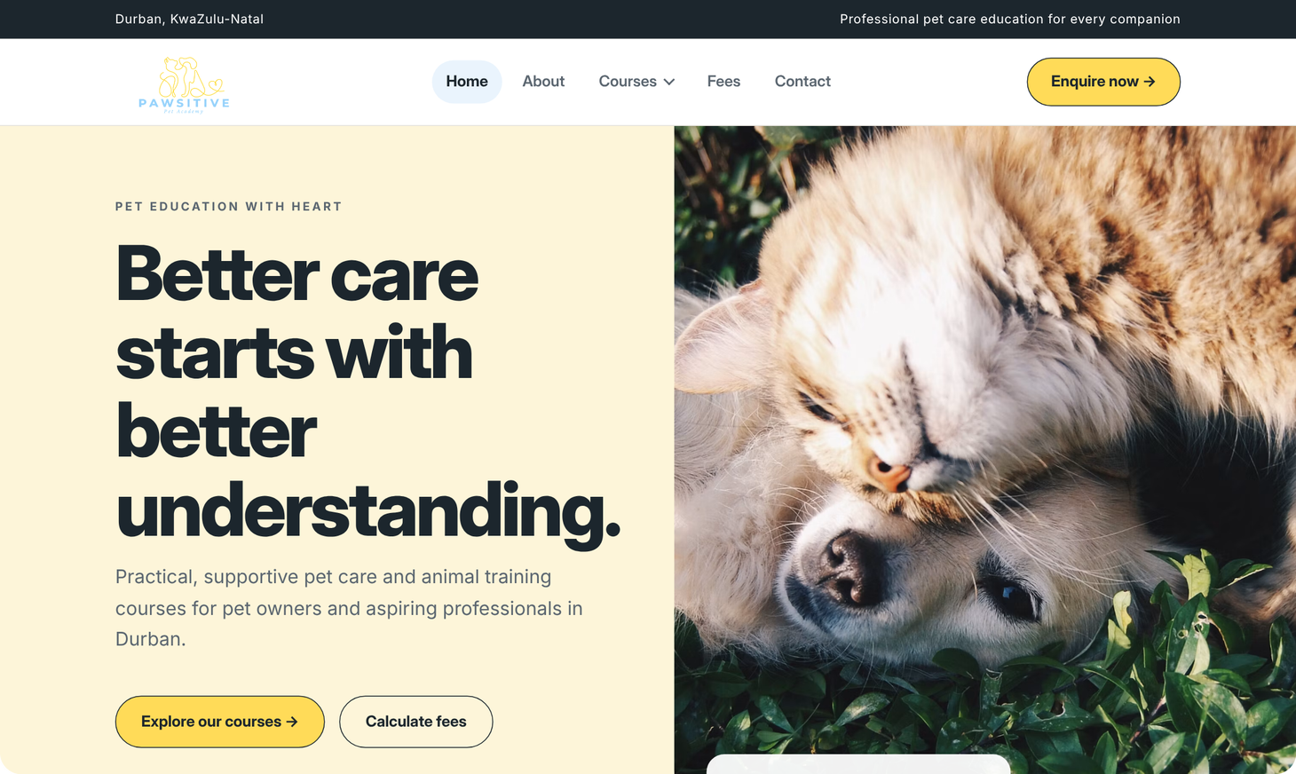
Designed to help visitors find a course fast
03 · WEBSITE DESIGN
1
Layout
A strong hero, course cards, a 'why choose us' section and a call to action on every page.
2
Navigation
Home, About, Courses, Fees and Contact, with a grouped Courses dropdown and an 'Enquire now' button.
3
User experience
Prices shown upfront, one clear next step per page, and a Menu button on phones.
Course structure
4 six-month programmes (R1,500) and 3 six-week short courses (R750)
Presenter: Ntsako
Notes:
SPEAKER: Ntsako
Thanks, Hlumelo. Our main goal for the website design was to help visitors find the right course quickly.
We chose a clean layout with lots of white space and big pet photos because our audience is pet lovers, and we wanted the site to feel friendly and welcoming, not corporate.
The home page opens with a friendly hero section and two clear buttons: explore our courses, or calculate your fees.
The navigation is simple: Home, About, Courses, Fees and Contact. Courses has a dropdown grouped into programmes and short courses, and the yellow Enquire now button is always visible.
We also designed for a good user experience: prices are shown upfront, each page ends with one clear next step, and on a phone the menu becomes a single Menu button.
Our course structure is four six-month programmes at R1,500 each, and three six-week short courses at R750 each.
Let me show you the wireframes we designed first.

Slide 5
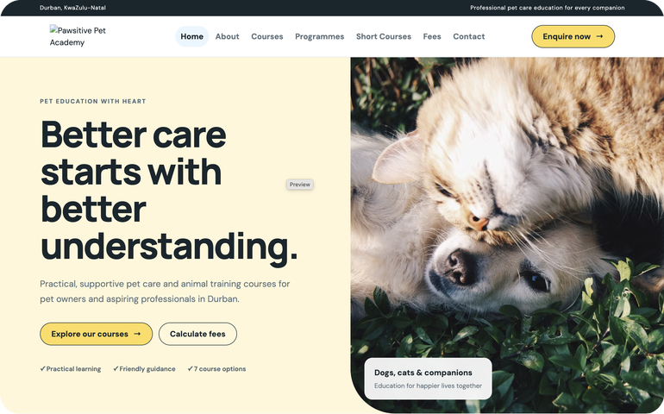
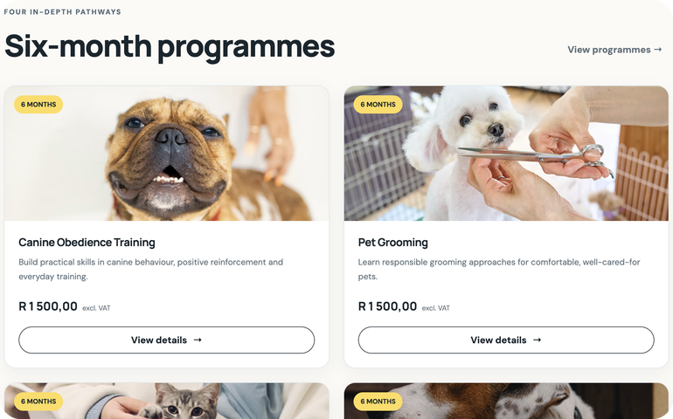
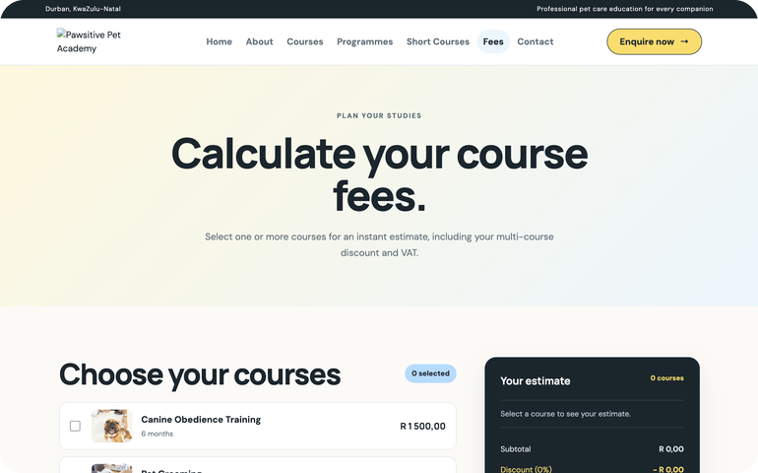

Designed in Figma before any code
04 · HIGH-FIDELITY WIREFRAMES
Home page
Hero, navigation and key actions
Courses page
Course cards with duration badge and price
Fees page
Course list with a live estimate panel
→
Colours, fonts and spacing became our CSS variables
→
Cards, buttons and badges became reusable CSS classes
→
Section order became our HTML page structure
View our Figma wireframes
Presenter: Ntsako
Notes:
SPEAKER: Ntsako
Before writing any code, we designed high-fidelity wireframes in Figma. Here are three of them: the home page, the courses page and the fees page.
These show the real colours, fonts, photos and spacing, so the whole group agreed on exactly what we were building.
They guided development directly. The colours, fonts and spacing became our CSS variables. Repeated pieces like course cards, buttons and badges became reusable CSS classes. And the order of sections became the structure of our HTML pages.
Now Musawenkosi will explain how we actually built the website.

Slide 6
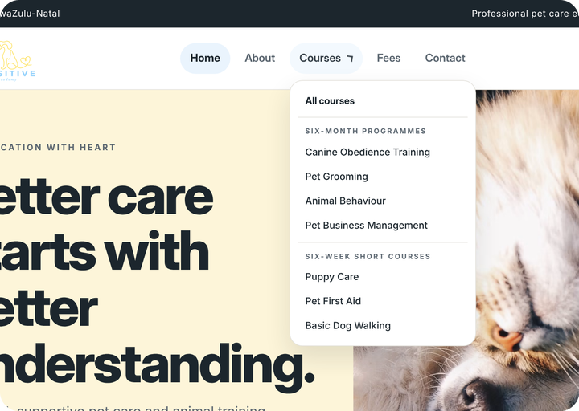
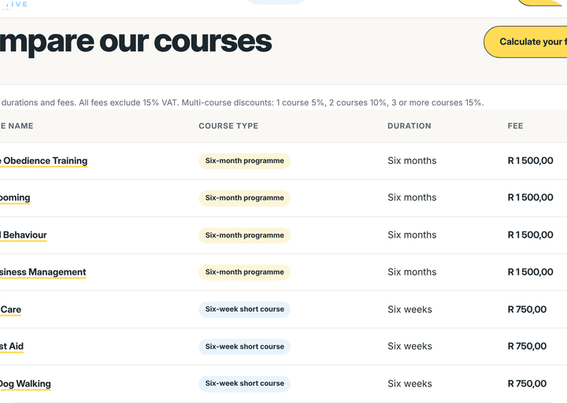
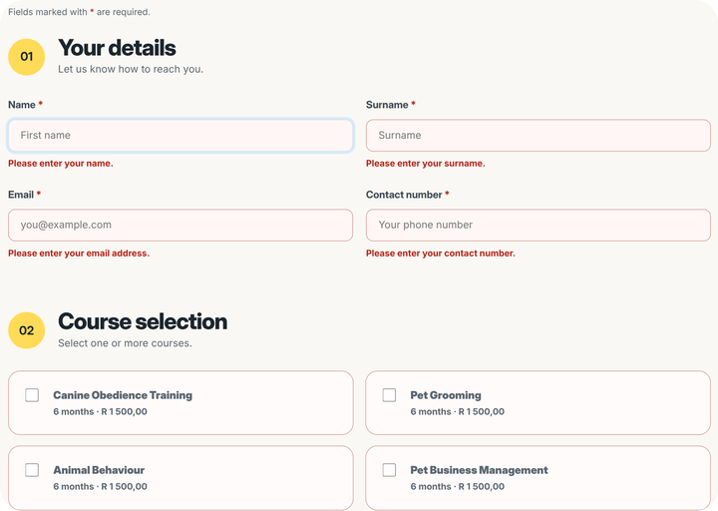
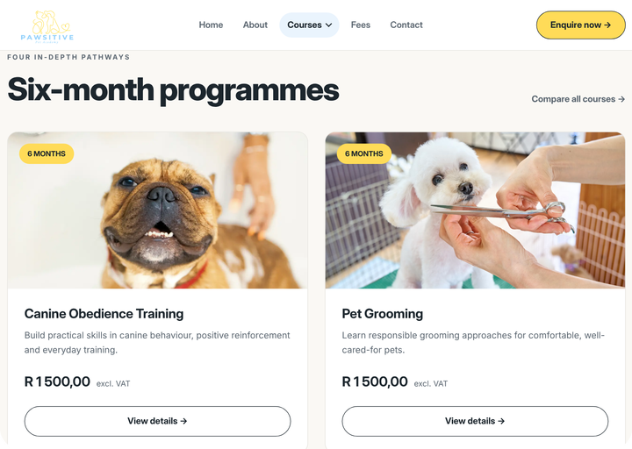
Built with HTML, CSS and JavaScript
05 · WEBSITE DEVELOPMENT
HTML
Structure
CSS
Design
JavaScript
Interaction
1
Responsive design
Layouts adapt to desktop, tablet and phone
2
Courses dropdown
Grouped menu that closes on outside click or Esc
Courses dropdown
Comparison table
3
Comparison table
Name, duration and fee; stacks into cards on phones
4
Fee calculator
Live estimate with discount and VAT
5
Form validation
Clear error messages and an honest confirmation
Form validation
Course cards
Presenter: Musawenkosi
Notes:
SPEAKER: Musawenkosi
Thanks, Ntsako. I'll take you through the technical side of the website.
We split the work across three languages. HTML gives every page its structure, with semantic elements like header, nav, main, section and footer. CSS handles the design. We stored our brand colours and fonts as CSS variables in :root, so one change updates the whole site. JavaScript adds the interactive features, and all of it lives in one file, script.js, loaded on every page.
One: responsive design. We used CSS Grid and Flexbox, plus media queries at 1100 and 760 pixels, so the layout reflows for tablet and phone, and the navigation collapses into a Menu button.
Two: the Courses dropdown. It's built on the HTML details element, and our JavaScript closes it when you click outside it or press Escape, and highlights the page you're currently on.
Three: the comparison table. On small screens, a media query hides the table header and turns each row into a stacked card, using data-label attributes to show the column names.
Four: the fee calculator, which I'll show in detail shortly.
Five: form validation. When you submit, JavaScript checks every field against a rule: required fields, a regular expression for email, and South African phone numbers. Errors appear under each field, the first invalid field gets focus, and we use aria-live so screen readers announce the errors. Because we don't have a backend, the confirmation message honestly says nothing was sent.
Ruthwane will now show you our mobile app.

Slide 7
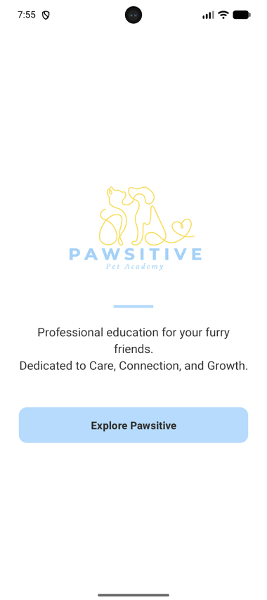
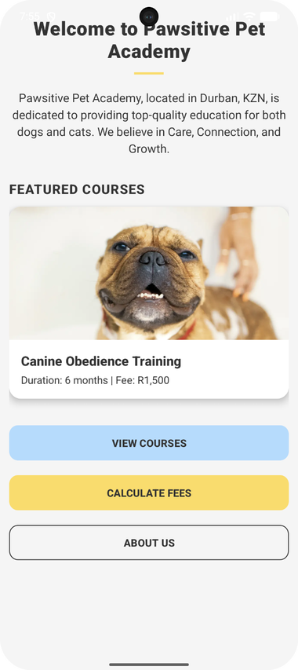




The same brand, designed for a phone
06 · MOBILE APPLICATION DESIGN
Layout
A splash screen with our logo, then a home screen with a featured course and three large buttons.
Navigation
A yellow top bar with a Back button on every screen. Courses are split into programmes and short courses.
Design choices
Butter yellow headers, baby blue buttons and navy headings keep the app on-brand with the website.
Splash screen
Home screen
Courses screen
Presenter: Ruthwane
Notes:
SPEAKER: Ruthwane
Thanks, Musawenkosi. Here are three screens from our Android app.
First, the splash screen. It shows our logo and tagline, with an Explore Pawsitive button.
Second, the home screen. It welcomes users, shows a featured course, and has three big buttons: View Courses, Calculate Fees and About Us.
Third, the courses screen, where users choose between Six-Month Programmes and Six-Week Short Courses.
We chose a simple layout with big buttons because it's easy to use on a small screen, even for someone opening the app for the first time.
For navigation, every screen has a yellow top bar with a Back button, so users always know how to get back.
And for design, we kept the same brand as the website: butter yellow headers, baby blue buttons, navy headings and our logo. So the app and the website clearly feel like one brand.
Nicholas will now explain how we built it.

Slide 8
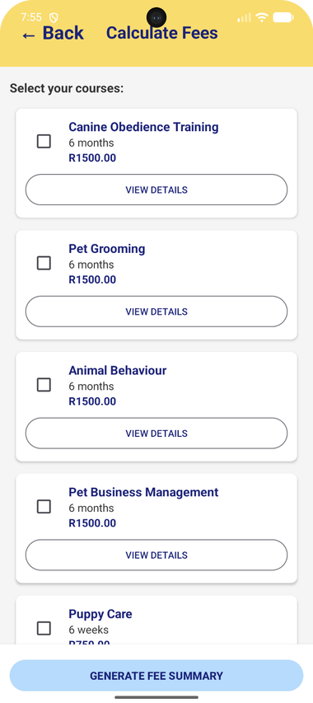
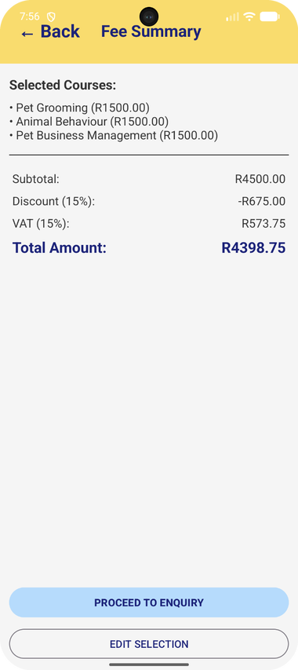




Built in Android Studio with Kotlin and XML
07 · MOBILE APPLICATION DEVELOPMENT
Android Studio
Our development environment, tested on a Pixel 7 emulator.
Kotlin
App logic: button actions, moving between screens and fee calculations.
XML
Screen layouts: text, images, buttons, colours and spacing.
How the screens connect
Splash
›
Home
›
Courses
›
Course lists
›
Calculate Fees
›
Fee Summary
›
Enquiry
Mobile app source code on GitHub
Calculate Fees
Fee Summary
Presenter: Nicholas
Notes:
SPEAKER: Nicholas
Thanks, Ruthwane. Now for the technical side of the app. We built it in Android Studio and tested it on a Pixel 7 emulator.
We separated the app into two parts. XML defines what each screen looks like: the layouts, text, images, buttons and colours. Kotlin controls how the app behaves: what happens when you tap a button, which screen opens next, and the fee calculations.
When you tap a button, our Kotlin code opens the next screen. The flow goes: splash screen, home, courses, the course lists, calculate fees, the fee summary, and then the enquiry.
On the right you can see the Calculate Fees screen, where users tick their courses, and the Fee Summary screen that shows the result. In this example, three six-month programmes come to R4,500. With the 15% discount that's R675 off, then 15% VAT adds R573.75, so the total is R4,398.75. That's the same rule the website uses, so both platforms always give the same answer.
All the source code is on GitHub at the link on this slide.
Musawenkosi will now take you through the fee calculator in more detail.

Slide 9
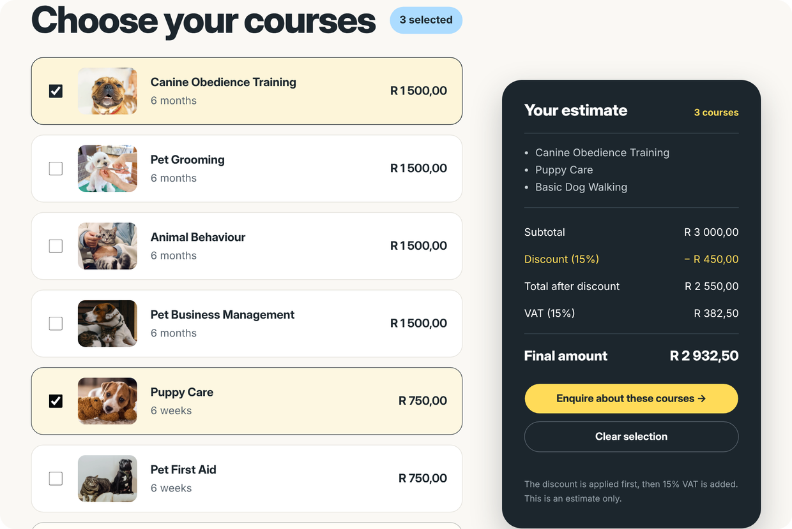
Instant, accurate fees with discounts and VAT
08 · COURSE FEE CALCULATOR
6-month programmes
R1,500
Canine Obedience · Pet Grooming · Animal Behaviour · Pet Business
6-week short courses
R750
Puppy Care · Pet First Aid · Basic Dog Walking
5%
1 course discount
10%
2 courses discount
15%
3+ courses discount
Example: Canine Obedience + Puppy Care + Basic Dog Walking
Subtotal
R3,000.00
Less 15%
−R450.00
Plus 15% VAT
+R382.50
Final amount
R2,932.50
Presenter: Musawenkosi
Notes:
SPEAKER: Musawenkosi
Thanks, Nicholas. The fee calculator is one of the most important features, so let's go through exactly how it works.
The pricing: six-month programmes are R1,500 each, and six-week short courses are R750 each.
The discount depends on how many courses you choose: 5% for one, 10% for two, and 15% for three or more. The order matters here. The discount is applied first, and then 15% VAT is added to the discounted amount.
Let's take the example on screen: Canine Obedience, Puppy Care and Basic Dog Walking. Subtotal: R1,500 plus R750 plus R750, which is R3,000. Three courses means 15% off, so minus R450, leaving R2,550. VAT is 15% of R2,550, which is R382.50. Final amount: R2,932.50.
On the website, JavaScript recalculates this every time a checkbox changes, using a change event listener, so the estimate updates live. If you try to continue without choosing a course, you get an error message. And we format every amount as South African Rand using toLocaleString with the en-ZA locale.
Nicholas will now talk about the challenges we faced.

Slide 10

What we solved along the way
09 · CHALLENGES AND LESSONS LEARNED
1
A tiny CSS typo broke the menu
A double dot in a selector and an unclosed comment stopped the dropdown and our colours from loading. We found and fixed both by checking the CSS line by line.
2
Matching our wireframes
Our first build didn't look like the Figma frames, so we rebuilt the styling directly against the high-fidelity designs.
3
JavaScript rounding
0.15 × 100 showed as 15.000000000000002%. We switched to whole-number percentages to fix it.
4
Forms without a server
With no backend, we validate in JavaScript and show an honest confirmation instead of pretending to send data.
Lessons learned: design before you code · test on phone and desktop early · read the browser console · keep the whole team updated
Presenter: Nicholas
Notes:
SPEAKER: Nicholas
Thanks, Musawenkosi. Like any real project, we ran into problems. Here are four we solved.
First, a tiny CSS typo broke our menu. One selector had two dots instead of one, and the comment at the top of the stylesheet was never closed. Because of that, the browser threw away whole rules: the dropdown links stopped stacking, and our :root colour variables never loaded. Reading the CSS line by line helped us find both.
Second, our first build didn't match our Figma wireframes closely enough, so we rebuilt the styling directly against the high-fidelity designs.
Third, a JavaScript rounding bug. Computers store decimals in binary, so 0.15 times 100 actually comes out as 15.000000000000002. Our calculator was showing that on screen. We fixed it by storing the percentages as whole numbers and dividing by 100.
Fourth, our forms have no server behind them, so we validate everything in JavaScript and show an honest confirmation instead of pretending the message was sent.
The big lessons: design before you code, test on phones early, check the browser console, and keep the whole team updated.
Ruthwane will now give you a demonstration of the website and app.

Slide 11
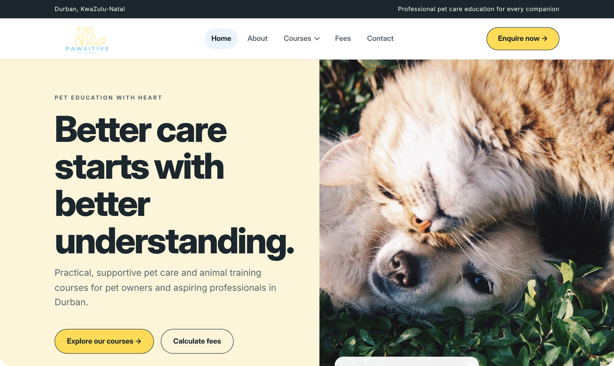


Demonstration: our website and app
10 · DEMONSTRATION
Published website
nicholasramsunder30.github.io/
PawsitivePetAcademy-Website
Website repository
github.com/nicholasramsunder30/
PawsitivePetAcademy-Website
Mobile app repository
github.com/nicholasramsunder30/
PawsitivePetAcademy-MobileApp
Figma wireframes
figma.com/make/JOel0Z9vJuU7ibH3y9wHIf/
High-Fidelity-Website-Wireframe
Website on desktop and phone
Android app
Presenter: Ruthwane
Notes:
SPEAKER: Ruthwane
Now for a demonstration of our website and mobile app.
(For the video: screen-record this part. At the expo: do it live.)
First, the website. Here's our home page. I'll open the Courses dropdown and choose a course to see its details. Next, I'll go to the Fees page and tick a few courses. You can see the estimate update straight away, with the discount and VAT. Finally, if I submit the enquiry form empty, you can see the error messages.
Now the app. I'll tap Explore Pawsitive, then View Courses, and open the Six-Month Programmes. Then I'll go to Calculate Fees, tick some courses and tap Generate Fee Summary, which shows the subtotal, discount, VAT and total.
Everything is publicly available. The links to our published website, our GitHub repositories and our Figma wireframes are on this slide.
Let me wrap up.

Slide 12
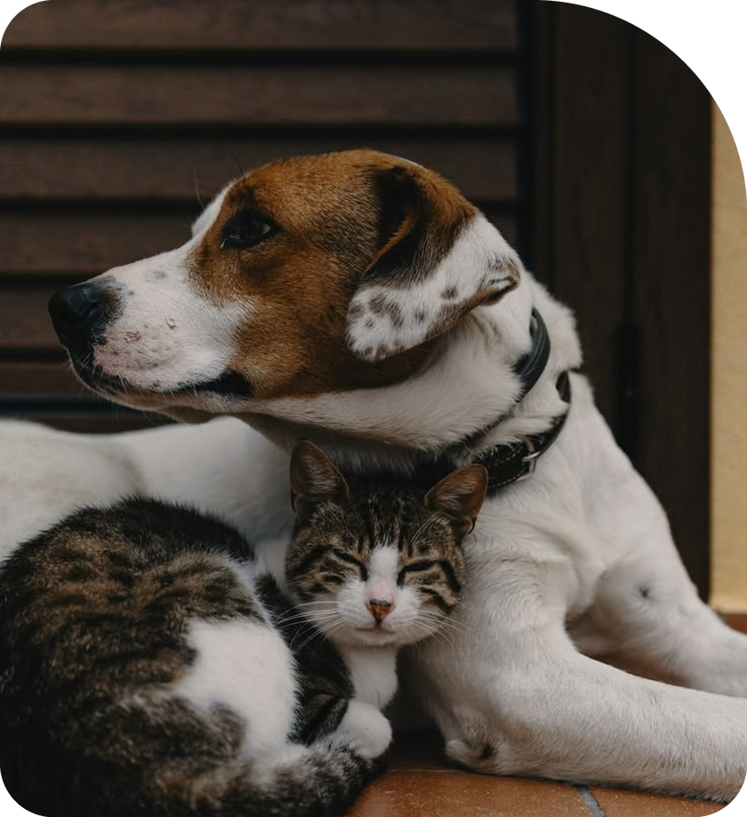
IN SUMMARY
Thank you
A clear brand built on butter yellow and baby blue
Figma wireframes that guided every page we built
A responsive website with a dropdown, comparison table, fee calculator and validated forms
An Android app built with Kotlin and XML
Care. Connect. Grow.
Hlumelo · Ntsako · Nicholas · Musawenkosi · Ruthwane
Notes:
SPEAKER: Ruthwane
To sum up: we created a clear brand using butter yellow and baby blue, designed our pages in Figma first, and built a responsive website and an Android app that both let people explore courses, calculate fees and send an enquiry.
Pawsitive Pet Academy: Care. Connect. Grow.
Thank you for watching.

