Slide 1
HW5: Representation Learning with Autoencoder

Slide 2
Notes
Please make sure you read slide decks 17
Please make sure you read chapter 30 of the textbook

Slide 3
Outline
Recap of Autoencoder
Recap of Convolution
Homework description (programming part)
Homework description (written part)

Slide 4
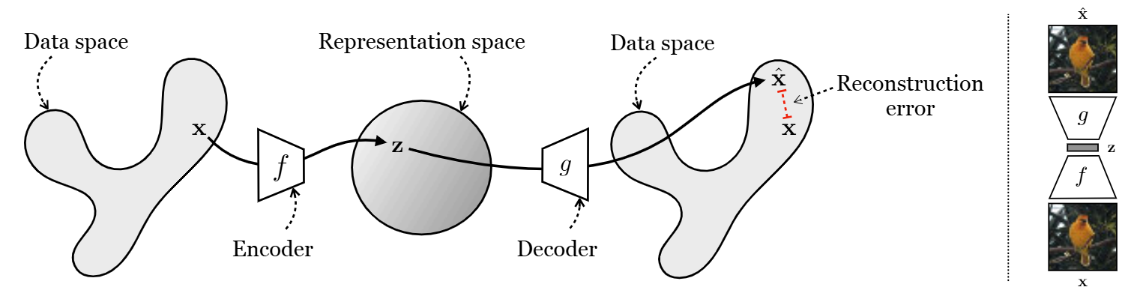

Autoencoder
Objective function:
Design principle: z with lower dimensionality
[Figure credit: A. Torralba, P. Isola, and W. T. Freeman, Foundations of Computer Vision.]

Slide 5
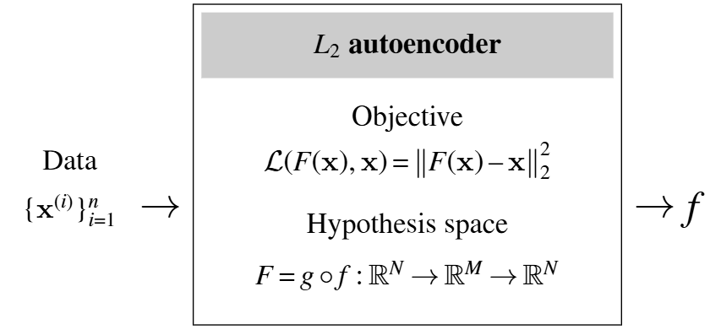
Autoencoder
[Figure credit: A. Torralba, P. Isola, and W. T. Freeman, Foundations of Computer Vision.]

Slide 6
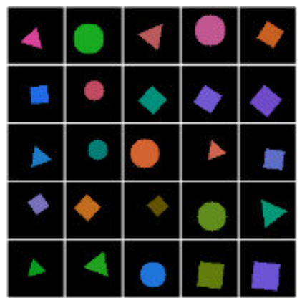
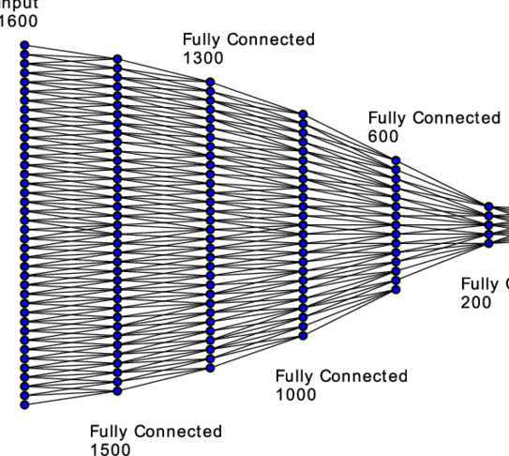
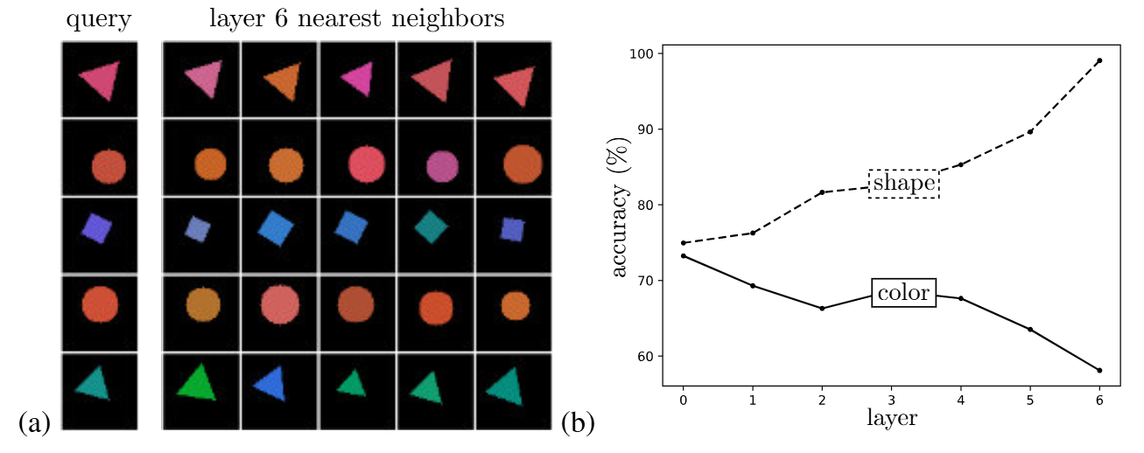
Example
Training data
Nearest neighbor search
[Figure credit: A. Torralba, P. Isola, and W. T. Freeman, Foundations of Computer Vision.]

Slide 7
Convolution
Inner product
Element-wise multiplication and sum
0 | 0 | 1
0 | 1 | 1
1 | 1 | 1
0 | 0 | 0 | 0 | 1
0 | 0 | 0 | 1 | 1
0 | 0 | 1 | 1 | 1
0 | 1 | 1 | 1 | 1
1 | 1 | 1 | 1 | 1
“Filter” weights
(3-by-3)
1
Feature map (nodes) at layer t
Feature map at layer t+1

Slide 8
Convolution
Inner product
0 | 0 | 1
0 | 1 | 1
1 | 1 | 1
0 | 0 | 0 | 0 | 1
0 | 0 | 0 | 1 | 1
0 | 0 | 1 | 1 | 1
0 | 1 | 1 | 1 | 1
1 | 1 | 1 | 1 | 1
“Filter” weights
(3-by-3)
6
Feature map (nodes) at layer t
Feature map at layer t+1

Slide 9
Convolution
Inner product
0 | 0 | 1
0 | 1 | 1
1 | 1 | 1
0 | 0 | 0 | 0 | 1
0 | 0 | 0 | 1 | 1
0 | 0 | 1 | 1 | 1
0 | 1 | 1 | 1 | 1
1 | 1 | 1 | 1 | 1
“Filter” weights
(3-by-3)
Zero-padding: Set the missing values to be 0
1
Feature map (nodes) at layer t
Feature map at layer t+1

Slide 10
Outline
Recap of Autoencoder
Recap of Convolution
Homework description (programming part)
Homework description (written part)

Slide 11
Q1: Generate the Training Dataset
In Q1, you are to implement the following steps
Generate the training data with THREE SHAPES and EIGHT COLORS
You will be given the following
s: scale for the shape
cx and cy: the center of the shape
Shapes:
Circle: Draw a circle centered at (cx, cy) with a diameter of s. Use d.ellipse().
Square: Draw a square centered at (cx, cy), with side length s, and rotated by a random angle. Use d.polygon().
Triangle: Draw an equilateral triangle centered at (cx, cy), scaled by s, and rotated by a random angle. Use d.polygon().

Slide 12
Dataset and Dataloader
Dataset:
Define how to yield one sample
Dataloader
(1 image, label_1, label_2, …)
(1 image, label_1, label_2, …)
A mini-batch of samples with batch size.
(1 image, label_1, label_2, …)
(1 image, label_1, label_2, …)
(1 image, label_1, label_2, …)
(1 image, label_1, label_2, …)

Slide 13
Q2 Create the AutoEncoder and Train It
ColorShapeDataset is responsible for loading each image (given an index) and preparing the labels
In __getitem__, you need to load one path from all_paths using idx
Load the image with PIL.Image, apply the transform
Parse shape & color labels from the filename using parse_labels.
build_dataloader is responsible for creating an instance of the Dataset and wrapping it inside the DataLoader to yield data batch by batch:
Instantiate a ColorShapeDataset with build_transform().
Wrap it in a DataLoader with the given batch_size, shuffle, and num_workers.

Slide 14
Q2 AutoEncoder
Conv2d
BatchNorm2d
ReLU
x6
Encoder
ConvTranspose2d
BatchNorm2d
ReLU
x5
Decoder
ConvTranspose2d
Sigmoid
x1

Slide 15
Q3 K Nearest Neighbor
Distance matrix ‘dist’
Num_ref_embeddings
0.1 | 0.01 | 0.052 | 0.12 | 0.04 | 0.5 | 0.3 | 0.03 | 0.06
Num_query_embeddings
For each query embedding,
You will calculate the distance between this query embedding and all the reference embedding
Thus, ‘dist’ has shape num_query_embembedings x num_ref_embeddings
For K= 3, you will select the closest 3 reference embeddings to plot.
For the distance, please use cosine distance, that is, pre-normalize each vector to have its L2 norm equal to 1, and compute the L2 distance

Slide 16
Q4 Achieve the best shape accuracy
You must NOT use any images from the test set (data_folder_test) for training.
You should NOT do any supervised training using labels from the training data
Potential directions
Modify the autoencoder architecture
Larger model?
Better architecture?
Change the training setup
Better loss?
Adjusting hyper-parameters?
Change the training set or adding data augmentations:
More data?
Data augmentation?

