Slide 1
Ticali Trio
K
3rd
A family-made practice game for kindergarten to 5th grade, based on the reading and math programs Anne Arundel County Public Schools uses
5th
A brief for school leadership · October 2026
From [Your name], parent
One profile per child: a kindergartener, a 3rd grader and a 5th grader
Notes:
This is a short brief about Ticali Trio, a practice game I made at home for my three children, who are in kindergarten, 3rd grade and 5th grade at Anne Arundel County Public Schools. It covers what the game is, what it is for, where its content came from, its limits, and how to try it. It is not an AACPS product, and I am sharing it for your information and feedback.

Slide 2
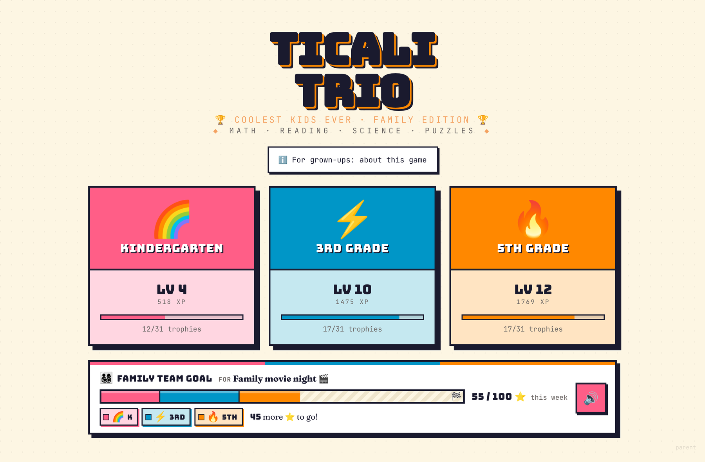
What it is
A learning game I made for my three children in Anne Arundel County Public Schools: a kindergartener, a 3rd grader and a 5th grader. It practices this year’s grade-level work in the programs AACPS uses (Amplify CKLA for reading and Reveal Math for math), explains why each answer is right, and shows those programs’ methods when a child is stuck.
It is one file that opens in a web browser on a laptop or desktop. It needs no internet connection, account or sign-in, and has no ads, tracking or purchases. It has not been reviewed or endorsed by AACPS or its teachers.
237
10,400+
topic packs, kindergarten to 5th grade
written questions, each with an explanation and coaching steps
The title screen: a link for grown-ups, one card per child, and a family goal the three reach together. The levels and stars shown come from a sample save made for these pictures, not the children’s real progress.
780
40
thinking puzzles, plus math generated fresh every round
Reading Road stops, from first letter sounds to comprehension
Notes:
Ticali Trio is a learning game I made for my three children. It practices this year's grade-level work in the programs AACPS uses, Amplify CKLA for reading and Reveal Math for math, explains why each answer is right, and shows those programs' methods when a child is stuck. It is a single HTML file that opens in a web browser on a laptop or desktop, with no internet connection, account or sign-in needed, and no ads, tracking or purchases. It has not been reviewed or endorsed by AACPS or its teachers. The figures are counted from the game itself: 237 topic packs from kindergarten to 5th grade; more than 10,400 written questions, each with its own explanation and step-by-step coaching, and a hint wherever a second try is offered; 780 thinking puzzles; 11 packs of math generated fresh every round; and a Reading Road of 11 lands and 40 stops with 251 story pages and 440 questions. The screenshots in this brief come from the game, using a sample save made for the pictures, not the children's real progress.

Slide 3






What it is for
Practice this year’s work
Understand, not just answer
Learn it the way the programs teach it
Each child’s hub holds this year’s work, with last year’s kept for review. Every grade from kindergarten to 5th is one tap away.
Every answer, right or wrong, is followed by why. On most question types, a wrong answer gets a hint and a second try.
SHOW ME HOW walks through the method step by step, with the question’s own numbers and words: make a ten, the area model, arm blending, look back in the story. Every question has it.
Think, not guess
Grow readers
Keep it fun and kind
Puzzles ask children to pick every answer that fits, put steps in order, sort, or answer and then prove it: the kinds of items on Maryland’s new MSTAR tests.
The Reading Road follows Amplify CKLA’s order of sounds. After the first five stops, each story uses only what the Road has taught so far. In kindergarten and 1st grade, every question, answer and story can be read aloud.
Levels, trophies, a buddy, fact stickers, daily missions, a day streak, boss battles, sprints against the child’s own best and a family goal. Siblings are never ranked; a missed day only restarts the streak.
Notes:
The game has six aims. First, practice this year's work, with last year's kept for review and every grade from kindergarten to 5th one tap away. Second, understanding rather than just answering: every answer, right or wrong, is followed by an explanation, and on most question types a wrong answer gets a hint and one more try. Third, learning it the way the programs teach it: SHOW ME HOW walks through the method Reveal Math or CKLA teaches, step by step, using the question's own numbers and words. Fourth, thinking rather than guessing, with puzzle formats like those on Maryland's new MSTAR tests. Fifth, growing readers through the Reading Road and read-aloud in kindergarten and 1st grade: the Road's first five stops read their stories to the child, and after that each story uses only what the Road has taught so far. Sixth, keeping it fun and kind: levels, trophies, a buddy, stickers that teach a fact, daily missions with a day streak, boss battles, sprints against the child's own best and a family goal. Siblings are never ranked against each other, a pack is a round of ten questions, a wrong answer never takes progress away, and a missed day only starts a new day streak; the best streak is kept.

Slide 4
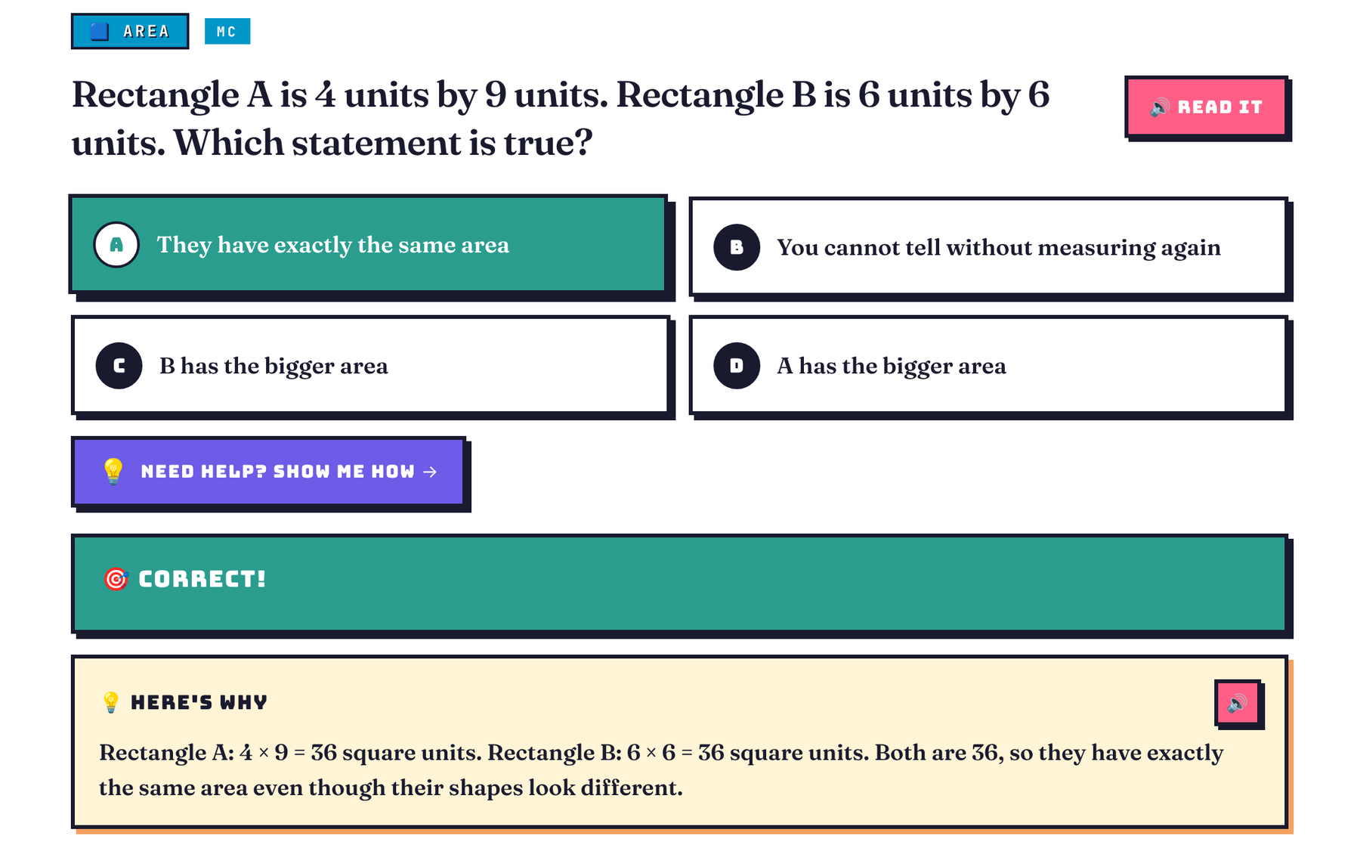
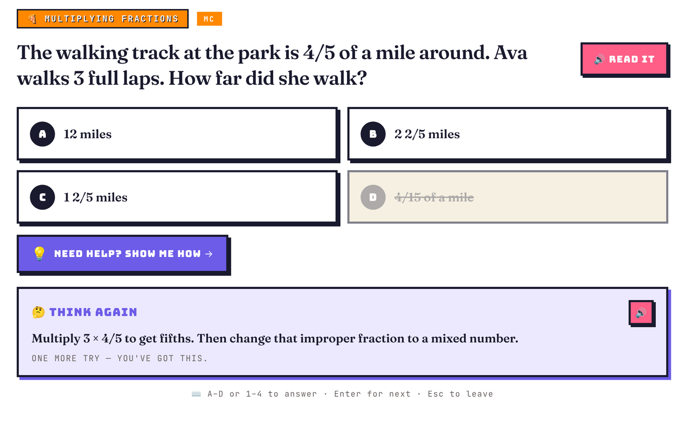
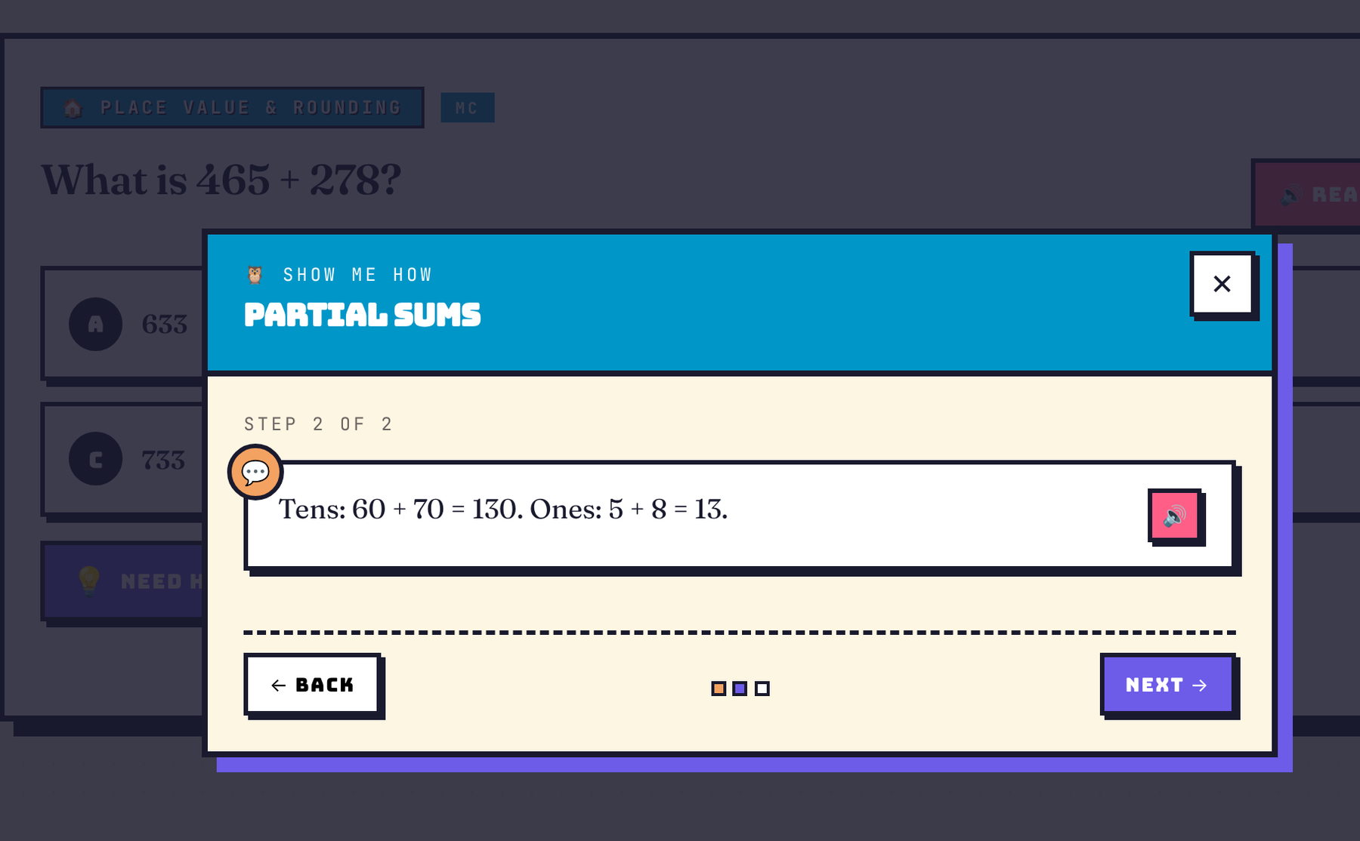
How a round works
A round is ten questions on one topic. It opens with a short card on why the topic matters.
1
Answer, then see why
2
A hint and one more try
3
SHOW ME HOW, any time
3rd grade · Area
5th grade · Multiplying fractions
3rd grade · Partial sums
After every answer, right or wrong, HERE’S WHY explains it.
After a wrong answer on most question types, THINK AGAIN gives a hint and a second try. A parent can turn second tries off for test-style practice.
The coach walks through the method Reveal Math or CKLA teaches, step by step, with the question’s own numbers, then hands the question back.
Notes:
A pack is a round of ten questions on one topic, and it opens with a short card on why the topic matters. After any answer, right or wrong, HERE'S WHY explains it. After a wrong answer, THINK AGAIN gives a hint and one more try, on every question type except true or false and two-part questions; a parent can switch second tries off for test-style practice. At any time, SHOW ME HOW walks through the method Reveal Math or CKLA teaches, step by step, with the question's own numbers and words, then hands the question back. Every one of the more than 10,400 written questions has its own coaching steps, and math questions generated each round build theirs from their own numbers. Question types include multiple choice, true or false, typing the answer, fill in the blank, show your work on paper, and four puzzle types.

Slide 5


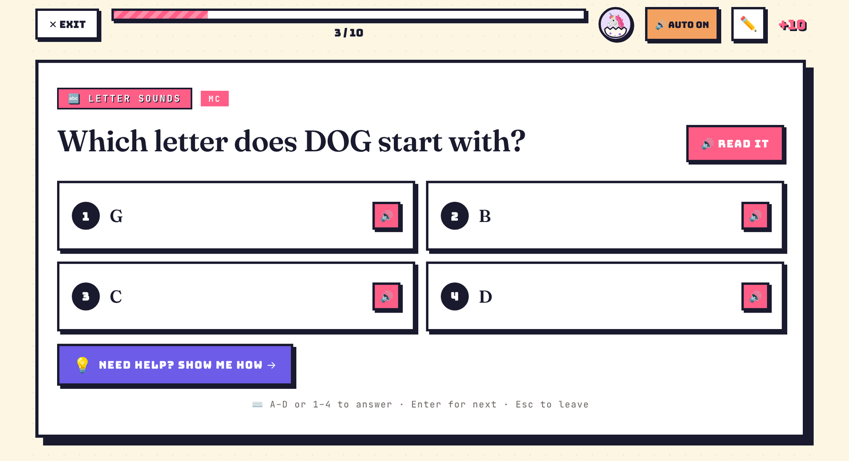
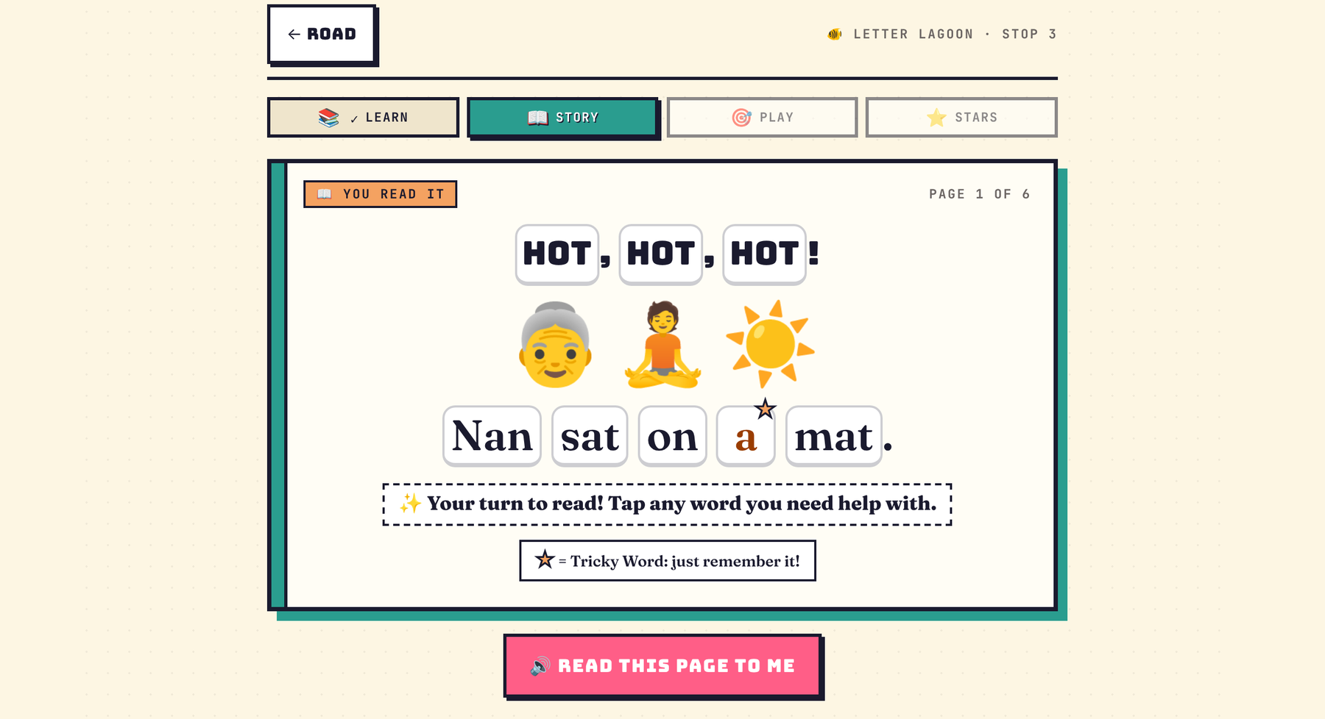
For children who cannot read yet
Read-aloud for early readers
The Reading Road
Kindergarten · Letter sounds: READ IT, a speaker on each numbered answer, AUTO on
Letter Lagoon, stop 3: a story page. The star marks a Tricky Word.
Every kindergarten and 1st grade question, answer and story has a speaker button. The kindergartener’s questions read themselves aloud.
Letter sounds are read as sounds, not names. One limit: when blending a word, the voice says /k/ and /t/ as “kuh” and “tuh”.
11 lands and 40 stops, from first letter sounds to comprehension, in the order Amplify CKLA teaches the sounds.
Each stop has learn cards, a story, games and questions. From stop 6 on, the child reads the story with only what the Road has taught.
Notes:
In kindergarten and 1st grade packs, every question, answer choice, puzzle piece, sort group and story has a speaker button, and the kindergartener's questions read themselves aloud (AUTO turns this on for any child), so a child who cannot read yet can play without a grown-up reading to them. In kindergarten and 1st grade, answer tiles are numbered 1 to 4, the numbers the voice names, except where the answers are themselves numbers. Letter sounds are read as sounds, never letter names, in the most natural voice the device offers. One limit: when the voice sounds out a word for blending, it says the short sounds /k/ and /t/ as kuh and tuh, because a speech engine cannot say them short. The written explanations give a key word instead, and a grown-up can model the short sounds. The Reading Road is a map from first letter sounds to comprehension, in the order Amplify CKLA teaches the sounds: 11 lands and 40 stops, with 251 story pages and 440 questions. Each stop teaches one piece of the code (or one comprehension skill) with learn cards, then gives a short story (read to the child in the first five stops; after that, one the child reads with only what the Road has taught so far, checked word by word), then practice games and questions about the story. The kindergartener starts at the first stop, the 3rd grader at Big Word Bay and the 5th grader at Detective Island, and every earlier stop stays open.

Slide 6

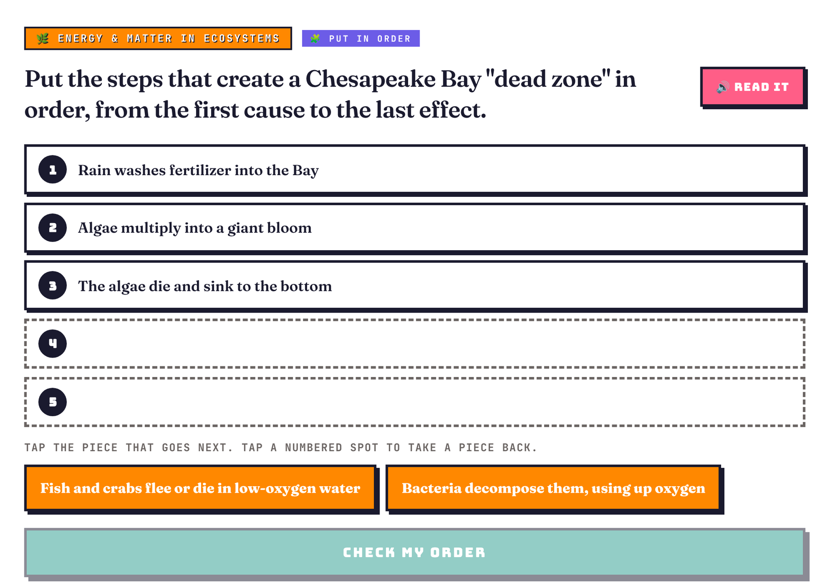




What it follows
Reading and writing
Amplify CKLA, which AACPS uses in K-5. Reading packs follow each grade’s CKLA units (2nd edition). Phonics follows CKLA Skills.
Math
McGraw Hill Reveal Math, which AACPS uses in K-5, and Maryland’s revised math standards (adopted July 2025, in effect this school year).
Science
Maryland’s NGSS-based standards. The grade 5 science test (MISA) covers grades 3-5, so 4th grade science stays available to the 5th grader.
Social studies
Maryland’s social studies framework, revised in 2025.
A 5th grade “put in order” puzzle: the steps that create a Chesapeake Bay dead zone. Ordering, pick-all, sorting and answer-then-prove items practice MSTAR-style formats.
Tests
Item formats like those on MSTAR, which replaces MCAP for grades 3-8 reading and math from spring 2027.
Questions are written to these topics; they are not tagged with standard codes.
Notes:
Reading and writing follow Amplify CKLA, which AACPS uses in K-5; the reading packs follow each grade's CKLA units in the 2nd edition, and phonics follows the CKLA Skills sequence. Math follows McGraw Hill Reveal Math, which AACPS uses in K-5, and Maryland's revised math standards, adopted in July 2025 and in effect this school year. SHOW ME HOW uses Reveal Math's strategies grade by grade and CKLA's reading routines. Science follows Maryland's NGSS-based standards. Because the grade 5 science test, MISA, covers grades 3 to 5, the 5th grader keeps 4th grade science on hand. Social studies follows Maryland's framework, revised in 2025. The puzzle questions practice formats similar to those on MSTAR, which replaces MCAP for grades 3 to 8 reading and math from spring 2027. Health packs use general elementary health content and leave out family-life topics; AACPS's health scope and sequence was not found. Questions are written to these topics; they are not tagged with standard codes.

Slide 7


How it was made, and its limits
How it was made
Its limits
The questions, explanations, coaching steps and stories were written by an AI assistant at my direction, working from the official curriculum information that is publicly available. They were then checked by automated tests and by further AI review passes that re-solved every question.
Documents the AI assistant read in full:
Amplify’s published CKLA curriculum maps and K-5 program guide
The openly licensed Core Knowledge teacher guides CKLA is built on
McGraw Hill’s published Reveal Math alignment documents for grades 3-5
A Reveal Math pacing guide from a district in another state
An AACPS family handout on math strategies
These were public PDF copies of the documents.
It is not an AACPS product, and has not been reviewed or endorsed by AACPS or its teachers.
It is not a product of Amplify or McGraw Hill, and neither has reviewed or endorsed it.
The AI assistant could not open several official websites (AACPS, MSDE, McGraw Hill, Amplify) directly, so some details rest on search results that quote them.
It did not use AACPS pacing guides, teacher editions or other licensed classroom materials.
Two things could not be confirmed: which edition of Amplify CKLA (2nd or new 3rd) AACPS classrooms use this year (the reading packs follow the 2nd edition’s units), and how AACPS maps Reveal Math onto Maryland’s revised standards.
AACPS’s health scope and sequence was not found; health packs use general content and leave out family-life topics.
A question can still be wrong. Corrections are welcome.
Notes:
I want to be plain about how this was made. The questions, explanations, coaching steps and stories were written by an AI assistant at my direction, working from the official curriculum information that is publicly available. They were then checked by automated tests, which check every question's format and that every pack deals a full, explained round, and by further AI review passes that re-solved every question and were told to assume there were mistakes. The documents the AI assistant read in full, from public PDF copies that opened even though the official websites did not, were Amplify's published CKLA curriculum maps and K-5 program guide, the openly licensed Core Knowledge teacher guides CKLA is built on, McGraw Hill's published Reveal Math alignment documents for grades 3 to 5, a Reveal pacing guide from a district in another state, and an AACPS family handout on math strategies. The limits: it is not an AACPS product and has not been reviewed or endorsed by AACPS or its teachers. Nor is it a product of Amplify or McGraw Hill, the publishers of CKLA and Reveal Math, and they have not reviewed or endorsed it. The AI assistant could not open several official websites, including AACPS, MSDE, McGraw Hill and Amplify, directly while the game was built, so some details rest on search results that quote them. It did not use AACPS pacing guides, teacher editions or other licensed classroom materials. It could not be confirmed whether classrooms use the 2nd or the new 3rd edition of Amplify CKLA this year (the reading packs follow the 2nd edition's units), or how AACPS maps Reveal Math onto Maryland's revised standards. AACPS's health scope and sequence was not found, so the health packs use general elementary health content and leave out family-life topics. A question can still be wrong, and corrections are welcome.

Slide 8






Privacy, and how to try it
Laptop or desktop (Windows, Mac or Chromebook)
Save the attached file Ticali_Trio_Family_Edition.html, then double-click it. It opens in the web browser. If your email system held the file back, please let me know.
Privacy
No accounts or sign-in. The only names are the profile labels Kindergarten, 3rd Grade and 5th Grade.
Progress is saved only in the browser on the device it is played on. A child’s answers are never sent anywhere.
No ads, tracking or purchases.
When online, the page loads its typefaces from Google Fonts. Some browsers’ most natural read-aloud voices are online and receive the words read aloud: the game’s own, plus any buddy name a 3rd or 5th grader types. A parent can choose a voice built into the device instead.
iPad
An emailed or downloaded copy opens in a preview that does not run the game (an iPad runs it only from a web address).
For grown-ups
On the title screen, “For grown-ups: about this game” explains what the game is, how it was made and its limits, and lists every grade’s packs.
Play
Click a grade’s card to open that child’s hub, then a pack to play a round. Explore Any Grade, near the bottom of every hub, opens all of K-5.
Parent dashboard
The small, faint word “parent” at the bottom right of the title screen shows progress and settings. The PIN is 0000.
Anything you do in the game stays on your own device. It does not touch the children’s progress at home.
Notes:
Privacy: there are no accounts and no names beyond the profile labels Kindergarten, 3rd Grade and 5th Grade. Progress is saved only in the browser on the device it is played on, and a child's answers are never sent anywhere. There are no ads, tracking or purchases. When online, the page loads its typefaces from Google Fonts, and some browsers' most natural read-aloud voices are online voices, which receive the words being read aloud: the game's own words, plus any name a 3rd or 5th grader types for their buddy. A parent can choose a voice built into the device instead. To try it: on a laptop or desktop, save the attached file Ticali_Trio_Family_Edition.html and double-click it; it opens in the web browser. If your email system held the file back, please let me know. On an iPad, an emailed or downloaded copy opens in a preview that does not run the game; an iPad runs it only from a web address, so please use a laptop or desktop. On the title screen, For grown-ups: about this game, above the three cards, explains what the game is, how it was made and its limits, and lists every grade's packs. Click a grade's card to open that child's hub, then a pack to play a round; Explore Any Grade, near the bottom of every hub, opens all of K-5. The small, faint parent link at the bottom right of the title screen opens the parent dashboard; the PIN is 0000. Anything you do stays on your own device and does not touch the children's progress at home.

Slide 9
I would welcome your feedback
K
3rd
I am sharing the game for your information, and would welcome feedback, especially on how well it matches what is taught in my children’s school.
If a question looks wrong, it may well be wrong, and corrections are welcome.
5th
[Your name], parent
Notes:
Thank you for looking at this. I am sharing the game for your information, and I would welcome any feedback, especially on how well the game matches what is taught in my children's school. If a question looks wrong, it may well be wrong, and I would be glad to correct it.

