Slide 1




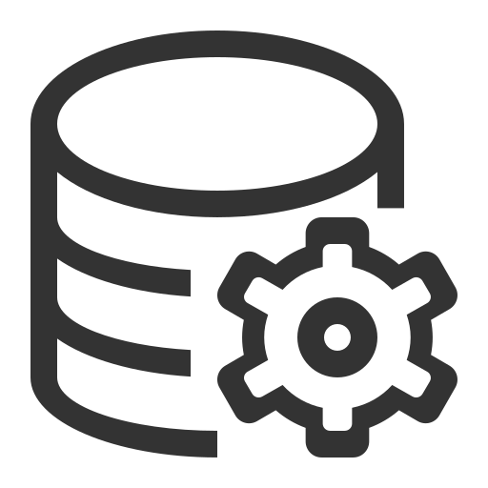

AI is only as smart as the data behind it Most organizations have access to AI. Few have data that AI can actually understand and trust.
87%
of organizations say data readiness and context are barriers to AI adoption¹
12%
believe their data is sufficiently ready for AI ²
</>
AI Agents
AI Assistants
Copilots
Analytics
90%
of enterprise data is unstructured ³
Enterprise Data
1 Survey: Context Engineering Challenges Hinder AI Success, Techstrong 2 “The Future of AI is Open” IBM, 2024, https://research.ibm.com/blog/ai-open-think 3 Precisely. 2025 Outlook: Data Integrity Trends and Insights
Nichole Zheng Nicholezheng123@ibm.com
Notes:
Introduction
Today I'd like to introduce IBM watsonx.data intelligence and discuss how it helps organizations create trusted, AI-ready data.
As companies continue investing in AI, many are discovering that the biggest challenge isn't the AI models themselves—it's making sure AI has access to trusted, governed, and understandable data.
Today I'll cover three things:
1. The business problem organizations face
2. How IBM solves that problem with watsonx.data intelligence
3. The business value customers achieve
---
Before going into the product, I would like to talk the challenge many organizations face.
Today, most organizations already have access to AI technologies such as AI agents, AI assistants, copilots, and advanced analytics. The technology itself is no longer the biggest barrier.
The challenge is that AI needs context.
AI is only as smart as the data behind it.
Diagram: 4 things organizations are investing heavily in today. These are the outcomes companies want.
AI agent automate tasks
assistant answer employee questions
copilot help sales or developers work more efficiently
analytics helps organizations make better decisions.
But notice that all four of these capabilities are connected to a single foundation: enterprise data.
AI must understand an organization's enterprise data — customer information, business processes, documents, policies, contracts, and operational data.
The problem is that most organizations struggle to make that data usable for AI.
In fact, 87% of organizations say that data readiness and context are barriers to AI adoption.
Even more surprisingly, only 12% believe their data is sufficiently ready for AI.
And a major reason for that is shown in the bottom statistic: 90% of enterprise data is unstructured.
That means valuable information is trapped inside emails, PDFs, documents, reports, presentations, and other formats that AI often cannot easily understand or trust.
So while many companies are investing heavily in AI, they're discovering that the real challenge isn't the AI itself.
Transition
And that's exactly where IBM watsonx.data intelligence comes in."

Slide 2




Watsonx.data intelligence Turning enterprise data into trusted intelligence
Core Capabilities
IBM Knowledge Catalog
Find and understand your data assets
Manta
Provides data lineage and understand where data originated
Enterprise Data
From across your organization
Watsonx.data intelligence
Unifies and understands your data
Trusted Context
Meaning, lineage, ownership, quality
Humans + AI
Make better faster decisions
Data Product Hub
Package and share trusted data products
Metadata provides context.
Helps us understand what data means, who owns it, where it came from, and whether we can trust it.
Notes:
IBM solves that challenge with watsonx.data intelligence. At a high level, it helps organizations connects scattered data across systems and turns them into trusted intelligence that both humans and AI can use.
If we follow the flow across the diagram from left to right, we start with enterprise data.
- This data exists across many different systems throughout an organization. It could include customer information, financial records, documents, and operational data. The challenge is that this information is often scattered across hundreds of locations and formats.
- watsonx.data intelligence
- Help organizations discover, connect, organize, and understand their data. Rather than simply storing data, it helps create a complete understanding of what that data means and how it relates to the rest of the business.
Leads to what IBM calls trusted context.
- Trusted context means understanding important information about the data, such as:
- What the data represents , Where it came from
- Who owns it, How it has changed over time
- Whether it can be trusted for business decisions or AI apps
Once organizations have that trusted context, both humans and AI systems can use the data with confidence to make faster and better decisions.
So the key idea of this slide is that watsonx.data intelligence acts as the bridge between raw enterprise data and trustworthy business outcomes.
---
This is made possible through three key capabilities.
IBM Knowledge Catalog: searchable inventory of an organization's data (Google search engine for enterprise data. Instead of spending hours searching through databases and spreadsheets, employees can quickly find trusted data, understand where it came from, and use it confidently for analytics and AI)
Manta tracks where data originated, how it moved through systems, and how it was transformed along the way.
Data Product Hub helps organizations package and share trusted data products so teams can easily access the information they need (Marketplace for data products)
---
Together, these capabilities create a metadata foundation that gives data meaning and context.
Metadata means 'data about data.’ It gives idea of who, what, when and where the data came from. With metadata, data becomes understandable and trustworthy, which is exactly what AI needs to generate accurate results.
---
So watsonx.data intelligence isn't just helping organizations manage data. It's helping them create trusted context, which ultimately makes AI more accurate, more explainable, and more valuable to the business.

Slide 3
Creating an intelligent metadata foundation
Discover
Find trusted data quickly
Natural language search
Data cataloging
Business glossary
Govern
Ensure security & compliance
Policy management
Data classification
Access controls
Understand
Gain visibility into data lineage
Track data flow
Impact analysis
Root cause analysis
Reuse
Turn data into reusable products
Data Product Hub
Self-service access
Faster delivery of new use cases
Notes:
IBM approaches this through four core capabilities : Discover, Govern, Understand, and Reuse.
Discover
- Organizations often have data spread across hundreds of systems, making it difficult for employees and AI applications to find the right information.
- IBM helps users quickly discover trusted data through capabilities like natural language search, data cataloging, and business glossaries.
- Instead of spending hours searching for data, users can find what they need in seconds.
2. Govern
Data found, needs to govern to make sure data is secure, compliant, and being used appropriately.
- IBM provides policy management, data classification, and access controls to help organizations manage sensitive information and meet regulatory requirements. This helps organizations build trust while reducing risk.
3. Understand
- t's not enough to know that data exists—we also need to understand where it came from and how it has changed over time.
IBM provides visibility into data lineage, allowing organizations to track data flow, perform impact analysis, and identify root causes when issues arise.
This creates transparency and confidence in the data being used by both people and AI.
4. Reuse
- organizations can maximize its value through Reuse.
Instead of repeatedly creating new datasets for every project, teams can package trusted information into reusable data products.
Through capabilities like Data Product Hub and self-service access, organizations can accelerate new AI and analytics initiatives while reducing duplication of effort.
---
Together, these four capabilities create a strong metadata foundation.
Organizations can discover their data, govern it properly, understand its context, and reuse it across the business.
The result is not just better data management. The result is measurable business value."

Slide 4

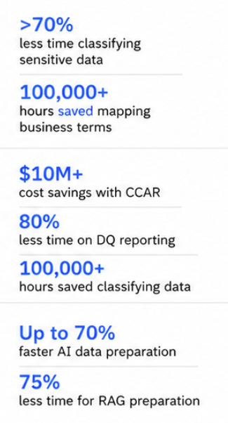

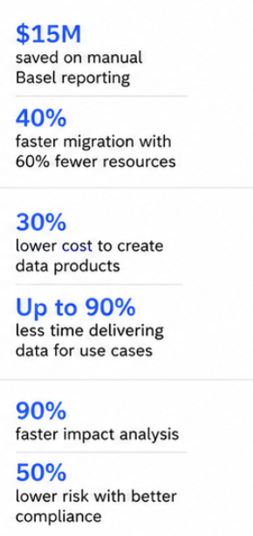
What outcomes does the customer achieve?
Data Lineage
Trusted, governed data for AI
Data Products
Trusted, governed data for AI
Impact & Compliance
Lower risk, greater impact
Data Governance
Trusted, governed data for AI
Data Quality
Trusted, governed data for AI
AI-Ready
AI-ready data at scale
Notes:
When customers implement watsonx.data intelligence, the outcomes extend beyond IT and data teams.
first outcome is faster AI adoption
Organizations can prepare governed, trusted data for AI significantly faster, with some customers seeing up to 70% faster preparation of AI-ready data.
2nd outcome is better decision making
When users can find trusted data and understand its context, they make decisions with greater confidence and less uncertainty.
3rd outcome is reduced risk
Governance, lineage, and policy enforcement improve compliance and auditability while helping protect sensitive information.
Finally, organizations gain higher productivity.
Employees spend less time searching for data and less time manually creating metadata.
Some organizations have reduced time spent searching for data by more than 75%, while AI-powered metadata generation has saved thousands of hours of manual effort.
Ultimately, the value isn't just managing data better.
The value is helping organizations accelerate AI adoption while increasing trust and reducing risk.
---
Let's look at what this can look like in practice.

Slide 5






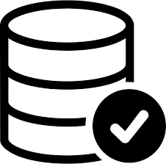



Real-world Impact
A global aerospace, defense, security, and advanced leader focused on innovation that matters
BEFORE
IBM Solution
Results
46
different data sets
Fragmented AI and analytics environment
Data silos
Unified data foundation
Governance and metadata management
Trusted AI environment
20%
improvement in AI response accuracy
46
systems consolidated
50%
reduction in data and AI tools
Notes:
A great example of this is Lockheed Martin.
Before working with IBM, Lockheed Martin faced significant data fragmentation.
- 46 different data systems and tools, multiple data silos, and a fragmented AI and analytics environment.
This made it difficult to create a consistent and trusted foundation for AI.
Using IBM's data intelligence capabilities, they established a unified data foundation, implemented governance and metadata management, and created a trusted AI environment.
As a result:
AI response accuracy improved by 20%
46 systems were consolidated
Data and AI tools were reduced by 50%
This demonstrates the broader goal of watsonx.data intelligence.
It's not simply about managing metadata.
It's about transforming enterprise data into trusted intelligence that enables better decisions, stronger governance, and more successful AI initiatives.
---
Data silos are isolated collections of data stored within one department or system
So to summarize:
Organizations today don't have an AI problem—they have a data context problem.
IBM watsonx.data intelligence helps solve that challenge by creating trusted context around enterprise data through discovery, governance, lineage, and reuse.
The result is trusted AI-ready data, faster decision making, lower risk, and improved business outcomes.

