Slide 1


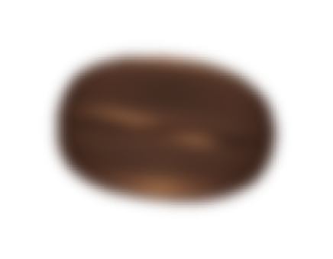
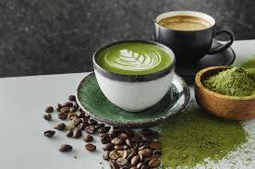
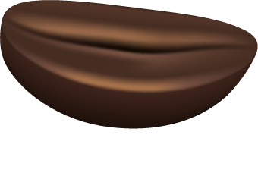
Global Caffeine Consumption & Health Patterns
Final Presentation & Demo
W209 Section 3: Abhay Naik • Nichol Flowers • Oleksii Lavrenin • Bryan Park
Notes:
My name is Nichol and I’m here with my team Abhay, Oleksii, and Bryan. We are Team CoffeeLens.
Our project focuseS on Global Caffeine Consumption and Health Patterns.

Slide 2

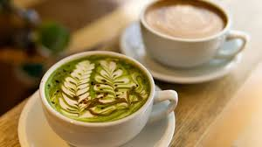
Introduction
For many, caffeine is part of daily life, and its relationship to stress depends on more than intake alone. We set out to examine how caffeine relates to stress and how factors such as country, age, sleep, and physical activity shape that relationship.
Notes:
Caffeine is one of the most widely consumed stimulants in the world.
It is found in coffee, tea, matcha, energy drinks,and more and is how billions of people start their day.
Most people think of it as a way to wake up and stay alert, but it's relationship with sleep, stress and even age vary greatly from person to person.
We used a synthetic dataset from Kaggle representing 20 countries to examine how caffeine relates to stress and how factors such as country, age, sleep and physical activity shape that relationship,
Our goal was to create an interactive tool that allows users to visualize and explore these relationships in a meaningful way.

Slide 3
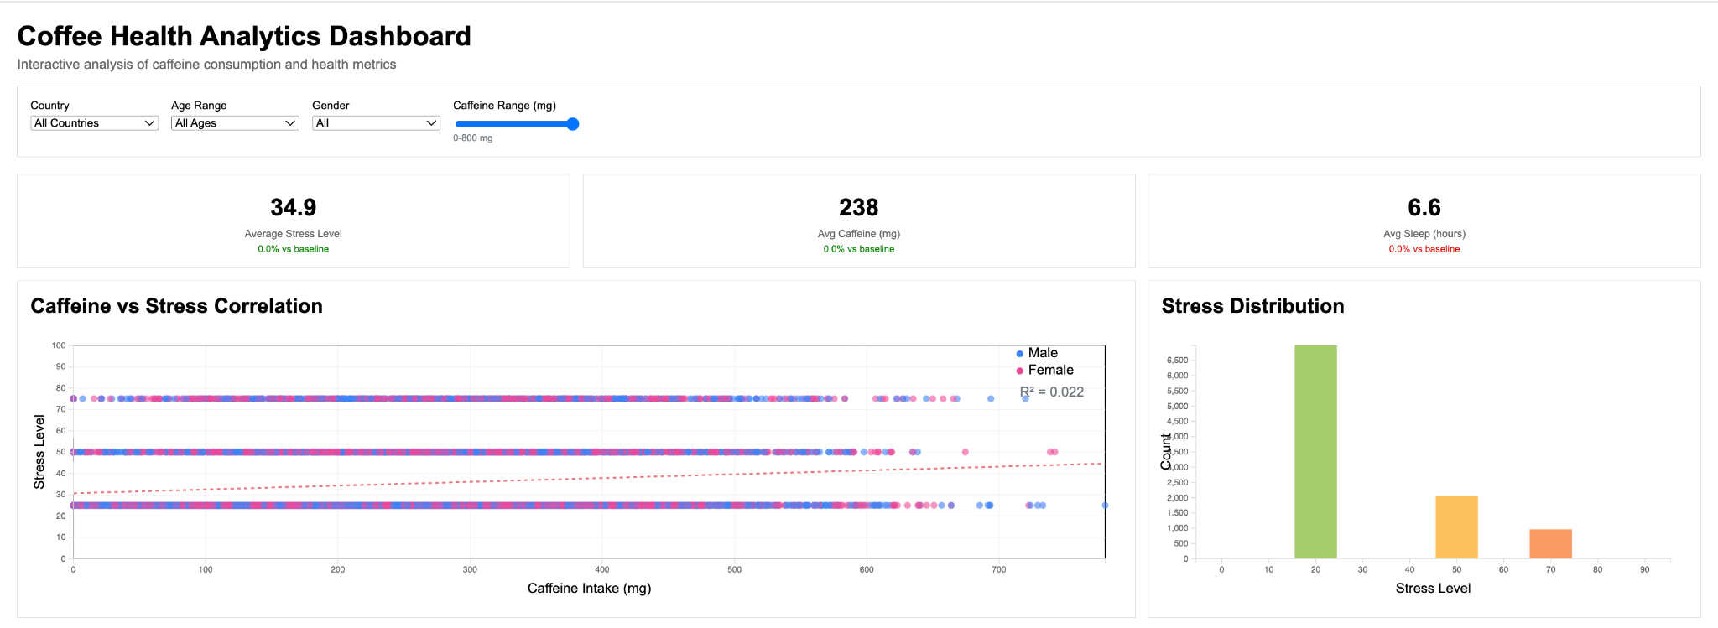
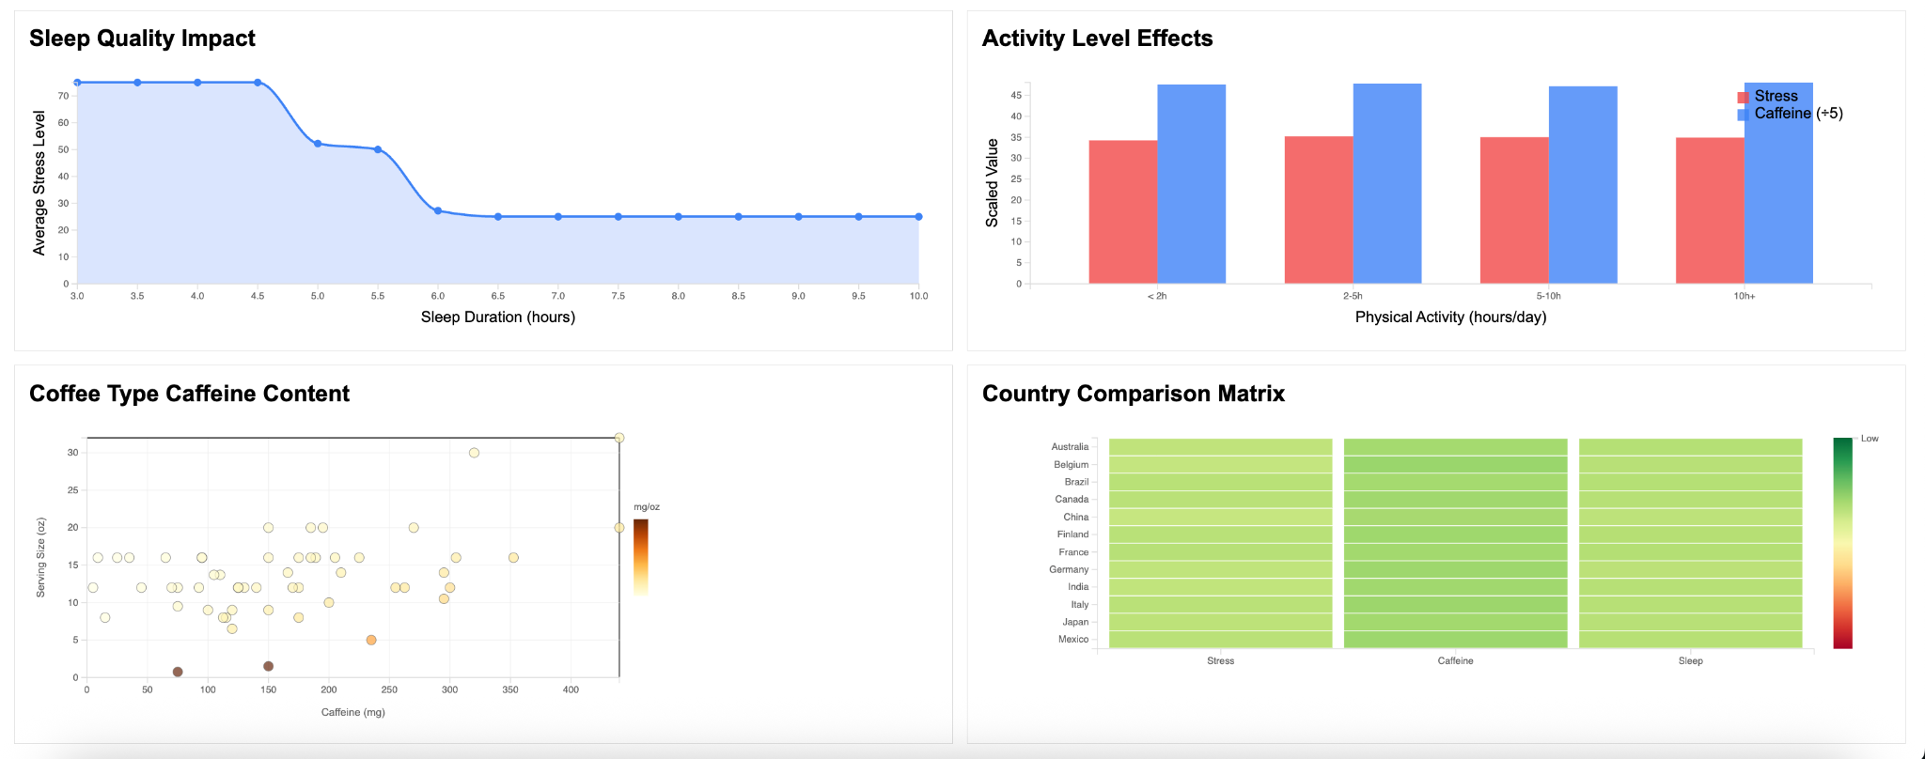
Iteration 1 (Dashboard)
Our Starting Point
Built a traditional D3.js dashboard exploring 10,000 records across 20 countries with real-time filtering by country, age, gender, and caffeine intake
Technical Foundation
Pure D3.js v7 with responsive CSS Grid, interactive tooltips, linear regression, and animated transitions across all charts
Key Features
Scatter plots, histograms, heatmaps, and metric cards with color encoding for gender, stress intensity, and caffeine levels
Notes:
Our first iteration was a traditional dashboard. It helped us explore the data, but many of the relationships we cared about were still difficult to see. We wanted the visualization to make the invisible visible, meaning we wanted users to understand how caffeine and lifestyle factors interact without having to interpret rows of charts or raw numbers.
That led us to design a more interactive, human centered view where people can adjust variables like caffeine, sleep, age, and activity, and immediately see how those changes relate to predicted stress.

Slide 4
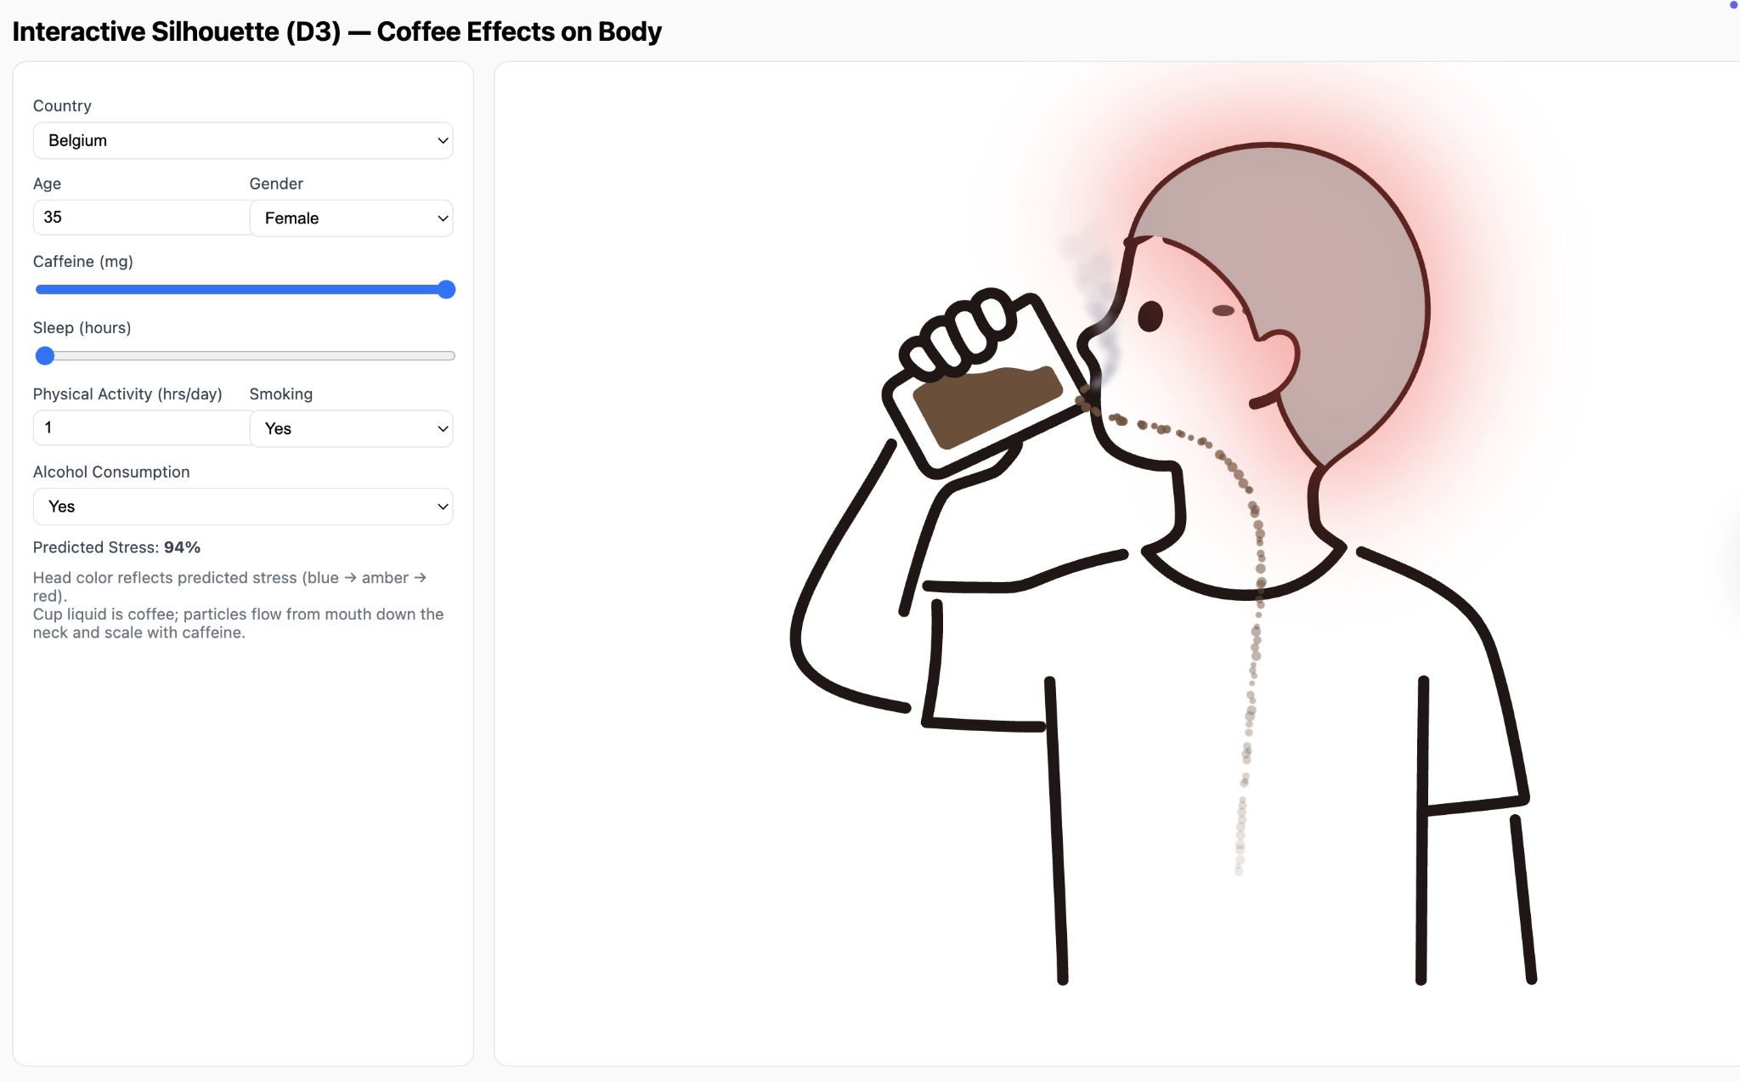
Iteration 2 (Interactive)
Human-Centered Design
Replaced abstract charts with a body silhouette visualization showing stress via head color and animated coffee particles flowing through the body
Interactive Controls
20 countries, 54 coffee products, caffeine (0-800mg), sleep hours, smoking, alcohol, and physical activity controls
Visual Feedback
Stress color gradient (blue to red), pulsing glow at high stress, smoke particles for smokers, and caffeine particles scaling with intake
Notes:
Summarize other changes we made per Usability Feedback:

Slide 5
Usability Study
MoSCoW Priority | Issue
Must | Add numeric labels to the sleep slider (e.g., “6 hrs”, “7 hrs”).
Must | Make predicted stress value significantly more prominent (larger font, bold, reposition). Move to the top of the page instead the bottom
Must | Add a color legend/scale explaining head color → stress mapping.
Must | Provide context/explanation of what the stress % represents and how it’s calculated.
Should | Improve title clarity and hierarchy (e.g., bigger title, short subtitle describing purpose).
Should | Add descriptions or tooltips explaining why country and age impact stress.
Should | Enhance visual changes when adjusting certain parameters (e.g., age). Nothing happens when age is changed by itself
Won't | Add message that signals user that new updates have been applied.
Could | Improve right/left layout balance (larger left visualization panel).
Won't | Allow coffee size/type to influence stress more realistically.
Could | Add optional source or “about the data” section.
Could | Add reset button so the viz can return to default values after use.
Won’t (for now) | Full redesign of character animation or visual aesthetic.
Must | Correct Title. Says Coffee instead of Caffeine
Must | The color scheme for stress is supposed to be blue -> amber -> red. viz uses green instead of blue. Update note or fix color
Should | Extend color representation for stress onto arms, hand to make it more intuitive.
Must | Stop updating caffeine when selecting new country. Make all countries default to same caffeine (mg).
Notes:
Usability results, metrics, (we interviewed this many people)
41 requests
3 interviews per team member

Slide 6
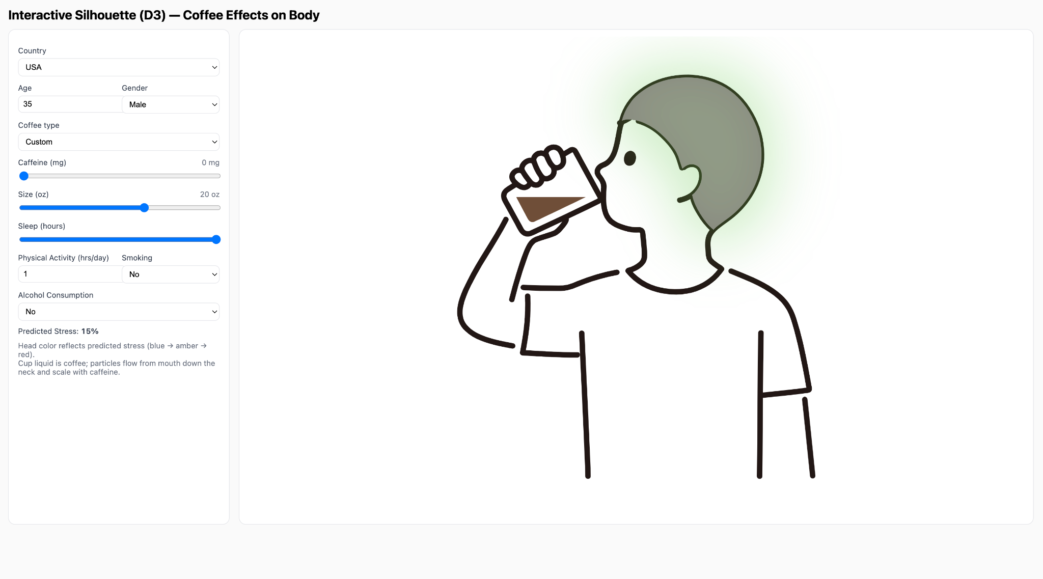
Caffeine
Color scheme
Color scale
Auto update
Hours
Smoker
Stress
Context
Notes:
Talk about the biggest issues: Users had trouble interpreting the data due to:
Lack of context about the relationships
Missing Labels
The smoker indicator was mistaken as steam from hot coffee
The primary indicator Predicted Stress was hard to see
Visual clues: smoking, legend, labeling

Slide 7
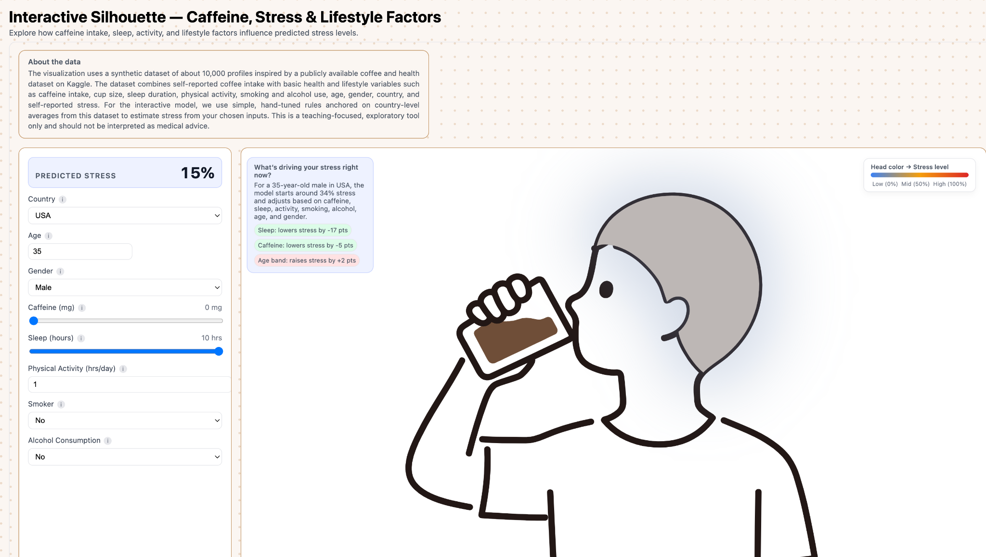
Final result

Slide 8
Tools Used
D3.js
HTML/CSS
Core visualization library for interactive charts, animations, and data bindings
Responsive layout with CSS Grid and custom styling for the body silhouette
JavaScript
GitHub Pages
Event handling, DOM manipulation, and real-time updates for user interactions
Free hosting platform for deploying our interactive visualization website
Notes:
The tools we used to build all our visualizations were D3, HTML/CSS, and JavaScript.
We used D3.js because it gave us low-level control over SVG elements, animations, and data bindings. This was essential for building the customized, dynamic visualizations that typical charting libraries can't support.
JavaScript handled all our user interactions — event handling, DOM updates, and real-time responsiveness. We chose JavaScript because it allowed us to integrate D3 tightly with the interface and keep everything running smoothly in the browser.
HTML and CSS provided the structural and visual foundation. We used CSS and custom styling to create a responsive layout and a clean silhouette design that adapts to different screen sizes.
We deployed the entire project using GitHub Pages. It was chosen because it offers free, reliable hosting and makes it extremely easy for collaborators and stakeholders to access the live visualization without needing any backend infrastructure.
Together, this stack allowed us to build a fully interactive, high-performance visualization tool that runs entirely client-side, loads instantly, and is simple to maintain.

Slide 9

Links: Final Demo| Final Visualization Site
Live Demo

Slide 10
If we had more time…
Would Add
Would Keep
Integrate ML model for real stress predictions
Support multiple coffee types with varying caffeine
Add enhanced character animations
Extend stress color to arms and hands
Human-centered body silhouette design
Real-time interactive slider controls
Country comparison functionality
Smoker vs non-smoker comparison
Notes:
If we had more time to continue developing this project, there are a few key enhancements we would add, while still keeping the core elements that already work well.
First, we would integrate a real machine-learning model to generate personalized stress predictions instead of using simulated logic.
We’d also extend the experience by supporting multiple coffee types with different caffeine levels and adding richer character animations so the visual feedback feels more lifelike. Finally, we’d improve the body visualization by extending the stress-color mapping to the arms and hands for a more complete representation.
At the same time, there are several features we would absolutely keep. The human-centered body silhouette has been very effective at making the visualization intuitive and relatable. Our real-time slider controls and country-level comparison views also work well and provide meaningful insights. And the smoker vs. non-smoker comparison turned out to be a strong storytelling element, so we’d preserve that as part of the final experience.
Overall, these additions would deepen the accuracy and richness of the tool, while keeping the elements that make it easy to understand and engaging to use.

Slide 11
Contributions
Abhay Naik: Ideation, Hypothesis Visuals, Iteration 2 Design & Development, Usability, Iteration 3 Design/Updates and Demo Video
Nichol Flowers: Data Preprocessing, Hypothesis 1 & 2 Analysis + Visualizations, Presentation Design, Usability, Iteration 3 Updates, Site Design & Deployment
Oleksii Lavrenin: Data Preprocessing, Hypothesis Visualizations, Presentation Design, Usability and Iteration 3 Updates
Bryan Park: Hypothesis 3 Analysis + Visualizations, Iteration 1 Design & Development, Usability and Iteration 3 updates

Slide 12
Thank You
Links: Final Demo| Final Visualization Site

