Slide 1
Curve stitching density plots
John Nicholson
Austin Peay State University
Dept of Computer Science and Information Technology

Slide 2
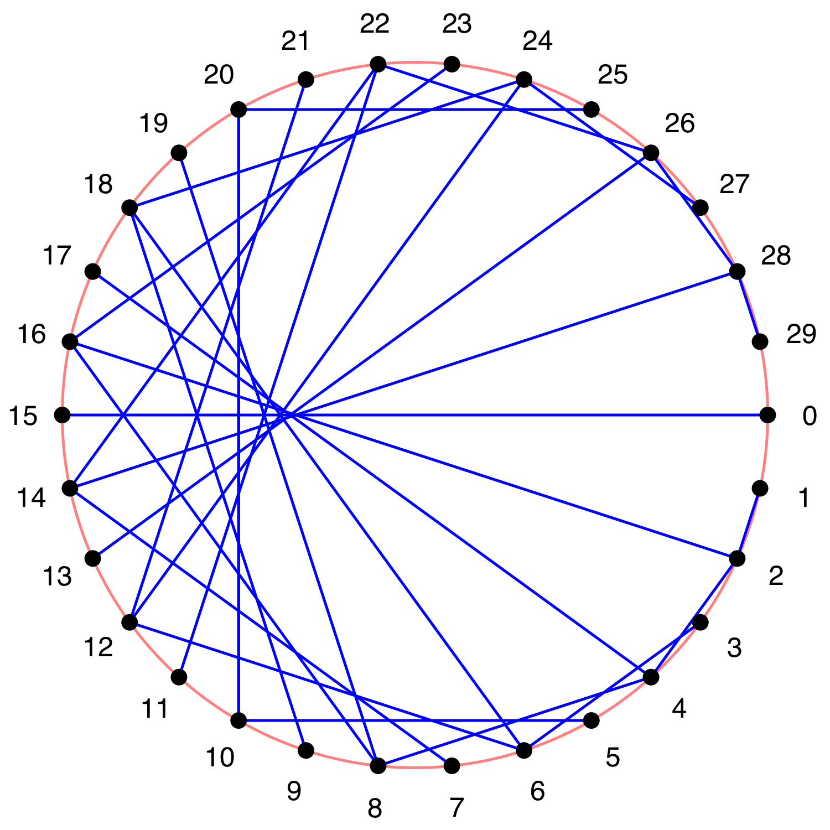
Basic curve stitching
Traditional method
  Place N points along curve
  Connect pairs of points:
Example

Slide 3
Simple modification
Change
  Connect
To
  Connect
Results in same image
  Easier to code and works with parametric equations

Slide 4
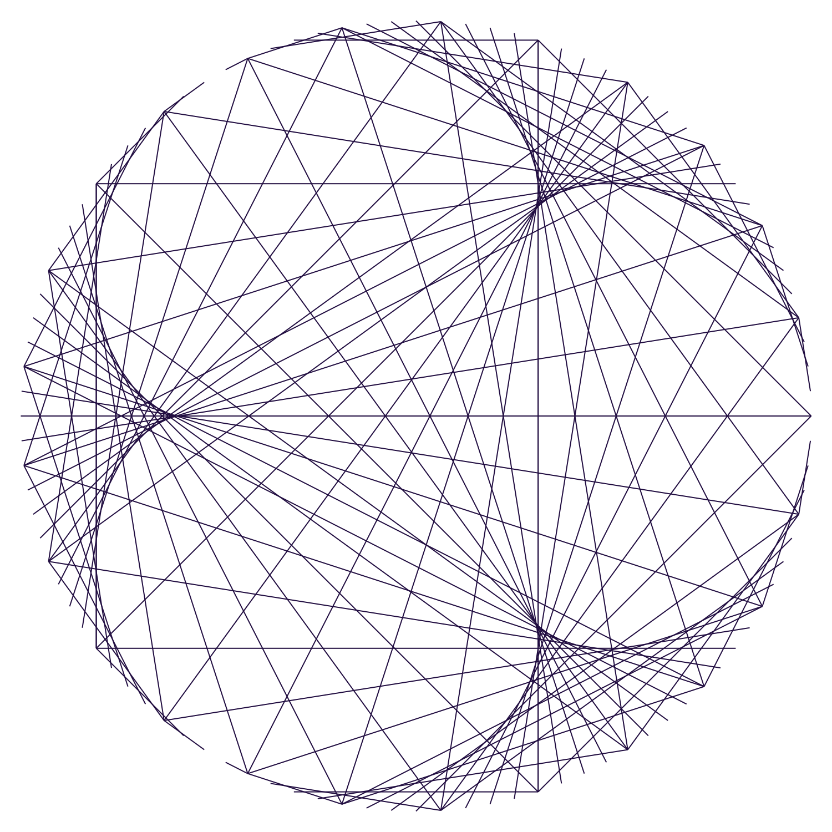
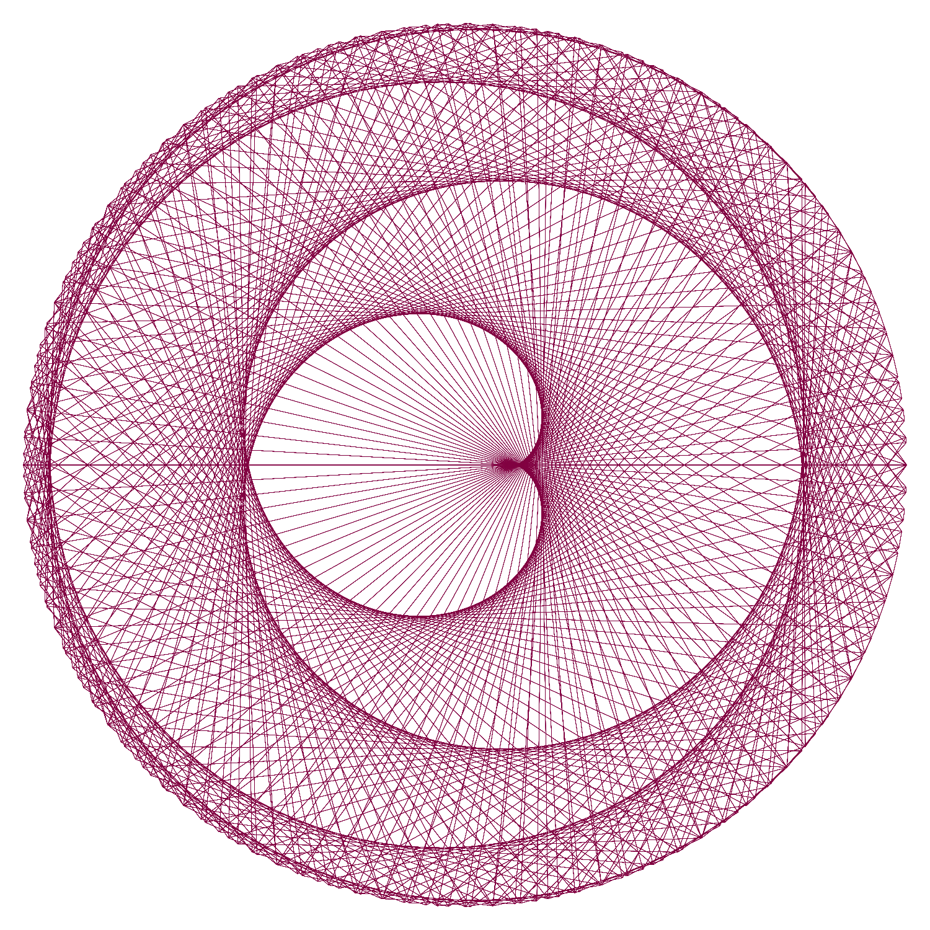
Examples

Slide 5
Density Plots
Rather than drawing N lines, randomly select S lines, and then randomly select a point on each line.
Keep track of counts
Convert the counts to an image

Slide 6
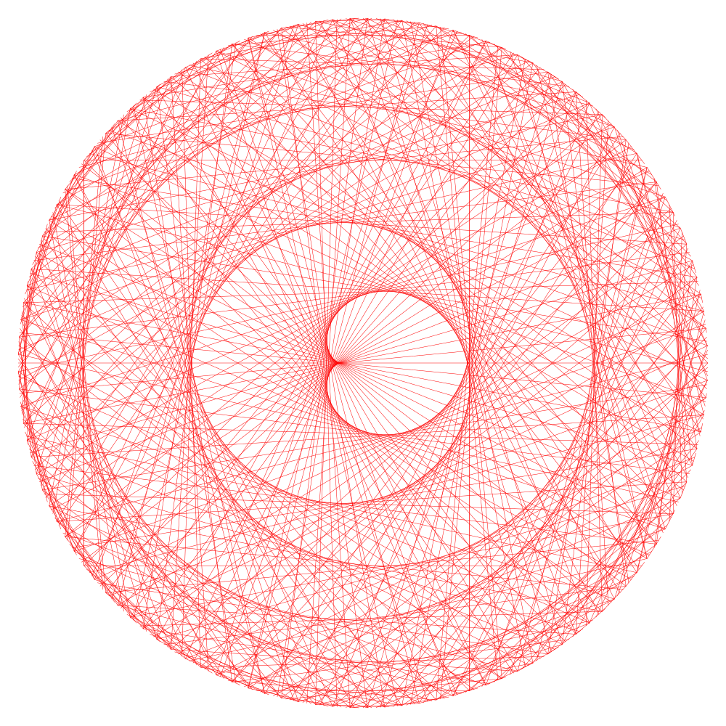
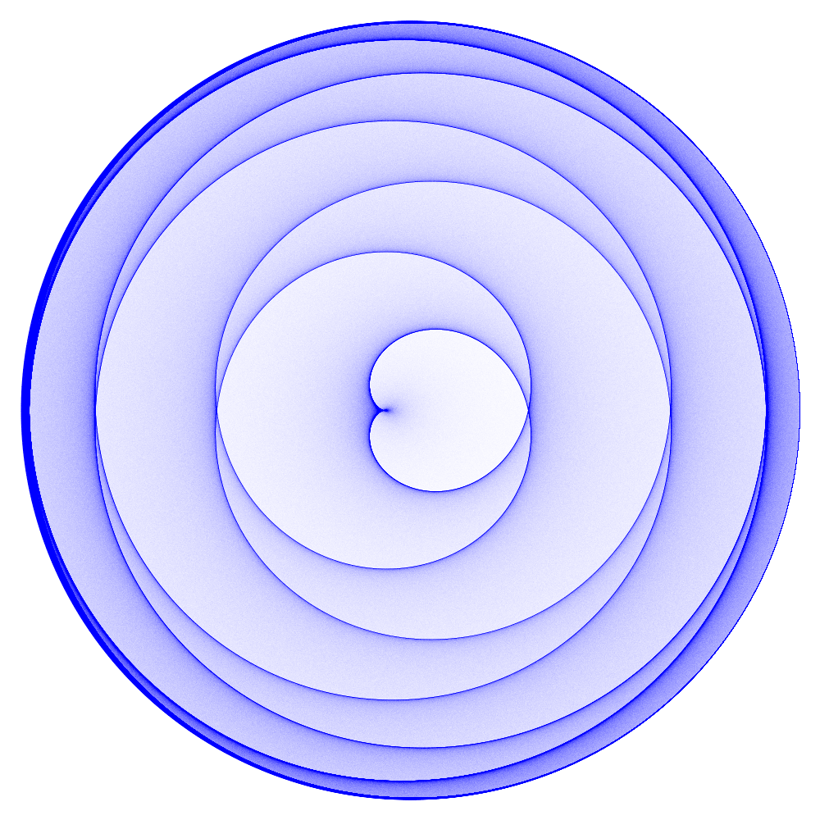
Comparison for k = 1.125
N=500
S=100,000,000

Slide 7
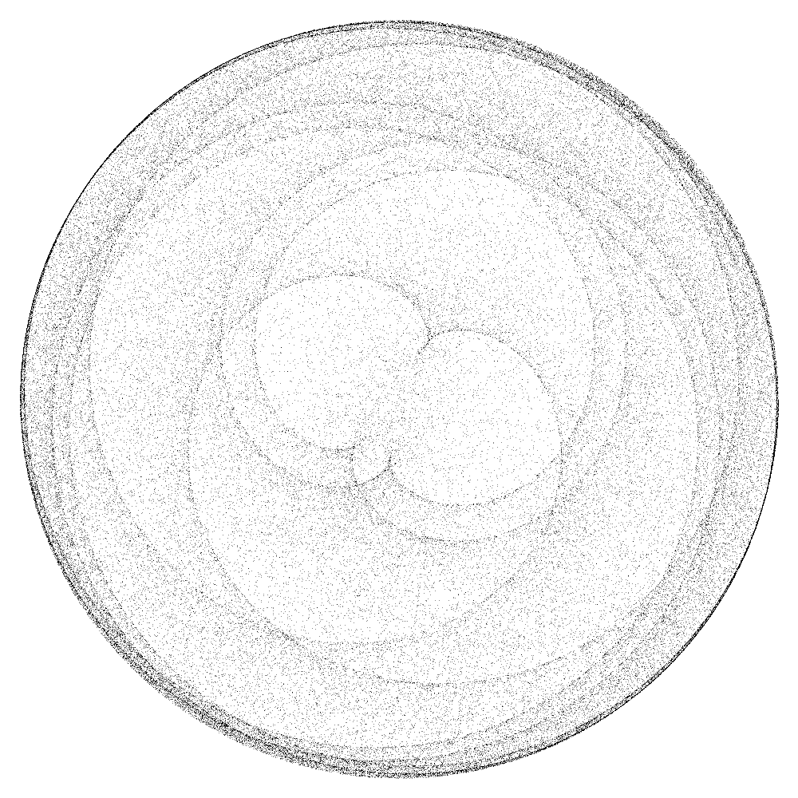
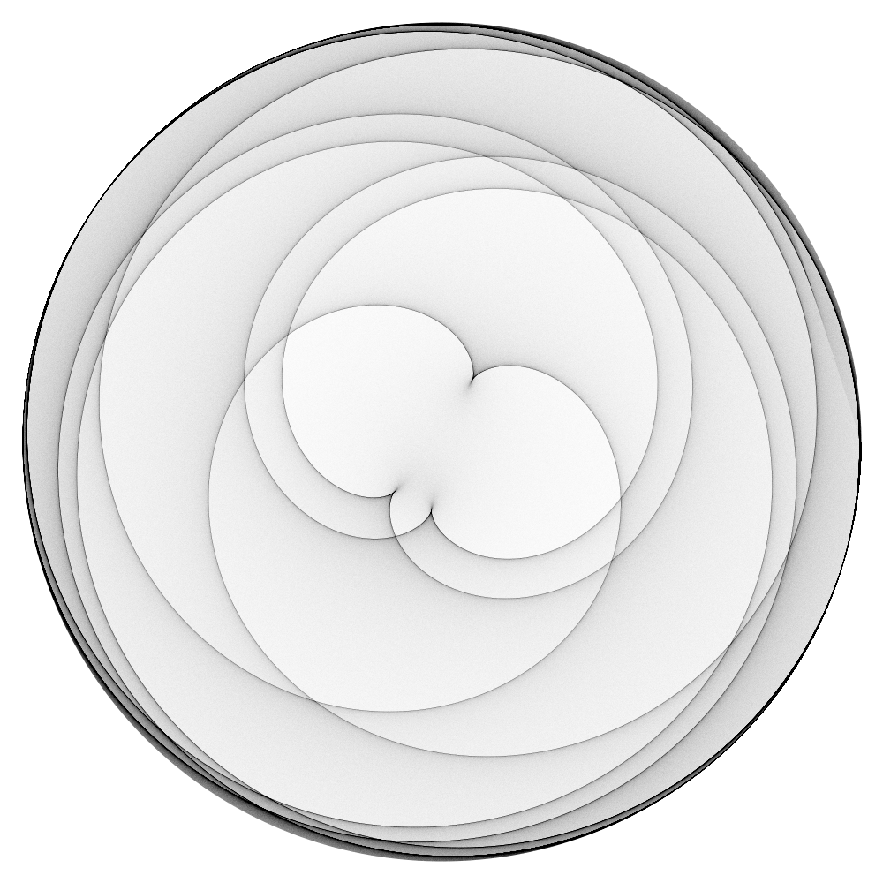
Effect of S value
S=100,000, time=1.9 sec
S=100,000,000, time=181.2 sec

Slide 8
Curve variations
No reason to limit curves to circles
Density plots can be created from any set of parametric equations for (x, y) for a curve,
  Closed curves
  Equations here based on θ, but could be time-based as well

Slide 9
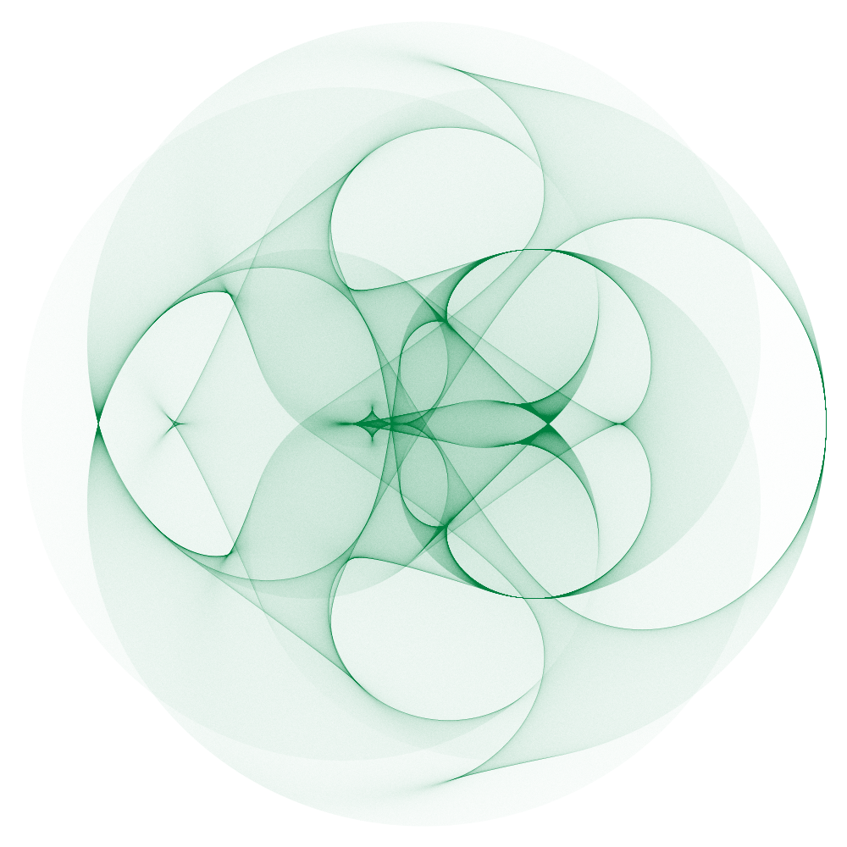
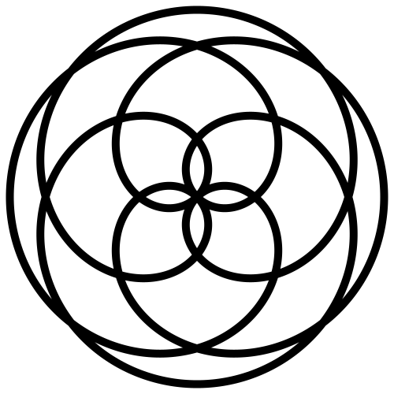
Rose curve
Rose curve
Example

Slide 10
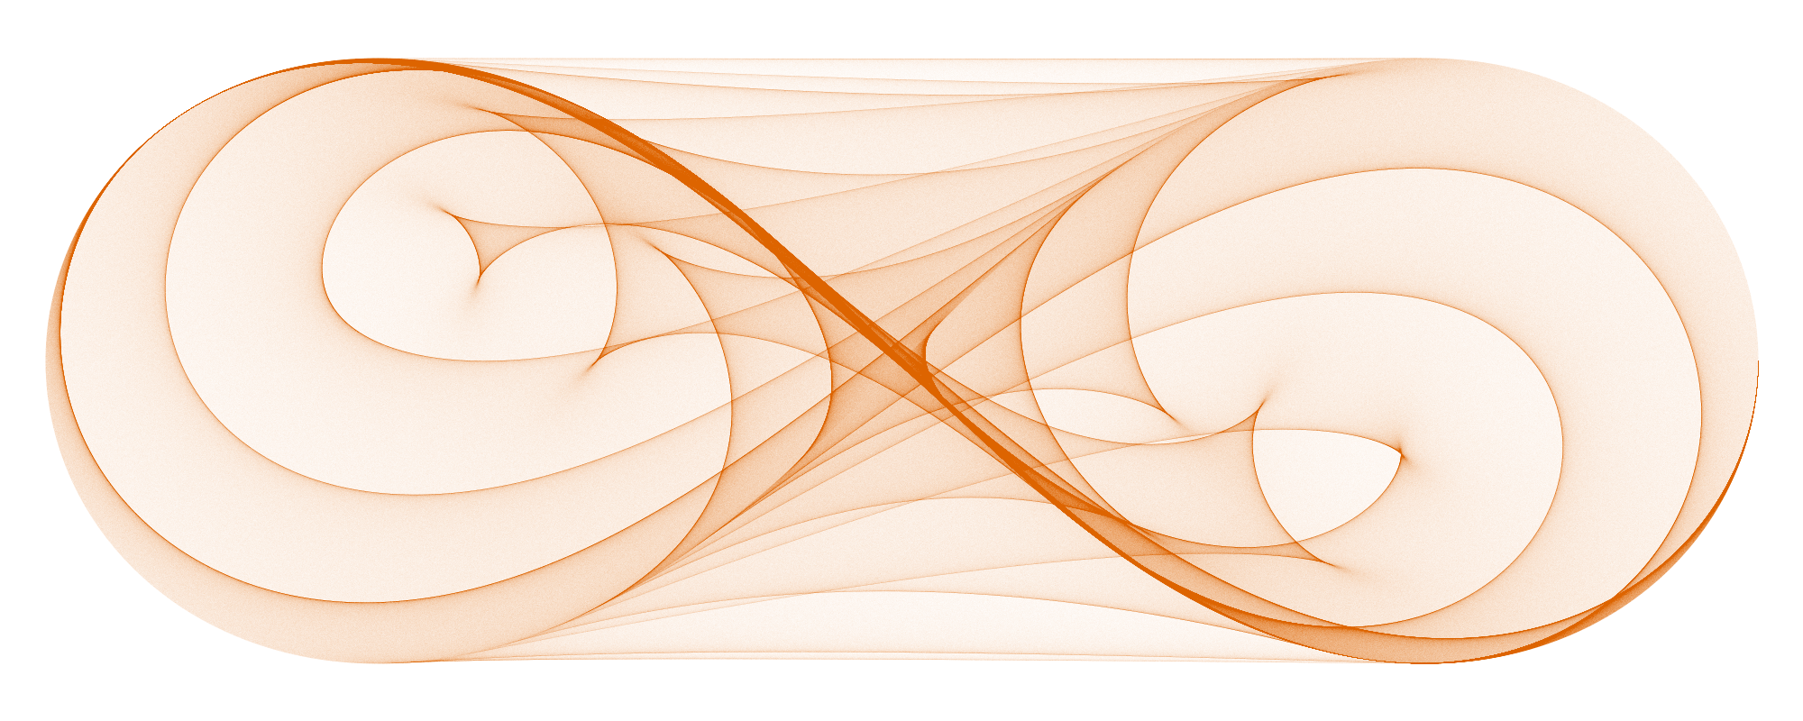
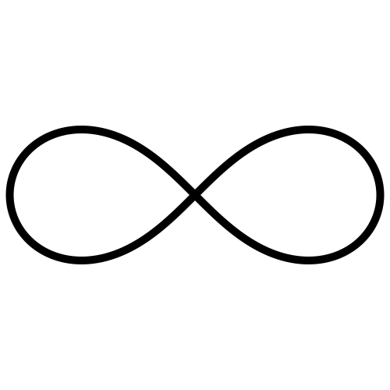
Lemniscate
Lemniscate
Example

Slide 11
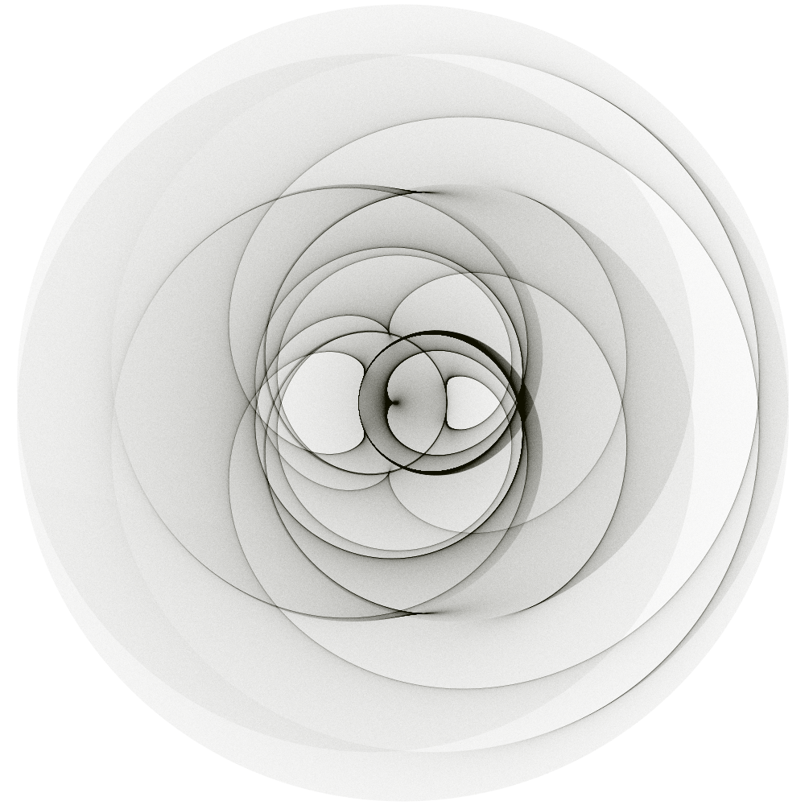
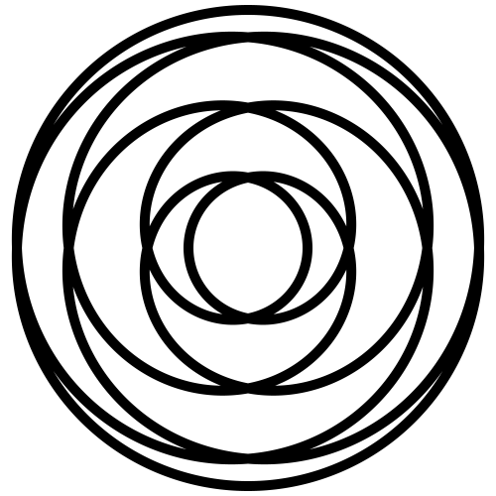
Hypotrochoid
Hypotrochoid
Example

Slide 12
Curve displacement
Previous images connect two points traveling at different speeds on one curve
Two curves can have
  Different sizes, and/or
  Different positions

Slide 13
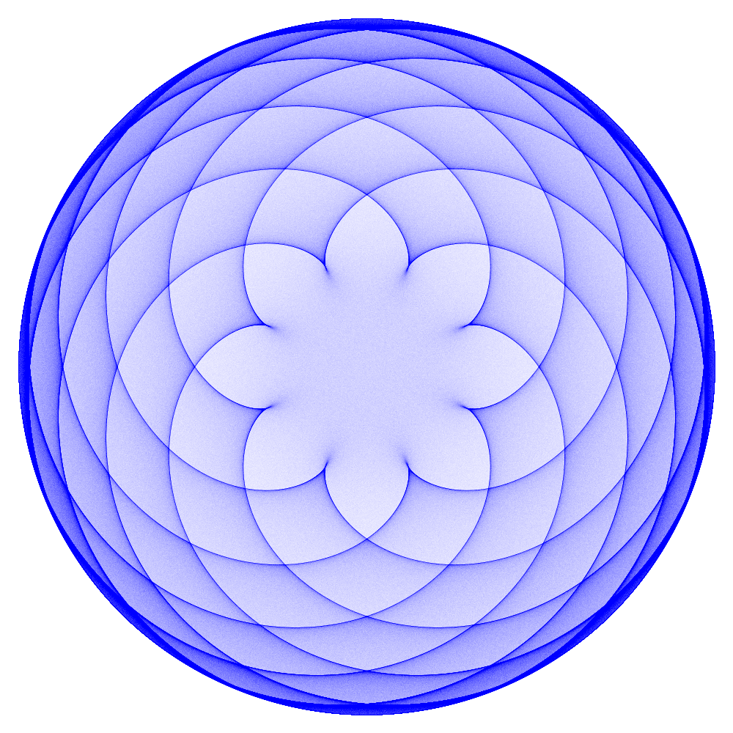
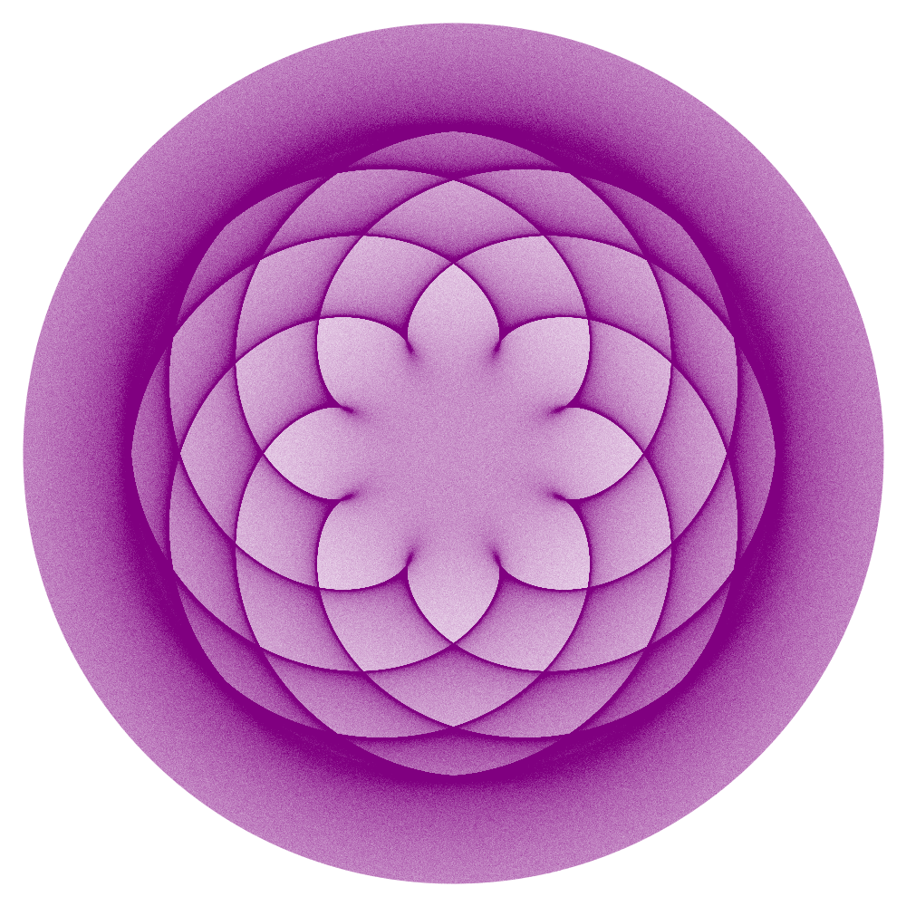
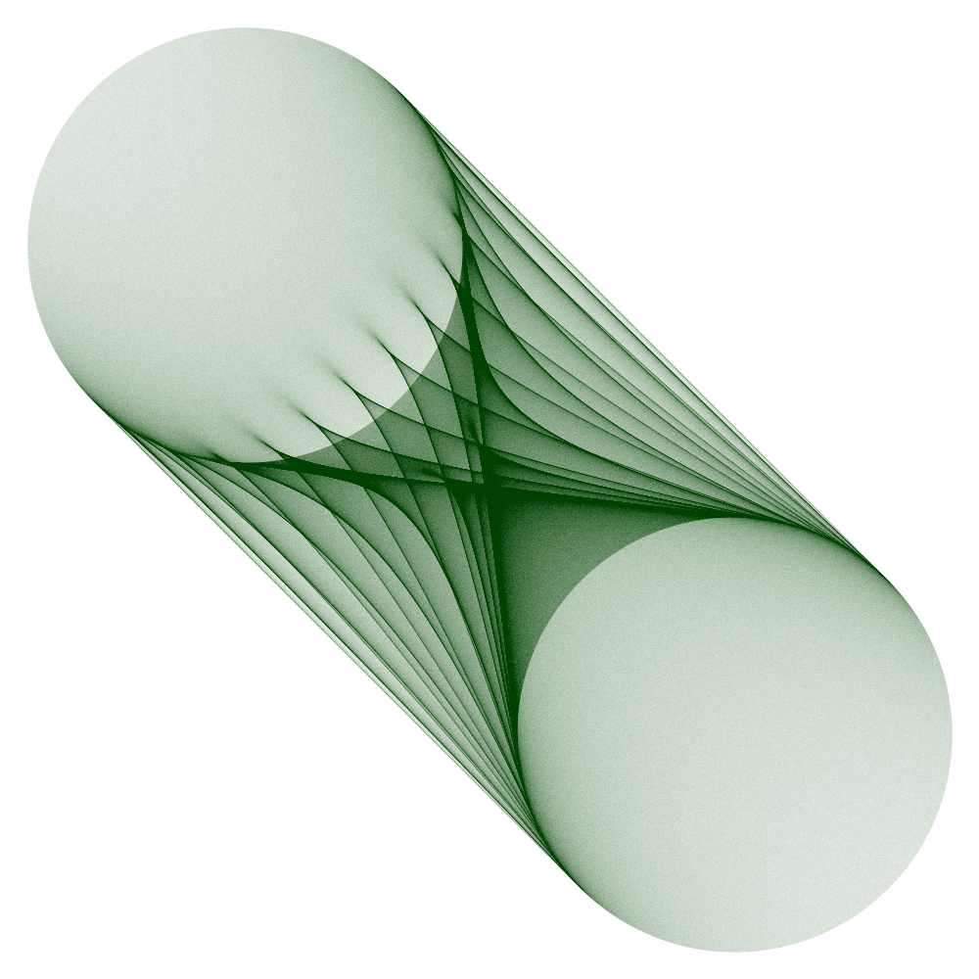
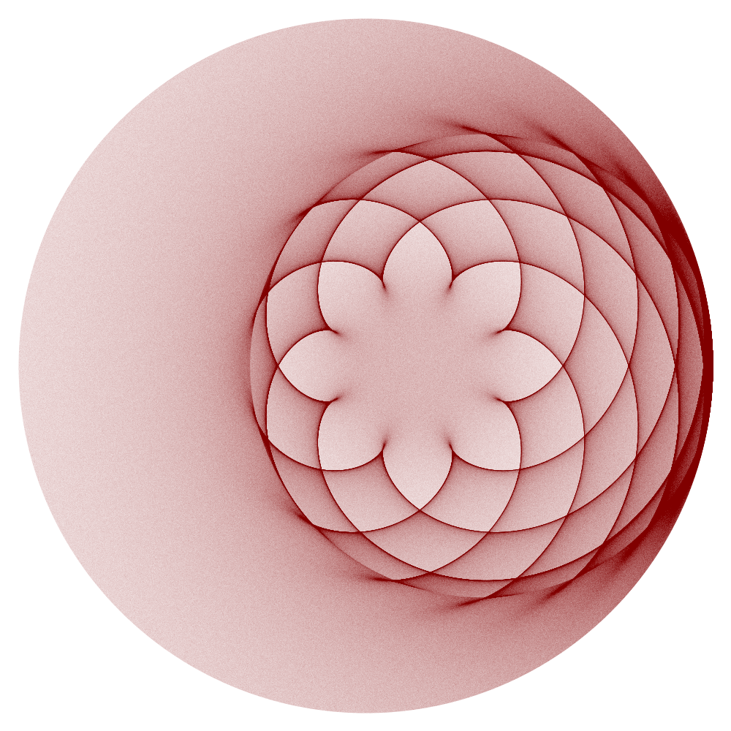
Examples
One circle
Two circles,
Different radii
Two circles,
Different
positions
Two circles,
Different sizes
And positions

Slide 14
Combining curves
With different versions of the same curve, additional variations become obvious
  Same curve, different parameters
  Two different curves
  More than two curves

Slide 15
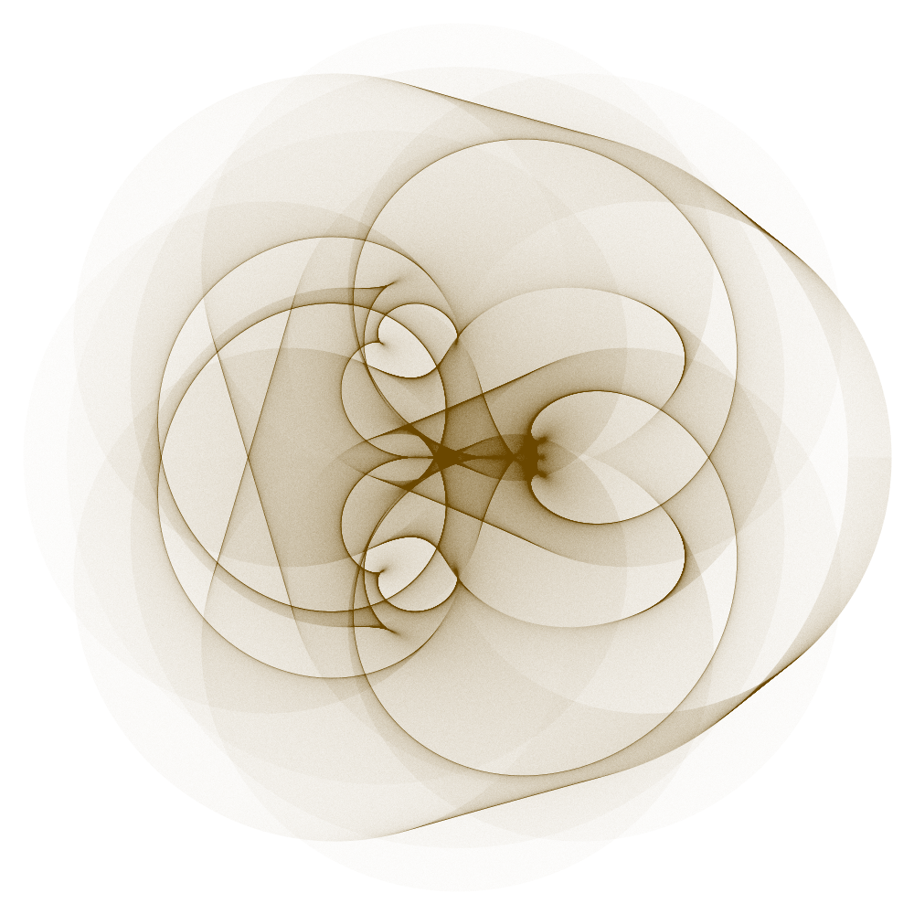
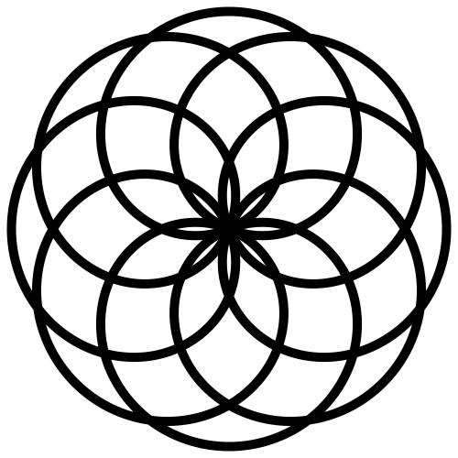
Example: two rose curves

Slide 16
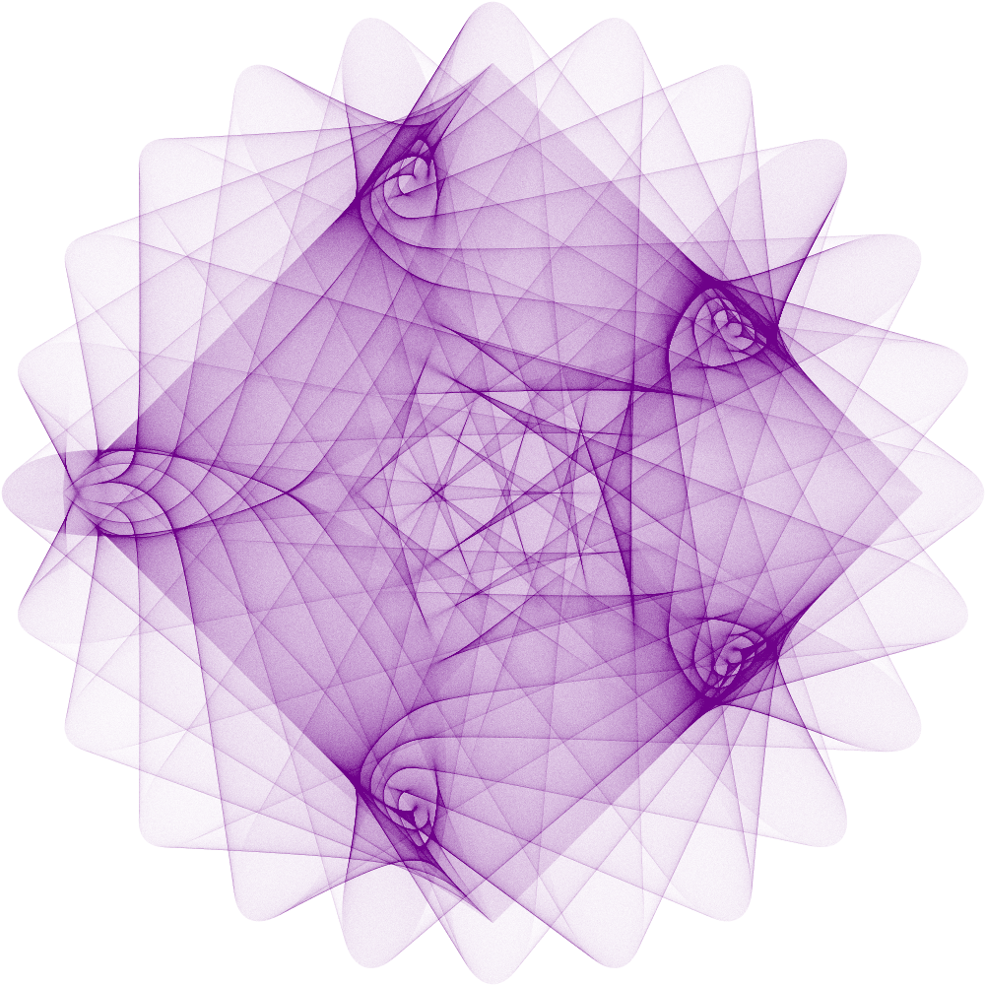
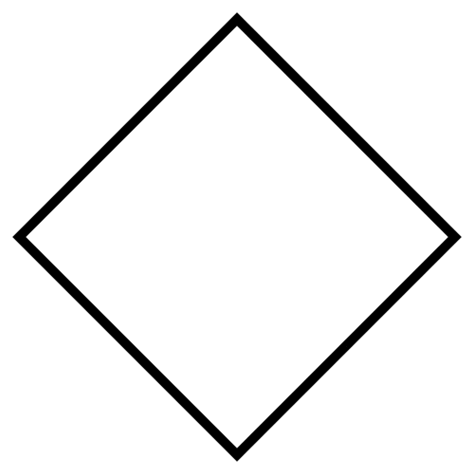

Example: square and hypotrochoid
Square
Hypotrochoid

Slide 17
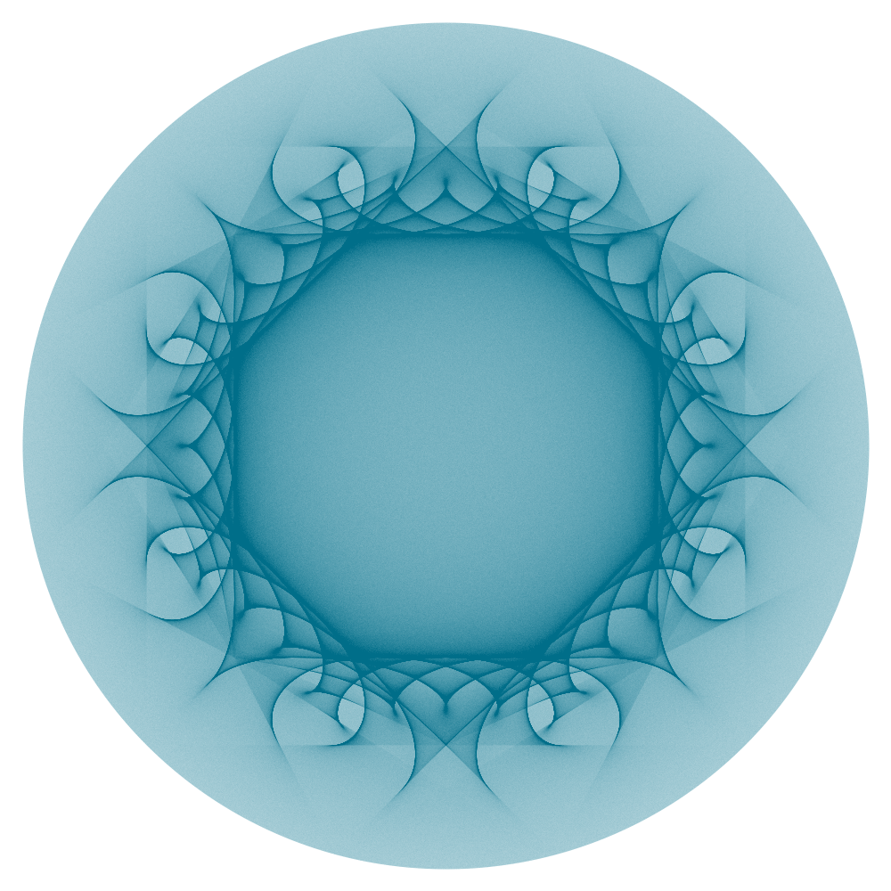
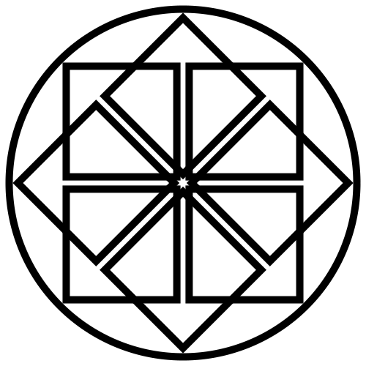
Example: circle with 8 squares
Pattern

Slide 18
Code examples
Sample Python code available at https://github.com/nicholsonja/Bridges-2019

Slide 19
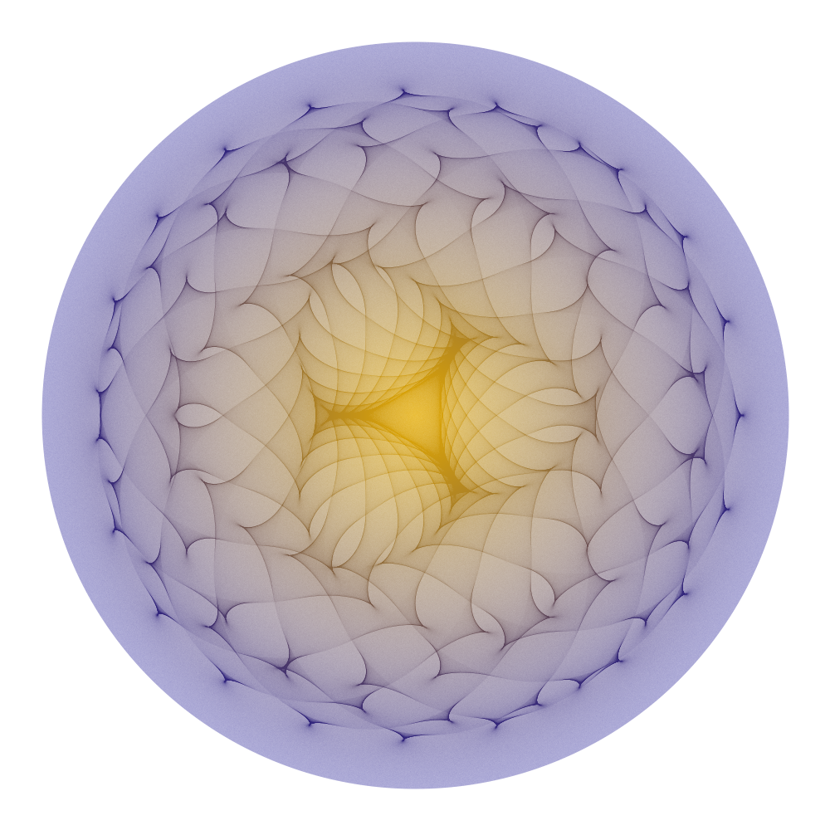
Questions?

