Slide 1
Curve Stitching
Density Plots
John Nicholson
Austin Peay State University

Slide 2

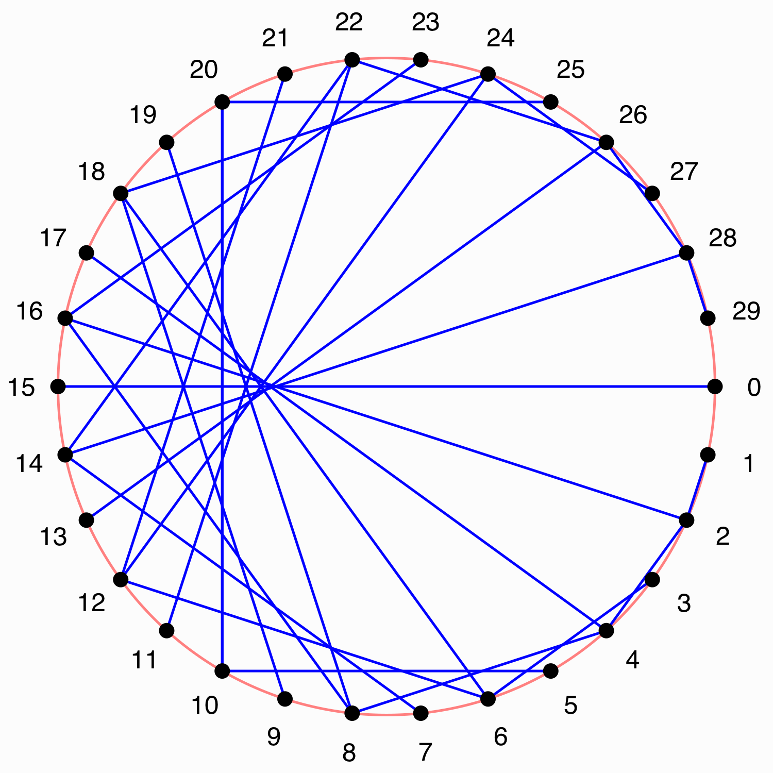
Basic curve stitching
Traditional method
  Place N points along curve
  Connect pairs of points according to formula, f(i)
Example
  N = 30
  f(i) = (k * i ) mod N
  where k = 2

Slide 3
Simple modification
Change the formula
  f(i) = (k * i ) mod N
To
  f(θ) = (k * θ ) mod N
Results in same image, but easier to code

Slide 4
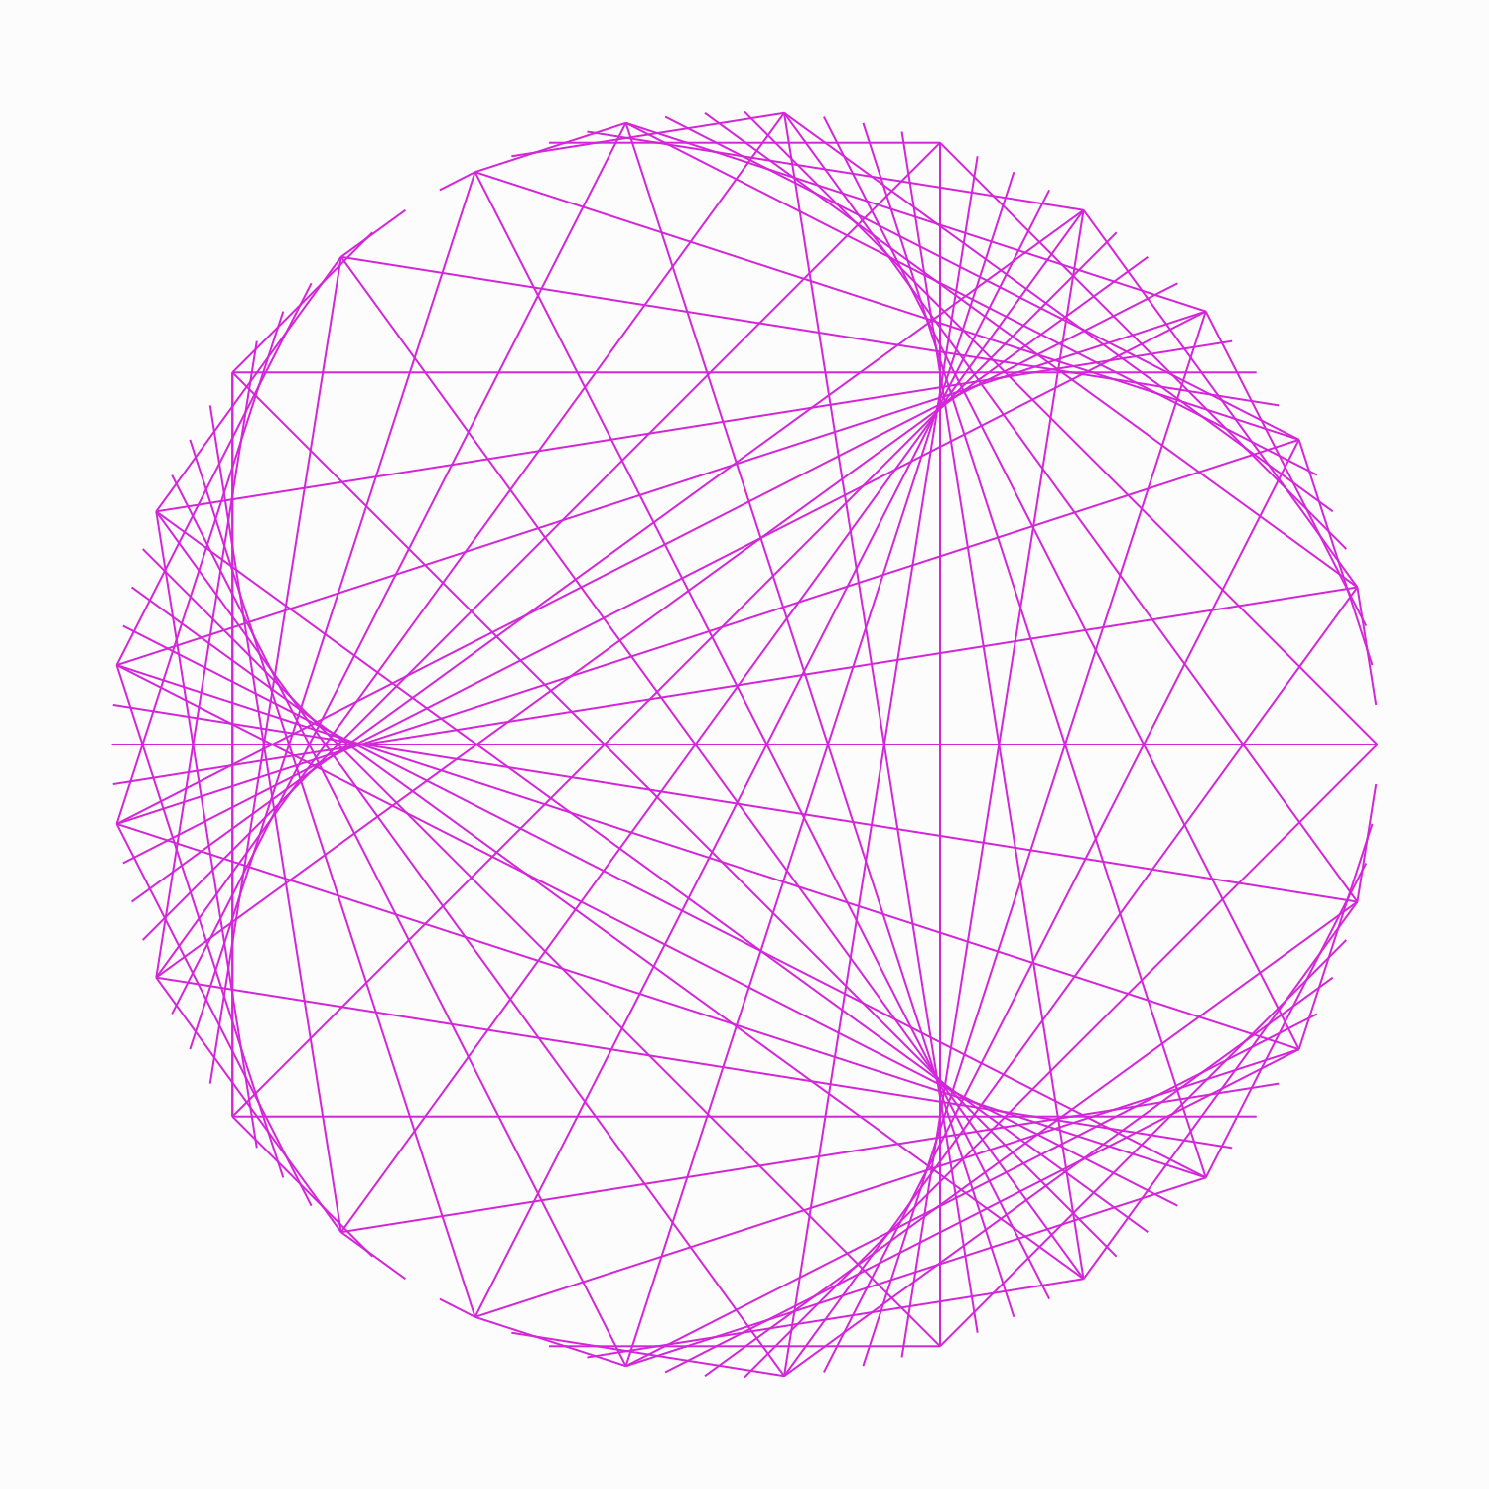
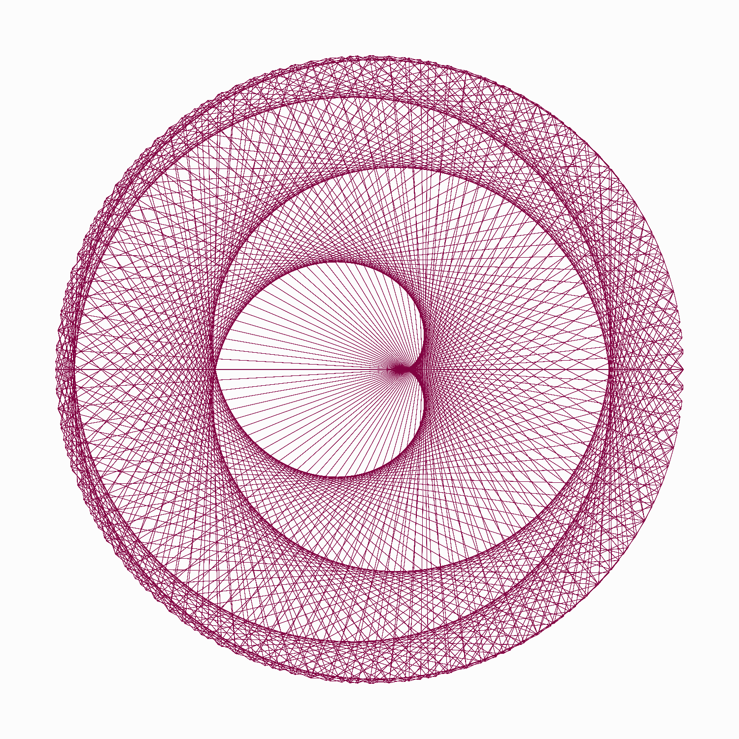
Examples

Slide 5
Sample code
Sample code in Python available at https://github.com/nicholsonja/Bridges-2019

