Slide 1
Converting PPM bitmap images to SVG vector images: a nifty assignment
John Nicholson
Austin Peay State University
CCSC:SE 2017

Slide 2
Basic assignment
Give the students a set of PPM files
Have them create programs that read the PPM and output SVG files
Converts images from bitmap to vector
Vector images allow pixels to be converted to different shapes, lines, and textures
The SVG images are stylistic and not exact copies of the PPM images

Slide 3

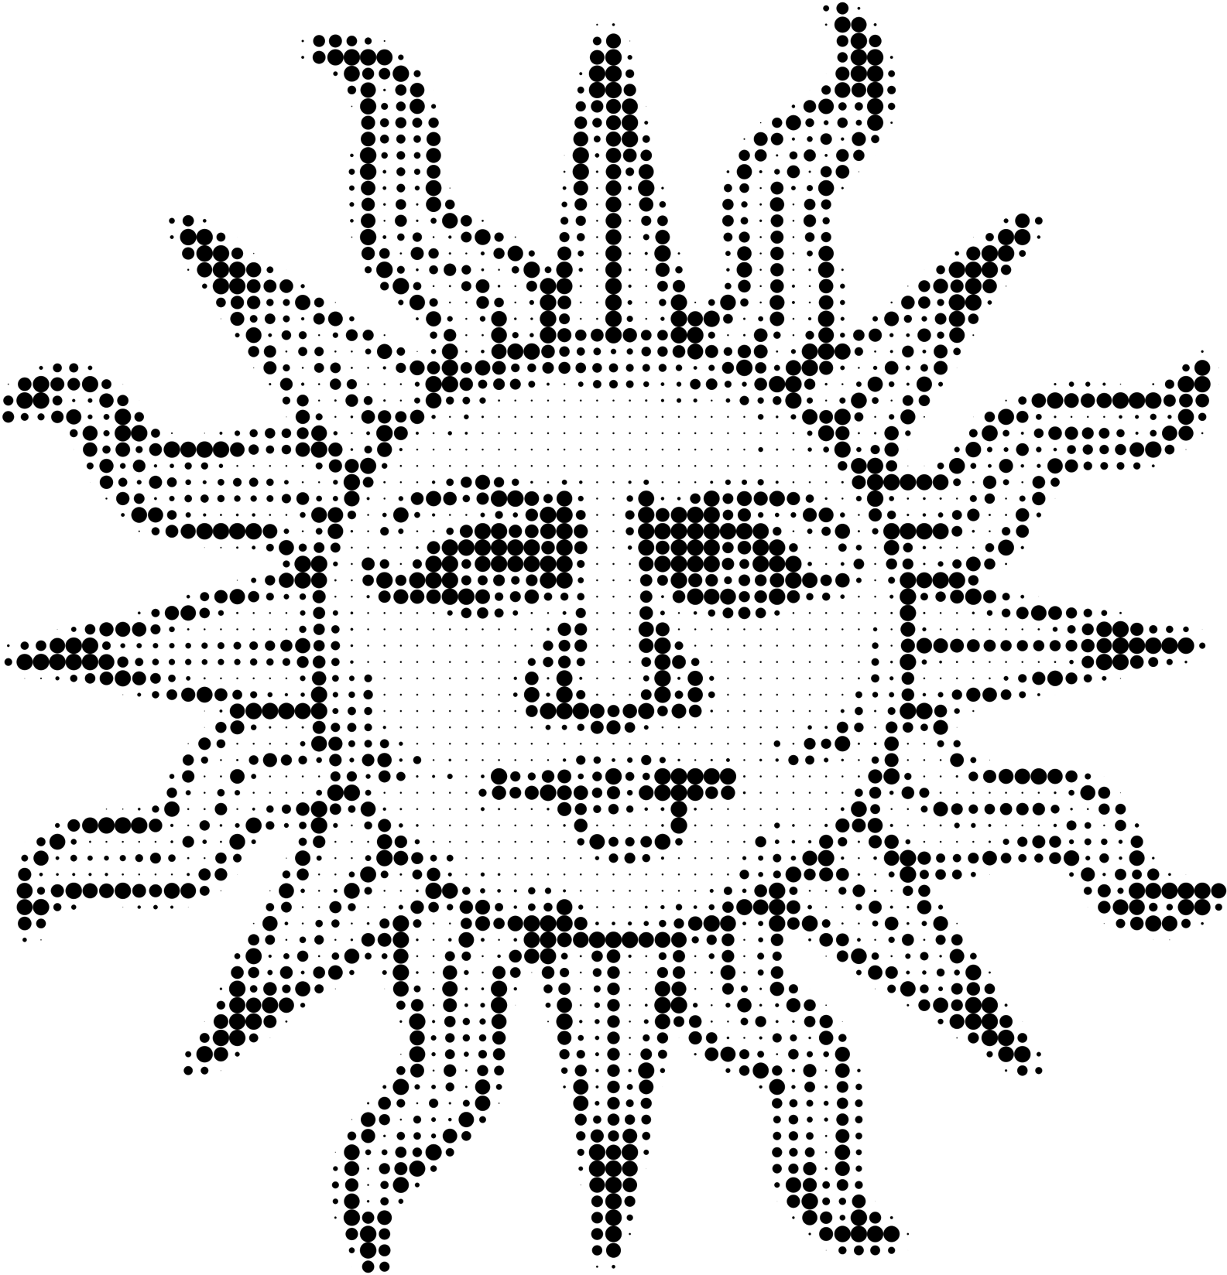
Sample input/output
Input
75x78 color PPM bitmap image
Output
SVG image. For each pixel, the color was converted to grayscale and an SVG circle element was created. The circle’s radius is proportionate to how black the grayscale value is.

Slide 4
Source images
Simple images work best
Simple images with plain backgrounds, although photographs can work
My image source: https://openclipart.org/
Primarily clip art and icons
Tend to have transparent backgrounds – should flatten images to remove transparency
Converting images to PPM
Gather PNG, JPEG, etc. source images
Resize
In general, no larger 100x100
Convert to PPM
SimplePPMConverter.java – custom code that formats the PPM in a beginner friendly format

Slide 5
PPM
Portable pixmap
Text-based bitmap format
Displaying
ppmReader.html - custom HTML/JavaScript that works in latest browsers (not IE)
GIMP
Preview (OS X)

Slide 6
PPM format
P3
100 125
255
213 200 155
211 198 153
206 193 148
200 189 143
192 181 136
192 181 136
...
First three lines are a header
This is an RBG image
Width is 100 pixels, height is 125 pixels
Each color-related value will be an integer in the range 0 – 255
Each remaining line represents a pixel
Three integers from 0 – 255
First value is red, then green, then blue.
File should have width x height lines (pixels)

Slide 7
SVG
Scalable Vector Graphics
Text-based vector format
Can be displayed by any modern browser
Format is more complex than PPM
Only need a small subset of the language for these assignments
Numbers can be floating point
Shapes used
Circles
Rectangles
Polygon
I’ve begun experimenting with
Line
Text

Slide 8
Bounding box
PPM uses pixels
Describe pixel as a 1x1 square
For SVG, introduce the concept of a bounding box
Possible to use a 1-to-1 conversion from PPM to SVG size, but images tend to be too small to see details
Usually define bounding box size as 10
Emphasize bounding box is not actually drawn

Slide 9
SVG root element
<svg xmlns='http://www.w3.org/2000/svg'
width='1000.0' height='1250.0'
version='1.1'>
<!-- all shape information -->
</svg>
<svg … > starts every SVG file
</svg> ends every SVG file
All other output goes between start and end
Quotes can be single quotes or double quotes
Single works well since many languages use double quotes when outputting text; removes need to escape double quotes
Width and height will be related to width and height of PPM
Scaled by a factor determined by bounding box size

Slide 10
SVG shapes: circle, rect, line
A black circle:
<circle cx='5.0' cy='5.0' r=’4.5'
fill=’rgb(0,0,0)' />
A red square:
<rect x='0' y='0' height=’20.0'
width=’20.0' fill='rgb(255,0,0)' />
A green line
<line x1=’10' y1=’20' x2=’15.5' y2=’30.5'
stroke='rgb(0,255,0)' stroke-width='1’ />

Slide 11
SVG shape: polygon and text
A blue triangle
<polygon points=‘0,0 10,10 5,10'
fill='rgb(0,0,255)' />
Points are (x,y) pairs separated by a space.
When drawn, polygon is closed closed
A yellow letter J
<text text-anchor='middle’
x='0.0’ y='10.0'
font-size='10.0’ font-weight='bold'
fill='rgb(255,255,0)' >J</text>
Due to the way text is rendered, “fiddling” with font-size may be required.
(x, y) is the middle bottom of the bounding box.

Slide 12
SVG Colors
SVG colors are similar to colors in HTML
#ff0000
rgb(255,0,0)
Some named colors such as “red”, “white”, etc.
PPM colors map easily to rgb() format.
50 100 42
in PPM is
rgb(50,100,42)
in SVG.

Slide 13
Basic code in C++, 1
ifstream in("sun.ppm");
ofstream out("sun.svg");
string tmp;
int width, height, red, green, blue;
const double SVG_PX_SIZE = 10;
in >> tmp; // P3 -> not needed
in >> width >> height;
in >> tmp; // 255 -> max value in file, not needed

Slide 14
Basic code in C++, 2
out << "<svg xmlns='http://www.w3.org/2000/svg' "
<< " width='" << width * SVG_PX_SIZE << "' "
<< " height='" << height * SVG_PX_SIZE<< "' "
<< " version='1.1'>\n";
for (int y = 0; y < height; y++) {
for (int x = 0; x < width; x++) {
in >> red >> green >> blue;
double gray = (red + green + blue) / 3.0;
double cx = x * SVG_PX_SIZE + SVG_PX_SIZE/2;
double cy = y * SVG_PX_SIZE + SVG_PX_SIZE/2;
double r = SVG_PX_SIZE/2 * (255 - gray) / 255;
out << "<circle cx='" << cx << "' cy='" << cy << "' "
<< " r='" << r << "' fill='rgb(0,0,0)' />\n”;
}
}
out << "</svg>\n";

Slide 15
Nifty things for the instructor
Language independent (C++, Java, Python, etc)
Store PPM data in arrays, vectors, lists for processing
Using functions
Make functions to output each required shape or conversion
Function to read data, function to write data
Using classes
A class that represents color
A class that represents a PPM file or an SVG
A converter class
Introduce randomness into conversions
Introduce basic image processing concepts
Color quantization
Dithering
Mapping to different color colorspaces

Slide 16
Nifty things for the student
See the results quickly
Invent their own conversion
Sometimes they do this on their own

Slide 17
Considerations
Helpful to do lab work or PPM/SVG before this assignment
Geometry can throw students off
(0,0) is in the top left of both PPM and SVG
Bounding box size needs to be taken into consideration during calculations
SVG, since it XML-based, has strict formatting rules
</svg> - Good
< /svg> - Bad
</ svg> - bad

Slide 18
Support
https://github.com/nicholsonja/CCSCSE2017-nifty
Contains
Helper code
SimplePPMConverter.java
ppmReader.html
Example source images
Example PPM images
Example conversions for each sample PPM image
Sample assignment
These slides

Slide 19


