Slide 1
Curve stitching variations in 2D and 3D
John Nicholson
Austin Peay State University
Clarksville, TN

Slide 2
Introduction
Curve stitching
  Methods for creating images
    String art
    Hand drawing
    Computational
  Can be 2D or 3D
Extend the approach to create related, yet new, types of curve stitching images

Slide 3
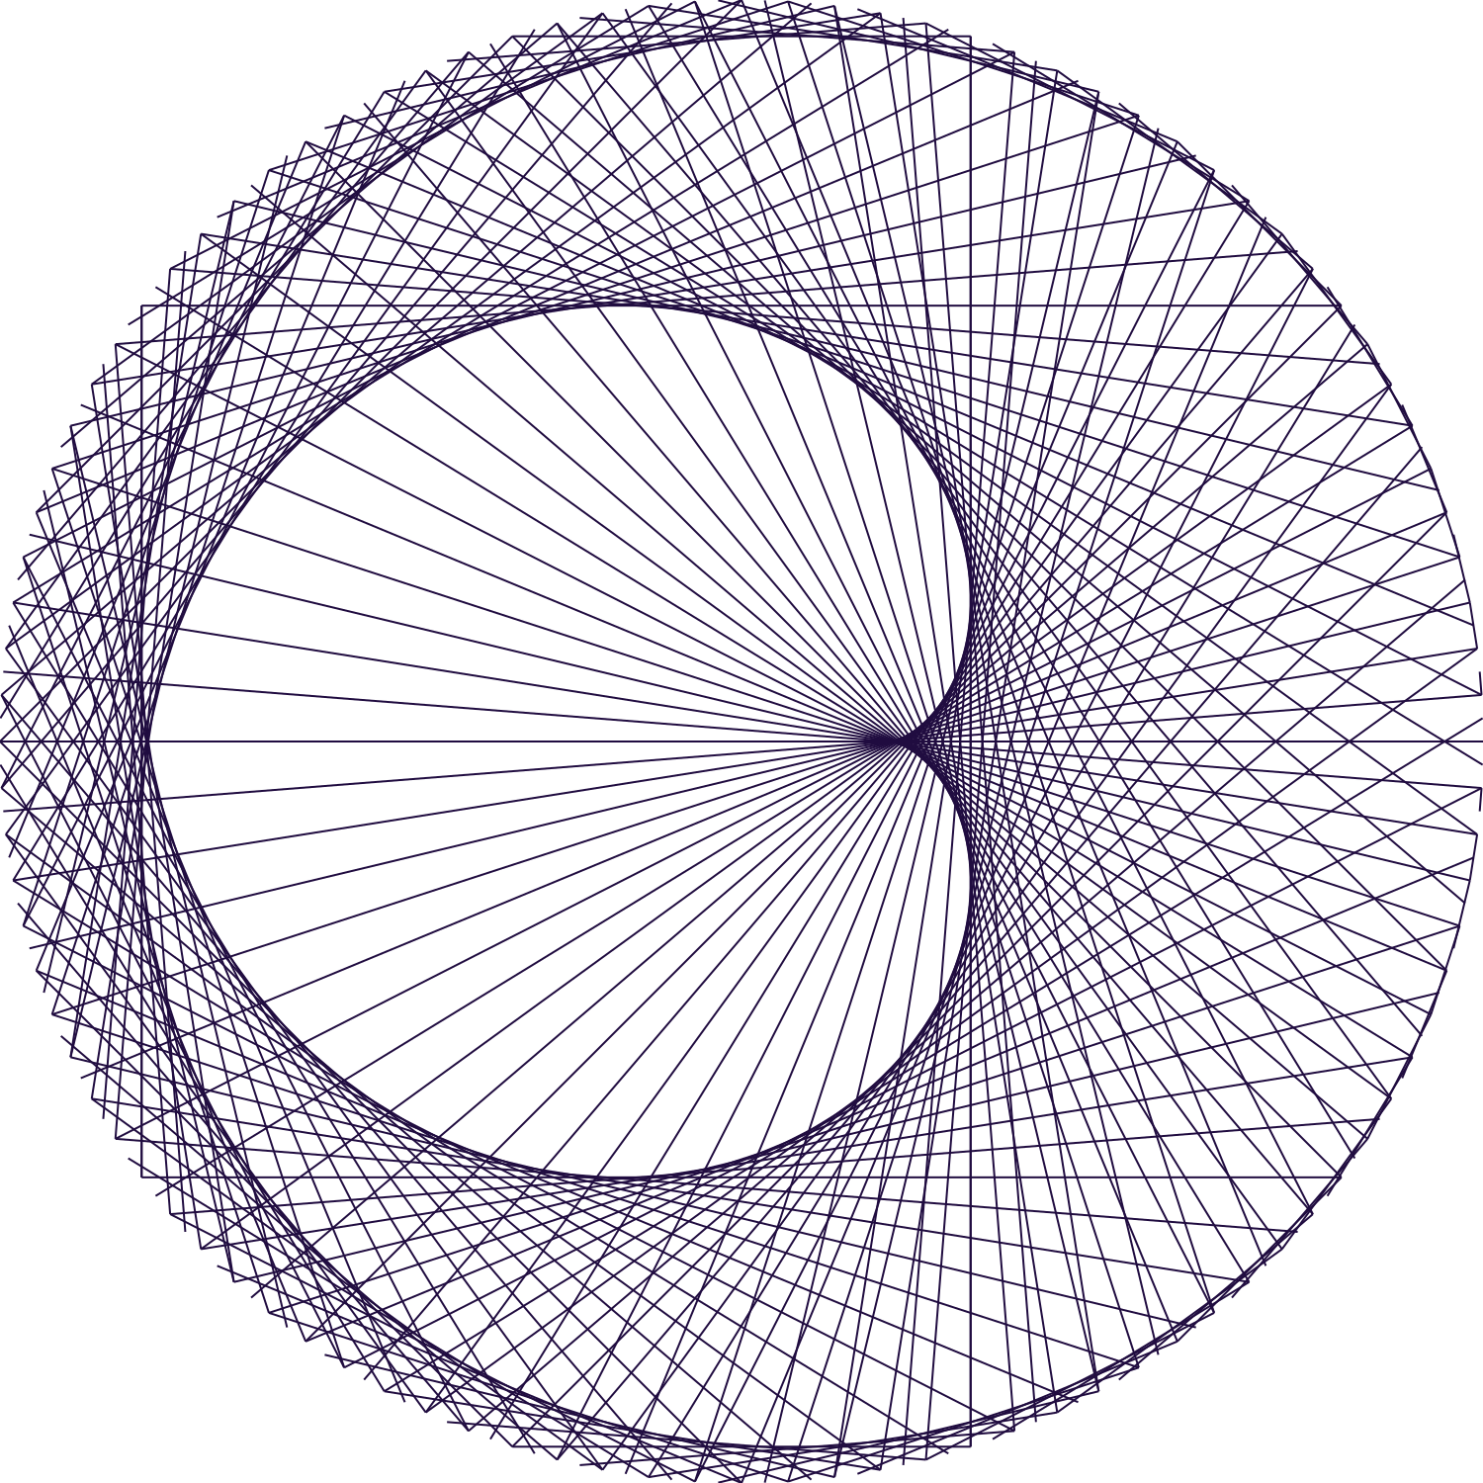
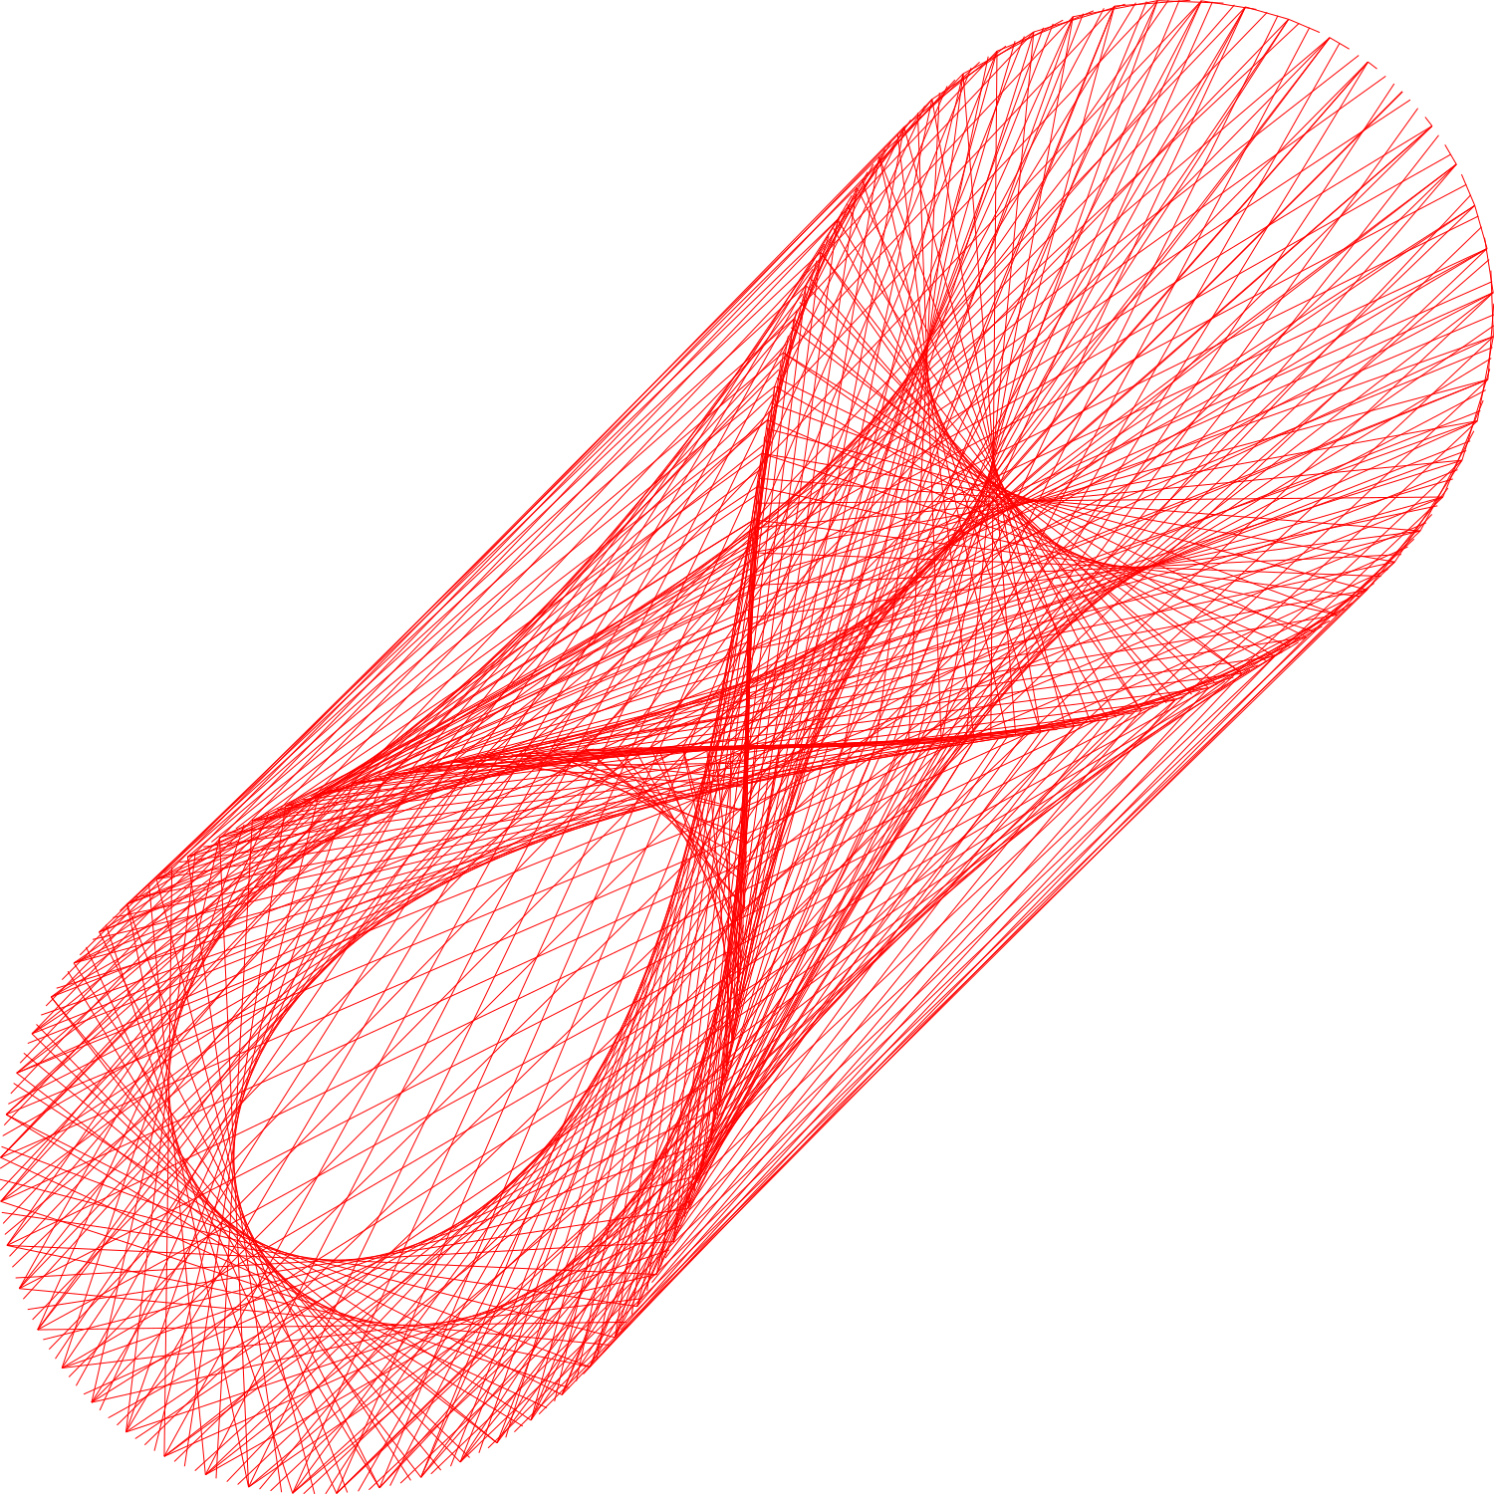
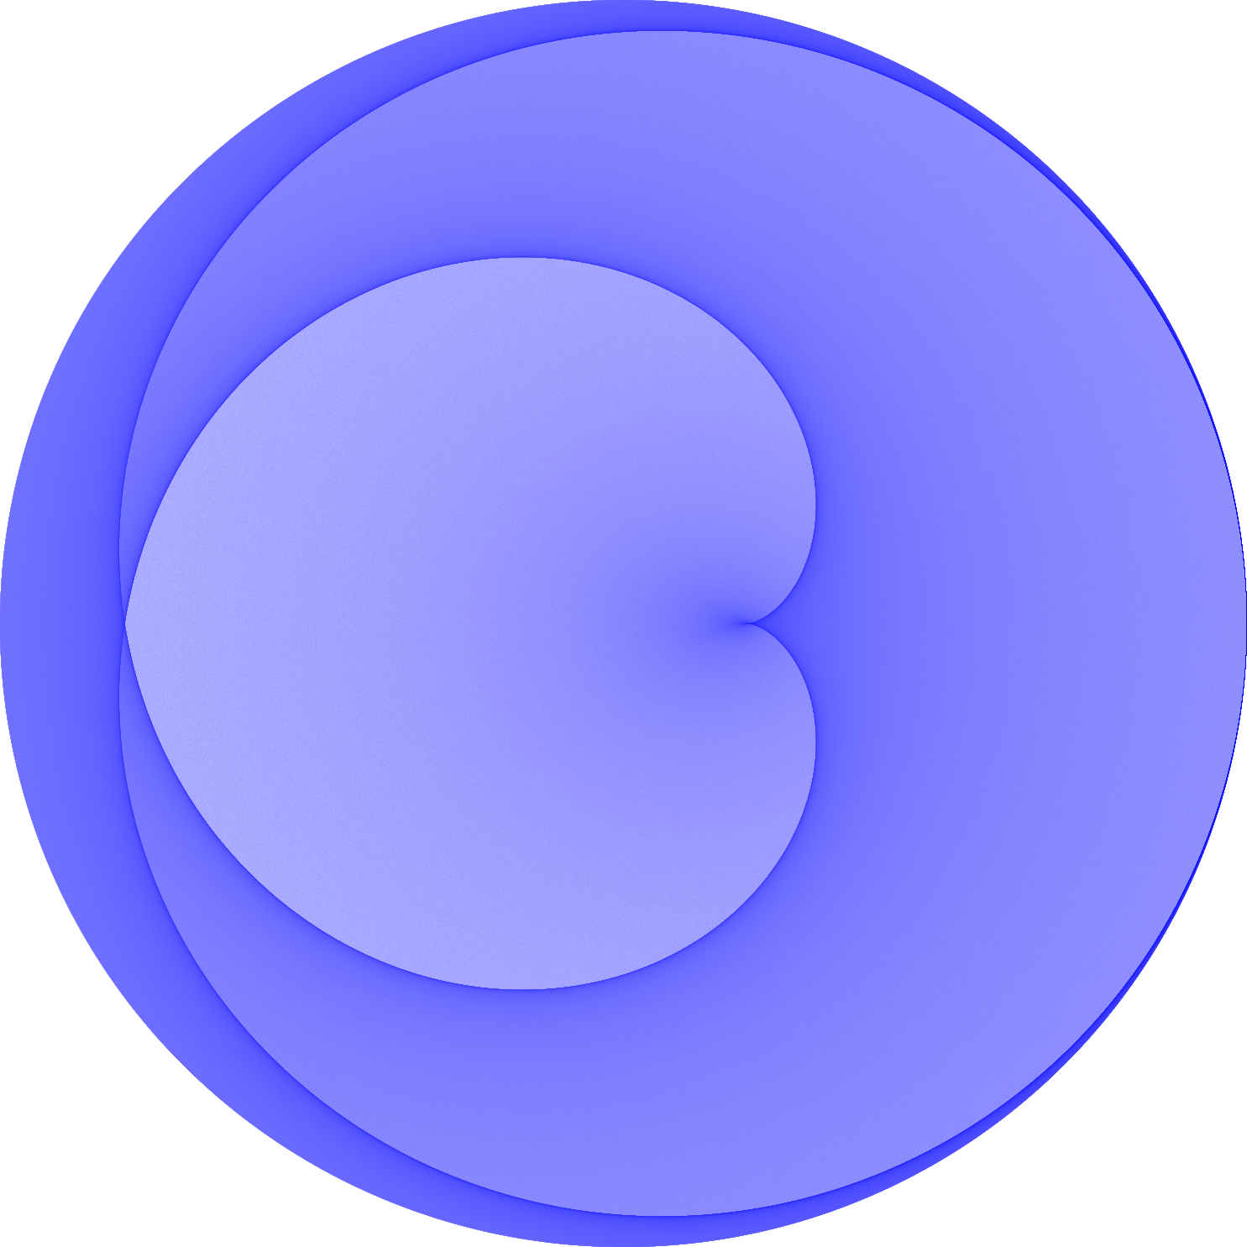
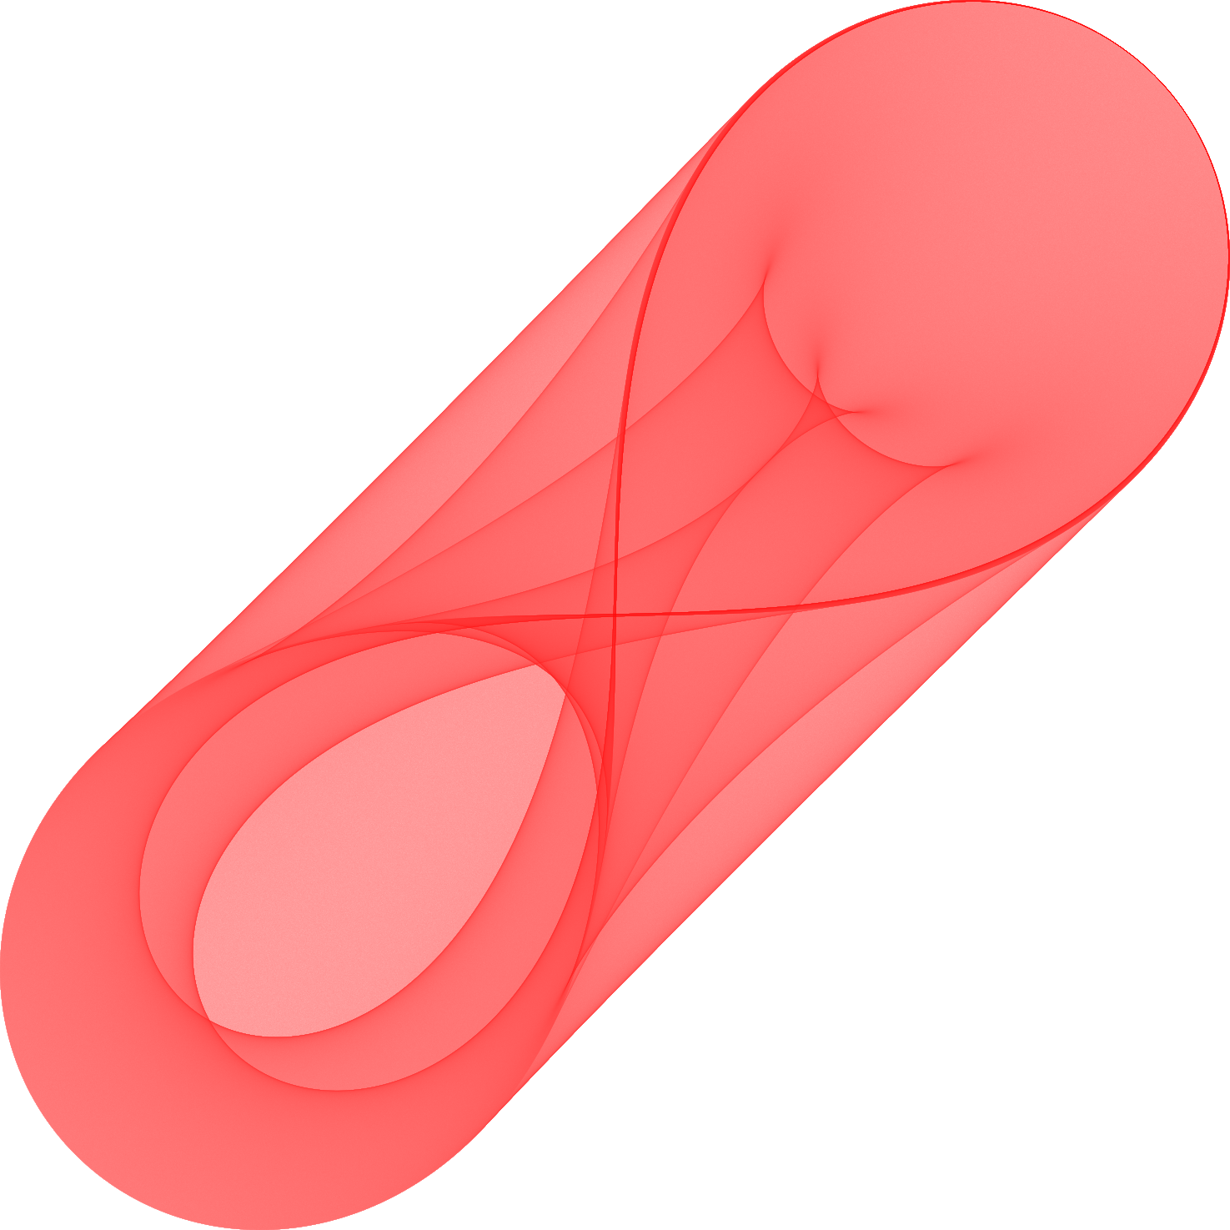
Traditional examples

Slide 4
Traditional curve stitching algorithm
Traditional
  P is some path or curve, e.g., a circle
  N is the number of connections to make along P
  kA and kB represent how fast two points, pointA and pointB, move along P
Curve stitching density plots
  Variation of traditional algorithm
  creates a histogram representation

Slide 5
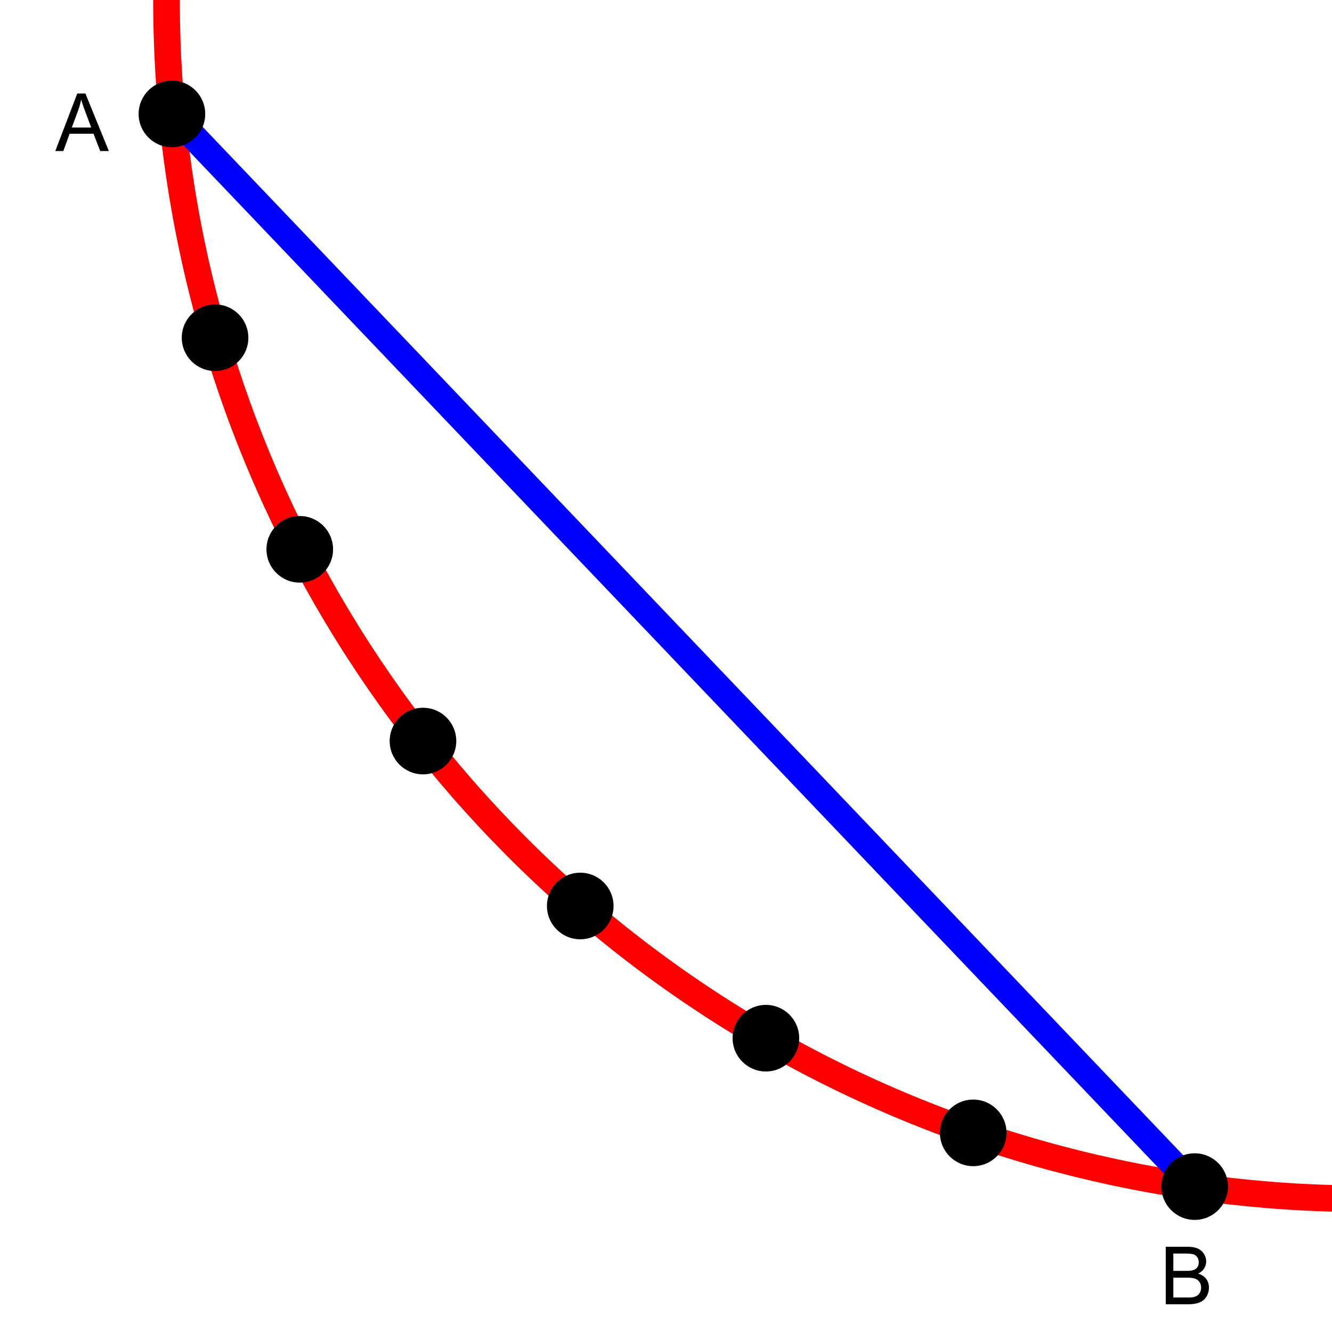
Traditional approach
Determine two points, A and B, on a curve
Connect points with a line segment
Do this for every pair of points on the curve
  Number of points varies
    Low in traditional images
    “High” in density plots

Slide 6
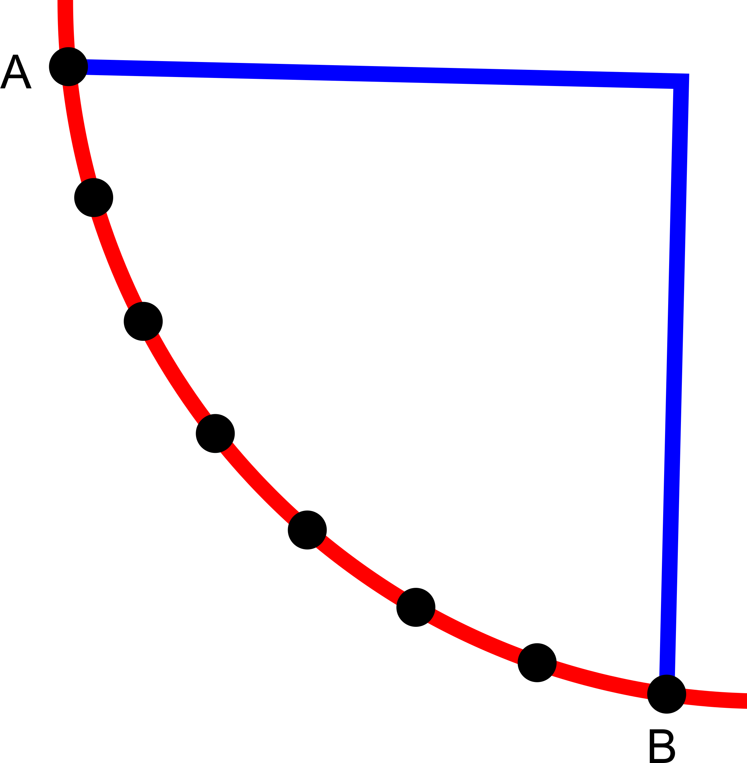
Questions
Traditionally, a line segment is used because of image history
  Mary Everest Boole invented curve stitching in the 1800s
  Took cards meant for painting, and laced thread though areas meant to be painted*
Why does it have to be a line segment connecting the two points?
What happens when you connect the points with something other than a straight line segment?
* Innes, S. 2004. Mary Boole and curve stitching: a look into heaven. Endeavour 28,1 (Mar 2004), 36-38.

Slide 7
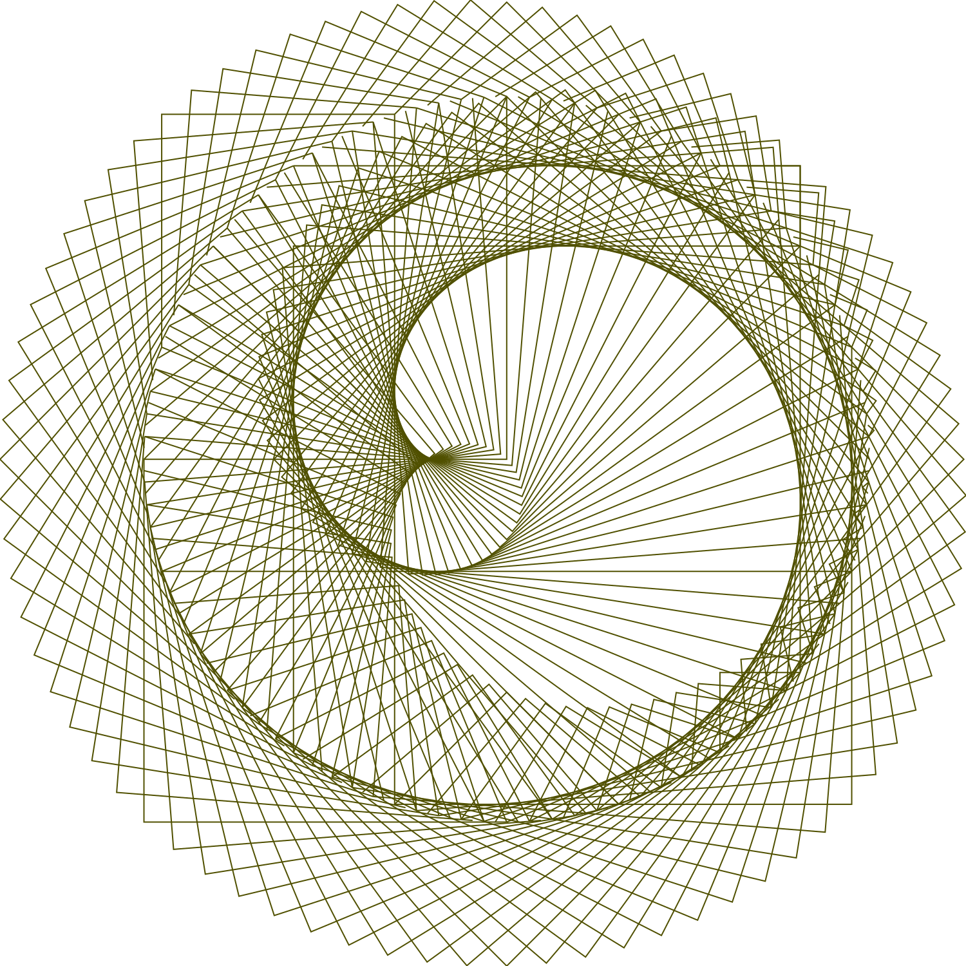
Line segment vs alternative
Line segment,
traditional
Right-angle path

Slide 8
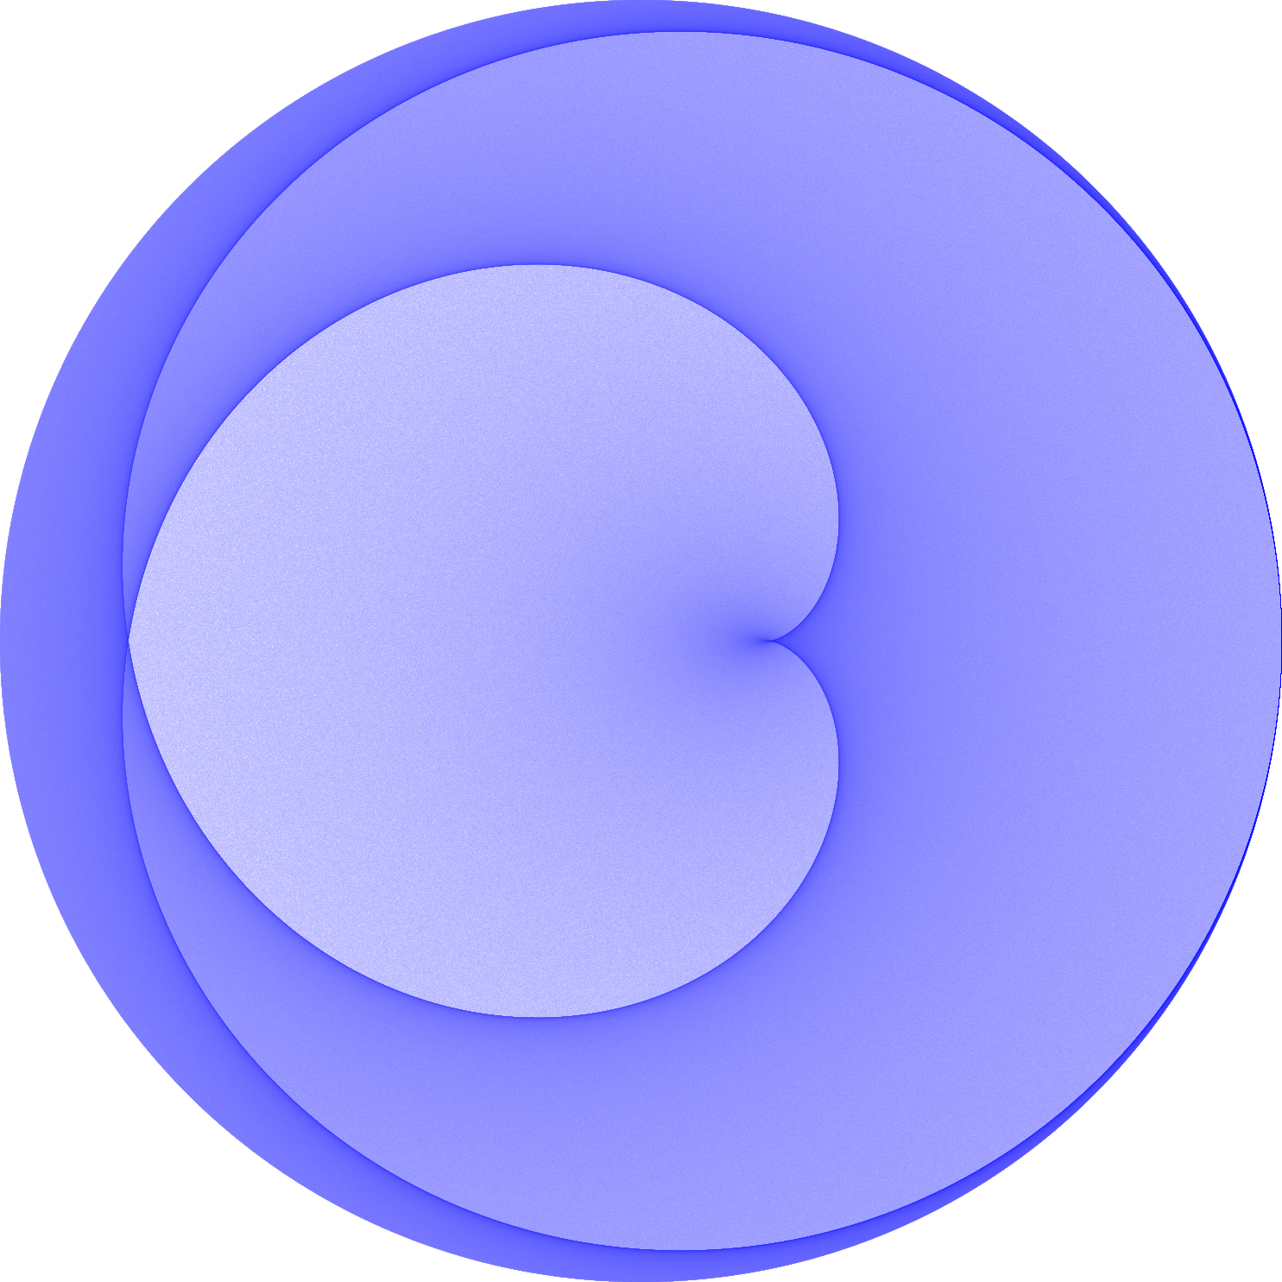
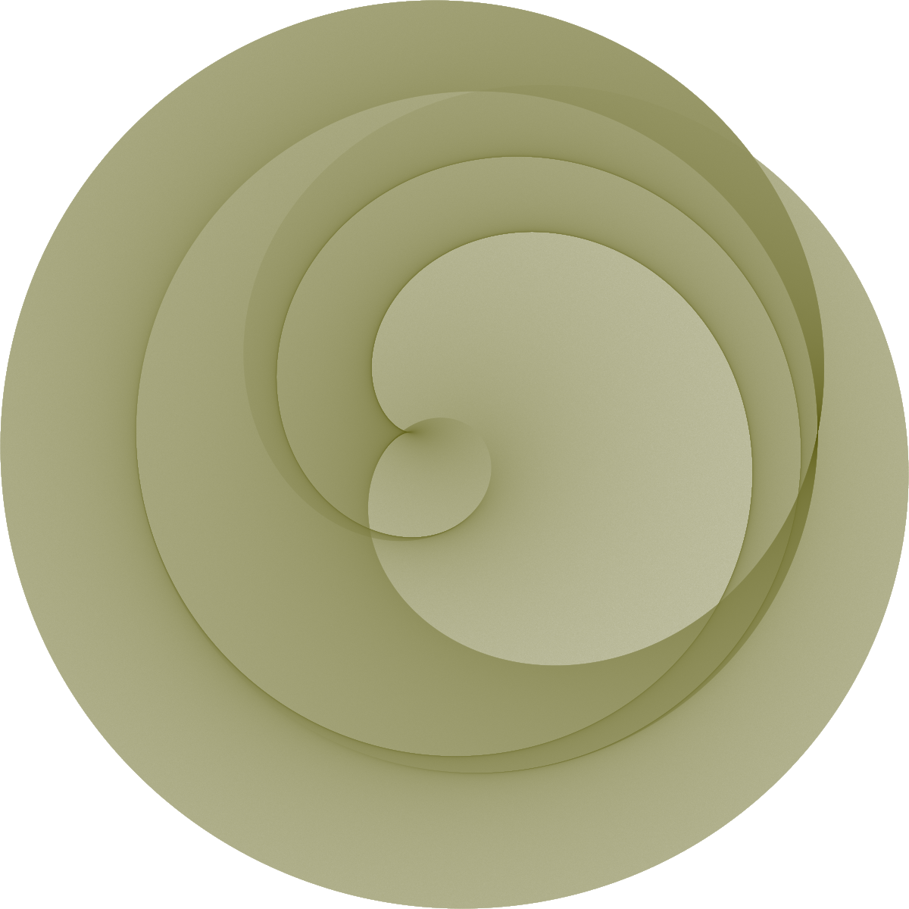
Line segment vs alternative as density plots
Line segment,
traditional
Right-angle path

Slide 9
Symmetry and non-symmetry
Connections between points and how they are manipulated can lead to symmetric or non-symmetric results
  A line segment between points has one drawing option
  A parabola has three options
    Orient curve based on original point order (non-symmetric)
    Orient curve towards a point, e.g. center of circle (symmetric)
    Orient curve away from target point, e.g., center of circle (symmetric)

Slide 10
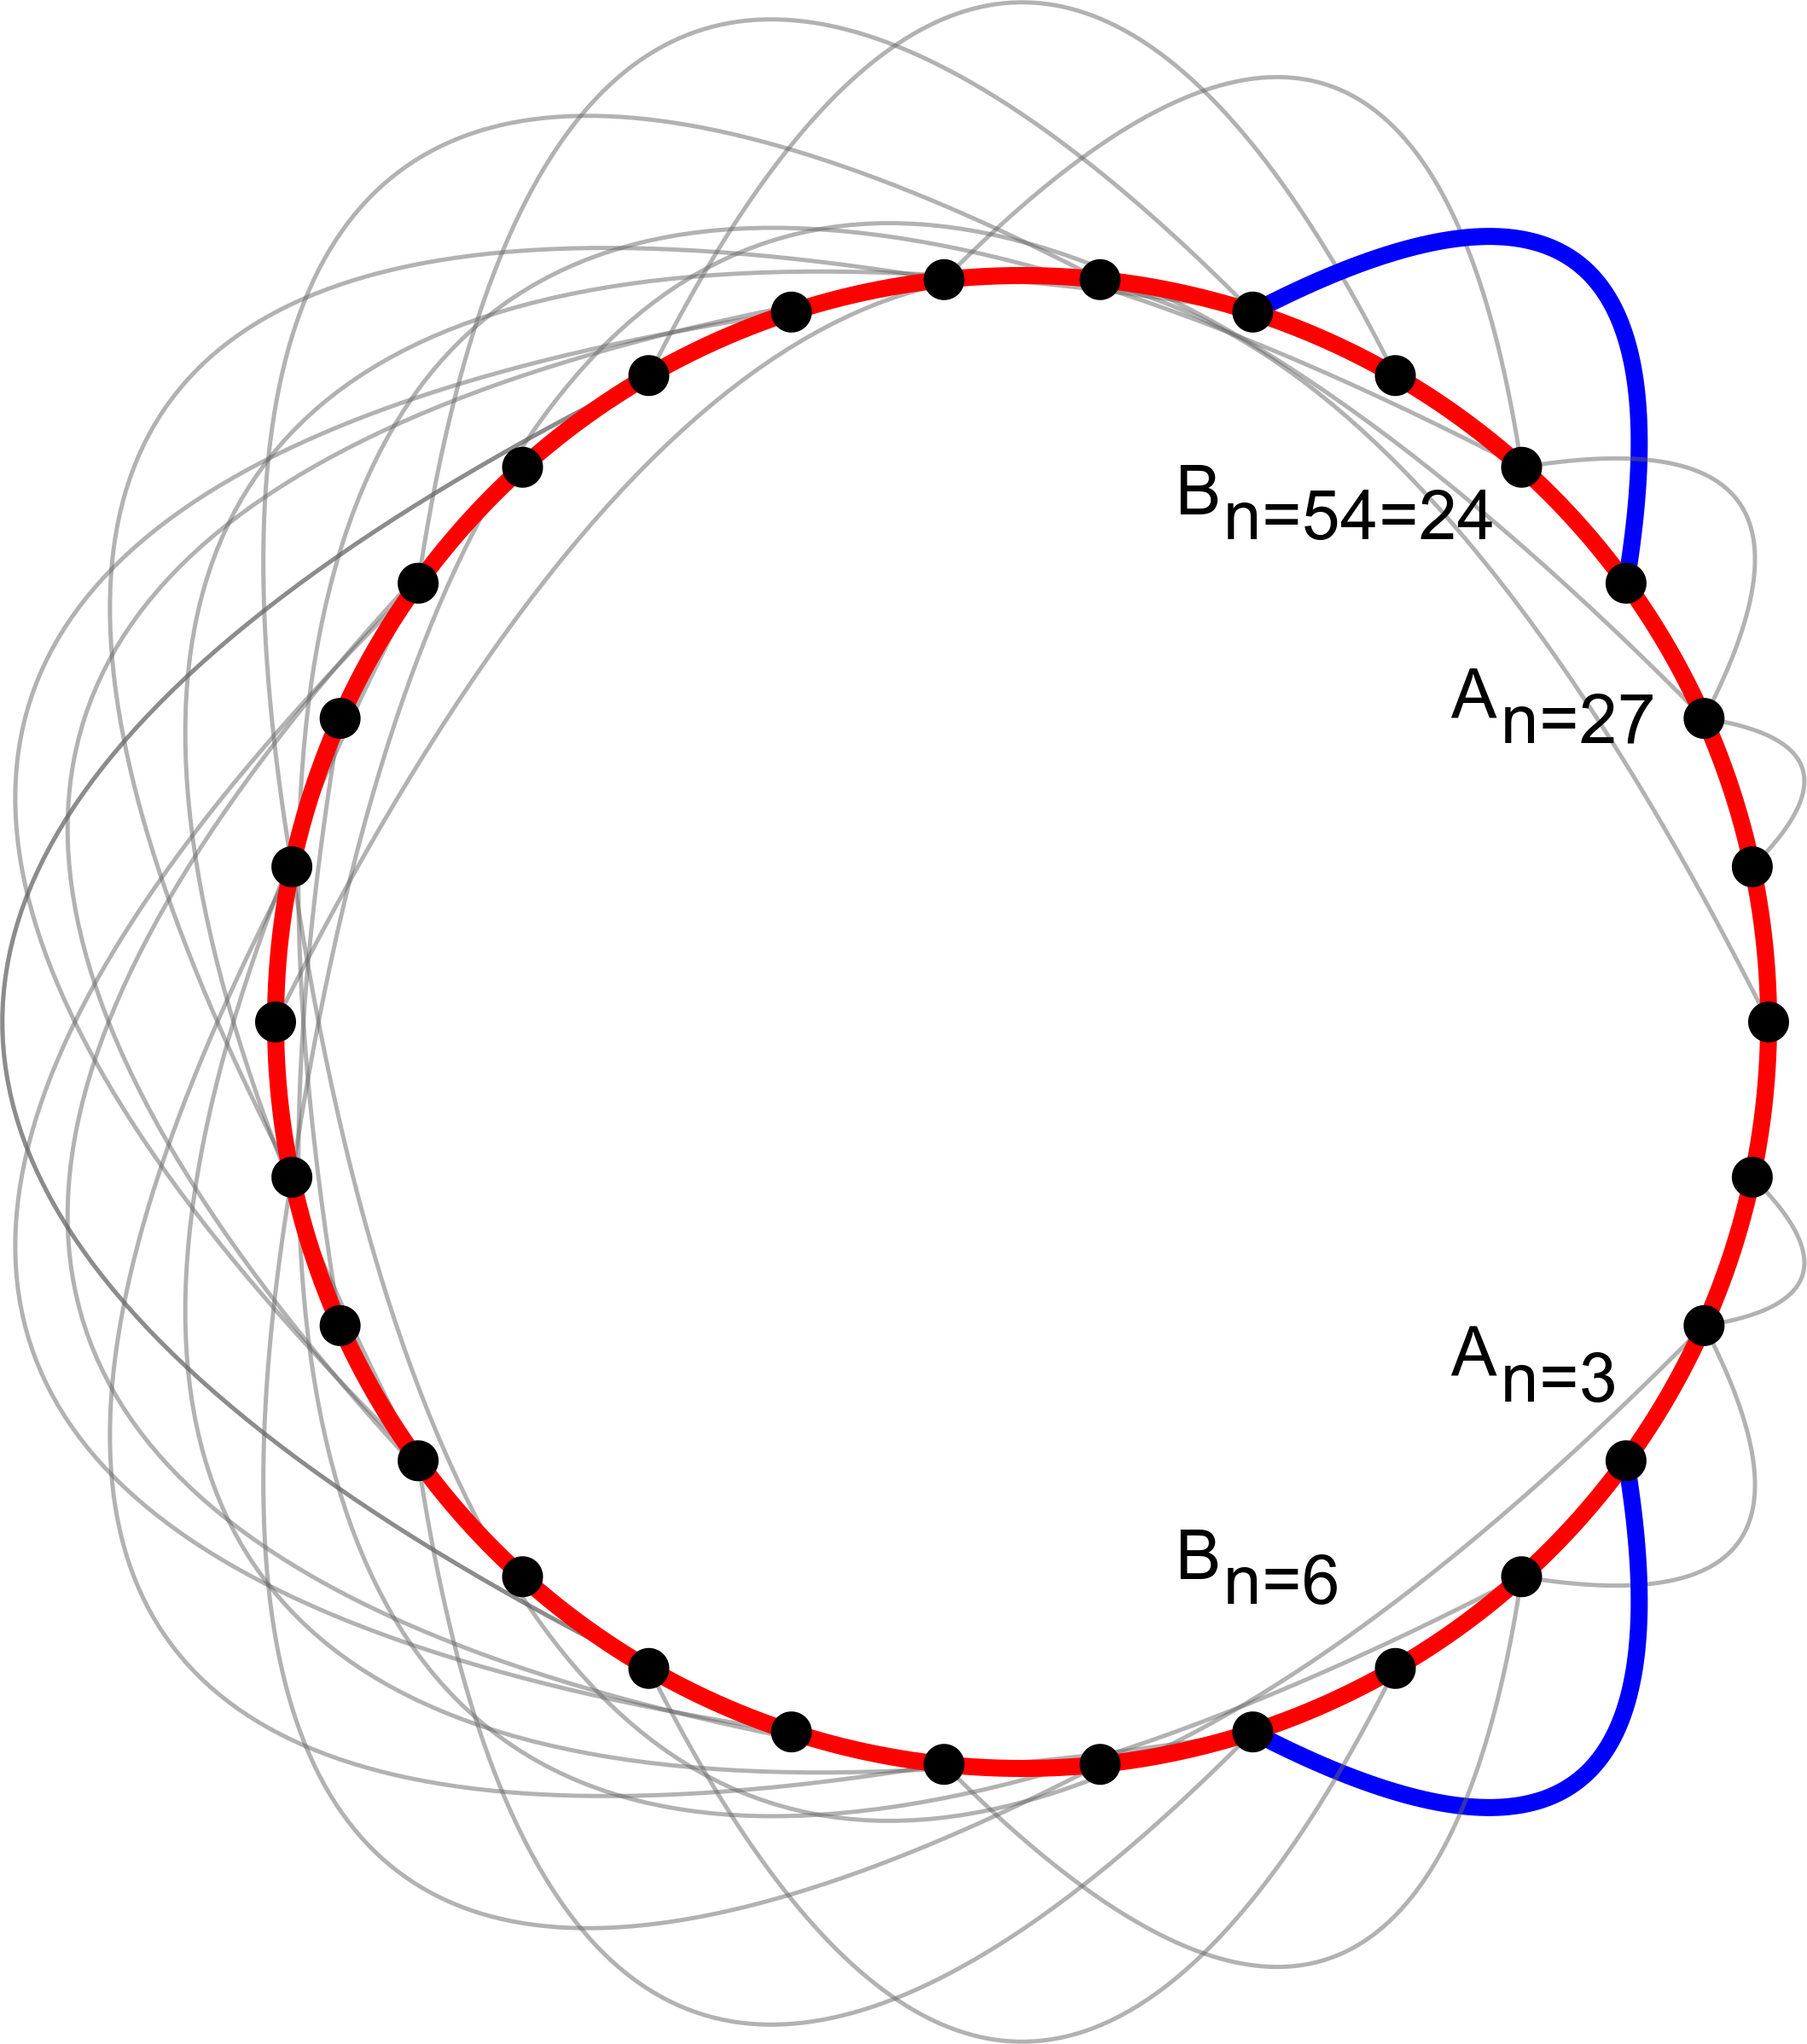
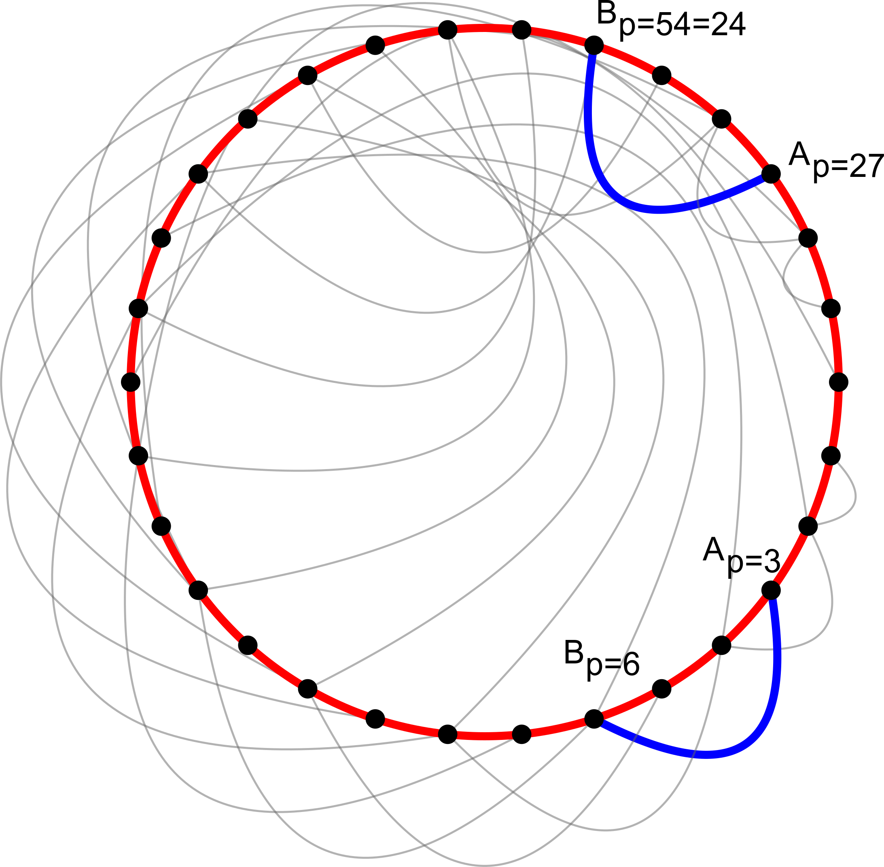
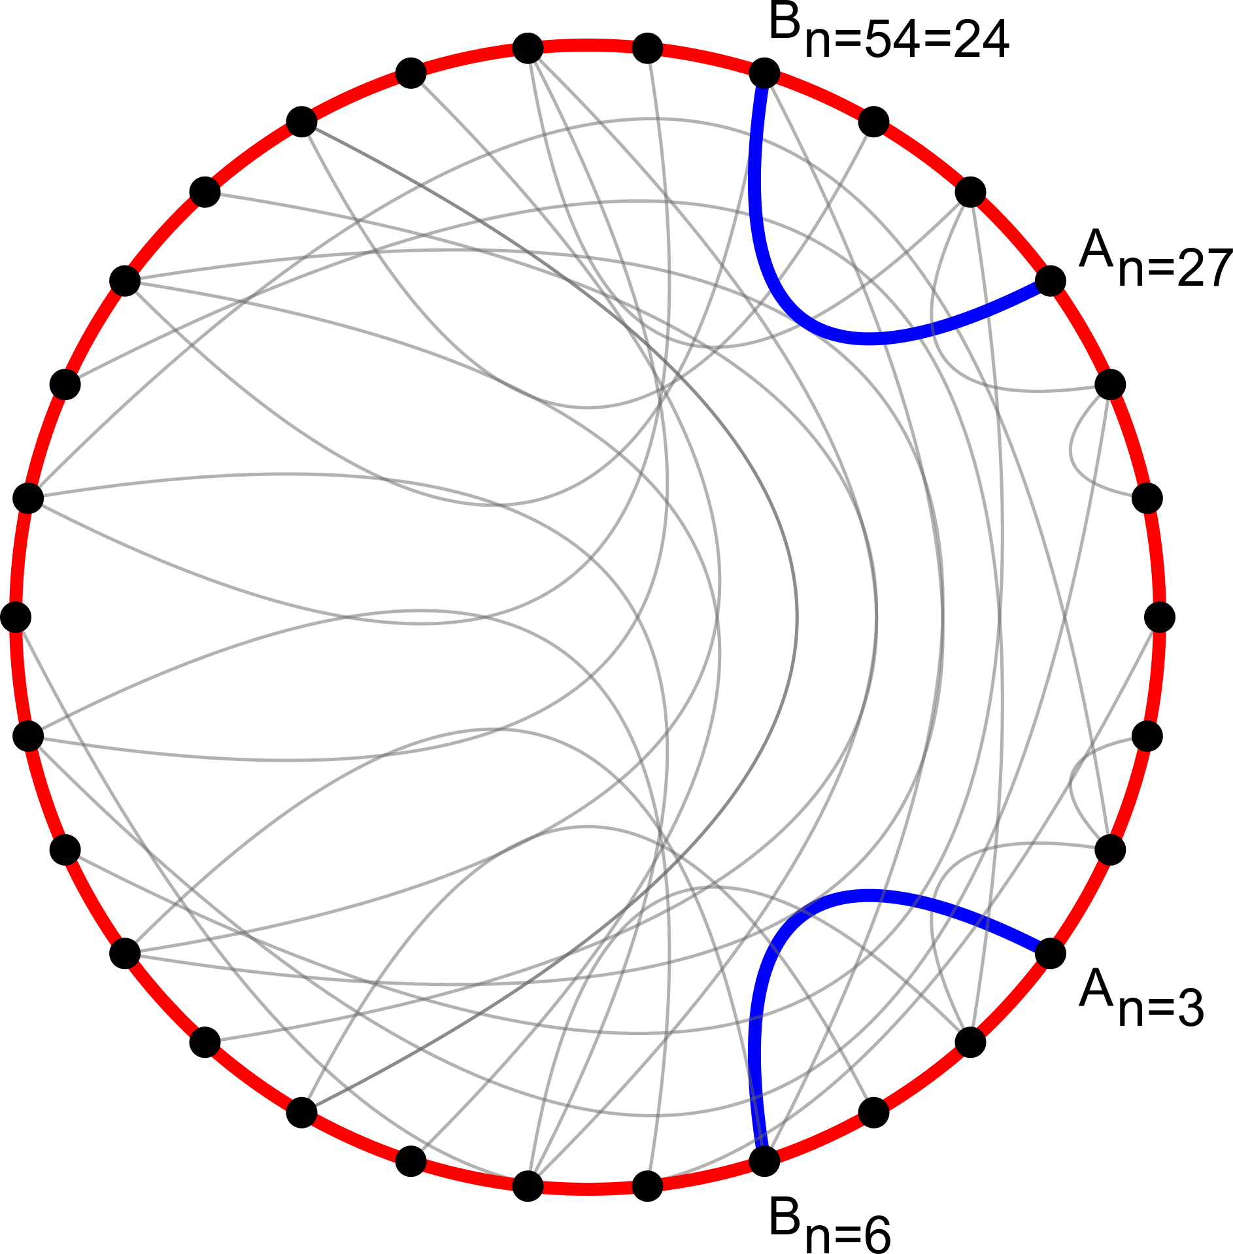
Controlling connection orientation
N = 30, kA = 1, kB = 2

Slide 11
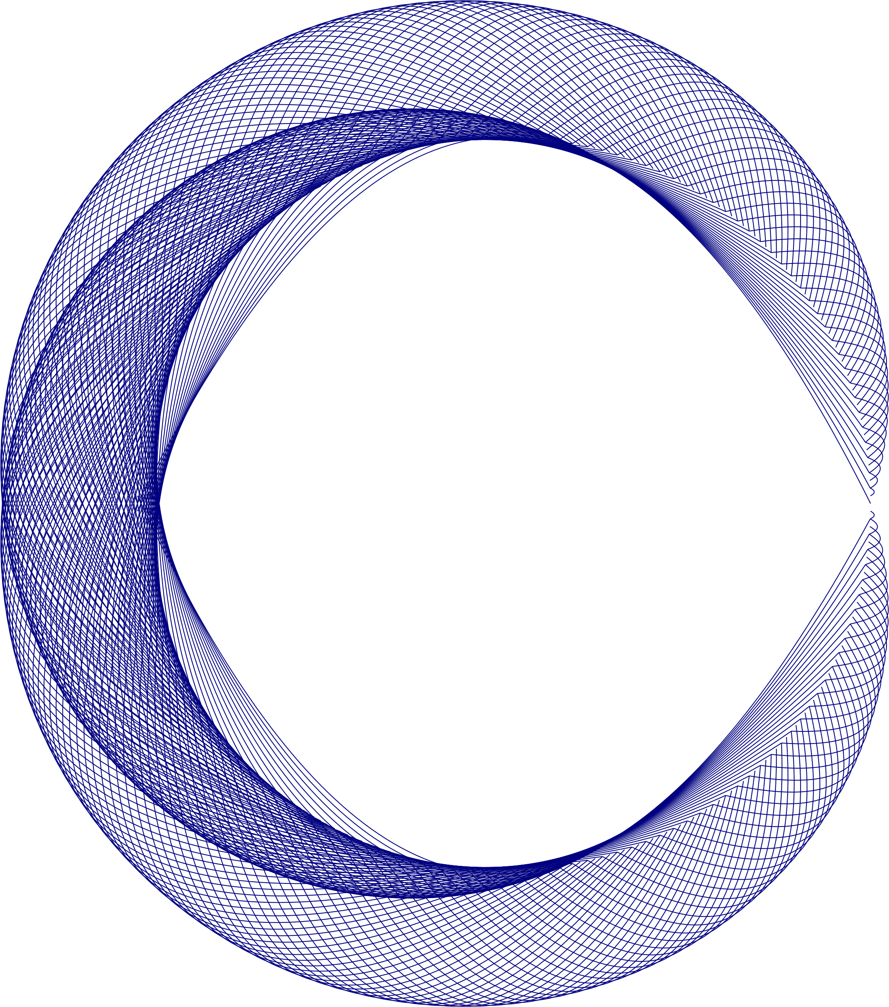
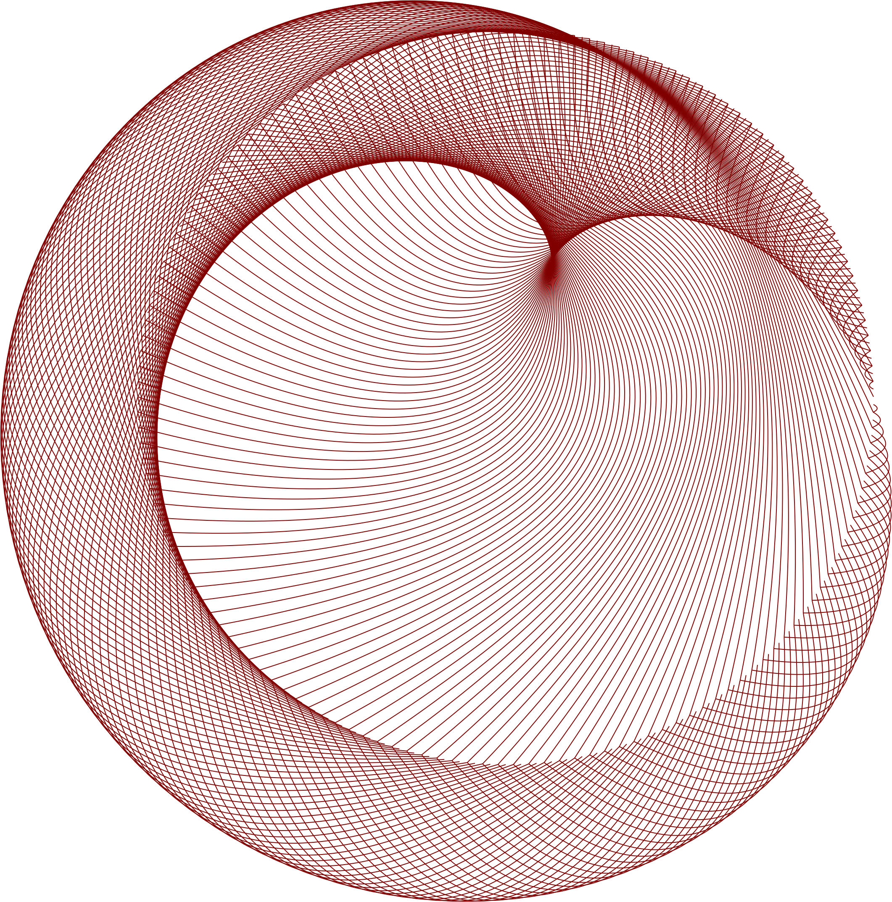
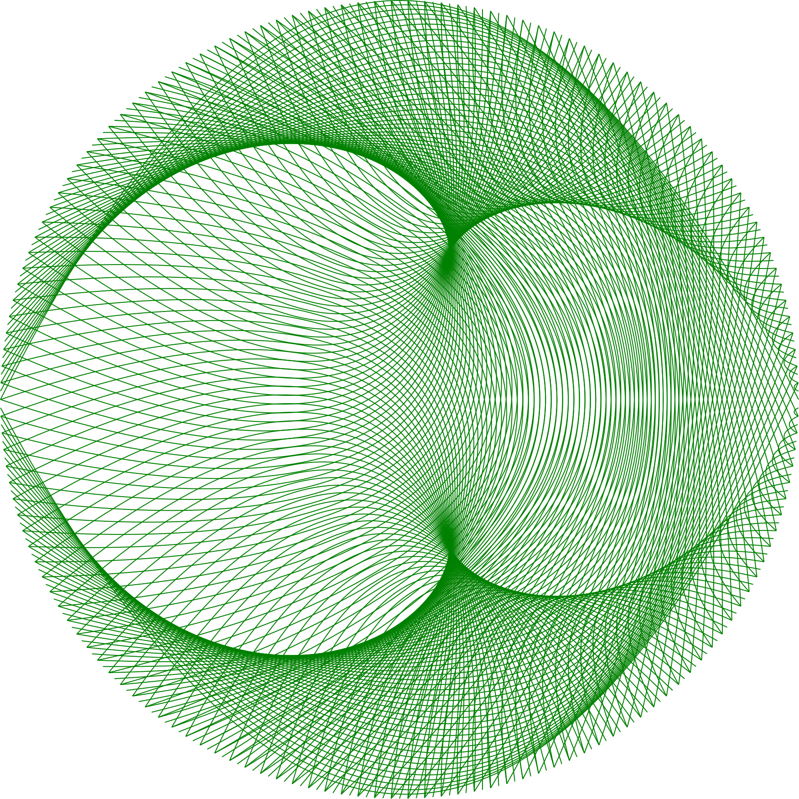
Controlling connection orientation
Orientation based on
point order
Oriented towards center
Oriented away
from center
N = 300, kA = 1, kB = 2

Slide 12
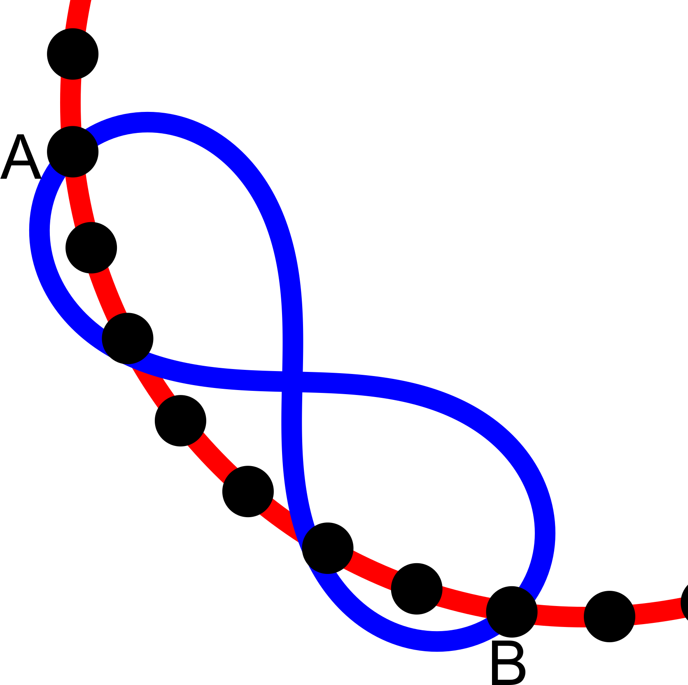
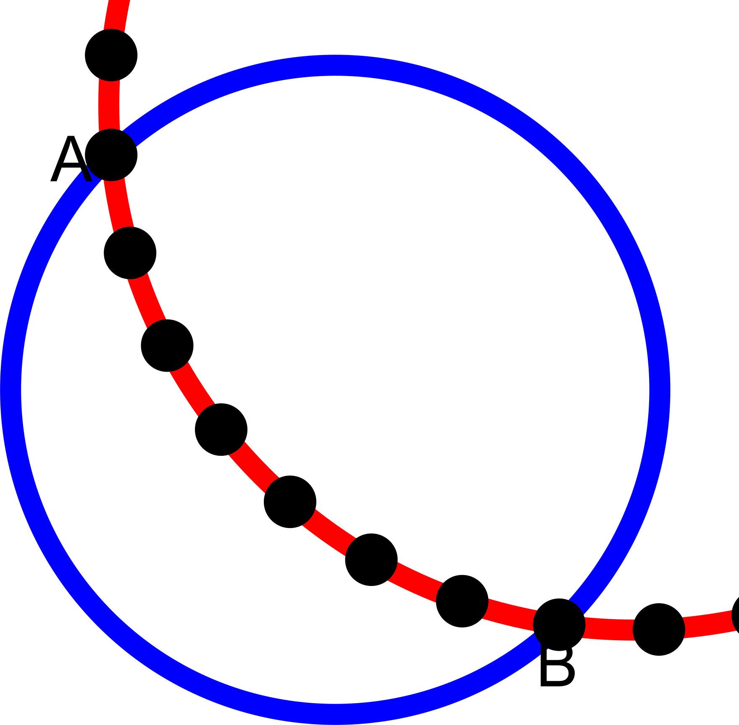
Shapes as connections
Connections can be extended to include shapes and closed curves
Examples
  Circle
  Lemniscate

Slide 13
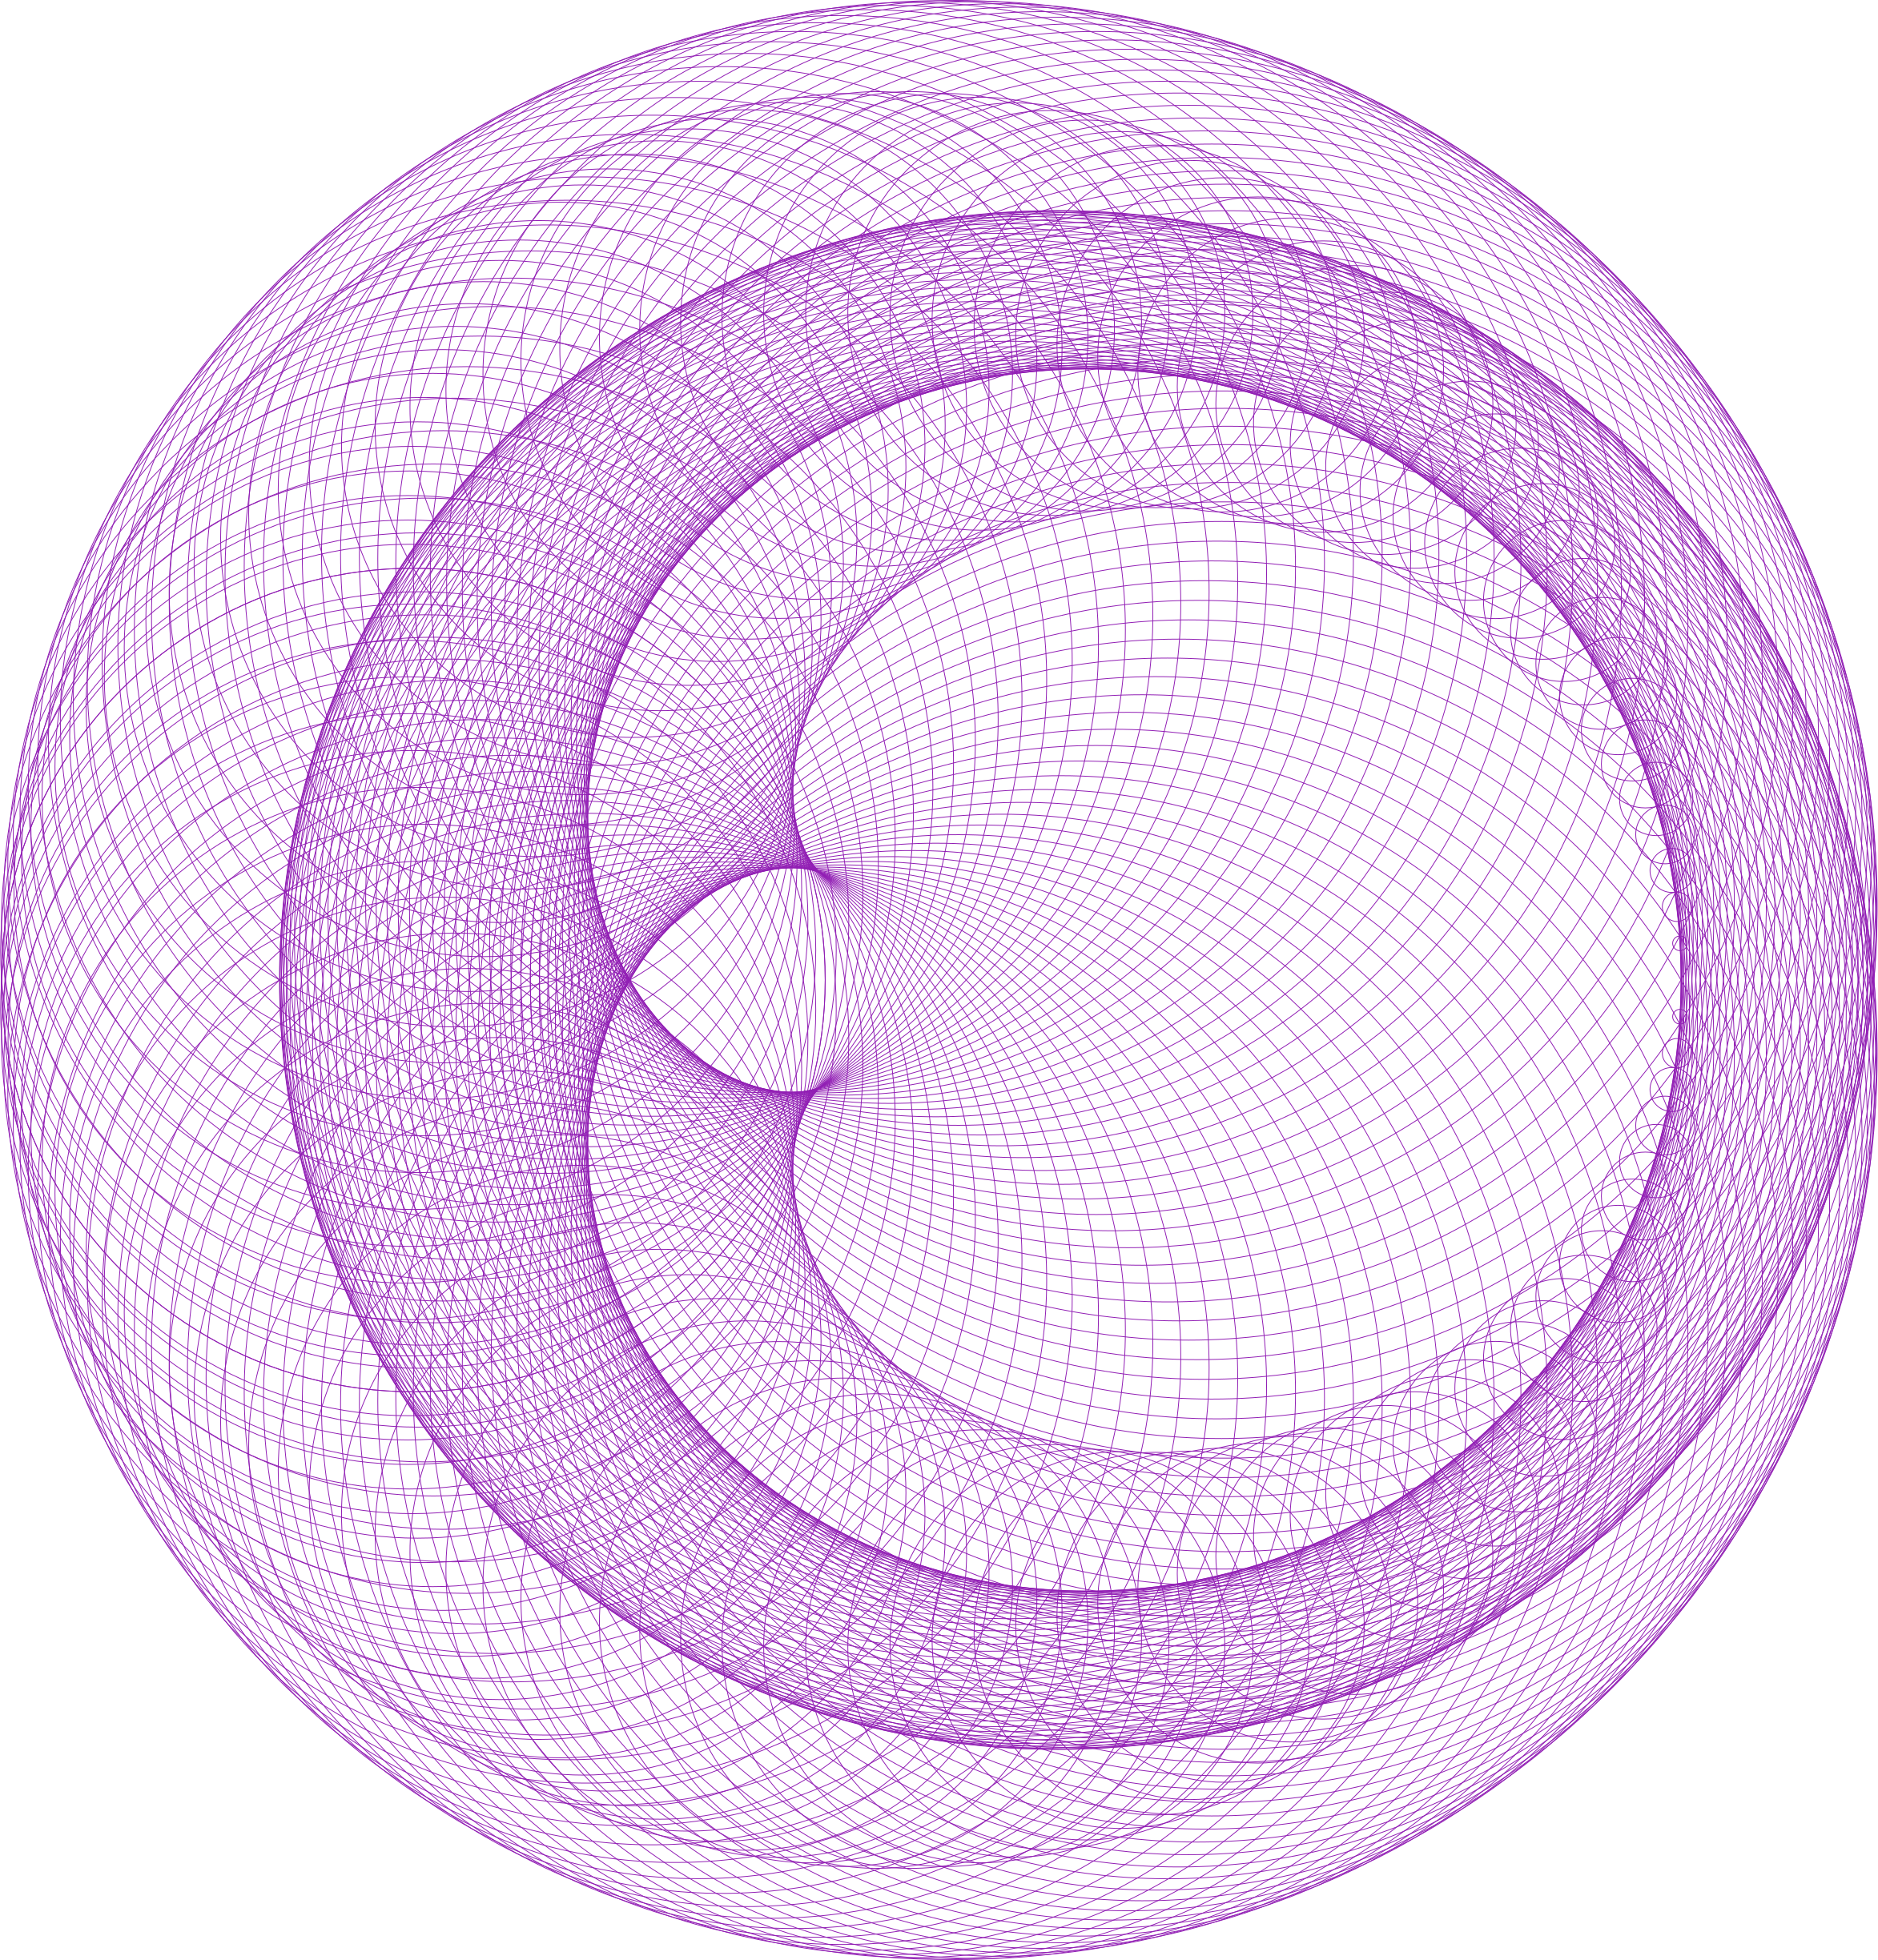
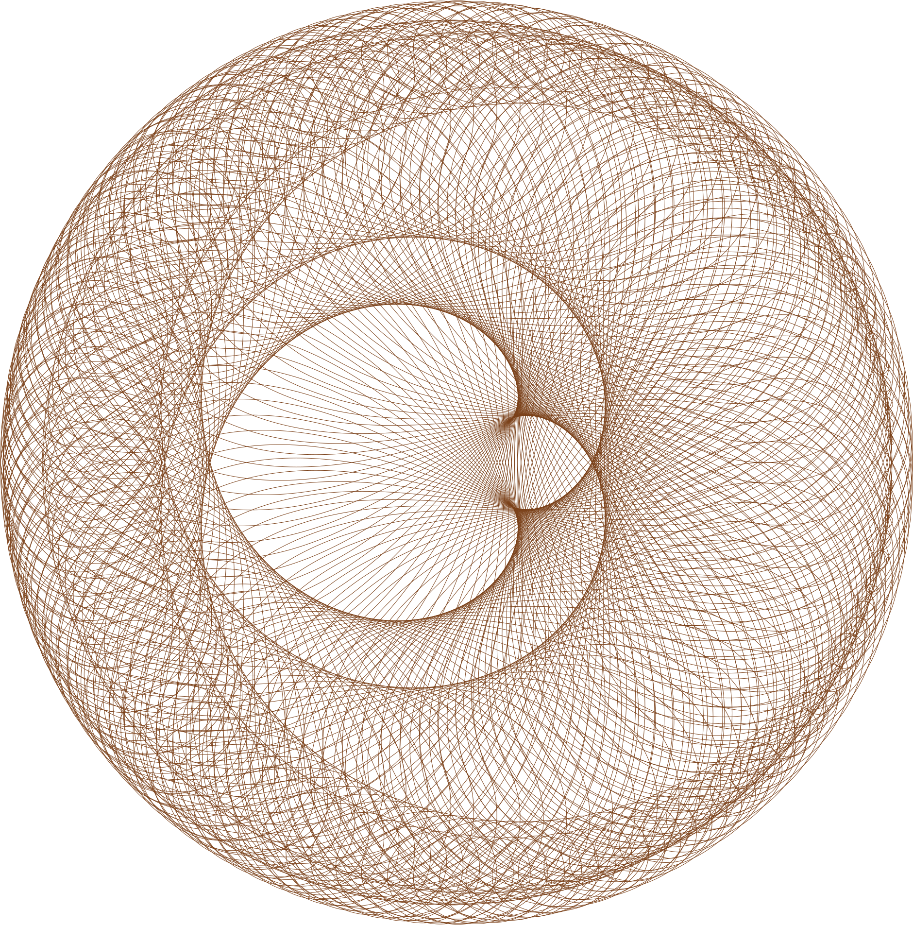
Comparison with line segment
line segment
circle
lemniscate
N = 300, kA = 1, kB = 2

Slide 14
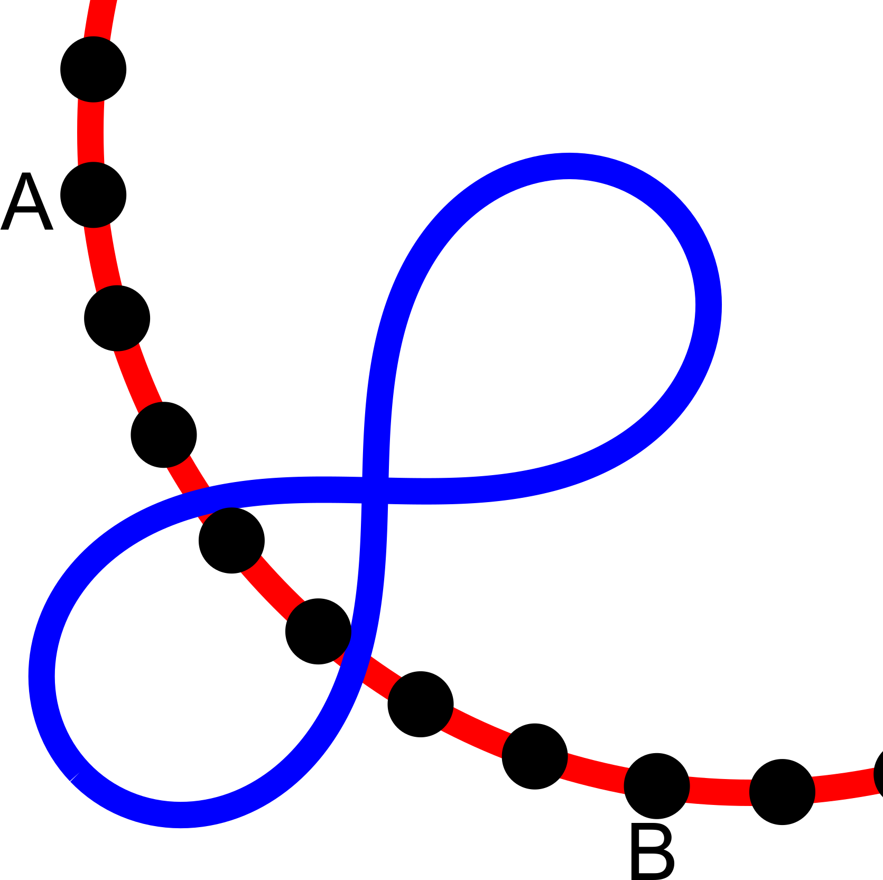
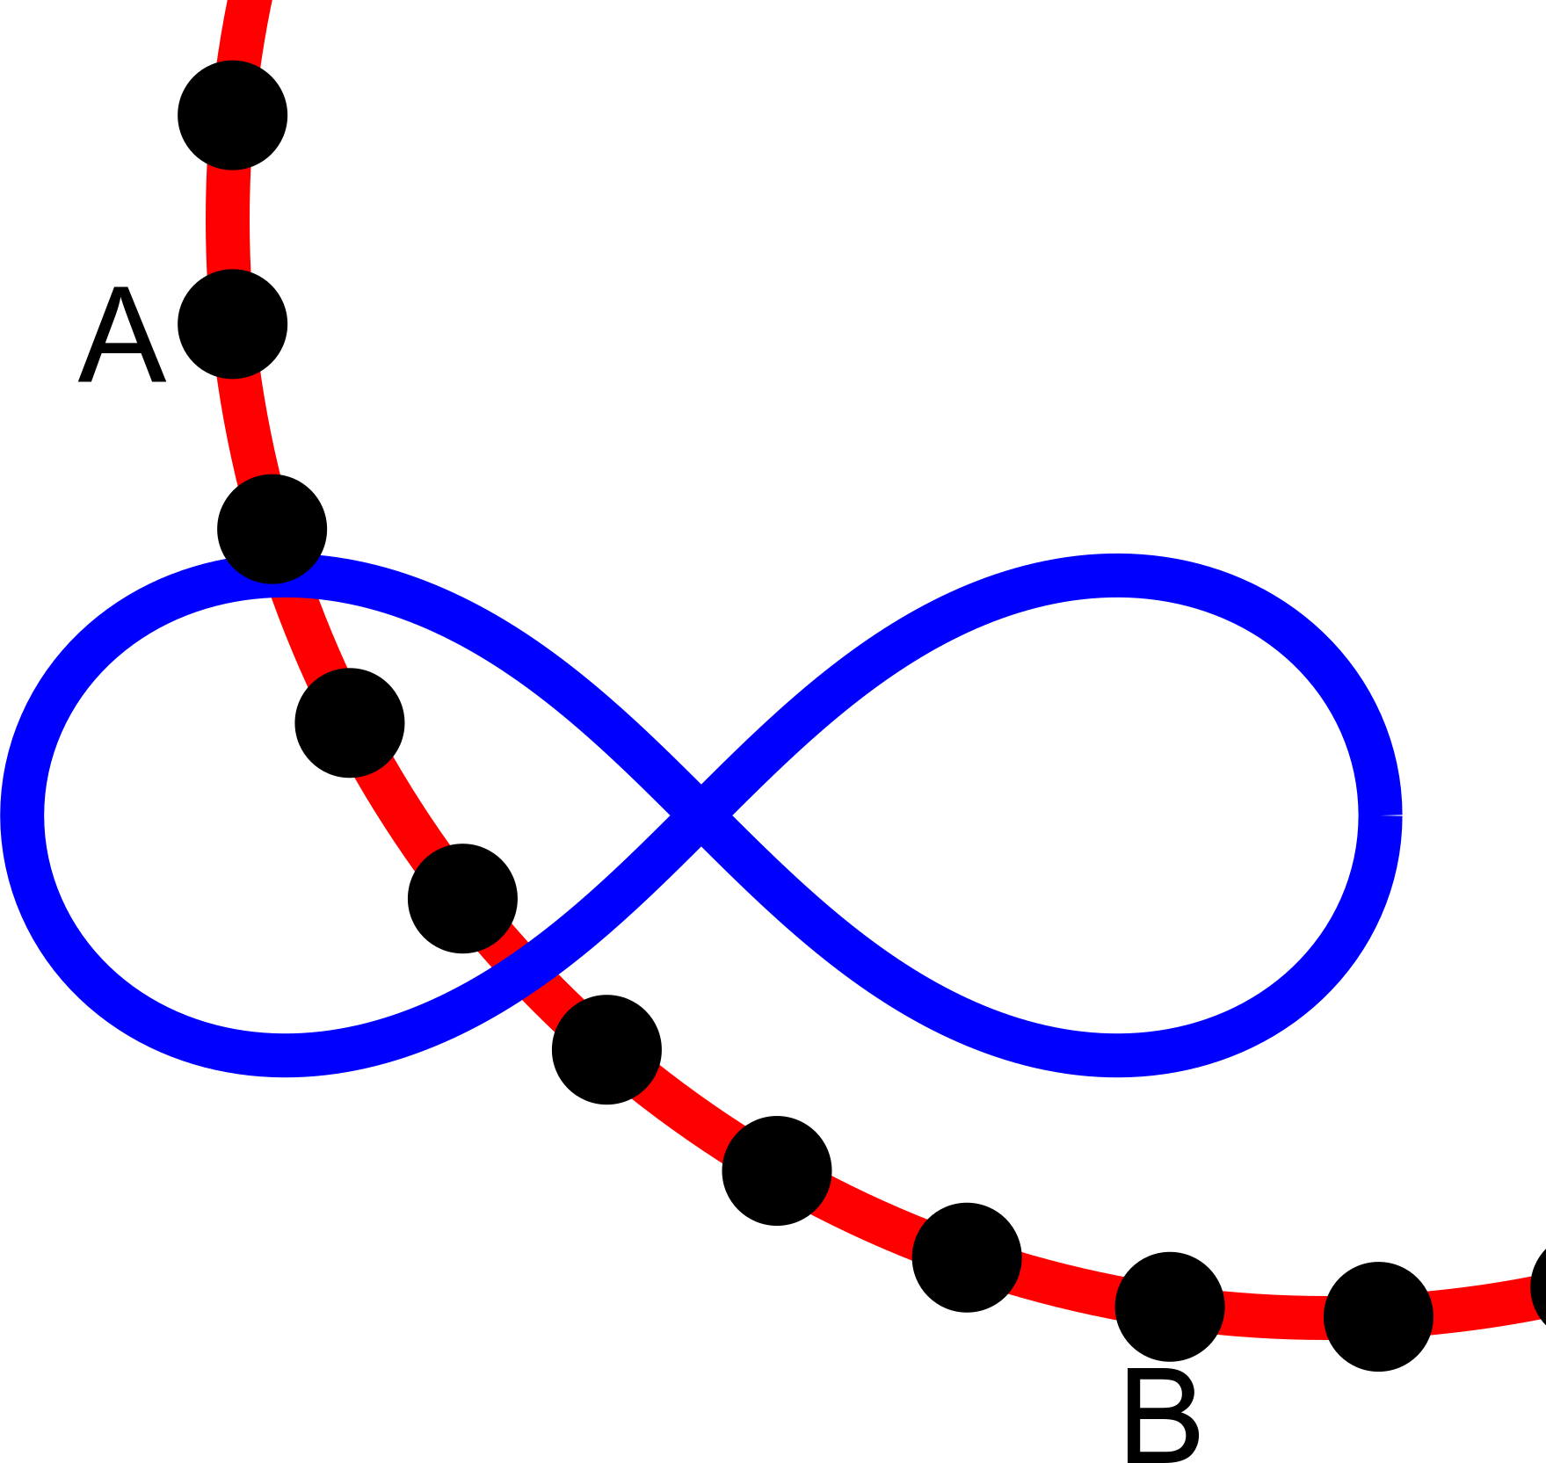
Orienting connections
Connections are traditionally connected to points A and B
Variations can use A and B as control points
Connected to
A and B
Rotated 90 based
on angle of A and B
Positioned between
A and B; always
horizontal

Slide 15
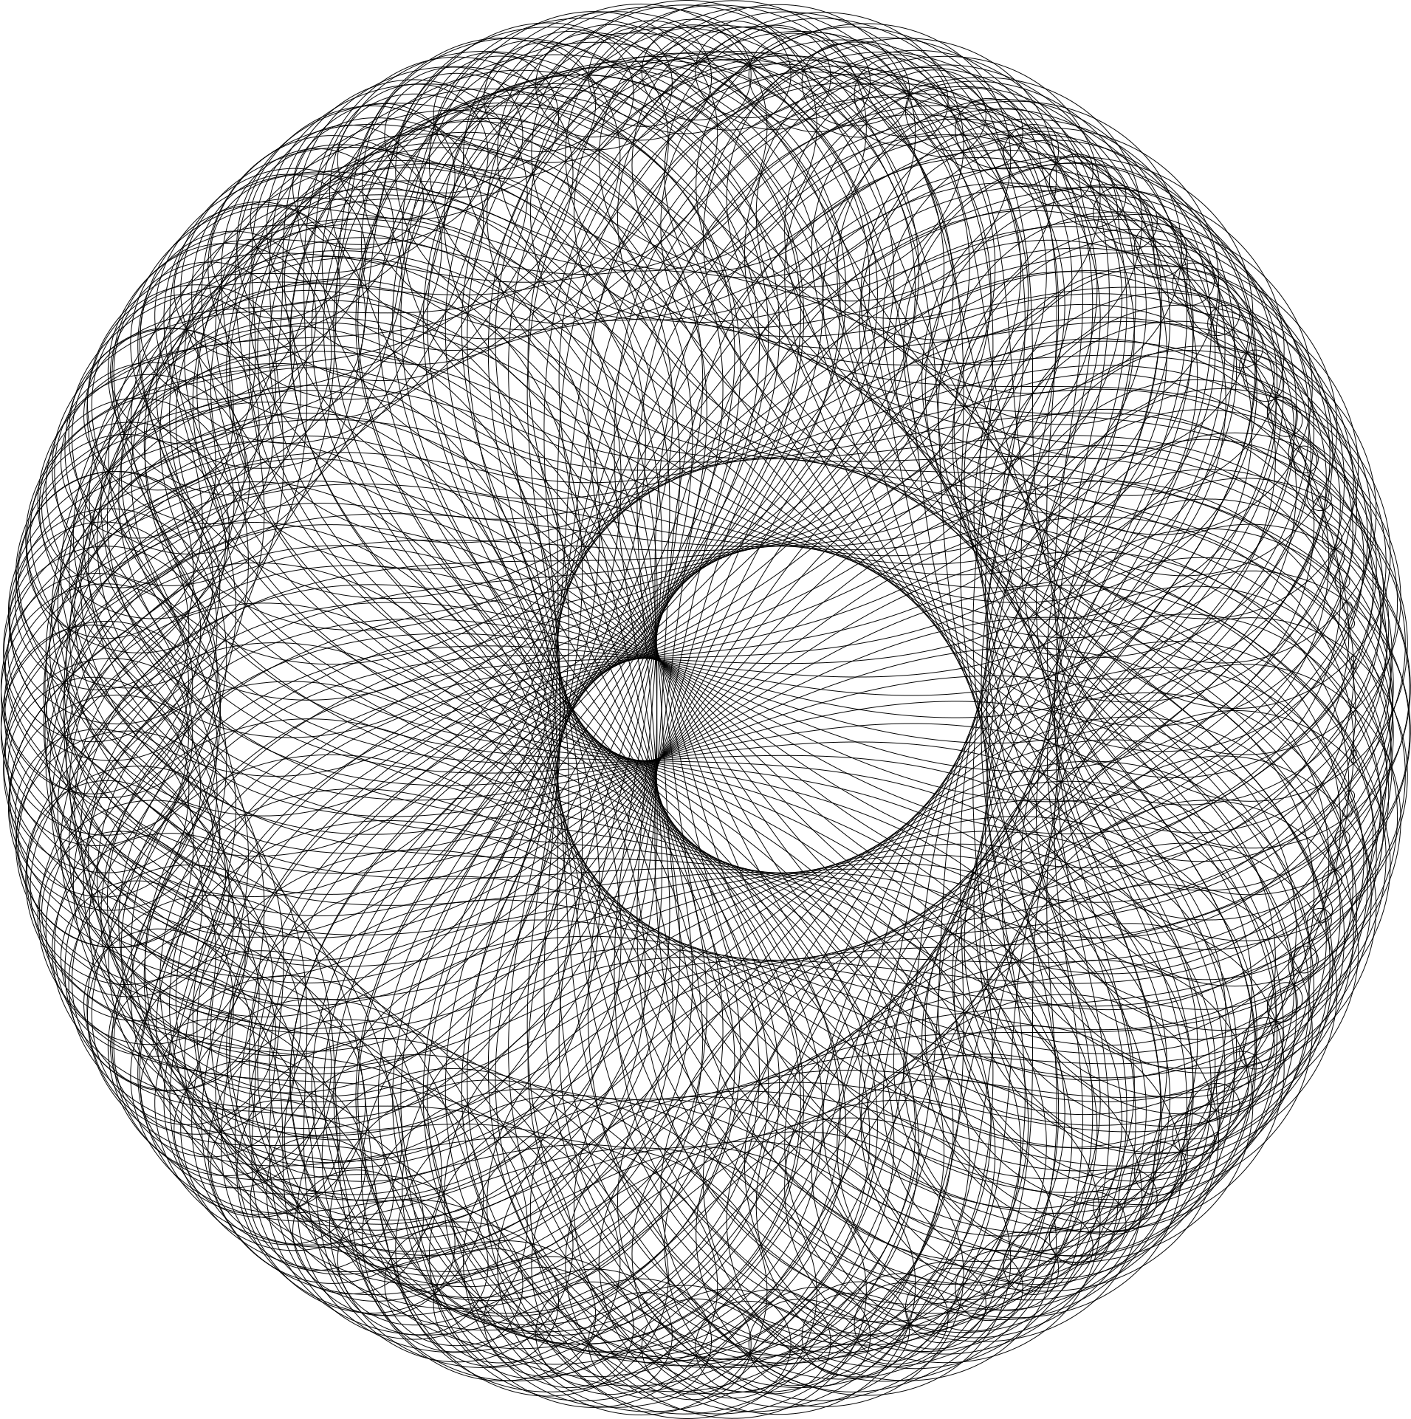
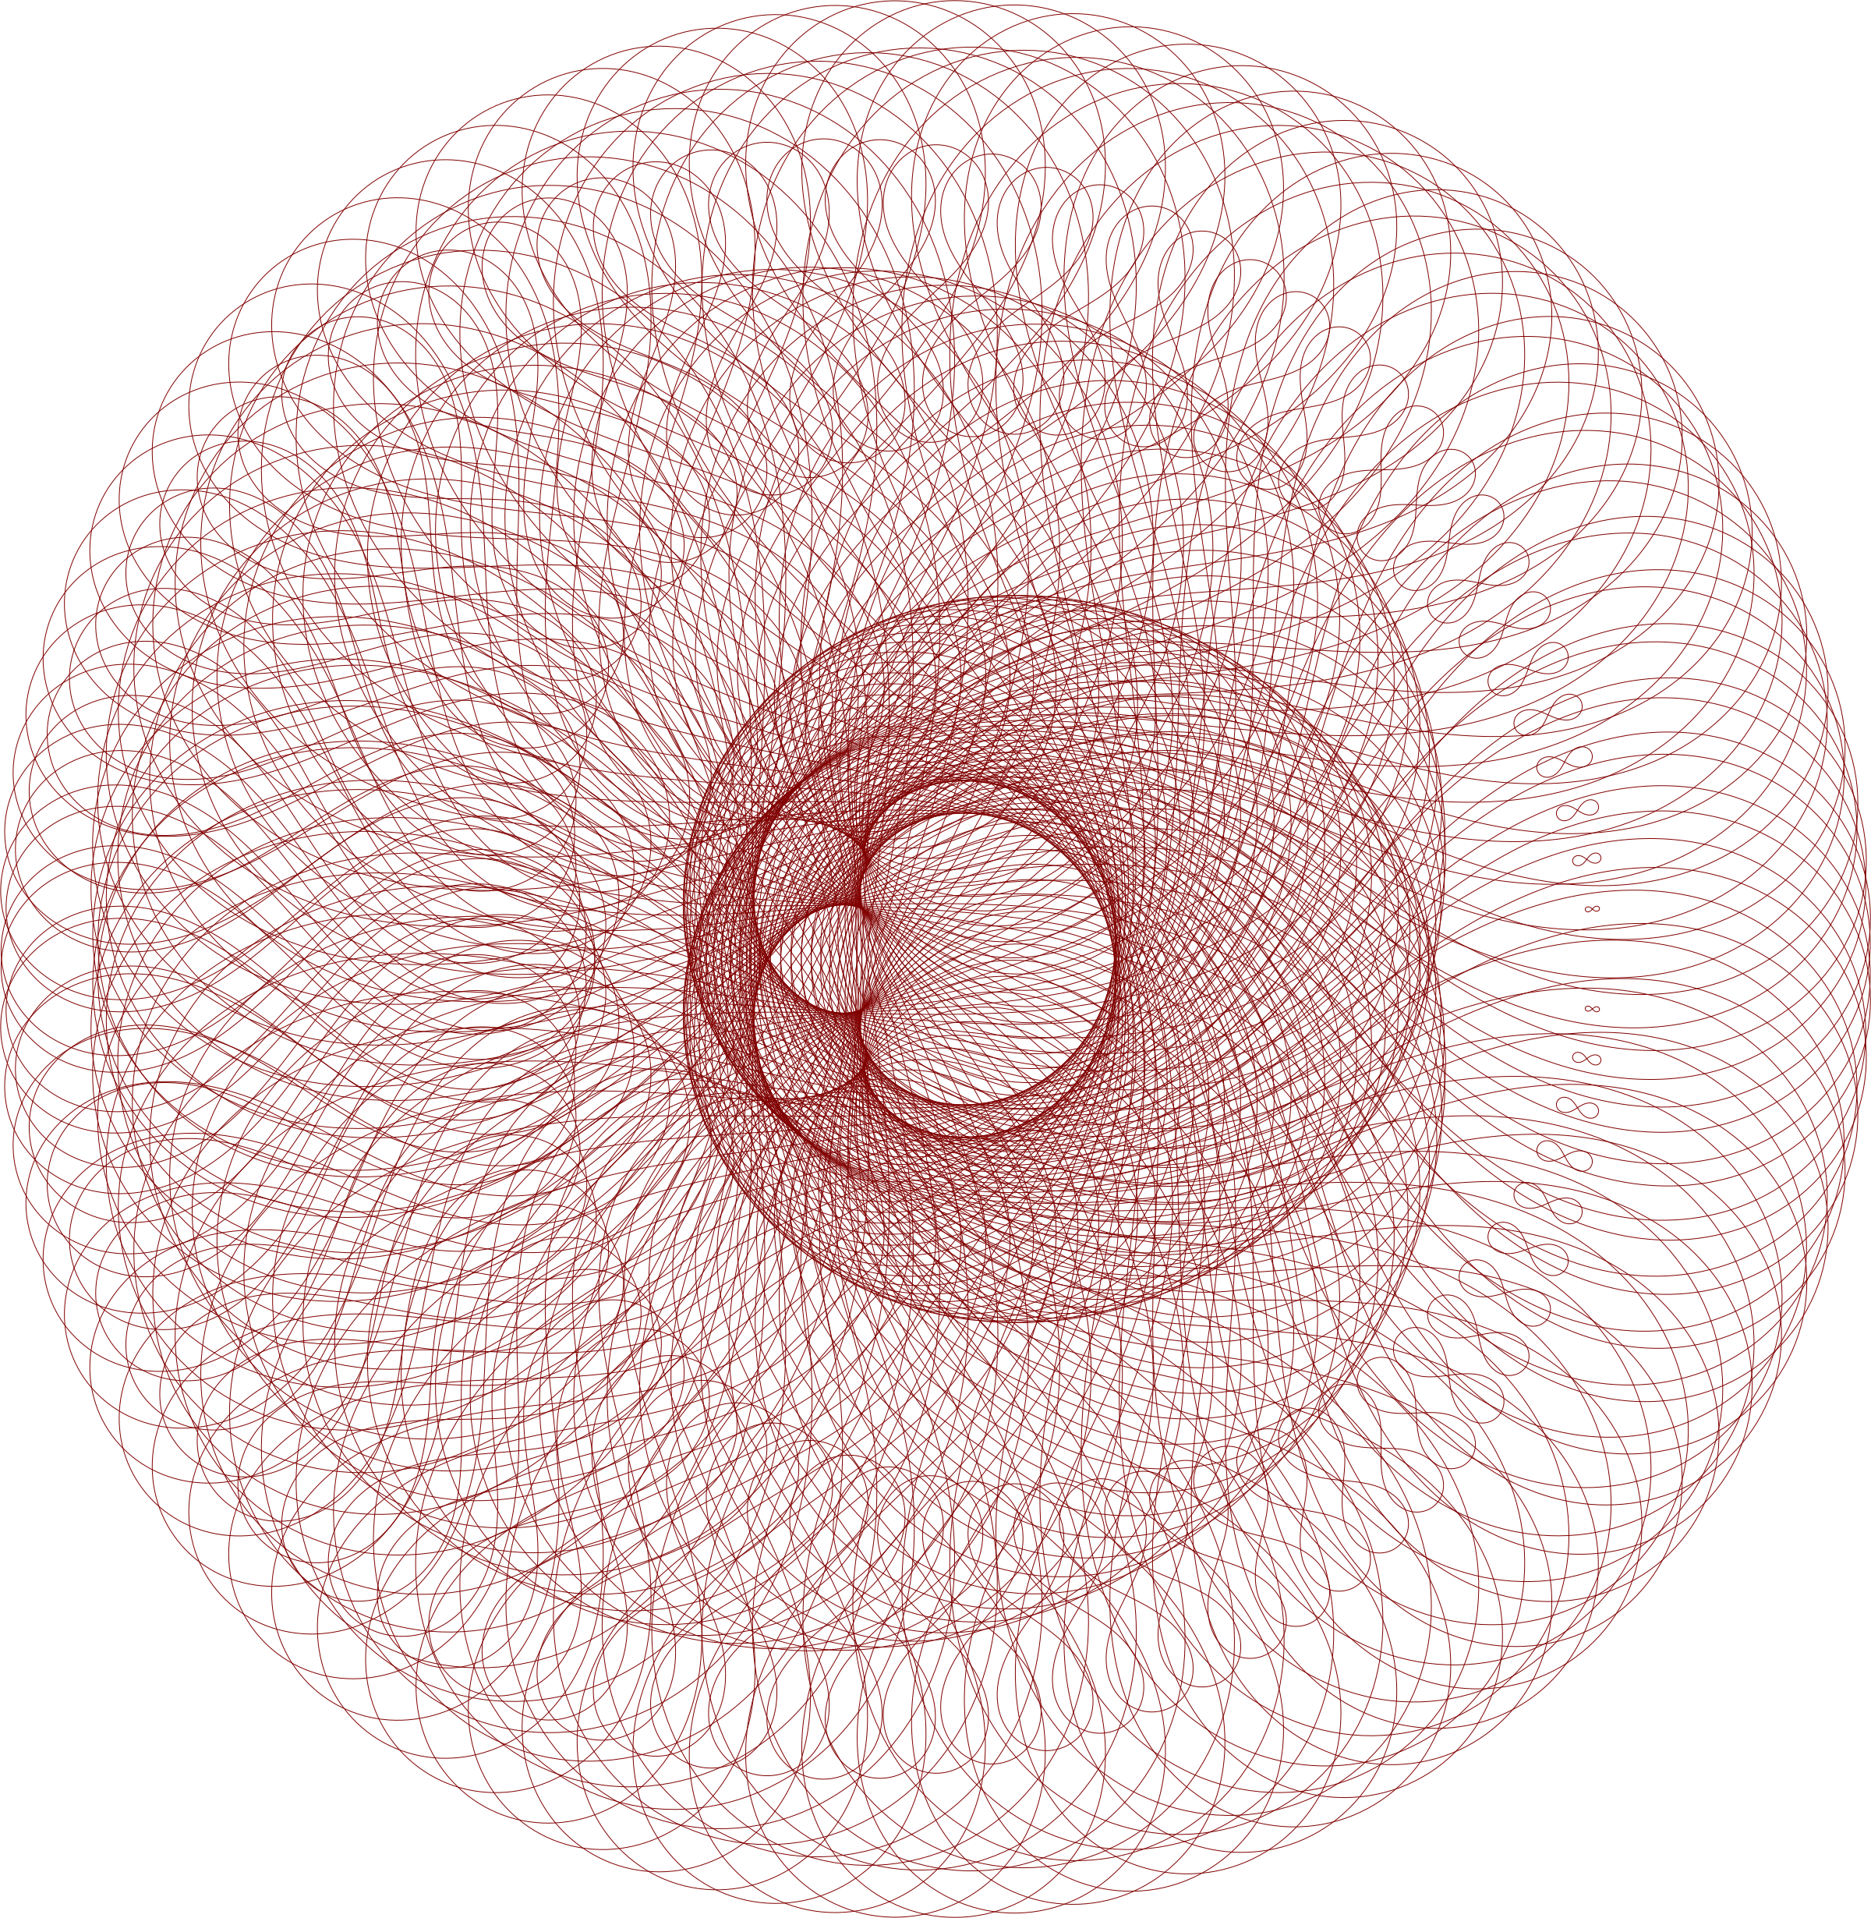
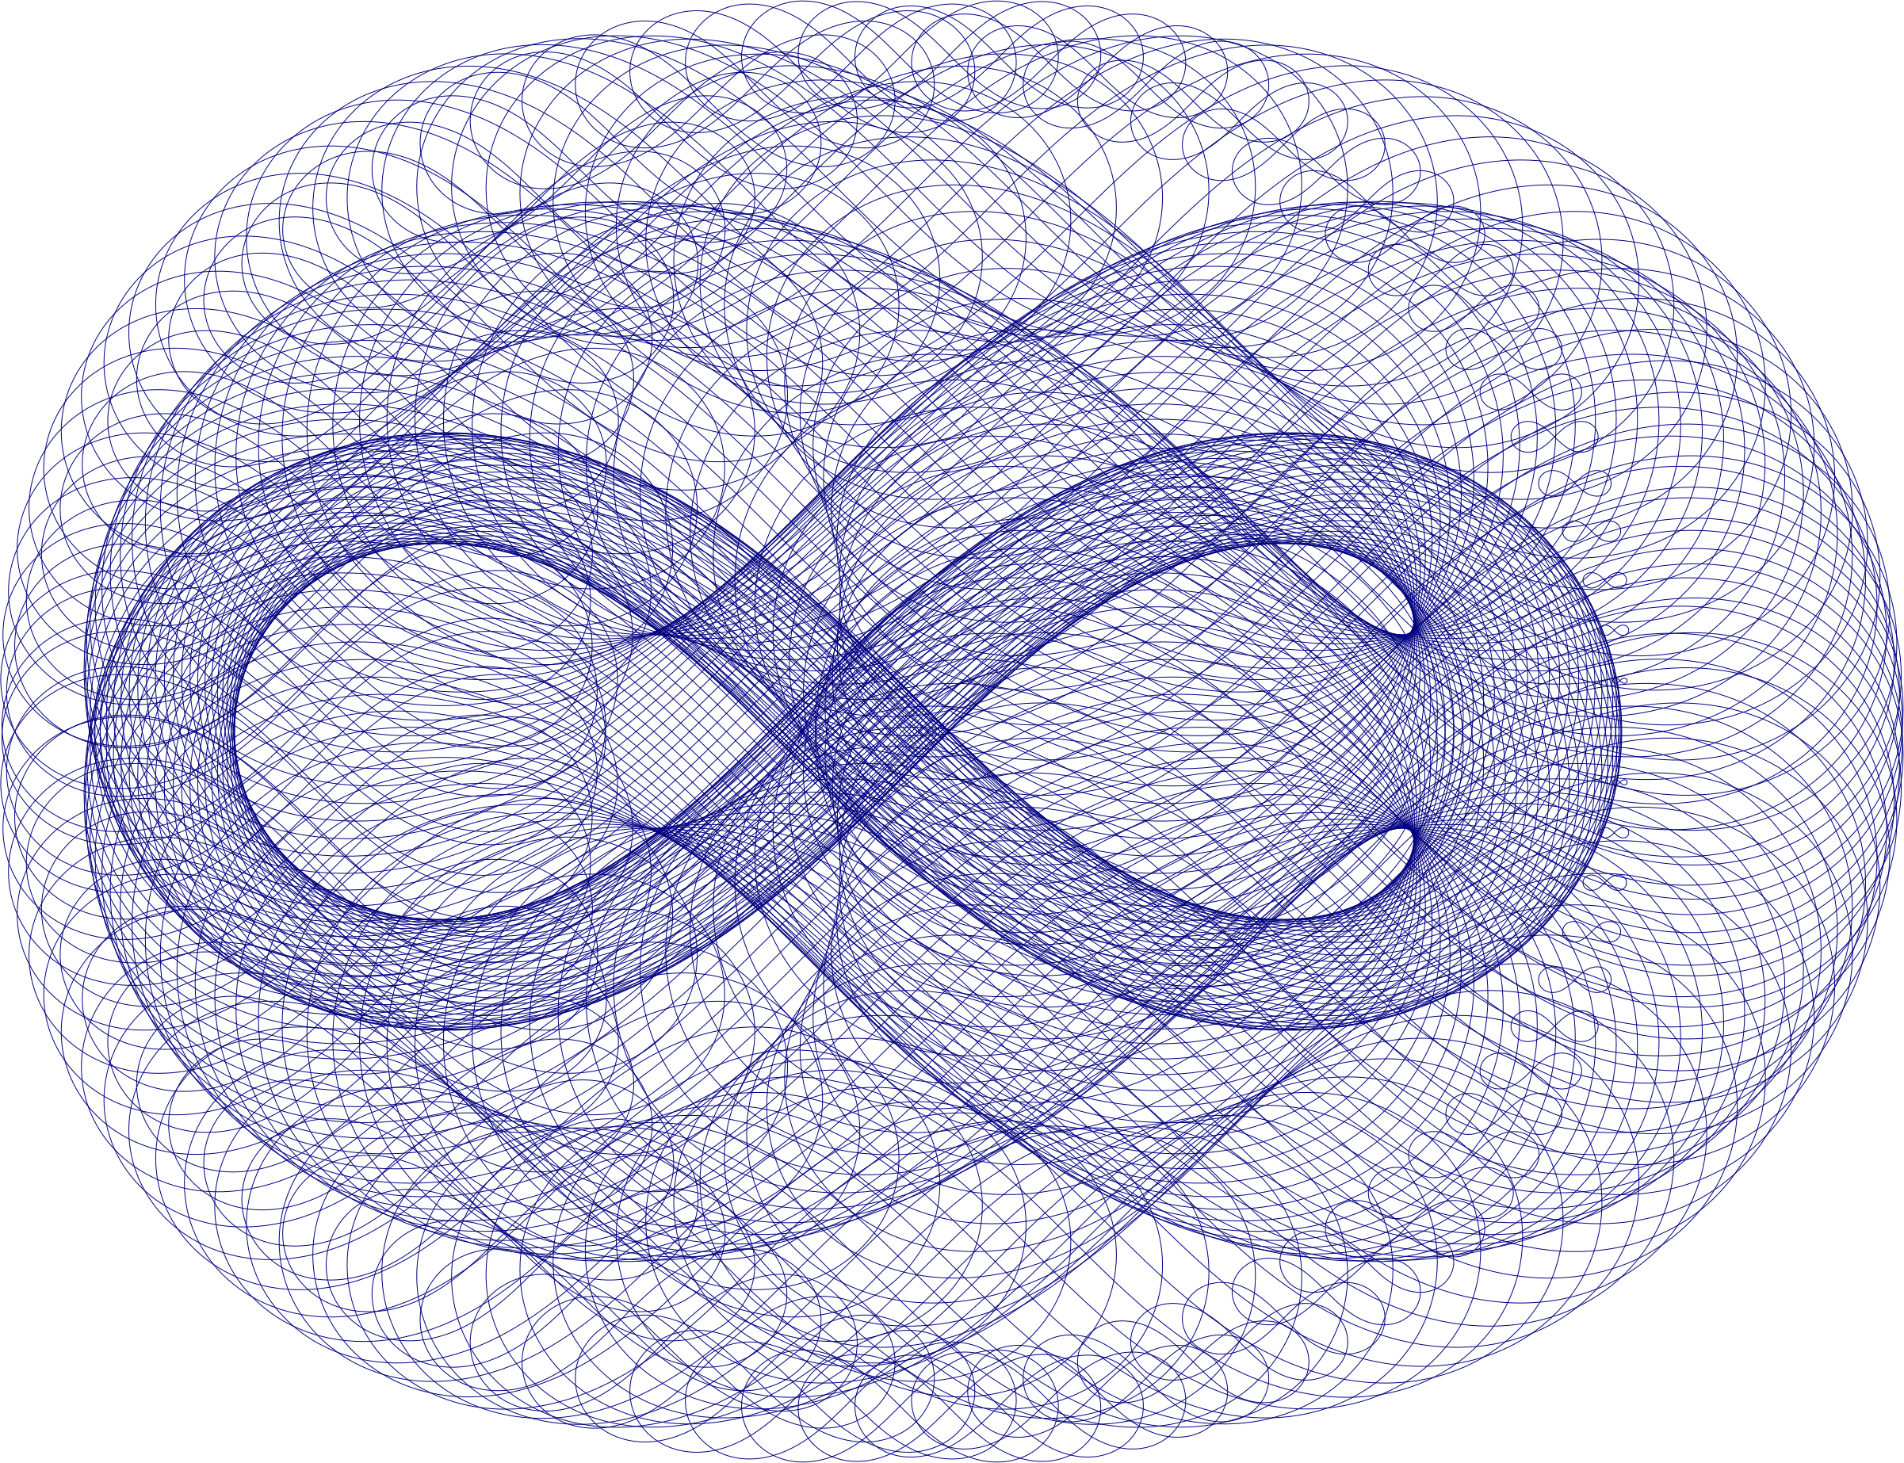
Orienting connections: lemniscate example
Connected to
A and B
Rotated 90 based
on angle of A and B
Positioned between
A and B; always
horizontal
N = 300, kA = 3, kB = 4

Slide 16
Curve stitching in 3d with variations
Curve stitching can be performed in 3d, and the previously applied variations can be applied as well
Following slides demonstrate curve stitching variations when applied to 3d

Slide 17
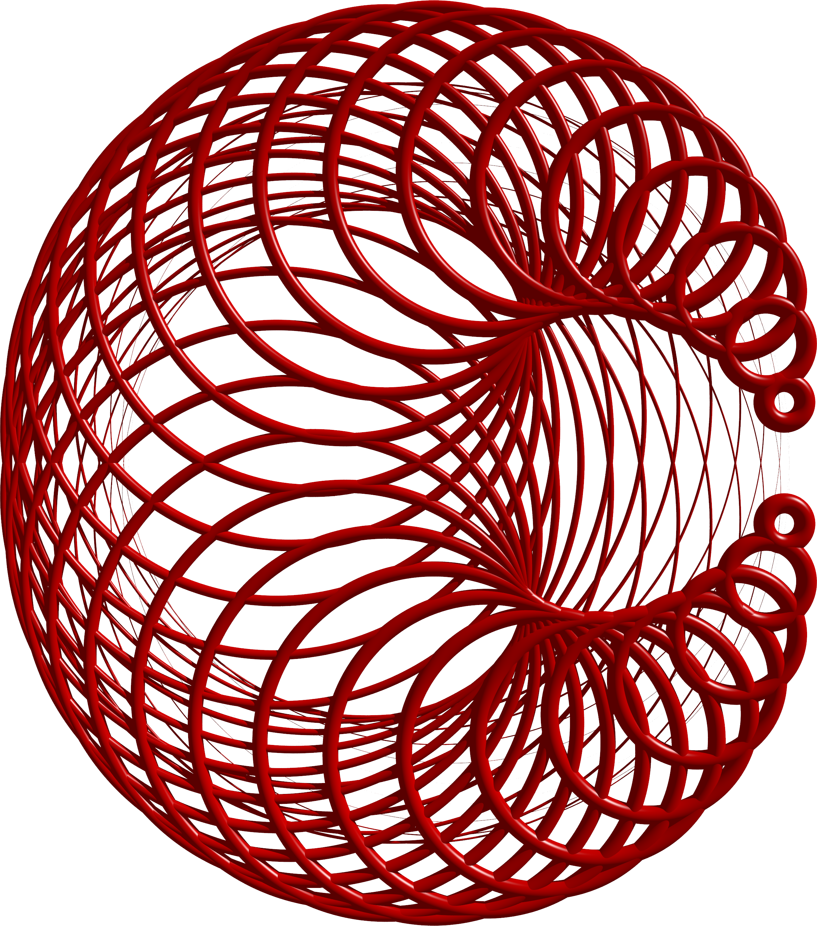

Example 1
Path: circle
Connection: torus
N = 51
kA = 1
KB = 2
Note: torus major and minor radii are determined by distance from A to B

Slide 18
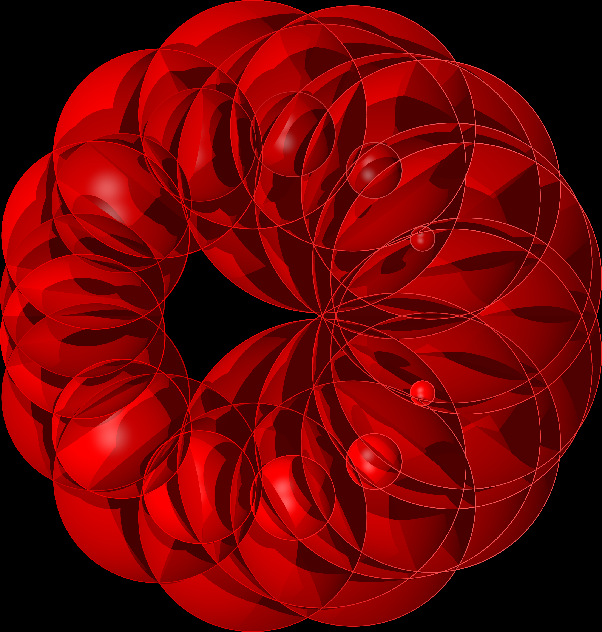
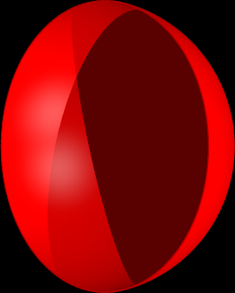
Example 2
Path: circle
Connection: hemisphere
N = 31
kA = 2
KB = 3
Note: hemisphere positioned at midpoint of AB and moved away from center of circle path

Slide 19
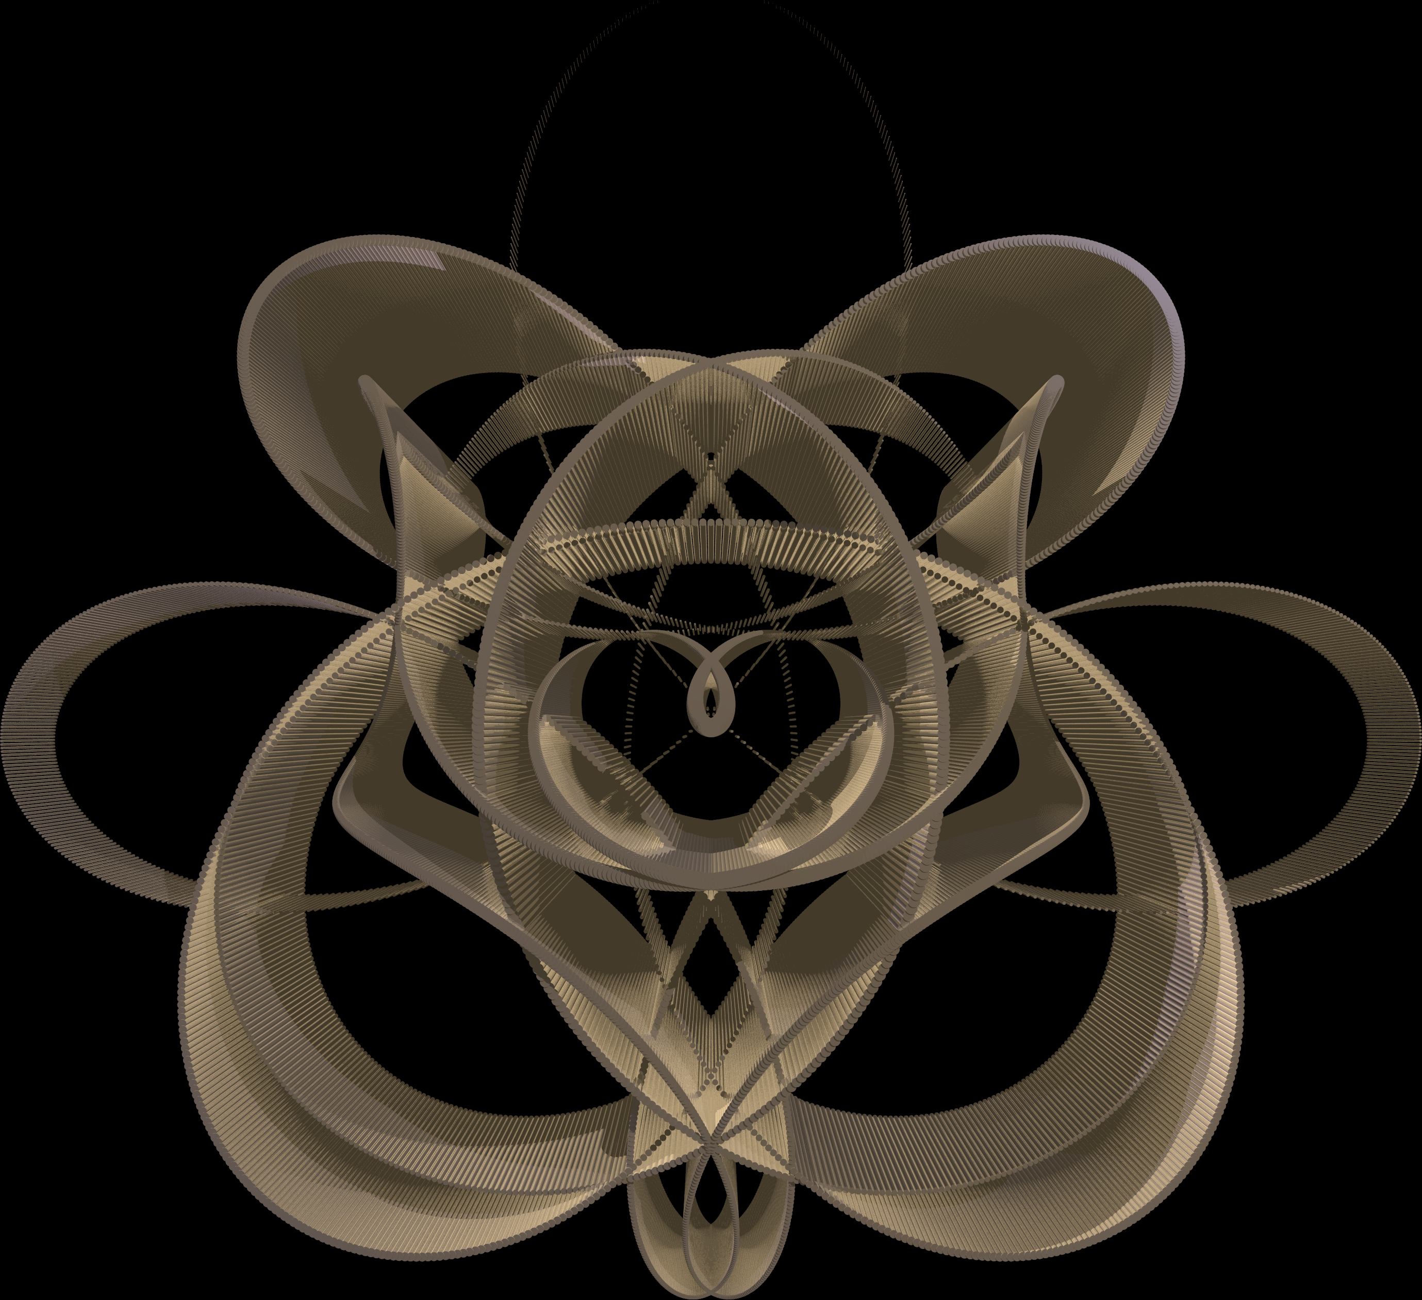
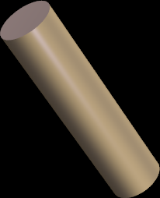
Example 3
Path: four-petal rose curve
Connection: cylinder
N = 5001
kA = 4
KB = 5
Note:
  cylinder perpendicular to path plane
  cylinder placed at midpoint of AB
  Size of cylinder determined by distance of AB

Slide 20
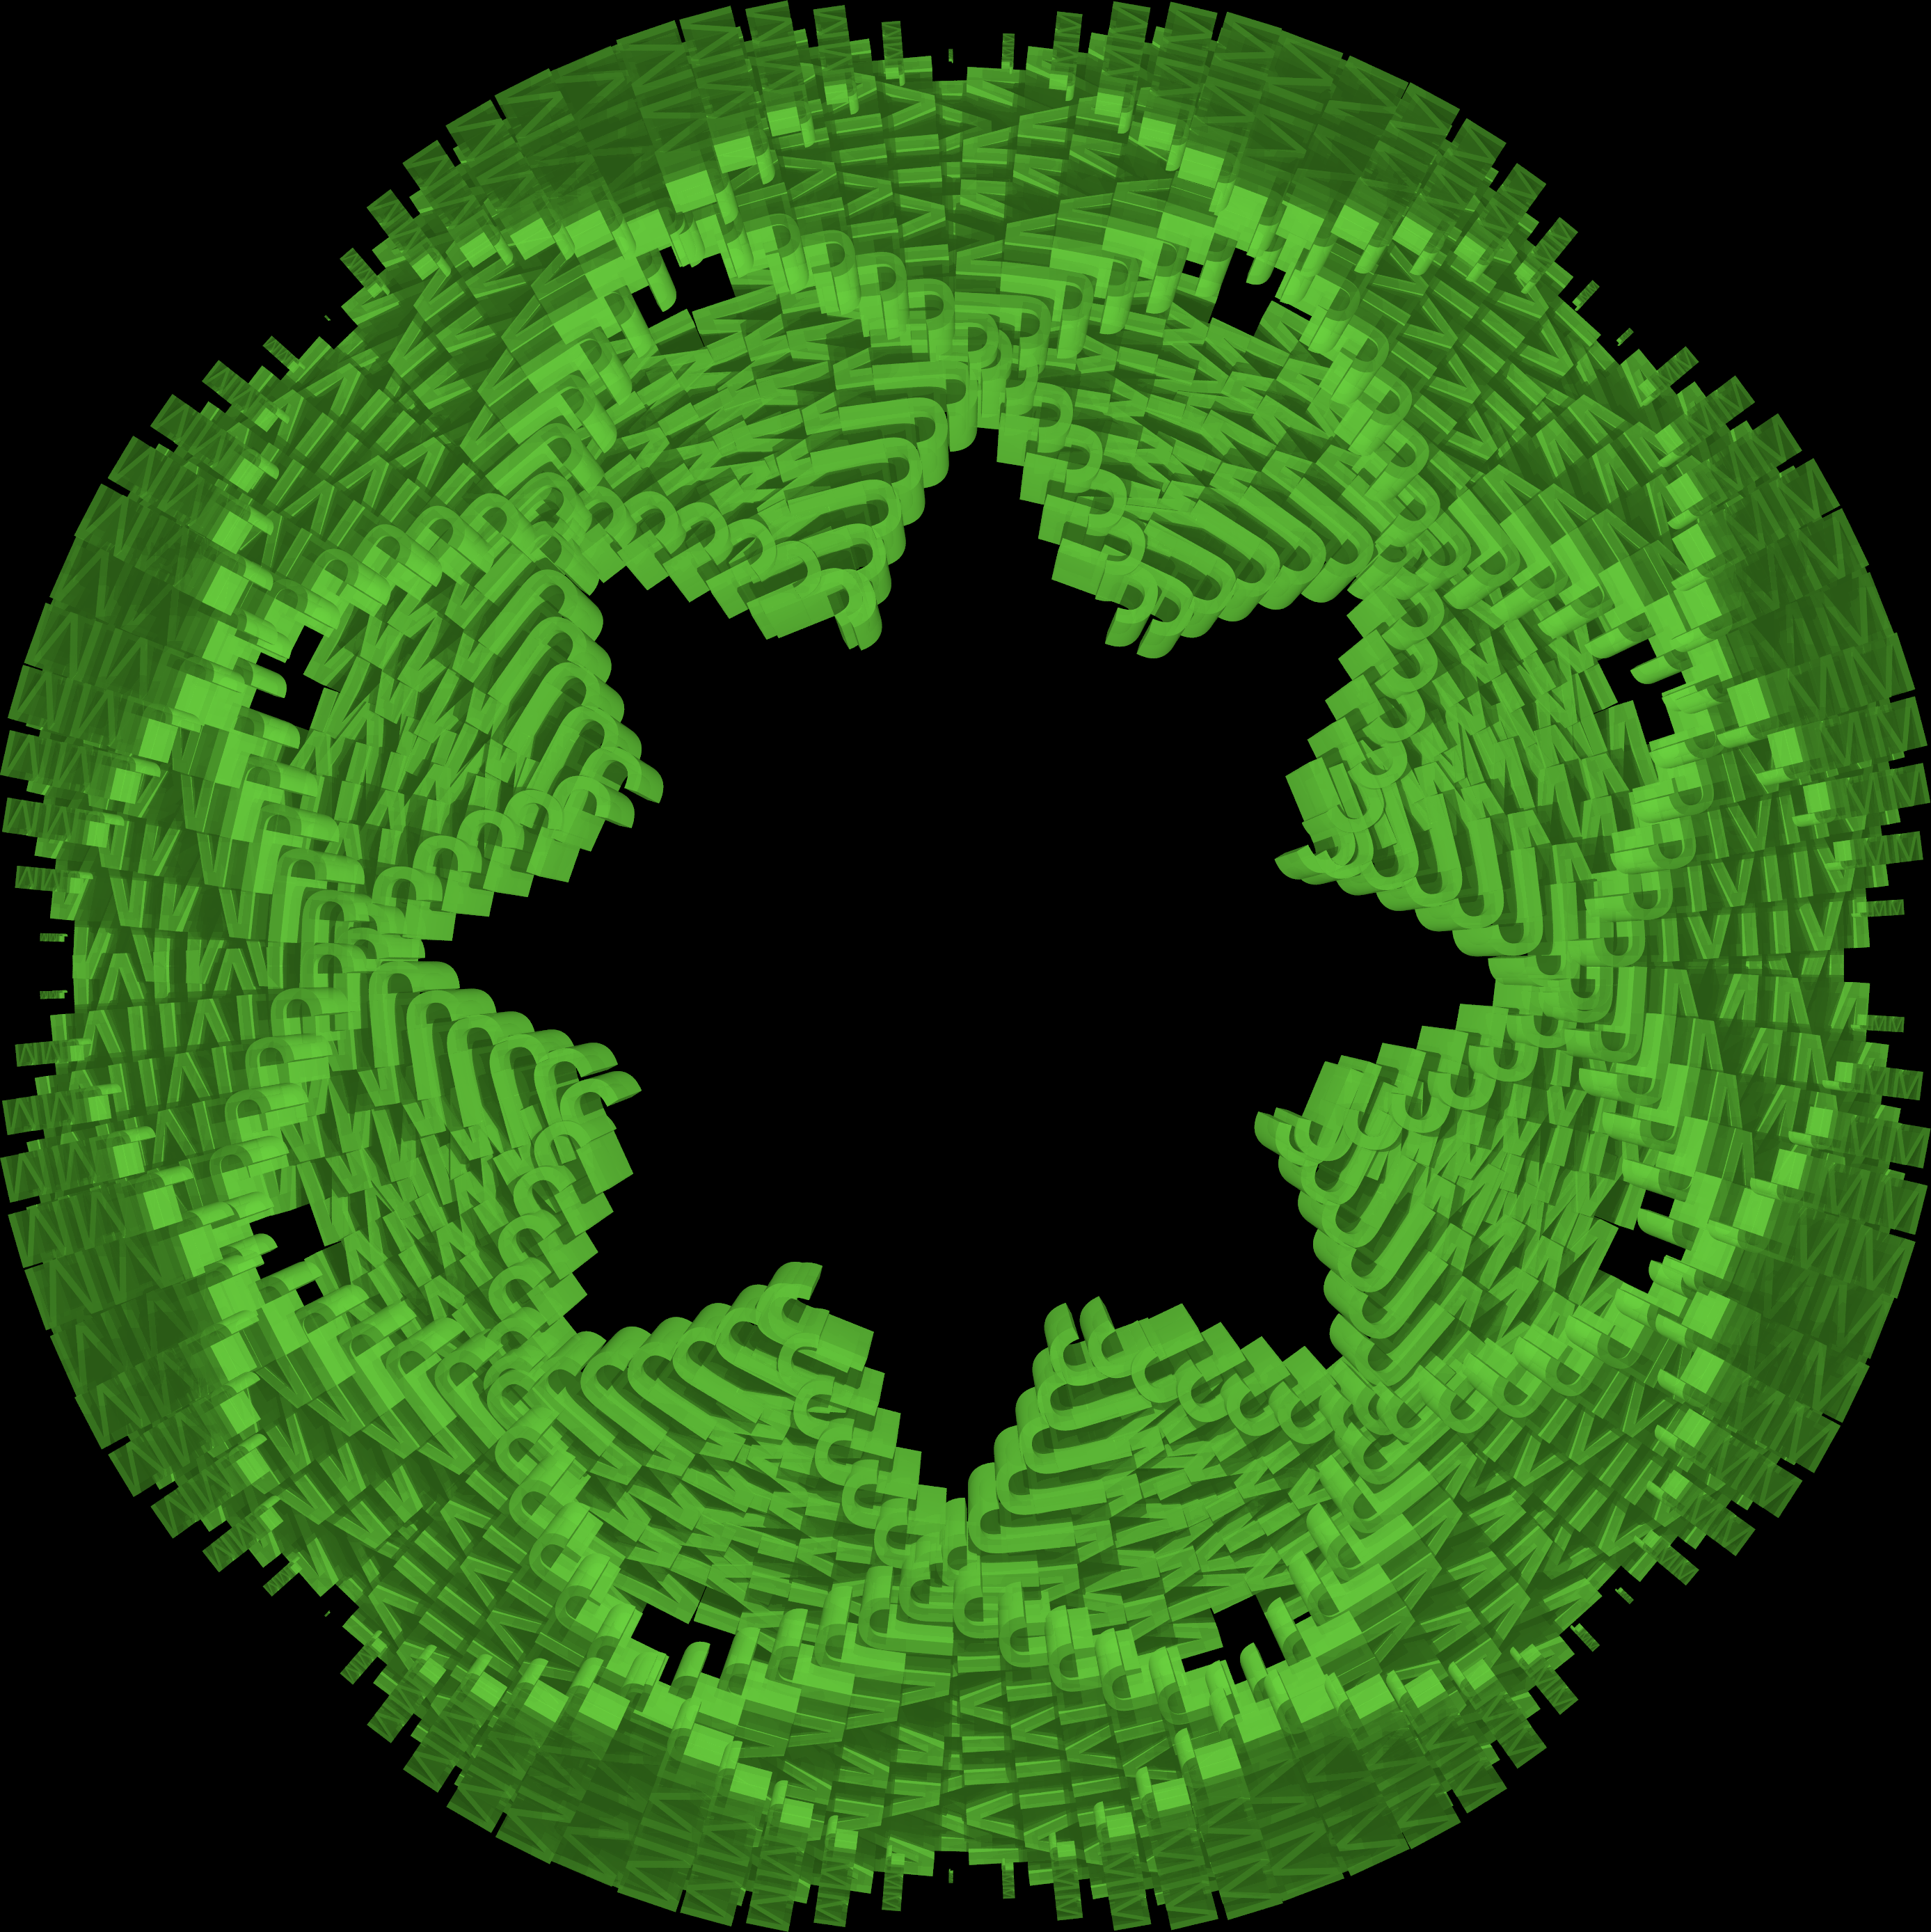

Example 4
Path: circle
Connection: extruded text
N = 301
kA = -1
KB = 7
Note:
  Text size based on distance from A to B
  Text rotated based on angle of midpoint AB to center

Slide 21
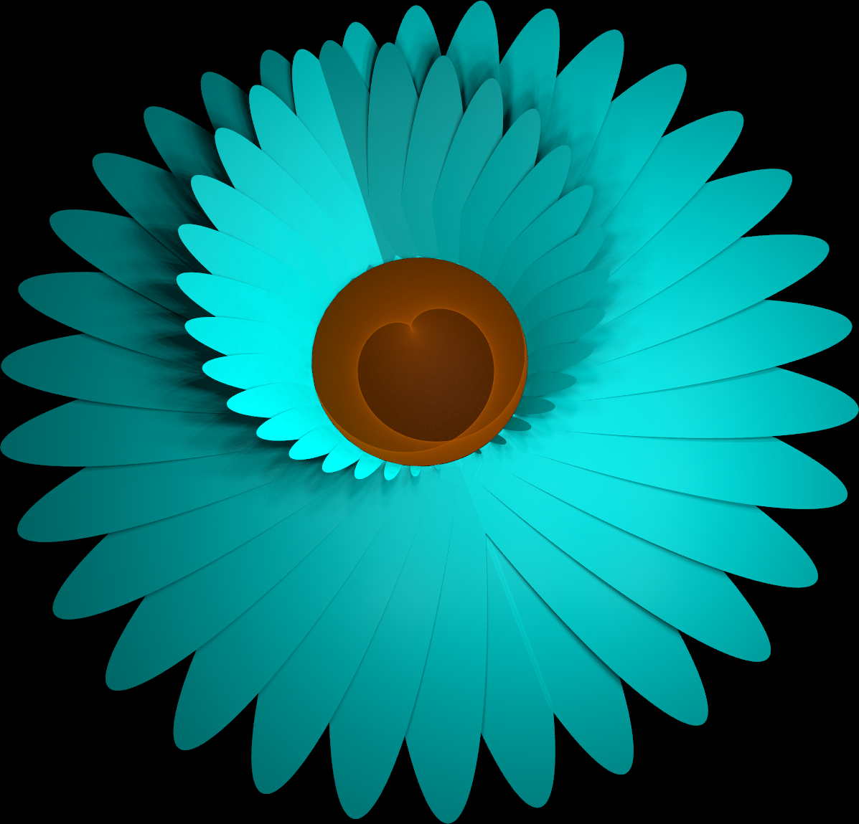
Conclusion
While non-traditional, line segments are not the only options for connections when creating curve stitching images
Slides and code used to make images available at: https://github.com/nicholsonja/JMM2020

