Slide 1
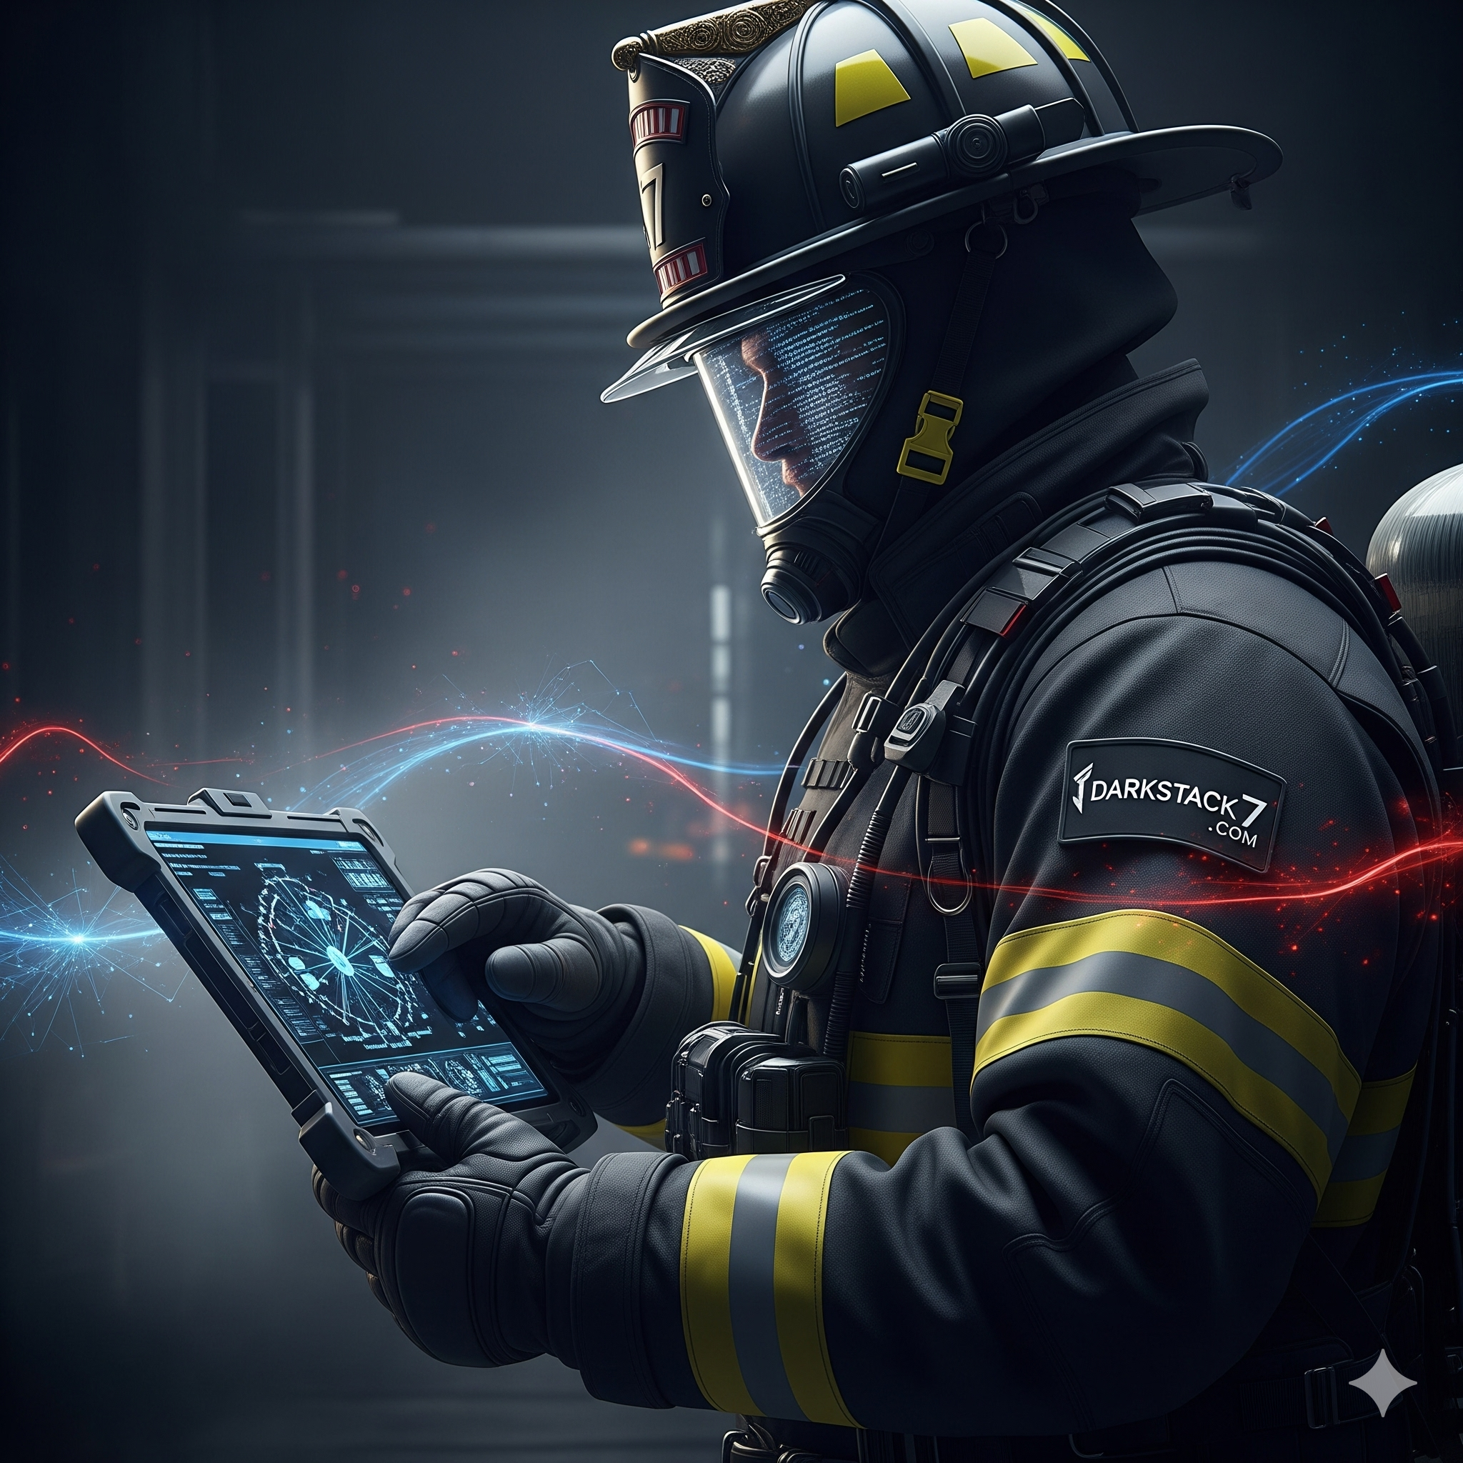

DARKSTACK7
Info@darkstack7.com | www.darkstack7.com
Digital Forensics & Incident Response (DFIR)
Incident Response
Expert-led cyber incident response, digital forensics, system recovery,
and remediation engineering — when seconds count.
24/7
24+
100+
Emergency
Response
Years of experience
Security Incidents Managed

Slide 2




Our Four DFIR Service Pillars
Comprehensive incident response capability — from first call to full recovery
01 IR Assist & Triage
02 IR Response & Forensics
Team Uplift & Support
Digital Forensic Investigation
24/7 emergency stakeholder coordination
Immediate threat scoping & response determination
Event is official declared an incident, IR plan activation, containment actions started and Forensics team engaged
Analyze security events across the client's environment in direct coordination with their internal team to rapidly identify and contain threats
Expert briefing and threat socialization
EDR deployment available for clients without an existing endpoint detection solution
Velociraptor-driven artifact collection, PowerShell collectors, and memory imaging Full-scope forensics across network infrastructure, event logs, memory, disk, and NTFS artifacts
Cloud system review and event collection & review
Attack timeline reconstruction mapped to MITRE ATT&CK TTPs
Root cause analysis and data exfiltration assessment
03 System Recovery
04 Incident Remediation
Computer & Infrastructure Restoration
Engineering & Hardening
Backup integrity verification
Safe, validated system reintroduction
IOC clearance confirmation
Decryption validation (if decryptor available)
Business continuity support
Patch & harden affected systems, create recovery Vlans
SIEM/EDR detection rule deployment
Active Directory hardening and EntraID security review
Cloud security hardening ( Azure and AWS)
Identify and Lockdown core areas of compromise
Lateral movement vector lockdown
Strategic remediation roadmap
Charlotte, NC | info@darkstack7.com | www.darkstack7.com

Slide 3
DARKSTACK7
Digital Forensics & Incident Response (DFIR)
info@darkstack7.com | www.darkstack7.com | Charlotte, NC
Expert-Led Incident Response
803-900-4609
Incident Response (IR) Service Program
From first call to full recovery — IR Triage · Digital Forensics · System Recovery · Remediation Engineering
IR Assist & Triage
IR Response & Forensics
Incident Remediation
System Recovery
Team Uplift & Support
Digital Forensic Investigation
Engineering & Hardening
Infrastructure Restoration
24/7 emergency response
Threat validation & Response scoping
Prioritization & Network isolation assistance
Credential reset, Lateral movement lockdown, C2 blocking, threat intel research
Expert uplift for in-house teams
Initial IOC list & action checklist
Expert recommendations & technical assistance
Customer is generally hands-on-keyboard
Cloud IR (Azure, AWS, GCP)
On-premise Network infrastructure, Firewalls, ID/IPS, Servers, AD/EntraID activity and access logs
Forensic artifact collection and processing, Memory, disk, NTFS & log forensics
Cloud IR (Azure, AWS, GCP)
Attack vector identification, root cause analysis, Attack timeline reconstruction
Data exfiltration assessment & scope
Patch and harden exploited systems
Tune SIEM/EDR detection rules
Active Directory security hardening
Lock down lateral movement paths
Enforce least-privilege access controls
Deliver strategic remediation roadmap
Develop a go-to-green plan
Verify and validate client backup integrity
Guide safe, staged system reintroduction
Confirm IOC clearance before production return
Support decryption and data restoration
Validate restored services and functionality
Advise on business continuity resumption
ADD-ON & RETAINER SERVICES
Tabletop Exercise (TTX)
Insider Threat Investigations
Standalone | Retainer Add-On
Standalone | Retainer Add-On
Proactive simulation scenarios that validate response playbooks and expose critical gaps. Required by many cyber insurance carriers and compliance frameworks (SOC 2, HIPAA, CMMC).
Forensic and behavioral investigation of malicious insiders, rogue IT staff, and data theft scenarios. Defensible evidence packages for HR, legal, and executive teams.
Outcome: Gap analysis · Updated IR runbooks · Team readiness
Outcome: Forensic evidence package · Legal-ready documentation
DELIVERABLES:
Triage Memo · Containment Actions Log · Host Forensic Report · Root Cause Analysis · Executive Briefing · Remediation Roadmap · Weekly Status Reports

Slide 4
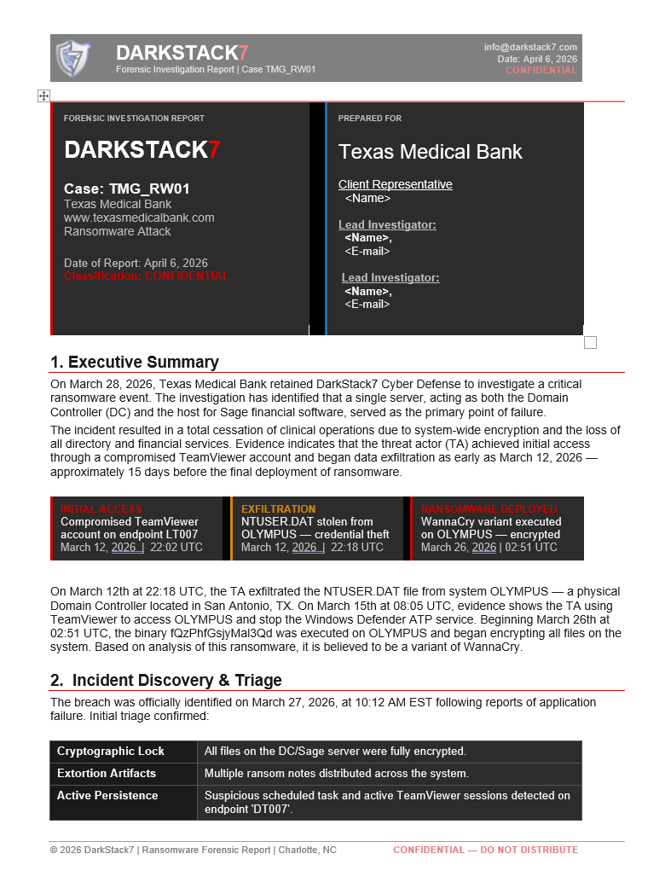
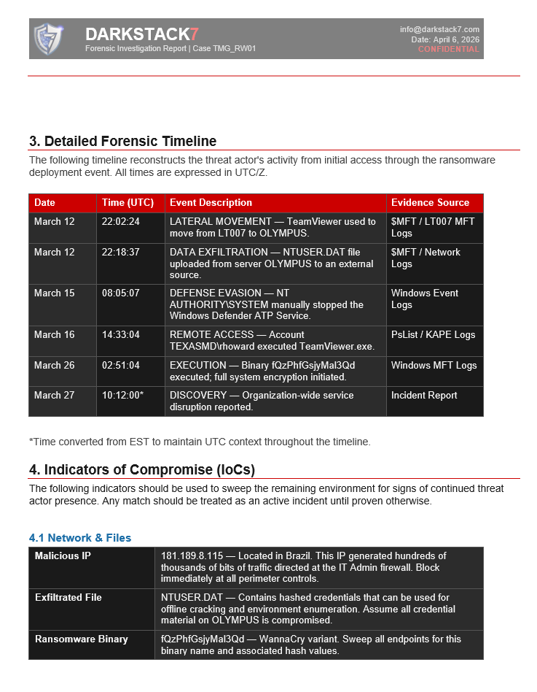
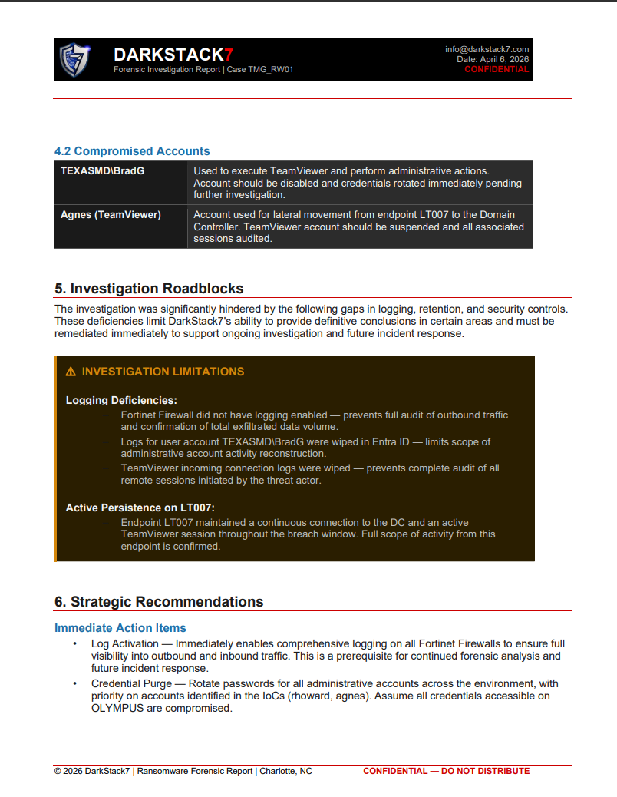

Example Report
Enterprise Tooling & Deliverables
Forensically sound methods · Defensible evidence · Actionable reporting
Velociraptor DFIR Platform
SIEM / EDR Analysis
Memory & Disk Forensics
Large-scale forensic artifact collection, endpoint interrogation, and live threat hunting across distributed environments.
Log ingestion, alert correlation, and detection rule tuning across your existing security platforms.
Forensically sound acquisition preserving chain of custody for legal or regulatory proceedings.
What You Receive
Incident Summary Report
Threat Intelligence
Active Directory Tools
MITRE ATT&CK Mapping
Timeline · IOCs · Attack TTPs
IOC correlation against industry-standard feeds to identify ransomware families, C2 infrastructure, and attacker TTPs.
Surface privilege escalation paths, Kerberos delegation abuse, and persistence mechanisms used by threat actors.
All findings tied to MITRE ATT&CK framework for structured threat modeling and defense planning.
Root Cause Analysis
MITRE ATT&CK mapped findings
Remediation Plan
Prioritized implementation guidance
Executive Briefing
Board-ready business impact summary
Evidence Artifacts
Log excerpts · Hashes · IOC lists
Remediation Workshop
Technical session with your team
Weekly Status Reports
Every Wednesday during engagement
Charlotte, NC | info@darkstack7.com | www.darkstack7.com

Slide 5


Add-On Services & IR Retainer Program
Sold standalone or bundled into an ongoing partnership — protection before and after incidents
Tabletop Exercise (TTX)
IR Retainer Program
Standalone
Retainer Add-On
Proactive partnership — not just break-fix response
Proactive incident simulation scenarios that validate your team's response playbooks and expose critical gaps. Required by many cyber insurance carriers and compliance frameworks.
What's Included:
Pre-authorized IR hours — activate immediately
Regular asset familiarization with your environment
Detection & response control reviews
Emerging threat briefings & advisory calls
Annual tabletop exercise (TTX) — included
Insider threat investigation support — included
Priority response SLAs — 2-hour mobilization
Discounted overage rates on additional hours
Outcome: Gap analysis report · Updated IR runbooks · Team confidence under fire
Insider Threat Investigations
Standalone
Retainer Add-On
Forensic and behavioral investigation of malicious insiders, rogue IT staff, and data theft scenarios. Defensible evidence packages supporting HR, legal, and executive teams throughout.
Outcome: Forensic evidence package · Legal-ready documentation · Remediation plan
Best For:
Organizations that want a trusted DFIR partner who already knows their environment — responding with speed and context, not starting from zero during a crisis.
Charlotte, NC | info@darkstack7.com | www.darkstack7.com

Slide 6
DARKSTACK7
IR Retainer Tier Comparison
info@darkstack7.com | www.darkstack7.com
Every tier answers the same questions — so your team and your prospects can compare apples to apples.
IR Assist
IR Respond
STANDARD
IR Defend
PREMIUM
BASIC
Entry Tier — The on-call foundation
Standard Tier — The active-engagement option with Forensics & Recovery
Premium Tier — The proactive-posture tier
$10,500 / yr · ~35 hrs. prepaid reserved for active incidents
$17,520 / yr · ~50 hrs. prepaid
$29,130 / yr · 86+ hrs prepaid
Prepaid Hours
Prepaid Hours
Prepaid Hours
35 hours / year — reserved for active incidents only
50 hours / year — proactive use eligible
86+ hours / year — IR use + Threat Hunting + Proactive
Response SLA
Response SLA
Response SLA
4-hour remote
2 hour remote · On-site within 24 hours if applicable
2-hour remote · On-site within 8 hours if needed
Onboarding
Onboarding
Onboarding
Basic environment audit + documented IR plan
Corporate runbooks updated with Darkstack7 IR Declaration
Full environment docs, Remote Access, pre-positioned tooling, etc.
Full Onboarding – Sr.IR Commander assigned, playbooks operationalized + Intel footprinting, architecture reviews, multi-team approach
Proactive Use
Proactive Use
Proactive Use
Reserved exclusively for active incident response — hours always available when it matters most
Yes — threat hunting walk through, IR playbook development, tabletop exercises, hours can be used for security assessments or threat hunting
Yes — expanded: Arch reviews, IR Maturity assessment & roadmap. Active Threat hunting is a service that can be included as part of this retainer
35-hour package covers small sized computer incidents and investigations (Pre-negotiated hourly rates and response SLA)
24/7 emergency hotline and designated point of contact
Client onboarding — network diagram review, key asset inventory, credential staging incident triage and scoping
First call Triage assessment (True positive vs False Positive),
Blast radius determination Containment assistance — network isolation, credential reset support, C2 blocking. Basic forensic artifact collection and IOC identification
Post-incident report with root cause analysis and remediation recommendations
50-hour package covers small-to-medium sized incidents including ransomware containment and forensic investigation Large or destructive events may require a supplemental SOW:
Package includes all of the IR Assist service plus proactive and advisory services
1x Tabletop Exercise per year
1x Threat Hunt (Threat Defense control testing)
Service Review meeting — 12x per year (Office Hours)
Credentials staged, jump-box deployed if needed, IR playbook co-developed and validated with client team
Response team operates natively within client toolsets; detection rules, SIEM queries, and EDR policies reviewed
86-hour package covers small-to-medium sized incidents including ransomware containment and forensic investigation large or destructive events may require a supplemental SOW
Named senior IR lead dedicated to the account —
Full pre-incident onboarding
2x Tabletop Exercises per year
Service Review meeting (1 hr.) — 12x per year (Office Hours)
Velociraptor deployment available for proactive threat hunting
(Additional Options) Annual Senior leadership tabletop exercise to evaluate their role
Optional: IR Ready — $400/hr.
No prepaid hours — no pre-negotiated rates and SLA locked in before an incident. Lowest-friction way to sign the master agreement and establish the relationship. Easy upsell path into IR Assist when the client is ready to commit.
Charlotte, NC | info@darkstack7.com | www.darkstack7.com | 803-900-4609

Slide 7
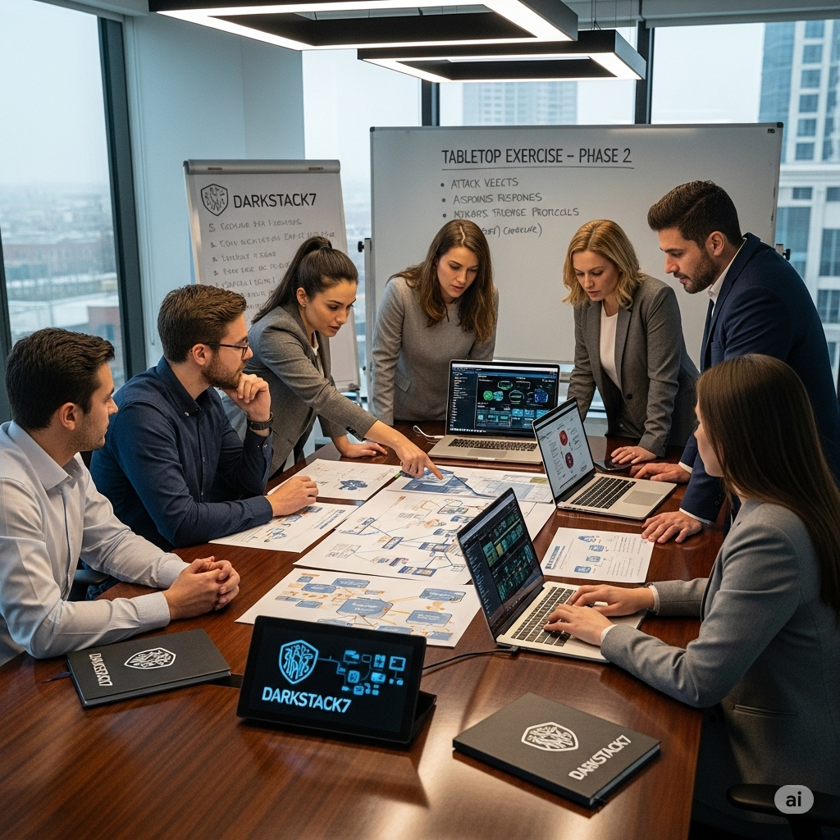
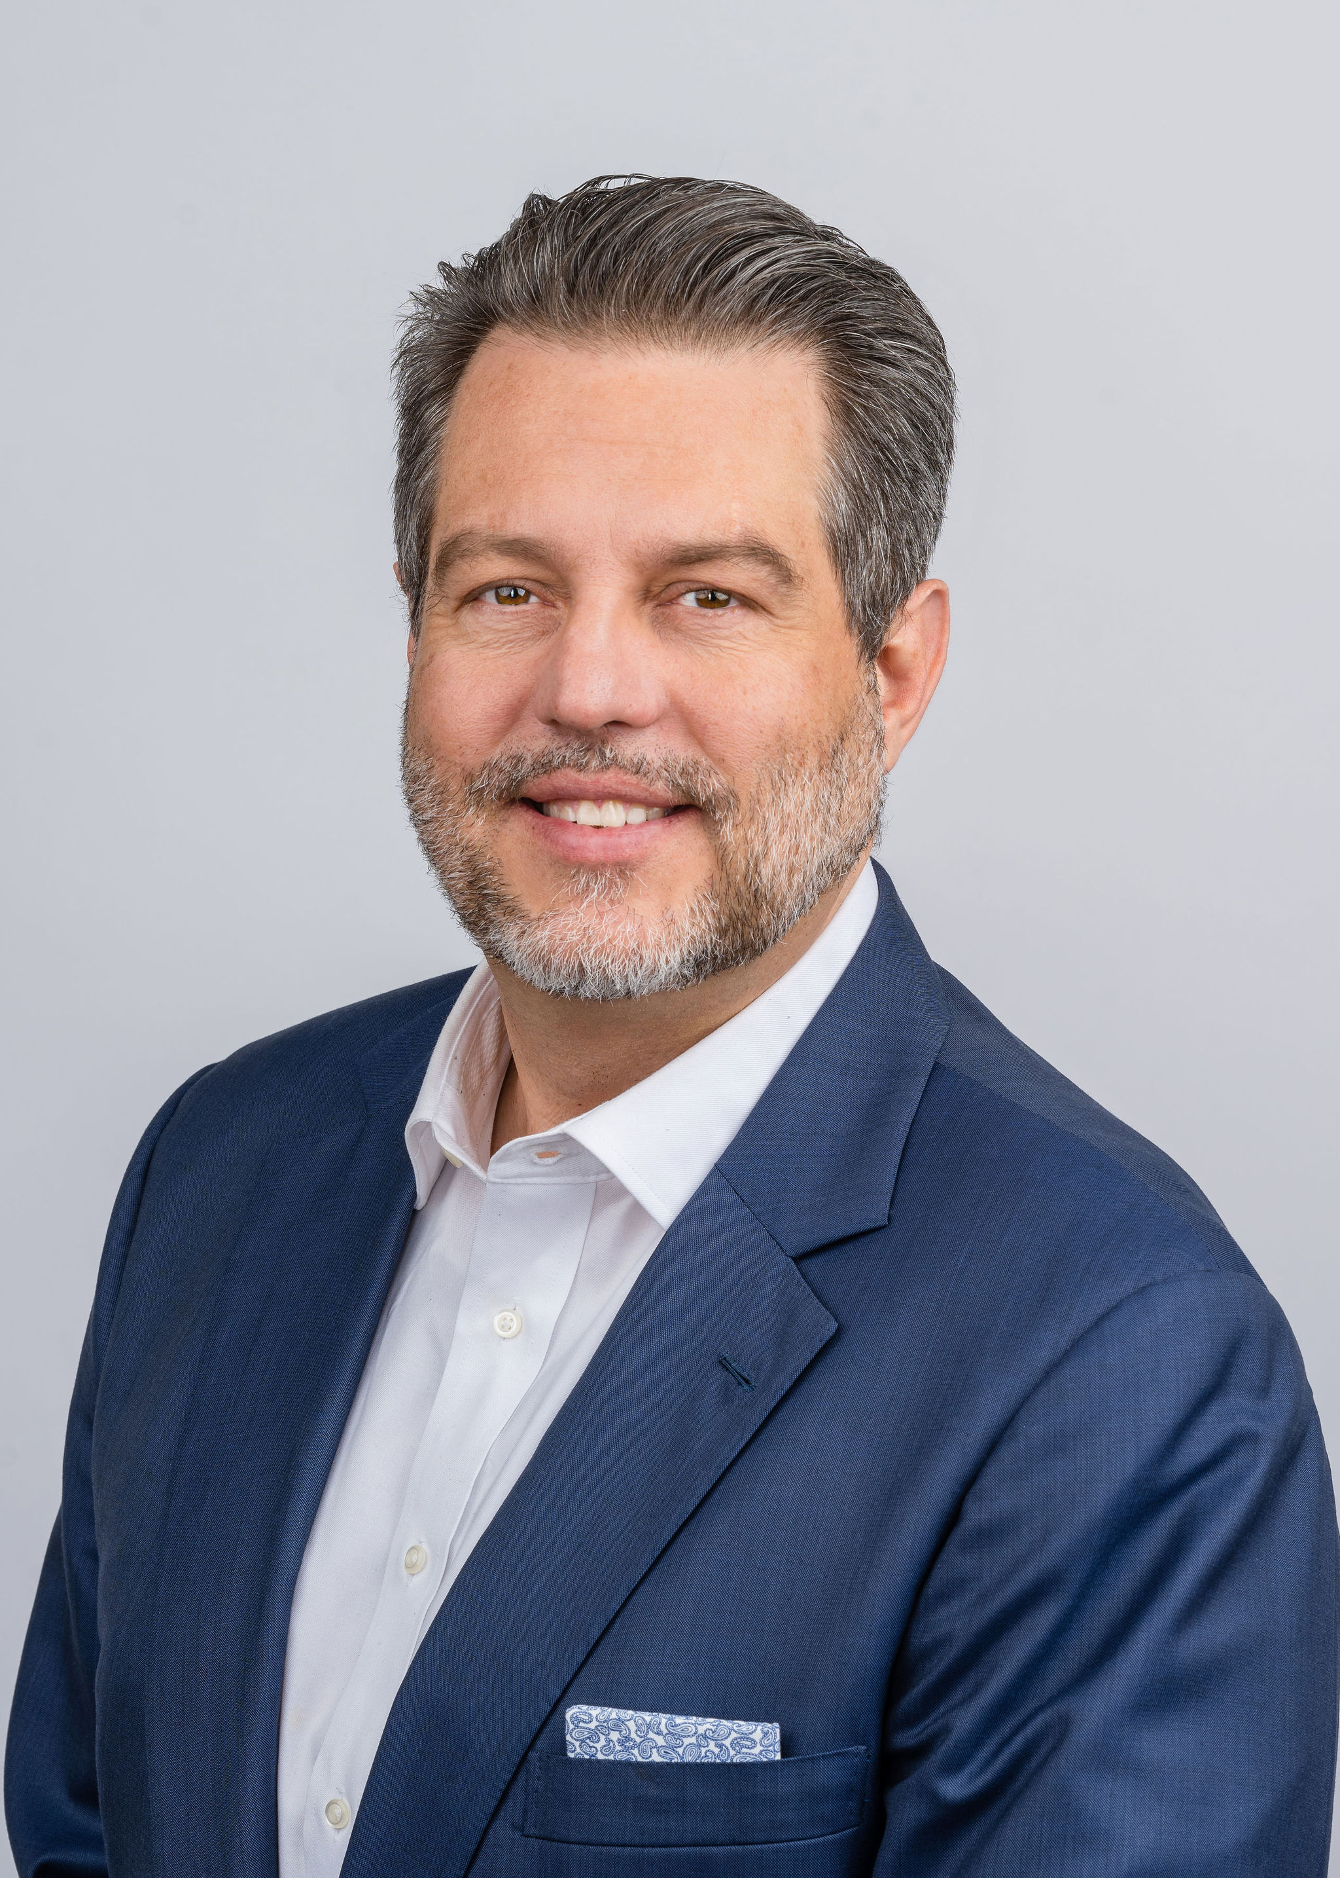
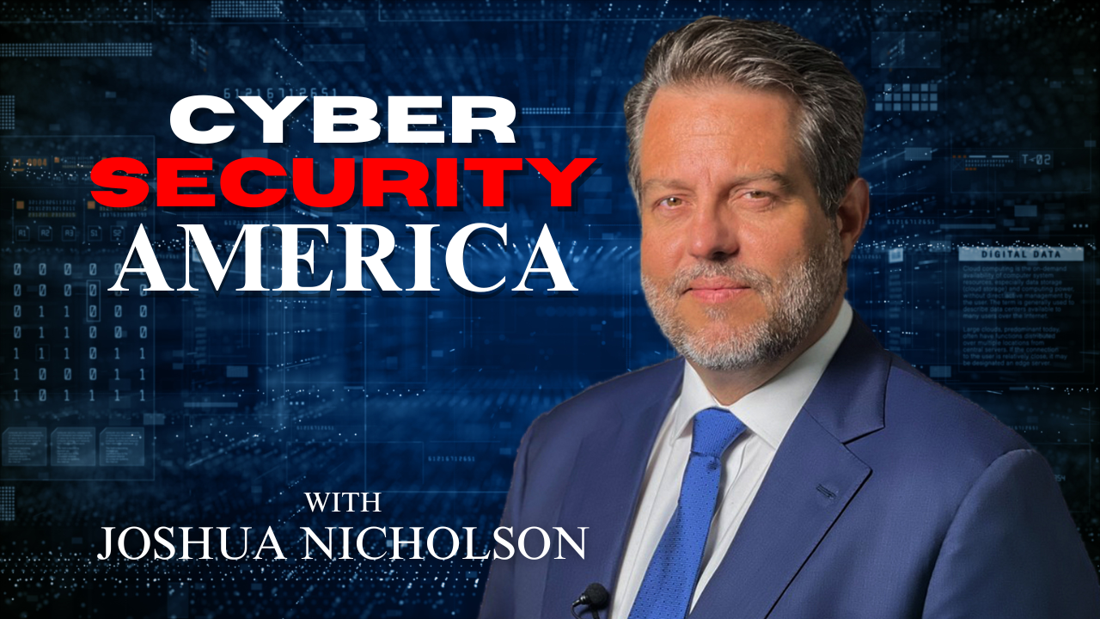
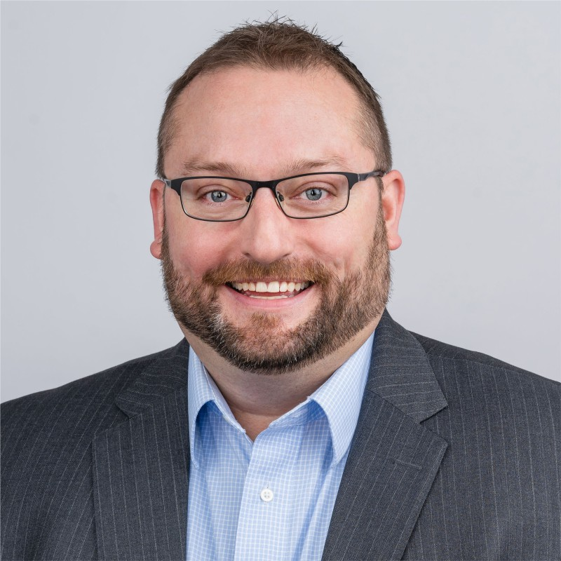
Ready to Respond.
Ready Before You Need Us.
When a breach hits, the cost of waiting is measured in hours — and millions.
Emergency IR response — remote or on-site within hours
Retainer programs for proactive cyber readiness
Tabletop exercises and insider threat investigations
Compliance-aligned forensics with board-ready reporting
Joshua R. Nicholson
President & Chief Security Officer
U.S. Marine Corps veteran | 24-year cybersecurity leader
Booz Allen Hamilton · EY · Wells Fargo · Northrop Grumman
CISSP · CISM · SANS-GCIH · Incident Response Commander / vCISO
Get Started
Email: info@darkstack7.com | Web: www.darkstack7.com
David Lavinder
Partner & Intelligence Advisor
Charlotte, NC | Founded 2019 | Sponsor of the Cyber Security America podcast
Lt. Colonel, U.S. Air Force Reserves
National Security Agency (NSA) · U.S. Intelligence Community
National-security perspective on cyber ops & resilience
803-900-4609

