Slide 1
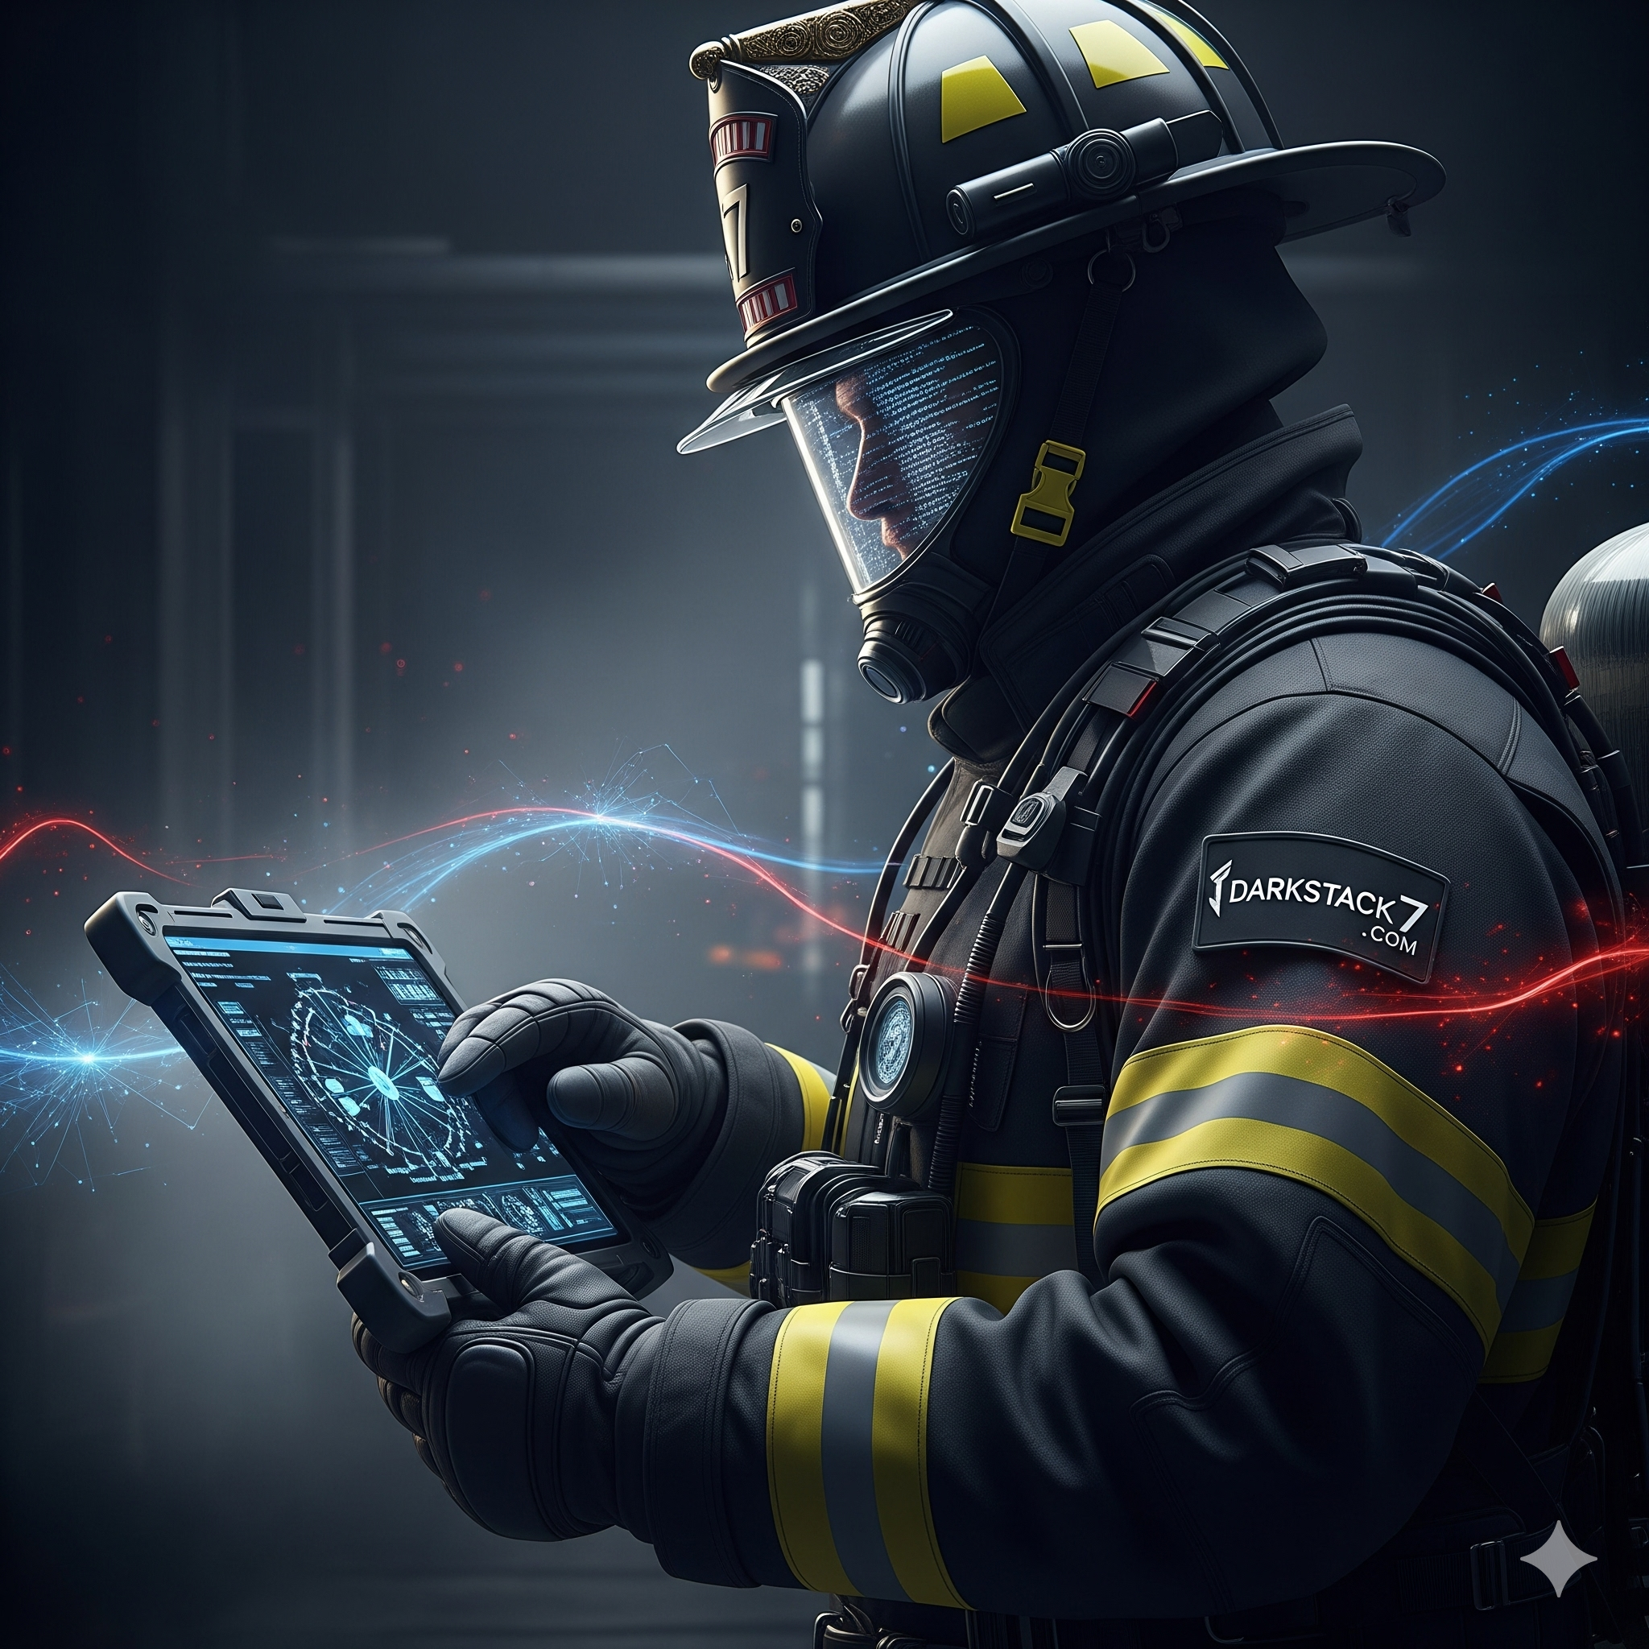

DARKSTACK7
Info@darkstack7.com | www.darkstack7.com
Digital Forensics & Incident Response (DFIR)
Incident Response
Expert-led cyber incident response, digital forensics, system recovery,
and remediation engineering — when seconds count.
24/7
24+
100+
Emergency
Response
Years of experience
Security Incidents Managed

Slide 2
DARKSTACK7
Digital Forensics & Incident Response (DFIR)
info@darkstack7.com | www.darkstack7.com | Charlotte, NC
Expert-Led Incident Response
Incident Response (IR) Service Program
From first call to full recovery — IR Triage · Digital Forensics · System Recovery · Remediation Engineering
IR Assist & Triage
IR Response & Forensics
Incident Remediation
System Recovery
Team Uplift & Support
Digital Forensic Investigation
Engineering & Hardening
Infrastructure Restoration
24/7 emergency response
Threat validation & Response scoping
Prioritization & Network isolation assistance
Credential reset, Lateral movement lockdown, C2 blocking, threat intel research
Expert uplift for in-house teams
Initial IOC list & action checklist
Expert recommendations & technical assistance
Customer is generally hands-on-keyboard
Cloud IR (Azure, AWS, GCP)
On-premise Network infrastructure, Firewalls, ID/IPS, Servers, AD/EntraID activity and access logs
Forensic artifact collection and processing, Memory, disk, NTFS & log forensics
Cloud IR (Azure, AWS, GCP)
Attack vector identification, root cause analysis, Attack timeline reconstruction
Ransomware variant deep-dive analysis
Data exfiltration assessment & scope
Patch and harden exploited systems
Tune SIEM/EDR detection rules
Active Directory security hardening
Lock down lateral movement paths
Enforce least-privilege access controls
Deliver strategic remediation roadmap
Develop a go-to-green plan
Verify and validate client backup integrity
Guide safe, staged system reintroduction
Confirm IOC clearance before production return
Support decryption and data restoration
Validate restored services and functionality
Advise on business continuity resumption
ADD-ON & RETAINER SERVICES
Tabletop Exercise (TTX)
Insider Threat Investigations
IR Retainer Program
Standalone | Retainer Add-On
Standalone | Retainer Add-On
Proactive partnership — not just break-fix response is how mature companies operate
Proactive simulation scenarios that validate response playbooks and expose critical gaps. Required by many cyber insurance carriers and compliance frameworks (SOC 2, HIPAA, CMMC).
Forensic and behavioral investigation of malicious insiders, rogue IT staff, and data theft scenarios. Defensible evidence packages for HR, legal, and executive teams.
IR Team Support
IR Respond (DFIR)
IR Defend
> Includes: 30+ hrs.
> Incident response support
> Monthly office hours
IR Assist
Yearly retainer: $10,500
IR Respond
Yearly retainer: $17,520
> Includes: 50 hrs.
> Monthly assessments
> 24/7 incident response
> Host forensics (DFIR)
Yearly retainer: $28,130
> Includes: 80 hr.
> Dedicated security advisor
> Onboarded team member
Outcome: Gap analysis · Updated IR runbooks · Team readiness
Outcome: Forensic evidence package · Legal-ready documentation
Pre-authorized IR hours — activate immediately
Regular asset familiarization with your environment, Emerging threats briefing
Detection & response control reviews
Annual TTX & Insider Threat support
DELIVERABLES:
Triage Memo · Containment Actions Log · Host Forensic Report · Root Cause Analysis · Executive Briefing · Remediation Roadmap · Weekly Status Reports

