Slide 1
Algorithmic and Economic Aspects of Networks
Nicole Immorlica

Slide 2
Syllabus
Jan. 8th (today): Graph theory, network structure
Jan. 15th: Random graphs, probabilistic network formation
Jan. 20th: Epidemics
Feb. 3rd: Search
Feb. 5th: Game theory, strategic network formation
Feb. 12th: Diffusion
Feb. 19th: Learning
Feb. 26th: Markets
Mar. 5th: TBA
Mar. 12th: Final project presentations

Slide 3
Assignments
Readings, weekly
From Social and Economic Networks, by Jackson
Research papers, one per week
Reaction papers, weekly
Class presentations
Two problem sets (?)
Final projects, end of term
Survey paper
Theoretical/empiracle analysis

Slide 4
Grading (Approximate)
Participation, class presentations [15%]
Reaction papers [25%]
Problem sets [20%]
Final project [40%]

Slide 5
Networks
A network is a graph that represents relationships between independent entities.
Graph of friendships (or in the virtual world, networks like facebook)
Graph of scientific collaborations
Web graph (links between webpages)
Internet: Inter/Intra-domain graph

Slide 6


New Testament Social Network

Slide 7
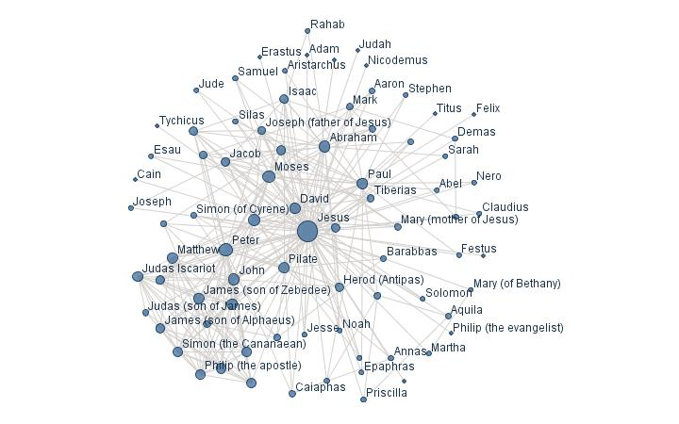
New Testament Social Network
Visualization from ManyEyes

Slide 8


United Routes Network
Honolulu
Seattle

Slide 9
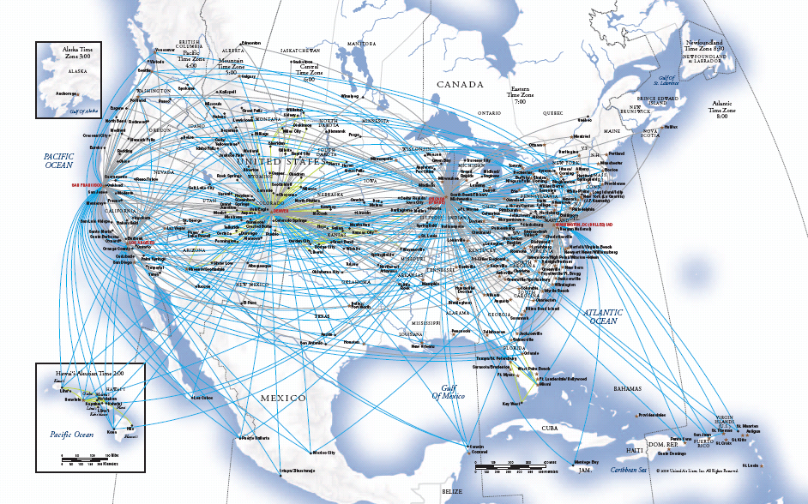
United Routes Network

Slide 10
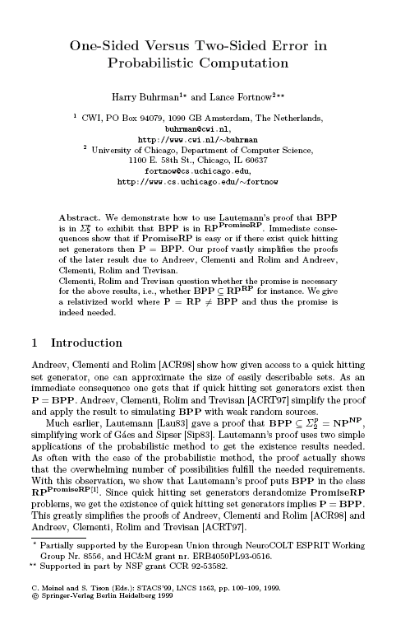


Erdos Collaboration Network
Harry Buhrman
Lance Fortnow

Slide 11
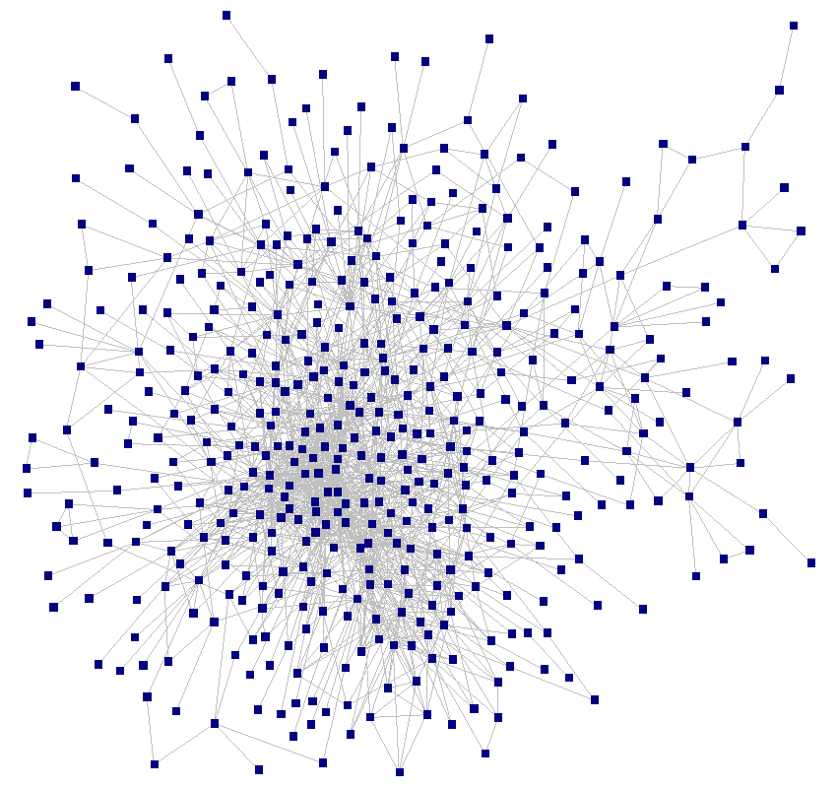
Erdos Collaboration Network
Visualization from Orgnet

Slide 12
Graph Theory
Graph G = (V,E)
A set V of n nodes or vertices
V = {i}
A subset E of V x V of m pairs of vertices, called edges
E = {(i,j)}
Edges can be directed (pair order matters), or undirected.

Slide 13
Drawing Graphs
Undirected graphs
Directed graphs

Slide 14
Representing Graphs
List of edges
(A,B), (A,C), (B,C), (B,D), (C,D), (D,E)
Node adjacency list
A: B, C; B: A, C; C: A, B; D: B, C, E; E: D
Adjacency matrix – A_{ij} = 1 if (i,j) is an edge, else = 0
A
B
C
A
B
C
D
E
A
0
1
1
0
0
D
B
1
0
1
1
0
C
1
1
0
1
0
E
D
0
1
1
0
1
E
0
0
0
1
0

Slide 15
Modeling Networks
symmetric networks = undirected graphs
“friendship”
“agents”
“agents”

Slide 16
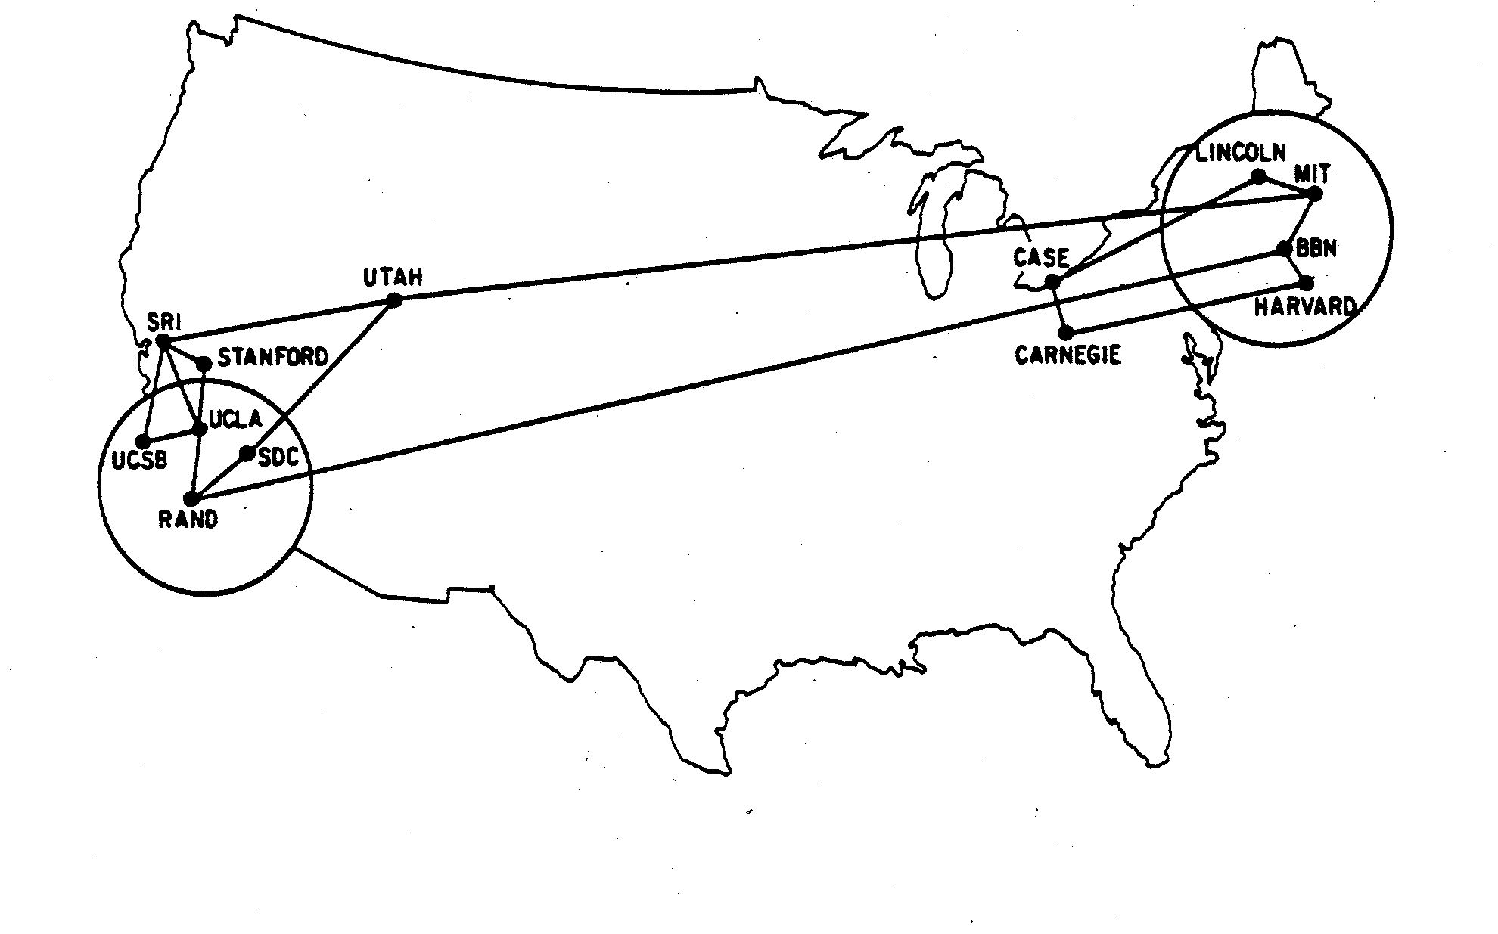
Example: Arpanet

Slide 17
Example: Arpanet
SRI
UTAH
LINC
MIT
CASE
UCSB
STAN
SDC
BBN
CARN
UCLA
RAND
HARV

Slide 18
Neighborhoods and Degrees
neighborhood of node i = nodes j with edge to i
degree of node i = number of neighbors
SRI
UTAH
LINC
MIT
CASE
UCSB
STAN
SDC
BBN
CARN
UCLA
RAND
HARV

Slide 19
Paths and Cycles
“path” = sequence of nodes such that each consecutive pair is connected
MIT – UTAH – SRI – STAN
SRI
UTAH
LINC
MIT
CASE
UCSB
STAN
SDC
BBN
CARN
UCLA
RAND
HARV
Notes:
Motivate paths by notion of indirect relationships

Slide 20
Paths and Cycles
simple path = one that does not repeat nodes
SRI
UTAH
LINC
MIT
CASE
UCSB
STAN
SDC
BBN
CARN
UCLA
RAND
HARV

Slide 21
Paths and Cycles
cycle = path that starts and ends at same node
SRI
UTAH
LINC
MIT
CASE
UCSB
STAN
SDC
BBN
CARN
UCLA
RAND
HARV
Notes:
Observe that graph is 2-connected (every edge belongs to a cycle)

Slide 22
Special Graphs
Trees = a unique path between each pair of vertices
Stars = an edge from each node to center node
Cliques (complete graphs) = an edge between each pair of vertices, written K_{n}
Notes:
Talk about height of tree

Slide 23
Connectivity
A graph is connected if there is a path between every pair of nodes.

Slide 24
SRI
UTAH
LINC
MIT
CASE
UCSB
STAN
SDC
BBN
CARN
UCLA
RAND
HARV
Connected

Slide 25
Connected components
SRI
UTAH
LINC
MIT
CASE
UCSB
STAN
SDC
BBN
CARN
UCLA
RAND
HARV
UNConnected

Slide 26
Giant Components
Friendless person
Weird guy in high school
Most of the world
You
Your TA from last quarter
Remote tribe on desert island
Your piano teacher
Your friends

Slide 27
Study Guide
Graph representations
Neighbors and degrees
Paths and cycles
Connectedness
Giant component

Slide 28
Network Questions
English
Math
How popular are we?
How connected are we?
How tight-knit are we?
How important am I?
What is degree dist.?
What is diameter?
What is clustering coeff.?
What is centrality?

Slide 29
Degree Distributions
relative frequency of nodes w/different degrees
P(d) = fraction of nodes with degree d
P(d) = probability random node has deg. d

Slide 30
Degree Distributions
P(d) = fraction of nodes with degree d
SRI
UTAH
LINC
MIT
CASE
UCSB
STAN
SDC
BBN
CARN
UCLA
RAND
HARV
P(0) = 0,
P(1) = 0,
P(2) = 7/13,
P(3) = 4/13,
P(4) = 2/13

Slide 31
Degree Distributions
Frequency
Clique deg. dist.
Star deg. dist.
A star?
1
A clique?
3/4
Arpanet deg. dist.
1/2
1/4
0
0
1
2
3
4
5
6
7
8
Degree

Slide 32
Degree Distributions
Some special degree distributions
Poisson degree distribution:
P(d) = p^{d} (1-p)^{d}
for some 0 < p < 1.
Scale-free (power-law) degree dist.: P(d) = cd^{-®}
n
d

Slide 33
Poisson vs Power-law
Frequency
1
Power-law: P(d) = cd^{-®}
n
d
Poisson: P(d) = p^{d} (1-p)^{d}
3/4
1/2
1/4
0
0
1
2
3
4
5
6
7
8
Degree

Slide 34
Log-log plots
Power-law: P(d) = cd^{-®}
log [ P(d) ] = log [ cd^{-®} ]
= log [ c ] – ® log [ d ]
So a straight line on a log-log plot.

Slide 35
Log-log plots
Log Frequency
0
Power-law: log P(d) = log [ c ] – ® log [ d ]
-2
-4
-6
A straight line, slope = exponent
Poisson
-8
0
1
2
3
4
5
6
7
8
Log Degree

Slide 36
Alternate views
Frequency (Number)
Log-log plot
There are j nodes with degree exactly d
Degree

Slide 37
Alternate views
Frequency (Number)
There are j nodes with degree at least d
Log-log plot
Degree
Cumulative Distribution

Slide 38
Alternate views
Degree
The j’th most popular node has degree d
Log-log plot
Rank

Slide 39
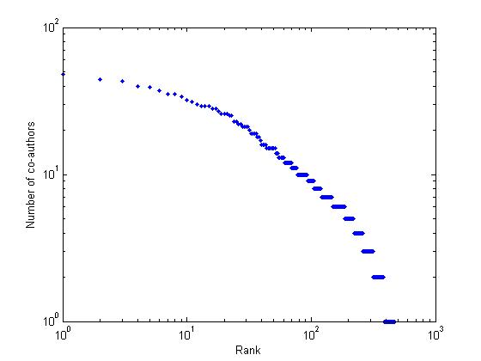
Example: Collaboration Graph
Power law exp:
c = 2.97
With exponential decay factor,
c = 2.46

Slide 40
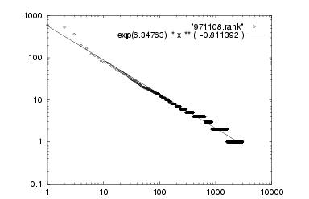
Example: Inter-Domain Internet
Power law exponent: 2.15 < c < 2.2

Slide 41
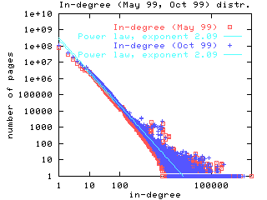
Example: Web Graph In-Degree
Power law exponent: c = 2.09

Slide 42
Q1. How popular are we?
Many social networks have
power-law degree distributions.
A few very popular people, many many unpopular people.

Slide 43
Diameter
How far apart are the nodes of a graph?
How far apart are nodes i and j?
What is the length of a path from i to j?

Slide 44
Length of a Path
The length of a path is # of edges it contains.
LINC – MIT – BBN – RAND – SDC has length 4.
SRI
UTAH
LINC
MIT
CASE
UCSB
STAN
SDC
BBN
CARN
UCLA
RAND
HARV

Slide 45
Distance
The distance between two nodes is the length of the shortest path between them.
Distance between LINC and SDC is 3.
SRI
UTAH
LINC
MIT
CASE
UCSB
STAN
SDC
BBN
CARN
UCLA
RAND
HARV
Notes:
Argue there is no length-one or length-two path.

Slide 46
Computing Distance
Grow a breadth-first search tree.

Slide 47
Computing Distance
Source
Target
Neighbors (Distance 1)
Distance 2
Notes:
Mention that BFS trees can be grown simultaneously.

Slide 48
Diameter
The diameter of a network is the maximum distance between any two nodes.
Diameter is 5.
SRI
UTAH
LINC
MIT
CASE
UCSB
STAN
SDC
BBN
CARN
UCLA
RAND
HARV

Slide 49
Diameter
Of a ….
clique?
star?
tree?
tree of height k?
binary tree?

Slide 50
Computing Diameter
Squaring adjacency matrix.
Height of arbitrary BFS tree (2-approx).

Slide 51
Computing Diameter
Squaring Adjacency matrix.
A_{ij} = 1 if (i,j) is an edge.
(A²)_{ij} > 0 if there is a k s.t. (i,k) is an edge and (k,j) is an edge.
A^{p} represents paths of length exactly p.
(A+Identity)^{p} represents paths of length · p.

Slide 52
Computing Diameter
Height of arbitrary BFS tree (2-approx).
Consider max shortest path (i₁, …, i_{k}).
Height of tree when reaching i₁ is at most k.
Number of remaining levels is at most k.
→ Height of BFS tree is at most twice the diameter k (the length of the maximum shortest path).

Slide 53
Final Project #1
Efficient algorithms for approximating diameters (and other statistics) of big graphs.

Slide 54
Examples
Collaboration graph
401,000 nodes, 676,000 edges (average degree 3.37)
Diameter: 23, Average distance: 7.64
Cross-post graph, giant component
30,000 nodes, 800,000 edges (average degree 53.3)
Diameter: 13, Average distance: 3.8
Web graph
200 million nodes, 1.5 billion edges (average degree 15)
Average connected distance: 16
Inter-domain Internet
3500 nodes, 6500 edges (average degree 3.71)
95% of pairs of nodes within distance 5

Slide 55
Q2. How connected are we?
Many social networks have small diameter.
There are short connections between most people (6 degrees of separation).

Slide 56
Clustering Coefficient
How many of your friends are also friends?

Slide 57
Clustering Coefficient
The clustering coeff. of a node is the fraction of its neighbors that are connected.
Clustering coeff. = 13/72

Slide 58
Clustering Coefficient
The clustering coefficient of a graph is the average clustering coefficient of its nodes,
Or the fraction of triangles among all connected triples of nodes.
Notes:
Point out that these are different with star of triples.

Slide 59
Examples
Collaboration graph
Clustering coefficient is 0.14
Density of edges is 0.000008
Cross-post graph
Clustering coefficient is 0.4492
Density of edges is 0.0016

Slide 60
Q 3. How tight-knit are we?
Social networks have high clustering coeff.
Many of our friends are friends.

Slide 61
Centrality
Measures of centrality
Degree-based: how connected is a node
Closeness: how easy can a node reach others
Betweenness: how important is a node in connecting other nodes
Neighbor’s characteristics: how important, central, or influential a nodes neighbors are

Slide 62
Degree Centrality
The degree centrality of a node is
d(i) / (n-1)
where d(i) is the degree of node i.
Degree centrality = 6/9
Notes:
Mention most central has highest degree

Slide 63
Degree Centrality
Low degree centrality, but close to all nodes.

Slide 64
Closeness Centrality
The closeness centrality of a node i is
∑ ± ^{d(i,j)}
where ± is a discounting factor in [0,1] and d(i,j) is length of shortest path from i to j.
Closeness centrality = 3± + 8±²
Notes:
Point out equivalence to degree centrality when delta is small.

Slide 65
Closeness Centrality
High closeness centrality, but peripheral.

Slide 66
Betweenness Centrality
Betweennes centrality of node i is fraction of shortest paths passing through i:
∑_{k,j} P_{i} (k,j)/P(k,j) / (n-1)(n-2)/2
where P_{i} (k,j) is # of shortest paths from j to k through i; P(k,j) is total # of shortest paths.
Betweennes centrality = [30 *(1/2)] / [12*11/2] = 15/66 = 5/22

Slide 67
Final Project #2
Investigate how these properties change as social network evolves.

Slide 68
Assignment:
Readings:
Social and Economic Networks, Part I
Graph Structure in the Web, Broder et al
The Strength of Weak Ties, Granovetter
Reactions:
Reaction paper to one of research papers, or a research paper of your choice
Presentation volunteer?

