Slide 1
Erlang programming language
Part 1
Kiyoshi Nitta
Yahoo Japan Research
<knitta@yahoo-corp.jp>

Slide 2
Literature
Joe Armstrong. 2010. Erlang. Commun. ACM 53, 9 (September 2010), 68-75. DOI=10.1145/1810891.1810910 http://doi.acm.org/10.1145/1810891.1810910
Joe Armstrong. 2013. Programming Erlang: Software for a Concurrent World (2nd edition). Pragmatic Bookshelf. http://pragprog.com/book/jaerlang2/programming-erlang

Slide 3
Objectives
Get the overall image of Erlang.
Become familiar with Erlang codes.

Slide 4
What is Erlang?

Slide 5
Functional language
Pure functional language
All expressions return values after evaluations.
Functions are one of data that can be took as arguments and can be returned as values.
No variables (like in imperative programming languages)
One variable can be bound once.
No arrays
Array structures are not included in the core part of Erlang. They can be used from one of standard libraries.
No types
No explicit type checking is performed.
However, some functions for identifying types of data can be used in guard part of function definitions.

Slide 6
Philosophy
Shared nothing
The system would have to be constructed from physically isolated components communicating through well-defined “pure” protocols
Erlang View of the World
Everything is a process that lacks shared memory and influences one another only by exchanging asynchronous messages.
Erlang View of errors
Let failing processes crash and other processes detect the crashes and fix them.

Slide 7
Sequential programming

Slide 8
Terms
Numbers
Integers, 24 bits (123, -34567, ...)
Floats, conventional representation
Examples: 12.345, -27.45e-05, 16#ffff, $A = 65
Atoms
Constants with names
Begin with a lower-case letter (a..z) and are terminated by a non-alphanumeric character
Examples:
friday unquoted_atoms_cannot_contain_blanks,
’A quoted atom which contains several blanks’,
’hello \n my friend’

Slide 9
Tuples
Terms separated by commas and enclosed in curly brackets are called tuples.
Tuple {E1,E2,...,En}, where n ≥ 0, is said to have size n.
Examples:
{a, 12, ’hello’}
{1, 2, {3, 4}, {a, {b, c}}}
{}

Slide 10
Lists
Terms separated by commas and enclosed in square brackets are called lists.
List [E1,E2,...,En], where n ≥ 0, is said to have length n.
Examples:
[1, abc, [12], ’foo bar’]
[]
[a,b,c]
"abcd"

Slide 11
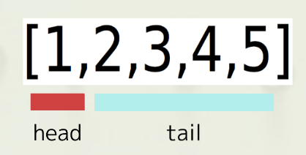
Lists
"abc" = [97,98,99]
head and tail of list

Slide 12
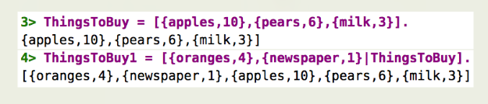
Lists
If T is a list, then [H|T] is also a list with head H and tail T. The vertical bar (|) separates the head of a list from its tail. [ ] is the empty list.

Slide 13
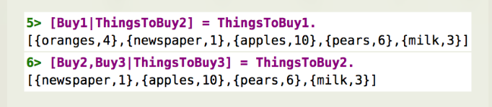
Lists
If we have the nonempty list L, then the expression [X|Y] = L, where X and Y are unbound variables, will extract the head of the list into X and the tail of the list into Y.

Slide 14
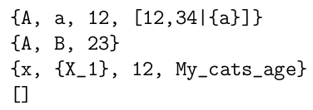
Pattern matching
Patterns have the same structure as terms, with the addition that they can include variables.
Variables start with an upper-case letter.
Examples:
A, B, X_1, and My_cats_age are variables in Erlang.

Slide 15
Pattern matching
Pattern matching provides the basic mechanism by which values become assigned to variables.
bound / unbound variables
assigning a value to a variable is called binding
Pattern matches with term:
They are structurally isomorphic
Whenever an atomic data type is encountered in the pattern, the same atomic data type is encountered at the same position in the corresponding term
If pattern contains an unbound variable, the variable is bound to the corresponding element in the term

Slide 16
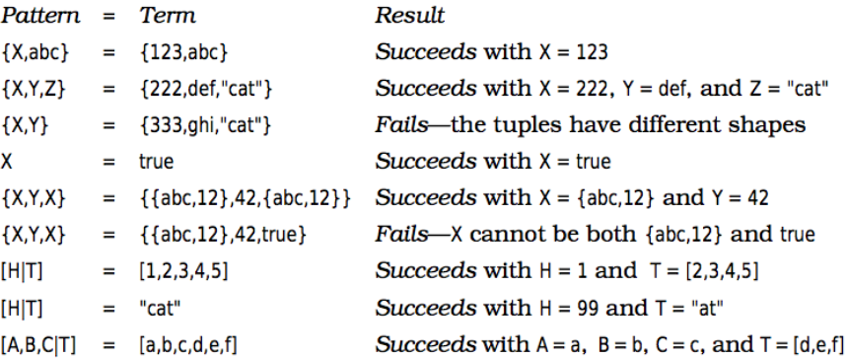
Pattern matching

Slide 17
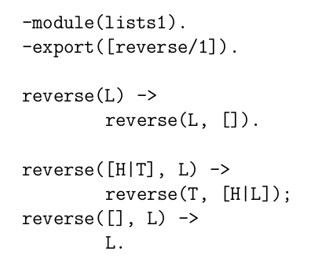
Modules
Erlang has a module system which allows us to divide a large program into a set of modules.
Each module has its own name space
Import or export declaration in the module

Slide 18
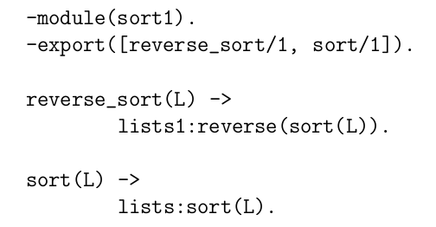
Modules
Calling functions in other modules

Slide 19
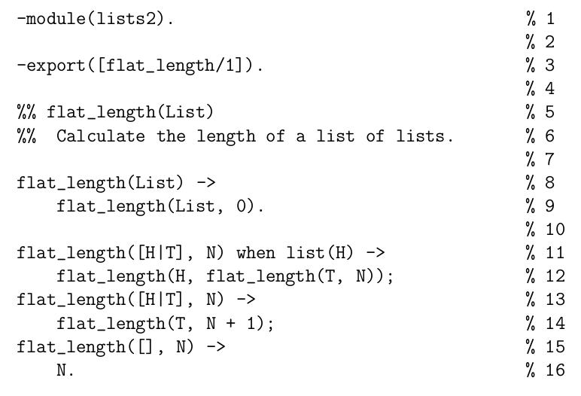
Modules
Terminology:
- module definition
- attributes
- blank lines
- comments
- exported function
- local function

Slide 20
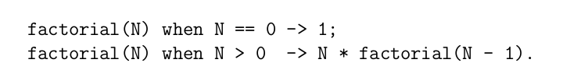
Functions
Syntax and semantics of Erlang functions
Structure of clauses:
Head of clause
Clause guards
Guard tests
Body of clause

Slide 21
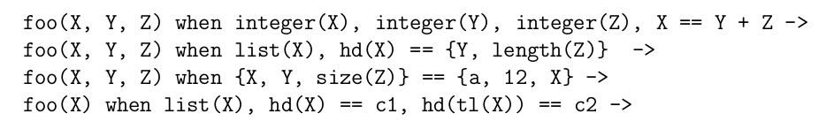
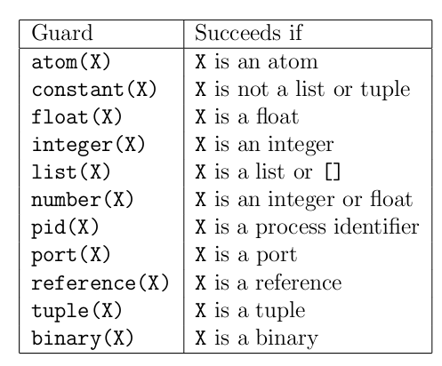
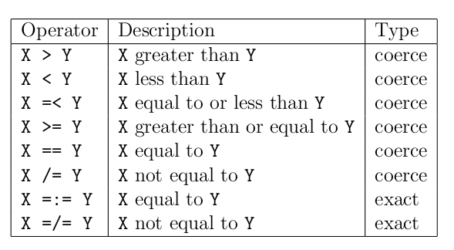
Functions
Clause guards:

Slide 22
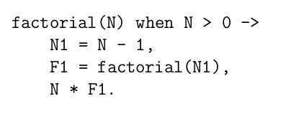
Functions
Clause body:
Consists of a sequence of one or more expressions which are separated by commas.
Last expression is value of body (function).

Slide 23


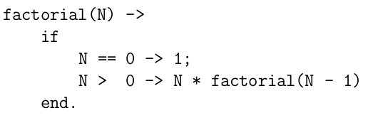
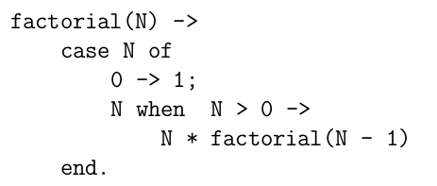
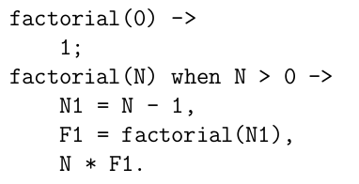
Examples

Slide 24
Programming with Lists

Slide 25

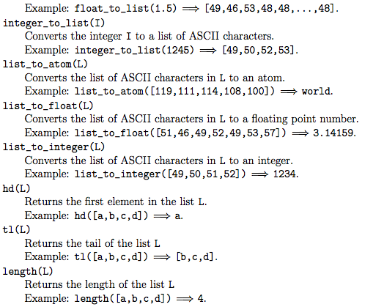
Programming with Lists
List Processing BIFs
Several built-in functions are available for conversion between lists and other data types.

Slide 26
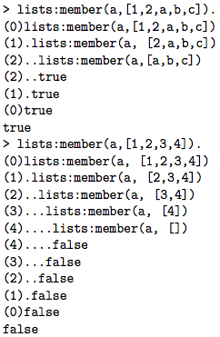

Programming with Lists
Some Common List Processing Functions
member(X, L) returns true if X is an element of the list L, otherwise false.

Slide 27

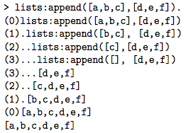
Programming with Lists
Some Common List Processing Functions
append(A,B) concatenates the two lists A and B.

Slide 28
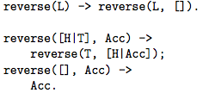
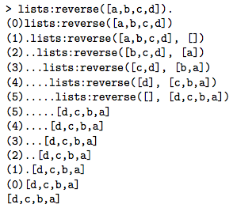
Programming with Lists
Some Common List Processing Functions
reverse(L) reverses the order of the elements in the list L.

Slide 29
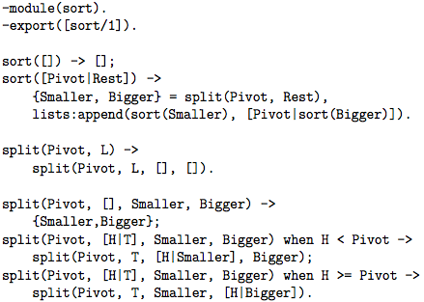


Programming with Lists
Examples
sort(X) returns a sorted list of the elements of the list X.

Slide 30
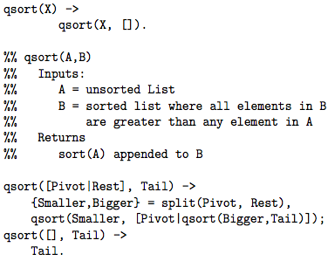
Programming with Lists
Examples
qsort(X) returns a sorted list of the elements of the list X.

Slide 31


Funs: The Basic Unit of Abstraction
Functions that manipulate functions are called higher-order functions, and the data type that represents a function in Erlang is called a fun.
funs are “anonymous” functions. They are called this because they have no name. You might see them referred to as lambda abstractions in other programming languages.

Slide 32

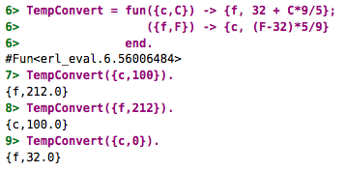
Funs: The Basic Unit of Abstraction

Slide 33



List Comprehensions
List comprehensions are expressions that create lists without having to use funs, maps, or filters.
Note that the generator part of a list comprehension works like a filter.

Slide 34
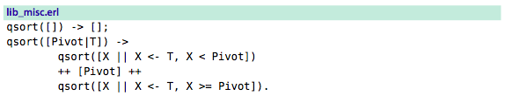




Quicksort

Slide 35
Programming with Tuples

Slide 36
Unbalanced Binary Trees
Internal nodes of the tree are represented by {Key,Value,Smaller,Bigger}.
Value is the value of some object which has been stored at some node in the tree with key Key.
Smaller is a subtree where all the keys at the nodes in the tree are smaller than Key, and
Bigger is a subtree where all the keys at the nodes in the tree are greater than or equal to Key.
Leaves in the tree are represented by the atom nil.

Slide 37
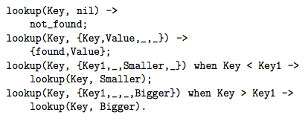
Unbalanced Binary Trees
Function lookup(Key,Tree) searches Tree to see if an entry associated with Key has been stored in the tree.

Slide 38
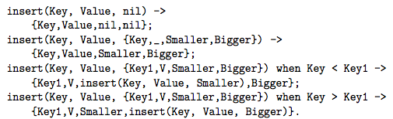
Unbalanced Binary Trees
Function insert(Key,Value,OldTree) inserts new data into the tree. It returns a new tree.

Slide 39
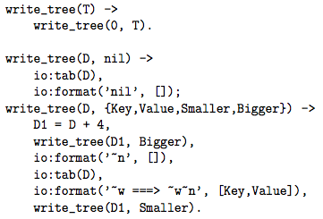
Unbalanced Binary Trees
Function write_tree(Tree) displays it in a way which reflects its structure.

Slide 40
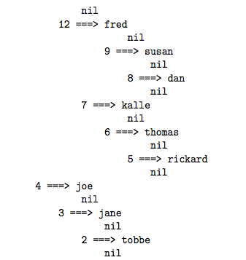
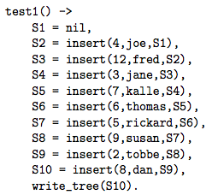
Unbalanced Binary Trees
Function test1() insert data into a tree and print it .

Slide 41
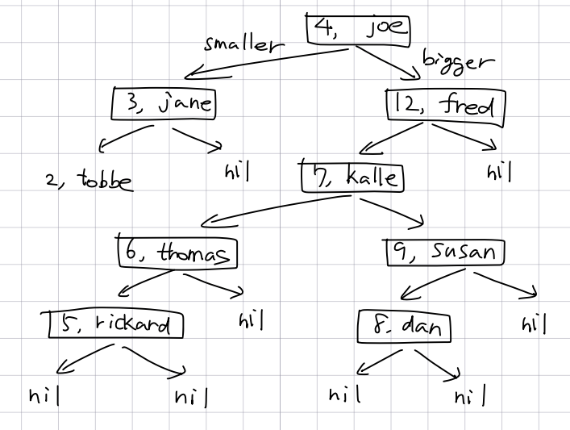
Unbalanced Binary Trees

Slide 42
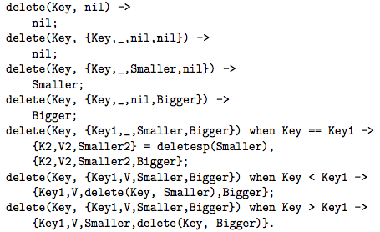
Unbalanced Binary Trees
Function delete(Key, Value) deletes elements from a binary tree.
1:
2:
3:
4:
5:
6:
7:

Slide 43
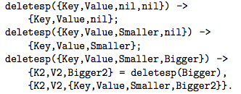
Unbalanced Binary Trees
In clause 5 the node to be deleted has been located, but this node is an internal node in the tree (i.e. the node has both a Smaller and Bigger subtree. In this case the node having the largest key in the Smaller subtree is located and the tree rebuilt from this node

Slide 44
Concurrent Programming (Basics)

Slide 45
Process Creation
The BIF spawn/3 creates and starts the execution of a new process.
The call to spawn/3 returns immediately when the new process has been created and does not wait for the given function to evaluate.
A process will automatically terminate when the evaluation of the function given in the call to spawn has been completed.

Slide 46
Inter-process Communication
In Erlang the only form of communication between processes is by message passing.
Sending a message is an asynchronous operation so the send call will not wait for the message either to arrive at the destination or to be received.
Messages are always delivered to the recipient, and always delivered in the same order they were sent.

Slide 47
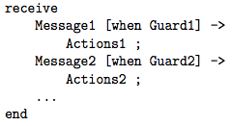
Inter-process Communication
The primitive receive is used to receive messages.
Each process has a mailbox and all messages which are sent to the process are stored in the mailbox in the same order as they arrive.
Message1 and Message2 are patterns which are matched against messages that are in the process’s mailbox.
The process evaluating receive will be suspended until a message is matched.

Slide 48
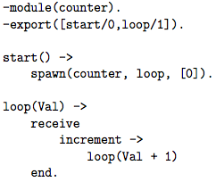
Inter-process Communication
Example: Here is a module which creates processes containing counters which can be incremented.
start a new counter process
a perpetual process which is suspended when waiting for input
selective message reception
loop is a tail recursive function

Slide 49
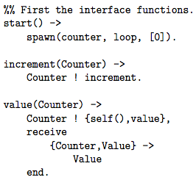
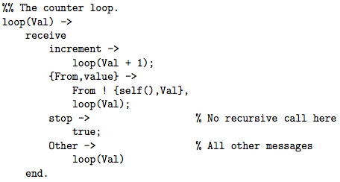
Inter-process Communication
Example: Here is an improved module counter which allows us to increment counters, access their values and also stop them.

Slide 50
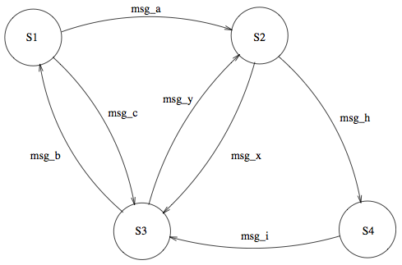
Inter-process Communication
Example: finite state machine (FSM).

Slide 51
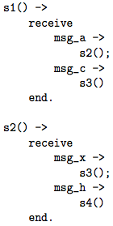
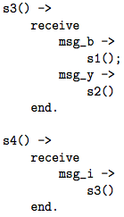
Inter-process Communication
Example: finite state machine (FSM).

Slide 52
Objectives were…
Get the overall image of Erlang.
Become familiar with Erlang codes.
The topics of the next lecture will be
Understanding the concept of concurrency.
Writing concurrent codes in Erlang.
Developing concurrent and robust applications in Erlang using OTP framework.

Slide 53
Thank you for your attention!

