Slide 1
Erlang programming language
Part 2
Kiyoshi Nitta

Slide 2
Literature
Joe Armstrong. 2010. Erlang. Commun. ACM 53, 9 (September 2010), 68-75. DOI=10.1145/1810891.1810910 http://doi.acm.org/10.1145/1810891.1810910
Joe Armstrong. 2013. Programming Erlang: Software for a Concurrent World (2nd edition). Pragmatic Bookshelf. http://pragprog.com/book/jaerlang2/programming-erlang

Slide 3
Objectives
Understanding the concept of concurrency.
Writing concurrent codes in Erlang.
Developing concurrent and robust applications in Erlang using OTP framework.

Slide 4
What is Erlang?

Slide 5
Programming Language
for Multicore Computers
Erlang is a concurrent programming language designed for programming fault-tolerant distributed systems at Ericsson.
It has been (since 2000) freely available subject to an open-source license.
The Erlang way of programming maps naturally to multicore computers.
Processes are created and managed by the Erlang runtime system.

Slide 6
Concurrent Programming Language
Erlang is used for programming fault-tolerant, distributed, real-time applications.
It's a concurrent programming language; concurrency belongs to the language, not to the operating system.
Its programs are collections of parallel processes cooperating to solve a particular problem.
Programmers can create large numbers of Erlang processes (tens of millions of processes on an ordinary PC server).

Slide 7
Uses Isolated Processes and Messages
All Erlang processes are "thread safe".
When Erlang applications are deployed on multicore computers, the individual Erlang processes are spread over the cores.
The isolated processes share no data, and polymorphic messages can be sent between processes.
Erlang could be viewed as extremely object-oriented though without the usual mechanisms associated with traditional OO languages.

Slide 8
Functional Programming Language
Erlang has no mutexes.
Even within a process, data is immutable.
The sequential Erlang subset is a dynamically typed functional programming language with immutable state.
Instead of classes, methods, and inheritance, Erlang has modules that contain functions, as well as higher-order functions.
It also includes processes, sophisticated error handling, code-replacement mechanisms, and a large set of libraries.

Slide 9
What is Erlang?
Shared nothing !

Slide 10
Shared Nothing - Requirement
Building highly reliable fault-tolerant systems:
at most four minutes of downtime per year
system software could be upgraded without stopping the system

Slide 11
Shared Nothing - Approach
Component isolation is the key to building reliable systems.
example
suppose a single machine, and the probability that it will fail during some time period is 10-3
If we have two identical isolated machines, then the probability they both will fail in the same time period is 10-6, with three machines 10-9 , and so on.

Slide 12
Shared Nothing - Key Properties for Fault-Tolerant Applications
Isolated processes;
Pure message passing between processes;
The ability to detect errors in remote processes; and
A method for determining what error caused a process to crash.

Slide 13
What is Erlang?
Erlang View of the World

Slide 14
Erlang View of the World
Everything is a process that lacks shared memory and influences one another only by exchanging asynchronous messages.

Slide 15
What is Erlang?
Erlang View of Errors

Slide 16
Erlang View of Errors
With thousands of processes at one's disposal one is less concerned about the failure of individual processes.
The recommended way of programming is to let failing processes crash and other processes detect the crashes and fix them.

Slide 17
What is Erlang?
Experience

Slide 18
Instant messaging
MochiWeb
Designed for building lightweight HTTP servers developed by MochiMedia for high-throughput, low-latency analytics, and ad servers, this Erlang library helps power Facebook chat among more than 70 million users.

Slide 19
Instant messaging
Ejabberd
This Erlang implementation of the XMPP protocol is the most widely used open source XMPP server.

Slide 20
Instant messaging
RabbitMQ
This Erlang implementation of the Advanced Message Queuing Protocol standard provides reliable asynchronous message passing at Internet scale.

Slide 21
Schema-free databases - CouchDB
Apache CouchDB is a distributed, fault-tolerant, schema-free document-oriented database accessible via a RESTful HTTP/JSON API.

Slide 22
Schema-free databases - Amazon SimpleDB
This scalable, transactional, distributed key-value store has a peer-to-peer architecture for supporting reliable transactions with ACID properties.

Slide 23
Sweet spot
communications
reliable data storage
The number of clients wanting simultaneous access to the system is potentially huge, with hundreds of thousands to millions of users. The data stores must therefore be reliable and the data protocols extensible.

Slide 24
Concurrent Programming (Basics)

Slide 25
Process Creation
The BIF spawn/3 creates and starts the execution of a new process.
The call to spawn/3 returns immediately when the new process has been created and does not wait for the given function to evaluate.
A process will automatically terminate when the evaluation of the function given in the call to spawn has been completed.

Slide 26
Inter-process Communication
In Erlang the only form of communication between processes is by message passing.
Sending a message is an asynchronous operation so the send call will not wait for the message either to arrive at the destination or to be received.
Messages are always delivered to the recipient, and always delivered in the same order they were sent.

Slide 27
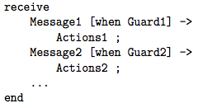
Inter-process Communication
The primitive receive is used to receive messages.
Each process has a mailbox and all messages which are sent to the process are stored in the mailbox in the same order as they arrive.
Message1 and Message2 are patterns which are matched against messages that are in the process’s mailbox.
The process evaluating receive will be suspended until a message is matched.

Slide 28
Introducing OTP

Slide 29
Introducing OTP
OTP stands for the Open Telecom Platform: an application operating system and a set of libraries and procedures used for building large- scale, fault-tolerant, distributed applications.
OTP contains a number of powerful tools—such as a complete web server, an FTP server, a CORBA ORB,1 and so on.
A behavior encapsulates common behavioral patterns—think of it as an application framework that is parameterized by a callback module.
A behavior encapsulates common behavioral patterns—think of it as an application framework that is parameterized by a callback module.

Slide 30
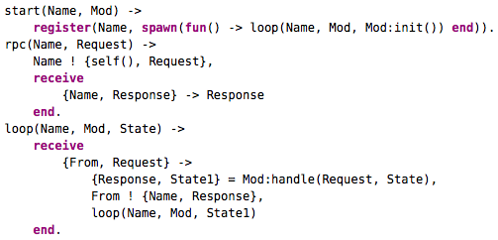
The Road to the Generic Server Server 1: The Basic Server
It’s a little server that we can parameterize with a callback module.

Slide 31
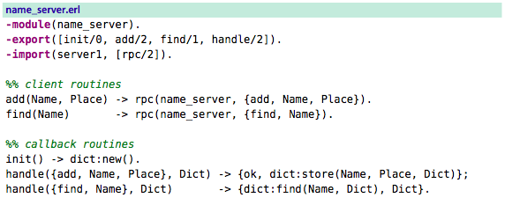
The Road to the Generic Server Server 1: The Basic Server
Let’s write a callback for server1. Here’s a name server callback.

Slide 32
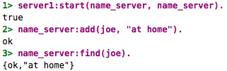
The Road to the Generic Server Server 1: The Basic Server
Just to prove that it works, do this:
The callback had no code for concurrency, no spawn, no send, no receive, and no register.
This means we can write client-server models without understanding anything about the underlying concurrency models.

Slide 33
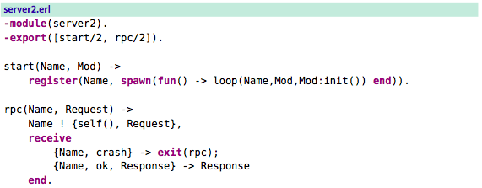
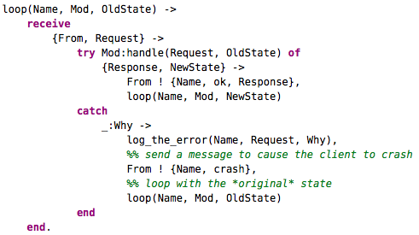

The Road to the Generic Server Server 2: A Server with Transactions
Here’s a server that crashes the client if the query in the server results in an exception:

Slide 34
The Road to the Generic Server Server 2: A Server with Transactions
This code provides “transaction semantics” in the server—it loops with the original value of State if an exception was raised in the handler function. But if the handler function succeeded, then it loops with the value of NewState provided by the handler function.
When the handler function fails, the client that sent the message that caused the failure is sent a message that causes it to crash. The client cannot proceed, because the request it sent to the server caused the handler function to crash. But any other client that wants to use the server will not be affected. Moreover, the state of the server is not changed when an error occurs in the handler.
Note that the callback module for this server is exactly the same as the callback module we used for server1.

Slide 35
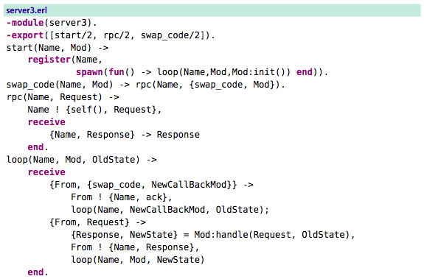
The Road to the Generic Server Server 3: A Server with Hot Code Swapping
When we want to change the behavior of our server, we just send it a message containing the new code, and it picks up the new code and continues with the new code and the old session data. This process is called hot code swapping.

Slide 36
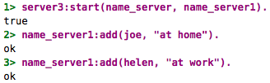
The Road to the Generic Server Server 3: A Server with Hot Code Swapping
First we’ll start server3 with the name_server1 (identical to name_server) callback module.

Slide 37
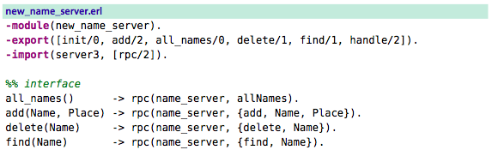
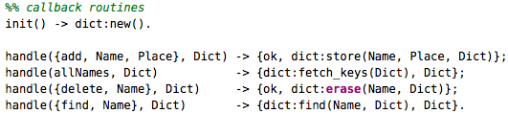
The Road to the Generic Server Server 3: A Server with Hot Code Swapping
Now suppose we want to find all the names that are served by the name server.

Slide 38


The Road to the Generic Server Server 3: A Server with Hot Code Swapping
We compile this and tell the server to swap its callback module.
Now we can run the new functions in the server.
This technique is used in products that are never taken out of service for software maintenance upgrades.

Slide 39
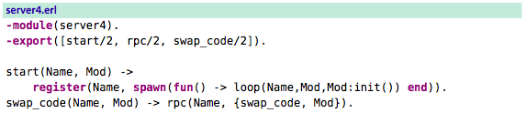
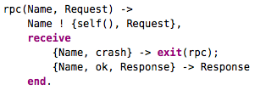

The Road to the Generic Server Server 4: Transactions and Hot Code Swapping
In the last two servers, code upgrade and transaction semantics were separate. Let’s combine them into a single server.

Slide 40
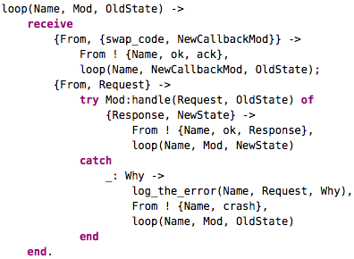
The Road to the Generic Server Server 4: Transactions and Hot Code Swapping
(continued)

Slide 41
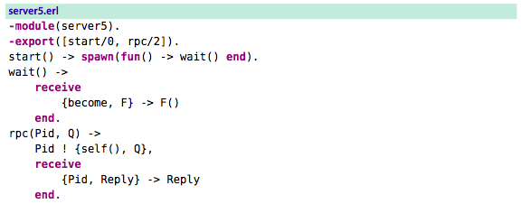

The Road to the Generic Server Server 5: Even More Fun
Here’s a server that does nothing at all until you tell it to become a particular type of server.
Our server does nothing and just waits for a become message.

Slide 42
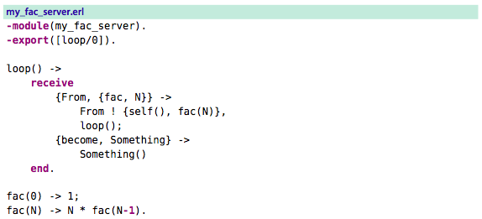


The Road to the Generic Server Server 5: Even More Fun
Define a server function to compute factorial.

Slide 43
The Road to the Generic Server Server 5: Even More Fun
We can make a range of different types of servers, with different semantics and some quite surprising properties.
When we make industrial-scale projects with dozens to hundreds of programmers involved, we might not actually want things to be too dynamic.
Having code that can morph into new versions while it runs is beautiful but terrible to debug if something goes wrong later.
If we have made dozens of dynamic changes to our code and it then crashes, finding out exactly what went wrong is not easy.
The Erlang module gen_server is the kind of logical conclusion of a succession of successively sophisticated servers.

Slide 44
Getting Started with gen_server
Here’s the simple three-point plan for writing a gen_server (one of OTP behaviors) callback module:
Decide on a callback module name.
Write the interface functions.
Write the six required callback functions in the callback module.

Slide 45
Getting Started with gen_server Step 1: Decide on the Callback Module Name
We’re going to make a simple payment system. We’ll call the module my_bank.

Slide 46
Getting Started with gen_server Step 2: Write the Interface Routines
We’ll define five interface routines, all in the module my_bank.
start()
Open the bank.
stop()
Close the bank.
new_account(Who)
Create a new account.
deposit(Who, Amount)
Put money in the bank.
withdraw(Who, Amount)
Take money out, if in credit.

Slide 47
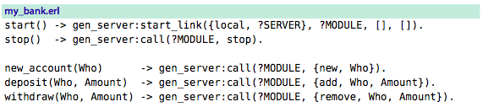
Getting Started with gen_server Step 2: Write the Interface Routines
Each of interface routines in exactly one call to the routines in gen_server.
gen_server:start_link({local, Name}, Mod, ...) starts a local server.
The second argument to start_link is Mod and is the name of the callback module.
The macro ?MODULE expands to the module name my_bank.
gen_server:call(?MODULE, Term) is used for a remote procedure call to the server.

Slide 48
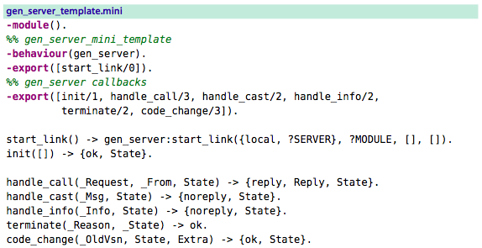
Getting Started with gen_server Step 3: Write the Callback Routines
The template contains a simple skeleton that we can fill in to make our server.

Slide 49
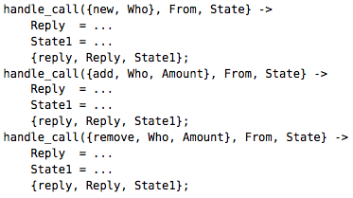
Getting Started with gen_server Step 3: Write the Callback Routines
The most important bit is the handle_call/3 function.
The values of Reply in this code are sent back to the client as the return values of the remote procedure calls.
State is just a variable representing the global state of the server that gets passed around in the server

Slide 50
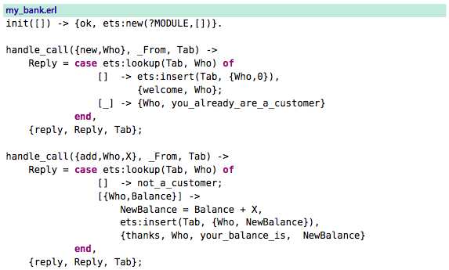
Getting Started with gen_server Step 3: Write the Callback Routines
When we’ve filled in the template and edited it a bit, we end up with the following code:

Slide 51
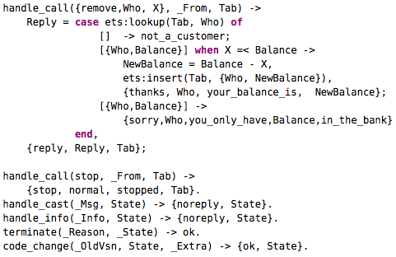
Getting Started with gen_server Step 3: Write the Callback Routines
my_bank.erl continued.

Slide 52
Getting Started with gen_server Step 3: Write the Callback Routines
We start the server by calling gen_server:start_link(Name, CallBackMod, StartArgs, Opts).
The first routine to be called in the callback module is Mod:init(StartArgs), which must return {ok, State}.
The value of State reappears as the third argument in handle_call.
How we stop the server:
handle_call(stop, From, Tab) returns {stop, normal, stopped, Tab}, which stops the server.
The second argument (normal) is used as the first argument to my_bank:terminate/2.
The third argument (stopped) becomes the return value of my_bank:stop().

Slide 53
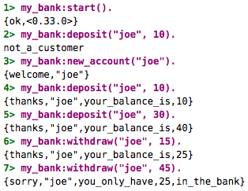
Getting Started with gen_server Step 3: Write the Callback Routines
Visit the bank.

Slide 54
Making a System with OTP

Slide 55
Making a System with OTP
We’re going to make a system that could function as the back end of a web-based company.
Our company has two items for sale:
prime numbers and
areas.
Customers can buy a prime number from us, or we’ll calculate the area of a geometric object for them
We’ll build two servers: one to generate prime numbers and the other to compute areas. To do this, we’ll use the gen_server framework that we talked above.
When the server crashes, we’ll need some mechanism to detect the fact that it has crashed and to restart it. For this we’ll use the idea of a supervision tree.
We’ll package all our code into an OTP application.

Slide 56
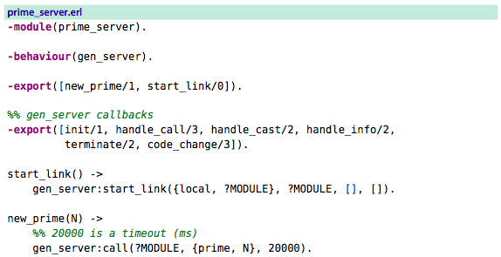
The Application Servers The Prime Number Server
Here’s the prime number server. It has been written using the gen_server behavior.

Slide 57
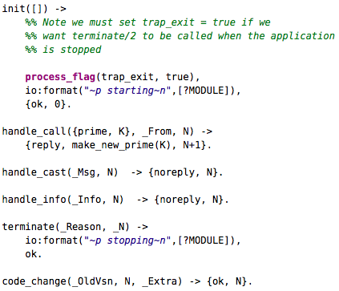
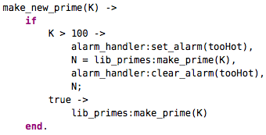
The Application Servers The Prime Number Server
prime_server continued.

Slide 58
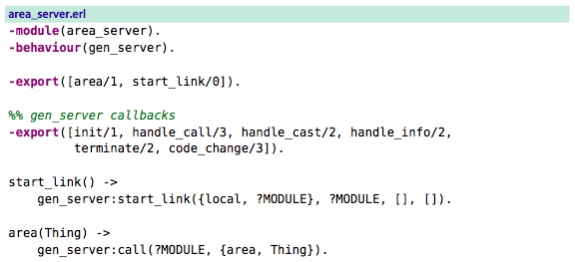
The Application Servers The Area Server
And now the area server. This is also written with the gen_server behavior.

Slide 59
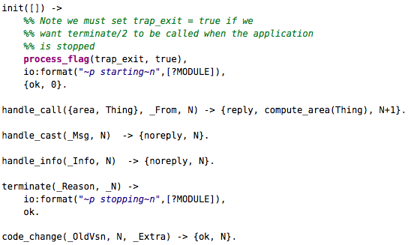

The Application Servers The Area Server
area_server continued.

Slide 60
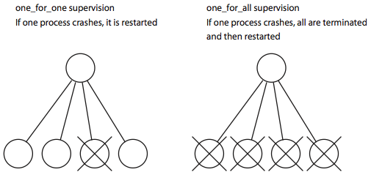
The Supervision Tree
A supervision tree is a tree of processes. The upper processes (supervisors) in the tree monitor the lower processes (workers) in the tree and restart the lower processes if they fail.
There are two types of supervision tree.

Slide 61

The Supervision Tree
Supervisors are created using the OTP supervisor behavior.
The supervisor tree is specified with a function of this form:
RestartStrategy is one of the atoms one_for_one or one_for_all.
If a supervisor performs more than MaxRestarts in Time seconds, then the supervisor will terminate all the worker processes and then itself.
Worker1, Worker2, and so on, are tuples describing how to start each of the worker processes.

Slide 62
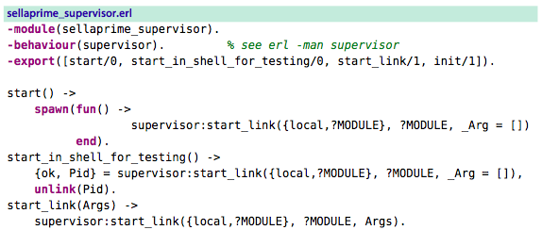
The Supervision Tree
The first thing we need to do is to choose a name for our company. Let’s call it sellaprime. The job of the sellaprime supervisor is to make sure the prime and area servers are always running.

Slide 63
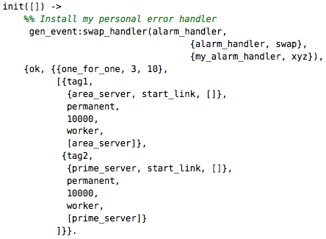
The Supervision Tree
sellaprime_supervisor continued.
defines a supervision strategy
worker specifications

Slide 64

The Supervision Tree
The Worker specifications are tuples of the following form:
Tag
This is an atom tag that we can use to refer to the worker process later (if necessary).
{Mod, Func, ArgList}
This defines the function that the supervisor will use to start the worker.
Restart = permanent | transient | temporary
A permanent process will always be restarted. A transient process is restarted only if it terminates with a non-normal exit value. A temporary process is never restarted.
Shutdown
This is the maximum time (milliseconds) a worker is allowed to take in terminating. If it takes longer than this, it will be killed.
Type = worker | supervisor
This is the type of the supervised process. We can construct a tree of supervisors by adding supervisor processes in place of worker processes.
[Mod1]
This is the name of the callback module if the child process is a supervisor or gen_server behavior callback module.

Slide 65
Summary
Described the concept of concurrency.
Gave examples for writing concurrent codes (servers) in Erlang.
Two typical OTP behaviors gen_server, and supervisor were explained with examples. These behaviors provides technological basis for coding robust systems.
Questions?

