Slide 1


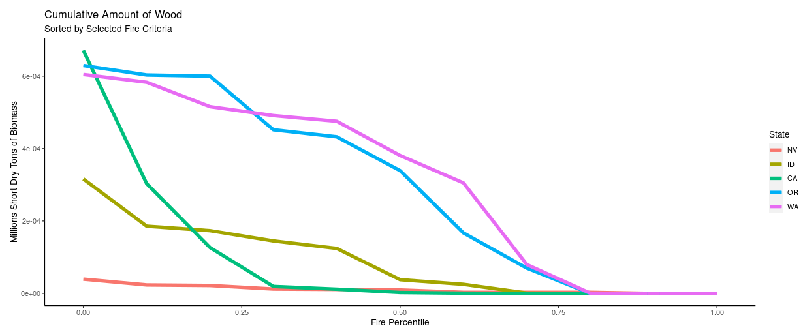
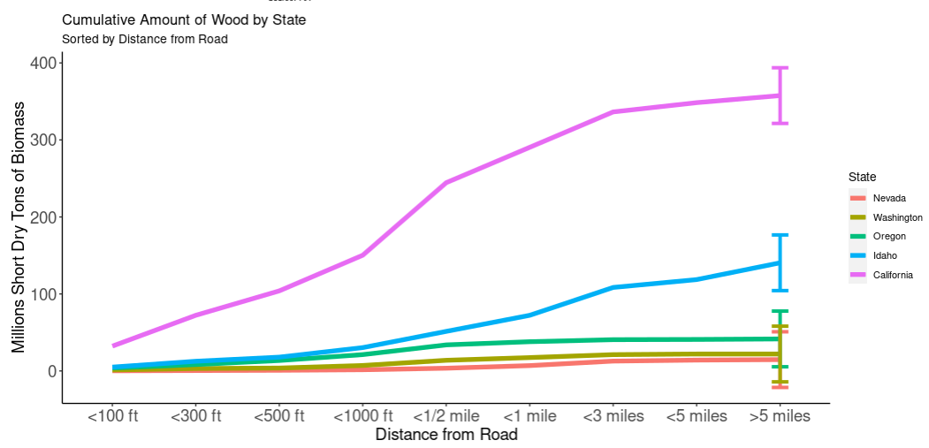
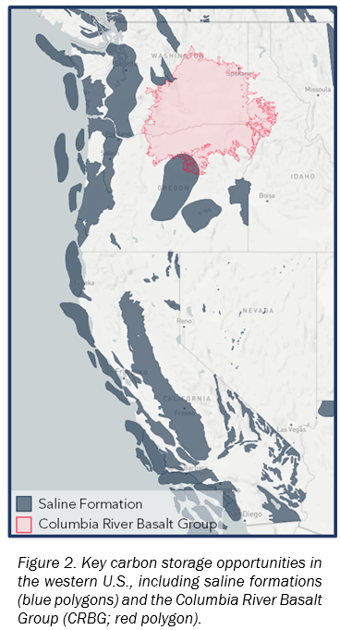
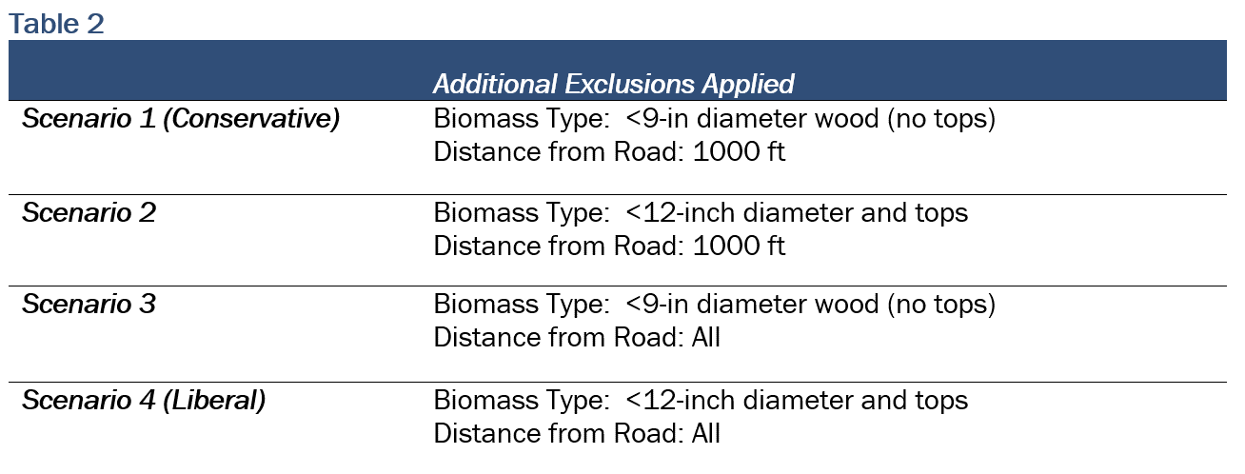
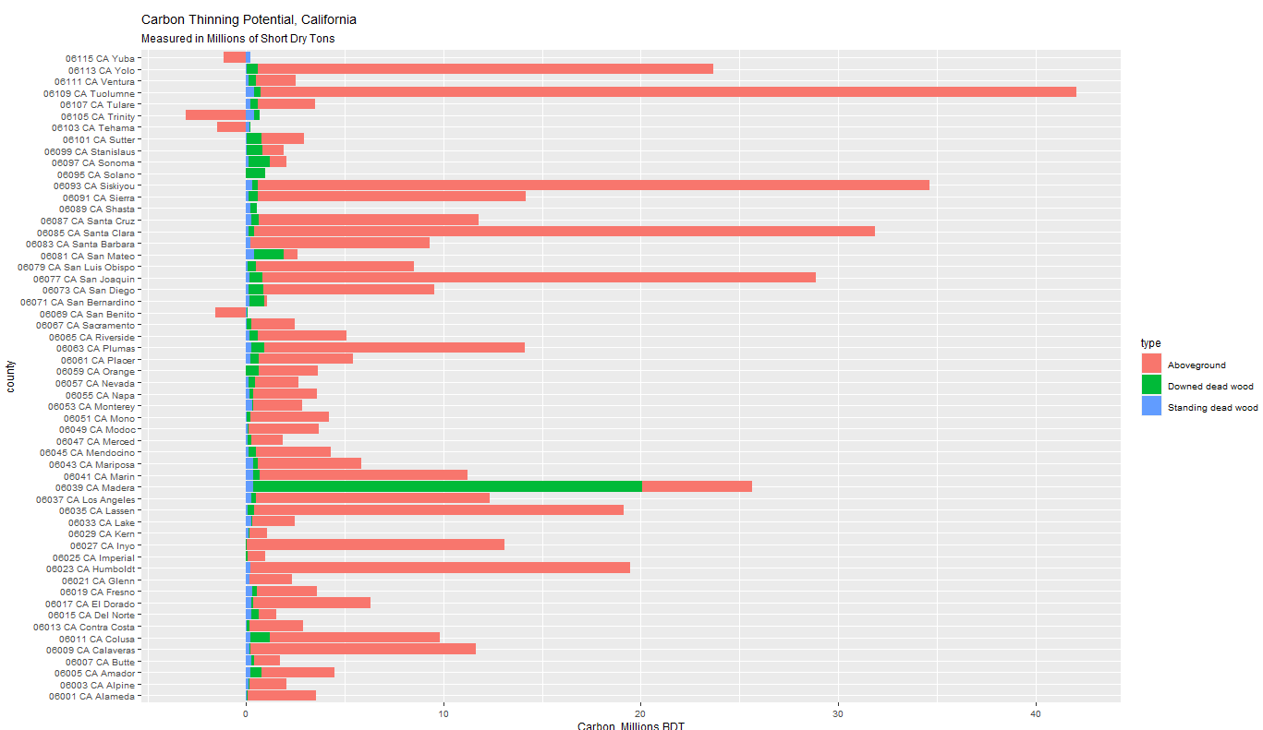
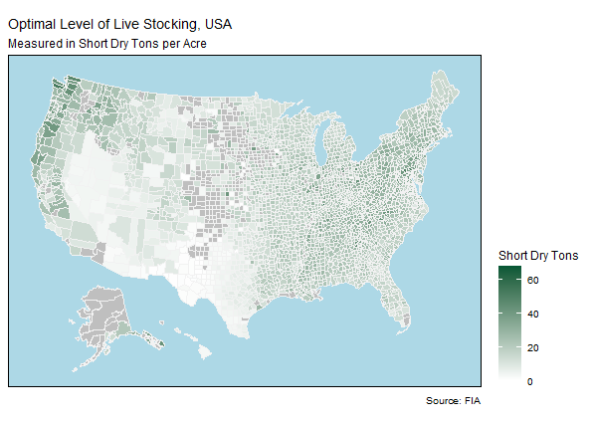
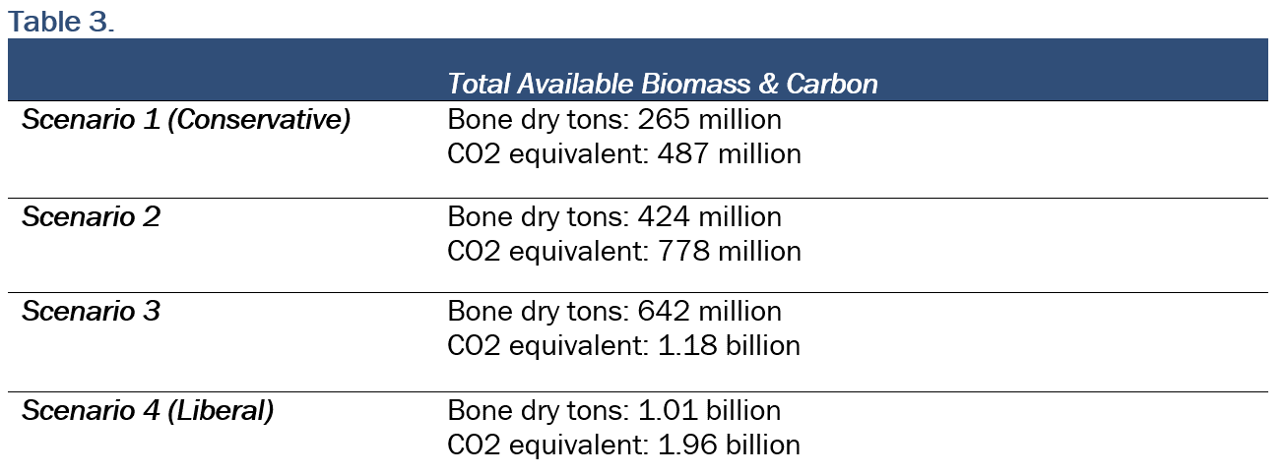
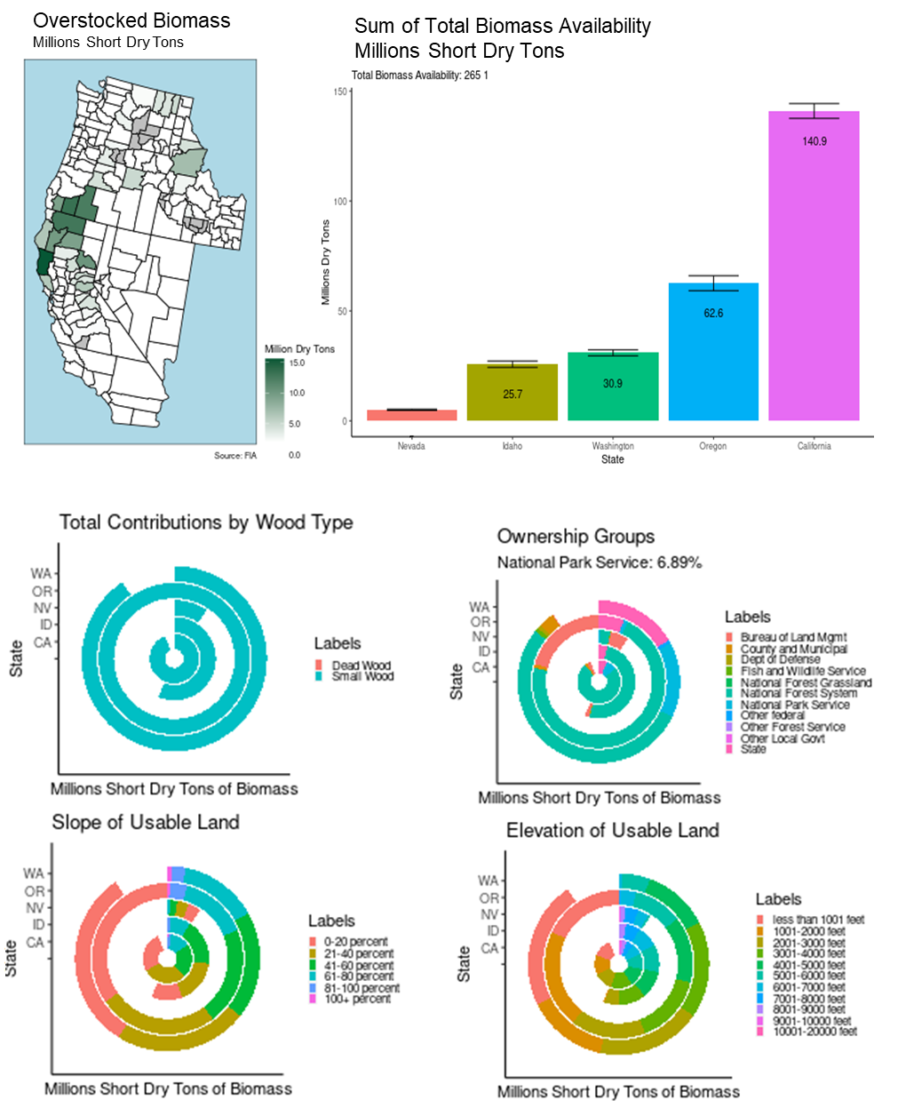
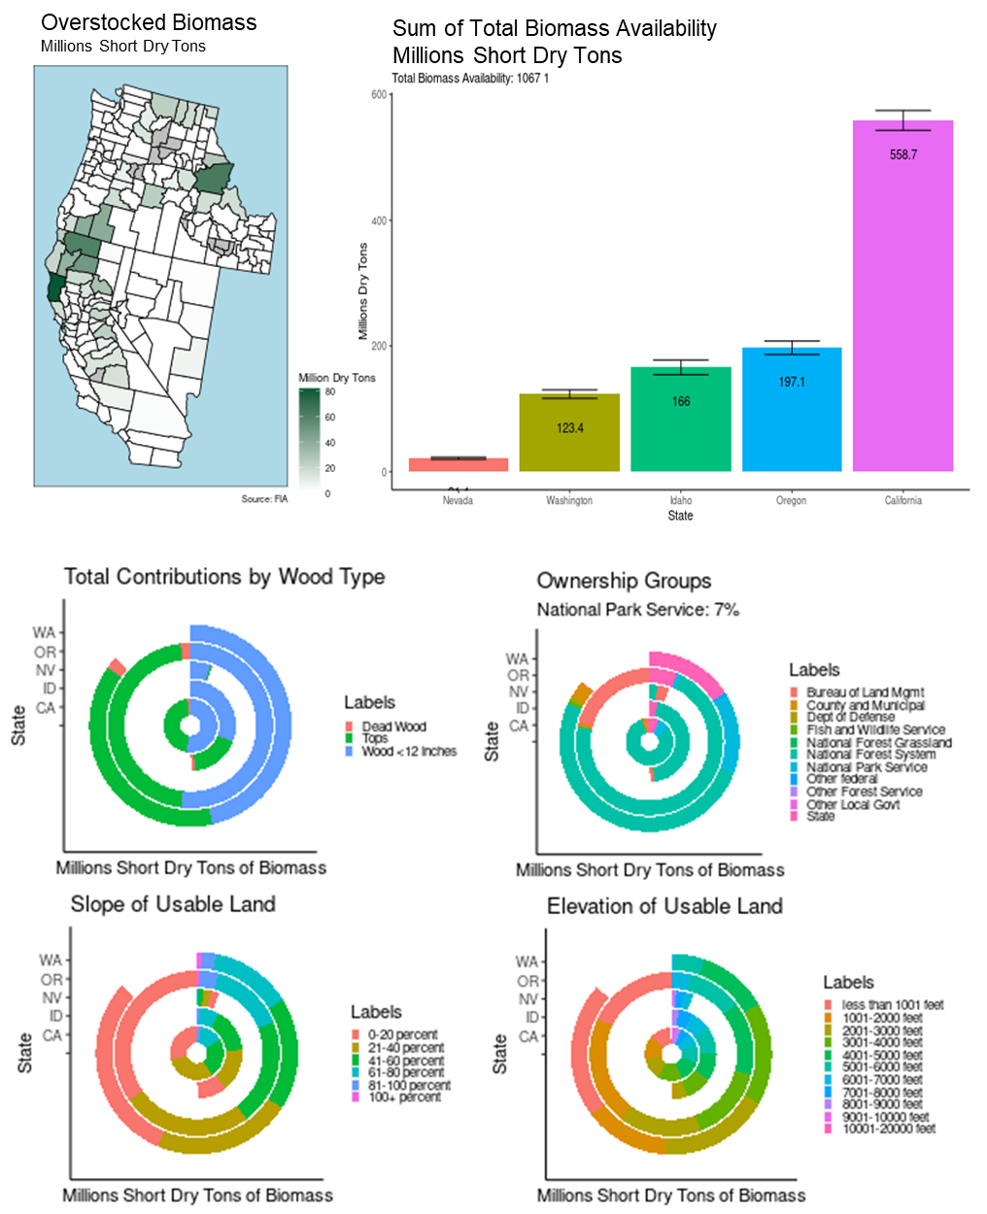
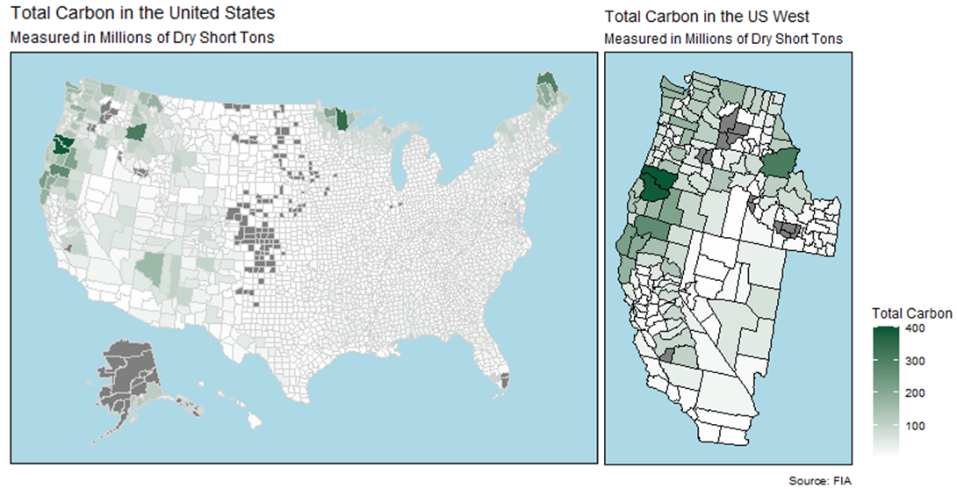
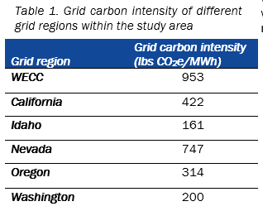
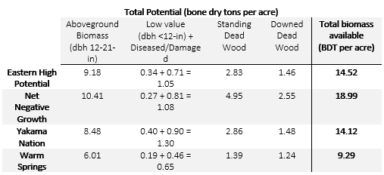
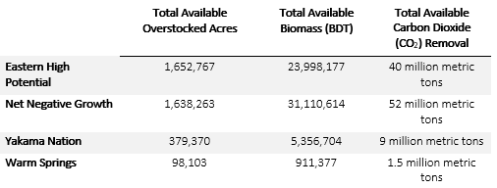
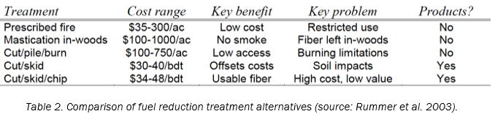
Bioenergy with Carbon Capture and Storage (BECCS) in the Western United States
Nicholas Dahl, Duke University Department of Statistical Science
In Collaboration with Carbon Containment Lab and Energy Futures Initiative
https://nickdahl.shinyapps.io/WoodyBiomassApp/
Introduction to Forest Management
Parameters and Methods
Data Queries – EVALIDATOR Tool
Conclusions
In the United States, forests represent the greatest source of carbon storage, holding 45% of land-based carbon.
47.2 billion tons of carbon tracked by Forest Inventory and Analysis (FIA), including 5.7 billion tons in Oregon/Washington, and 2.6 billion in California
Forest restoration for wildfire hazard reduction through mechanical thinning or prescribed burning reduces fuel loads and wildfire severity
Biomass can be safely removed to reduce fire risk and to utilize in carbon storage, avoiding economic damages
It is crucial to determine where and how to instigate these techniques, and to validate economic validity.
Region: States at significant risk of severe wildfire, largest quantities of overstocked biomass
Reserved Status: Land permanently reserved from wood products utilization through statute or administrative design
Wildfire Hazard Potential: Index that quantifies relative potential for wildfire
Desired Stocking Level: Prescriptive level of biomass considered “full” for region
Standing Deadwood: Remnants of living trees still self-supported
Accessibility: National Park land at slope greater than 40%
Biomass Type: Overstocked biomass under 9-inch diameter at breast height
Distance to Road: Straight-line distance to nearest improved road (pavement, gravel, grading, ditching, and/or other improvements)
FIA EVALIDATOR: Custom query database that allows for segmentation, exploration, and summary of current carbon stocks in the United States
Custom queries generated from input fed into user interface of Shiny application to return updated statistics adherent with filtrations
Estimates are made through 10,000+ monitored plots to record annotations on basal area, tree size, species, and quantity of carbon stocks
Stocks are broken out into downed woody debris, aboveground biomass, and soil carbon content among other labels
Estimate between 265 and 1.07 billion bone dry tons of woody biomass available (487 million – 1.96 billion tons of carbon dioxide)
Particular abundance in California and northern regions of Idaho, aligned with Columbia River Basalt region
Large quantities of this wood are available within 2 miles of access roads
Additionally, high percentage of wood in counties within top 35% of highest wildfire hazard potential nationally, as reported by USDA
Key Carbon Storage Opportunity
Western U.S. has several major geologic formations to utilize in CO2 storage through deep saline aquifers
Trapping mechanisms include solubility, mineral, structural, and residual trapping
Alternate potential methodology of in-situ carbon mineralization of mafic and ultra-mafic acid
For injection, large pools of low value, easily accessible carbon need to be identified for transportation and storage, or usage as fuel
Help to safely remove and reduce some of the 851 million metric tons of CO2 released by forest fires in California alone.
Results – Scenario 1 (Conservative)
Results – Scenario 4 (Liberal)
Recommendations
Update the federal Renewable Fuel Standard to reflect the modern-day threat of catastrophic wildfire in the west so that emphasis is placed not only on carrying potential, but also risk potential
Implement existing and appropriate future Department of Energy funding to support BECCS projects
Enhance USDA’s BECCS portfolio in the 2023 Farm Bill and recognize carbon benefits of reduced fuel costs
Support market development and enhancement within the U.S. Forest Service to increase economic viability of BECCS projects
Enhance federal policy stability and coherency
Expand federal and state procurement policy to grow market pull regionally in the Pacific Northwest
Objectives
Limitations
Create a web-based user interface for customization of scenario assumptions based on research-driven questions, where filters are fed into query to intelligently construct remaining resources
Generate a server for calculation and visualization on an R-Shiny web application that returns set of key figures and tables under set of assumptions
Quantify and report biomass availability in units of bone-dry tons of carbon
Scope economic viability of removals
FIA county level data estimates to granularity of carbon pools using select number of monitored plots to extrapolate wider estimations
Project adjusts available biomass by proportion of the land labeled “reserved” by FIA definition rather than filtering on specific acreage
Course measures of forest health and optimal stocking delineated by the USDS FIA Program, not a universally accepted methodology
Wildfire hazard data describes historic conditions, which may not represent conditions moving forward
Beyond slope and distance to road, other aspects (ownership, protections, intractable land) might limit accessibility of carbon pools
Implementation is highly on economics and financial viability of BECCS technologies and subsequently on delivered feedstock cost
Fuel reduction techniques must be maintained regularly to have effects last beyond 5-10 years
Total contributions by wood type, ownership groups, slope of usable land, and elevation of usable land for region under consideration
Determine regions for deployment of a pilot work study program based on intensity findings and generate specific views of resources within these regions
Resources in Select Regions
Resources in Select Regions
References

