Slide 1



Git + GitHub tutotial Part 2
Branching and merging

Slide 2

Recap – local
`git init` #initialize new git repository
`git add` # stages a change
`git commit [-m “...”]` #snapshot changes
`git status` # show status of changes
`git diff` # show changes
https://guides.github.com/introduction/git-handbook/

Slide 3
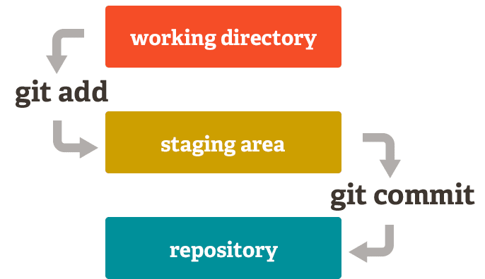
http://git-school.github.io/visualizing-git/#free

Slide 4
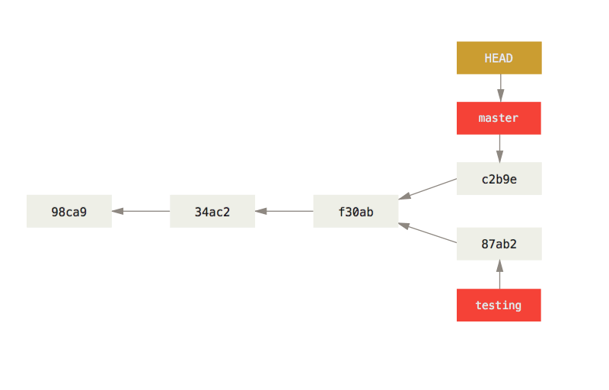
Branching
`git checkout [-b]` # move HEAD to commit/branch [branch]
`git branch [-d]` # create new branch at HEAD [delete]
HEAD is a reference to the last commit in the currently check-out branch.

Slide 5
Branching
Example case
http://git-school.github.io/visualizing-git/#free

Slide 6
Recap – remote
`git clone` #copy remote project
`git pull` #update local ~ remote
`git push` #update remote ~ local

Slide 7

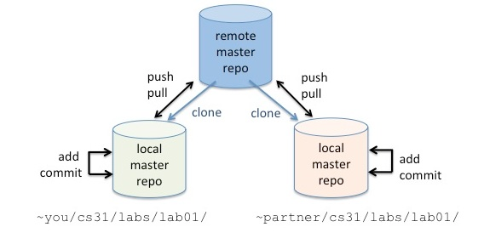
GitHub
“origin”

Slide 8
Exercise
Visual: http://git-school.github.io/visualizing-git/#free-remote
Small test:
clone my `R-code-club` GitHub repository
git checkout --track origin/nick
Create branch locally = your workspace
Modify one of the files/ or create new file in `Party/`
Add + commit + push
git push --set-upstream origin <BRANCH-NAME>
Merge ?
Pull other’s “work”

Slide 9
Rstudio
Has to be R project
> Create New Project
> …
Git tab in upper right View

Slide 10
`git reset`
Cutting branch back to previous state !!!CAREFUL TO DELETE STUFF!!!
`git log` # to view history
`git reset` # to move project to earlier version

Slide 11
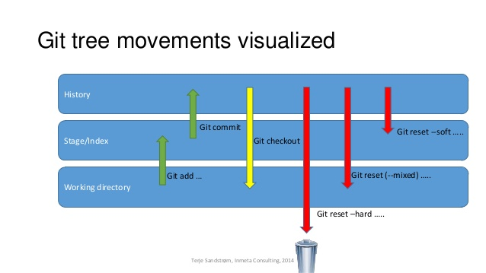

Slide 12
Extra’s to play with
`git revert`
`git rebase`
`git cherry-pick`
`git add --patch`

